Slide 1
WGBS Data of Primary Human Adult Islet Cells (Alpha & Beta)
https://www.cell.com/cell-stem-cell/pdfExtended/S1934-5909(19)30466-7

Slide 2
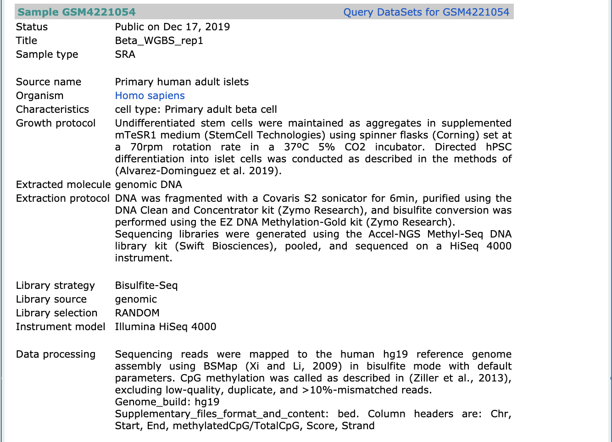
NCBI GEO

Slide 3
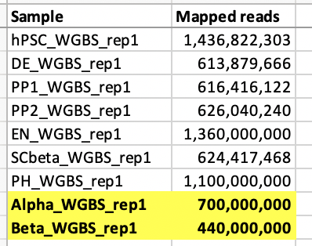
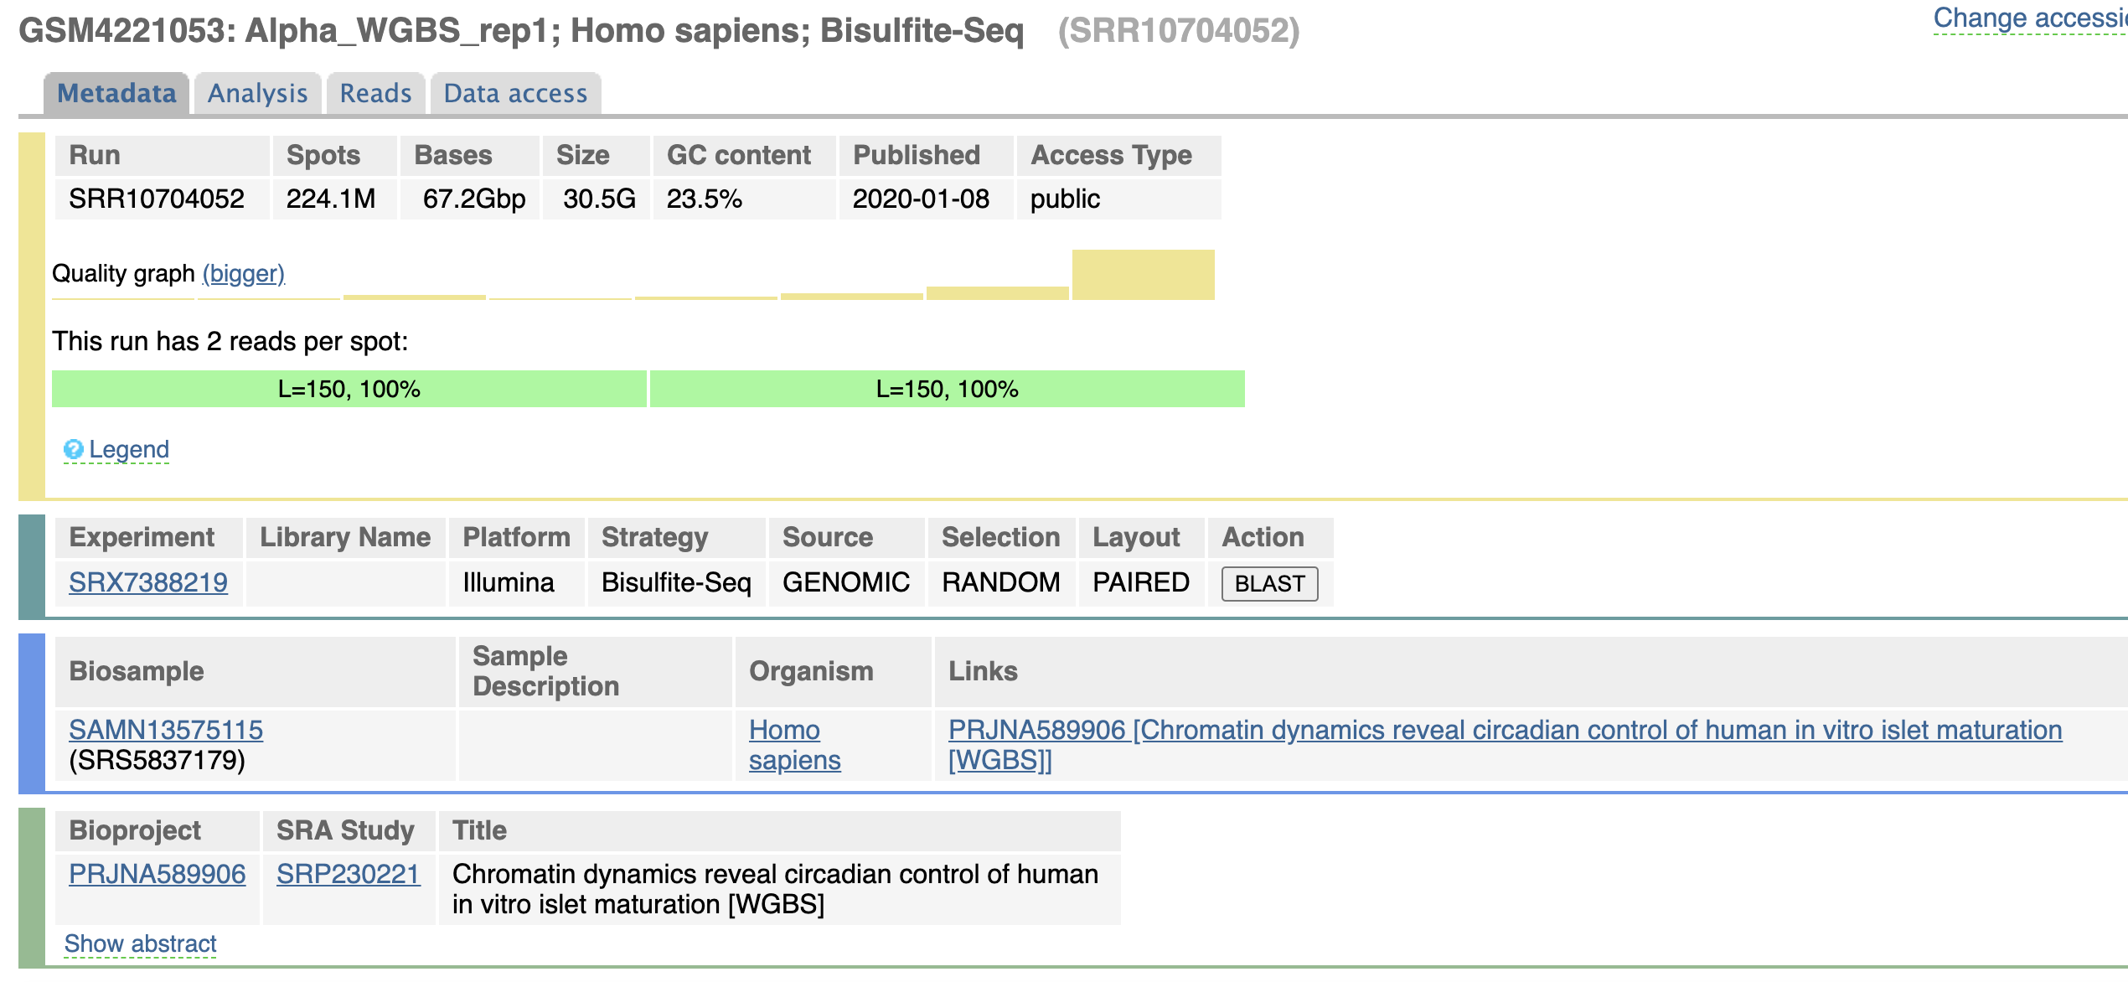
Metadata – Alpha cells

Slide 4
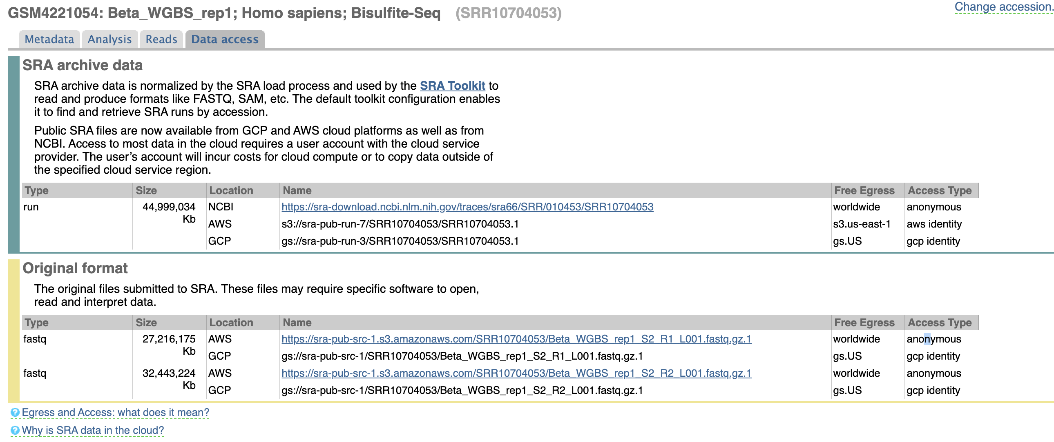
Metadata – Beta cells

