Slide 1


Slide 2
Chapter 24
Enhanced Data Models for Advanced Applications

Slide 3
Outline
Active database & triggers
Temporal databases
Spatial and Multimedia databases
Deductive databases

Slide 4
Active Database Concepts and Triggers
Generalized Model for Active Databases and Oracle Triggers
Triggers are executed when a specified condition occurs during insert/delete/update
  Triggers are action that fire automatically based on these conditions

Slide 5
Event-Condition-Action (ECA) Model
Generalized Model (contd.)
Triggers follow an Event-condition-action (ECA) model
  Event:
    Database modification
      E.g., insert, delete, update),
  Condition:
    Any true/false expression
      Optional: If no condition is specified then condition is always true
  Action:
    Sequence of SQL statements that will be automatically executed

Slide 6
Trigger Example
Generalized Model (contd.)
When a new employees is added to a department, modify the Total_sal of the Department to include the new employees salary
  Logically this means that we will CREATE a TRIGGER, let us call the trigger Total_sal1
    This trigger will execute AFTER INSERT ON Employee table
    It will do the following FOR EACH ROW
      WHEN NEW.Dno is NOT NULL
      The trigger will UPDATE DEPARTMENT
      By SETting the new Total_sal to be the sum of
        old Total_sal and NEW. Salary
        WHERE the Dno matches the NEW.Dno;
Condition

Slide 7
Example: Trigger Definition
Can be CREATE or ALTER
CREATE TRIGGER Total_sal1
AFTER INSERT ON Employee
FOR EACH ROW
WHEN (NEW.Dno is NOT NULL)
UPDATE DEPARTMENT
SET Total_sal = Total_sal + NEW. Salary
WHERE Dno = NEW.Dno;
Can be FOR, AFTER, INSTEAD OF
Can be INSERT, UPDATE, DELETE
The condition
The action

Slide 8
CREATE or ALTER TRIGGER
Generalized Model (contd.)
CREATE TRIGGER <name>
  Creates a trigger
ALTER TRIGGER <name>
  Alters a trigger (assuming one exists)
CREATE OR ALTER TRIGGER <name>
  Creates a trigger if one does not exist
  Alters a trigger if one does exist
    Works in both cases, whether a trigger exists or not

Slide 9
Conditions
Generalized Model (contd.)
AFTER
  Executes after the event
BEFORE
  Executes before the event
INSTEAD OF
  Executes instead of the event
    Note that event does not execute in this case
      E.g., used for modifying views

Slide 10
Row-Level versus Statement-level
Generalized Model (contd.)
Triggers can be
  Row-level
    FOR EACH ROW specifies a row-level trigger
  Statement-level
    Default (when FOR EACH ROW is not specified)
Row level triggers
  Executed separately for each affected row
Statement-level triggers
  Execute once for the SQL statement,

Slide 11
Condition
Generalized Model (contd.)
Any true/false condition to control whether a trigger is activated on not
  Absence of condition means that the trigger will always execute for the even
  Otherwise, condition is evaluated
    before the event for BEFORE trigger
    after the event for AFTER trigger

Slide 12
Action
Generalized Model (contd.)
Action can be
  One SQL statement
  A sequence of SQL statements enclosed between a BEGIN and an END
Action specifies the relevant modifications

Slide 13
Triggers on Views
Generalized Model (contd.)
INSTEAD OF triggers are used to process view modifications

Slide 14
Active Database Concepts and Triggers
Design and Implementation Issues for Active Databases
An active database allows users to make the following changes to triggers (rules)
  Activate
  Deactivate
  Drop

Slide 15
Active Database Concepts and Triggers
Design and Implementation Issues for Active Databases
An event can be considered in 3 ways
  Immediate consideration
  Deferred consideration
  Detached consideration

Slide 16
Active Database Concepts and Triggers
Design and Implementation Issues (contd.)
Immediate consideration
  Part of the same transaction and can be one of the following depending on the situation
    Before
    After
    Instead of
Deferred consideration
  Condition is evaluated at the end of the transaction
Detached consideration
  Condition is evaluated in a separate transaction

Slide 17
Active Database Concepts and Triggers
Potential Applications for Active Databases
Notification
  Automatic notification when certain condition occurs
  Enforcing integrity constraints
    Triggers are smarter and more powerful than constraints
  Maintenance of derived data
    Automatically update derived data and avoid anomalies due to redundancy
      E.g., trigger to update the Total_sal in the earlier example

Slide 18
Active Database Concepts and Triggers
Triggers in SQL-99
Can alias variables inside the REFERENCINFG clause

Slide 19
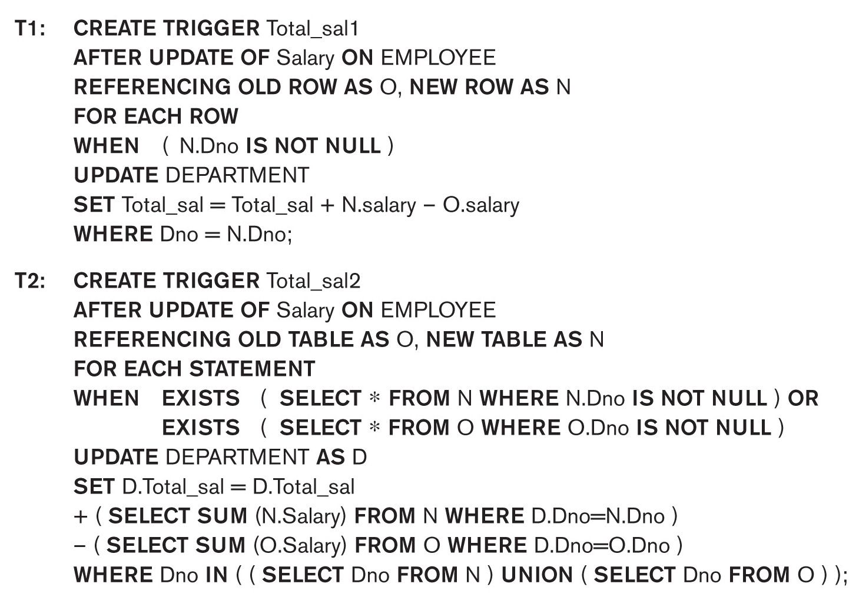
Active Database Concepts and Triggers
Trigger examples

Slide 20
Temporal Database Concepts
Time Representation, Calendars, and Time Dimensions
Time is considered ordered sequence of points in some granularity
  Use the term choronon instead of point to describe minimum granularity

Slide 21
Temporal Database Concepts
Time Representation, … (contd.)
A calendar organizes time into different time units for convenience.
  Accommodates various calendars
    Gregorian (western)
    Chinese
    Islamic
    Hindu
    Jewish
    Etc.

Slide 22
Temporal Database Concepts
Time Representation, … (contd.)
Point events
  Single time point event
    E.g., bank deposit
  Series of point events can form a time series data
Duration events
  Associated with specific time period
    Time period is represented by start time and end time

Slide 23
Temporal Database Concepts
Time Representation, … (contd.)
Transaction time
  The time when the information from a certain transaction becomes valid
Bitemporal database
  Databases dealing with two time dimensions

Slide 24
Temporal Database Concepts
Incorporating Time in Relational Databases Using Tuple Versioning
Add to every tuple
  Valid start time
  Valid end time

Slide 25
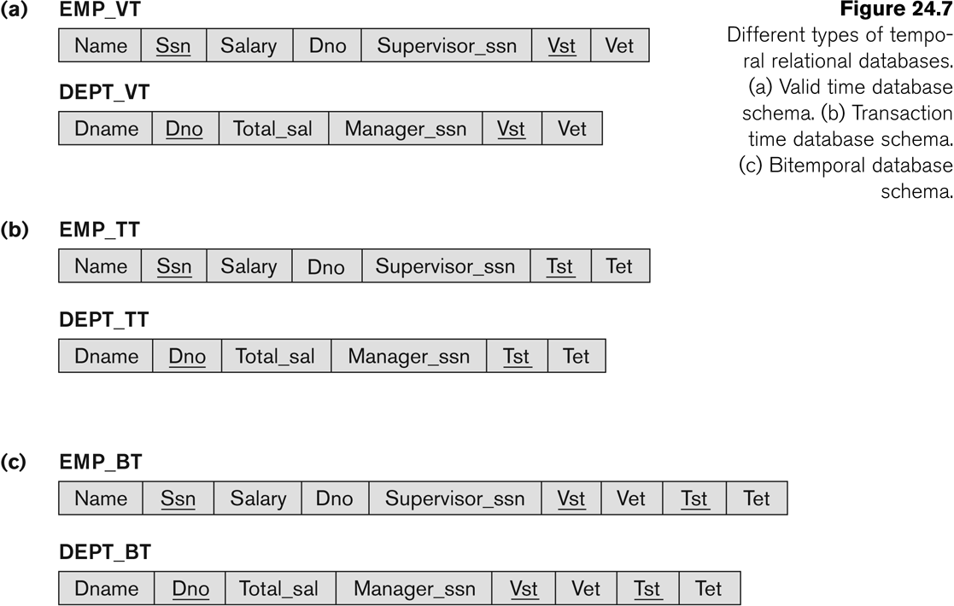
Temporal Database Concepts

Slide 26
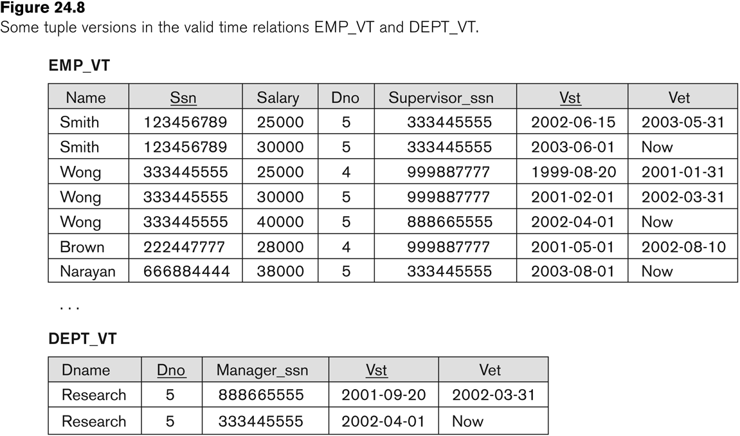
Temporal Database Concepts

Slide 27
Temporal Database Concepts
Incorporating Time in Object-Oriented Databases Using Attribute Versioning
A single complex object stores all temporal changes of the object
Time varying attribute
  An attribute that changes over time
    E.g., age
Non-Time varying attribute
  An attribute that does not changes over time
    E.g., date of birth

Slide 28
Spatial and Multimedia Databases
Spatial Database Concepts
Multimedia Database Concepts

Slide 29
Spatial Databases
Spatial Database Concepts
Keep track of objects in a multi-dimensional space
  Maps
  Geographical Information Systems (GIS)
  Weather
In general spatial databases are n-dimensional
  This discussion is limited to 2-dimensional spatial databases

Slide 30
Spatial Databases
Spatial Database Concepts
Typical Spatial Queries
  Range query: Finds objects of a particular type within a particular distance from a given location
    E.g., Taco Bells in Pleasanton, CA
  Nearest Neighbor query: Finds objects of a particular type that is nearest to a given location
    E.g., Nearest Taco Bell from an address in Pleasanton, CA
  Spatial joins or overlays: Joins objects of two types based on some spatial condition (intersecting, overlapping, within certain distance, etc.)
    E.g., All Taco Bells within 2 miles from I-680.

Slide 31
Spatial Databases
Spatial Database Concepts
R-trees
  Technique for typical spatial queries
  Group objects close in spatial proximity on the same leaf nodes of a tree structured index
  Internal nodes define areas (rectangles) that cover all areas of the rectangles in its subtree.
Quad trees
  Divide subspaces into equally sized areas

Slide 32
Multimedia Databases
Multimedia Database Concepts
In the years ahead multimedia information systems are expected to dominate our daily lives.
  Our houses will be wired for bandwidth to handle interactive multimedia applications.
  Our high-definition TV/computer workstations will have access to a large number of databases, including digital libraries, image and video databases that will distribute vast amounts of multisource multimedia content.

Slide 33
Multimedia Databases
Types of multimedia data are available in current systems
  Text: May be formatted or unformatted. For ease of parsing structured documents, standards like SGML and variations such as HTML are being used.
  Graphics: Examples include drawings and illustrations that are encoded using some descriptive standards (e.g. CGM, PICT, postscript).

Slide 34
Multimedia Databases
Types of multimedia data are available in current systems (contd.)
  Images: Includes drawings, photographs, and so forth, encoded in standard formats such as bitmap, JPEG, and MPEG. Compression is built into JPEG and MPEG.
    These images are not subdivided into components. Hence querying them by content (e.g., find all images containing circles) is nontrivial.
  Animations: Temporal sequences of image or graphic data.

Slide 35
Multimedia Databases
Types of multimedia data are available in current systems (contd.)
  Video: A set of temporally sequenced photographic data for presentation at specified rates– for example, 30 frames per second.
  Structured audio: A sequence of audio components comprising note, tone, duration, and so forth.

Slide 36
Multimedia Databases
Types of multimedia data are available in current systems (contd.)
  Audio: Sample data generated from aural recordings in a string of bits in digitized form. Analog recordings are typically converted into digital form before storage.

Slide 37
Multimedia Databases
Types of multimedia data are available in current systems (contd.)
  Composite or mixed multimedia data: A combination of multimedia data types such as audio and video which may be physically mixed to yield a new storage format or logically mixed while retaining original types and formats. Composite data also contains additional control information describing how the information should be rendered.

Slide 38
Multimedia Databases
Nature of Multimedia Applications:
  Multimedia data may be stored, delivered, and utilized in many different ways.
  Applications may be categorized based on their data management characteristics.

Slide 39
Introduction to Deductive Databases
Overview of Deductive Databases
Prolog/Datalog Notation
Datalog Notation
Clausal Form and Horn Clauses
Interpretation of Rules
Datalog Programs and Their Safety
Use the Relational Operations
Evaluation of Non-recursive Datalog Queries

Slide 40
Overview of Deductive Databases
Declarative Language
  Language to specify rules
Inference Engine (Deduction Machine)
  Can deduce new facts by interpreting the rules
  Related to logic programming
    Prolog language (Prolog => Programming in logic)
    Uses backward chaining to evaluate
      Top-down application of the rules

Slide 41
Overview of Deductive Databases
Speciation consists of:
  Facts
    Similar to relation specification without the necessity of including attribute names
  Rules
    Similar to relational views (virtual relations that are not stored)

Slide 42
Prolog/Datalog Notation
Predicate has
  a name
  a fixed number of arguments
    Convention:
      Constants are numeric or character strings
    Variables start with upper case letters
  E.g., SUPERVISE(Supervisor, Supervisee)
    States that Supervisor SUPERVISE(s) Supervisee

Slide 43
Prolog/Datalog Notation
Rule
  Is of the form head :- body
    where :- is read as if and only iff
  E.g., SUPERIOR(X,Y) :- SUPERVISE(X,Y)
  E.g., SUBORDINATE(Y,X) :- SUPERVISE(X,Y)

Slide 44
Prolog/Datalog Notation
Query
  Involves a predicate symbol followed by y some variable arguments to answer the question
    where :- is read as if and only iff
  E.g., SUPERIOR(james,Y)?
  E.g., SUBORDINATE(james,X)?

Slide 45
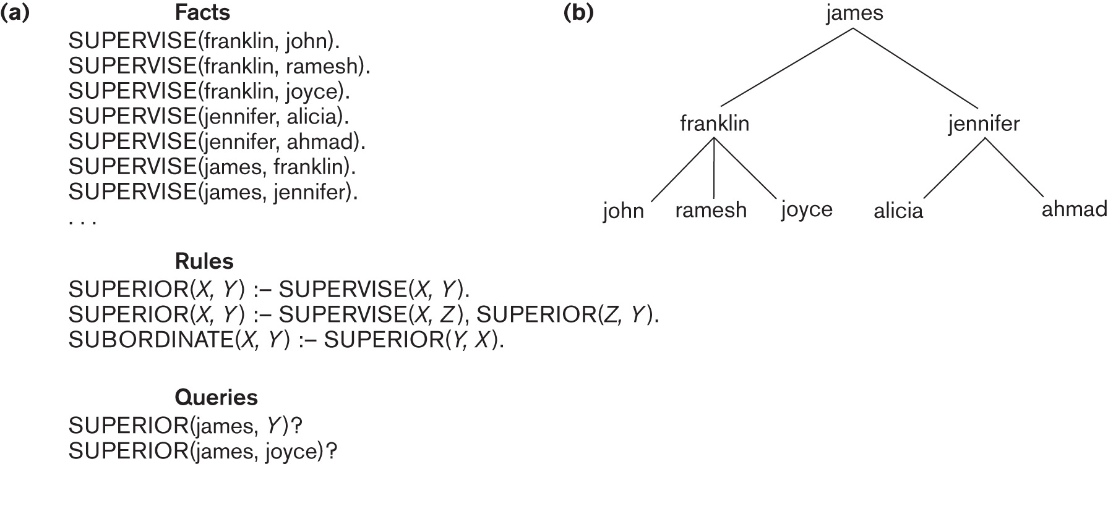
Figure 24.11
(a) Prolog notation (b) Supervisory tree

Slide 46
Datalog Notation
Datalog notation
  Program is built from atomic formulae
    Literals of the form p(a1, a2, … an) where
      p predicate name
      n is the number of arguments
    Built-in predicates are included
      E.g., <, <=, etc.
  A literal is either
    An atomic formula
    An atomic formula preceded by not

Slide 47
Clausal Form and Horn Clauses
A formula can have quantifiers
  Universal
  Existential

Slide 48
Clausal Form and Horn Clauses
In clausal form, a formula must be transformed into another formula with the following characteristics
  All variables are universally quantified
  Formula is made of a number of clauses where each clause is made up of literals connected by logical ORs only
  Clauses themselves are connected by logical ANDs only.

Slide 49
Clausal Form and Horn Clauses
Any formula can be converted into a clausal form
  A specialized case of clausal form are horn clauses that can contain no more than one positive literal
Datalog program are made up of horn clauses

Slide 50
Interpretation of Rules
There are two main alternatives for interpreting rules:
  Proof-theoretic
  Model-theoretic

Slide 51
Interpretation of Rules
Proof-theoretic
  Facts and rules are axioms
  Ground axioms contain no variables
  Rules are deductive axioms
  Deductive axioms can be used to construct new facts from existing facts
  This process is known as theorem proving

Slide 52
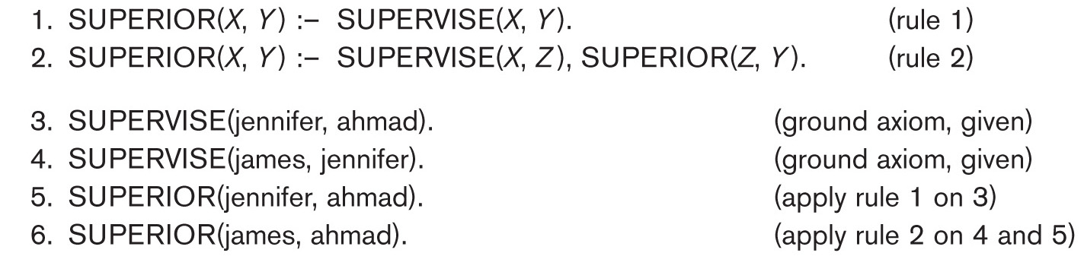
Proving a new fact
Figure 24.12

Slide 53
Interpretation of Rules
Model-theoretic
  Given a finite or infinite domain of constant values, we assign the predicate every combination of values as arguments
  If this is done fro every predicated, it is called interpretation

Slide 54
Interpretation of Rules
Model
  An interpretation for a specific set of rules
Model-theoretic proofs
  Whenever a particular substitution to the variables in the rules is applied, if all the predicated are true under the interpretation, the predicate at the head of the rule must also be true
Minimal model
  Cannot change any fact from true to false and still get a model for these rules

Slide 55
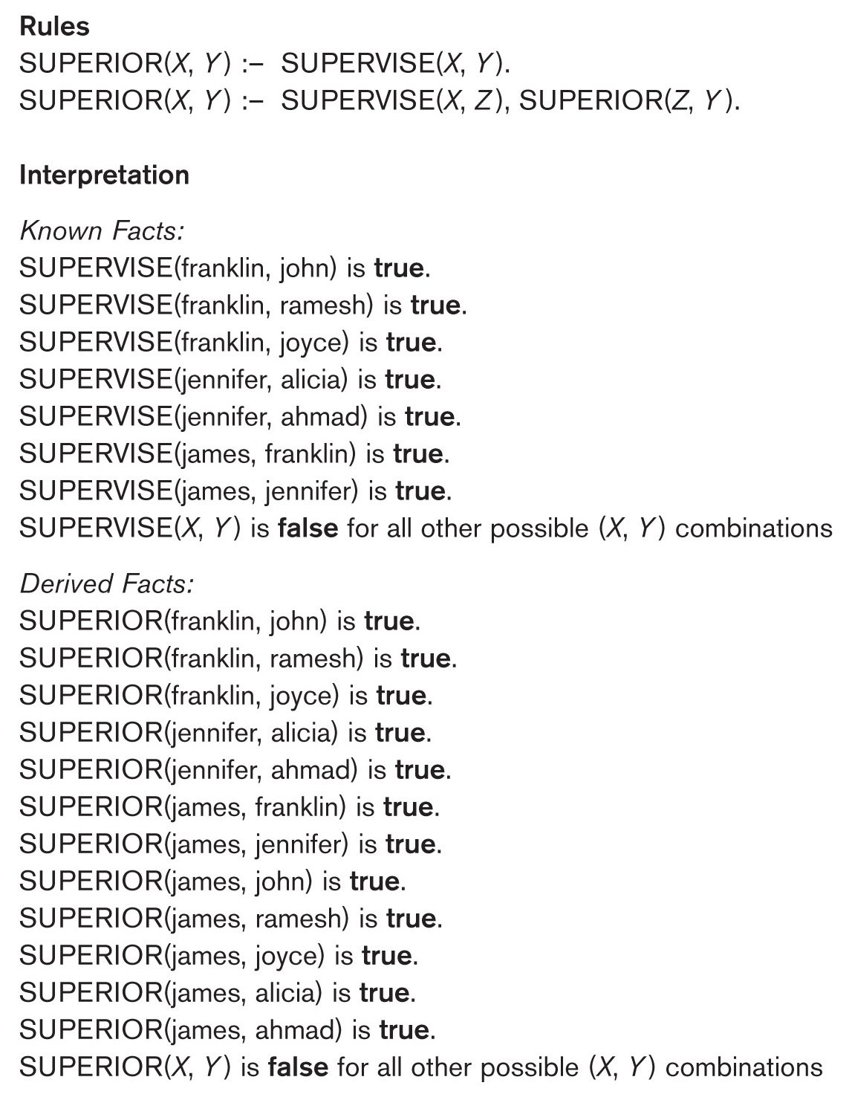
Minimal model
Figure 24.13

Slide 56
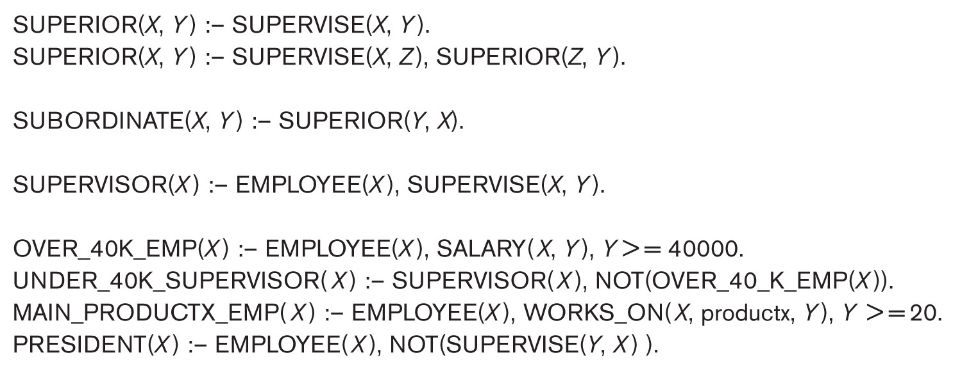
Datalog Programs and Their Safety
Two main methods of defining truth values
  Fact-defined predicates (or relations)
    Listing all combination of values that make a predicate true
  Rule-defined predicates (or views)
    Head (LHS) of 1 or more Datalog rules, for example Figure 24.15

Slide 57
Datalog Programs and Their Safety
A program is safe if it generates a finite set of facts
  Fact-defined predicates (or relations)
    Listing all combination of values that make a predicate true
  Rule-defined predicates (or views)
    Head (LHS) of 1 or more Datalog rules, for example Figure 24.15

Slide 58
Use the Relational Operations
Many operations of relational algebra can be defined in the for of Datalog rules that defined the result of applying these operations on database relations (fact predicates)
  Relational queries and views can be easily specified in Datalog

Slide 59
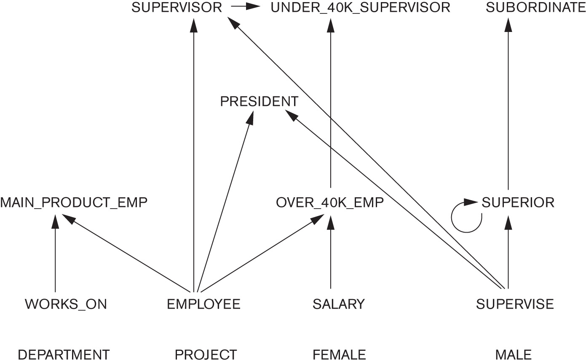
Evaluation of Non-recursive Datalog Queries
Define an inference mechanism based on relational database query processing concepts
  See Figure 24.17 on predicate dependencies for Figs 24.14 and 24.15

Slide 60
Recap
Active database & triggers
Temporal databases
Spatial and Multimedia databases
Deductive databases

