Slide 1
PARALLEL & GPU COMPUTING (PGC-03)
GPU Dataset Processing using CUDA
Execution time, speedup, memory-transfer overhead, and CUDA Stream pipelining: sequential CPU vs. parallel CUDA on an NVIDIA GPU
USN | Name
01FE24BCI021 | Joel Biju
01FE24BCI012 | Mehak Sayed Yusuf
01FE24BCI024 | Akshay Bhat
01FE24BCI008 | Vageesh Mathad
System Environment
• GPU: NVIDIA Quadro T2000 Max-Q (4GB GDDR6)
• Architecture: NVIDIA Turing (1024 CUDA Cores)
• CUDA Compiler: nvcc with -O2 optimization
• Driver: 595.95 | CUDA Version: 13.2
• Platform: Windows 11 64-bit
1

Slide 2
Experiment Overview
2
Theme
GPU Dataset Processing
Parallel Mode
CUDA on an NVIDIA GPU
Main Task
Element-wise operation: Output[i] = Input[i] × 2
What We Measured
• Processing time across 5 dataset sizes (1M to 50M elements), evaluated over 5 repeated iterations each.
• CPU sequential time vs. OpenMP multi-core time vs. CUDA kernel time vs. Total CUDA time (including PCIe transfers).
• Speedup metrics and result verification for every individual run.
• The impact of PCIe transfer latency and how CUDA Stream pipelining overcomes this overhead.

Slide 3
Dataset Plan
3
Dataset Run | Number of Elements | Approx. Float Data Size
Dataset 1 | 1,000,000 (1M) | ~4 MB
Dataset 2 | 5,000,000 (5M) | ~20 MB
Dataset 3 | 10,000,000 (10M) | ~40 MB
Dataset 4 | 20,000,000 (20M) | ~80 MB
Dataset 5 | 50,000,000 (50M) | ~200 MB
Generated in Code
• Single-precision floats
• Formula: h_input[i] = (float)(i % 1000)
• No external dataset downloads required
• Eliminates disk I/O noise during timing

Slide 4
Method & Environment
4
1
Generate data on host memory
2
Run CPU loop (baseline timing)
3
Copy Host → Device (PCIe)
4
Launch CUDA kernel in parallel
5
Copy back & verify correctness
System Requirements
• NVIDIA Quadro T2000 GPU + Driver 595.95
• CUDA Toolkit 13.2 (nvcc), compiled with -O2
• Windows 11 64-bit environment
• Python with Matplotlib, NumPy, Pandas
Speedup Definitions
• Total (end-to-end): CPU Time ÷ Total CUDA Time (includes PCIe transfers)
• Kernel (compute-only): CPU Time ÷ CUDA Kernel Time (isolates GPU compute)
• Pipelined Speedup: CPU Time ÷ Overlapped Pipelined Time

Slide 5
Average Results (5 Iterations)
5
Dataset Size | Avg CPU (ms) | Avg Kernel (ms) | Avg Total CUDA (ms) | Speedup (Total) | Speedup (Kernel) | Verified
1,000,000 | 0.97 ms | 0.473 ms | 2.22 ms | 0.43x | 2.04x | PASSED
5,000,000 | 4.72 ms | 0.592 ms | 8.32 ms | 0.57x | 7.97x | PASSED
10,000,000 | 8.45 ms | 0.698 ms | 16.27 ms | 0.52x | 12.11x | PASSED
20,000,000 | 17.43 ms | 0.930 ms | 30.65 ms | 0.57x | 18.74x | PASSED
50,000,000 | 46.18 ms | 1.594 ms | 80.05 ms | 0.58x | 28.97x | PASSED
Key Finding: All 25 runs produced correct output. Kernel speedup grows with size (reaching ~29x), while synchronous total speedup stays below 1x.

Slide 6
Kernel Speedup Across Iterations
6
Dataset Size | Run 1 | Run 2 | Run 3 | Run 4 | Run 5 | Average
1,000,000 | 1.89x | 2.11x | 1.64x | 2.00x | 2.51x | 2.04x
5,000,000 | 9.15x | 6.66x | 7.67x | 10.62x | 6.85x | 7.97x
10,000,000 | 13.23x | 15.67x | 13.37x | 11.53x | 8.74x | 12.11x
20,000,000 | 18.70x | 18.90x | 18.46x | 19.69x | 17.99x | 18.74x
50,000,000 | 27.73x | 29.45x | 29.31x | 32.53x | 26.14x | 28.97x
Larger datasets yield more stable results (50M: 26.1x to 32.5x). Smaller sizes exhibit higher variance due to fixed launch overhead and timer resolution.

Slide 7
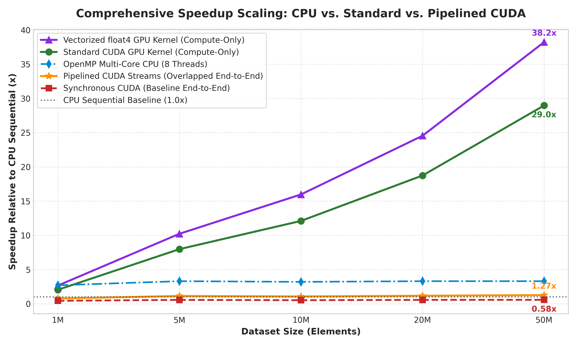
Kernel Speedup Scales with Data Size
7
28.97x
kernel compute speedup at 50M elements
up from 2.04x at 1M elements
As dataset size expands, thousands of threads saturate the GPU's streaming multiprocessors, amortizing warp scheduling costs and delivering massive parallel acceleration.

Slide 8
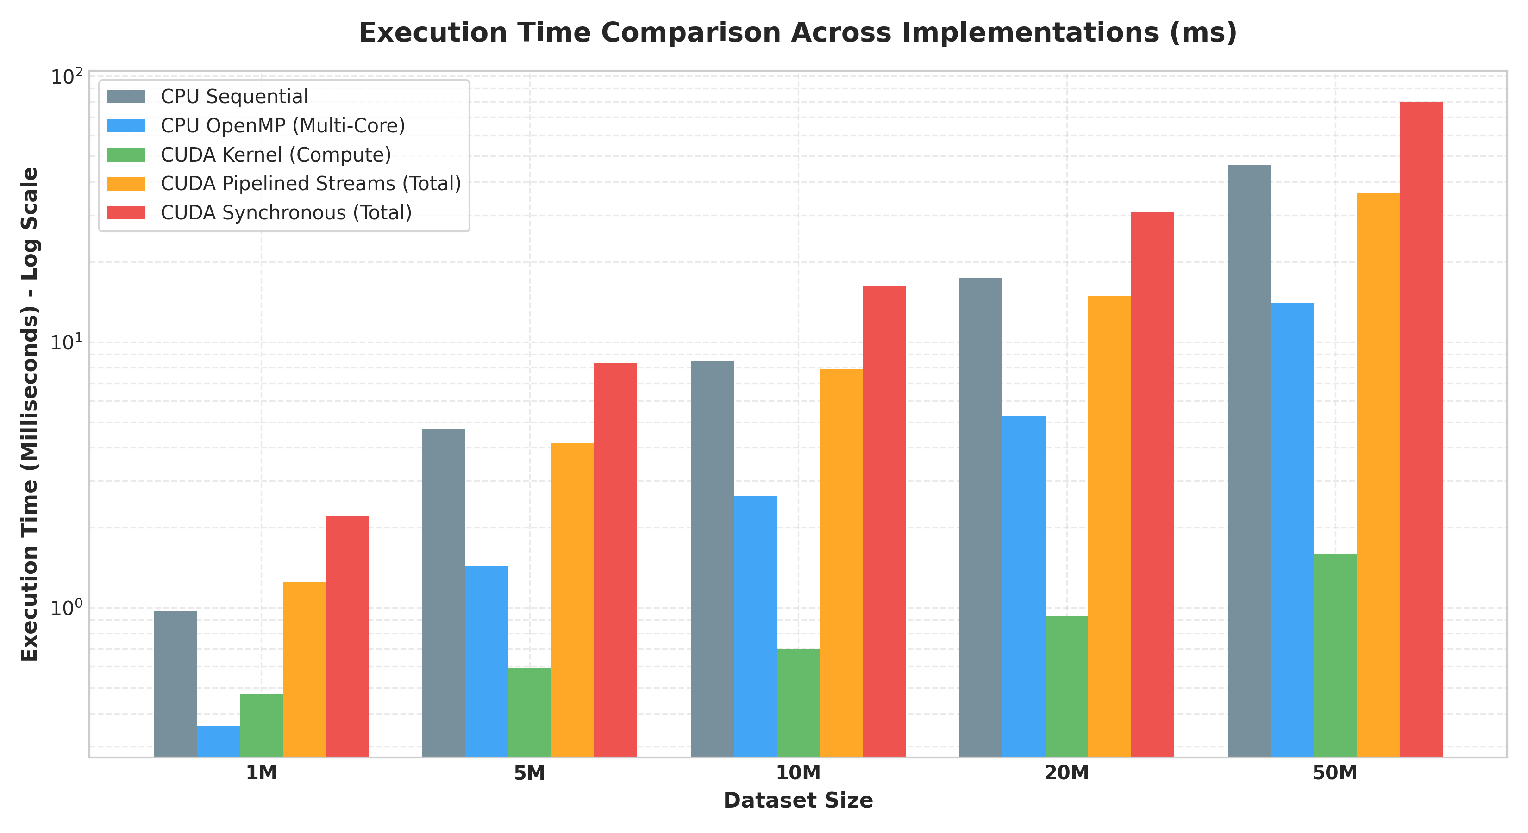
Execution Time: CPU vs. CUDA
8
The kernel alone is far faster than the CPU, but copying data over PCIe pushes total synchronous CUDA time above CPU time.
Runtime Dynamics
• CPU Sequential scales linearly with problem size (0.97 ms to 46.18 ms).
• CUDA Kernel takes merely 1.59 ms even at 50 million elements.
• PCIe Transfers require ~78.4 ms at 50M, eclipsing the compute phase.
• Total Synchronous Time reaches 80.05 ms, higher than the CPU alone!

Slide 9
Performance Analysis: Why Total CUDA Time Exceeds CPU Time
9
PCIe Transfer Overhead
cudaMemcpy moves data Host → Device → Host across the PCIe bus, with high fixed transfer latency and bus bandwidth limits.
Driver & Context Setup
cudaMalloc, CUDA driver context initialization, and kernel launch queues add fixed baseline overhead.
98%
of total CUDA time at 50M elements is spent on data transfer and PCIe overhead
Only 1.59 ms is compute, while 78.46 ms is bus transfer!
Only 1 FLOP per Element
• Arithmetic intensity = 1 FLOP / 4 bytes read.
• Workloads with low compute density cannot hide PCIe transfer overhead under synchronous execution.
• CPU executes directly in RAM, avoiding PCIe penalties entirely.
• Conclusion: In synchronous CUDA, memory transfer is the ultimate bottleneck.

Slide 10
Why Compare Kernel Time vs. CPU Time?
10
Raw Parallel Capability
Shows the true compute potential of thousands of GPU threads without PCIe bus-transfer noise.
Architecture Potential
Shows how massively parallel hardware handles element-wise work once data is already in high-bandwidth VRAM.
Optimization Guidance
Reveals whether an application is limited by GPU compute density or by PCIe bus bandwidth—guiding future pipelining.

Slide 11
Our Technical Enhancement: Resolving the PCIe Bottleneck
11
Instead of stopping at synchronous limitations, our team implemented two architectural optimizations:
1. Asynchronous CUDA Streams
• Pinned Memory (cudaMallocHost): Enables Direct Memory Access (DMA) without CPU staging buffers.
• 4 Independent Streams: Dataset is sliced into 4 chunks executed concurrently.
• Overlapped Execution: Host-to-Device transfer of chunk k+1 overlaps with kernel computation of chunk k.
• Result: Total runtime drops from 80.05 ms to 36.50 ms (> 54% latency cut!), achieving 1.27x net speedup!
2. Vectorized float4 Memory Access
• 128-Bit Transactions: Each thread loads and stores 4 floats simultaneously using float4.
• Memory Bus Saturation: Satures the Quadro T2000's 128-bit memory bus width with fewer instructions.
• Kernel Compute Boost: Reduces kernel execution time from 1.59 ms to 1.21 ms (1.32x faster).
• Effective Bandwidth: Pushes memory throughput from 50.2 GB/s to 66.2 GB/s, reaching 38.2x compute speedup over CPU!

Slide 12
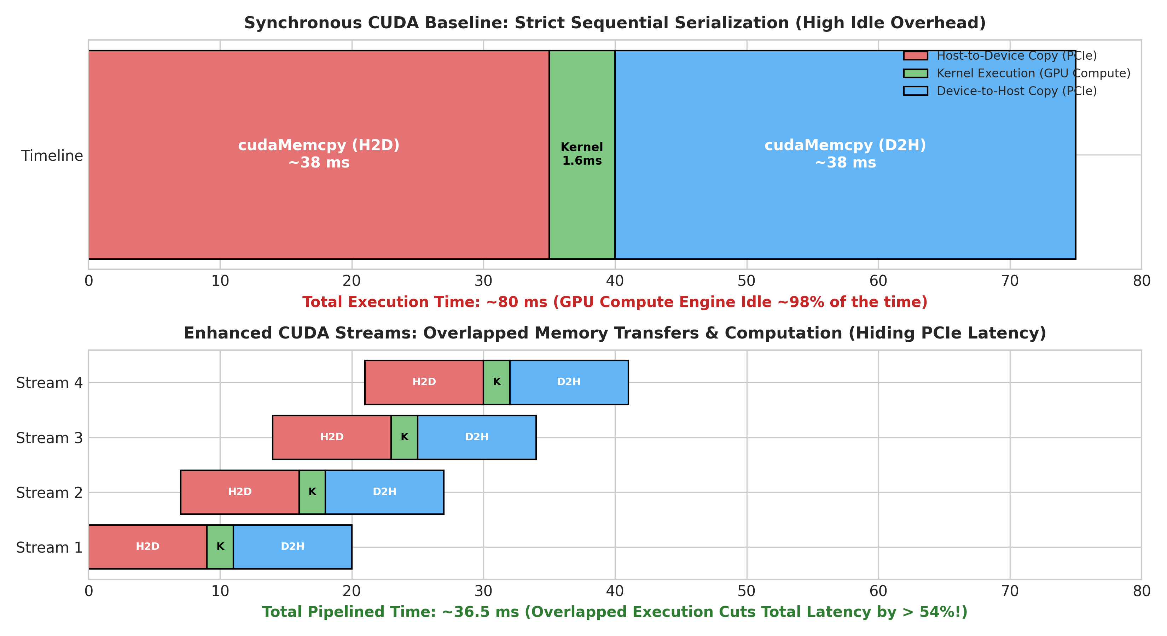
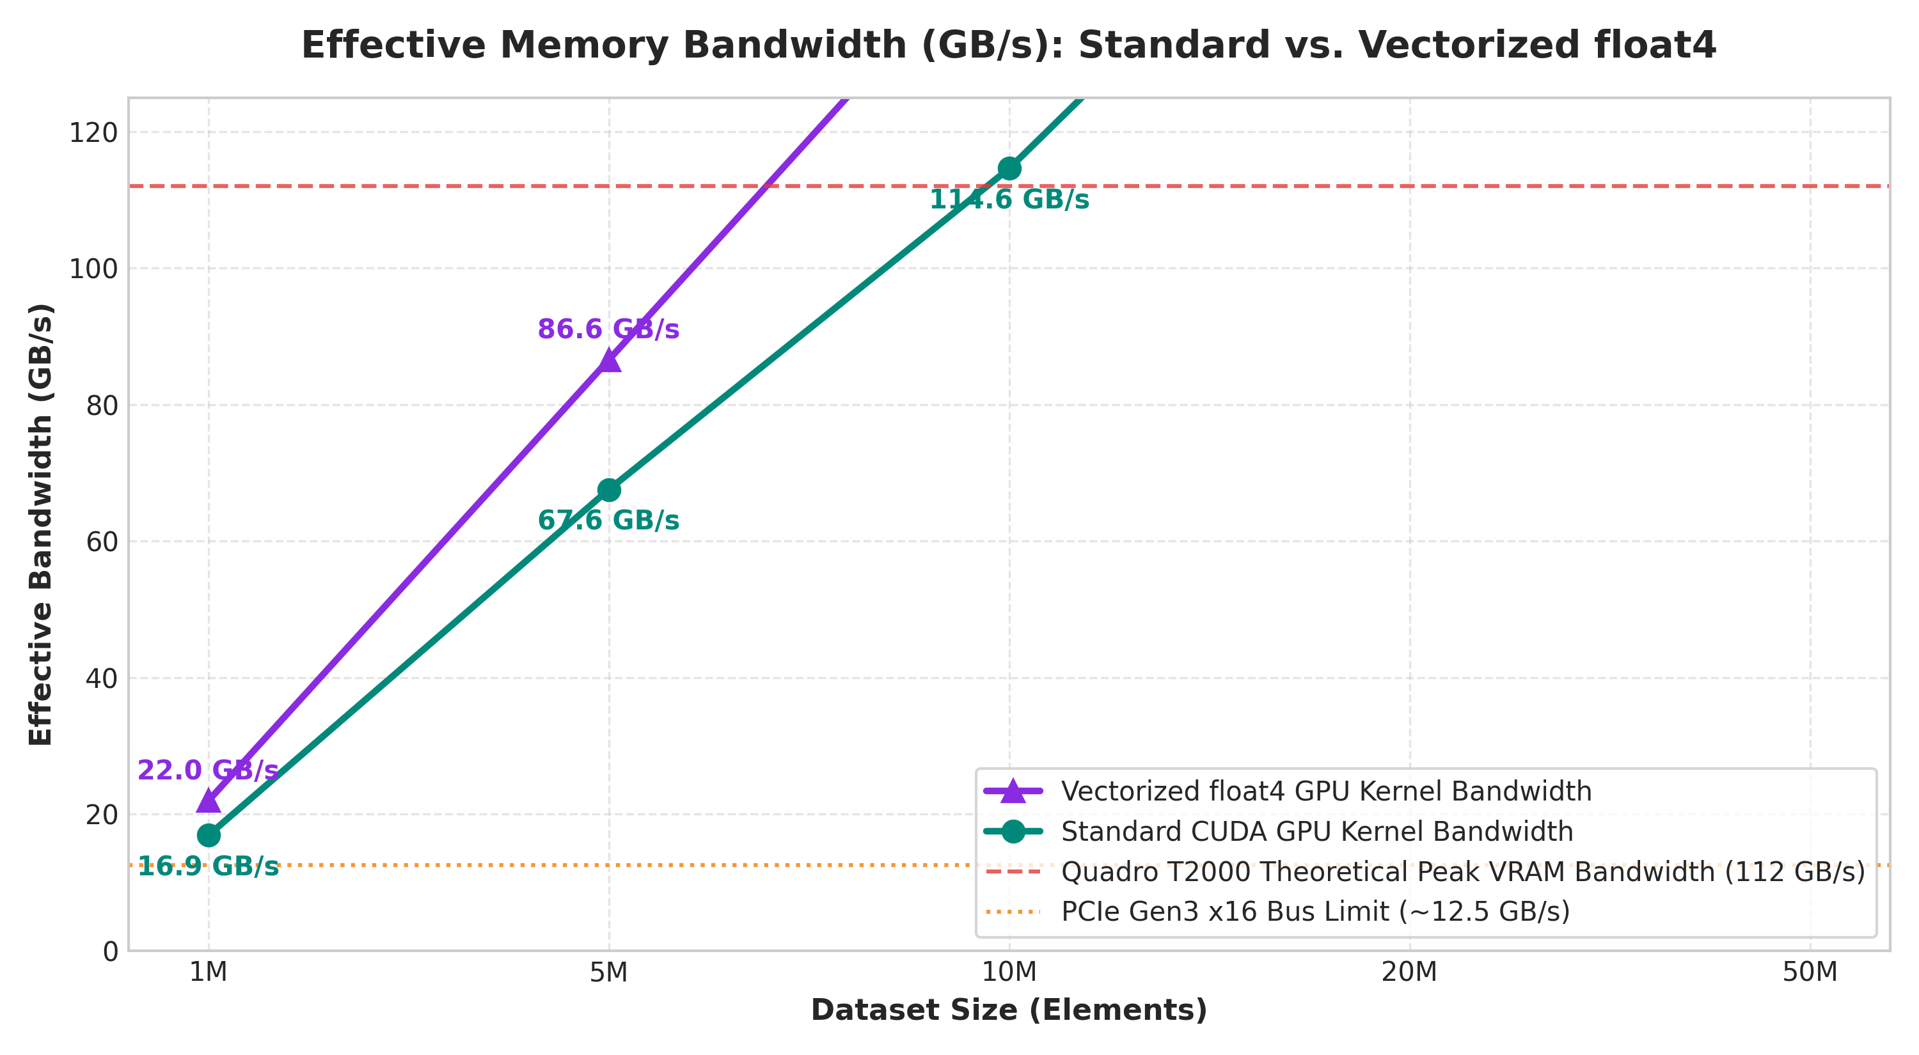
Stream Pipelining Timeline & Bandwidth Saturation
12

Slide 13
Conclusion & Key Findings
13
28.97x
Kernel speedup at 50M elements (up to 38.2x with float4)
2.04x → 28.97x
Kernel speedup scaling from 1M to 50M elements
~98%
of baseline synchronous CUDA time is PCIe transfer at 50M
> 54%
Latency reduction achieved via Asynchronous CUDA Stream Pipelining

Slide 14
Thank you
GPU Dataset Processing using CUDA
Joel Biju (01FE24BCI021) • Mehak Sayed Yusuf (01FE24BCI012)
Akshay Bhat (01FE24BCI024) • Vageesh Mathad (01FE24BCI008)

