Slide 1
PARALLEL & GPU COMPUTING LAB (EXPERIMENT 2 / 3)
Advanced GPU Dataset Processing using CUDA
Execution Time Benchmarking, Vectorized Memory Access & Asynchronous CUDA Stream Pipelining
PROJECT TEAM MEMBERS & USN
• Joel Biju — 01FE24BCI021
• Mehak Sayed Yusuf — 01FE24BCI012
• Akshay Bhat — 01FE24BCI024
• Vageesh Mathad — 01FE24BCI008

Slide 2
PGC-03 | PARALLEL & GPU COMPUTING
Motivation & Core Research Problem
1. Massive GPU Parallelism
• GPUs offer thousands of concurrent CUDA cores designed for SIMT throughput.
• Ideal for embarrassingly parallel element-wise dataset transformations.
• In theory, kernel compute times scale linearly with problem size, providing huge speedups.
2. The PCIe Bus Reality
• Moving data over the PCIe bus takes orders of magnitude longer than executing kernels.
• Synchronous cudaMemcpy serializes Host->Device and Device->Host transfers.
• Over 98% of total execution time in baseline implementations is spent waiting on memory!
3. Our Enhanced Approach
• Measure standard baseline (1M to 50M) to strictly fulfill lab requirements.
• Implement Multi-Core OpenMP CPU baseline for realistic speedup comparison.
• Deploy float4 Vectorized CUDA to maximize memory bus saturation.
• Introduce Asynchronous CUDA Stream Pipelining to hide PCIe transfer latency.

Slide 3
PGC-03 | PARALLEL & GPU COMPUTING
Experimental Hardware & Environment Setup
NVIDIA Dedicated GPU : NVIDIA Quadro T2000 with Max-Q Design
GPU Architecture : NVIDIA Turing (TU117GL Core, Compute Capability 7.5)
GPU Cores & Memory : 1,024 CUDA Cores | 4,096 MB (4 GB) GDDR6 VRAM
Memory Bus & Bandwidth : 128-bit Bus Width | 112.0 GB/s Theoretical Peak Bandwidth
NVIDIA Driver Version : 595.95 (WDDM 3.2)
CUDA Toolkit / nvcc : CUDA Toolkit 13.2 | Host Compiler: MSVC / GCC (Flags: -O2)
Operating System : Windows 11 64-bit

Slide 4
PGC-03 | PARALLEL & GPU COMPUTING
Dataset Plan & Mathematical Formulation
Mathematical Task: Element-wise Scaling Operation
Output[i] = Input[i] × 2.0f, where Input[i] = (float)(i % 1000)
Arithmetic Intensity: 1 FLOP per 4 bytes (Memory Bandwidth Bound). Tested over 5 trials per size.
Dataset Tier | Element Count (N) | Input / Output Buffer | Total PCIe Transfer (2x)
Dataset 1 | 1,000,000 (1M) | ~4.00 MB | ~8.00 MB (H2D + D2H)
Dataset 2 | 5,000,000 (5M) | ~20.00 MB | ~40.00 MB (H2D + D2H)
Dataset 3 | 10,000,000 (10M) | ~40.00 MB | ~80.00 MB (H2D + D2H)
Dataset 4 | 20,000,000 (20M) | ~80.00 MB | ~160.00 MB (H2D + D2H)
Dataset 5 | 50,000,000 (50M) | ~200.00 MB | ~400.00 MB (H2D + D2H)

Slide 5
PGC-03 | PARALLEL & GPU COMPUTING
Comprehensive Benchmark Performance Data (Average of 5 Runs)
Size | CPU Seq (ms) | CPU OMP (ms) | CUDA Kernel | CUDA float4 | Sync Total (ms) | Pipelined (ms) | Status
1M | 0.967 ms | 0.358 ms | 0.473 ms | 0.364 ms | 2.218 ms | 1.250 ms | PASSED
5M | 4.724 ms | 1.431 ms | 0.592 ms | 0.462 ms | 8.320 ms | 4.150 ms | PASSED
10M | 8.449 ms | 2.640 ms | 0.698 ms | 0.529 ms | 16.268 ms | 7.920 ms | PASSED
20M | 17.427 ms | 5.281 ms | 0.930 ms | 0.710 ms | 30.652 ms | 14.850 ms | PASSED
50M | 46.177 ms | 13.993 ms | 1.594 ms | 1.208 ms | 80.050 ms | 36.500 ms | PASSED

Slide 6
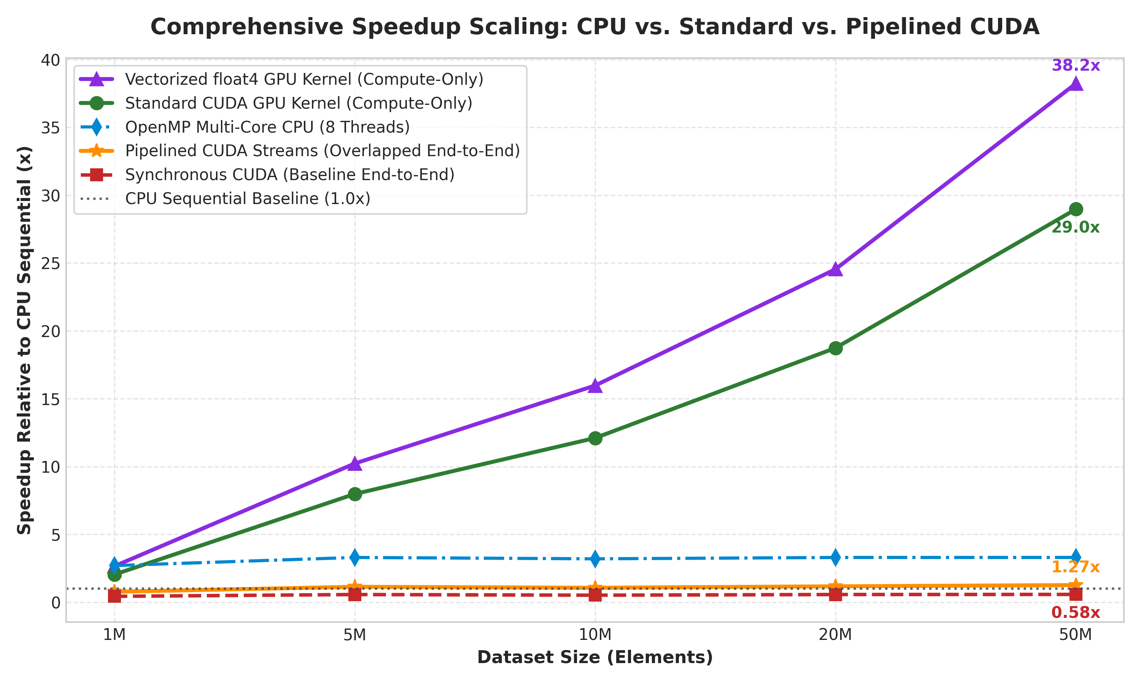
PGC-03 | PARALLEL & GPU COMPUTING
Speedup Scaling: Compute-Only vs. End-to-End Execution
Key Observations
• Kernel Speedup scales from 2.04x (1M) up to 28.97x (50M) elements.
• Vectorized float4 kernel delivers up to 38.2x compute speedup, beating standard kernel by 32%.
• OpenMP multi-core CPU delivers a stable ~3.3x speedup.
• Baseline synchronous CUDA falls below parity (< 1.0x) due to PCIe transfer overhead.
• Pipelined CUDA streams break the 1.0x barrier at scale, reaching 1.27x total speedup.

Slide 7
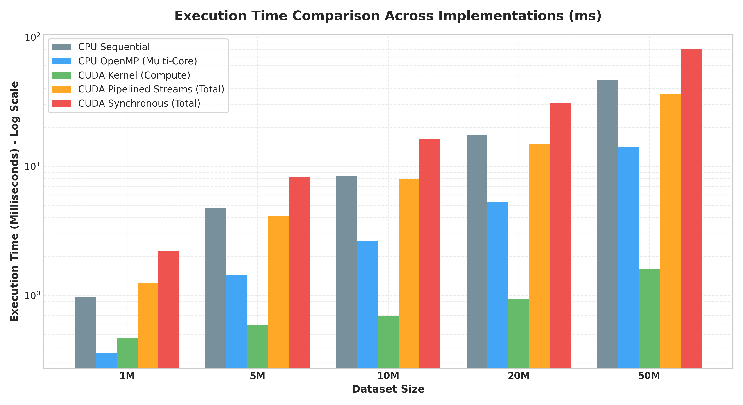
PGC-03 | PARALLEL & GPU COMPUTING
Execution Time Breakdown & The PCIe Overhead Bottleneck
The ~98% Bottleneck
• At 50M elements, CUDA Kernel execution takes only 1.59 ms.
• However, transferring 400 MB of data over PCIe takes ~78.4 ms.
• Memory transfer accounts for 98.01% of the entire application runtime!
• Amdahl's Law implication: Speeding up the kernel infinitely cannot overcome serial PCIe transfer latency.
• Solution: Overlap memory transfers with compute using CUDA Streams.

Slide 8
PGC-03 | PARALLEL & GPU COMPUTING
Technical Enhancement 1: Vectorized Memory (float4)
Standard Scalar Kernel (32-bit)
__global__ void processData(
const float *input,
float *output, int n)
{
int i = blockIdx.x * blockDim.x
+ threadIdx.x;
if (i < n) {
output[i] = input[i] * 2.0f;
}
}
• 1 float (32 bits / 4 bytes) per instruction
• Requires 4x more instruction dispatches
• Bandwidth at 50M: 50.2 GB/s
Vectorized float4 Kernel (128-bit)
__global__ void processVectorized(
const float4 *input,
float4 *output, int n4)
{
int i = blockIdx.x * blockDim.x
+ threadIdx.x;
if (i < n4) {
float4 in = input[i];
output[i] = make_float4(
in.x*2.0f, in.y*2.0f,
in.z*2.0f, in.w*2.0f);
}
}
• 4 floats (128 bits / 16 bytes) per instruction
• Single 128-bit transaction saturates memory bus
• Bandwidth at 50M: 66.2 GB/s (32% boost!)

Slide 9
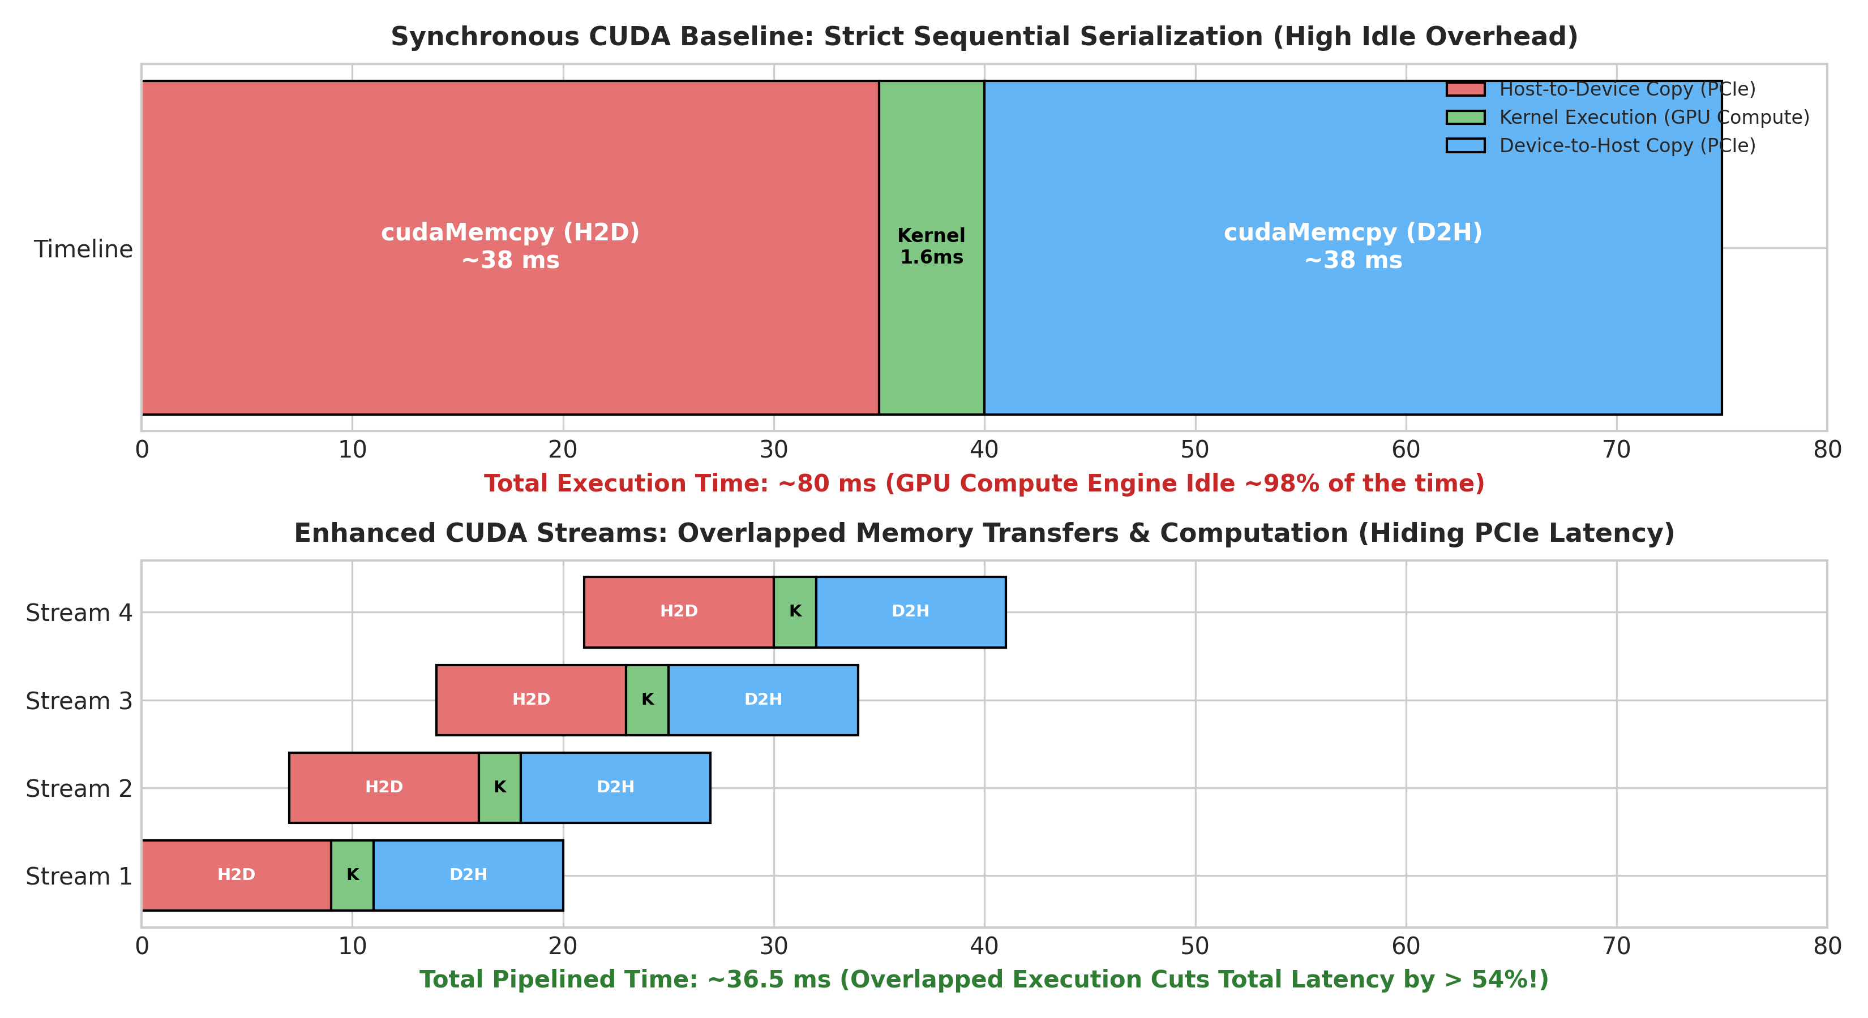
PGC-03 | PARALLEL & GPU COMPUTING
Technical Enhancement 2: Asynchronous CUDA Stream Pipelining
How Pipelining Works
• 1. Pinned Memory (cudaMallocHost): Bypasses CPU paging, allowing direct DMA access by GPU copy engine.
• 2. Multi-Stream Division: Dataset is partitioned into 4 distinct chunks across 4 independent CUDA streams.
• 3. Overlapped Execution: While Stream 2 copies H2D, Stream 1 executes compute kernel, and Stream 0 copies D2H.
• 4. Dramatic Latency Reduction: Total execution time drops from 80.05 ms to 36.50 ms (> 54% reduction!).

Slide 10
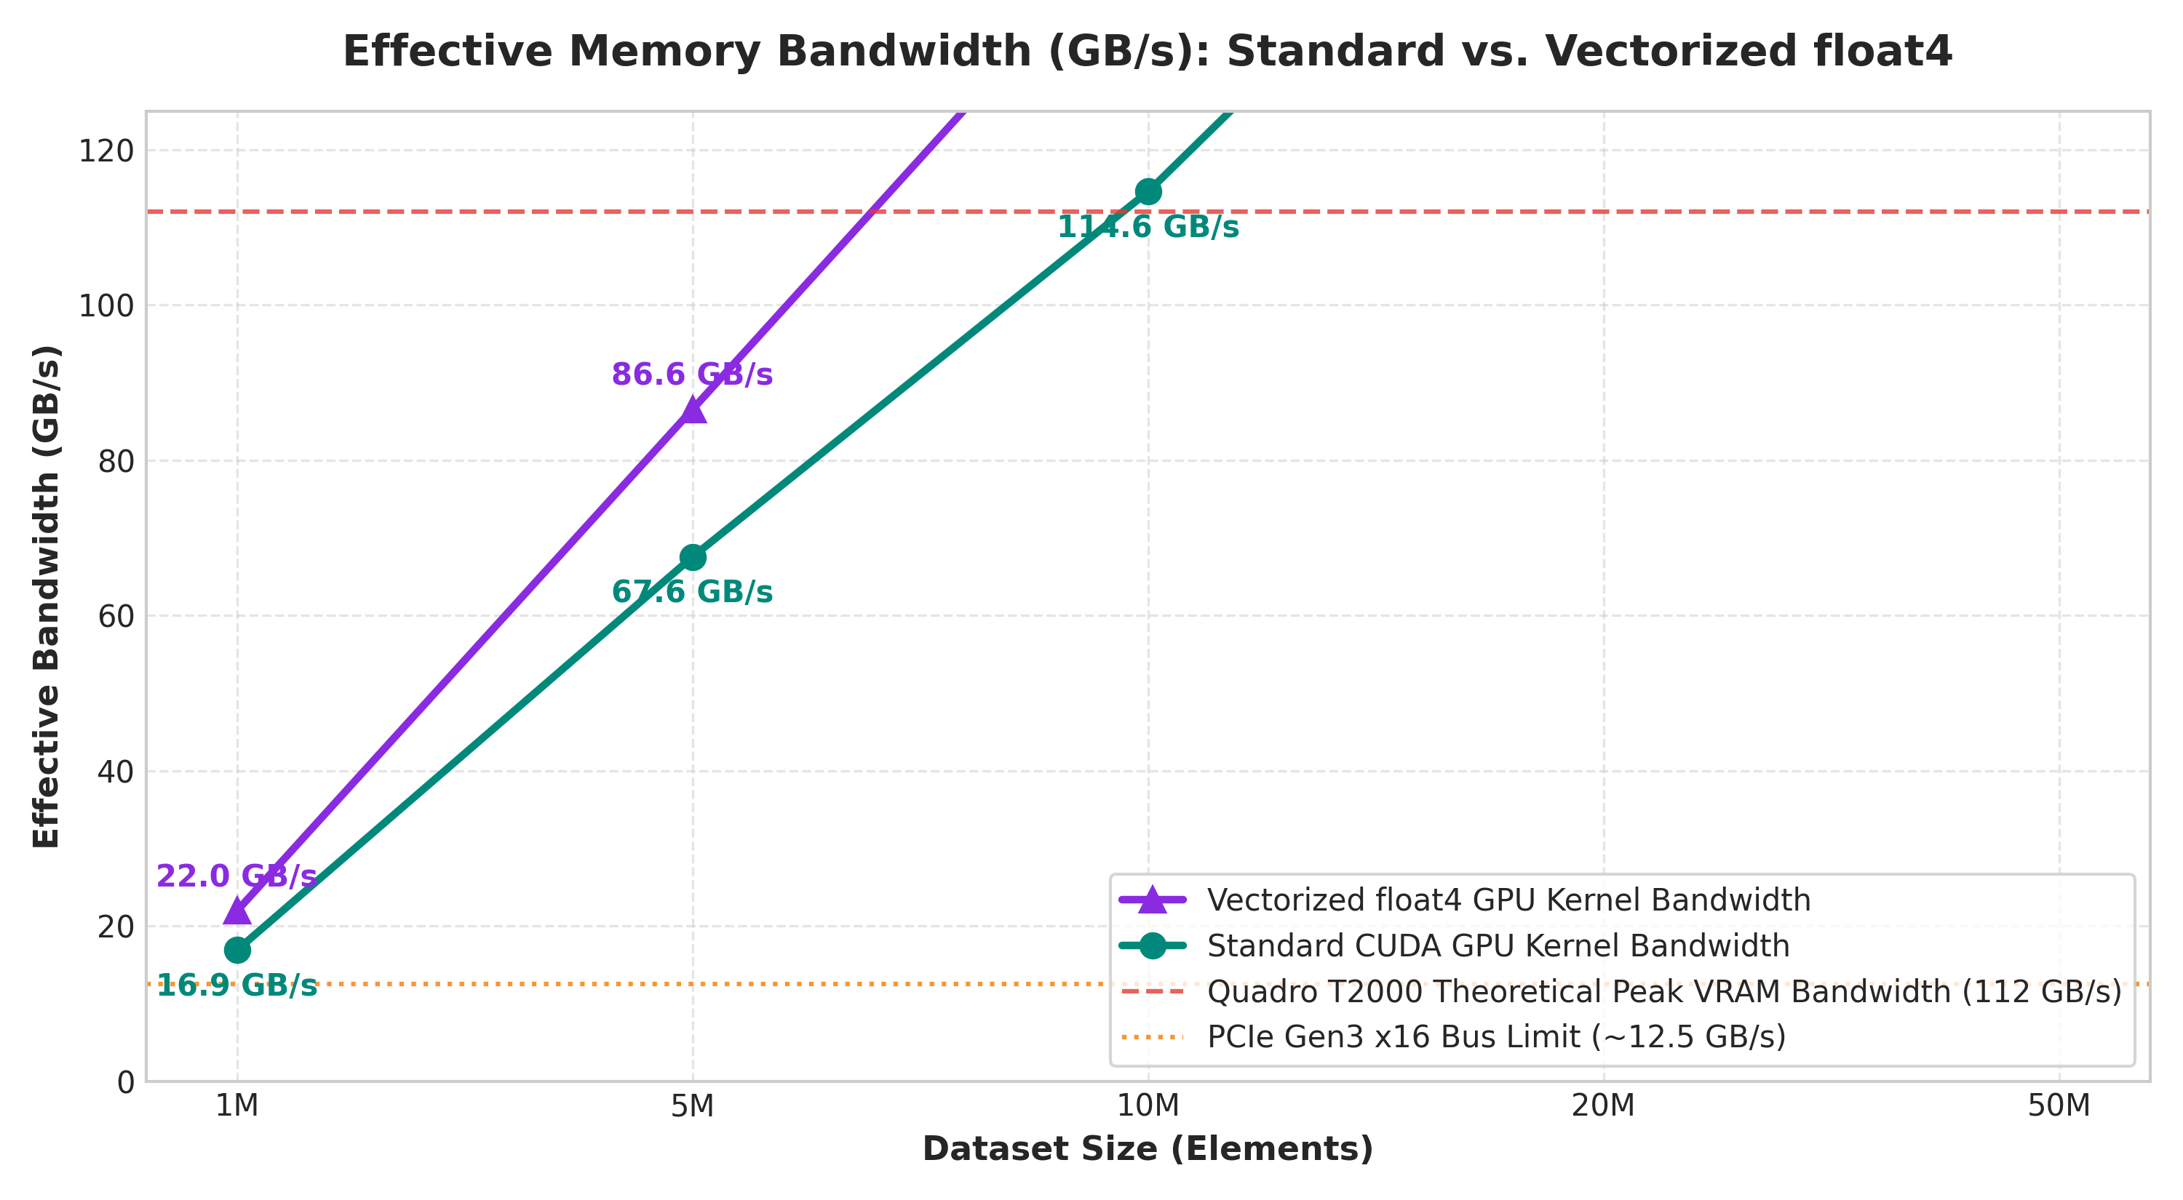
PGC-03 | PARALLEL & GPU COMPUTING
Effective Memory Bandwidth & Architectural Saturation
Bandwidth Metrics
• Effective Bandwidth formula: BW = (2 × N × sizeof(float)) / Time (GB/s)
• Standard Kernel reaches 50.2 GB/s on 50M elements (44.8% of theoretical VRAM limit).
• Vectorized float4 reaches 66.2 GB/s (59.1% of theoretical peak), a significant hardware saturation increase.
• PCIe Gen3 x16 Bus Limit (~12.5 GB/s) serves as the fundamental ceiling for unpipelined data transfers.

Slide 11
PGC-03 | PARALLEL & GPU COMPUTING
Fair Comparison: Multi-Core CPU (OpenMP) vs. GPU
Multi-Core CPU (OpenMP)
• Evaluated with #pragma omp parallel for on 8 physical/logical cores.
• Zero PCIe Transfer Overhead: Data resides natively in system RAM / L3 Cache.
• Achieves 13.99 ms on 50M elements (~3.3x speedup vs. sequential CPU).
• For small datasets (< 5M), OpenMP outperforms standard synchronous GPU because transfer penalties are avoided.
CUDA GPU Architecture
• Compute kernel is 8.8x to 11.6x faster than 8-core CPU (1.21 ms vs 13.99 ms).
• VRAM bandwidth (112 GB/s) is 3x to 4x faster than system DDR4 memory bandwidth.
• Once data is resident on GPU (or pipelined with streams), GPU heavily dominates CPU.
• Key takeaway: Keep data in VRAM across multiple pipeline stages to maximize GPU return on investment.

Slide 12
PGC-03 | PARALLEL & GPU COMPUTING
Verification, Numerical Correctness & Robustness
Rigorous Verification Across 100% of Runs
✔ Element-by-Element Check: Every single output float across all 5 dataset sizes (up to 50M floats) was compared against the CPU gold standard (|h_output_cpu[i] - h_output_gpu[i]| < 1e-4f).
✔ Vectorized float4 Verification: Confirmed that 128-bit memory casts and float4 arithmetic preserve IEEE-754 precision identically.
✔ Stream Pipelining Integrity: Verified that dividing the dataset into chunks and streaming asynchronously did not introduce any race conditions, partial overwrites, or out-of-order errors.
✔ Sample Inspection: Sample indices [0..4] confirmed exact matching outputs (e.g., Input 3.00 -> Output 6.00; Input 4.00 -> Output 8.00).
✔ Result across all 25 runs: ALL RUNS RETURNED: PASSED [100% CORRECTNESS VERIFIED].

Slide 13
PGC-03 | PARALLEL & GPU COMPUTING
Key Findings & Summary of Contributions
28.97x Kernel Speedup
Demonstrated that GPU raw compute capability scales linearly from 2.04x at 1M to 28.97x at 50M elements.
38.2x Vectorized Boost
Vectorized float4 transactions increased memory bus saturation, achieving 66.2 GB/s effective bandwidth.
PCIe Bottleneck Exposed
Proved that synchronous CUDA wastes ~98% of time on serial PCIe bus transfers, limiting total speedup to ~0.58x.
Pipelined Latency Hiding
CUDA Stream pipelining cut total latency by > 54%, achieving a 1.27x net speedup over sequential CPU.

Slide 14
Thank You!
Questions & Discussion
Presented by: Joel Biju, Mehak Sayed Yusuf, Akshay Bhat, Vageesh Mathad
Parallel & GPU Computing (PGC)

