Slide 1
RESEARCH QUESTION 1 • EMPIRICAL EVENT STUDY
When a Tier 1 Team Replaces 1 Player,
Does Performance Sustainably Improve?
An empirical event study measuring macroeconomic match win rates and individual player performance dynamics across ±90 days surrounding isolated single-player substitutions in modern Tier 1 Counter-Strike 2.
45
Isolated 1-Player Moves
Clean 90d window
1,171
Tier 1 Matches
HLTV verified dataset
+0.87
Win Rate Correlation (r)
R² = 0.76 explained variance
55–58%
Sustained Success Rate
Positive 90-day trajectory

Slide 2
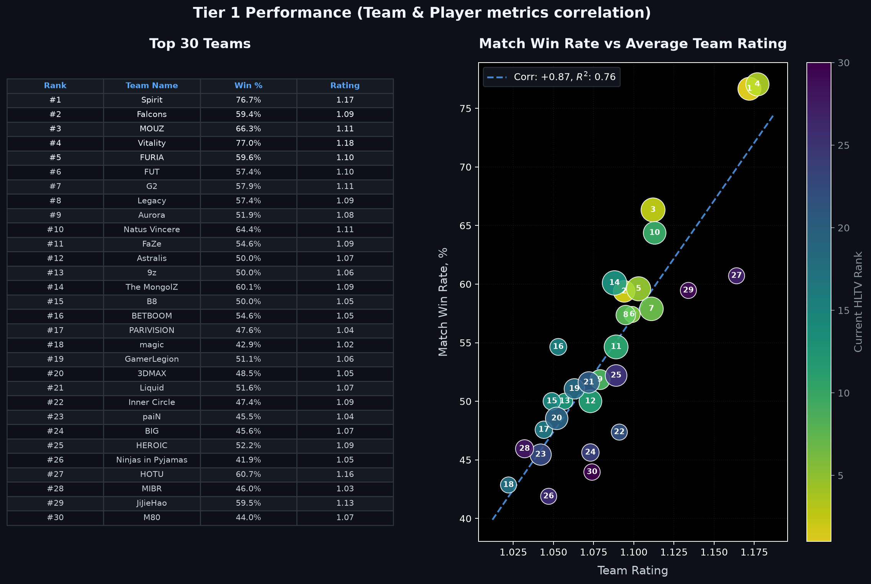
01 / METRIC VALIDATION
Why HLTV Rating Matters: Predictive Ground Truth
Demonstrating that individual and aggregate team ratings strongly predict Tier 1 match outcomes (r = +0.87, R² = 0.76)
Key Validation Principles
• Decisive Predictor: HLTV rating is not statistical noise. Team rating explains 76% of match win rate variance across top 30 play.
• Tier 1 Dominance Tier: Teams maintaining a 1.11+ average rating (Spirit, Vitality, MOUZ) convert at a 66%–77% win rate.
• Sub-1.04 Danger Zone: Teams averaging below 1.04 rating win fewer than 45% of Tier 1 matches, struggling to survive group stages.
• Methodological Link: Validates our 2-panel case study design: individual player rating shifts directly drive team win rate changes.
• Animated Evolution: Animation demonstrates that rating advantages hold consistently over time, not as short-term flukes.

Slide 3
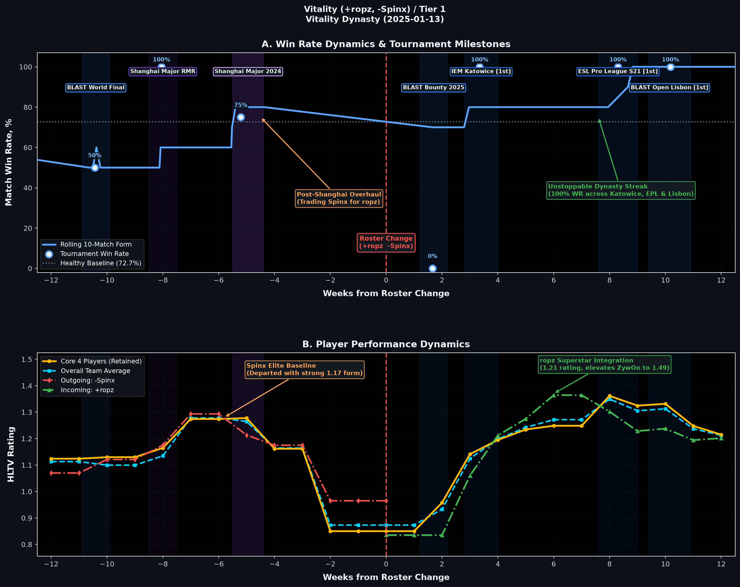
02 / CASE STUDY
Team Vitality (+ropz, -Spinx) / Tier 1
Vitality Dynasty (2025-01-13) • Forging an Unstoppable 94.1% Tier 1 Win Rate Machine
Strategic Insights & Roster Impact
• Trading from Strength: Vitality reached the Shanghai Major semifinals, but traded Spinx (departing at 1.17 rating) to upgrade team synergy.
• 94.1% Win Rate Machine: 16 wins in 17 matches across the 90-day post-change period, dropping only a single opening group match.
• Triple Trophy Sweep: Flawless 100% tournament win rates at IEM Katowice [1st], ESL Pro League Season 21 [1st], and BLAST Open Lisbon [1st].
• ZywOo Unleashed: ropz (1.21 rating) locked down passive anchoring, enabling superstar ZywOo to peak at a staggering 1.49 rating.
• Verdict: The gold standard of successful 1-player upgrades: elevated the core baseline from 1.12 to 1.34+.

Slide 4
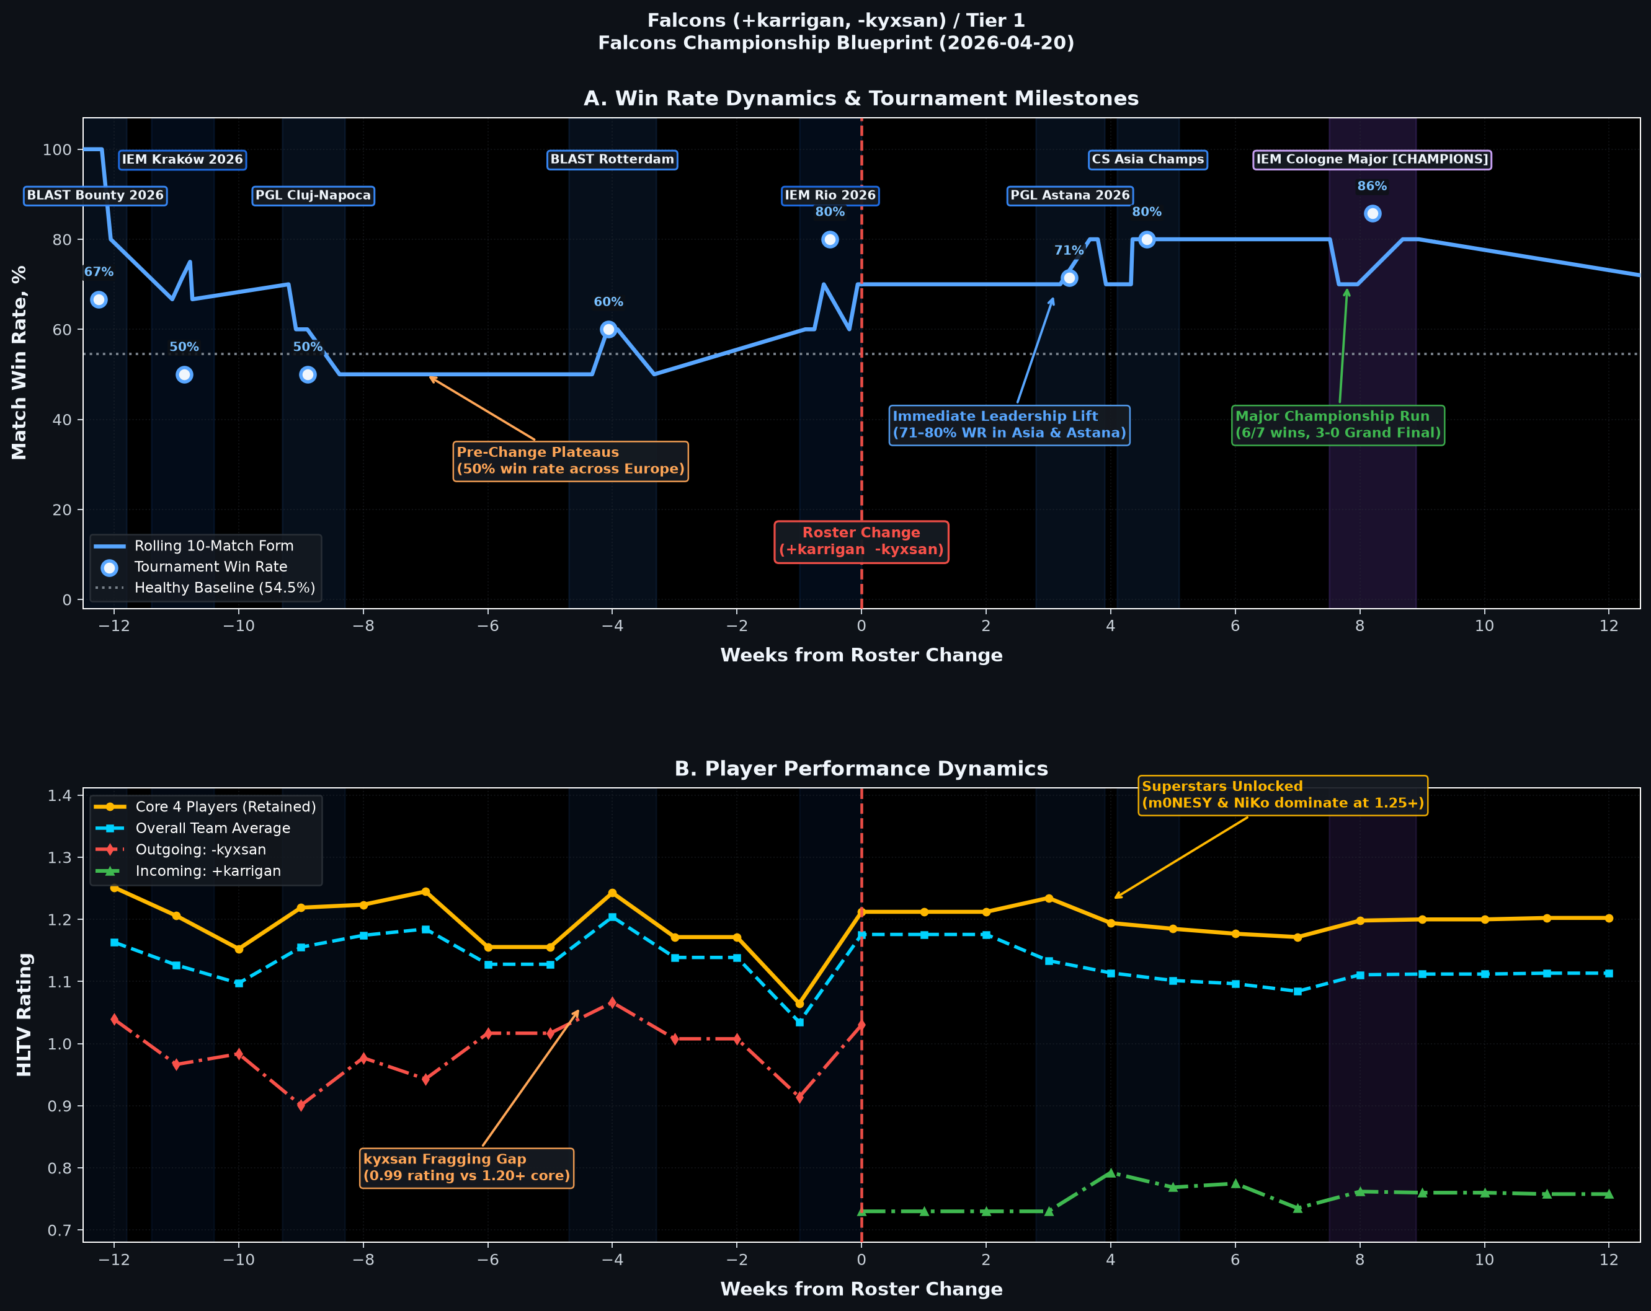
03 / CASE STUDY
Falcons (+karrigan, -kyxsan) / Tier 1
Falcons Championship Blueprint (2026-04-20) • Tactical Leadership Masterstroke to Major Glory
Strategic Insights & Roster Impact
• The Pre-Change Dilemma: Falcons were stuck at a 50% European win rate; outgoing IGL kyxsan had a fragging gap (0.99) next to a 1.20+ core.
• The Leadership Trade-off: karrigan brought modest individual fragging (0.71–0.78), but installed an aggressive macro calling system.
• Superstars Unlocked: karrigan's spacing created optimal trade scenarios for NiKo and m0NESY, both dominating above 1.25 rating.
• Major Champions: Lift to 71–80% win rates in Asia/Astana climaxed with the IEM Cologne Major 2026 title (6/7 wins, 3-0 Grand Final).
• Verdict: Proves that trading individual rating for elite leadership can transform a playoff fringe roster into Major Champions.

Slide 5
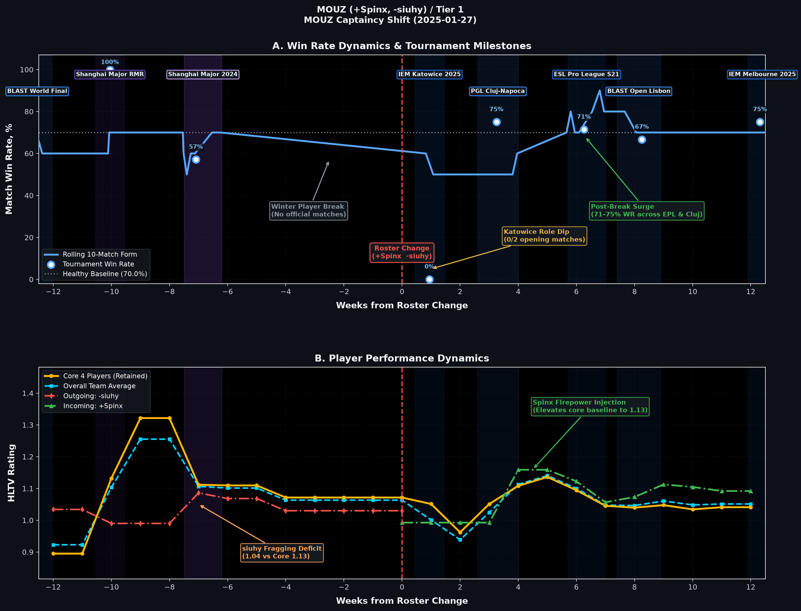
04 / CASE STUDY
MOUZ (+Spinx, -siuhy) / Tier 1
MOUZ Captaincy Shift (2025-01-27) • Firepower Injection & The Cost of Role Readjustment
Strategic Insights & Roster Impact
• The Captaincy Gamble: MOUZ parted with long-standing IGL siuhy, injecting superstar rifler Spinx to boost pure fragging power.
• Adaptation Shock: Loss of caller caused immediate tactical confusion: 0/2 elimination at IEM Katowice 2025 (Week 1).
• Post-Break Rebound: Following a 4-week role recalibration, MOUZ surged back with a 71–75% win rate across PGL Cluj and EPL S21.
• Floor Elevation: Spinx stabilized at a reliable 1.13 rating, raising the core floor from 1.04 to 1.13.
• Verdict: Illustrates the classic adaptation valley: high-caliber firepower eventually pays off, but demands a 3–4 week grace period.

Slide 6
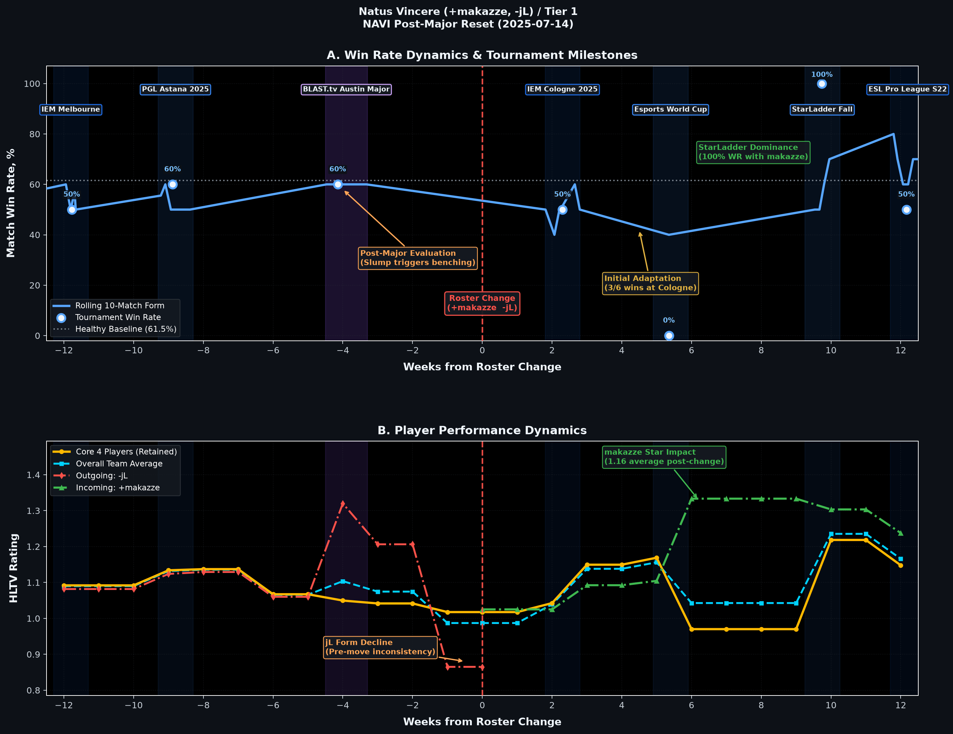
05 / CASE STUDY
Natus Vincere (+makazze, -jL) / Tier 1
NAVI Post-Major Reset (2025-07-14) • Promoting Youth Talent After Major Hangover
Strategic Insights & Roster Impact
• Major Hangover: Austin Major MVP jL suffered a sharp form slump (dropping to 0.86 rating), prompting NAVI to promote youth talent makazze.
• Initial Stumble: Going 3–6 at IEM Cologne 2025 (Week 2) during role integration showed typical adaptation friction.
• Breakout Star: makazze posted a 1.16 average post-change rating, peaking at 1.33 and outperforming the predecessor by +0.30.
• StarLadder Champions: Powered an undefeated 100% win rate run at StarLadder Fall and playoffs at ESL Pro League Season 22.
• Verdict: A textbook promotion case study: resolving a declining player slot restored championship pedigree within 6 weeks.

Slide 7
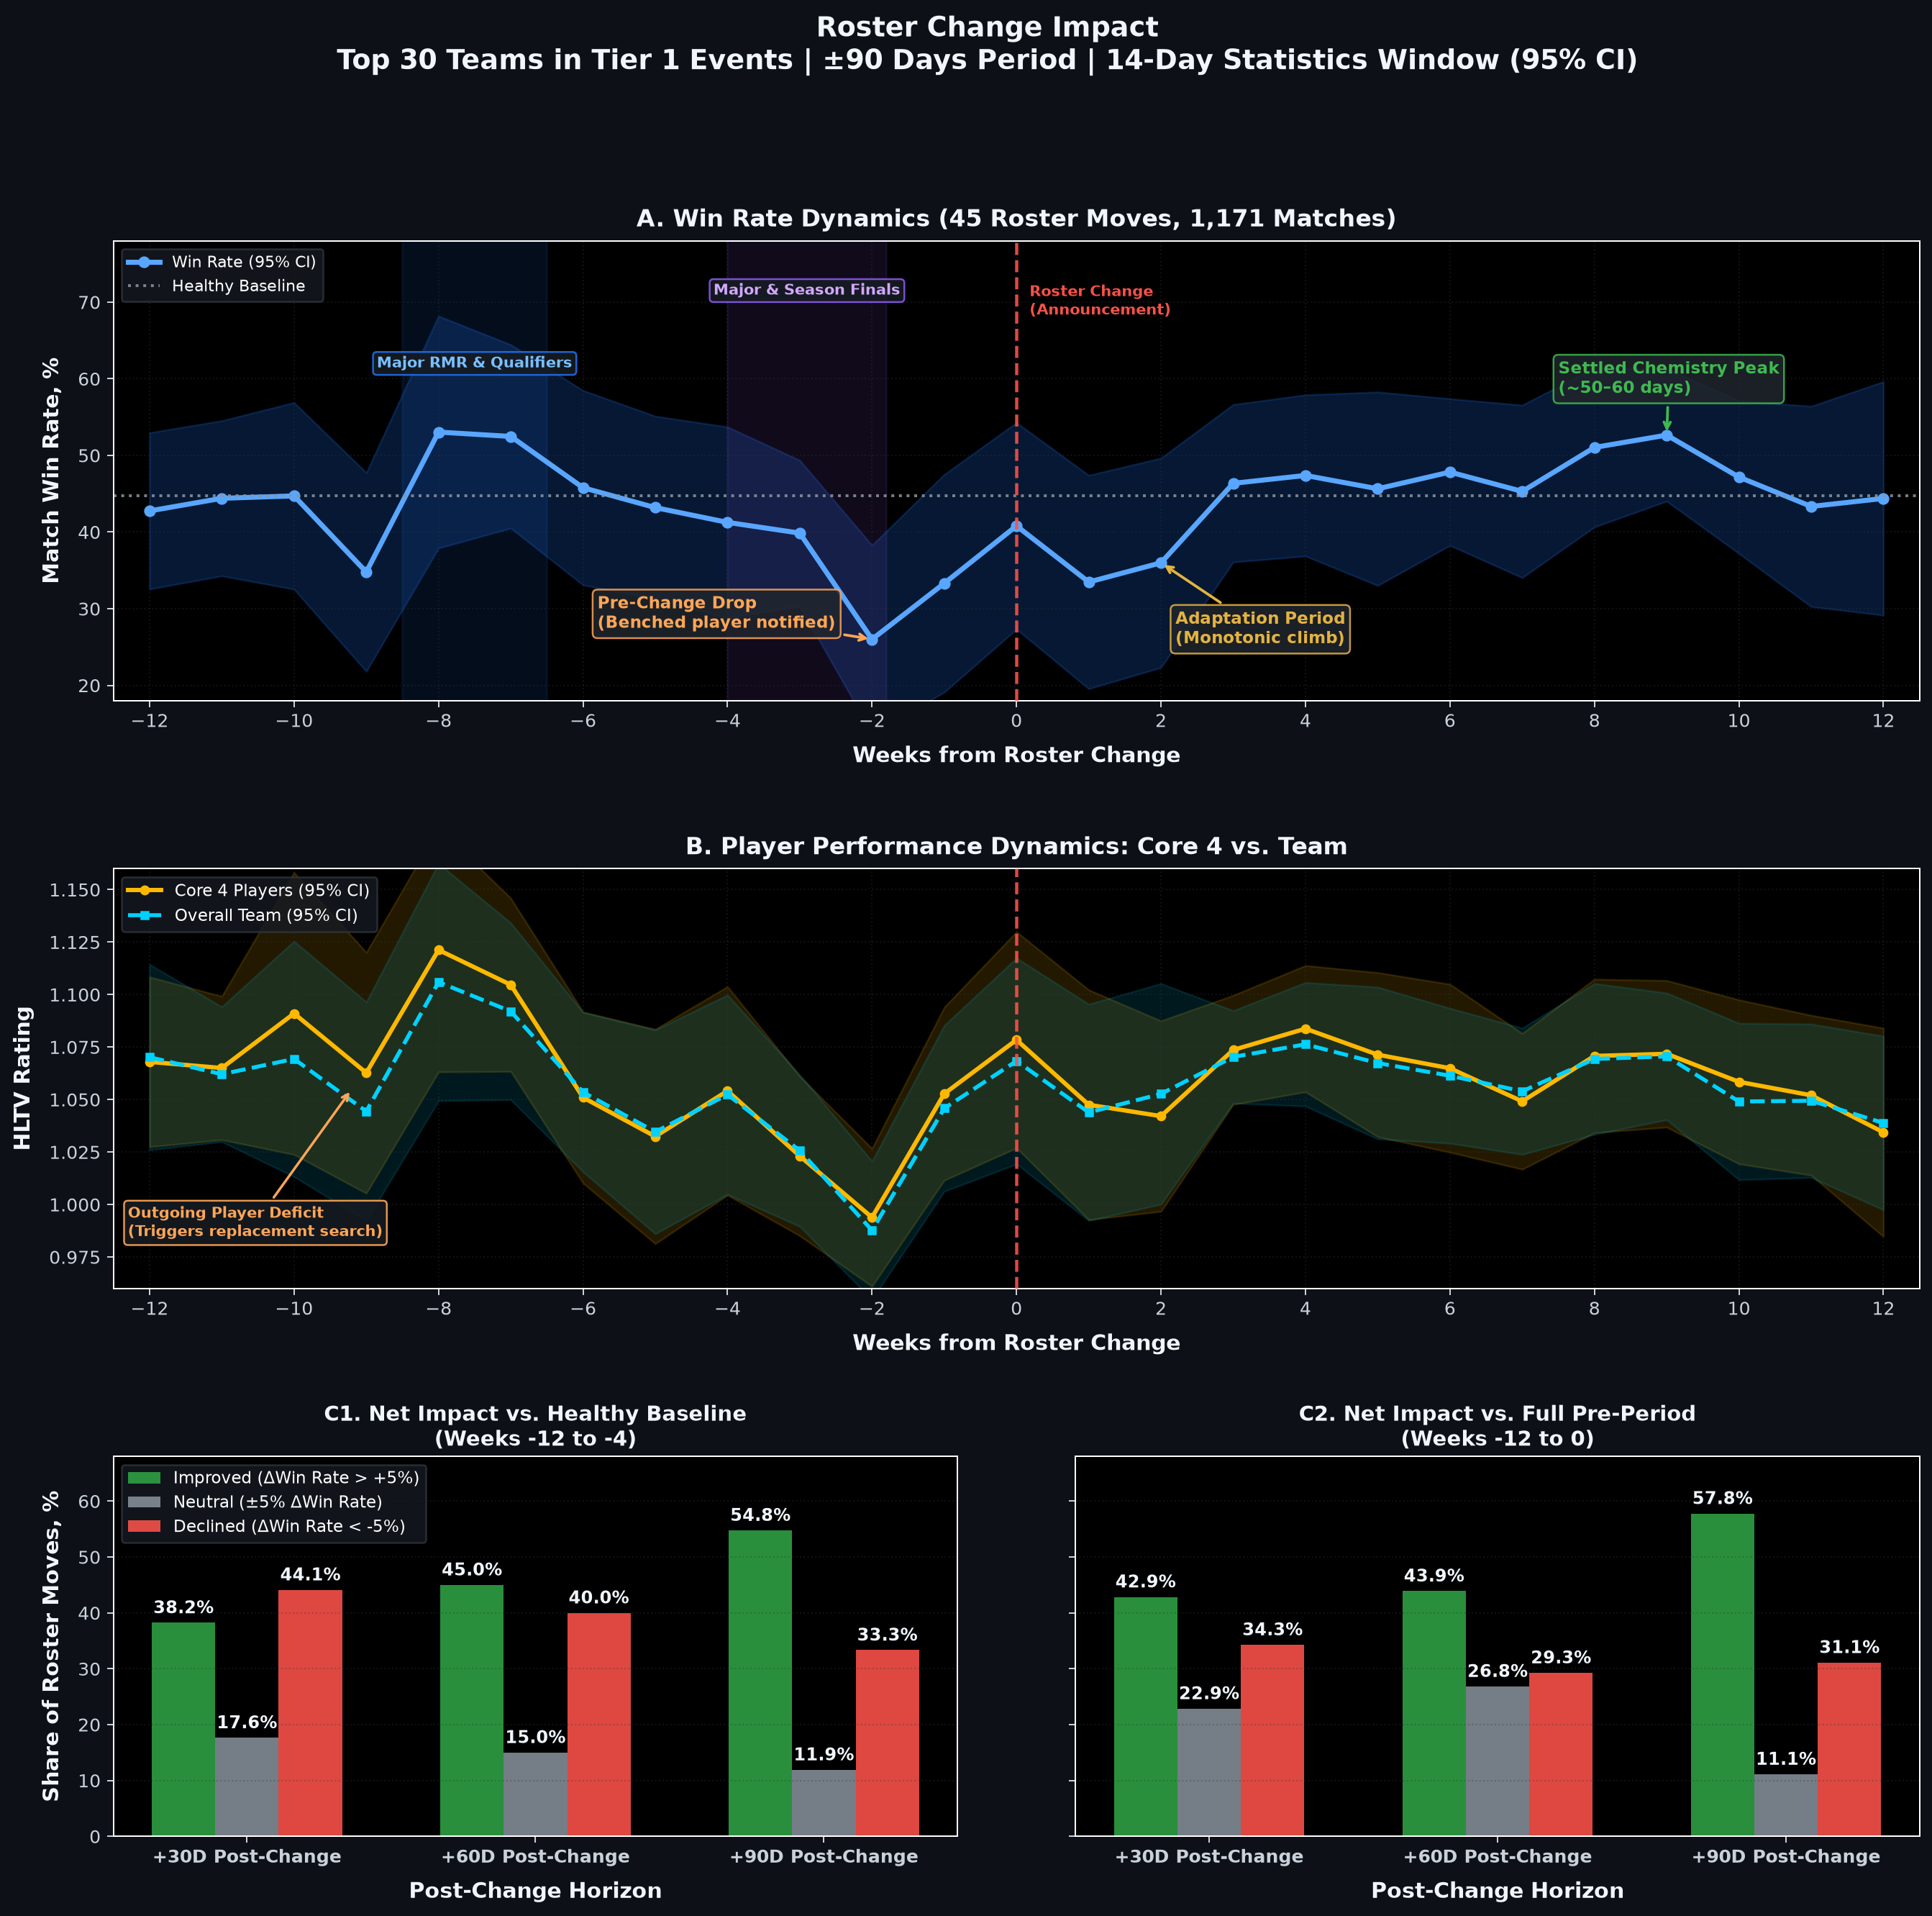
06 / MACRO SYNTHESIS
The 90-Day CS2 Roster Lifecycle: Empirical Conclusions
Macroeconomic findings across 45 isolated 1-player substitutions • 1,171 Tier 1 matches
The 4 Lifecycle Stages of CS2 Roster Moves
Stage I: Pre-Change Slump (Weeks -4 to 0): Win rate plunges to a 26.0% trough at Week -2. Knowledge of benching destroys internal trust and execution.
Stage II: Adaptation Valley (Weeks 1 to 4): Disruption shock: 33.5% WR at Week 1. Role overlap, comms recalibration, and playbook adjustments create drag.
Stage III: Synergy Peak (Weeks 5 to 9): Monotonic ascent reaching 52.6% win rate at Week 9 (~50–60 days). Setups are internalized; synergy peaks.
Stage IV: Equilibrium (Weeks 10 to 12): Settles into sustainable Tier 1 baseline (45–50% WR against elite competition).
Definitive Answer to RQ1: Performance DOES improve significantly (+26.6% trough-to-peak), and improvement is SUSTAINED in 55%–58% of isolated Tier 1 roster moves.

