Slide 1
Musical Fingerboard
Mobile Pervasive Lab Challenge
Mangirish Wagle
Gourav Shenoy

Slide 2
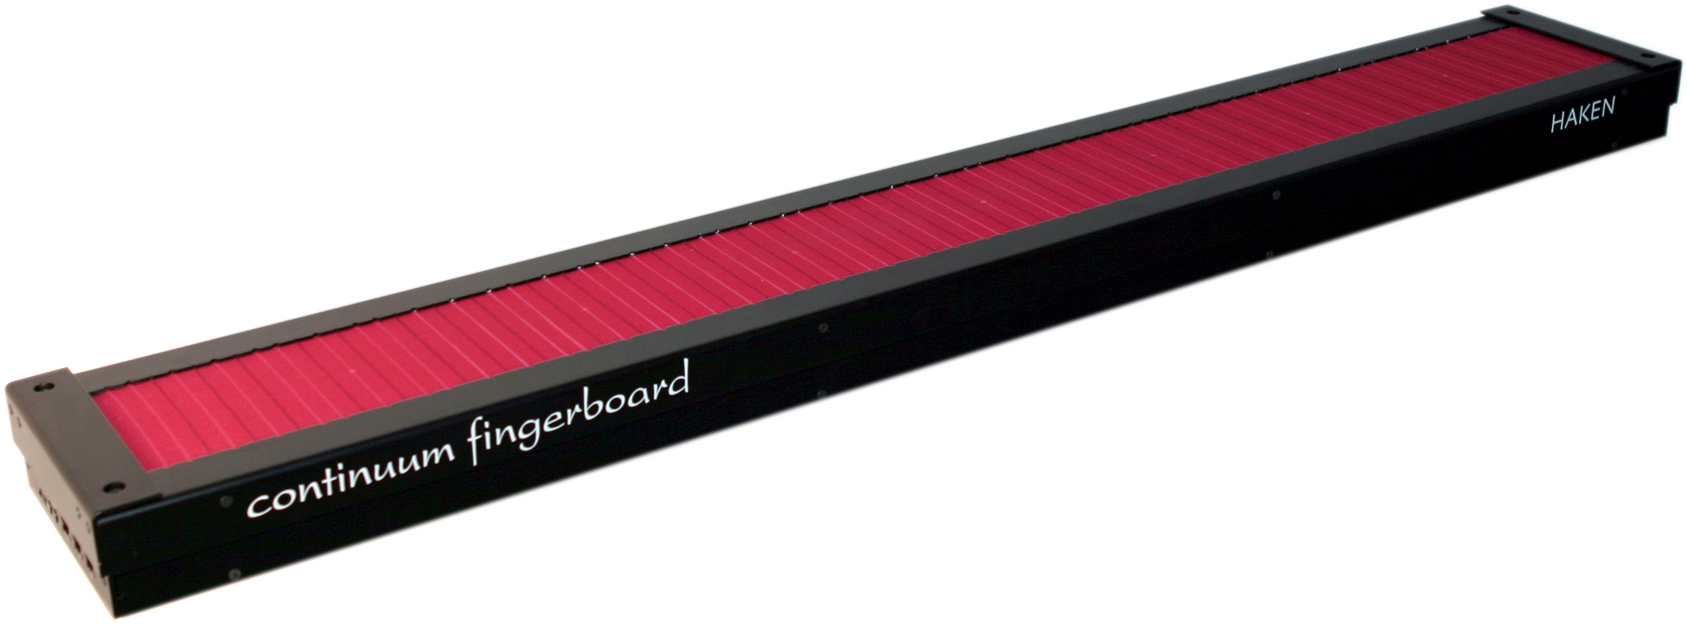
Inspiration

Slide 3
Arduino Components used
Arduino Red Board (x 1)
Soft Potentiometer (x 1)
Flex Sensor (x 1)
Photo Resistor (x 1)
Piezo Buzzer (x 1)
RGB LED (x 1)
Push Buttons (x 3)
Resistors 330Ω (x 4)
Resistors 10KΩ (x 5)

Slide 4
Features Implemented
Touch fingerboard music play (5 notes of major scale)
Pitch Bend
Musical Scale Change
Intelligent Dancing Light

Slide 5
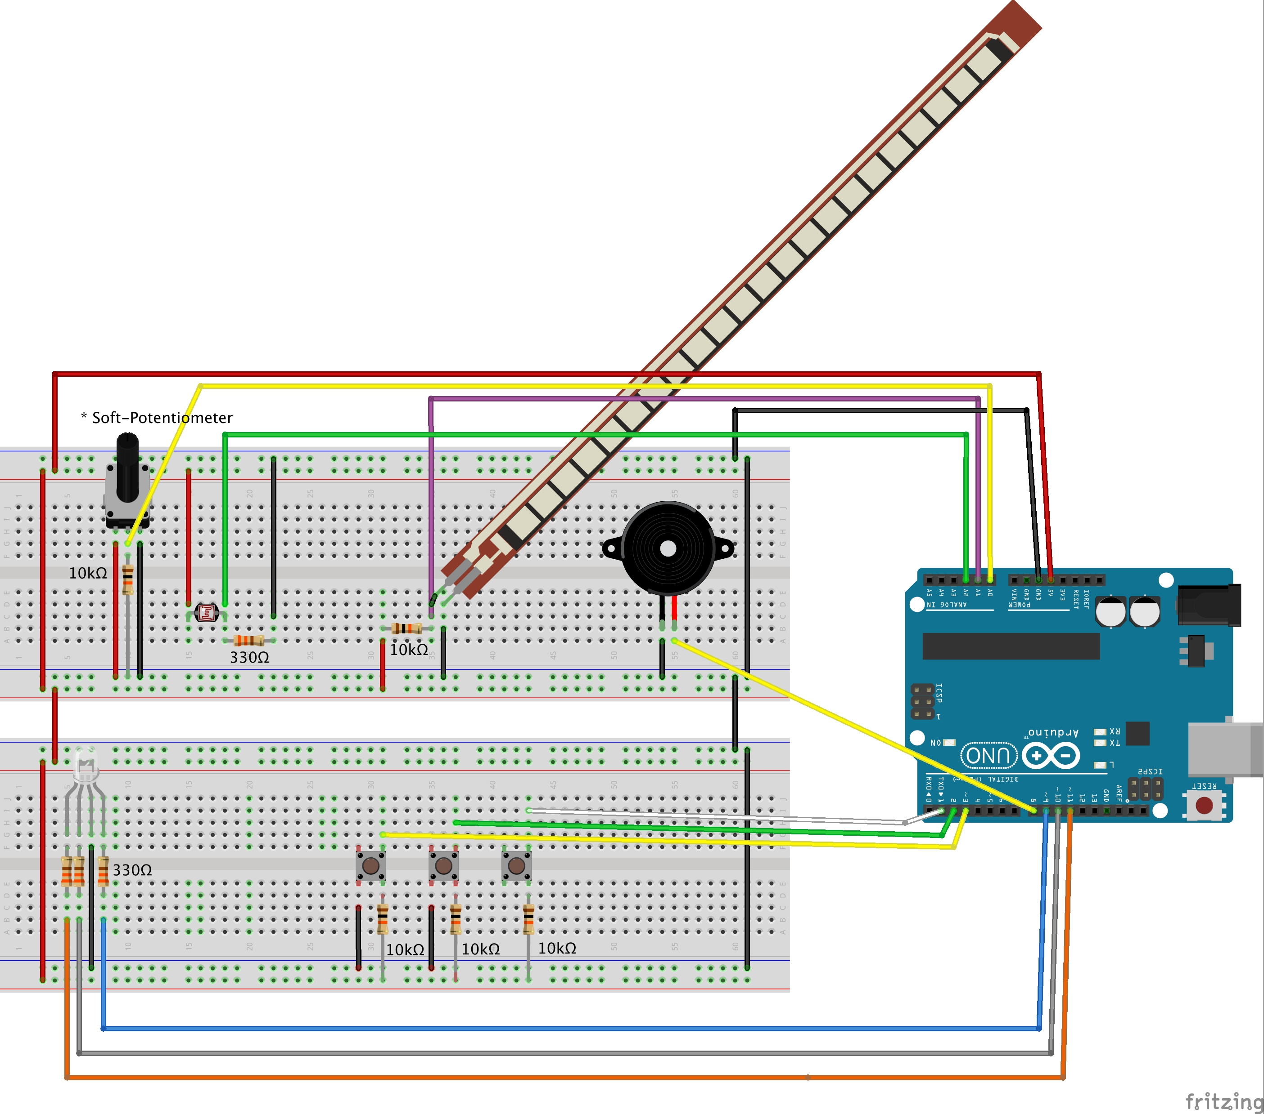
Fritzing Diagram

Slide 6
DEMO

Slide 7
THANK YOU!

