Slide 1

Mini Project I Covid STATS in Mexico
Vagner Bauer | 07 January 2023

Slide 2
Business context
Coronavirus disease (COVID-19) is an infectious disease caused by the SARS-CoV-2 virus.¹
Most people who fall sick with COVID-19 will experience mild to moderate symptoms and recover without special treatment. However, some will become seriously ill and require medical attention. Older people and people with existing health conditions are at higher risk.²
Deaths/100K Population³
Australia: 67.89
New Zealand: 48.36
Mexico: 259.18
Brazil: 326.69

Slide 3
Business Question
Is there a significant difference in the survival rate of hospitalized COVID positive elderly patients in different age groups?

Slide 4
Data pipeline
Data Acquisition
Data Exploration
Data Visualisation
Hypothesis Testing
Next Steps

Slide 5
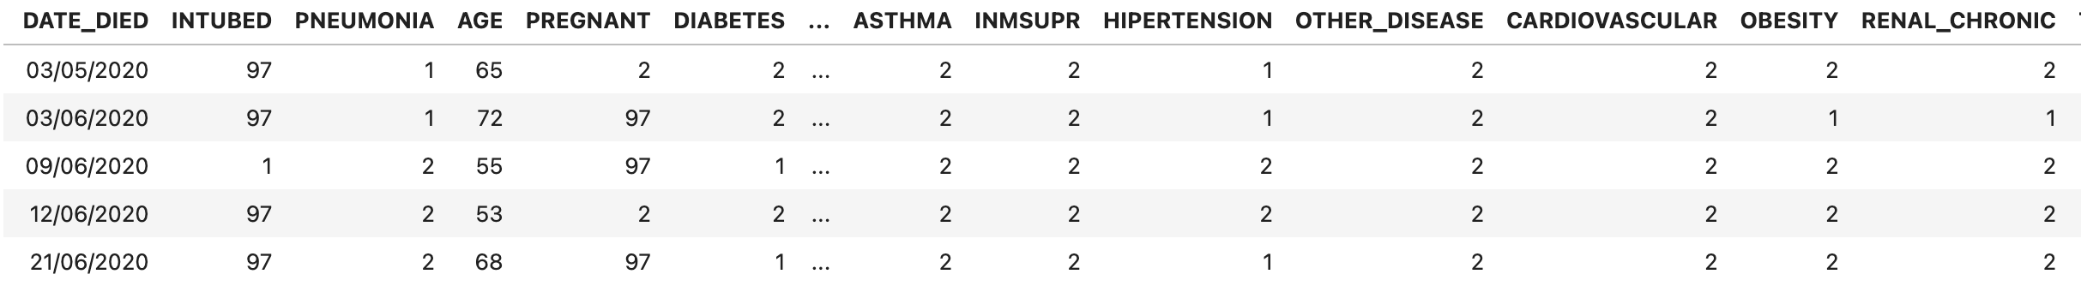
DATA Summary
Observations: 1,048,576 unique patients
Unique features: 21
Source: Mexican Government (from 2020 to 2021)

Slide 6
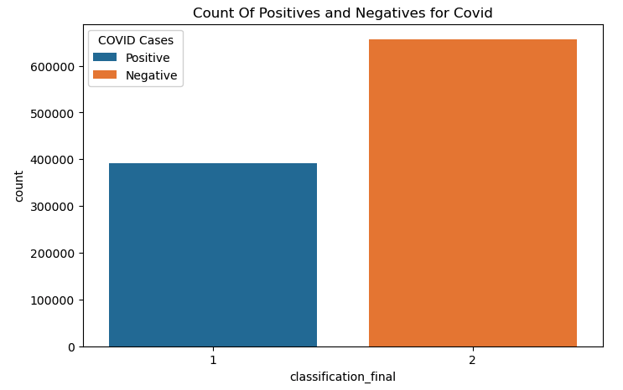
Exploratory data analysis

Slide 7
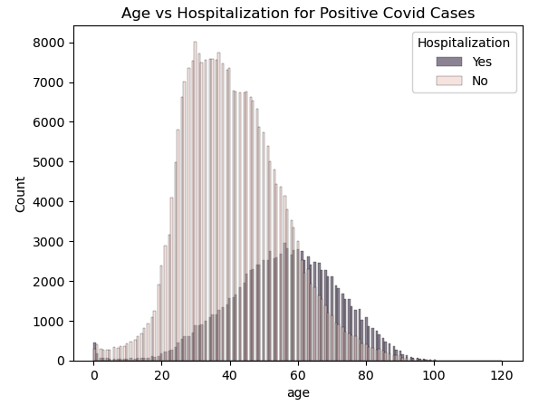
Exploratory data analysis

Slide 8
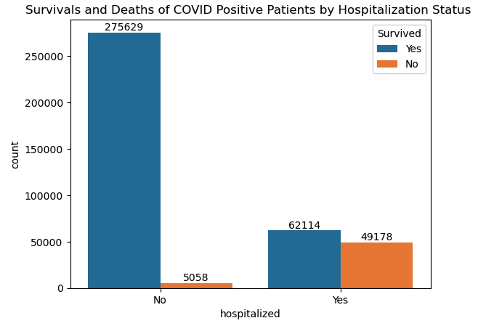
Exploratory data analysis

Slide 9
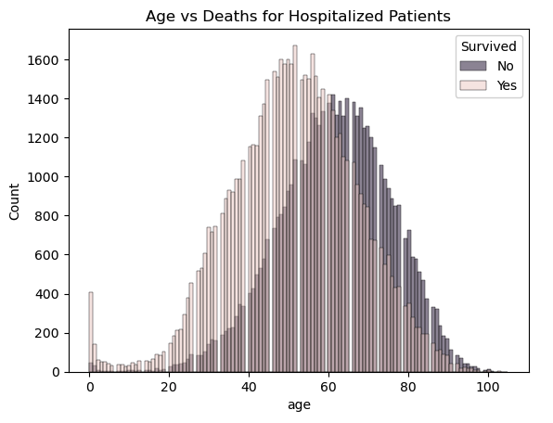
Exploratory data analysis

Slide 10
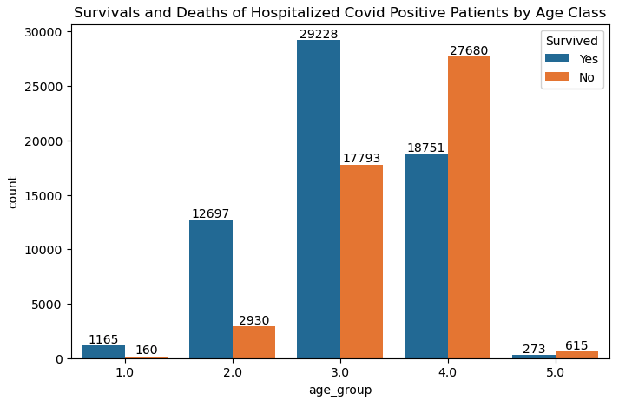
Exploratory data analysis
Age Class:
1 = Under 16
2 = Between 16 & 40
3 = Between 40 & 60
4 = Between 60 & 90
5 = Over 90

Slide 11
HYPOTHESIS ANALYSIS
NULL HYPOTHESIS: There is no statistical difference in the survival rate between hospitalized COVID positive elderly in ages 60-90 and over 90 years old.
ALTERNATIVE HYPOTHESIS: There is statistical difference in the survival rate between hospitalized COVID positive elderly in ages 60-90 and over 90 years old.
SIGNIFICANCE LEVEL: 0.05
OUTCOME: Calculate P-Value is 6.42e-09
CONCLUSION: The Null Hypothesis can be rejected.

Slide 12
NEXT STEPS
Explore other features with strong correlation with survival (example: whether patients already have air sacs inflamed or not – pneumonia feature; )
Explore if gender plays a role in COVID deaths as well

Slide 13
THANK you

Slide 14
REFERENCES
¹ WHO - https://www.who.int/news-room/questions-and-answers/item/coronavirus-disease-covid-19-how-is-it-transmitted
² Age Concern NZ -https://www.ageconcern.org.nz/Public/Information/Age_Well/Health_Topics_A-Z/Covid_19/Public/Info/Health_Topics/Covid_19.aspx?hkey=f588d916-5c4f-49f2-89b5-9d70b3fb9d8d
³ John Hopkins University - https://coronavirus.jhu.edu/data/mortality

