Slide 1


WFP/Badre Bahaji
Consolidated Approach for Reporting Indicators of Food Security (CARI) Assessments & Targeting
2024 August

Slide 2
AUDIENCE
The audience of this PowerPoint can range from VAM and Programme staff in regional and country offices. It can also be used for the training of partners.

Slide 3
Introduction

Slide 4
What is food security?
Food security exists when all people, at all times, have physical and economic access to sufficient safe and nutritious food, that meets their dietary needs and food preferences for an active and healthy life (FAO, 1996).
The complexity of the food security problem can be simplified by focusing on three (or four, with cross-cutting stability) distinct, but interrelated, dimensions:
Food availability
Food Access
Utilization
Stability

Slide 5
What are the four pillars of food security?
Food availability
addresses the supply aspect of food security, with factors such as food production levels, stock levels, net trade, and the inclusion of food aid. It focuses on ensuring an adequate and consistent food supply.
Food Access
refers to the presence of sufficient resources for acquiring appropriate foods that contribute to a nutritious diet. It encompasses factors such as incomes, expenditures, markets, and prices.
Utilization
refers to how the body utilizes the nutrients in food with consideration to factors such as feeding practices, diverse diet, food preparation. It contributes to individuals' sufficient energy and nutrient intake.
Stability refers to the consistent and reliable access to sufficient, safe, and nutritious food over time. This includes factors such as stable food production, distribution systems, access to markets, and the ability to withstand and recover from various shocks that could threaten food availability and access.
Notes:
Utilization ultimately contributes to individuals' sufficient energy and nutrient intake.

Slide 6
What is CARI?
CARI stands for the Consolidated Approach for Reporting Indicators of Food Security
CARI is an approach used to aggregate different food security indicators into one index to report on a population's overall food security status.
CARI provides a clear snapshot of the rates of different food security levels within a population at a quick glance.
CARI has two domains:
Assesses the availability and access to food by measuring the current status of household food consumption.
Measures the ability of a household to stabilize consumption over time by evaluating the coping capacity through economic vulnerability and livelihood coping strategies.

Slide 7
How to use CARI?
CARI classifies the population into four groups, ranging from food secure to severely food insecure, and estimates the number of people at different levels of food security in each area.
In the absence of Integrated Phase Classification (IPC) for Acute Food Insecurity (AFI) and Cadre Harmonisé (CH), CARI is employed to estimate the number of people in need (PiN) for acute food security assistance.
CARI is used to identify the factors associated with food insecurity in a given population and can be utilized to establish targeting criteria.

Slide 8
Indicator Combo
The third edition of CARI contains two possible combinations, and each combination has been deemed to contain sufficient information for establishing households’ level of food security.
Indicator Combo | Food Security Indicators
 | Current Status |  | Coping Capacity
 | Food Consumption Score (FCS) | Reduced Coping Strategies Index (rCSI) | Economic Capacity to Meet Essential Needs (ECMEN) | Food Expenditure Share (FES) | Livelihood Coping Strategies – Food Security (LCS-FS)
Combo 1 | X | X | X |  | X
Combo 2 | X | X |  | X | X
Indicator description | Measures current food consumption. Households are allocated into groups based on the variety and frequency of foods consumed | Measures short-term coping measures to meet basic food needs. Households receive a score based on the frequency of applying reduced coping strategies | Measures economic vulnerability. Households’ expenditure value compared to minimum expenditure basket | Measures economic vulnerability. Households categorised based on the share of total expenditures directed to food. | Measures the medium and long-term capacity for future productivity. Households categorised based on severity of applied livelihood coping strategies due to lack of food.

Slide 9

Indicator Combo
FCS & rCSI
Summary of
Current Status
WFP Food Insecurity Group (1-4)
Based on simple average of summary measures of Current Status and Coping Capacity
A simplification of the number of combinations of food security indicators used for computing CARI.
Scenario A is preferred – using ECMEN.
Scenario B, using FES, is only for when ECMEN is not available.
ECMEN
Summary of
Coping Capacity
Based on simple average of ECMEN and LCS-FS
LCS - FS
INPUT INDICATORS
DOMAIN SUMMARY
CONSOLE OUTCOME
FCS & rCSI
Summary of
Current Status
WFP Food Insecurity Group (1-4)
Based on simple average of summary measures of Current Status and Coping Capacity
FES
Summary of
Coping Capacity
Based on simple average of FES and LCS-FS
LCS - FS
INPUT INDICATORS
DOMAIN SUMMARY
CONSOLE OUTCOME
Notes:
The combinations for computing CARI has been reduced from six to two (second CARI edition to third CARI edition).

Slide 10
Description of the overall WFP food security classifications
The below table provides a description of the four categories belonging to CARI.
 | Food secure | Marginally Food Secure | Moderately Food Insecure | Severely Food Insecure
CARI | Able to meet food needs without engaging in reduced and livelihood coping strategies for food security | Has minimally inadequate food consumption, relies on reduced coping and applies stress coping strategies to secure food needs | Has food consumption gaps and unable to meet required food needs without applying crisis coping strategies | Has extreme food consumption gaps, OR has extreme loss of livelihood assets will lead to food consumption gaps, or worse

Slide 11
Why is ECMEN favoured over FES?
ECMEN measures economic capacity in relation to a Minimum Expenditure Basket (MEB) or a Survival Minimum Expenditure Basket (SMEB). It is an absolute measure that directly measures the concept we want to assess: the ability to meet needs.
On the other hand, the FES is a relative measure that serves as a proxy for this concept in a more indirect manner. For instance, one can allocate a significant portion of their budget to food but still be considered relatively wealthy.
When calculating ECMEN, we remove the value of received assistance (in cash or in-kind) from the economic capacity of households, which provides an understanding of their status in the absence of assistance.

Slide 12
Why is ECMEN favoured over FES? (cont.)
The FES does not work very well in situations where non-food groups and services are provided to the surveyed community for free, such as shelter in the case of a refugee context. It is usually difficult to estimate the value of these non-food items. Therefore, the FES should be used carefully in refugee settings.
The new methodology, using ECMEN, better estimates food insecurity in the absence of assistance and will provide a more accurate People in Need (PiN) figure for food security.
Notes:
However, it is important to note that CARI ECMEN could influence the food insecurity number, as the assistance value is deducted from the household's economic capacity calculation.

Slide 13
The console’s Coping Capacity domain aims
to measure households’ resilience to shocks.
The CARI console considers two dimensions of
household Coping Capacity:
1. Economic vulnerability and;
2. Livelihood Coping Strategies
Two Domains in CARI
Current Status Domain
The CARI console’s Current Status domain reports on the adequacy of households’ food consumption at the time of the survey. The console measures food consumption by using two indicators:
Food Consumption Score (FCS)
reduced Coping Strategies Index (rCSI)
Notes:
The FCS and rCSI are used to classify households into the four CARI categories under the Current Status domain:
Food Secure
Marginally Food Secure
Moderately Food Insecure
Severely Food Insecure

Slide 14
Current Status Domain
4-Point Scale Category | Score
Food Secure | 1
Marginally Food Secure | 2
Moderately Food Insecure | 3
Severely Food Insecure | 4
Domain |  | Indicator | Food secure (1) | Marginally Food Secure (2) | Moderately Food Insecure (3) | Severely Food Insecure (4)
Current Status | Food Consumption | Food Consumption Score and reduced Coping Strategies Index | Acceptable consumption and reduced Coping Index below 4 | Acceptable consumption and reduced Coping Index 4 or above | Borderline consumption | Poor consumption
Notes:
The CARI console’s Current Status domain reports on the adequacy of households’ food consumption at the time of the survey. The console measures food consumption by using two indicators:
Food Consumption Score (FCS)
reduced Coping Strategies Index (rCSI)
Both these indicators need to be converted to CARI’s 4-point scale, indicated here.

Slide 15
Current Status:
Food Consumption Score (FCS)

Slide 16
Current Status: Food Consumption Score
The Food Consumption Score (FCS) indicator is a composite score based on households’ dietary diversity, food consumption frequency, and relative nutritional value of different food groups.
The FCS is a proxy indicator of household access to food.
For more information and guidance on the FCS indicator, go to VAM Resource Center

Slide 17
Current Status: FCS 4-Point Scale Conversion
The FCS analysis results in categorizing each household into one of the three Food Consumption Groups (FCG): Poor, Borderline, or Acceptable. To convert the results of the FCS analysis to CARI’s 4-point scale, the analyst must:
First, calculate the FCS and categorize each household into one of the three FCG. This should be done using the country’s standard FCG thresholds. For more information on constructing the FCG, see here.
Then, use the FCGs to create a new variable in your dataset by converting each household’s food consumption into the corresponding 4-point scale.
To do this:
Convert | To the assigned category | With the assigned score
'Acceptable' households | 'Food secure' | 1
'Borderline' households | 'Moderately food insecure' | 3
'Poor' households | 'Severely Food Insecure' | 4

Slide 18
Current Status:
Reduced Coping Strategies Index (rCSI)

Slide 19
Current Status: reduced Consumption-based Coping Strategies Index
The reduced consumption-based coping strategy index (rCSI) is used to assess the level of stress faced by a household due to food shortages. It is measured by combining the frequency and severity of the reduced strategies that households are engaging in to cope with the lack of food or money to buy it.
It is calculated using the five standard strategies using a 7-day recall period.
For more information and guidance on the rCSI indicator, go to VAM Resource Center

Slide 20
Current Status: rCSI 4-Point Scale Conversion
To converge the rCSI with the FCG 4-point scale, the analyst must:
Using rCSI score convert ‘Acceptable Consumption’ households to ‘Marginally Acceptable Consumption’ if they have rCSI of 4 or more and assign them a score of 2.
Only households with an rCSI below 4 should remain in the ‘Acceptable Consumption’ category, with a score of 1.

Slide 21
Current Status Domain
Domain |  | Indicator | Food secure (1) | Marginally Food Secure (2) | Moderately Food Insecure (3) | Severely Food Insecure (4)
Current Status | Food Consumption | Food Consumption Score and reduced Coping Strategies Index | Acceptable consumption and reduced Coping Index below 4 | Acceptable consumption and reduced Coping Index 4 or above | Borderline consumption | Poor consumption
Notes:
The CARI console’s Current Status domain reports on the adequacy of households’ food consumption at the time of the survey. The console measures food consumption by using two indicators:
Food Consumption Score (FCS)
reduced Coping Strategies Index (rCSI)
Both these indicators need to be converted to CARI’s 4-point scale, indicated here.

Slide 22
Current Status: Overview of the Conversion
STEP 2: Convert the Food Consumption Groups into the 4pt scale
STEP 3: Split the acceptable consumption based on the reduced Coping Strategies Index
STEP 1: Categorize the Food Consumption Score into groups
Food Consumption Score |  | Food Consumption
Thresholds | Thresholds with oil and sugar eaten on a daily basis (~7 days per week)
0 – 21 | 0 – 28 | Poor food consumption (1)
21.5 – 35 | 28.5 – 42 | Borderline food consumption (2)
35.5 - 112 | 42.5-112 | Acceptable food consumption (3)
Food Consumption |  | 4pt scale profiles
Poor food consumption (1) |  | Poor consumption (4)
Borderline food consumption (2) |  | Borderline consumption (3)
Acceptable food consumption (3) |  | Acceptable consumption (1)
4pt scale profiles | rCSI | FCS 4pt scale profiles + rCSI
Poor consumption (4) |  | Poor consumption (4)
Borderline consumption (3) |  | Borderline consumption (3)
Acceptable consumption (1) | Greater than or equal to 4 | Marginally acceptable consumption (2)
Acceptable consumption | Less than 4 | Acceptable consumption (1)

Slide 23
Current Status: Why Does rCSI Converge with FCS?
Conceptually, households cannot be considered food secure if their acceptable consumption comes with the application of reduced coping strategies, such as reducing the number or quantity of meals.
The rCSI 4 is the cut-off used by the IPC Phase 2 (Stressed) group, which is comparable to the marginally food-secure category in CARI.
Notes:
It is thought that the rCSI is most useful in early-onset crises when households change their food consumption patterns to respond to shocks, but not in protracted emergencies when households are likely to have already exhausted some coping mechanisms
When using a convergence of evidence approach in acute IPC analyses, the HFCIS findings strongly suggest the use of at least one indicator from each of the two identified indicator groups (experiential and diet diversity), that is, either HHS or rCSI and either FCS or HDDS.

Slide 24
The console’s Coping Capacity domain aims
to measure households’ resilience to shocks.
The CARI console considers two dimensions of
household Coping Capacity:
1. Economic vulnerability and;
2. Livelihood Coping Strategies
Two Domains in CARI
Coping Capacity Domain
The console’s Coping Capacity domain aims to measure households’ resilience to shocks. The CARI console considers two dimensions:
Economic Vulnerability, using:
Economic capacity to meet essential needs (ECMEN) OR
Food expenditure share (FES)
Livelihood Coping Strategies

Slide 25
Coping Capacity:
A. Economic Capacity to Meet Essential Needs

Slide 26

Coping Capacity: ECMEN
The economic capacity to meet essential needs (ECMEN) is a measure of the economic vulnerability of a population. It is defined as the percentage of households whose economic capacity is sufficient to meet their essential needs, as measured through the minimum expenditure basket (MEB).
An MEB is defined as what a household requires in order to meet their essential needs, on a regular or seasonal basis, and its cost. Households are considered to have the economic capacity to meet their essential needs if their consumption expenditures exceed the minimum expenditure basket (MEB).
Two versions of the ECMEN indicator exist:
ECMEN excluding assistance (used for assessments)
ECMEN including assistance (used for programme monitoring)
This is the version that should be used for the CARI analysis.

Slide 27
Coping Capacity: ECMEN Calculation
To calculate ECMEN:
Calculate the total value of food consumption expenditures (excluding the value of consumed in-kind food assistance).
Calculate the total value of non-food consumption expenditures (excluding the value of consumed in-kind non-food assistance).
Calculate household economic capacity by summing up food and non-food consumption expenditures and deducting the value of cash assistance received.
Compare the economic capacity of each observation to the MEB threshold. The ECMEN is the share of those with economic capacity equal or above the MEB.
In order to convert ECMEN to a 4-point scale for CARI, a second threshold – a Survival Minimum Expenditure Basket (SMEB) - is required. The SMEB is the absolute minimum amount required to maintain existence and cover lifesaving needs. Together with the MEB, the SMEB can be used to classify households into different categories of economic vulnerability.
For more information and guidance on the ECMEN indicator, go to VAM Resource Center
Notes:
Food and non-food will always need to be 30 days.
So if you are using a 7-day recall for food expenditures then the total will need to be multiplied by 4
For 6 month recall non-food expenditures, the total will need to be divided by 6

Slide 28
Coping Capacity: Economic Capacity to Meet Essential Needs
The ECMEN categorizes households on CARI’s 4-point scale, as follows:
• If the economic capacity exceeds the MEB, then the variable should be assigned a score of 1.
• If the economic capacity falls below the MEB, and above the SMEB then the calculated variable should be assigned a score of 3.
• If the economic capacity falls below the SMEB, then the calculated variable should be assigned a score of 4.
Domain |  | Indicator | Food secure (1) | Marginally Food Secure (2) | Moderately Food Insecure (3) | Severely Food Insecure (4)
Coping Capacity | Economic Vulnerability | ECMEN | Economic capacity > MEB |  | SMEB >= Economic capacity < MEB | Economic capacity < SMEB
To find the scripts for ECMEN, go to GITHUB WFP .
Notes:
All calculations of economic capacity and MEB are done on a per capita basis.

Slide 29
COPING CAPACITY:
Or
1B) FOOD EXPENDITURE SHARE

Slide 30
Coping Capacity: Food Expenditure Share
Food Expenditure Share (FES) is an indicator used to measure households’ economic vulnerability. It determines economic vulnerability without the need of having a reference to a minimum expenditure basket (MEB).
The higher the share of households’ consumption expenditures on food - out of the total consumption expenditure - the more vulnerable the households are to food insecurity.

Slide 31
Coping Capacity: Food Expenditure Share
The FES indicator is essentially constructed by dividing the total food consumption expenditures by the total household consumption expenditures.
An important note is that both the numerator and denominator must include the value of non-purchased consumed foods (i.e., food consumed through own production or in-kind assistance and gifts during the recall period).
By including both non-purchased foods and purchased foods within the overall FES estimate, the indicator considers households with different food access situations similarly.

Slide 32
Coping capacity: Food Expenditure Share
To calculate FES:
Calculate the total value of food consumption expenditures.
Calculate the total value of non-food expenditures & consumption.
Divide the one-month food expenditures value by the sum of the one-month food and non-food values.
Apply the standard thresholds shown in the table in the next slide.
Notes:
Food and non-food will always need to be 30 days.
So if you are using a 7-day recall for food expenditures then the total will need to be multiplied by 4
For 6 month recall non-food expenditures, the total will need to be divided by 6

Slide 33

Coping capacity: Food Expenditure Share
The calculated FES variable will need to be recoded into a new variable with the same value codes based on the table shown below:
Domain |  | Indicator | Food secure (1) | Marginally Food Secure (2) | Moderately Food Insecure (3) | Severely Food Insecure (4)
Coping Capacity | Economic Vulnerability | Food expenditure share | < 50% | 50% - <65% | 65% - <75% | >= 75%

Slide 34
COPING CAPACITY:
&
2) LIVELIHOOD COPING STRATEGIES FOR FOOD SECURITY

Slide 35
LCS-fs: What is it?
The LCS-FS measures the extent to which households have applied livelihoods coping strategies as a response to lack of food (or money to purchase food) during the last 30 days prior to the survey. This involves longer-term alteration of income-earning or food production patterns and one-off responses such as asset sales due to lack of food.
While the Food Consumption Score (FCS) and reduced Coping Strategies Index (rCSI) are proxies for the current food security situation and encompass only food-related behaviors (e.g., reducing the number/portion of meals), LCS-FS helps to assess longer-term household coping and productive capacities and their future impact on access to food.

Slide 36
Lcs-FS: classification of households
If a household had relied on one or more stress coping strategy (ies) in the last 30 days or had exhausted this strategy(ies) in the previous 12 months
Household is applying stress coping
If the same household had relied on one or more crisis coping strategy (ies) in the last 30 days or had exhausted this (or these) strateg(ies) in the previous 12 months
Household is applying crisis coping
If the same household had relied on one or more emergency coping strategy(ies) in the last 30 days or had exhausted this (or these) strategy(ies) in the previous 12 months
Household is applying emergency coping

Slide 37


Lcs-FS: calculation
Build a dichotomous variable for each coping severity level, representing if a household adopted or exhausted any strategy with that level of severity.
Three dichotomous variables need to be created:
• stress_coping
• crisis_coping
• emergency_coping
Then, a categorical variable is built, representing the severity level of the most severe strategy that a household adopted or exhausted. The categorical variable ranges from 1 to 4 and reflect one of four groups in which households are allocated:
no use of stress, crisis, or emergency strategies
use of stress strategies
use of crisis strategies
use of emergency strategies
Note: the same variable can be used to calculate CARI.
Notes:
If a household responds with “No, because we already sold those assets or have engaged in this activity within the last 12 months and cannot continue to” to a strategy, that household is considered to have experienced that strategy. Conversely, if a household responds with “No because we did not need to” or “Not applicable (don’t have access to this strategy)”, then the household is considered to not have experienced that particular strategy.

Slide 38
Coping capacity domain
Domain |  | Indicator | Food secure (1) | Marginally Food Secure (2) | Moderately Food Insecure (3) | Severely Food Insecure (4)
Coping Capacity | Economic Vulnerability | ECMEN | Economic capacity > MEB |  | SMEB >= Economic capacity < MEB | Economic capacity < SMEB
 |  | Food expenditure share | < 50% | 50% - <65% | 65% - <75% | >= 75%
 | Livelihood Coping Indicator for Food Security | Livelihood Coping Indicator for Food Security | None | Applied stress strategies | Applied crisis strategies | Applied emergency strategies
Notes:
It summarizes the economic vulnerability and livelihood coping capacity of the households

Slide 39
Aggregation of the Current Status and Coping Capacity domains

Slide 40
Domain |  | Indicator | Food secure (1) | Marginally Food Secure (2) | Moderately Food Insecure (3) | Severely Food Insecure (4)
Current status | Food Consumption | Food Consumption Score and reduced Coping Strategies Index | Acceptable consumption and reduced Coping Index below 4 | Acceptable consumption and reduced Coping Index 4 or above | Borderline consumption | Poor consumption
Coping Capacity | Economic Vulnerability | ECMEN | Economic capacity ≥ MEB |  | SMEB ≥ Economic capacity < MEB | Economic capacity < SMEB
 |  | Food expenditure share | < 50% | 50%-65% | 65%-75% | ≥75%
 | Livelihood Coping Strategies | Livelihood Coping Indicator for Food Security | No coping strategies applied | Applied stress strategies | Applied crisis strategies | Applied emergency strategies
Preferred
Otherwise

Slide 41
CARI: Aggregation scenarios
Indicator Combo | Current Status (CS) | Coping capacity (CC) |  |  | Formula | Final food security outcome for household Overall WFP Food Security Group
 | Food consumption score and rCSI | ECMEN | Food expenditure share | Livelihood Coping Strategies Categories
Scenario 1 | Poor food consumption (CARI scale 4) | SMEB ≥ Economic capacity ≤ MEB (CARI scale 3) |  | Stress coping strategy (CARI scale 2) | CS = 4 CC = 3 + 2 / 2 = 2.5 | (4 + 2.5)/ 2 = 3.25 Moderately food insecure
Scenario 2 | Poor food consumption (CARI scale 4) |  | 65%-<75% (CARI scale 3) | Crisis coping strategy (CARI scale 3) | CS = 4 CC = 3 + 3 / 2 = 3 | (4 + 3)/2 = 3.5 Severely food insecure
Notes:
Two scenarios of aggregating the current status and coping capacity domains. One shows an example of the coping capacity domain with ECMEN, and the second scenario includes FES.
How rounding is done:
Result values falling between 0 and 1.25 would be classified as “food secure”
Values falling between 1.50 up to 2.25 would be classified as “marginally food secure”
Values falling between 2.50 and 3.25 would be classified as “moderately food insecure”
Values falling between 3.50 and 4 would be classified as “severely food insecure

Slide 42
CARI: calculation
The steps to calculate the overall food security classification for a household are described below:
Calculate the ‘summary indicator of Current Status’ by averaging the household’s console score (i.e., 4-point scale) for the indicators in the Current Status domain (CS).
Calculate the ‘summary indicator of Coping Capacity’ by averaging the household’s console scores (i.e., 4-point scale) for available indicators in the Coping Capacity domain (CC).
Average these results together: (CS+CC)/2
Round to the nearest integer number, which will always fall between 1 and 4. This number represents the household’s overall food security outcome.
To find the scripts for CARI, go to GITHUB WFP
Notes:
Compute Mean_coping_capacity = MEAN (Max_coping_behaviour, Foodexp_4pt).
Compute CARI_class_unrounded = MEAN (FCS_4pt, Mean_coping_capacity).

Slide 43
CARI: calculation example
The table presented below illustrates the average CARI score for all possible combinations of indicators in which households could be classified.
The four shades of red present the different food security classifications, after rounding to the nearest integer.
 |  | Food Consumption and Livelihood Coping Groups on 4-point scale
 |  | FCS Acceptable (1) |  |  |  | FCS Acceptable and rCSI >= 4(2) |  |  |  | FCS Borderline (3) |  |  |  | FCS Poor (4)
 |  | Summary of livelihood coping strategies |  |  |  | Summary of livelihood coping strategies |  |  |  | Summary of livelihood coping strategies |  |  |  | Summary of livelihood coping strategies
 |  | (1) | (2) | (3) | (4) | (1) | (2) | (3) | (4) | (1) | (2) | (3) | (4) | (1) | (2) | (3) | (4)
Economic Vulnerability Groups (Economic Capacity to Meet Essential Needs) | 1 | 1.00 | 1.25 | 1.50 | 1.75 | 1.50 | 1.75 | 2.00 | 2.25 | 2.00 | 2.25 | 2.50 | 2.75 | 2.50 | 2.75 | 3.00 | 3.25
 | 3 | 1.50 | 1.75 | 2.00 | 2.25 | 2.00 | 2.25 | 2.50 | 2.75 | 2.50 | 2.75 | 3.00 | 3.25 | 3.00 | 3.25 | 3.50 | 3.75
 | 4 | 1.75 | 2.00 | 2.25 | 2.50 | 2.25 | 2.50 | 2.75 | 3.00 | 2.75 | 3.00 | 3.25 | 3.50 | 3.25 | 3.50 | 3.75 | 4.00

Slide 44
CARI: calculation example
Each household has been assigned to a food security group based on an averaging process
using the 4-point scale attained for each indicator. Specifically, each household’s Food Security
Classification is based on a simple average of their Current Status score and their Coping
Capacity score. The final CARI index rounded to classify each household into 4 categories (food secure, marginally food secure, moderately food insecure, and severely food insecure)
 |  | Food Consumption and Livelihood Coping Groups on 4-point scale
 |  | FCS Acceptable (1) |  |  |  | FCS Acceptable and rCSI >= 4(2) |  |  |  | FCS Borderline (3) |  |  |  | FCS Poor (4)
 |  | Summary of livelihood coping strategies |  |  |  | Summary of livelihood coping strategies |  |  |  | Summary of livelihood coping strategies |  |  |  | Summary of livelihood coping strategies
 |  | (1) | (2) | (3) | (4) | (1) | (2) | (3) | (4) | (1) | (2) | (3) | (4) | (1) | (2) | (3) | (4)
Economic Vulnerability Groups (Food Expenditure Share) | 1 | 1.00 | 1.25 | 1.50 | 1.75 | 1.50 | 1.75 | 2.00 | 2.25 | 2.00 | 2.25 | 2.50 | 2.75 | 2.50 | 2.75 | 3.00 | 3.25
 | 2 | 1.25 | 1.50 | 1.75 | 2.00 | 1.75 | 2.00 | 2.25 | 2.50 | 2.25 | 2.50 | 2.75 | 3.00 | 2.75 | 3.00 | 3.25 | 3.50
 | 3 | 1.50 | 1.75 | 2.00 | 2.25 | 2.00 | 2.25 | 2.50 | 2.75 | 2.50 | 2.75 | 3.00 | 3.25 | 3.00 | 3.25 | 3.50 | 3.75
 | 4 | 1.75 | 2.00 | 2.25 | 2.50 | 2.25 | 2.50 | 2.75 | 3.00 | 2.75 | 3.00 | 3.25 | 3.50 | 3.25 | 3.50 | 3.75 | 4.00

Slide 45
Example of a CARI console
Domain |  | Indicator | Food secure (1) | Marginally Food Secure (2) | Moderately Food Insecure (3) | Severely Food Insecure (4)
Current status | Food Consumption | Food consumption groups and rCSI | Acceptable 21.1% | Acceptable and rCSI ≥ 4 30.3% | Borderline 36.2% | Poor 13.4%
Coping Capacity | Economic Vulnerability | Economic capacity to meet essential needs | Economic capacity ≥ MEB 10.1% |  | SMEB ≥ Economic capacity ≤ MEB 18.4% | Economic capacity ≤ SMEB 71.5%
 | Livelihood Coping Strategies | Livelihood coping strategies for Food Security | No coping 66.0% | Stress 19.0% | Crisis 3.6% | Emergency 11.4%
CARI |  |  | 30.1% | 27.0% | 25.3% | 17.6%

Slide 46
Module Design

Slide 47
CARI: what goes into it?
To construct the CARI console, the questionnaire must include the main food security indicators, which are:
Food Consumption Score (FCS)
reduced Coping Strategies Index (rCSI)
Economic Capacity to Meet Essential Needs (ECMEN) or Food Expenditures Share (FES)
Livelihood Coping Strategies for Food Security (LCS-FS)

Slide 48
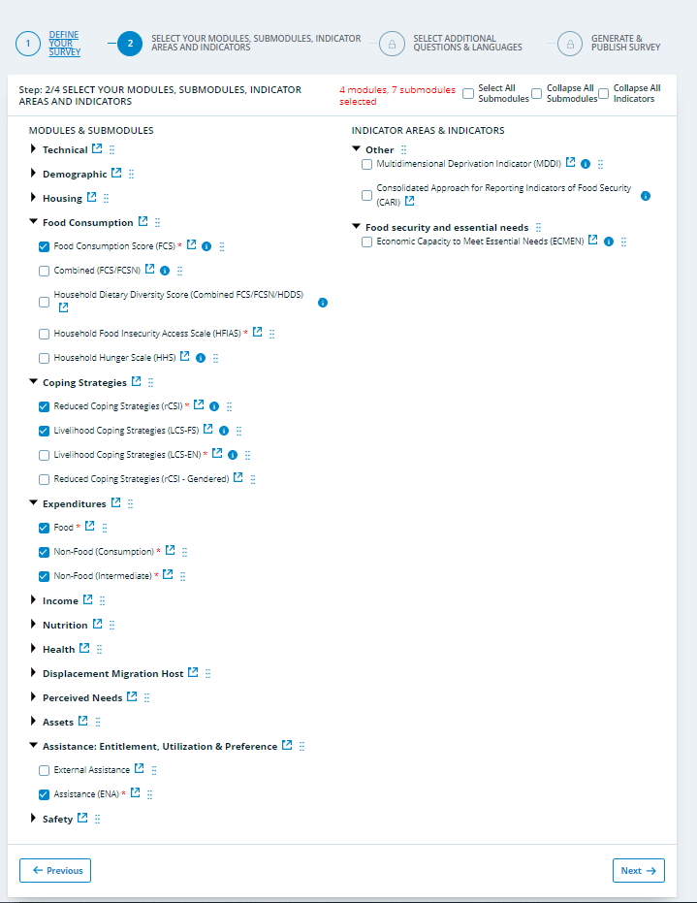
Survey Designer
After selecting the FCS, rCSI, LCS-FS, Expenditures and Assistance (ENA) modules in the WFP Survey Designer, you will be able to move to the next step where you will choose the appropriate and relevant recall period for your food expenditure submodule and the livelihood coping strategies for the LCS-FS module.
To Access Survey Designer, click here.

Slide 49
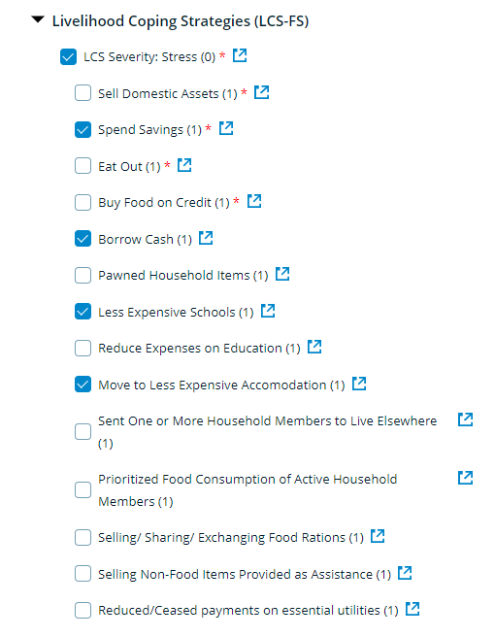
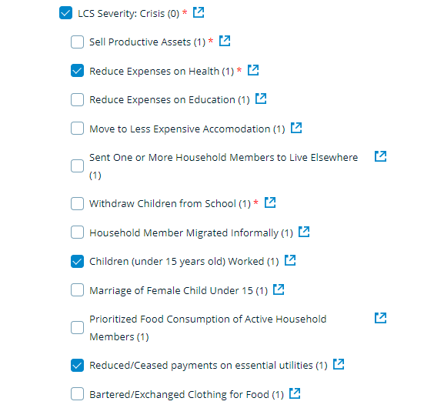
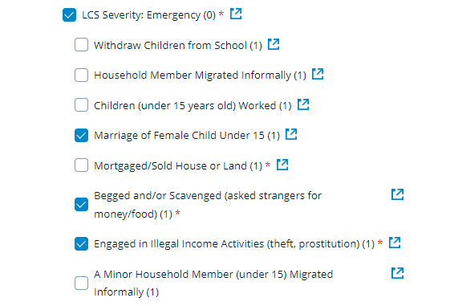
Survey Designer
After selecting the LCS-FS module and relevant setting (urban or rural), ensure the inclusion of the minimum mandatory number of strategies to calculate the indicator, that is 4 stress, 3 crisis and 3 emergency coping strategies. If you have both rural and urban setting coverage in the assessment, then ensure that you go beyond the 10 mandatory strategies.
Please refer to the LCS-FS guidance note for more information.

Slide 50
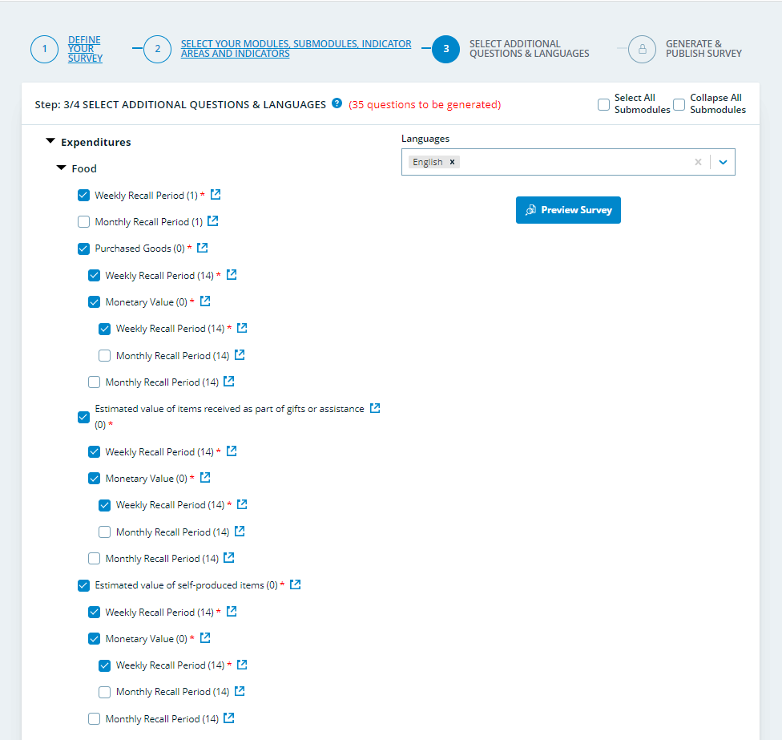
Survey Designer
As for the recall period of the food expenditure submodule, it is recommended to use the 7-day recall period, unless the 30-day recall for expenditures is found to be a better fit for the context.

Slide 51
Module design lookouts
While the standard 8 food groups cannot be altered, the food items listed under food groups in the FCS module must be contextualized
The selection of livelihood-coping strategies from the master list must be adequately adapted to the local context and target population
There should be a differentiation made between camps, rural and urban areas.
The final LCS list must contain strategies of different severity at least 4 stress, 3 crisis, and 3 emergency strategies.

Slide 52
Module design lookouts (cont.)
Expenditure groups should be maintained as in the standard module as much as possible, while it is important to customize the example of items within each group.
Expenditure groups can be customized in certain cases:
Can be dropped if almost no one in the population spends on a certain category (e.g., utilities in camps)
Can be further disaggregated if a specific sub-category or item is particularly important
As a rule, relevant categories relate to good that represent regular consumption (i.e., no expenditures on investments, business inputs, transfers or large/irregular expenditures)

Slide 53
Module design lookouts (cont.)
The assistance (ENA) module is necessary to compute ECMEN as it provides info on received cash assistance to be deducted from household consumption expenditures
If the MEB includes rent, it is important to also include a housing module in the questionnaire (to estimate the would-be value of rent of those that do not pay it)
If you are using the food expenditure module with a 7-day recall, then DO NOT include any visibility or validation rules between this submodule and the FCS module, as the two modules ask different questions and measure different things.

Slide 54
LimitationS

Slide 55
LIMITATIONS OF CARI
As with any composite indicator, summarizing multiple data from different dimensions into one summary indicator could result in a loss of information.
Looking solely at the final CARI aggregation would not enable distinguishing between a household with poor consumption but adequate coping capacity and a household in the opposite situation.
In addition to CARI, analysts need to use other data to analyze drivers and contributing factors for food insecurity.
When FES is used, CARI cannot present the food security situation in the absence of assistance.
Notes:
The contextual information is also crucial for developing the analytical narrative which underpins the key findings.
Assistance is included in the calculation of FES with a caveat that analysts cannot evaluate the vulnerability status of the household in the absence of assistance. If the value of food assistance received is not included in the calculation, the Food Expenditure Score (FES) may be underestimated. This could lead to households spending less on food and more on non-food items, affecting the accuracy of the assessment.
Similarly. we can not remove the impact of food assistance from the food consumption score indicator to know the food consumption status of the households in the absence of assistance.

Slide 56
Reporting

Slide 57
CARI: VISUALIZATION
The prevalence of food security can be presented in a bar chart diagram using the standard color codes to display the share of the population at different severity levels of food security. A bar chart allows the presentation of CARI results over time and compares geographical regions or population groups.
Food Security Classification | Color Code (RGB)
Food Secure | 255, 215, 215
Marginally Food Secure | 255, 110, 110
Moderately Food Insecure | 215, 0, 0
Severely Food Insecure | 130, 0, 0

Slide 58
CARI with ECMEN: Console Indicators, % Population Distribution Table
Below are some example statements which can be made about the severely food-insecure households shown in the table:
• Overall, 100% of the severely food insecure households have economic capacity below the MEB.
• Almost 63% of those severely food insecure households have economic capacity below the SMEB.
• 25% of the severely food insecure households have borderline consumption, however, are have economic capacity below the SMEB and applying emergency coping strategies.
 |  | FCS Acceptable (1) |  |  |  | FCS Acceptable and rCSI >= 4 (2) |  |  |  | FCS Borderline (3) |  |  |  | FCS Poor (4)
 |  | Summary of LCS |  |  |  | Summary of LCS |  |  |  | Summary of LCS |  |  |  | Summary of LCS
 |  | (1) | (2) | (3) | (4) | (1) | (2) | (3) | (4) | (1) | (2) | (3) | (4) | (1) | (2) | (3) | (4)
Economic Vulnerability Groups (Economic Capacity to Meet Essential Needs) | 1 | 6.8% | 12.8% | 1.9% | 2.6% | 0.3% | 2.1% | 0.5% | 1.7% | 0.4% | 4.9% | 0.4% | 0.1% | 2.6% | 0.1% | 0.1% | 0.9%
 | 3 | 1.5% | 3.1% | 2.1% | 7.1% | 1.5% | 3.0% | 0.1% | 0.5% | 0.3% | 0.1% | 1.2% | 0.1% | 0.2% | 1.4% | 3.4% | 3.8%
 | 4 | 3.7% | 2.3% | 6.9% | 0.5% | 0.9% | 2.5% | 0.3% | 0.6% | 0.1% | 0.2% | 0.3% | 4.8% | 2.2% | 3.1% | 2.6% | 1.5%

Slide 59
CARI with FES: Console indicators, % population distribution table
The population distribution table is useful for generating a high-level analytical narrative to accompany the console. However, this is not a substitute for traditional techniques for reporting on the indicators contained in the console.
 |  | Food Consumption and Livelihood Coping Groups on 4-point scale
 |  | FCS Acceptable (1) |  |  |  | FCS Acceptable and rCSI >= 4(2) |  |  |  | FCS Borderline (3) |  |  |  | FCS Poor (4)
 |  | Summary of LCS |  |  |  | Summary of LCS |  |  |  | Summary of LCS |  |  |  | Summary of LCS
 |  | (1) | (2) | (3) | (4) | (1) | (2) | (3) | (4) | (1) | (2) | (3) | (4) | (1) | (2) | (3) | (4)
Economic Vulnerability Groups (FES) | 1 | 5.0% | 7.8% | 1.9% | 2.6% | 0.3% | 2.1% | 0.5% | 0.7% | 0.4% | 1.6% | 0.4% | 0.1% | 0.6% | 0.1% | 0.1% | 0.9%
 | 2 | 6.8% | 1.3% | 0.2% | 3.8% | 4.9% | 0.9% | 0.9% | 0.1% | 4.0% | 0.1% | 0.6% | 0.3% | 0.8% | 0.0% | 1.3% | 7.1%
 | 3 | 1.5% | 1.1% | 2.1% | 7.1% | 0.5% | 0.0% | 0.1% | 0.5% | 0.3% | 0.0% | 0.1% | 0.1% | 1.4% | 1.4% | 1.3% | 3.8%
 | 4 | 3.7% | 2.3% | 5.3% | 0.9% | 0.0% | 2.5% | 0.3% | 0.6% | 0.1% | 0.2% | 0.3% | 2.8% | 2.1% | 2.1% | 1.4% | 0.8%
Notes:
It is important that all indicators used in the console are also separately reported on in later sections of the assessment, using their traditional thresholds and reporting methods.

Slide 60
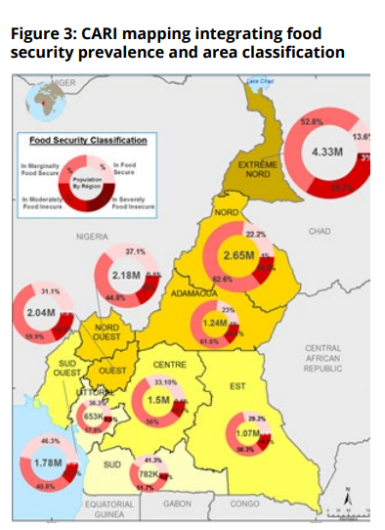
CARI: VISUALIZATION & MAPPING
Figure 3: CARI mapping integrating food security prevalence and area classification
The area is classified into four classes of food security based on the CARI prevalence of food security in the area. The food security situation of the most food insecure 25% of the population will be used to classify each area.
Then, a second layer of food security information is generated and imposed on the background map. This prevalence of the food security layer is presented as pie charts, to visualize the four population classifications of food security for each administrative subdivision.
Area Classification | Color Code (RGB)
More than 75% of population in the area are food secure | 255, 255, 212
More than 25% of the population in the area marginally food secure, moderately or severely food insecure | 255, 255, 82
Moderately Food Insecure | 245, 204, 2
Severely Food Insecure | 199, 166, 0

Slide 61
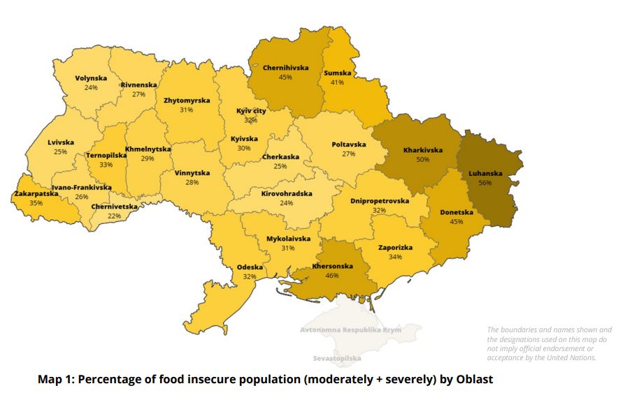
CARI: REPORTING EXAMPLE
Food security estimates differ between oblasts and between population groups. Oblasts in the eastern and southern parts of the country were found to have the highest estimated levels of food insecurity, with one in every two households being food insecure (see map 1). Luanska stands out as the worst-off oblast in food security terms. This is also an oblast with significant access challenges, which could play a large part in the food security situation.
Comparisons between IDPs and residents further demonstrate a higher level of food insecurity among IDPs (54%), compared to residents (23%). IDPs in the east and south are the most food insecure. In the east, 62% of IDPs are food insecure (14% severe and 48% moderate), while this figure is 59% for IDPs in the south (8% severe and 51% moderate). Furthermore, results showed that separated households have a higher level of food insecurity than those not separated from each other. On average, one in every two separated households is food insecure compared to around one in every four non-separated households.
The boundaries and names shown, and the designations used on this map do not imply official endorsement or acceptance by the United Nations
Map 1: Percentage of food insecure population (moderately + severely) by Oblast

Slide 62
CARI: REPORTING EXAMPLE
The below chart shows food security by both displacement and separation status. Households that are both displaced and separated display the highest levels of food insecurity (56%).
Chart 1: CARI by household separation status

Slide 63
Reporting

Slide 64
Available Resources

Slide 65
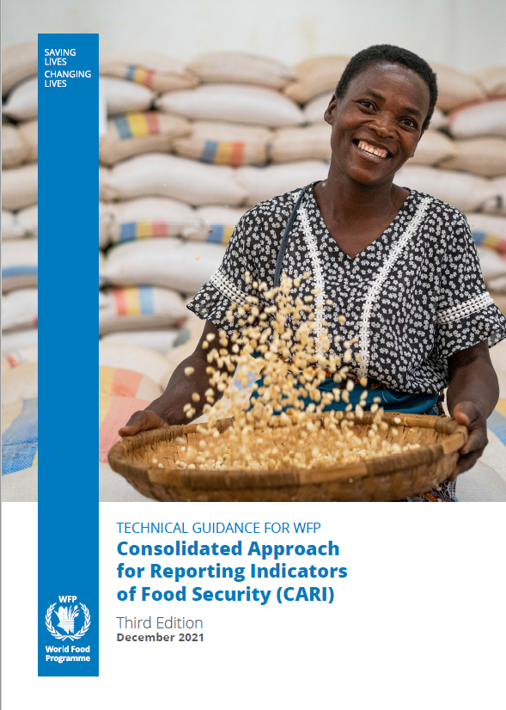
For more information and guidance go to the CARI technical guidance and the following pages:
Food Consumption Score (FCS)
reduced Coping Strategies Index (rCSI)
Economic Capacity to Meet Essential Needs (ECMEN)
Food Expenditure Share (FES)
Livelihood Coping Strategies – Food Security (LCS-FS)

Slide 66
Thank You!

