Slide 1

L4 – Security of Computer Systems
Evaluating data encryption on locally hosted open- source Amazon S3 compatible object storage platform
Evangelos Dimoulis
Department of Computer Science & Engineering
University of Ioannina
February 2021

Slide 2
Presentation
Object Storage Systems
Amazon Simple Storage Service
MinIO Object Storage
Threat Model
Encryption Schemes
Experimental Setup
Performance Evaluation
2

Slide 3
Object Storage Systems
Processing data as discrete units called objects.
Objects are variable-length size and can be used to store all types of data (e.g., database records, medical records, system backup).
Benefits:
  Scalability: increase number of storage nodes.
  Reduced complexity: removing unnecessary hierarchies.
  Pay as you go: pricing is usually volume-based.
  Cloud compatible
3

Slide 4
Amazon Simple Storage Service (Amazon S3)
Amazon S3 is an object storage service provides high scalability, data availability, security and performance.
Objects are stored and managed into buckets.
Provides REST API for managing objects and buckets.
Bucket architecture:
Object #1
Object #2
Object #N
Key
Key
Key
Version ID
Version ID
Version ID
Value
Value
Value
Metadata
Metadata
Metadata
4

Slide 5
MinIO
MinIO: High performance object dtorage released under Apache License v2.0
API compatible with Amazon S3 cloud storage service.
Deployment: a) Standalone, b) Distributed, and c) Cloud Scale.
Multi-Tenant Standalone Deployment:
TENANT 1
TENANT 2
9001
9002
HOST
MINIO 1
MINIO 2
DISK 1
5

Slide 6
Accessing MinIO with TLS
Transport Security Layer (TLS) enforces essential security guarantees:
  Encryption: hides data being transferred.
  Authentication: ensure identity of communicating parties.
  Integrity: verifies the content of the transferred data.
Communication with MinIO servers and clients is protected via TLS.
MinIO server provides public certificate signed by a private key to establish communication.
The certificate is provided through a Certificate Authority (CA) or is self-signed.
6

Slide 7
MinIO Encryption
MinIO supports two types of Server-Side Encryption (SSE):
  SSE-C: en/decrypting objects with client provided keys.
  SSE-S3: object encryption keys are managed by a Key. Management System (KMS).
For any encrypted object in the server there exist three keys:
  OEK: unique key stored encrypted to en/decrypt an object
  KEK: key to en/decrypt the OEK, is not stored anywhere
  EK: external key, either client provided or managed by KMS
Encryption algorithm: AES-256-GCM with keys 256 bits long.
7

Slide 8
Threat Model
We focus on three kind of principals:
  User: someone who want to securely store data online
  Third-Party Service: an entity that claims or requests access to the user’s data.
  Cloud Storage Provider: a MinIO object storage server instance.
Vulnerability: the third-party service gain access to an object’s en/decryption keys through side-channel attacks e.g., cold boot attacks, and/or storage server is compromised.
Goal: revoke access to the third-party service by introducing client side encryption schemes.
8

Slide 9
Client Side Encryption
9

Slide 10
MinIO Server Side Encryption (SSE)
Python client code for SSE-C encryption with client provided key.
10

Slide 11
Key Rotation
MinIO supports a key rotation mechanism through a special HTTP COPY Request.
Key Rotation:
  Provide initial external secret key and a newly derived secret key.
  Decrypt OEK with the old key and re-encrypt with the newly provided key.
11

Slide 12
Experimental Setup
Standalone deployment with a single storage server.
Server equipped with 4 cores Intel (R) Core (TM) i5-4590 at 3.30 GHz and 7.7 GB of memory.
Debian 10 64-bit Linux distribution 4.19.0-13-amd64
OpenSSL version 1.1.1d.
Go version go1.15.6 linux/amd64 and latest MinIO built from source.
12

Slide 13
System Architecture
Go Encryption
Module
Python Client
MINIO
HTTP Request
SSL/TLS
Data
Encrypted Data
9000
Object
SSE-C
HDD
10.7.2.207
13

Slide 14
Performance Evaluation (1)
Benchmark
  Binary files ranging from 1KB up to 500 MB worth of data.
  Runned tests 100 times for each input file.
  Plotting median for encryption metrics and system resource utilization.
Performance Metrics
- Python’s psutil for system resource utilization.
  Encryption Time (second): time spent for encrypting input files.
  Re-Encryption Time (second): time spent for client side re-encryption and SSE-C key rotation.
  CPU Usage (%) and RAM Usage (%): system resource usage percentage during evaluation.
14

Slide 15
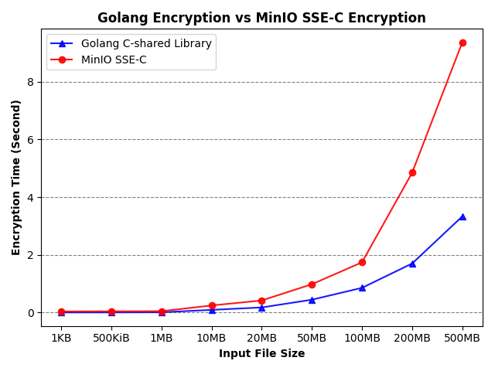
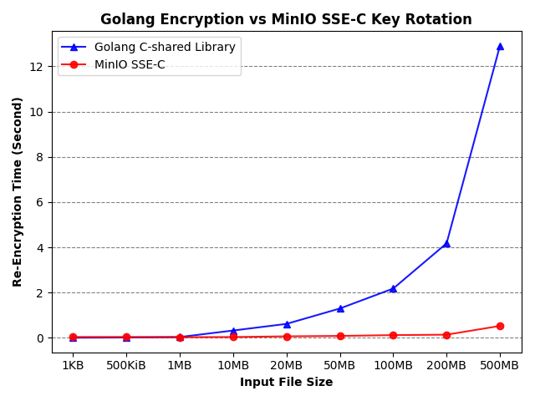
Performance Evaluation (2)
Encryption Time and Re-Encryption Time of Golang client-side scheme and MinIO SSE-C.
15

Slide 16
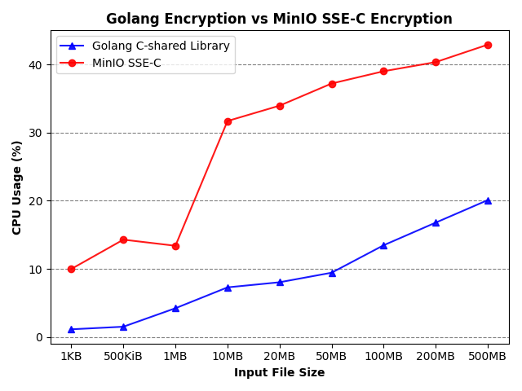
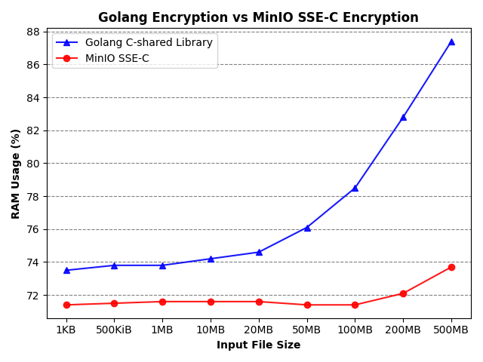
Performance Evaluation (3)
CPU and RAM utilization of Golang encryption and MinIO SSE-C encryption.
16

Slide 17

Questions
17

