Slide 1
软件度量

Slide 2
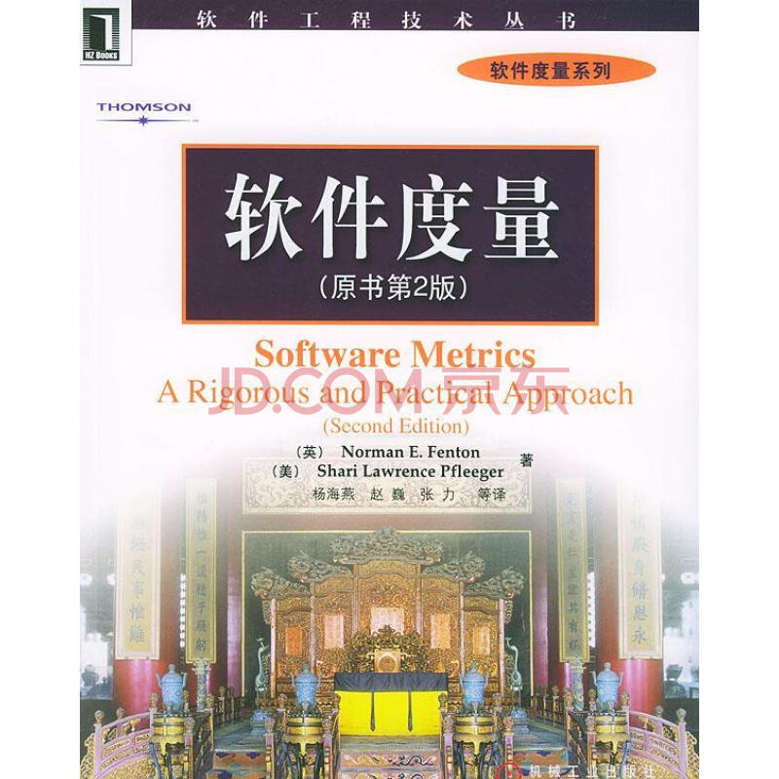
一门课，一本书

Slide 3
场景1
单元测试中的一个问题
所测试的系统规模大，模块数目很多
时间非常紧，人手不够用
不可能测试所有模块，那么应该优先测试哪些模块？
建议：
优先测试“关键”模块
优先测试“最有可能包含bug”的模块

Slide 4
场景1
引发两个新的问题
如何识别系统中的“关键”模块？
如何识别系统中“最有可能包含bug”的模块？
基本思路：
软件度量
源代码/
二进制代码
关键模块序列
预测模型
缺陷模块序列

Slide 5
场景1
源代码
Step 1:
分析
类间依赖图
Step 2:
计算
度量
Step 3:
排序
候选的关键类

Slide 6
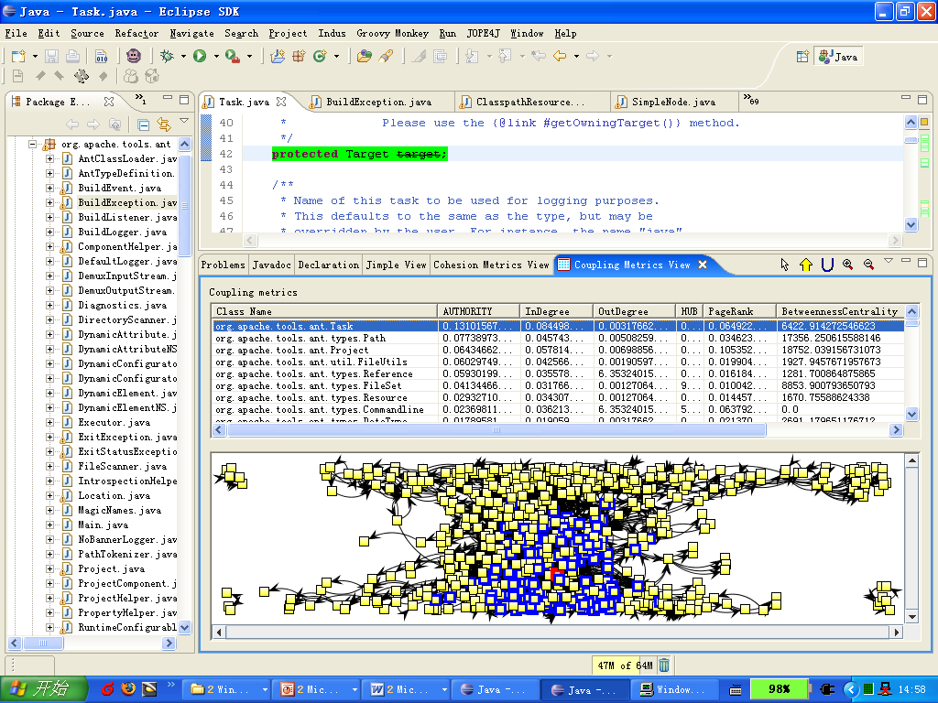
场景1

Slide 7
场景1
实验分析
系统 | 类的数目 | 总代码行数 | 真实的关键类
Ant 1.6.1 | 664 | 76K | 10
JMeter 2.0.1 | 706 | 73K | 14
Identified from documents by
Zaidman et al. (JSME 2008)

Slide 8
场景2
程序调试中的一个问题
给定一个有bug的程序和一批测试用例。当这些测试用例在程序上执行时，有些测试用例passed，有些测试用例failed。如何仅通过程序结构信息和测试用例的执行信息自动识别出有bug的语句？

Slide 9
mid() { int x,y,z,m; | 3, 3, 5
1: read(x, y, z);
2: m = z;
3: if (y<z)
4: if (x<y)
5: m = y;
6: else if (x<z)
7: m = y;
8: else
9: if (x>y)
10: m = y;
11: else if (x>z)
12: m = x;
13: print(m);
}

Slide 10
mid() { int x,y,z,m; | 3, 3, 5
1: read(x, y, z); | •
2: m = z;
3: if (y<z)
4: if (x<y)
5: m = y;
6: else if (x<z)
7: m = y;
8: else
9: if (x>y)
10: m = y;
11: else if (x>z)
12: m = x;
13: print(m);
}

Slide 11
mid() { int x,y,z,m; | 3, 3, 5
1: read(x, y, z); | •
2: m = z; | •
3: if (y<z)
4: if (x<y)
5: m = y;
6: else if (x<z)
7: m = y;
8: else
9: if (x>y)
10: m = y;
11: else if (x>z)
12: m = x;
13: print(m);
}

Slide 12
mid() { int x,y,z,m; | 3, 3, 5
1: read(x, y, z); | •
2: m = z; | •
3: if (y<z) | •
4: if (x<y)
5: m = y;
6: else if (x<z)
7: m = y;
8: else
9: if (x>y)
10: m = y;
11: else if (x>z)
12: m = x;
13: print(m);
}

Slide 13
mid() { int x,y,z,m; | 3, 3, 5
1: read(x, y, z); | •
2: m = z; | •
3: if (y<z) | •
4: if (x<y) | •
5: m = y;
6: else if (x<z)
7: m = y;
8: else
9: if (x>y)
10: m = y;
11: else if (x>z)
12: m = x;
13: print(m);
}

Slide 14
mid() { int x,y,z,m; | 3, 3, 5
1: read(x, y, z); | •
2: m = z; | •
3: if (y<z) | •
4: if (x<y) | •
5: m = y;
6: else if (x<z) | •
7: m = y;
8: else
9: if (x>y)
10: m = y;
11: else if (x>z)
12: m = x;
13: print(m);
}

Slide 15
mid() { int x,y,z,m; | 3, 3, 5
1: read(x, y, z); | •
2: m = z; | •
3: if (y<z) | •
4: if (x<y) | •
5: m = y;
6: else if (x<z) | •
7: m = y; | •
8: else
9: if (x>y)
10: m = y;
11: else if (x>z)
12: m = x;
13: print(m);
}

Slide 16
mid() { int x,y,z,m; | 3, 3, 5
1: read(x, y, z); | •
2: m = z; | •
3: if (y<z) | •
4: if (x<y) | •
5: m = y;
6: else if (x<z) | •
7: m = y; | •
8: else
9: if (x>y)
10: m = y;
11: else if (x>z)
12: m = x;
13: print(m); | •(3)
}

Slide 17
mid() { int x,y,z,m; | 3, 3, 5
1: read(x, y, z); | •
2: m = z; | •
3: if (y<z) | •
4: if (x<y) | •
5: m = y;
6: else if (x<z) | •
7: m = y; | •
8: else
9: if (x>y)
10: m = y;
11: else if (x>z)
12: m = x;
13: print(m); | •(3)
} | P

Slide 18
mid() { int x,y,z,m; | 3, 3, 5 | 1, 2, 3 | 3, 2, 1 | 5, 5, 5 | 5, 3, 4 | 2, 1, 3
1: read(x, y, z); | • | • | • | • | • | •
2: m = z; | • | • | • | • | • | •
3: if (y<z) | • | • | • | • | • | •
4: if (x<y) | • | • |  |  | • | •
5: m = y; |  | •
6: else if (x<z) | • |  |  |  | • | •
7: m = y; | • |  |  |  |  | •
8: else |  |  | • | •
9: if (x>y) |  |  | • | •
10: m = y; |  |  | •
11: else if (x>z) |  |  |  | •
12: m = x;
13: print(m); | •(3) | •(2) | •(2) | •(5) | •(4) | •(1)
} | P | P | P | P | P | F

Slide 19
场景2
基本方法
构造执行频谱矩阵
  行: 语句
  列: 测试用例
  值: 测试用例执行时是否覆盖到了该语句
利用各种方法计算语句的可疑程度
  被越多的passing测试用例执行，越不可能有bug
  被越多的failing测试用例执行，越有可能包含bug
  …

Slide 20
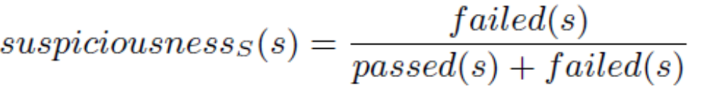
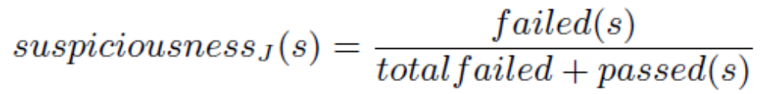

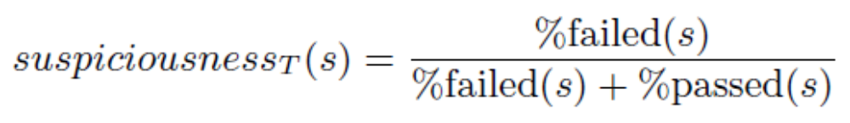
场景2
语句可疑度度量示例

Slide 21
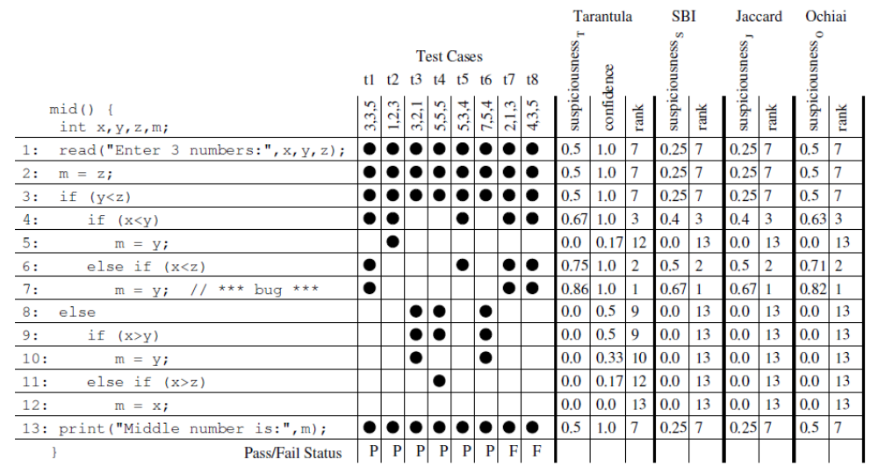
场景2
语句可疑度度量示例

Slide 22

场景2
工具支持
Mary Jean Harrold

Slide 23
场景2
mid() { int x,y,z,m; | 3,3,5 | 1,2,3 | 3,2,1 | 5,5,5 | 5,3,4 | 2,1,3
1: read(x,y,z); | ● | ● | ● | ● | ● | ●
2: m=z; | ● | ● | ● | ● | ● | ●
3: if(y<z) | ● | ● | ● | ● | ● | ●
4: if(x<y) |  | ●
5: m=y; |  | ●
6: elseif(x<z) | ● |  |  |  | ● | ●
7: m=y; | ● |  |  |  |  | ●
8: else | ● |  | ● | ●
9: if(x>y) |  |  | ●
10: m=y; |  |  | ●
11: elseif(x>z)
12: m=x;
13: print(m); | ● | ● | ● | ● | ● | ●
} | P | P | P | P | P | F

Slide 24
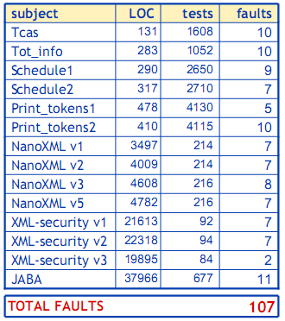

场景2
实验结果
R. Santelices et al.
ICSE 2009

Slide 25
其他场景
设计模式检测
“热”路径预测
剽窃代码检测
代码重构
软件度量

Slide 26
Position
需求度量
Requirement
Design
设计度量
Code
编码度量
Test
测试度量
Maintenance
维护度量

Slide 27
Course Position (cont’d)
过程
资源
产品
人
团队
软件
硬件
…
Specifications
Designs
Test data
…
构造 Specification
Detailed design
Testing
…
度量

Slide 28
Section 2
Outline of The Course
Measurement theory
Software product and process measurements
Measurement & management

Slide 29
1: Measurement Theory
The basics of measurement
Framework for software measurement
Empirical investigation

Slide 30
2: Measurement in Software Engineering
Software metrics data collection
Analyzing software measurement data
Measuring internal product attributes: size
Measuring internal product attributes: structure
Measuring external product attributes
Measuring software reliability
Making process predictions

Slide 31
3: Measurement & Management
Planning a measurement program
Resource measurement: productivity, teams, and tools

Slide 32
Section 3
What is Measurement?

Slide 33
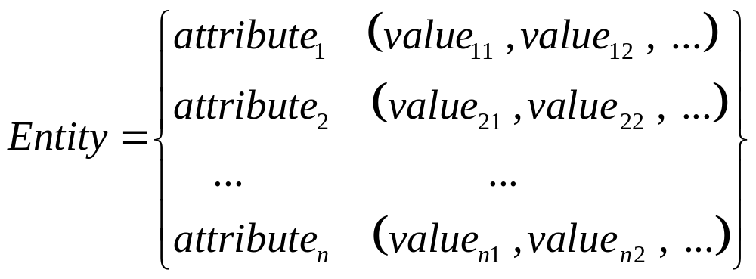
Measurement: Definition /1
abstractions used to reflect perceptions of the real world
Measurement is the process by which numbers or symbols are assigned to attributes of entities in the real world in such a way as to ascribe them according to defined rules
feature or property of an entity
an object or an event in the real world

Slide 34
Measurement: Definition /2
Metrics are standards (i.e., commonly accepted scales) that define measurable attributes of entities, their units and their scopes

Slide 35
Measurement: Types
Measurements are needed as:
  Descriptors of entities already in existence.
  Predictors to estimate properties of entities yet to be designed or implemented.

Slide 36
Measurement : How to
In order to make entities measurable:
  What entities should be selected?
  What attributes should be selected?
  What values should be assigned to the attributes?
  What shall be the rules ascribed to the attributes and their entities?
Note: assigned values and/or ascribed rules can be either quantitative or qualitative

Slide 37



Example1：entities/attributes
Clinton’s heights
T-shirt’s size

Slide 38
Section 4
What are Software Metrics?

Slide 39
Concerns & FAQ frequently asked questions
for Project Managers
  Is the project within the progress?
  Whether the budget will be exceeded?
  When the final product is ready for delivery?
for Software Developers
  Whether the requirements are consistent and complete?
  Whether the design is of high quality?
  Does the code still contain defects?
  How about the software maintainability, reliability, etc.?

Slide 40
Concerns & FAQ (cont’d)
for Customers
  Whether the delivered product meets our needs defined in requirements?
for Maintainers
  upgraded or re-developed?

Slide 41
What are Software Metrics?
Software metrics are metrics that are used to quantify software products, software development resources, and/or the software development process
This includes items which are directly measurable, such as lines of code, as well as items which are calculated from measurements, such as software quality

Slide 42
Why Use Metrics?
“You cannot control what you cannot measure” (Demacro, 1982)
“You can neither predict nor control what you cannot measure” (Norman 1992)

Slide 43


Measurement in SE
Measurement in SE is selecting, measuring and putting together many different attributes of the software, and adding our subjective interpretations in order to get a whole picture of the software
This is not a trivial task!

Slide 44
Various Types of Metrics
Project Performance Metrics
Quality Metrics
Productivity Metrics
Business Metric
User Service Metrics
…

Slide 45
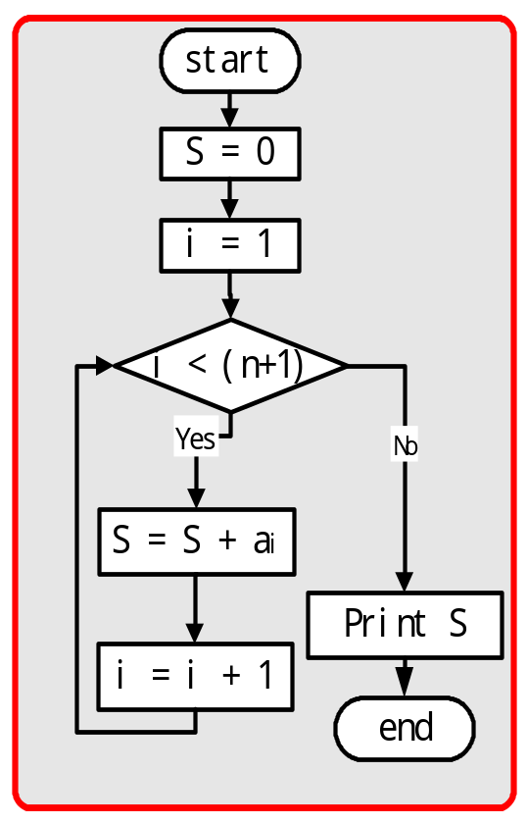
Example
圈复杂性 v(G) = e - n + 2p
= 8 -8 + 2 × 1
= 2
void sum()
{
S=0;
i=1;
while(i<n+1)
{
S=S+a[i];
i=i+1;
}
printf(“S is %d“, s);
}

Slide 46
Section 5
Scope of software engineering metrics: a chronological review

Slide 47
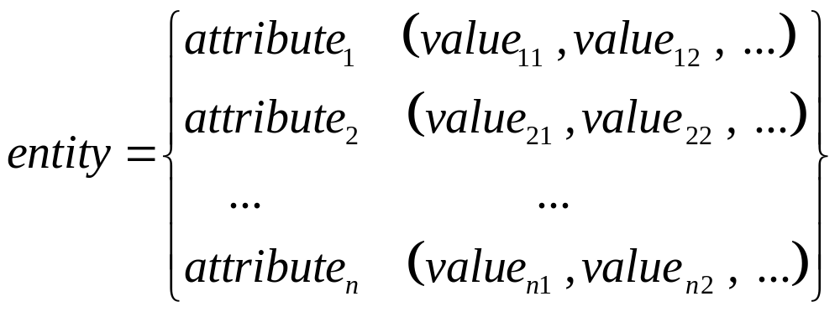
Measurement: Definition /1
Measurement is the process by which numbers or symbols are assigned to attributes of entities in the real world in such a way as to ascribe them according to defined rules

Slide 48
Measurement: Definition /2
Metrics are standards (i.e., commonly accepted scales) that define measurable attributes of entities, their units and their scopes
Software metrics are measures that are used to quantify:
  Software product
  Software development resources
  Software development process

Slide 49
Software Metrics Challenges
Physical metrics:
  entity attribute unit value
  Human Height cm 178
Non-physical metrics:
  entity attribute unit value
  Human IQ IQ index 89
SE metrics are mostly non-physical
  Reliability, maturity, portability, flexibility, maintainability, interoperability, …

Slide 50
Misleading Metrics!
  Fact (1): Knowledge is power
  Fact (2): Time is money
  Relation (rule) : power = work / time
Substituting “power” and “time”
  Knowledge = work / money
As knowledge approaches zero money approaches infinity regardless of the amount of work done!
Conclusion:
  The less you know, the more you make!

Slide 51
Scope of Software Metrics
Cost and effort estimation
Productivity measures and models
Data collection
Quality models and measures
Reliability models
Performance evaluation and models
Structural and complexity metrics
Capability maturity assessment
Management by metrics
Evaluation of methods and tools

Slide 52
Scope of Software Metrics /1
Cost and effort estimation
  Software cost estimation is the process of predicting the amount of effort required to build a software system
  Estimates for project cost and time requirements is derived during the planning stage of a project
  Models used to estimate cost can be categorized as either cost models (e.g., Constructive Cost Model COCOMO) or constraint models (e.g., SLIM)
  Experience is often the only guide used to derive these estimates, but it may be insufficient if the project breaks new ground
  Many models are available as automated tools

Slide 53
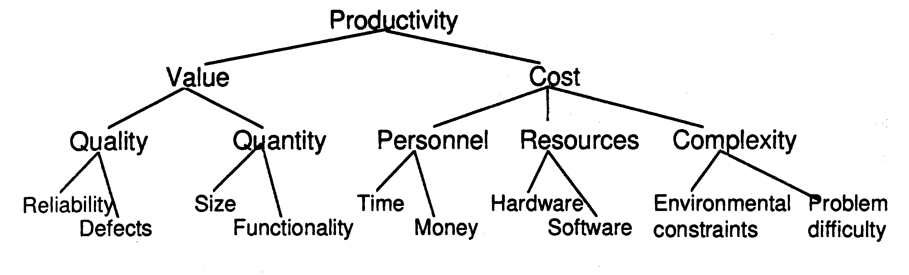
Scope of Software Metrics /2
Productivity models and measures
Definition: The rate of output per unit of input
  Productivity = size / effort
  Productivity = LOC / person-month
Productivity model based on decomposition to measurable attributes:
measurable

Slide 54
Scope of Software Metrics /3
Data collection
Very critical and very hard step
  What data should be collected?
  How it should be collected?
  Is collected data reproducible?
Example: failure data collection
    Time of failure
    Time interval between failures
    Cumulative failure up to a given time
    Failures experienced in a time interval

Slide 55
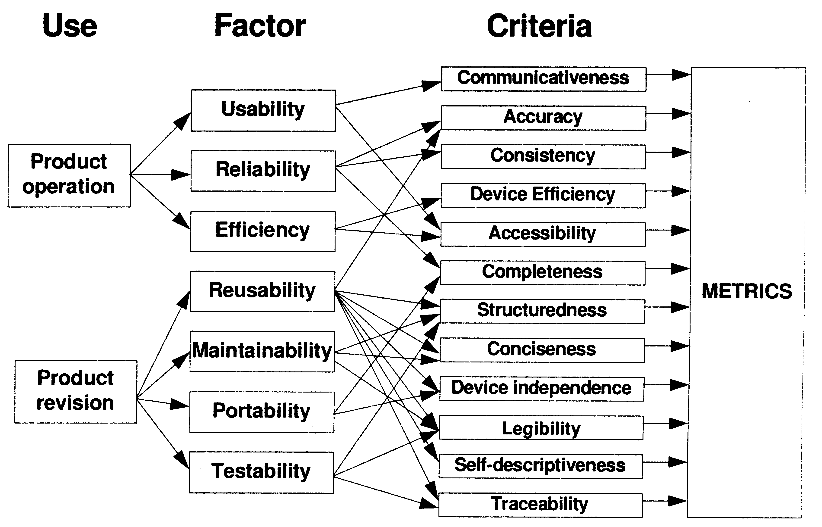
Scope of Software Metrics /4
Quality models and measures
McCall’s quality factors (1977~)
ISO 9126

Slide 56
Scope of Software Metrics /5
Reliability models
Plot the change of failure intensity (λ) against time
Many models are proposed. The most famous ones are basic exponential model and logarithmic Poisson model
The basic exponential model assumes finite failures in infinite time; the logarithmic Poisson model assumes infinite failures
Automated tools such as CASRE are available

Slide 57
Scope of Software Metrics /6
Performance evaluation and models
Using externally observable performance characteristics such as response time and completion rate (Ferrari 1978~)
Efficiency of algorithms (Garey 1979~)

Slide 58
Scope of Software Metrics /7
Structural and complexity metrics
  Control-flow structure
  Data-flow structure
  Data structure
  Information flow attributes
Complexity metrics (1979~)
  Cyclomatic complexity (McCabe 1989) defining number of independent paths in execution of a program

Slide 59
Scope of Software Metrics /8
Metrics for Management
Metrics for project control (1980~)
  Metrics related to specification quality
  Metrics for the design model
  Metrics for documentation
  Checking and testing metrics
  Resource metrics
  Change metrics

Slide 60
Scope of Software Metrics /9
Evaluation of methods and tools
Efficiency of methods (1991~)
Efficiency and reliability of tools
Certification test of acquired tools and components

Slide 61
Scope of Software Metrics /10
Capability maturity assessment
US Software Engineering Institute (SEI) model (1989): Grading using five-level scale.
ISO 9001: Quality systems: models for quality assurance in design/development, production, installation and servicing (1991)
ISO 9000-3: Guidelines for application of ISO 9001 to the development, supply and maintenance of software (1991)

Slide 62
Who benefits from Measurement
Managers
  What does each process cost?
  How productive is the staff?
  How good is the code being developed?
  Will the user be satisfied with the product?
  How can we improve?
Software Developers
  Are the requirements testable?
  Have we found the defects?
  Have we met our product or process goals?
  What can we predict about our software product in the future?

Slide 63
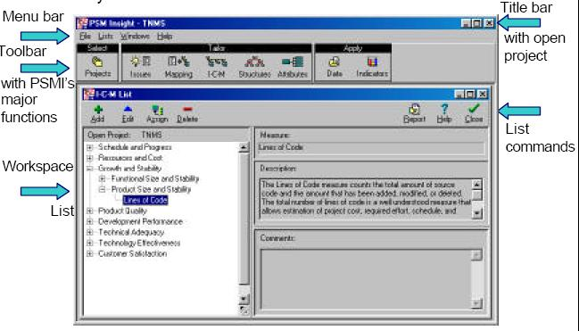
Tools：PSM

Slide 64
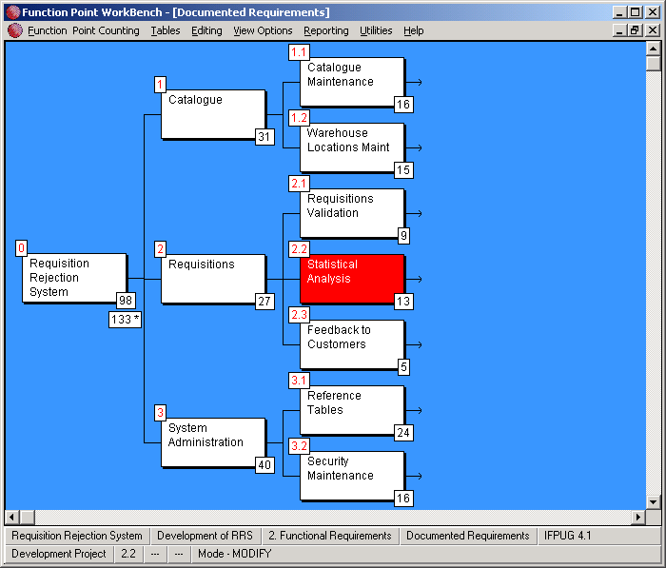
Tools：Function Point WorkBench

Slide 65
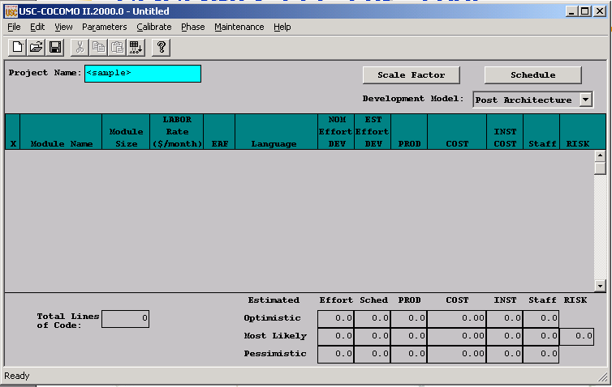
Tools: COCOMO II 2000

Slide 66
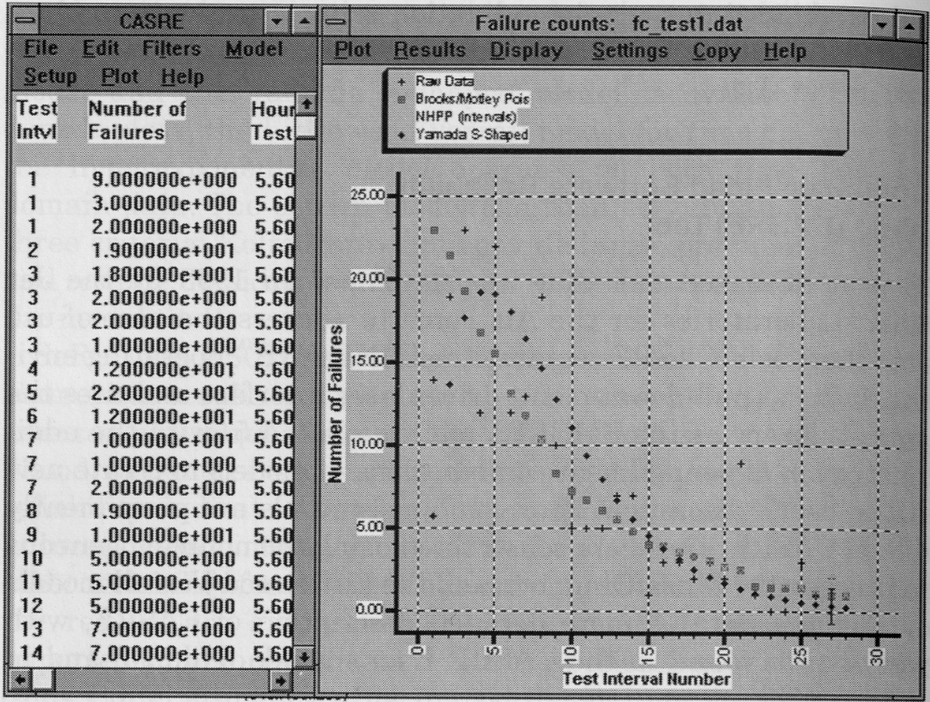
Tools: CASRE

Slide 67
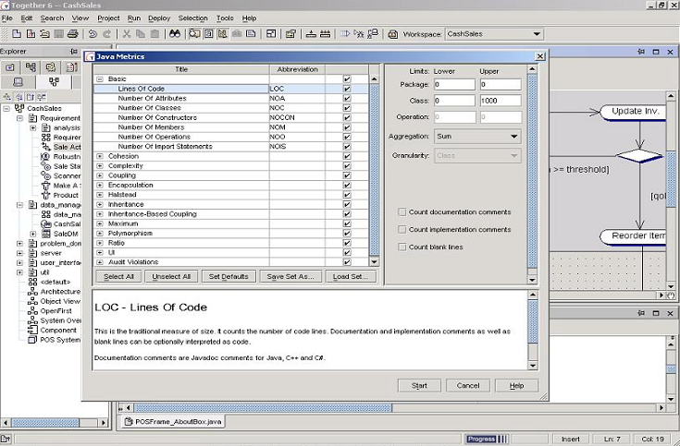
Tools: Together Control Center

