Slide 1
Land Cover Change and Land Surface Temperature Study for Jaipur: A Decadal Analysis
Team Members
Kashik P S - 2023101082
Korlapati Keerthana - 2023101121
Sambhavi Singh - 2024117010
Vishakha Agrawal - 2023101040

Slide 2
Project Overview
Objective: Analyze how urbanization in Jaipur between 2014–2024 has impacted land cover and land surface temperature.
Approach:
Compare two land cover classification methods:
Index-Based (NDVI, NDBI, etc.)
Quadratic Discriminant Analysis (QDA - MLC) – Supervised ML
Estimate Land Surface Temperature (LST) from Landsat 8 imagery.
Conduct sector-wise analysis using 8 directional sectors (each 45 degrees) around city center.
Why it matters:
Understand patterns of urban expansion & other classes. Inform climate-sensitive urban planning strategies.

Slide 3
Study Area
City: Jaipur, India
Coordinates: 26.9124°N, 75.7873°E
Climate: Semi-arid, prone to high temperatures and rapid urban expansion.
Region of Interest (ROI):
Defined as a 30 km buffer around the city center.
Divided into 8 equal radial sectors (45° each) to analyze spatial variation.
Motivation for Choosing Jaipur:
Urban growth in recent decades.
Could represent typical challenges of urbanization in semi arid regions.

Slide 4
Methodology: Data Collection
Landsat 8 Collection 2 Level-2 Surface Reflectance (SR) Products
Years Used: 2014, 2019, 2024
Temporal Window: October – December (Post-monsoon period) → Reduces seasonal variability → Ensures vegetation presence and clearer skies
Cloud Filtering: Applied cloud masking and filter. → Ensures high-quality, cloud-free imagery
Reason for Multi-Month Aggregation: Single-month imagery was not sufficient Data combined from Oct, Nov, Dec due to: • Occasional missing bands • Cloud/shadow cover

Slide 5
Methodology: Data Collection
Bands Used:
SR_B1 to SR_B7 → Optical reflectance bands → Used for computing indices (NDVI, NDBI, etc.)
ST_B10 → Thermal infrared band → Used for LST calculation
Indices Computed:
NDVI – Vegetation cover
NDBI – Built-up/Urban index
MNDWI – Water body detection
BSI – Bare soil/others

Slide 6
Methodology: Data Collection
Data (Raster)
About 30 manually digitized training points (Urban, Vegetation, Water, Others) per class per year. Balanced samples across classes improved classifier performance
Exported as GeoJSON for supervised classification
Landsat data (even for index based classification)

Slide 7
Methodology: Pre - Processing
1. Scale Factor Application
Optical bands (SR_B1 to SR_B7): Reflectance = DN × 0.0000275 − 0.2
Thermal band (ST_B10): Brightness Temperature (K) = DN × 0.00341802 + 149.0
Applied to ensure radiometric consistency across all years
DN (Digital Number)
2. Cloud Masking (QA_PIXEL)
Used QA_PIXEL band to remove: • Clouds (bit 3) • Shadows (bit 4)
Masking improves spatial accuracy of land cover and LST analysis

Slide 8
Methodology: Index Based Classification
1. Index-Based Classification (GEE)
Rule-based classification using thresholds on spectral indices:
Urban: NDBI > 0.15 & NDVI < 0.5
Vegetation: NDVI > 0.37 & MNDWI < 0.3
Water: MNDWI > 0.01
Others: BSI ≤ 0.025
Simple and interpretable approach
Fast classification across years

Slide 9
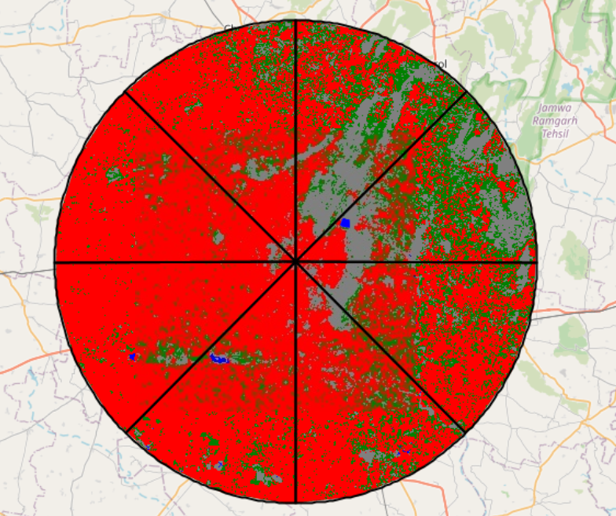
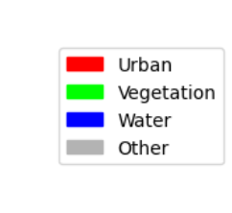
Index Based Classification (2024)

Slide 10
Methodology: Classification
1. Classification Algorithms
Quadratic Discriminant Analysis (QDA): • Assumes class-specific covariance • Suitable for mixed land cover zones • Regularization used: reg_param = 0.5
Random Forest (RF): • Ensemble of decision trees using bagging • Robust to noise and overfitting • Parameters:
n_estimators = 200
max_depth = 10
min_samples_leaf = 5

Slide 11
Methodology: Classification
2. Feature Stack
Each pixel represented by 11 features: • 7 spectral bands (SR_B1–SR_B7) • 4 indices (NDVI, NDBI, MNDWI, BSI)
Image stacks exported from GEE and processed in Python
Split into 70 % Train and 30% Test
3. Class Codes
Land cover categories assigned as: 0 = Urban / Built-up 1 = Vegetation 2 = Water Bodies 3 = Others (barren, mixed, sand, rocky)

Slide 12
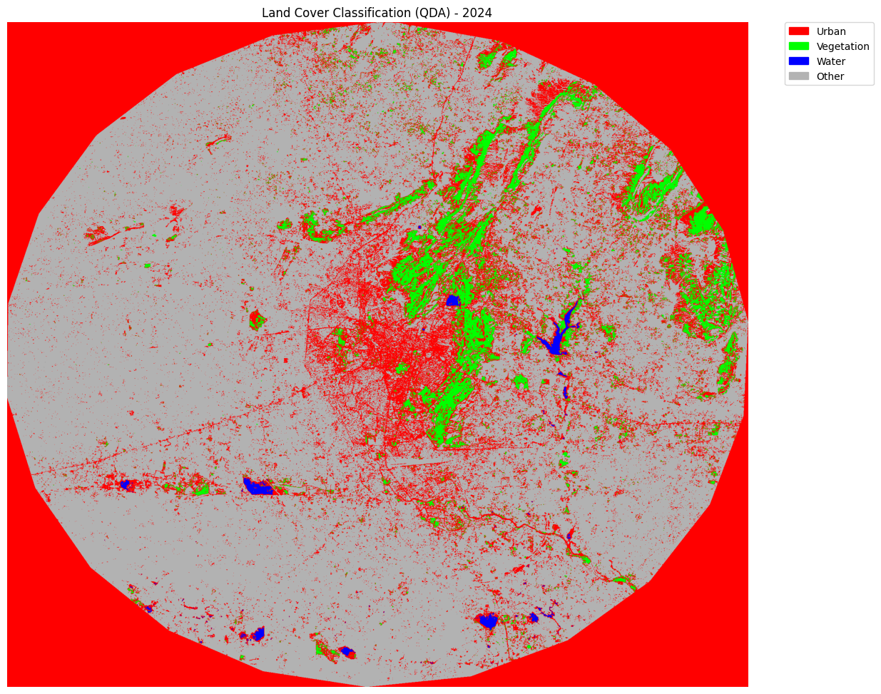
MLC Based Classification (2024)

Slide 13
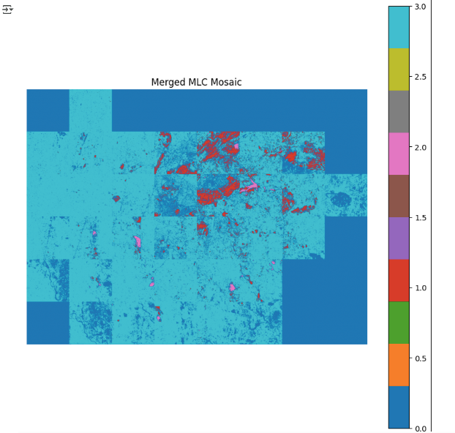
Mosaic Classification (2024)

Slide 14
Model Performance
Year | Model | Accuracy | Kappa | MSE
2014 | QDA | 96.61% | 0.9542 | 0.1356
2014 | Random Forest | 100.00% | 1 | 0
2019 | QDA | 89.39% | 0.8574 | 0.7576
2019 | Random Forest | 100.00% | 1 | 0
2024 | QDA | 92.06% | 0.8915 | 0.7143
2024 | Random Forest | 98.41% | 0.9785 | 0.1429

Slide 15
Model Performance
2. Confusion Matrix Comparison (2014 Example)
QDA: Minor misclassifications in Urban vs Others
RF: Good classification across all classes in 2014
Visual heatmaps used to highlight error concentration areas

Slide 16
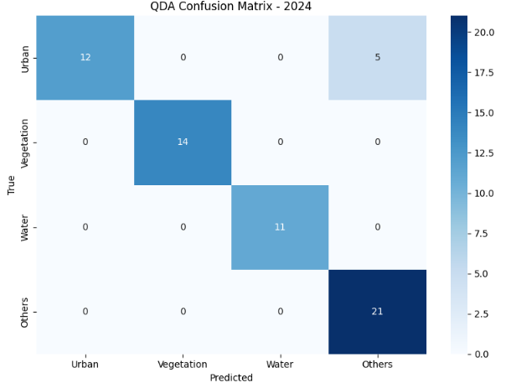
Confusion Matrix (2024)

Slide 17
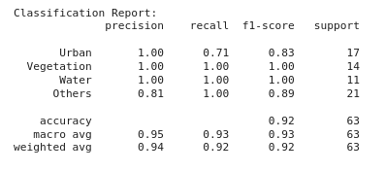
Metrics
Key Observations
Some urban pixels are misclassified.
“Others” absorbs mixed or fringe pixels.
Vegetation and Water are clearly separable.
QDA struggles in mixed-use zones.
Urban boundaries are less distinct spectrally.
QDA favors high-certainty classes.
Needs support in urban–nonurban transitions.

Slide 18
LST Estimation
1. Mono-Window Algorithm (MWA)
Used Landsat 8 ST_B10 thermal band
Calculates Land Surface Temperature (LST) in Kelvin and converted to °C
Based on brightness temperature and surface emissivity
2. Emissivity via NDVI
NDVI = (SR_B5 − SR_B4) / (SR_B5 + SR_B4)
Proportion of vegetation (Pv): Pv = (NDVI − 0.2) / (0.5 − 0.2)
Emissivity (ε): ε = 0.004 × Pv + 0.986

Slide 19
LST Estimation
3. Final LST Equation
LST = Tb / [1 + (w × Tb / ρ) × ln(ε)]
w = 10.8 × 10⁻⁶ m (wavelength of emitted radiance (in meters))
ρ = 14380 (constant derived from Planck’s law)
Tb = Brightness temperature
ε = Surface emissivity

Slide 20
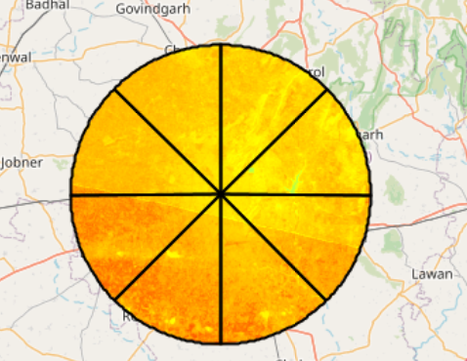
LST Map (2024)

Slide 21
Classification Comparison
Aspect | QDA | Index-Based
Type | Supervised ML (QDA) | Rule-based Thresholding
Inputs | Spectral Bands + Indices | NDVI, NDBI, MNDWI, BSI
Strengths | Accurate class separation, smoother outputs | Easy to implement, interpretable rules
Weaknesses | Requires training data, computationally heavier | Sensitive to threshold values

Slide 22
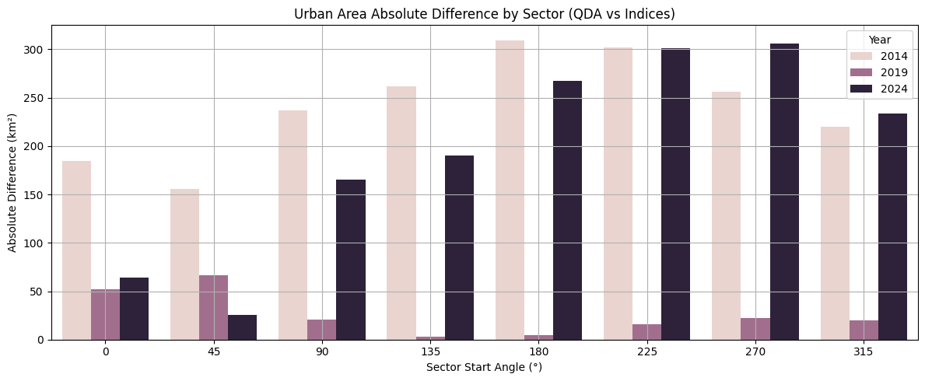
Index vs QDA Absolute area difference

Slide 23
Classification Comparison
Observation:
Urban & “Others” classes show most variability
“Others” class frequently misclassified by index method
QDA and Index based methods provide consistent estimates

Slide 24
MLC Based Method : Intra Year Comparison of LULC & Spatio Temporal Comparison Of LULC

Slide 25
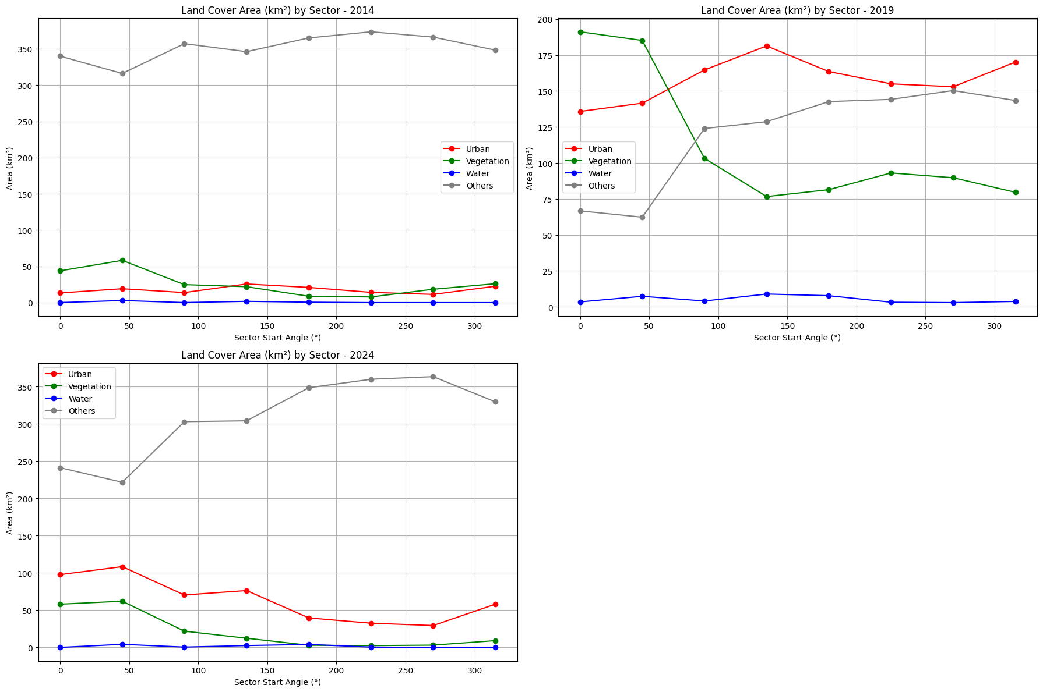

Slide 26
Index Based Method : Intra Year Comparison of LULC & Spatio Temporal Comparison Of LULC

Slide 27
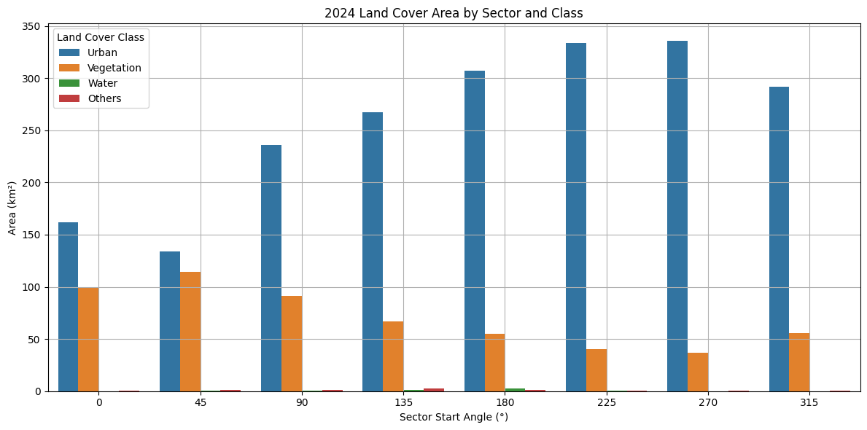

Slide 28
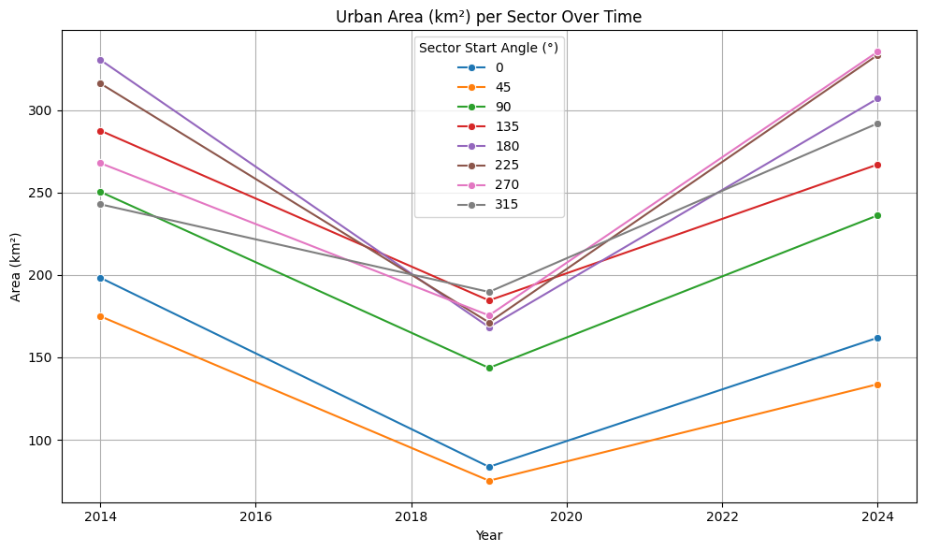

Slide 29
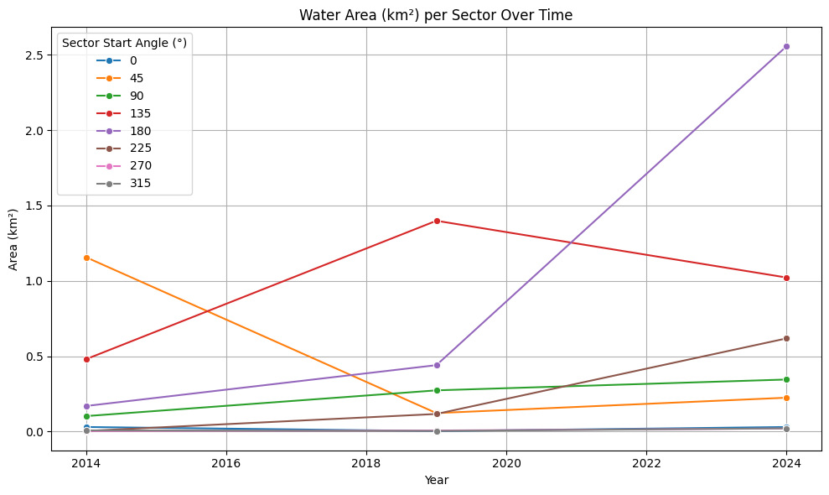

Slide 30
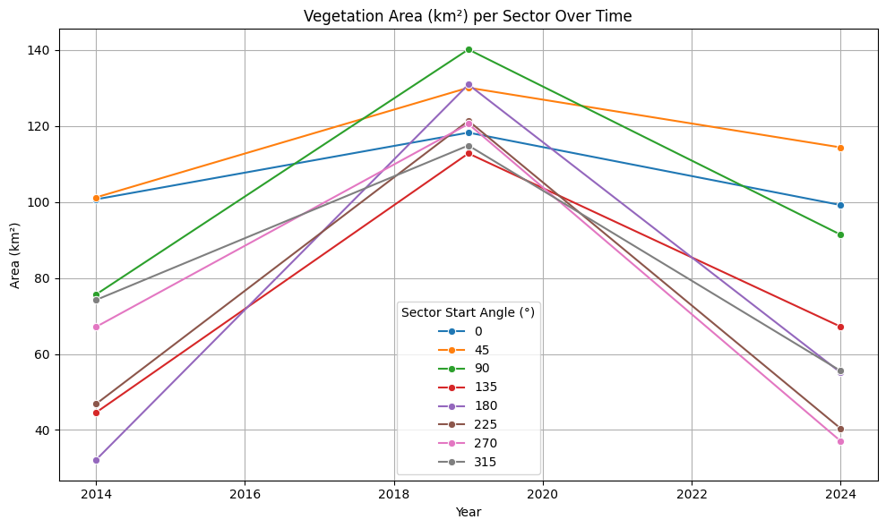

Slide 31
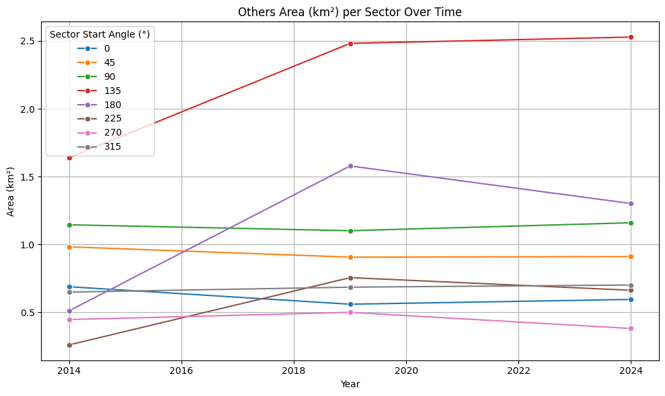

Slide 32
Overall Land Cover Transition
1. Urban Growth
Urban area increased from 2014 to 2024 overall
Steady rise, especially in southern sectors
2. Vegetation Decline
Vegetation increased & then reduced
3. Others Class
Somewhat dominant in area but slightly decreased over time
Includes bare land, rocky zones, and mixed-use pixels

Slide 33
Overall Land Cover Transition
4. Water Bodies
Minimal change over the decade
Man Sagar Lake remained spatially stable
5. Interpretation
Urban growth came at the cost of vegetation and Others & little increased LST
Water bodies had spatiotemporal changes

Slide 34
LST Map (2024)

Slide 35
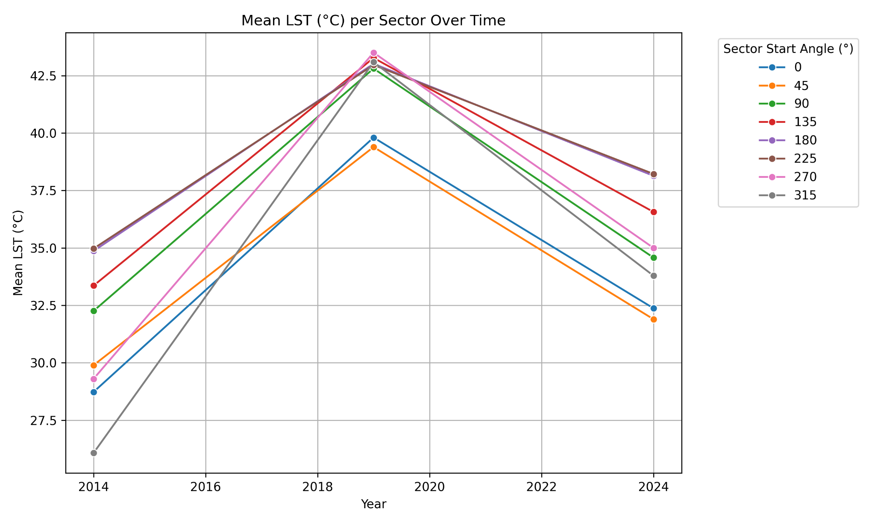
LST Stats:

Slide 36
LST Patterns
1. LST Maps (2014, 2019, 2024)
Derived using Mono-window algorithm
Visualized surface heat distribution across the city
2. Urban Heat Islands
Central and southeastern sectors show consistently high LST
2019 recorded the hottest zones, expanding radially
3. Cooling Zones
Vegetated and open areas in the north and periphery remained cooler
4. Interpretation
Clear link between built-up density and surface heat
Urban heat islands intensified with land cover change

Slide 37
Urban & Vegetation Influence
Urban Influence
Sectors with >50% Urban show higher mean LST
Strongest heat rise observed in 2019
Vegetation Cooling Effect
Sectors with significant vegetation showed lower LST
Especially effective in 2019 and 2024
Cooling effect more consistent than water or Others class
In some areas LST was relatively more even though vegetation was more

Slide 38
Sectoral LST
1. Sector-Wise Mean LST
LST extracted per 45° sector for all three years
2. 2019 Peak Temperatures
Highest average LST across almost all sectors
Sector 180°–225° reached up to 43°C
3. Decreasing LST in 2024
Some sectors show modest LST decrease
Possibly due to seasonal variation or vegetation rebound
4. Key Insight
2019 is the thermal extreme
Highlights need for yearly monitoring to capture thermal dynamics

Slide 39
Land Cover & LST relationships
Correlation Analysis
Pearson correlation between LST and land cover %
Compared for both Threshold-based and QDA methods
2. Key Correlations (Threshold-Based)
Urban % ↔ LST: +0.68
Vegetation % ↔ LST: −0.69
3. Key Correlations (QDA-Based)
Urban % ↔ LST: Variable; positive throughout
Vegetation % ↔ LST: Strongly negative

Slide 40
Land Cover & LST relationships
4. Scatter Plots
Plots show positive trend for Urban %
Negative slope for Vegetation %
5. Insight
Urbanization consistently raises LST
Vegetation helps suppress surface temperature

Slide 41
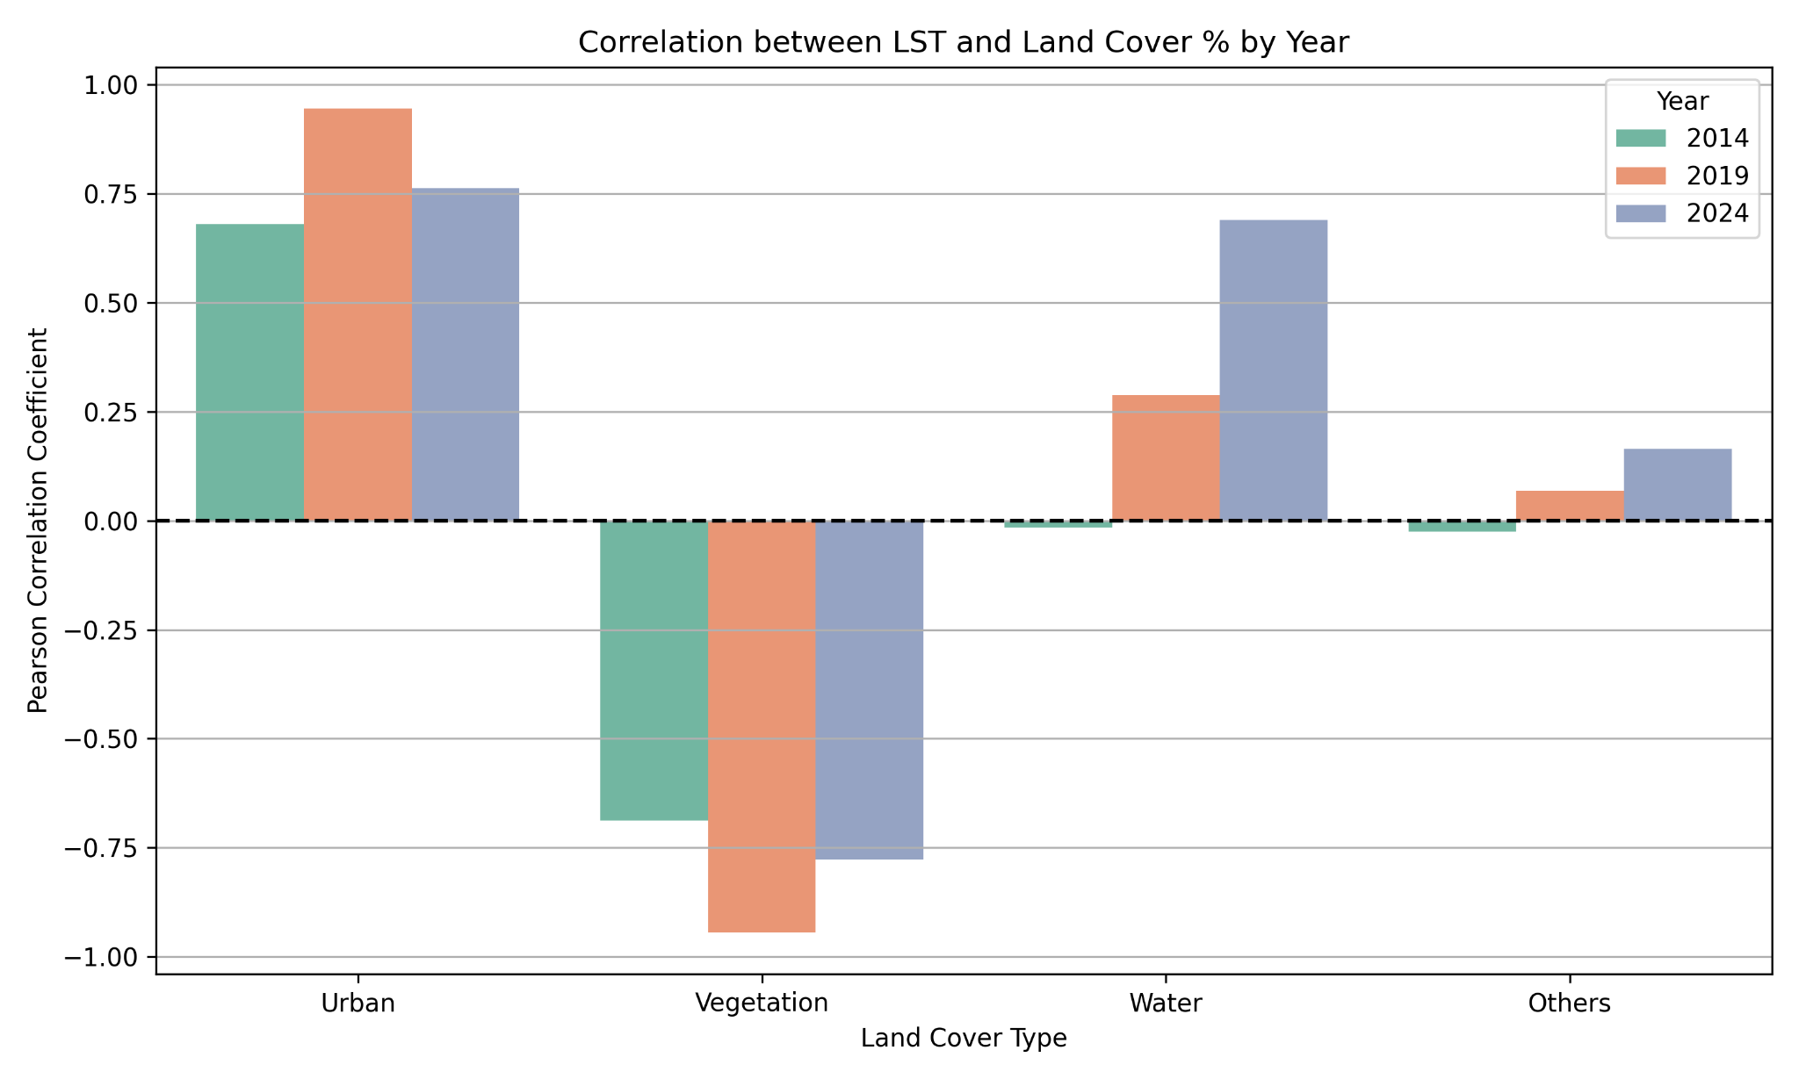

Slide 42
Land Cover vs LST
Spatial Observations
Sectors with highest urban growth (SE, SW) had more LST rise
Cooler sectors usually had higher water bodies, vegetation and lower urban density
Temporal Shift
Relationship was slightly inconsistent over the decade
Slight deviations in 2024 due to increased heterogeneity and urban sprawl

Slide 43
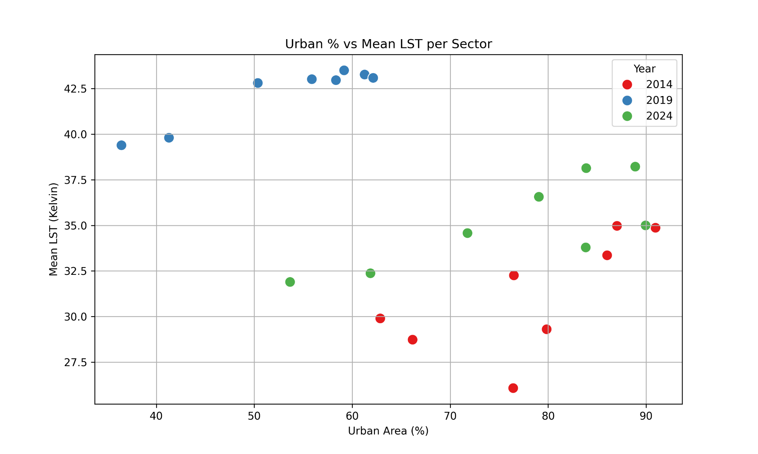

Slide 44
Methodology: Large water body & influence on LST around it
Buffer Zones around Man Sagar Lake
Concentric rings at 2 km intervals: 2 km to 10 km
Used to study LST outward from water body
Objective: Quantify how far thermal influence of the lake extends

Slide 45
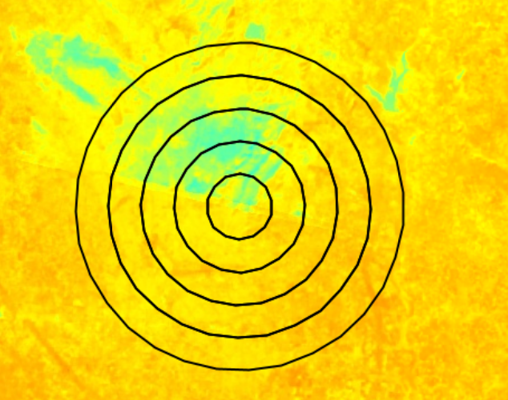
Man Sagar Lake Analysis
1. Buffer Ring Setup
Concentric buffers at 2 km intervals (2–10 km)
Centered on Man Sagar Lake
Used to assess spatial cooling gradient
2. LST Gradient Plot (2014, 2019, 2024)
2019 shows steepest rise: LST increases from ~34.1°C (2 km) to ~38.9°C (10 km)
2024 shows milder gradient than 2019
2014 had the lowest overall LST near the lake

Slide 46
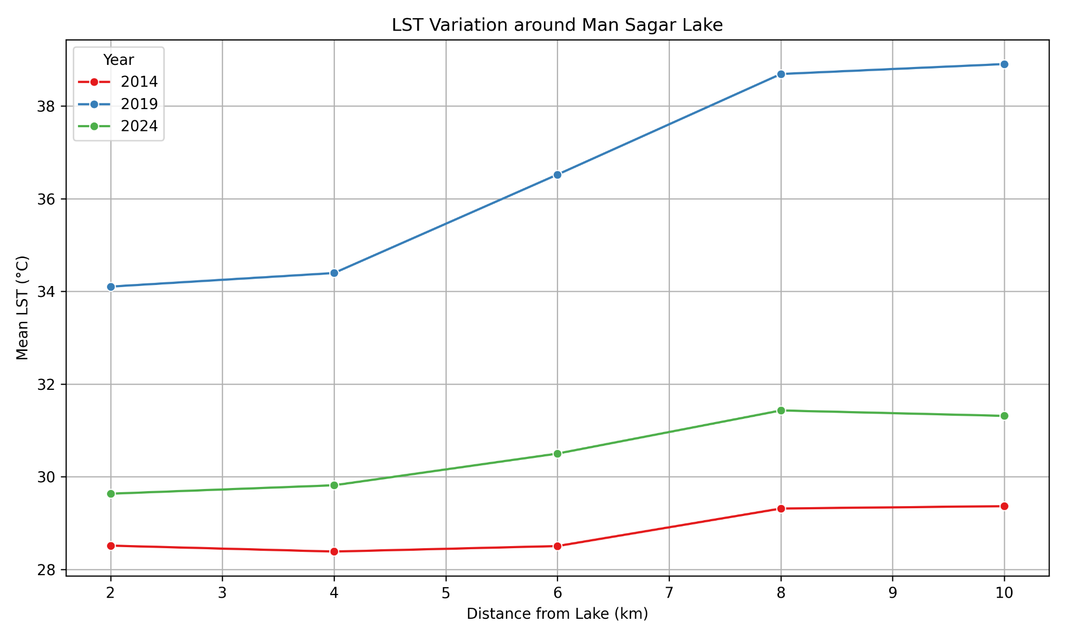

Slide 47
Man Sagar Lake Analysis
3. Observations
Cooling effect strongest within 2–4 km radius
Effect fades beyond 6 km
Most pronounced in hot years (e.g., 2019)
4. Interpretation
Lake acts as localized thermal buffer
Encroachment and urban buildup reduce its range
Preserving lake and buffer zone is crucial for thermal regulation

Slide 48
Key Findings
Urban area increased irregularly
Vegetation cover increased from 2014 to 2019 & declined post 2019 till 2024
LST increased, peaking in 2019
Some water bodies dried & some were stable , but with limited thermal impact
Strong positive correlation between Urban % and LST
Strong negative correlation between Vegetation % and LST
Man Sagar Lake shows lower LST within 2–4 km as compared to 8-10 km radius

Slide 49
Implications and Recommendations
Urban Planning
Use high-accuracy land cover maps (like QDA) to guide zoning and infrastructure development
Identify sectors with rapid urban expansion for monitoring and regulation
Green Infrastructure
Prioritize green belt creation in sectors with highest LST
Encourage rooftop gardens, urban forestry, and park development in hot zones
Heat Mitigation Strategies
Promote reflective roofing, permeable pavements, and heat-resilient materials
Target UHI hot spots for focused interventions

Slide 50
Implications and Recommendations
Policy Recommendations
Integrate remote sensing into municipal planning systems
Support policies that balance urban growth with ecological conservation
Research Extensions
Combine with demographic/socioeconomic data for deeper insights
Apply similar methods to other growing cities in arid/semi-arid zones

Slide 51
Conclusion
Successfully conducted a sector-wise analysis of land cover change and LST across Jaipur (2014–2024) Demonstrated the impact of classification method (QDA vs Index-based) on LST interpretation Revealed strong positive correlation between urbanization and increased LST
Key Takeaways
QDA provided superior classification accuracy and spatial consistency
Urban expansion is concentrated in specific directions (especially S and W)
Vegetation plays a role in mitigating thermal impacts
LST increase is not solely dependent on Urban area increase, but a on complex interaction of other factors.

Slide 52
Future Work
Future Work
Incorporate population density, land use regulations, and socioeconomic data
Extend to multi-city comparisons in similar climate zones
Explore machine learning alternatives (e.g., Random Forest, SVM) for better performance
Use higher-resolution data (e.g., Sentinel-2, MODIS) for finer-scale analysis

Slide 53
Thank You!
Any questions?

