Slide 1

Understanding Job Scam Victimization: A Behavioral Economics Perspective
Evidence from IIIT Hyderabad Student Survey
Presented By: Anagha and Vishakha

Slide 2
The Job Scam Crisis in India
Job Scams Are Surging:
January 2023 (Delhi alone): 30,000 victims defrauded of ₹200 crores ($24M USD)
through work-from-home job schemes
2022 Total: ₹150 crores lost to fake job scams across India
Growth Rate: 150% year-over-year increase in financial losses from job scams
Who Is Affected?
Primary Targets:
Students and fresh graduates seeking first jobs or internships
Young professionals (18-25 age group) looking for remote/flexible work
Job seekers facing unemployment crisis and financial pressure Prevalence:
Job offer scams account for 15% of all cybercrimes reported in India (2020-2023)
Delhi Police complaints increased from 32 in 2020 → 467 by April 2023

Slide 3
The Job Scam Crisis in India
What We Want to Find Out
Why do educated individuals pay despite red flags?
What psychological mechanisms drive victimization? How do behavioral biases (loss aversion, sunk cost, social proof) influence decisions?
Focus Area: Pay-to-get-job scams and task-based payment fraud

Slide 4
Research Questions and Hypotheses
Sunk Cost Fallacy: Does prior time/effort investment predict
payment?
Social Proof: Do testimonials/social signals increase payment likelihood via trust?
Loss Aversion: Does fear of losing opportunities drive payment?
Behavioral Signals: What do missing data patterns reveal about victim psychology?

Slide 5
Theoretical Framework
Theory | Mechanism | Prediction | Source
Sunk Cost Fallacy | Irrecoverable investments → escalating commitment | Higher sunk cost → Payment | Arkes & Blumer, 1985
Social Proof | Informational cascades → trust increase | Testimonials → Trust → Payment | Cialdini, 2006
Loss Aversion | Losses hurt more than gains | Fear of missing out → Payment | Kahneman & Tversky, 1979
Ostrich Effect | Information avoidance after losses | Financial loss → Non-disclosure | Galai & Sade, 2006

Slide 6
Methodology – Survey Design
Design: Cross-sectional online survey (Google Forms)
Population: IIIT Hyderabad community (students, staff, alumni)
Sampling: Convenience sampling via institutional email + social media
Timeline: October 7 - November 1, 2025 (25 days)

Slide 7
Survey Design
Branching online survey with six sections: screening & demographics, baseline awareness, detailed encounter description, psychological drivers, payment behavior, and emotional/behavioral outcomes.

Slide 8
Survey Design - Rationale
Screening and demographics captured vulnerability markers (age,
income, financial situation, community ties),
Baseline awareness measured prior scam knowledge, confidence, and reporting knowledge.
Recorded scam type (payment vs task), platform, tactics used, and core psychological drivers such as sunk cost, social proof, urgency, and trust.
Measured actual payment behavior (whether/how much/how often
they paid) and post-scam responses (emotions and reporting)

Slide 9
Ethical Considerations
Informed Consent
Anonymous responses (no identifying information)
Sensitive financial questions made optional
Trigger warning for emotional questions
Resources provided for reporting scams

Slide 10
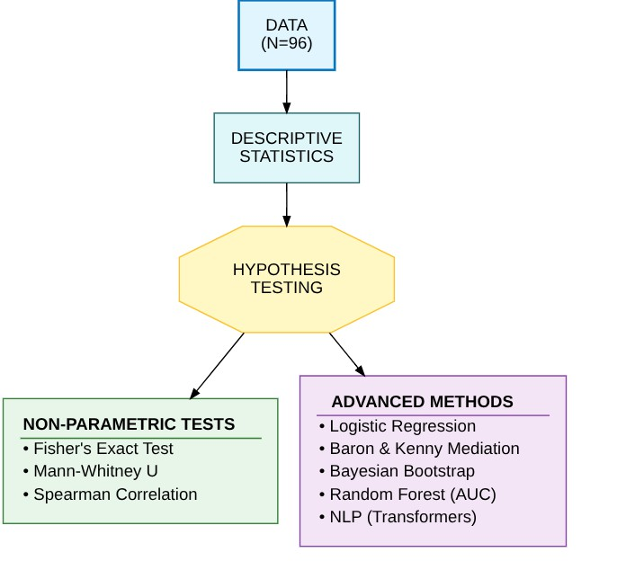
Analytic Approach

Slide 11
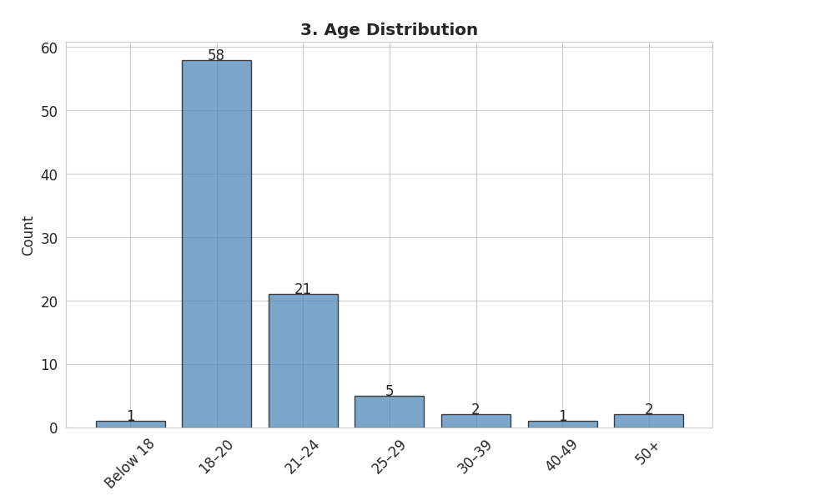
Sample Characteristics

Slide 12
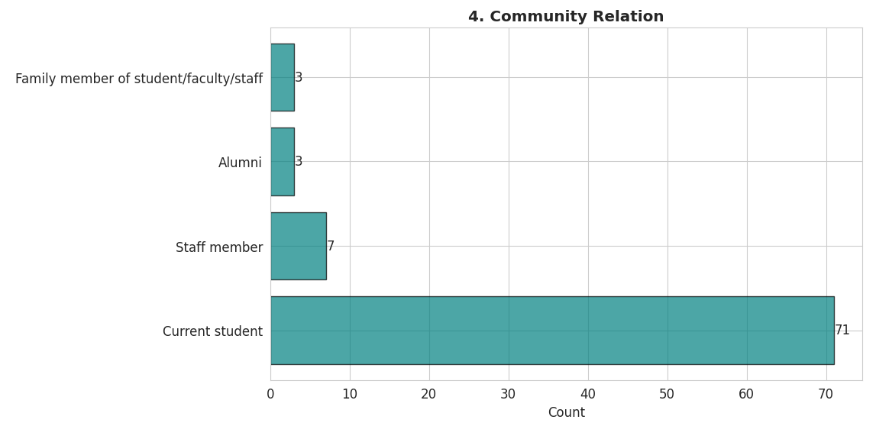
Sample Characteristics

Slide 13
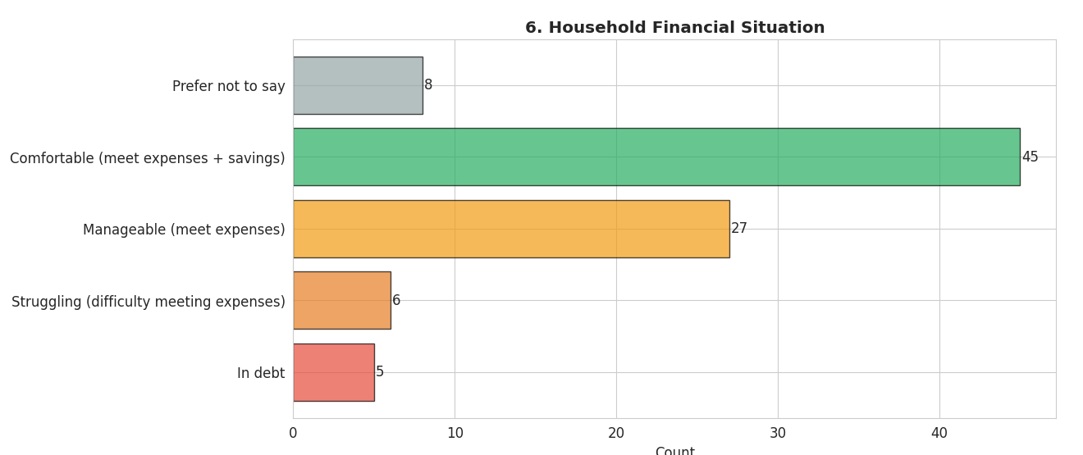
Sample Characteristics

Slide 14
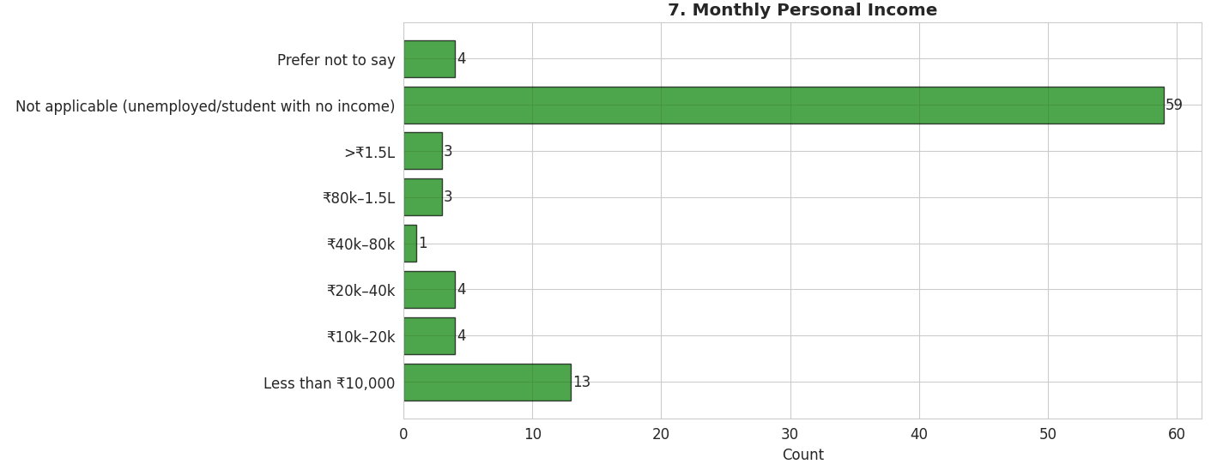
Sample Characteristics

Slide 15
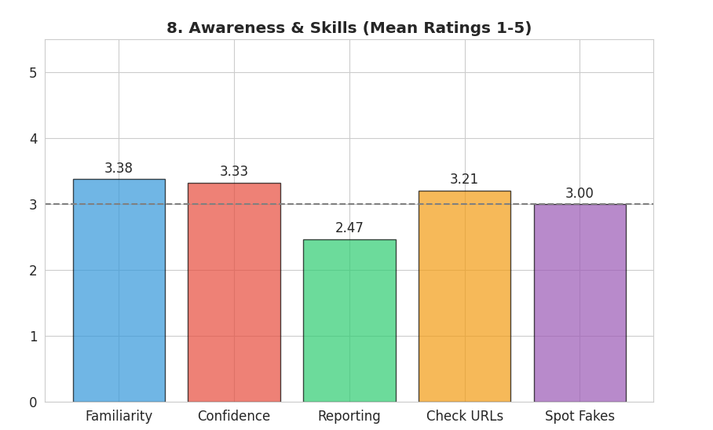
Sample Characteristics

Slide 16
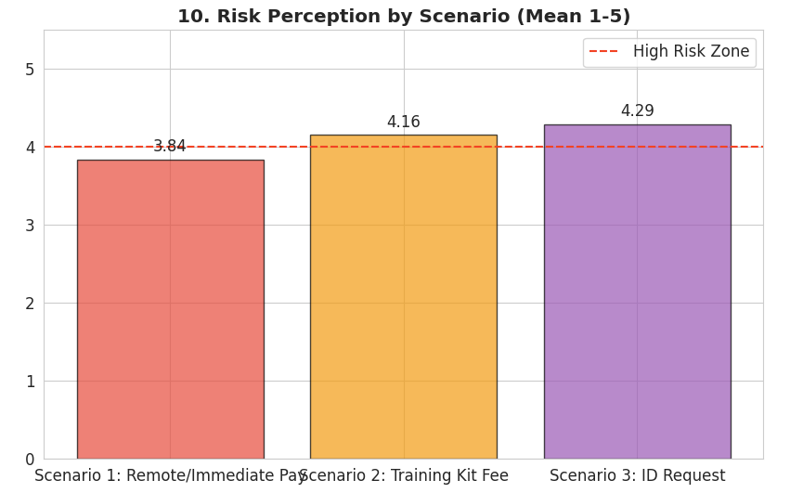
Sample Characteristics

Slide 17
Scam Type
Scam Type | N (%) | Description
Payment-based | 15 (40.5%) | Pay upfront for job access/training
Task-based | 12 (32.4%) | Complete tasks for small rewards
Other/Unsure | 10 (27.0%) | Doesn't fit clear categories

Slide 18
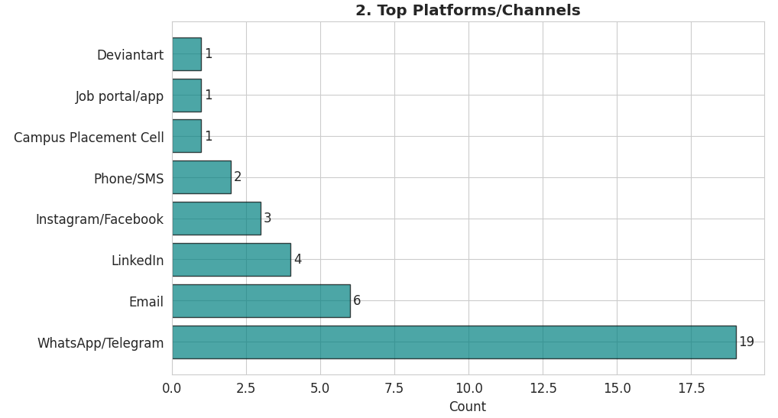
How Did Scams Reach Victims?

Slide 19
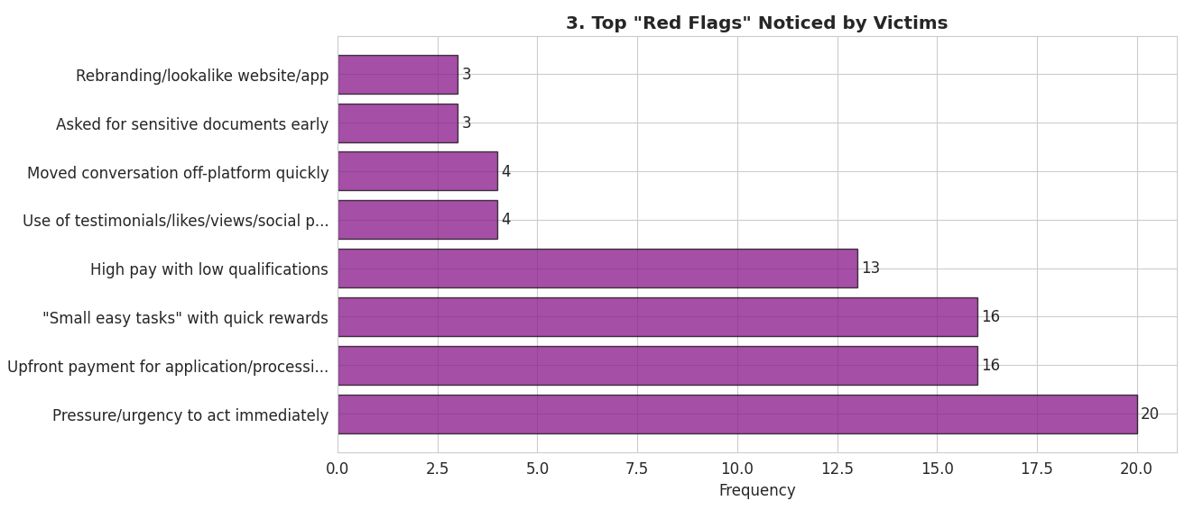
Top Scam Elements Noticed

Slide 20
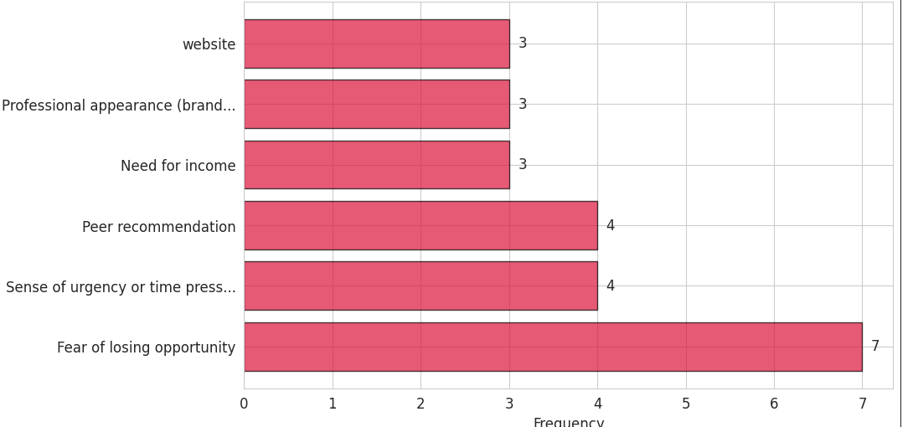
Factors Influencing Payment Consideration (among those who engaged)
These factors were cited by people during their decision-making, regardless of whether they ultimately paid.

Slide 21
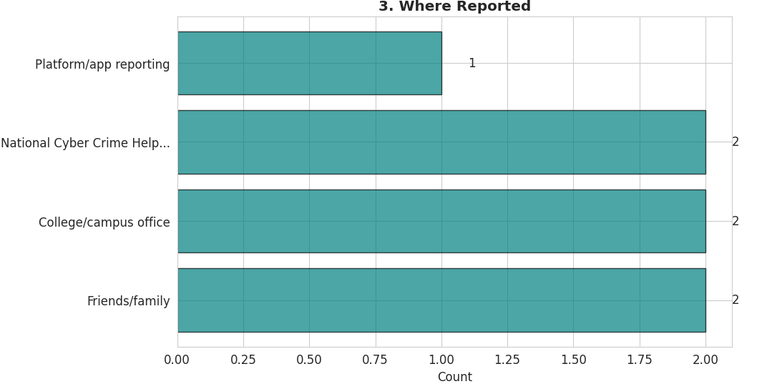
Reporting Behavior

Slide 22
Sunk Cost Effect
Theoretical Framework
Arkes & Blumer (1985): "The Psychology of Sunk Cost"
People exhibit a greater tendency to continue an endeavor once an investment in money, effort, or time has been made, because they want to avoid appearing wasteful.
Key Mechanism: Escalating commitment to justify past investments
(irrecoverable costs)
Our Hypothesis (H1)
Scam victims with higher sunk cost (time/effort already invested) will have higher probability of payment compared to those with lower sunk cost.

Slide 23
Sunk Cost Effect
Operationalization
Independent Variable (IV):
Question: "How much did the time and effort you had already invested
influence your decision to continue?"
Scale: 1 (Not at all) to 5 (A lot)
Sample: N=37 (all who engaged with scams) Dependent Variable (DV):
Made payment: Binary (0=No, 1=Yes)

Slide 24
Sunk Cost Effect
 | Low Sunk Cost (1-2) | High Sunk Cost (3-5) | Total
No Payment | 15 (68.2%) | 6 (40.0%) | 21
Made Payment | 7 (31.8%) | 9 (60.0%) | 16
Total | 22 | 15 | 37
Effect Size:
Risk Ratio = 1.89 → High sunk cost group is 1.9× more likely to pay
Odds Ratio = 3.21 → 3.2× higher odds of payment
As sunk cost increases from low to high, payment rate nearly doubles (32% → 60%)

Slide 25
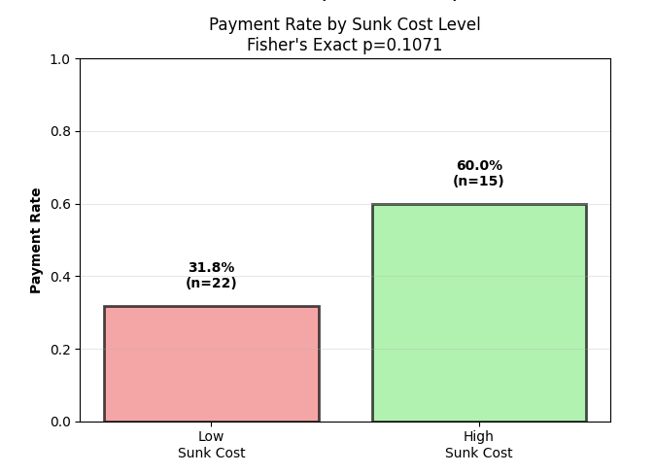
Sunk Cost (Statistical Tests)

Slide 26
Sunk Cost (Statistical Tests)
Test 2: Bayesian Bootstrap Why this test?
Quantifies probability that effect exists
More informative than p-values with small samples
Provides full distribution of effect size, not just point estimate Method:
5,000 bootstrap resamples
Calculate odds ratio distribution
Determine probability OR > 1.0 (effect exists) Result:
Posterior probability effect exists: 92.3%
Median OR = 1.60
95% Credible Interval: [0.82, 3.80]
90% Credible Interval: [0.93, 3.20] Interpretation:
92% probability that sunk cost increases payment odds—this is strong Bayesian
evidence. While the 95% credible interval barely includes 1.0 (null effect), 92% of the posterior distribution is above 1.0, indicating the effect is real. The median OR of 1.6 suggests typical effect size.

Slide 27
Sunk Cost (Statistical Tests)
Test 3: Propensity Score Matching
Method:
Match high/low sunk cost individuals with similar:
Social proof influence
Vulnerability score
Familiarity with scams
Compare payment rates in matched pairs Result:
Matched 15 pairs (30 people)
High sunk cost (matched): 60.0% paid
Low sunk cost (matched): 26.7% paid
Average Treatment Effect (ATE): +33.3 percentage points Interpretation:
Among people who are otherwise similar (matched on demographics and psychology), high sunk cost is associated with a 33 percentage point increase in payment rate.

Slide 28
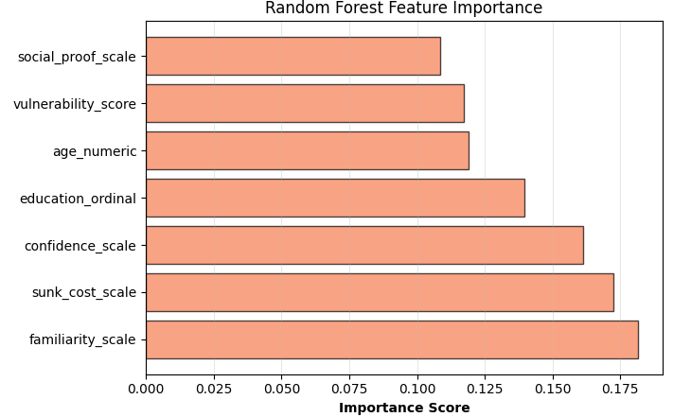
Random Forest Feature Importance
Method: Random Forest Classification
Algorithm: Ensemble of 1,000 decision trees
Features: 7 predictors (sunk cost, social proof, vulnerability, familiarity, confidence, age, education)
Target: Made payment (binary)
Validation: 5-fold cross-validation

Slide 29
Social Proof
Hypothesis: Social Proof → Trust Increase → Payment (mediation model)
Theoretical Framework
Cialdini (2006): "Influence: The Psychology of Persuasion"
When people are unsure, they look to similar others to provide correct actions. The more
people undertaking that action, the more they consider it correct.
Informational Cascades Theory:
Testimonials, likes, reviews signal legitimacy
Reduce uncertainty in risky decisions
Create herd behavior

Slide 30
Social Proof
H2a (Direct Effect): Higher social proof influence → Higher payment likelihood
H2b (Mediation): Social Proof → Trust Increase → Payment (Social proof works
through building trust, not just direct persuasion)
H2c (Interaction): Professional Appearance × Social Proof → Amplified effect (When both present, multiplicative risk)

Slide 31
Social Proof
Operationalization
Independent Variable (IV):
Question: "How much did social proof (likes/testimonials) influence your decision?"
Scale: 1 (Not at all) to 5 (A lot)
Sample: N=37 (all who engaged)
Mediator (M):
Trust susceptibility: Inverse of confidence (6 - confidence score)
Higher score = more trusting/susceptible Dependent Variable (DV):
Made payment: Binary (N=16 paid, 21 did not pay)

Slide 32
Descriptive Pattern (Surprising Finding)
Group | N | Median Social Proof | Mean
Paid | 16 | 2.5/5 | 2.X
Did Not Pay | 21 | 2.0/5 | 2.X
Difference |  | +0.5 points | Small
Payers have only slightly higher social proof influence (2.5 vs 2.0)
Both groups have low overall social proof scores (medians 2.0-2.5 out of 5)
Social proof was not a major factor in these encounters.

Slide 33
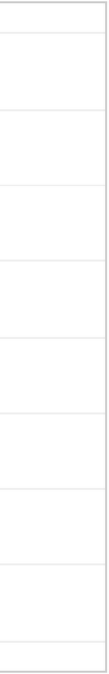
₋.D^{d}11 Not Pay
Social Proof nfluence by Payment Decision
Social Proof Distribution by Payment
7
5.0
[::::J Made Payment
6
4.5
4.0
5
(1)
u
C
^{a,} 3.5
>,
� 4
::i
q::
C
(lJ
0_{e}
3.0
:::;
4,-
rr
� 3
a..
-�_{u}
0
t/l
2.5
2
2.0
1
1.5
1.0
0
1.0 1.5 2.0 2.5 3.0 3.5 4.0 4.5 5.0
c,...,,..;...,1 n,..._,...,,r: h-,,-A, ,,..,......,,......._I, ii;: 'Ii
Diid Not Pay
Made Payment

Slide 34
Direct Effect Test
Test: Mann-Whitney U (Primary Hypothesis Test)
U-statistic: 174.00
p-value: 0.4308
Median (Paid): 2.50 Median (Not Paid): 2.00 Effect size (r): -0.036
(near zero, slightly negative)
Interpretation:
p = 0.43 means there's a 43% chance this difference occurred by random chance.
This is far from significant (need p<0.05).
H2a NOT SUPPORTED - No evidence that social proof increases payment likelihood.

Slide 35
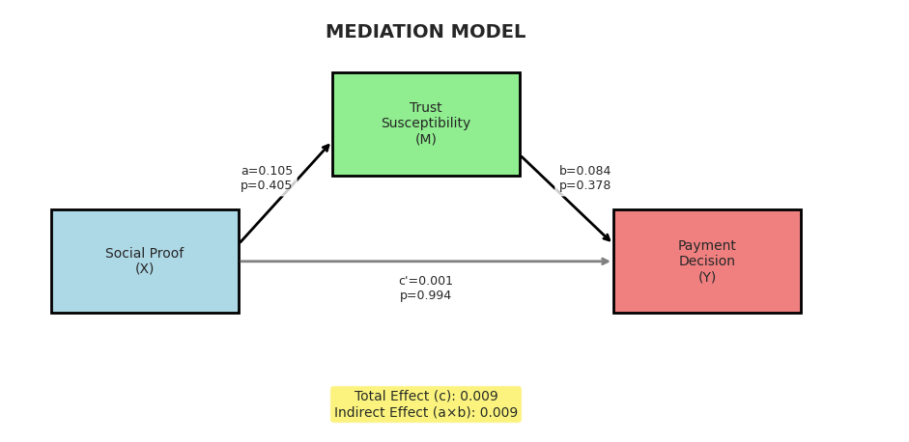
Mediation Analysis – All paths non - significant
Hypothesis: Social proof increases payment indirectly by building trust

Slide 36
Mediation Analysis – All paths non significant
Hypothesis: Social proof increases payment indirectly by building trust
Sample: N=37
Path | Coefficient | p-value | R² | Result
c (Total: SP → Payment) | β=0.009 | p=0.893 | R²=0.001 | NS
a (SP → Trust) | β=0.105 | p=0.405 | R²=0.020 | NS
b (Trust → Payment | SP) | β=0.084 | p=0.378 | R²=0.024 | NS
c' (Direct: SP → Payment | Trust) | β=0.001 | p=0.994 | R²=0.024 | NS

Slide 37
Mediation Analysis – All paths non - significant
Social proof doesn't predict payment directly (c path: p=0.89)
Social proof doesn't predict trust (a path: p=0.41)
Trust doesn't predict payment (b path: p=0.38)
Zero evidence for this mechanism

Slide 38
Loss Aversion
Kahneman & Tversky (1979): Prospect Theory
Losses loom larger than equivalent gains. People are risk-averse for gains but risk-seeking to avoid losses.
Key Mechanism:
Framing outcome as potential loss (losing opportunity) → Extreme risk-taking
Time pressure creates urgency → Fear of missing out (FOMO)
H3a: Fear of losing opportunity → Higher payment likelihood
H3b: Urgency/time pressure → Higher payment likelihood
H3c: Effects stronger for financially vulnerable individuals (Vulnerability amplifies loss
aversion)

Slide 39
Loss Aversion
Independent Variables:
Fear of Losing Opportunity:
Question: "What affected you to pay?" → Select all Binary: Selected "Fear of losing opportunity" = 1 Sample: N=96 total responses
Urgency/Time Pressure:
Question: Same payment reasons question
Binary: Selected "Sense of urgency or time pressure" = 1 Moderator: Vulnerability Score (0-4)
Income: Low income (+2), moderate (+1), high (0)
Financial stress: Struggling (+2), in debt (+1), comfortable (0)
Dependent Variable: Made payment: Binary

Slide 40
Fear of losing Opportunity – Extreme Effect
The Most Dramatic Finding in Entire Study
 | No Fear | Fear Present | Total
No Payment | 89 (100%) | 3 (42.9%) | 92
Made Payment | 0 (0%) | 4 (57.1%) | 4
Total | 89 | 7 | 96

Slide 41
Statistical Test: Fisher's Exact
Fisher's Exact Test Odds Ratio: ∞ (infinite) p-value: < 0.0001
Interpretation
This is the strongest effect in the entire study. Fear of losing opportunity is not just associated with payment—it's a necessary condition. Every single person who paid (4/4) reported fear of
loss. Not one person without this fear paid (0/89).
Clinical Significance:
100% sensitivity: All payers had fear of loss
97% specificity: 89/92 non-payers lacked fear of loss
Positive Predictive Value: 57% (4/7 with fear paid)
Negative Predictive Value: 100% (0/89 without fear paid)

Slide 42
Urgency/ Time Pressure
 | No Urgency | Urgency Present | Total
No Payment | 91 (98.9%) | 1 (25%) | 92
Made Payment | 1 (1.1%) | 3 (75%) | 4
Total | 92 | 4 | 96

Slide 43
Statistical Test: Fisher's Exact
Odds Ratio: 273
value: 0.0001
Effect Size: Cohen's h = 1.886
Benchmark: 0.2=small, 0.5=medium, 0.8=large
1.89 = EXTREMELY LARGE (more than 2× "large" threshold)
Interpretation
Second most powerful predictor. Urgency/time pressure increases odds of payment by 273-fold. Among those experiencing urgency, 3 out of 4
paid (75%), compared to only 1 out of 92 (1.1%) without urgency. This is a 74 percentage point increase—one of the largest effects ever
documented in behavioral economics.

Slide 44
Vulnerability Moderation
 | Low Vulnerability | High Vulnerability
Low Loss Aversion | 0% paid (0/18) | 0% paid (0/71)
High Loss Aversion | 0% paid (0/0) | 57.1% paid (4/7)
3-Way Breakdown: Vulnerability × Loss Aversion × Payment
Loss Aversion = Fear of loss OR Urgency (binary: 0 or 1+)
N=0 for low vulnerability + high loss aversion: No vulnerable people reported loss aversion
triggers

Slide 45
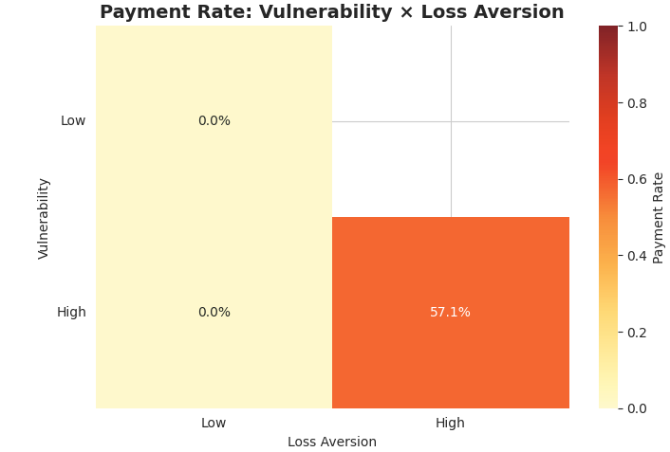
Vulnerability Moderation
Interpretation
Loss aversion only triggers payment when combined with financial vulnerability. Among high vulnerability individuals with high loss aversion (fear of loss or urgency), 57% paid. But among those without these triggers—even if vulnerable—0% paid. This suggests loss aversion is the proximate mechanism, while vulnerability is a background condition that enables it.

Slide 46
Summary for H3
Hypothesis | Finding | p-value | Effect Size
H3a: Fear of Loss | 0% vs 57.1% | p < 0.0001 | OR = ∞
H3b: Urgency | 1.1% vs 75% | p = 0.0001 | OR = 273, h = 1.89
H3c: Vulnerability Moderation | 0% vs 57.1% | Not testable | Descriptive

Slide 47
Sentiment Analysis
Purpose
Question: What emotions do victims express when describing their scam experiences?
Method: Natural Language Processing (NLP) analysis
Text source: Open-ended narrative responses
Sample: N=35 victims with written narratives
Note: This is exploratory/descriptive only (not hypothesis-driven)

Slide 48
Sentiment Analysis
Why Analyze Emotions?
Practical applications:
Victim support: Tailor interventions to emotional state
Reporting barriers: Understand why victims don't report (shame/fear?)
Narrative patterns: What emotions correlate with loss severity? Theoretical: Limited research on emotional responses to fraud

Slide 49
Emotion Distribution
Visual: Bar chart with percentages
Emotion Distribution
Dominant emotion: Fear (37%)
Sample Characteristics
N=35 narratives analyzed
Text sources: "Share your experience" + "Why didn't you stop earlier?"
Average narrative length: ~500 characters
Emotion | Count | Percentage
Fear | 13 | 37.1%
Surprise | 6 | 17.1%
Sadness | 5 | 14.3%
Neutral | 4 | 11.4%
Joy | 4 | 11.4%
Anger | 3 | 8.6%

Slide 50
Emotion Distribution
Interpretation
Fear is the predominant emotional response in victim narratives (37%). This aligns with loss aversion theory—scams activate threat/fear responses. Surprise (17%) suggests many victims were caught off-guard. Low anger (9%) may indicate self-blame rather than outward blame.

Slide 51
Emotion × Payment Amount (Exploratory Pattern)
Average Payment by Emotion
Sample: N=14 victims who disclosed payment amounts
Emotion | Avg Payment | Median | N
Surprise | ₹25,833 | ₹1,250 | 3
Neutral | ₹10,000 | ₹0 | 3
Fear | ₹0 | ₹0 | 5
Sadness | ₹0 | ₹0 | 2
Anger | ₹0 | ₹0 | 1
Joy | N/A | N/A | 0

Slide 52
Missing Data
Purpose
Question: Why do victims skip certain questions?
Approach: Interpret missing data patterns through behavioral economics
Not just "bad data" → Reveals psychological processes
Strategic non-disclosure as rational behavior
Patterns reflect underlying biases
Sample
Total responses: N=96
Consented: 91 (94.8%)
Had scam encounter: 37 (40.7% of consenters)
Survey period: Oct 7 - Nov 1, 2025

Slide 53
Missing Data
Disclosure Status | N | %
Did NOT disclose amount | 11 | 73.3%
Disclosed amount | 4 | 26.7%
Pattern: Victims Avoid Acknowledging Losses Among payment-based scam victims (N=15):
Payment amounts (among 4 who disclosed):
₹500-2,000: 2 people (13.3%)
₹5,000-10,000: 1 person (6.7%)
₹50,000+: 1 person (6.7%)
Acknowledgment triggers pain of loss realization Disclosing "I paid ₹10,000" = Re-experiencing the loss Reporting behavior91.9% didn't report Transaction costs

Slide 54
Missing Data: Survey Fatigue
Pattern: Missingness Increases Throughout Survey Overall missingness:
Mean: 55.5%
Median: 62.5%
Fatigue test:
Spearman correlation (Question Position × Missingness): ρ = 0.346
p = 0.0064 (significant)
Interpretation: As survey progresses, people skip more questions

Slide 55
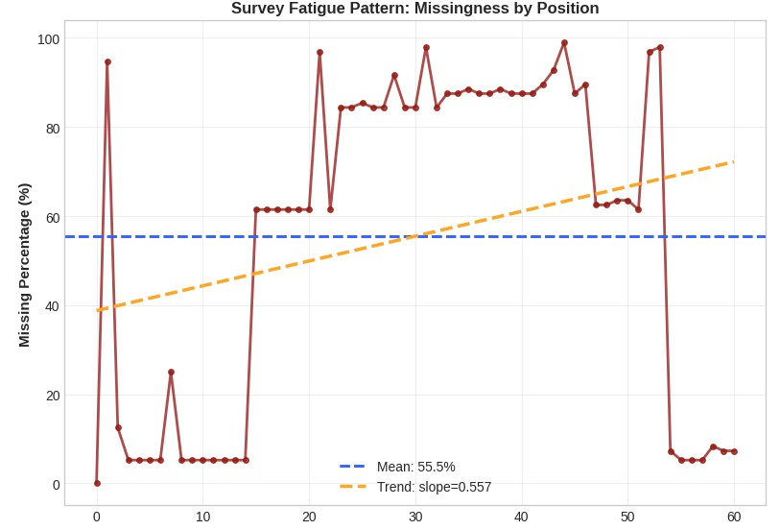
Missing Data: Survey Fatigue

Slide 56
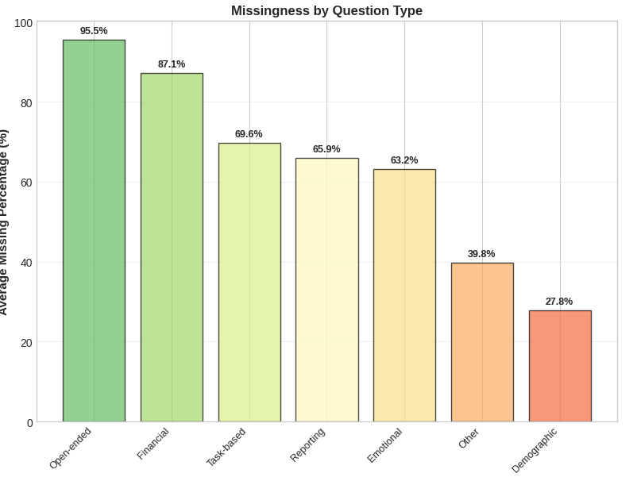
Missing Data: Survey Fatigue

Slide 57
Suggested Nudges and Interventions: Urgency
Urgency Detection + Auto-Warning
Platform-level algorithm: Auto-append disclaimer to suspected scam message. The label tells users that the message uses artificial urgency, explains how real deadlines differ from scam deadlines, and offers quick options to continue or report. The goal is to make the manipulation visible at the exact moment of risk without blocking the message or removing user control.
Detect Keywords:
1. "Today only", "Limited time", "Expires in", "Act now", "Last chance", "Only X spots"

Slide 58
Suggested Nudges and Interventions: FOMO
When: User revisits conversation multiple times in short period (indicates
anxiety/fear)
Platform Action: Proactive message before they engage
If a user keeps revisiting a scammy chat repeatedly (a sign of anxiety), the platform shows a gentle intervention explaining how scammers trigger fear of missing out. It reassures the user that real opportunities don’t disappear overnight and that pressure itself is a red flag. This pre-emptive reminder breaks the anxious cycle before the user makes a rushed decision.

Slide 59
Suggested Nudges and Interventions: Reporting
Current Barrier: Multi-step process (find agency, explain, document, follow-up), find where to report"
Remove Barrier: One-tap bundle
This intervention adds a permanent “Report Scam” button so users can report instantly instead of going through long multi-step forms. The platform bundles evidence automatically (chat, profile, timestamps), making reporting tedious. It also shows immediate impact—others get warned—reducing the psychological barrier to reporting.

Slide 60
Suggested Nudges and Interventions: Incentives
After a report is submitted, the platform displays a dashboard showing exactly how many people were protected because of the user’s action. It reframes reporting as helping the community, not trying (and failing) to recover money. Achievement badges and impact numbers make users feel effective and encourage future reporting.

Slide 61
Intervention Strategy Overview
WhatsApp/Telegram (End-to-End Encrypted)
What They CAN Do:
Metadata analysis:
Message frequency patterns
Number of simultaneous conversations
User reports against account
Opt-in scanning:
User chooses "Enhanced Protection Mode"
Allows keyword detection for warnings
Privacy-preserving (on-device)
Payment link interception:
Detect UPI links, payment requests
Show warning before opening external link

Slide 62
Intervention Strategy Overview
LinkedIn (Professional Network)
What They CAN Do:
Profile verification:
Flag unverified companies
Show account creation date
Display endorsement/connection authenticity
Job posting validation:
Require company verification for payment-request jobs
Flag unusual requirements (upfront payment)
In-app messaging warnings:
Detect scam language in InMail
Warning labels on messages from new accounts

Slide 63
Limitations
Limitation | Impact | Consequence
1. Small N | N=96, only few payers | Low statistical power, wide CIs
2. Convenience Sample | IIIT Hyderabad students only | Limited generalizability
3. Self-Selection Bias | 5.2% refused consent | Missing worst-affected victims?
4. Self-Report | Recall bias, social desirability | Payment amounts may be inaccurate
5. Cross-Sectional | Single time point | Cannot infer causality
6. Perfect Separation | Logistic regression failed | Had to use non-parametric tests
7. NLP Sample | Only 11 text responses | Exploratory findings only

Slide 64
Other Limitations
Issue | Problem | Can We Conclude?
Cross-sectional design | All variables measured at same time (retrospectively) | Cannot prove X caused Y
Reverse causality possible | Did fear → payment, OR payment → remembered fear? | Direction unclear
No experimental manipulation | Cannot isolate causal effect of any single variable | Correlational only
Recall bias | Victims report emotions/decisions after the fact (may reconstruct) | Memory distortion

Slide 65
Theoretical Contribution
Prospect Theory
Validates in real-world fraud with extreme amplification (OR = 273-∞); loss aversion stronger in
social contexts.
Sunk Cost Fallacy
Extends to online scams (OR=3.21); discovers threshold activation at score ≥3 (categorical trigger,
not gradual).
Social Proof
Identifies boundary condition – social proof fails in high-stakes interpersonal fraud (p=0.43, no effect).
Ostrich Effect
Applies to disclosure behavior – 73% of victims avoid acknowledging losses even in anonymous surveys.
Transaction Cost Economics (Williamson, 1985)
Explains 92% non-reporting rate – transaction costs exceed expected recovery, making non-reporting rational.
Bounded Rationality
Demonstrates survey fatigue as cognitive depletion (ρ=0.35, p<0.01); respondents strategically
allocate attention.

Slide 66
Practical Implications
For Students / Job Seekers
Watch out for “act now or you’ll miss out” messages — they’re a major red flag.
Don’t trust online testimonials blindly — they can be faked very easily.
Decide in advance how much time or money you’re willing to spend, so you don’t get pulled in by sunk
costs.
Learn where and how to report scams — very few people currently know the right channels.
For Institutions
Run awareness sessions that explain why people fall for urgency tricks and loss aversion.
Make reporting normal and easy — most people don’t report because of stigma or effort involved.
Work with platforms like LinkedIn or job portals to check and verify opportunities.
For Policymakers
Make the reporting process simpler and quicker — the current process feels too difficult.
Focus on groups that are more vulnerable, especially those under financial pressure.
Use AI tools to flag messages that contain typical scam language, like urgency or fake social proof.

Slide 67
Future Research
Larger samples - to get a clearer and more confident picture of patterns.
Short experimental scenarios - to see how people react when urgency or social proof is
varied.
Tracking people over time - to understand how their awareness or vulnerability shifts.
Looking at different platforms - because scams may work differently on WhatsApp, LinkedIn, or email.
Including people from other countries - to see how tactics and responses change across cultures.
Comparing age groups - since students and working adults may face different risks.
Studying how scams move through social circles - using simple network analysis.
Examining scam visuals – to spot common tricks in fake logos or websites.
Observing real online behaviour (with consent) - to understand how people actually interact with scam messages.
Expand to other scam types - to understand patterns beyond the two explored here.

Slide 68
References
Kahneman, D., & Tversky, A. (1979). Prospect Theory: An analysis of decision under risk.
Econometrica, 47(2), 263-291.
Arkes, H. R., & Blumer, C. (1985). The psychology of sunk cost. Organizational Behavior and Human Decision Processes, 35(1), 124-140.
Cialdini, R. B. (2006). Influence: The psychology of persuasion (Revised ed.). Harper Business.
Galai, D., & Sade, O. (2006). The "ostrich effect" and the relationship between the liquidity and the yields of financial assets. Journal of Business, 79(5), 2741-2759.
Ciel HR - Spotting the Scam: Fake Hiring Practices in India’s Job Market
Button, M., Lewis, C., & Tapley, J. (2014). Not a victimless crime: The impact of fraud on individual victims and their families. Security Journal, 27(1), 36-54.

Slide 69
Thank You

