Slide 1
Investigating the Word Superiority Effect
Mithun Rameshbabu - 2023101070 Aditya Nair - 2023111029 Vishakha Agrawal - 2023101040

Slide 2
Table of contents
01
02
03
04
05
06
Hypothesis
Literature Review
Variables
Experiment Design, Flow & Data Collection
Results and Discussion
Inference and Conclusion

Slide 3
Hypothesis
Letters are recalled more accurately when presented within real words, compared to when they appear in isolation or in nonword strings. This phenomenon is known as the Word Superiority Effect (WSE).

Slide 4
Our Hypothesis
Participants will demonstrate higher accuracy and faster response times in identifying a target letter when it appears in a real word compared to a scrambled nonword.
We aim to replicate and extend Reicher’s findings using a modern experimental setup and reaction time measures.

Slide 5
Literature Review
Reicher (1969): Perceptual Recognition as a Function of Meaningfulness of Stimulus material
Background Motivation: At the time, word recognition was assumed to be based on independent letter recognition. Reicher challenged this, suggesting that letters are perceived better in the context of real words.
What Reicher Wanted to Test: Does the presence of a meaningful word context enhance letter identification accuracy, even when word redundancy is controlled?

Slide 6
Literature Review
Experimental Design Insight:
Used tachistoscopic presentation (very brief exposure of a stimulus).
Followed by a forced-choice test (2-alternative letter identification).
Redundancy was controlled by ensuring both choices formed valid words (e.g., WORK vs. WORD when testing the last letter).

Slide 7
Literature Review
Method Summary:
Stimuli: 4-letter English words, nonwords, and isolated letters.
Participants Action: Viewed stimuli very briefly, followed by masking.
Task: Indicate which of two letters was in a specific position.
Both options created valid words (e.g., D/K after seeing WORD).

Slide 8
Literature Review
Key Finding: Letter recognition accuracy was significantly higher in word contexts than in isolated letters or nonwords. → Reicher demonstrated the Word Superiority Effect even when redundancy was fully controlled.

Slide 9
Literature Review
Theoretical Explanations:
WSE is often explained by top-down processing and interactive activation models (e.g., McClelland & Rumelhart, 1981), where existing knowledge of words facilitates the perception of the letters within them.
Relevance to this Experiment: Our study aims to show WSE using a similar but modified letter detection task within words and matched nonwords.

Slide 10
Experiment Variables
Independent Variable:
Stimulus Type (Condition): The type of letter string presented to the participant.
Levels (2):
Word: Meaningful 4-letter English words (e.g., WORK, CART).
Nonword: 4-letter nonwords, created as anagrams of the words (e.g., RWOK, ARCT).

Slide 11
Experiment Variables
Dependent Variables (DVs):
Accuracy: Whether the participant correctly responded "Yes" or "No" to the presence of the critical letter. Measured as the proportion or percentage correct.
Reaction Time (RT): The time (in seconds) from the onset of the response prompt until the participant pressed a key. Analyzed only for correct trials.

Slide 12
Experiment Variables
Confounding Variables
These are uncontrolled factors that may unintentionally affect results.
Individual Differences
Reading ability and vocabulary level
Familiarity with specific words used in the stimuli
Language background (e.g., native vs. non-native English speakers)
Methodological Factors
Variations in screen size, resolution, or brightness (especially in online setups)
Environmental distractions during testing (e.g., noise, interruptions)
Task-Related Factors
Position of the critical letter in the word (beginning vs. middle vs. end)
Response bias (e.g., tendency to press “Yes” more than “No”)
Strategy development — participants might learn patterns or adopt shortcuts mid-task

Slide 13
Experiment Variables
Controlled Variables:
Stimulus Length (all 4 letters).
Letter Content (nonwords are anagrams of words).
Presentation Time (Fixation +: 500ms, Stimulus: 500ms).
Task Instructions.
Response Mapping (Left = Yes, Right = No).

Slide 14
Experiment Design
Design: Within-Subjects Design. Each participant was exposed to both Word and Nonword trials. This allows for direct comparison of performance within the same individual across conditions.
Stimuli:
9 four-letter words (e.g., WORK, CART, CARD)
9 matched non-words created by scrambling the letters (e.g., RWOK, ARCT, RCAD)
Critical letters occurred equally in all positions (1-4)
Equal number of trials where letter was present vs. absent

Slide 15
Experiment Design
Implementation:
Built using PsychoPy/PsychoJS for both lab and online testing
User-friendly interface with clear instructions
Randomization:
Trial order was randomized for each participant, 18 trials were presented in random order.
Conditions were balanced across participants

Slide 16
Experiment Flow
Participants read instructions.
Each trial consisted of:
Fixation +
Stimulus (Word or Nonword)
Response Screen: "Did the word contain the letter [X]?" with YES/NO buttons (Displayed until response).
Participants responded using Left (YES)/Right (NO) arrow keys or mouse clicks.
Data (condition, response, accuracy, RT) was recorded for each trial.
Feedback was provided to participants at the end

Slide 17
Participants
Sample Size: 41 student participants completed the experiment
31 male (75.6%)
10 female (24.4%)
Average age: ~19 years old
Recruitment:
Participants were recruited from our class group or academic program

Slide 18
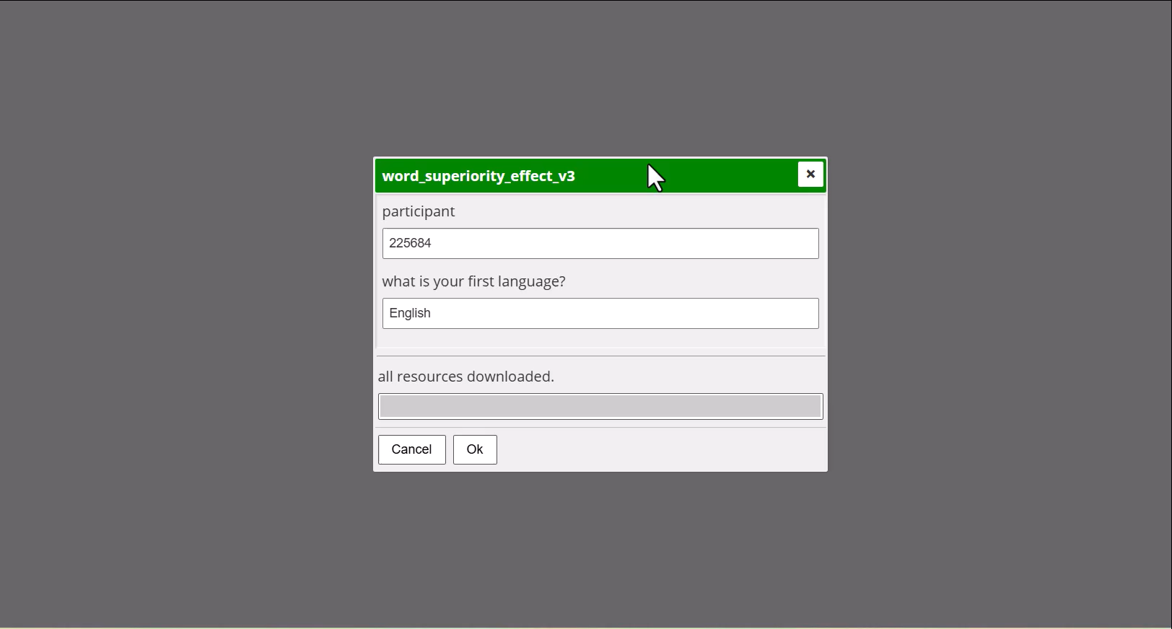

Slide 19
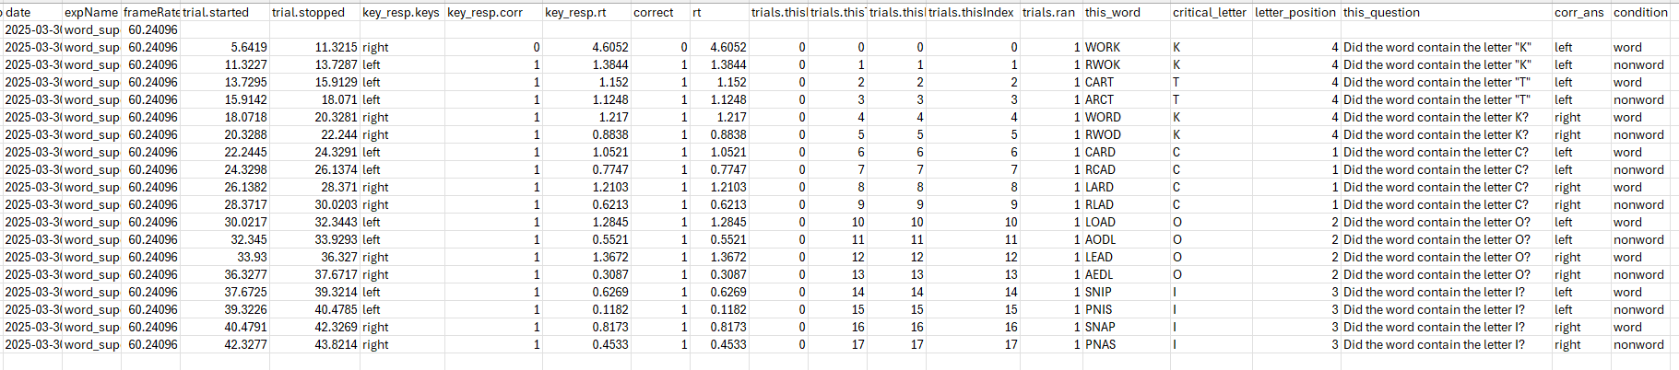
Data Collection Snapshot
Example raw data output (.csv format) collected via PsychoJS, showing key recorded variables per trial.

Slide 20
Data Collection Measures
Measures Collected:
Response accuracy (correct/incorrect)
Reaction time (in seconds)
Trial information (condition, stimulus, correct answer)

Slide 21
Statistical Test Used – Wilcoxon Signed-Rank Test
A non-parametric test used to compare two related samples (e.g., same participants in two conditions).
It compares the median differences without assuming normal distribution.
Appropriate here due to non-normality and small sample size.

Slide 22
Results - Accuracy
Wilcoxon Signed-Rank Test
Statistic (W): 396.5
p-value (one-tailed, word > nonword): 0.675
No statistically significant difference in accuracy between word and nonword conditions.
Condition | Mean Accuracy (%) | Standard Deviation
Word | 93.5 | 14.3
Nonword | 94.6 | 9.7

Slide 23
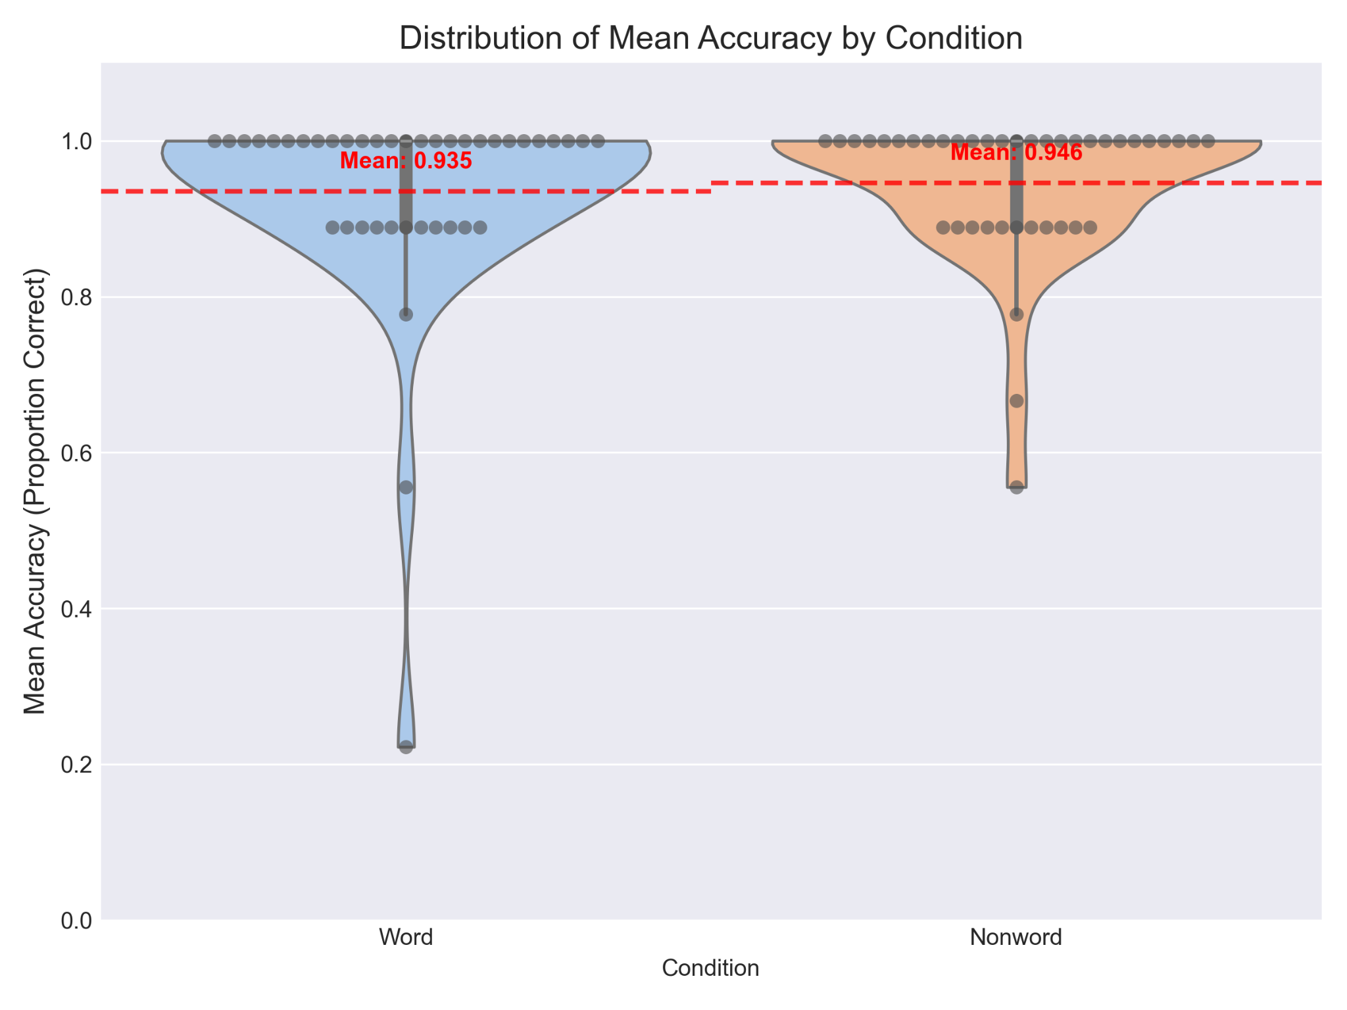

Slide 24
Results - Response Time
Wilcoxon Signed-Rank Test
Statistic (W): 260.0
p-value (one-tailed, word < nonword): 0.013
Interpretation:
Statistically significant difference found.
Participants responded faster to words than to nonwords.
Condition | Median RT (seconds) | Standard Deviation
Word | 0.930 | 0.216
Nonword | 0.963 | 0.245

Slide 25
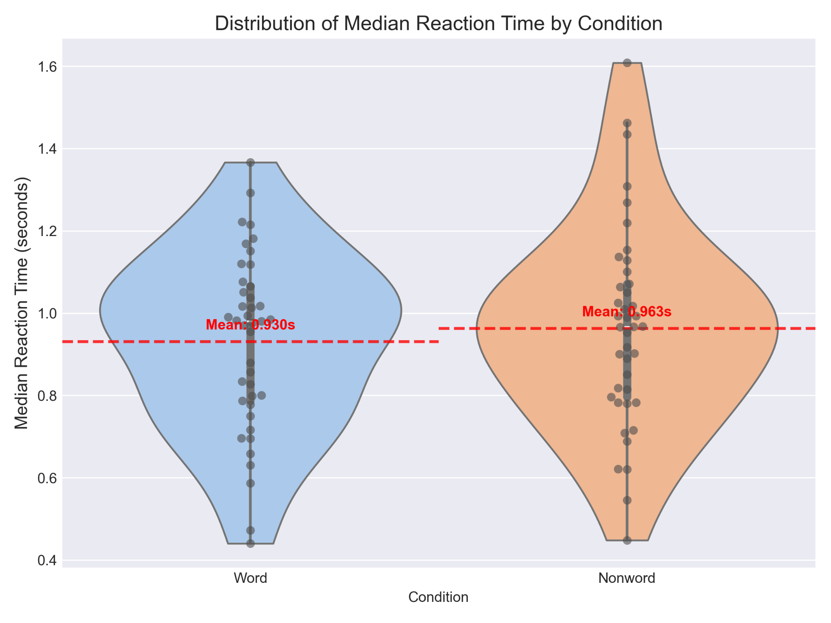

Slide 26
Discussion
Partial Support for Hypothesis:
Reaction time showed the expected word superiority effect
Accuracy did not show a significant difference
Comparing to Original Studies:
Original Reicher (1969) study found accuracy advantages
Our study found mainly reaction time advantages

Slide 27
Discussion
Ceiling Effect:
High accuracy in both conditions (>93%) suggests the task may have been easy for our volunteers, who are used to a high focus on received stimuli.
Longer stimulus presentation time might have allowed for detailed processing
RT differences show processing advantages even when accuracy is at ceiling
Speed-Accuracy Tradeoff:
Participants may have prioritized speed for words but accuracy for non-words
Words might feel more "familiar," leading to faster but occasionally careless responses

Slide 28
Limitations
Task Difficulty:
High accuracy rates suggest task might have been easy
More difficult task might reveal stronger effects
Online Testing:
Less control over viewing conditions and participant attention
Potential for more variability in timing precision

Slide 29
Inference and Conclusion
Partial Word Superiority Effect:
Confirmed for reaction time (faster letter detection in words)
Not observed for accuracy (likely due to ceiling effects)
Theoretical Implications:
Results support the idea that words are processed more efficiently than non-words
Even when accuracy is high, processing speed advantages remain
Consistent with parallel processing and interactive activation models

Slide 30
Future Directions
Exclude the first few trials from the analysis (e.g., first 1–2) — participants often show longer RTs as they are unfamiliar with the task.
Use longer words (8–10 letters): May increase the benefit of word context and strengthen the WSE.

Slide 31
Thank You

