Slide 1

Modelling Player Impact and Game Momentum in Professional Basketball Using Temporal Event Analysis

Slide 2

Introduction (Industry Context & Problem)
Global Sports Growth: Revenues projected to grow from $486.6B (2022) → $623.6B (2027) (Statista, 2023).
Rise of Analytics: From Moneyball (Lewis, 2004) to NBA adoption of data-driven performance strategies.
Player Impact Challenge: Traditional stats (points, plus-minus) miss context (assists, defense, pressure).
Momentum Debate:
Widely referenced in basketball culture.
Academics divided: illusion vs. measurable effect.
Recent studies (Weimer et al., 2023) show causal impact on team scoring.

Slide 3
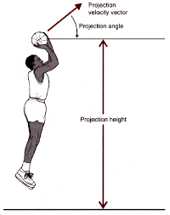
Introduction (Research Focus & Contribution)
Data Source: Event-based NBA logs (scoring plays, fouls, substitutions, rebounds).
Rich temporal & categorical info, but no spatial tracking.
Gap in Literature:
Existing models rely on cumulative stats.
Lack of real-time, sequential context for tactical insights.
This Study Develops:
A temporal event-based framework for basketball analytics.
Methods: change-point detection, unsupervised clustering, temporal feature engineering.
Models to:
Capture player impact holistically.
Detect momentum shifts.
Attribute responsibility to specific players/actions.

Slide 4

Research Problem
Current Limitations: Existing metrics rely on simple summations, ignoring the dynamic and contextual flow of basketball.
Momentum Issue: Widely discussed in practice but poorly defined and quantified, limiting its strategic use.
Research Problem: How to model player impact and game momentum using event-timestamped logs (without spatiotemporal tracking) to capture context, timing, and in-game action flow.
Notes:
The evaluation metrics used to assess performance in basketball currently use some form of summation which ignores the dynamic and contextual intricacies of a game’s flow. Moreover, the notion of momentum which is quite popular among players, coaches, and analysts is defined in a highly vague and is poorly quantified manner which makes it inefficient for strategic planning. The problem is how to effectively model player impact and game momentum using event timestamped data without spatiotemporal tracking: using tracking data that follows the flow of in-game actions, context, and timing. An event-driven approach to analyzing the outcomes of basketball performances could be very useful in reconstructing performance analysis for more effective multi-level strategies.

Slide 5

Aim
To enhance the usefulness of performance data for strategic decision-making by developing an interpretable, temporal, context-aware analytics framework that models player impact and visualises game momentum in professional basketball.

Slide 6

Objectives
Player Impact Modelling: Estimate player impact using advanced temporal, context-aware models that go beyond traditional aggregate metrics by incorporating timing, sequence, and situational context of in-game actions.
Momentum Detection & Visualisation: Detect and quantify momentum shifts using change-point detection and clustering techniques, and present these phases interactively through a dashboard.
Integrated Analysis: Examine the interplay between individual player impact and momentum dynamics, and assess their joint influence on team performance and game outcomes.

Slide 7
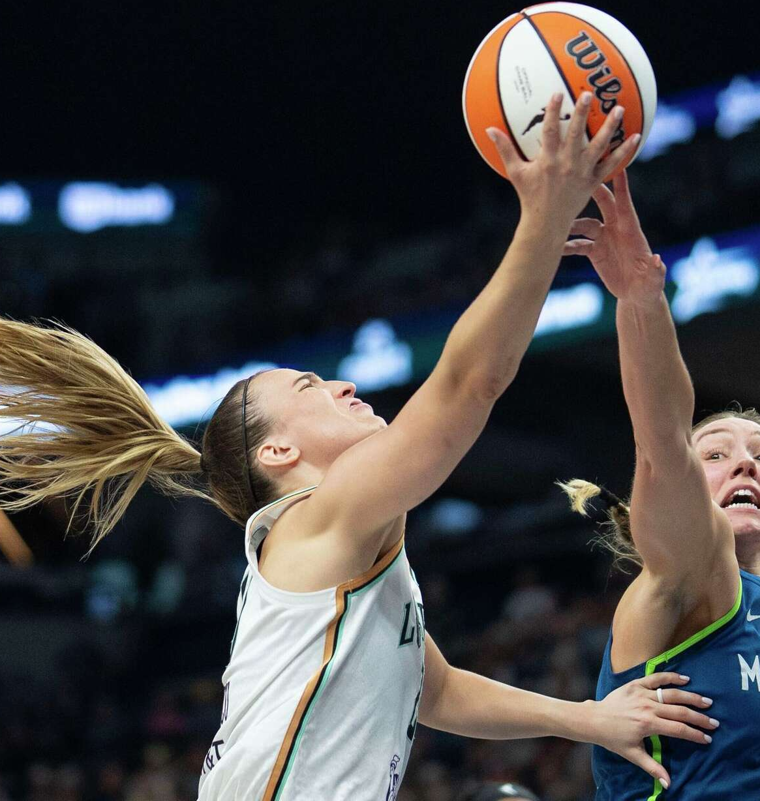
Limitations
Does not include spatiotemporal tracking data (e.g., player positioning, body movement, biomechanics).
Psychological and momentum-related inferences are made indirectly, without direct observation of player states.
Results may have limited generalizability to:
Other sports or leagues with less detailed event-logging systems.
Contexts with different rules, game dynamics, or data availability.

Slide 8
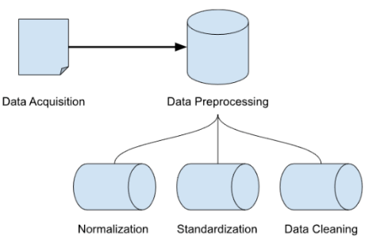
Methodology
Data Acquisition and Preprocessing
Input Data: NBA 2020–21 play-by-play logs. Each record contains timestamp, quarter, player, event type, and play description.
Preprocessing Steps:
Handle missing/null values.
Convert quarter + seconds-left into a unified time axis (total_seconds_elapsed).
Segment games into 15-second intervals for consistent temporal granularity.
Extract player names and standardize event descriptions.

Slide 9

Methodology
Feature Engineering
Features Created:
Contextual features: score differential, quarter, time remaining.
Event-based features: one-hot encoding of event types (shot, rebound, foul, turnover).
Player encodings: binary presence indicators for players on the court.
Rolling metrics: RollingScore and RollingFouls over last 10 events.
Possession features: possession change indicators.

Slide 10
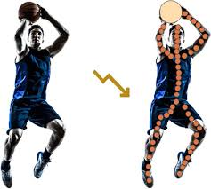
Methodology
Player Impact Estimation
Model 1: LASSO Logistic Regression
Predicts whether a positive outcome (made shot, rebound, or forced turnover) occurs in an interval.
Reasoning: L1 penalty ensures interpretability by shrinking non-informative coefficients to zero.
Libraries: scikit-learn (LogisticRegression, metrics like accuracy_score, f1_score).

Slide 11
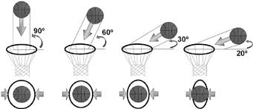
Methodology
Player Impact Estimation
Model 2: XGBoost Classifier
Captures nonlinear interactions between players, score context, and events.
Provides feature importance and SHAP explanations.
Libraries:
xgboost – gradient boosting implementation.
shap – model interpretability through SHAP values.

Slide 12
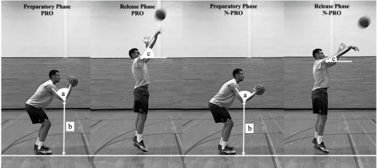
Methodology
Momentum Phase Detection
Bayesian Change-Point Analysis:
Detects structural changes in the score differential time series.
Breakpoints define transitions between positive, negative, and neutral momentum phases.
Libraries: ruptures
Momentum Classification with Random Forests:
Classifies each interval into momentum states using engineered features.
Libraries: scikit-learn (RandomForestClassifier).

Slide 13

Methodology
Model Evaluation and Visualization
Evaluation Metrics: Accuracy, Precision, Recall, F1-score, AUC-ROC.
Visualization:
Player impact curves across games.
Score differential with detected change-points.
Momentum phase overlays.

Slide 14
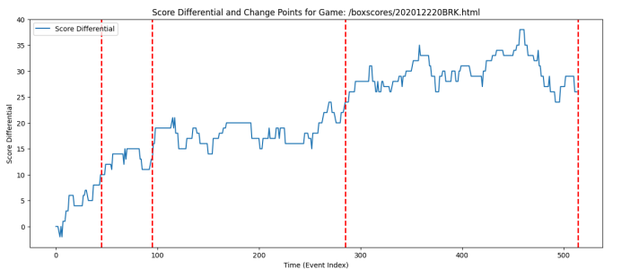
Results Summary
Score Differential and change points for the game using LASSO regularized logistic regression
(For a single game)

Slide 15

Player Impact Insight
LASSO Logistic Regression – Player Impact
Key Contributors Identified: Players like J. Allen and B. Bowen were rewarded for rebounds and shot-making impact.
Negative Signals: Fouls and low-value plays penalized (e.g., K. Blevins, N. Hinton).
Strength: Highly interpretable, sparse, quick.
Limitation: Ignores nonlinear effects and team synergy.
Best Use: Scouting reports, lineup selection, quick evaluations.

Slide 16

Player Impact Insight
XGBoost Classifier – Player Impact
Synergy & Context Captured: Player impact varied depending on teammates, score differential, or clutch moments.
Strengths:
+5% better F1-score than LASSO.
Captures nonlinear interactions.
SHAP values allow interpretability at both player and team level.
Limitations: Less transparent than LASSO, needs careful tuning, heavier computational cost.
Best Use: Richer impact estimation for performance optimization.

Slide 17
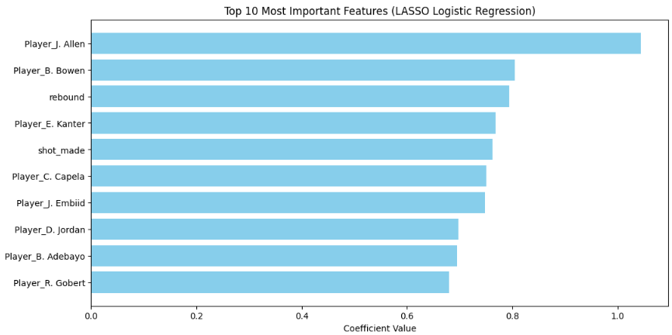
Results Summary

Slide 18
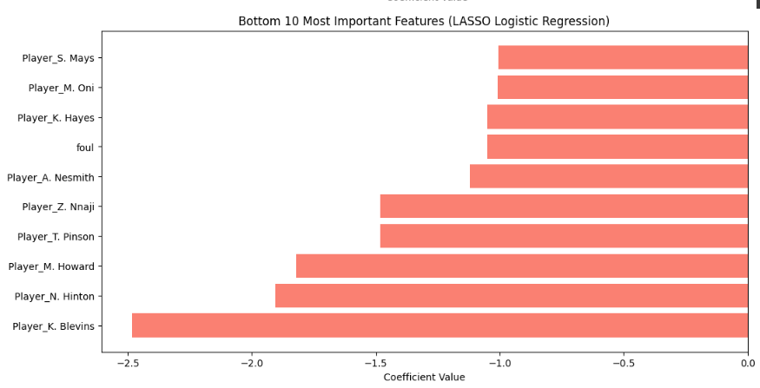
Results Summary

Slide 19
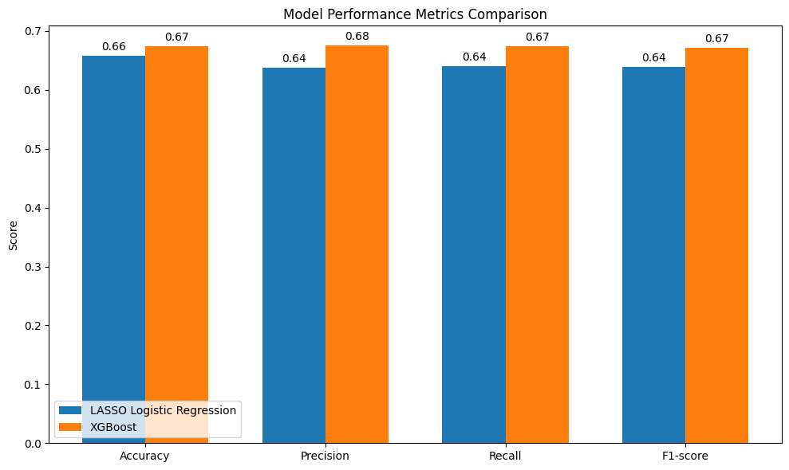
Player Impact Insight

Slide 20

Results Summary
Model | Accuracy | Precision | Recall | F1-Score
LASSO Logistic Regression | 65.76% | 63.76% | 64.07% | 63.91%
XGBoost | 69.84% | 68.92% | 69.30% | 69.11%
Random Forest (Momentum) | 74.59% | 75.80% | 74.59% | 73.06%

Slide 21
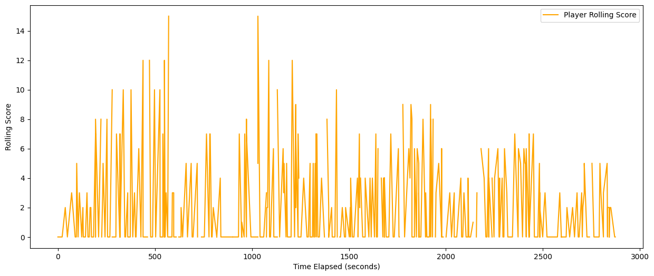
Player Impact Rolling Score for Game

Slide 22
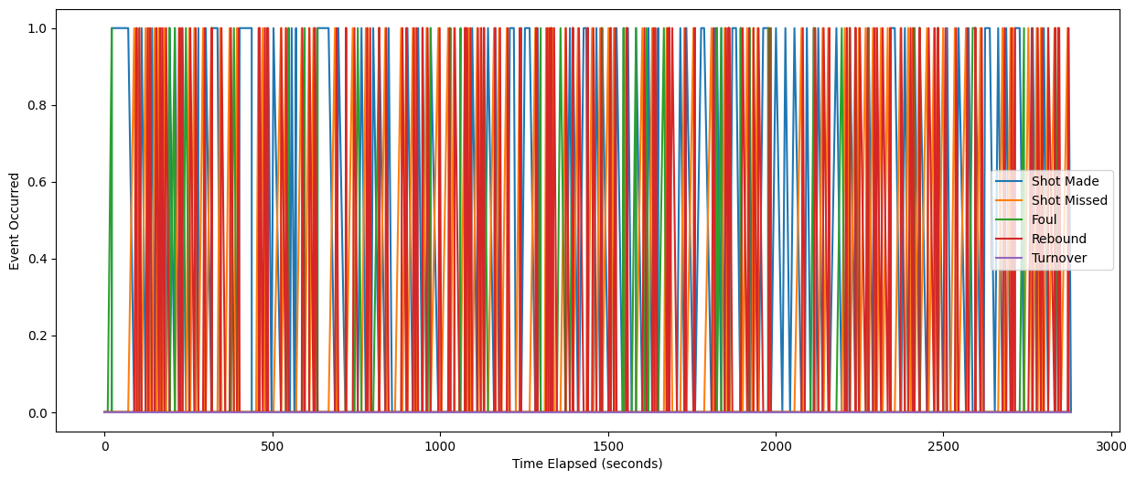
Event Spikes

Slide 23
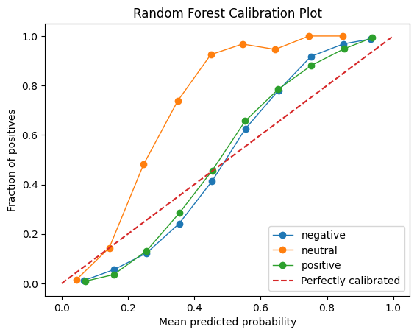
Momentum Phase Classification

Slide 24

Momentum Phase Classification
Random Forest classified momentum into Positive, Negative, Neutral with ~75% accuracy
Key Predictors:
Score Differential & Time Remaining (high importance)
Rolling shot/rebound/foul events (moderate)
Substitutions (lower)

Slide 25

Conclusion
Player Impact Estimation
The LASSO logistic regression model served as a transparent and interpretable baseline, directly linking players and event types to positive or negative outcomes.
The XGBoost classifier improved predictive performance, achieving ~69% F1 compared to ~64% for LASSO. Crucially, it captured non-linear effects such as lineup synergies and context-dependent player performance. SHAP values confirmed the critical influence of rebounds, shot-making, and fouls.
Momentum Phase Classification
Using Bayesian change-point detection and a Random Forest classifier, momentum phases were modelled into positive, neutral, and negative states.
The Random Forest achieved ~74% accuracy, with score differential, time remaining, and rolling metrics emerging as primary drivers of game flow.
Notes:
Player Impact Estimation
The LASSO logistic regression model served as a transparent and interpretable baseline, directly linking players and event types to positive or negative outcomes.
The XGBoost classifier improved predictive performance, achieving ~69% F1 compared to ~64% for LASSO. Crucially, it captured non-linear effects such as lineup synergies and context-dependent player performance. SHAP values confirmed the critical influence of rebounds, shot-making, and fouls.
Momentum Phase Classification
Using Bayesian change-point detection and a Random Forest classifier, momentum phases were modelled into positive, neutral, and negative states.
The Random Forest achieved ~74% accuracy, with score differential, time remaining, and rolling metrics emerging as primary drivers of game flow.

Slide 26

Conclusion
Comparative Insights
Each model addressed different dimensions of the problem: LASSO prioritised interpretability, XGBoost optimised accuracy for player-level analysis, and Random Forests effectively modelled team-level momentum.
Integrating these approaches enabled both micro-level (player impact) and macro-level (team momentum) perspectives, supporting tactical decision-making in professional basketball.

Slide 27
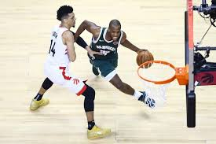

Future Work
Integration of Spatial
Advanced Temporal
Enhanced Player
Real-Time Deployment
Cross-Sport Adaptability
Notes:
Integration of Spatial Data – Incorporating player tracking data to capture spacing, defensive pressure, and off-ball activity.
Advanced Temporal Models – Leveraging sequence models such as LSTMs or Temporal Convolutional Networks to capture long-range dependencies.
Enhanced Player Embeddings – Applying representation learning to discover latent player synergies, matchup tendencies, and context-sensitive roles.
Real-Time Deployment – Extending the Streamlit dashboard into a live system for in-game decision support with real-time alerts.
Cross-Sport Adaptability – Applying the framework to other sports with event-based logging, enabling comparative studies of momentum and player impact.
By integrating LASSO, XGBoost, and Random Forests, this dissertation contributes a multi-layered analytical framework capable of evaluating both individual player contributions and team momentum shifts. Balancing accuracy with interpretability, the work not only advances basketball analytics but also lays the groundwork for future real-time, data-driven decision support systems in professional sports.

Slide 28

Thank you

