Slide 1

Satellite-based optimal sensor placement with autoencoder sensor validation for PM2.5 monitoring in metropolitan areas
Vahid Ghorbani
Term project proposal, AI application course
November, 2022

Slide 2
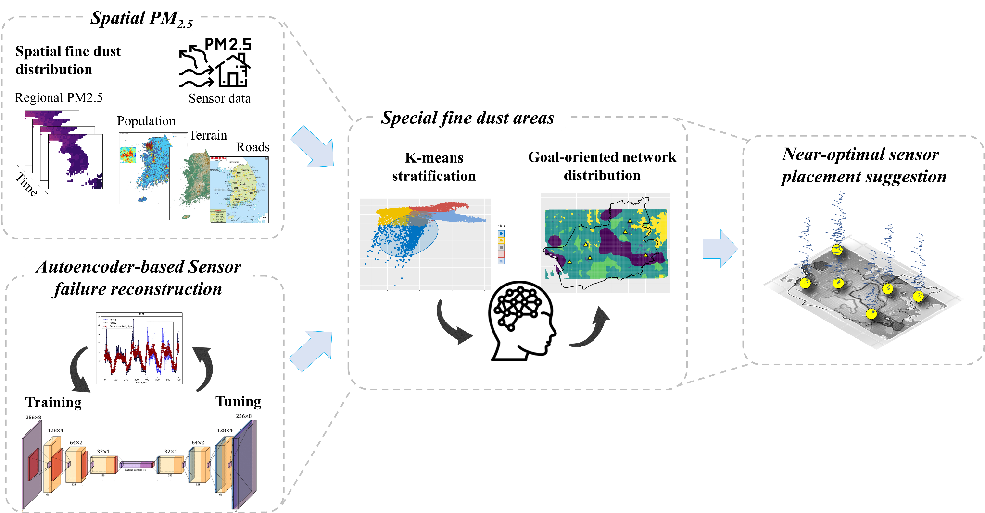
Objectives
To develop a novel near-optimal framework for smart sensor placement suggestion and sensor validation for fine particulate matter monitoring in urban areas.
This newly continuous design framework uses the K-means clustering to identify special areas of sampling by grouping the PM_{2.5} concentrations with local variable similarities. Aside from the suggestion of the new sensor locations, the reconstruction module will catch the behavior of measured data and reconstruct the time series measurements in case of sensor failures.
A novel AE-based sensor validation module offers a worthy tool to monitor broken measurements of the suggested installed sensors by the reliable reconstruction of the particulate matter (PM_{2.5}) concentrations, gaining robust and accurate measurements of the fine particulate.
Fig. 1. Conceptual framework for a near-optimal sensor placement for PM_{2.5} with autoencoders

Slide 3
Background
Ambient air pollution is considered a major environmental risk. According to the World Health Organization (WHO), 4.2 million premature deaths associated with air pollution were registered worldwide in 2016.
Only 10 percent of the countries have designed and installed an air quality monitoring network (AQMN) to determine the fine particulate matter concentrations in the air and the sources focusing on the development of policies to diminish air pollution (Martin et al., 2019).
the accuracy of the fine dust concentrations may suffer due to either a lack of spatial coverage of the air quality monitoring network and the precision of measurement of the sensor devices. . On the other hand, the installation and maintenance of a high number of monitoring stations is costly and associated with many uncertainties (Su et al., 2022).
Sensor measurements may exhibit partial failures such as bias, drifting, complete failure or precision degradation as displayed in Fig. 2. To establish valid research, the measured data from the sensor must be validated before fitting to the model, therefore, we will design and implement a soft sensor validation framework to detect and reconstruct the faulty sensor measurements. Various kinds of autoencoder architectures have been employed for anomaly detection in different tasks such as faulty sensor detection and reconstruction of data.

Slide 4
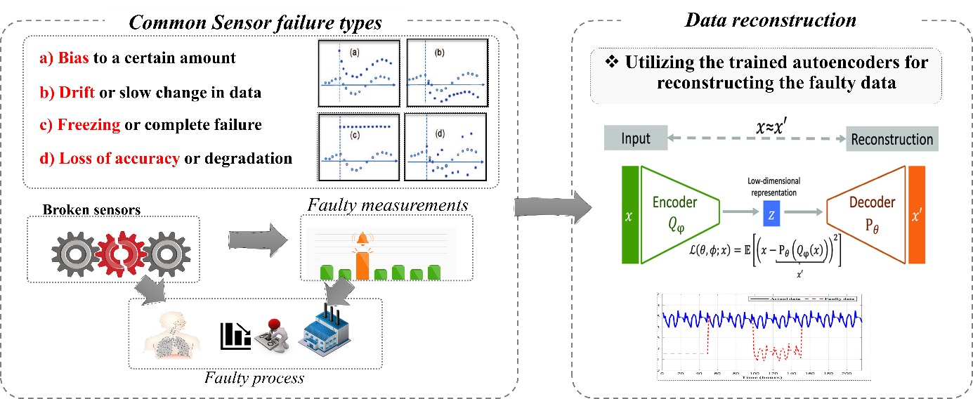
Sensor failure
Sensor’s failures could reduce the accuracy and reliability of the measurement, which may result in an erroneous action and false perception on the performance of the system.
Faulty sensors that are either completely or partially failed (hard fault or soft fault) could provide incorrect information for monitoring and control. This can be detrimental to various data-driven decision schemes. Moreover, data may not be available due to sensor malfunction or communication problems within the data collection system. These problems could make it difficult to extract and interpret information from data. As a result, making decisions based on incorrect measurements would become problematic (Xayasouk et al., 2020).
Fig. 2. Employing AEs to detect and reconstruct four common types of sensor faults: bias, drifting, complete failure, and precision degradation.

Slide 5
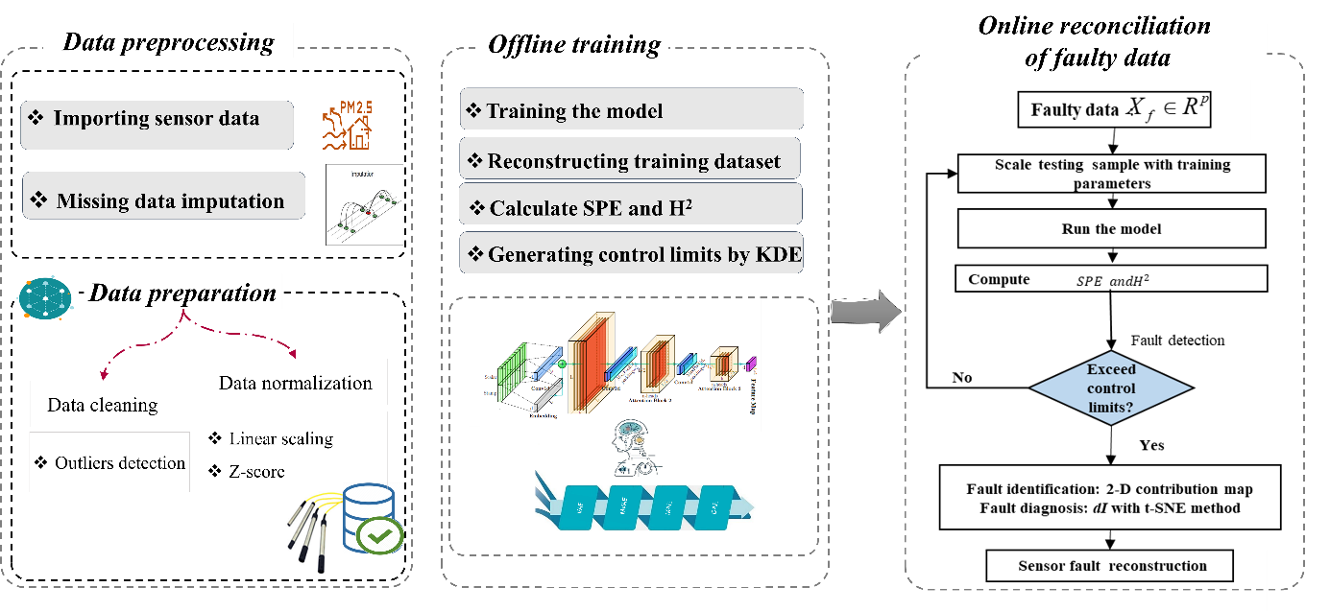
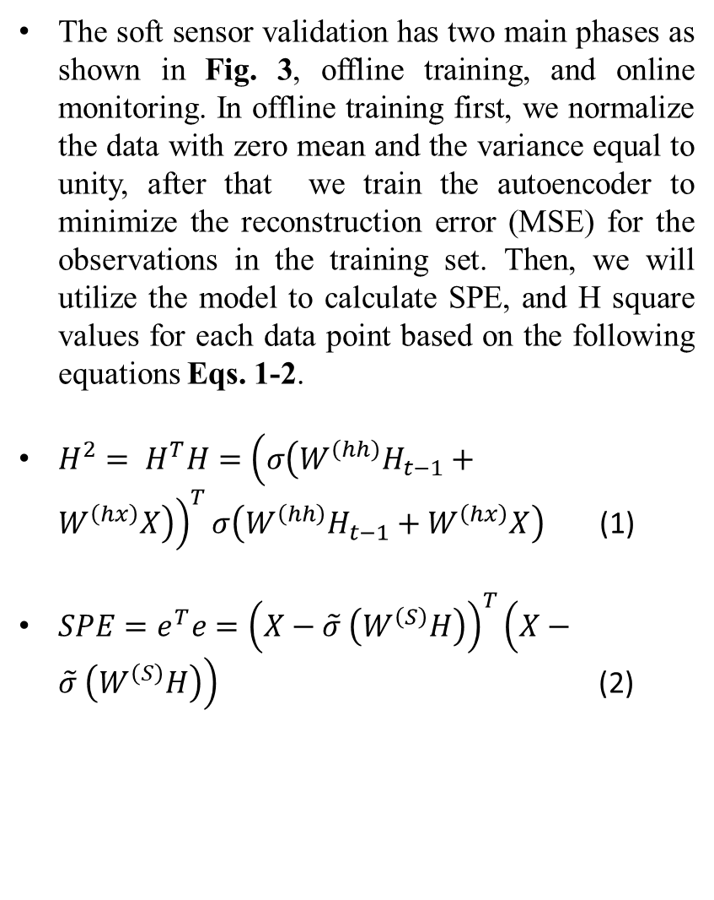
Sensor validation framework
The soft sensor validation has two main phases as shown in Fig. 3, offline training, and online monitoring. In offline training first, we normalize the data with zero mean and the variance equal to unity, after that we train the autoencoder to minimize the reconstruction error (MSE) for the observations in the training set. Then, we will utilize the model to calculate SPE, and H square values for each data point based on the following equations Eqs. 1-2.
$H^{2}= H^{T}H={\left(σ\left(W^{\left(hh\right)}H_{t−1}+W^{\left(hx\right)}X\right)\right)}^{T}σ\left(W^{\left(hh\right)}H_{t−1}+W^{\left(hx\right)}X\right)$ (1)
$SPE=e^{T}e={\left(X−\tilde{σ} \left(W^{\left(S\right)}H\right)\right)}^{T}\left(X−\tilde{σ} \left(W^{\left(S\right)}H\right)\right)$ (2)
Fig. 3. Autoencoder-based soft sensor validation framework for reconstructing faulty measurements

Slide 6
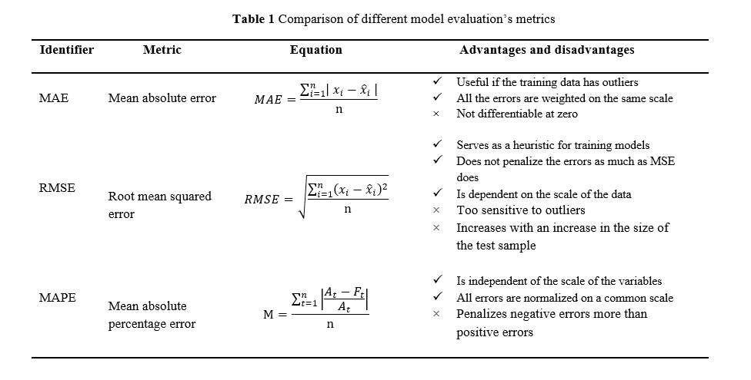
Performance measurements
Table1 illustrates each metric’s advantages and disadvantages. Here, the MAE, RMSE and MAPE are proposed to evaluate the model performance.
Some test scenarios will be generated to ensure the model performs well in different situations.

Slide 7
References
[1] Alsahli, M. M., & Al-Harbi, M. (2018). Allocating optimum sites for air quality monitoring stations using GIS suitability analysis. Urban Climate, 24, 875–886. https://doi.org/10.1016/J.UCLIM.2017.11.001
[2] Hammer, M. S., Van Donkelaar, A., Li, C., Lyapustin, A., Sayer, A. M., Hsu, N. C., Levy, R. C., Garay, M. J., Kalashnikova, O. V., Kahn, R. A., Brauer, M., Apte, J. S., Henze, D. K., Zhang, L., Zhang, Q., Ford, B., Pierce, J. R., & Martin, R. V. (2020). Global Estimates and Long-Term Trends of Fine Particulate Matter Concentrations (1998-2018). Environmental Science and Technology, 54(13), 7879–7890. https://doi.org/10.1021/ACS.EST.0C01764/ASSET/IMAGES/LARGE/ES0C01764_0007.JPEG
[3] Martin, R. V., Brauer, M., van Donkelaar, A., Shaddick, G., Narain, U., & Dey, S. (2019). No one knows which city has the highest concentration of fine particulate matter. Atmospheric Environment: X, 3, 100040. https://doi.org/10.1016/J.AEAOA.2019.100040
[4] Masood, A., & Ahmad, K. (2021). A review on emerging artificial intelligence (AI) techniques for air pollution forecasting: Fundamentals, application and performance. Journal of Cleaner Production, 322, 129072. https://doi.org/10.1016/J.JCLEPRO.2021.129072
[5] Su, L., Gao, C., Ren, X., Zhang, F., Cao, S., Zhang, S., Chen, T., Liu, M., Ni, B., & Liu, M. (2022). Understanding the spatial representativeness of air quality monitoring network and its application to PM2.5 in the mainland China. Geoscience Frontiers, 13(3), 101370. https://doi.org/10.1016/J.GSF.2022.101370
[6] Sun, C., Li, V. O. K., Lam, J. C. K., & Leslie, I. (2019). Optimal Citizen-Centric Sensor Placement for Air Quality Monitoring: A Case Study of City of Cambridge, the United Kingdom. IEEE Access, 7, 47390–47400. https://doi.org/10.1109/ACCESS.2019.2909111
[7] Xayasouk, T., Lee, H., & Lee, G. (2020). Air Pollution Prediction Using Long Short-Term Memory (LSTM) and Deep Autoencoder (DAE) Models. Sustainability 2020, Vol. 12, Page 2570, 12(6), 2570. https://doi.org/10.3390/SU12062570
[8] Zhang, Y., Li, Z., Chang, W., Zhang, Y., de Leeuw, G., & Schauer, J. J. (2020). Satellite Observations of PM2.5 Changes and Driving Factors Based Forecasting Over China 2000–2025. Remote Sensing 2020, Vol. 12, Page 2518, 12(16), 2518. https://doi.org/10.3390/RS12162518

Slide 8


