Slide 1

Research Progress: Proposed Model
Vahid Ghorbani
November 25th , 2022

Slide 2
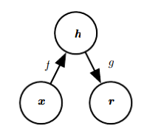
Background & Motivation
An autoencoder is a neural network that is trained to attempt to copy its input. Internally, it has a hidden layer h that describes a code used to represent the input. The network may be viewed as consisting of two parts: an encoder function h = f(x) and a decoder that produces a reconstruction r = g(h).
If an autoencoder succeeds in simply learning to set g(f(x)) = x everywhere, then it is not especially useful. Instead, autoencoders are designed to be unable to learn to copy perfectly.
Instead, we hope that training the autoencoder to perform the input copying task will result in h taking on useful properties.
Usually they are restricted in ways that allow them to copy only approximately, and to copy only input that resembles the training data.
The general structure of an autoencoder, mapping an input x to an output (called reconstruction) r through an internal representation or code h. The autoencoder has two components: the encoder f (mapping x to h) and the decoder g (mapping h to r)

Slide 3
Cont’d
Undercomplete autoencoders: One way to obtain useful features from the autoencoder is to constrain h to have smaller dimension than x. An autoencoder whose code dimension is less than the input dimension is called undercomplete.
Learning an undercomplete representation forces the autoencoder to capture the most salient features of the training data.
L(x, g(f(x)))
where L is a loss function penalizing g(f(x)) for being dissimilar from x, such as the mean squared error.
If the encoder and decoder are allowed too much capacity, the autoencoder can learn to perform the copying task without extracting useful information about the distribution of the data.
A similar problem occurs if the hidden code is allowed to have dimension equal to the input, and in the overcomplete case in which the hidden code has dimension greater than the input. In these cases, even a linear encoder and linear decoder can learn to copy the input to the output without learning anything useful about the data distribution.
So, how can we tackle this problem?
Using regularizer.

Slide 4


Cont’d
A regularized autoencoder can be nonlinear and overcomplete but still learn something useful about the data distribution even if the model capacity is great enough to learn a trivial identity function.
Regularized autoencoders use a loss function that encourages the model to have other properties besides the ability to copy its input to its output. These other properties include sparsity of the representation, smallness of the derivative of the representation, and robustness to noise or to missing inputs.
Regulaized autoencoders:
Sparse Autoencoders:
Loss function: L(x, g(f(x))) + Ω(h)
Contractive autoencoders:
Loss function: L(x, g(f(x))) + Ω(h)
Denoising Autoencoders: Rather than adding a penalty Ω to the cost function, we can obtain an autoencoder that learns something useful by changing the reconstruction error term of the cost function.
Loss function: L(x, g(f(x)))
Sparsity penalty
Is the squared Frobenius norm (sum of squared elements) of the
Jacobian matrix of partial derivatives associated with the encoder function
L(x, g(f($\tilde{x}$)))

Slide 5
Models
Advantages and disadvantages of different types of autoencoders.
First, I have considered 5 different types of autoencoders:
AE: As a baseline model (typical undercomplete autoencoder).
DAE: Denoising autoencoder.
VAE: Variational autoencoder.
MemAE: Memory augmented autoencoder.
MVAE: Memory augmented variational autoencoder.
Finally, proposed an “integrated” autoencoder which has the constrains of all above models to learn the distribution od data.

Slide 6
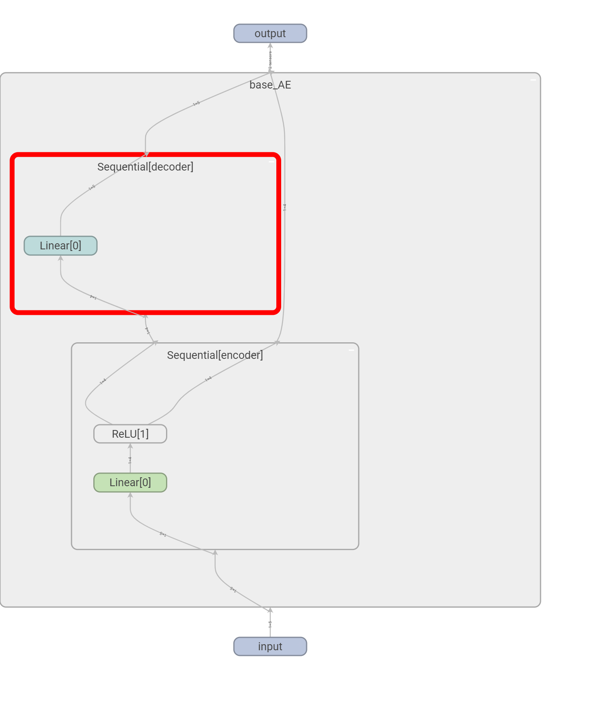
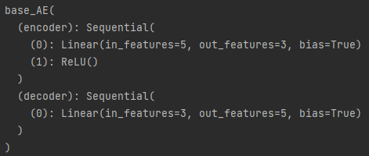
Models’ structure (AE, DAE)
Model structure printed in console
Model structure generated by tensorboard

Slide 7
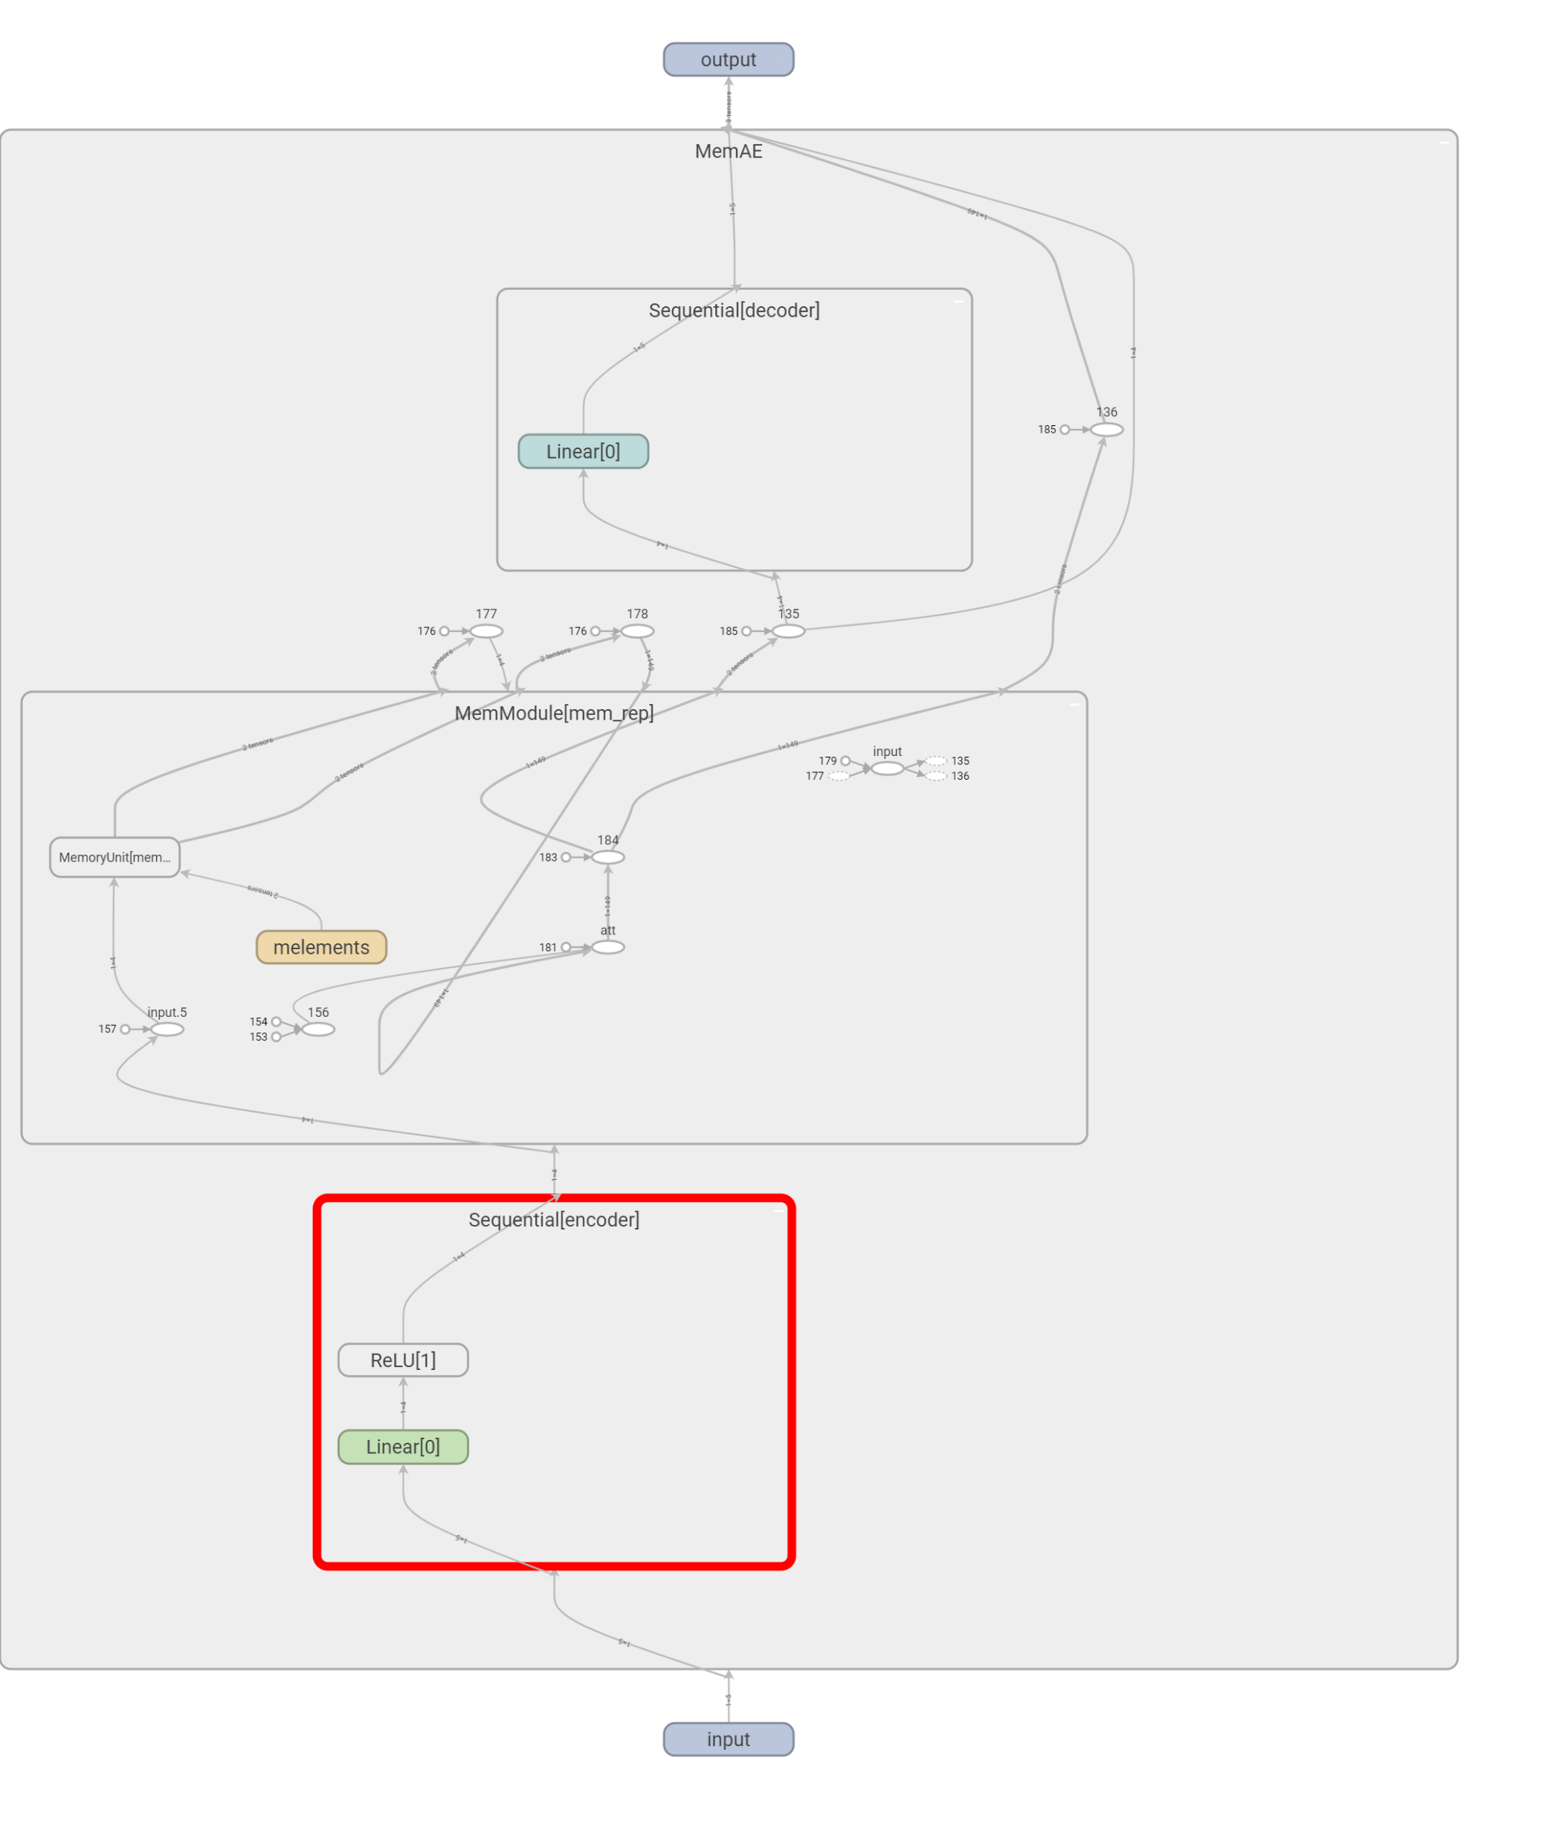
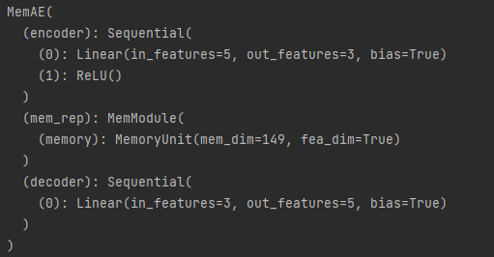
Models’ structure (MemAE)
Model structure printed in console
Model structure generated by tensorboard

Slide 8
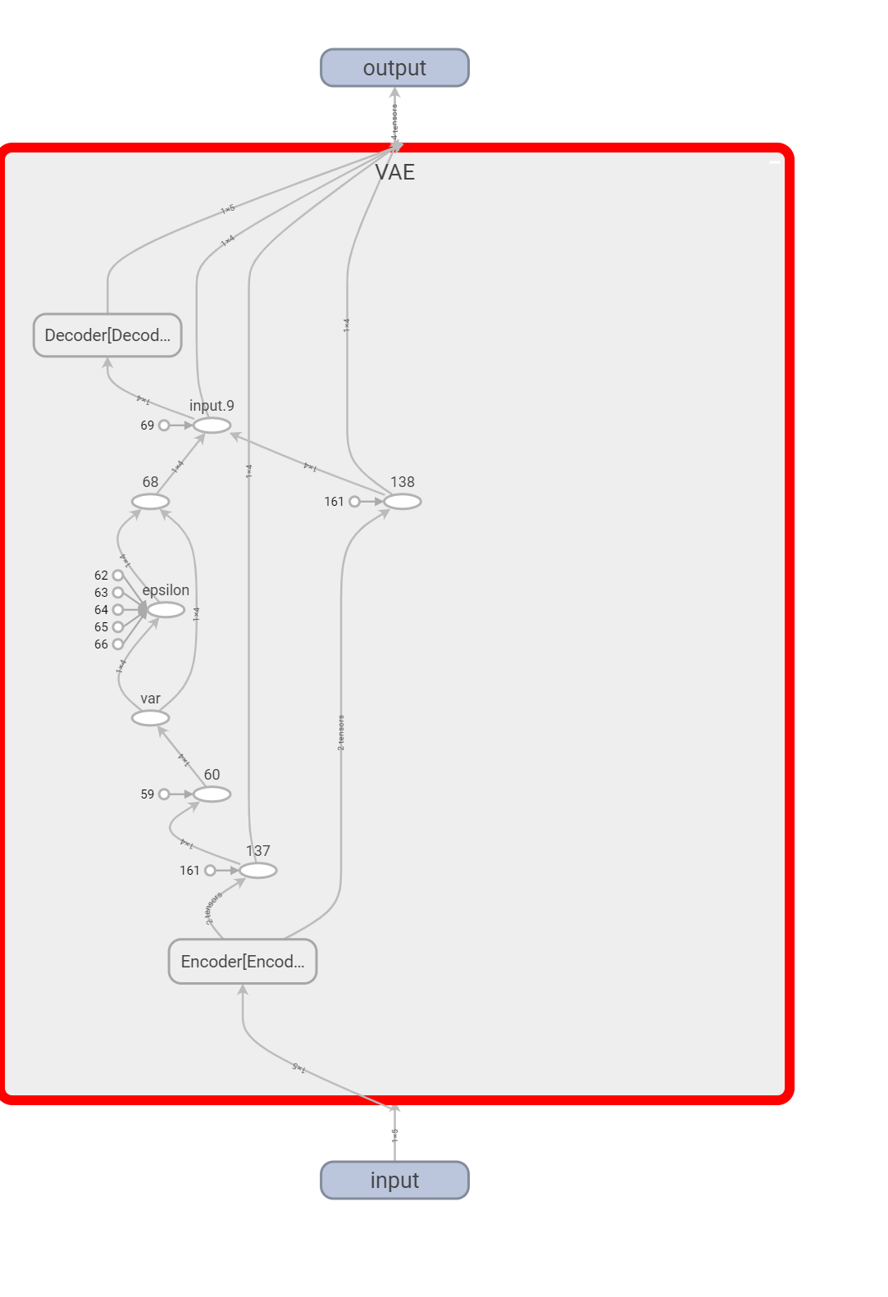
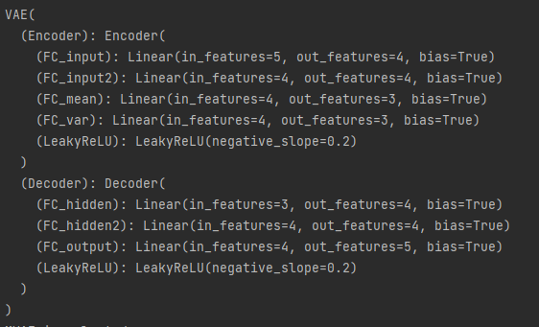
Models’ structure (VAE)
Model structure printed in console
Model structure generated by tensorboard

Slide 9
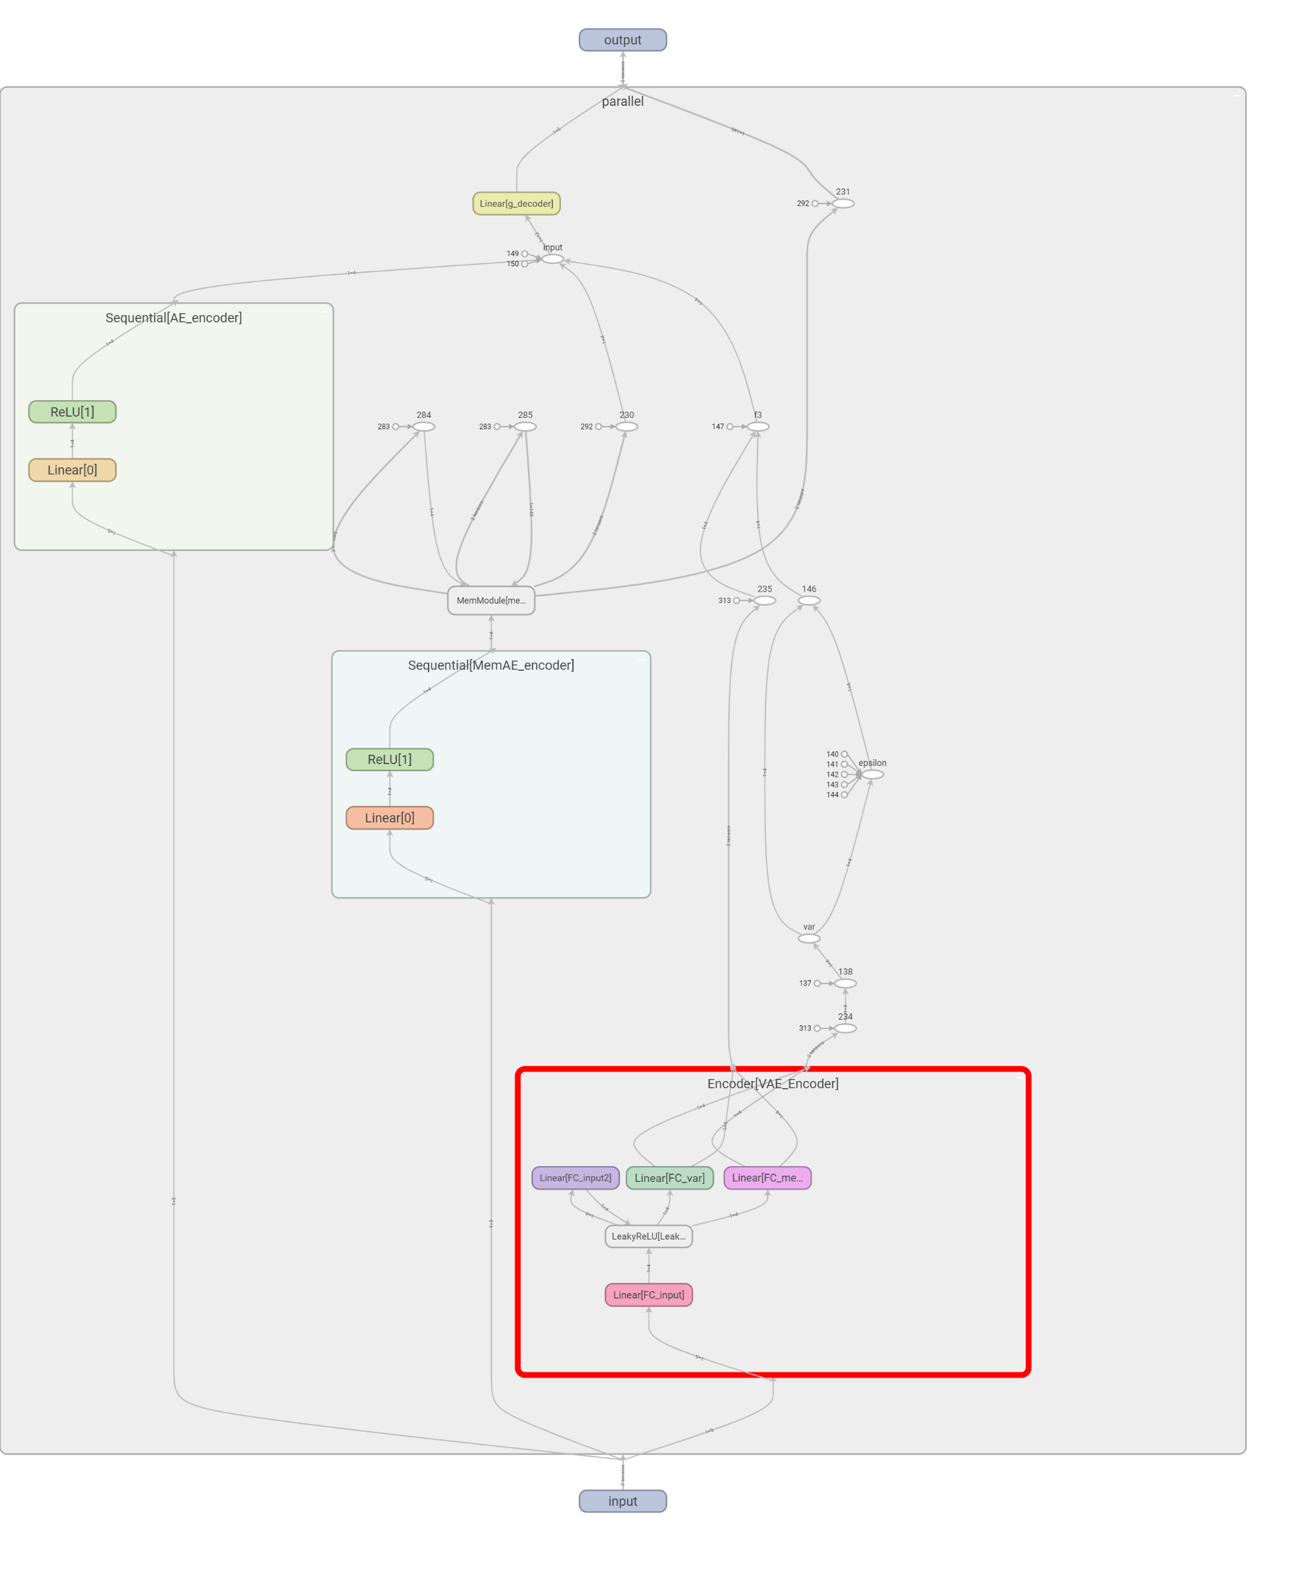
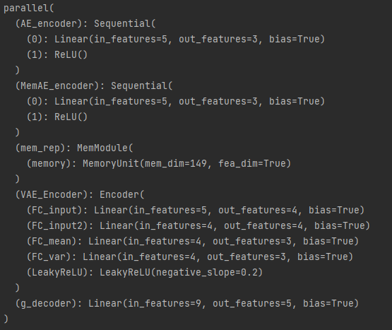
Models’ structure (proposed model)
Model structure generated by tensorboard
Model structure generated by tensorboard

Slide 10
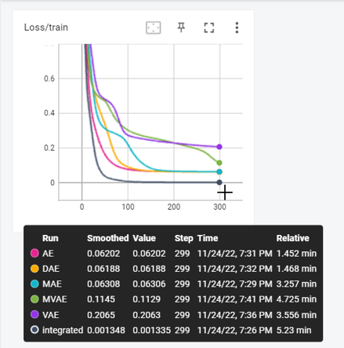
Training the models
Training each model on training data set (2 month data from platform)
5 Features (dimension): PM25, PM10, CO2, Temp, Humidity.
Training the models for 300 epochs.
7142 samples (data point).
Loss curves for each model during training generated by tensorbaord

Slide 11
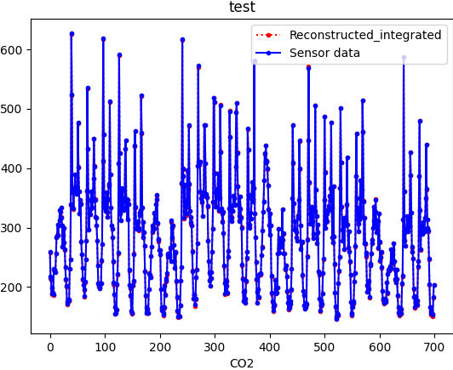
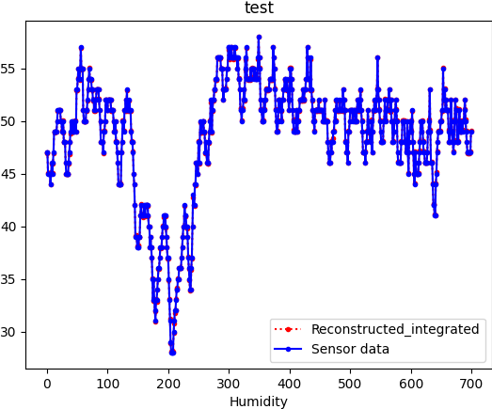
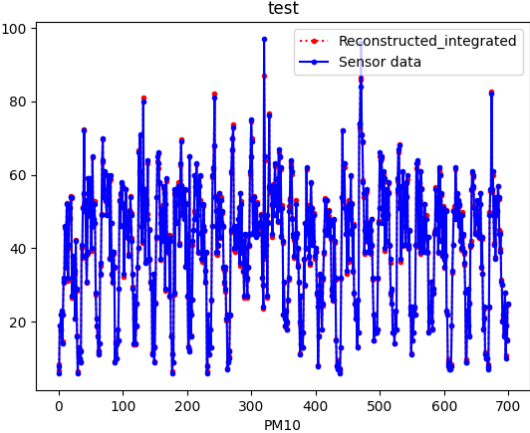
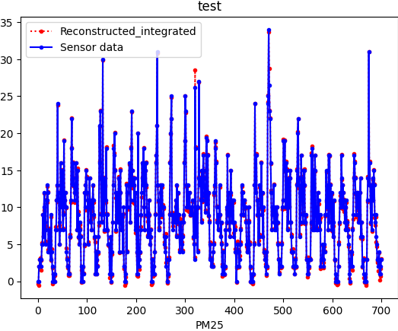
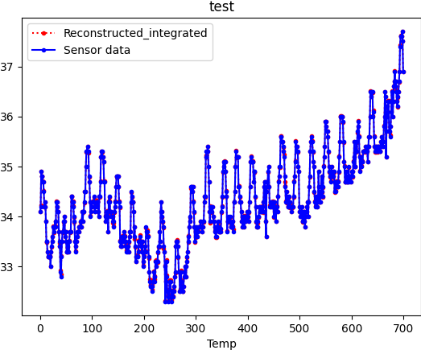
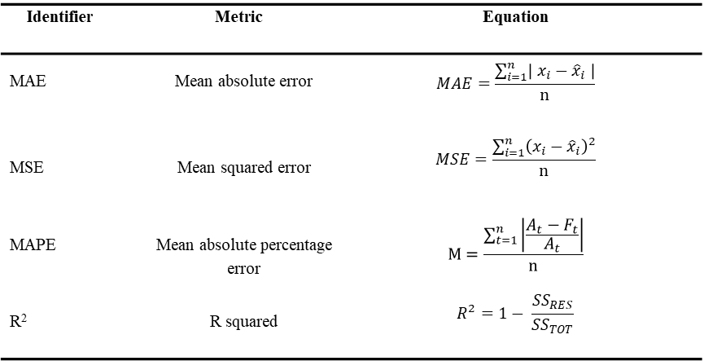
Testing
1786 samples (data point) for testing (normal data).
Four metrics were utilized to measure the reconstruction error of each model as below:
Model evaluation’s metrics
Identifier | Metric | Equation
MAE | Mean absolute error | $$MAE=\frac{\sum_{i=1}^{n}{\left| x_{i}−{\hat{x}}_{i} \right|}}{n}$$
MSE | Mean squared error | $$MSE=\frac{\sum_{i=1}^{n}{{\left(x_{i}−{\hat{x}}_{i}\right)}^{2}}}{n}$$
MAPE | Mean absolute percentage error | $$M=\frac{\sum_{t=1}^{n}{\left|\frac{A_{t}−F_{t}}{A_{t}}\right|}}{n}$$
R² | R squared | $$R^{2}=1− \frac{{SS}_{RES}}{{SS}_{TOT}}$$
Performance evaluation of MAE, AE, DAE, VAE, and MVAE on normal test data
Model\Performance measurement | MSE | RR | MAE | MAPE
MAE | 284.2620 | 0.9294 | 6.4921 | 15.4087
AE | 274.5918 | 0.9312 | 6.3981 | 11.0444
DAE | 274.5249 | 0.9304 | 6.4014 | 10.6129
VAE | 338.3720 | 0.7331 | 8.0319 | 16.5869
MVAE | 393.8235 | 0.8581 | 7.6866 | 9.8758
Integrated | 0.2739 | 0.9993 | 0.2790 | 2.1873
Reconstruction of normal test data for the integrated model

Slide 12
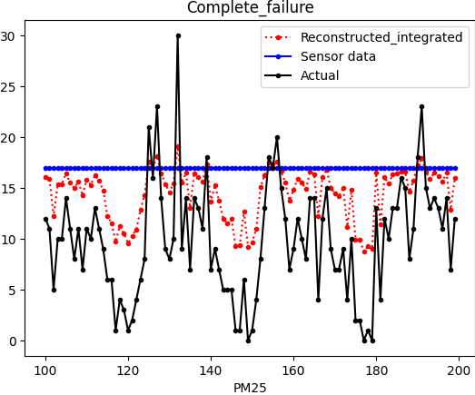
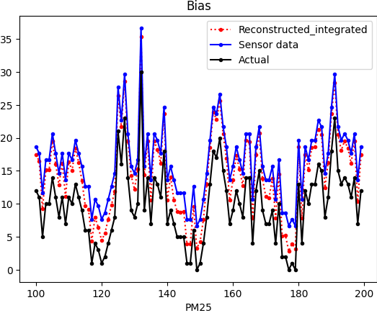
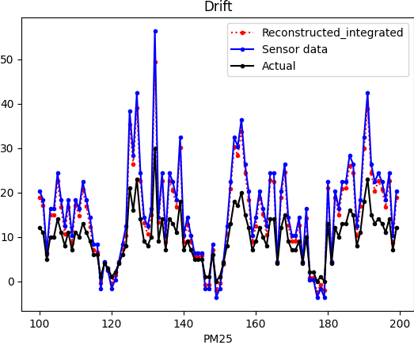
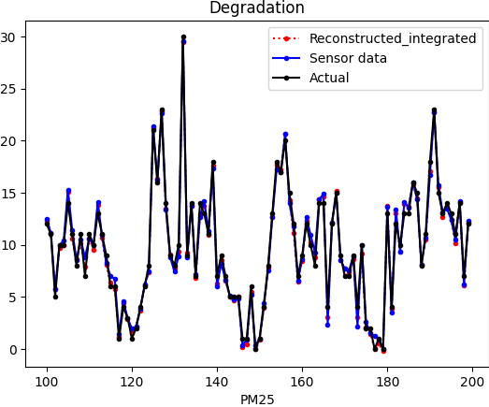
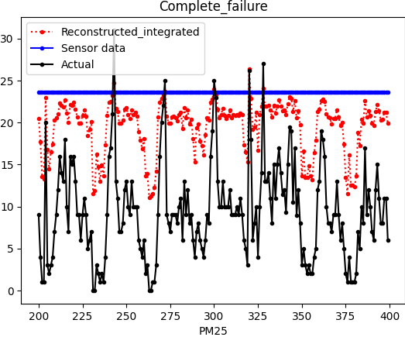
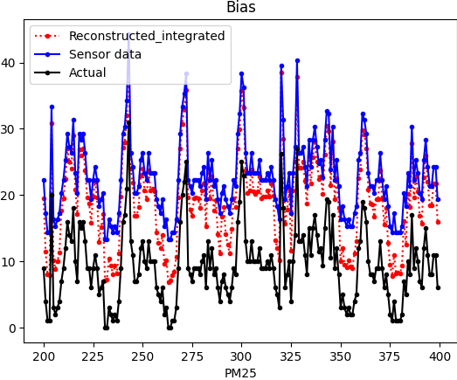
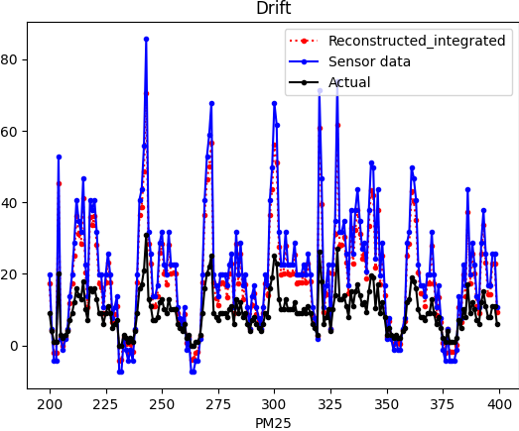
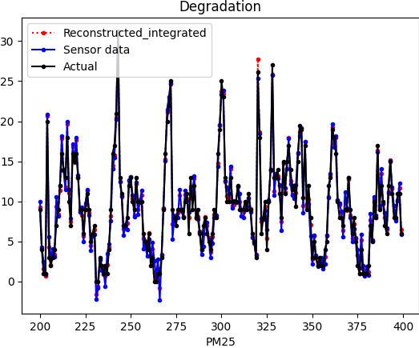
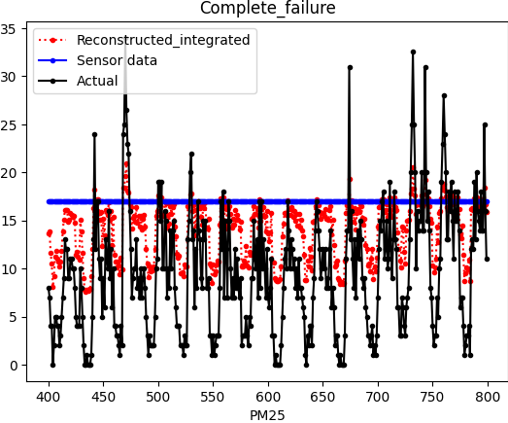
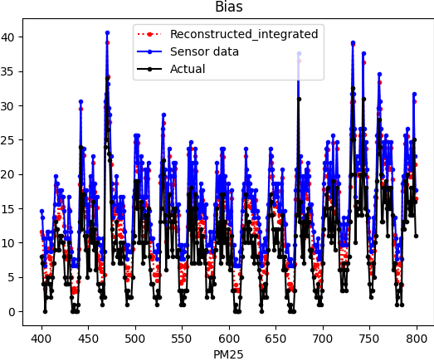
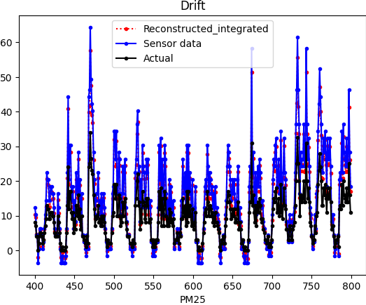
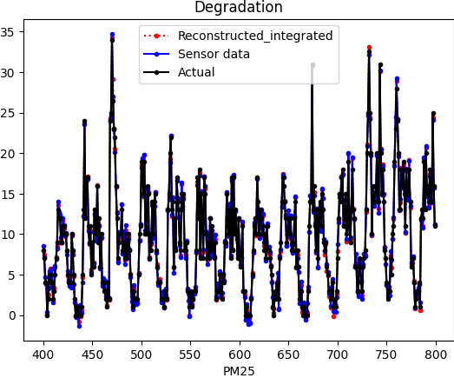
Testing the proposed model on different sensor failures types
Complete Failure
Bias
Drift
Degradation
Four common sensor failure (complete failure, bias, drift, degradation) were considered with different fault magnitudes, and fault sizes.
Only the faulty sensor is plotted here.

Slide 13


