Slide 1
Data Mining presentation
WQD180001

Slide 2
OUTLINE
Introduction
Problem Statement
Methodology
Data Analysis
Results and Recommendations

Slide 3
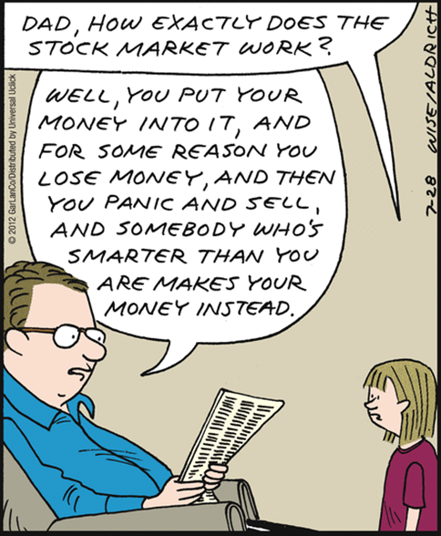
Introduction
Stock market trends:
Government Effect (foreign, monetary policies, …)
International Effect (tariffs, deals, energy & metal price, …)
Participant Effect
Supply and Demand Effect
Is tied to the type of News that are issued

Slide 4

Problem statement
Gold price
Oil price
Stock Price
Gas price
Silver price
News

Slide 5
Methodology
Get data
Clean and normalize data
Analyze data
Build model
Results & Recommendations

Slide 6
Results and recommendations
different sectors have different set of correlations between market forces and stock prices
For example, while there is positive correlation between stock and gold price of famous companies in LOAN sector, this relationship is negatively correlated in MAIN sector
more interestingly, within the same sector, the correlation between market forces and stock values varies.

Slide 7
Results and recommendations
While the content of news (positive or negative) can affect PETRONAS stock values, it was not the case for AIRASIA and CIMBBANK bodies.
it is recommended that PETRONAS should invest more on activities that are environmentally more friendly, participate in charity exhibition, get more involved in community and …
Based on our analysis, AIRASIA and CIMBBANK bodies should be more focused on international trends, energy price rather than their public faces.

Slide 8
Thank you

Slide 11
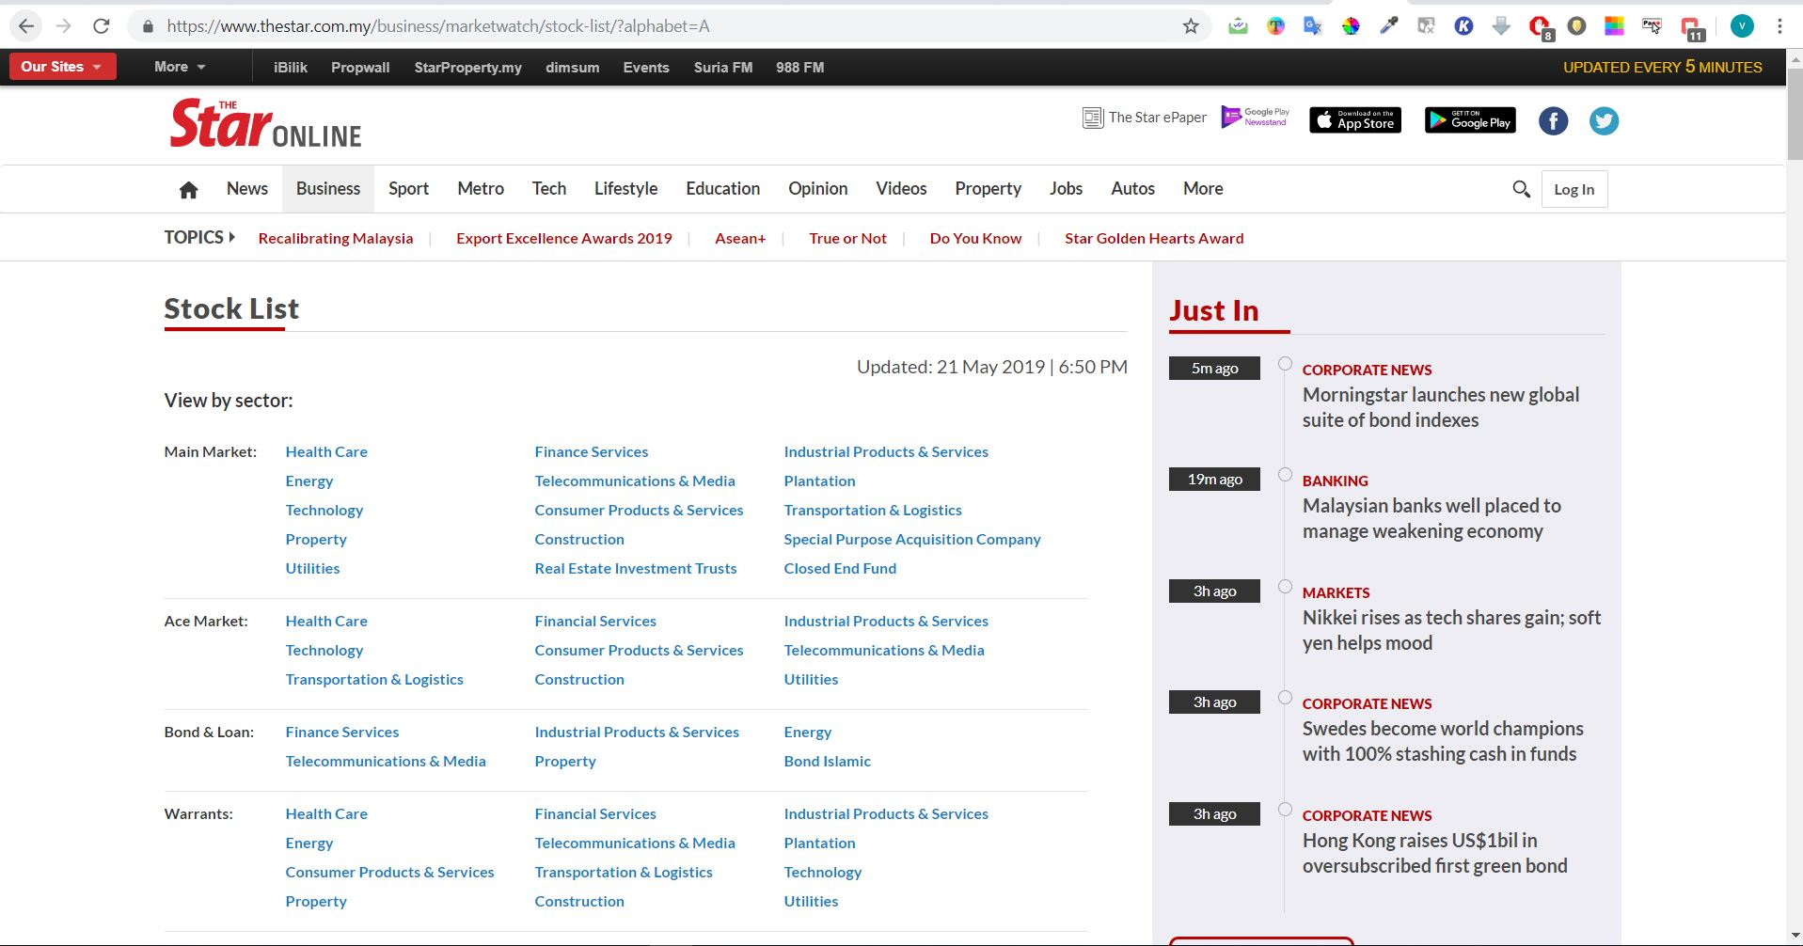
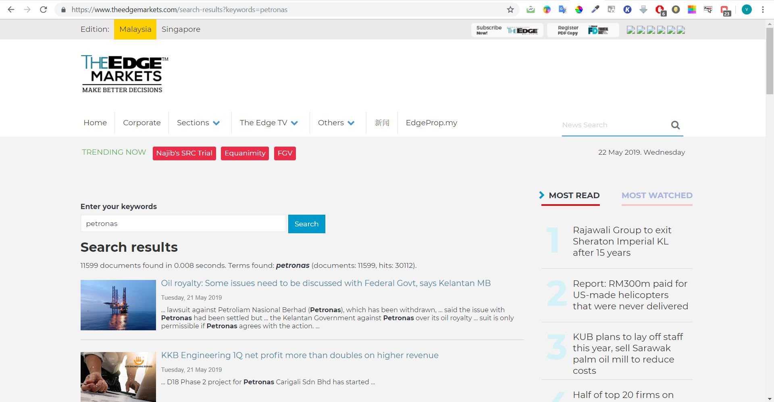
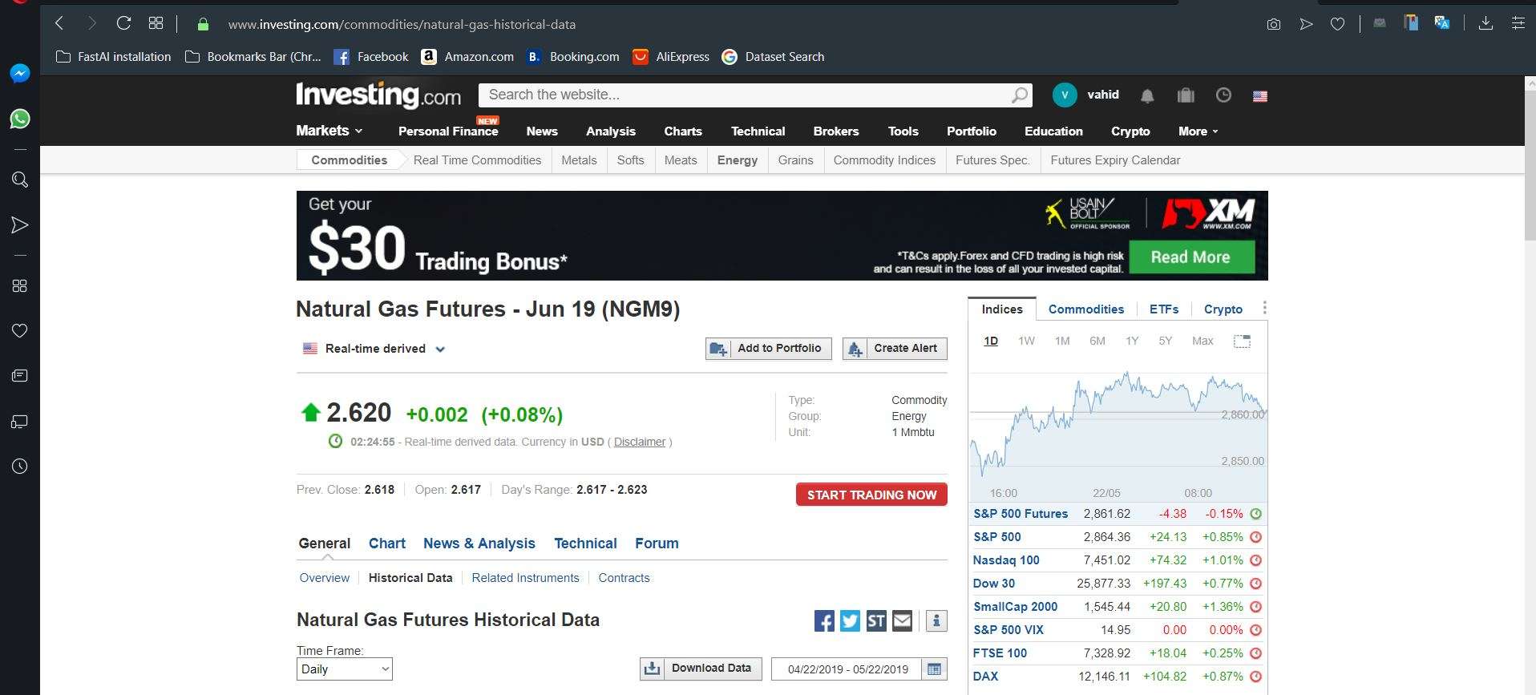
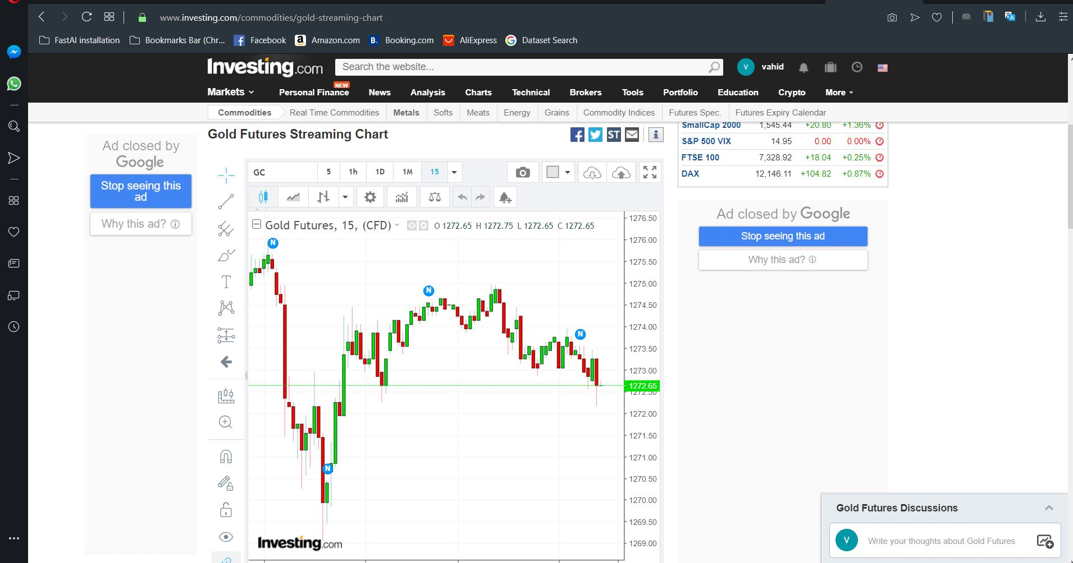
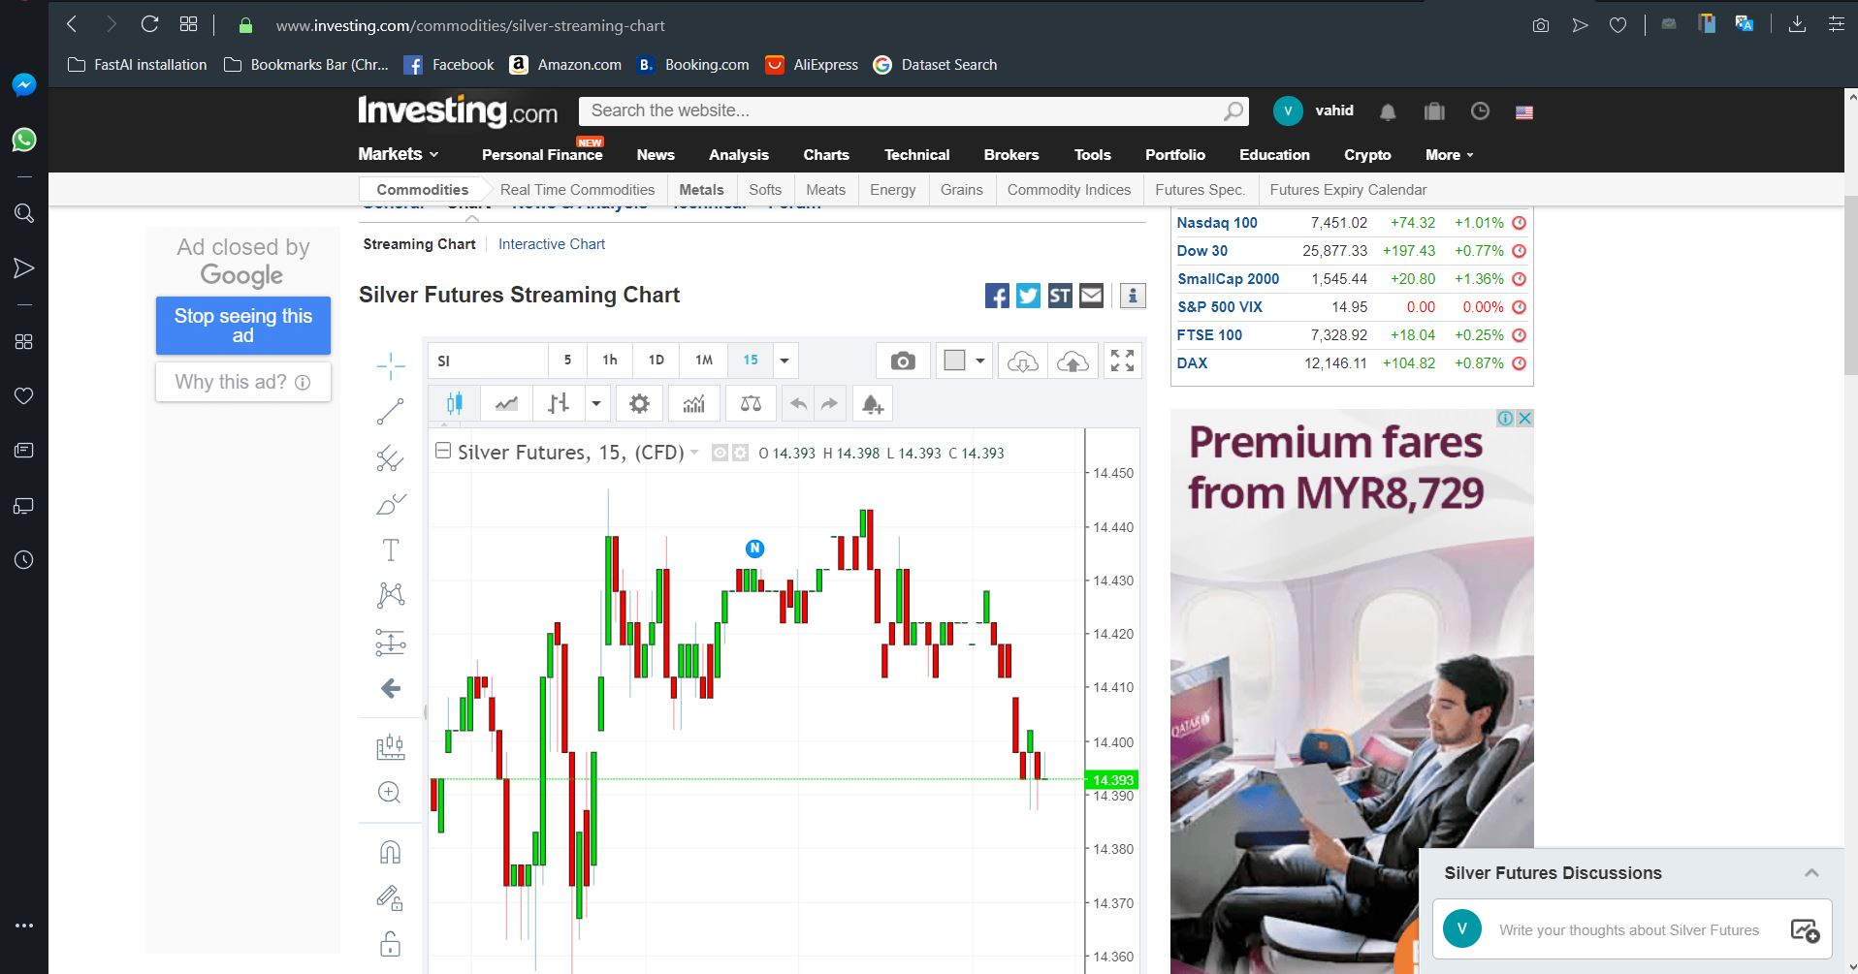
Appendix 1

Slide 12
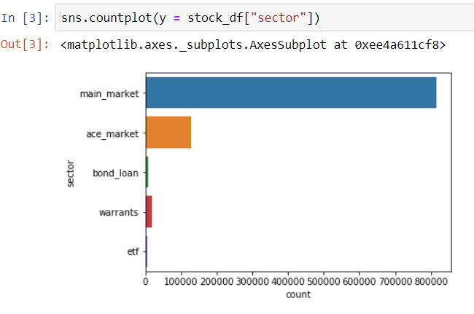
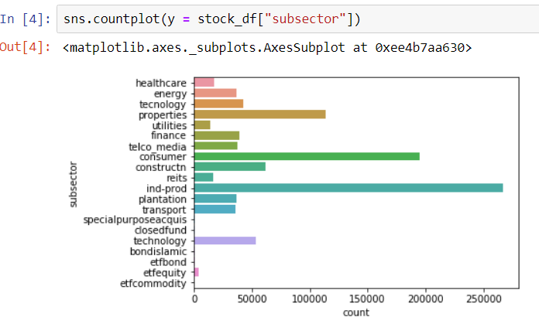
Quantitative analysis
General overview

Slide 13
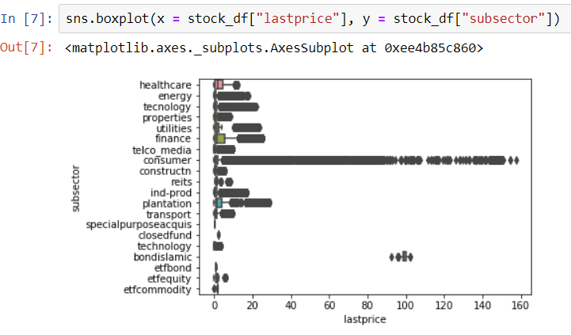
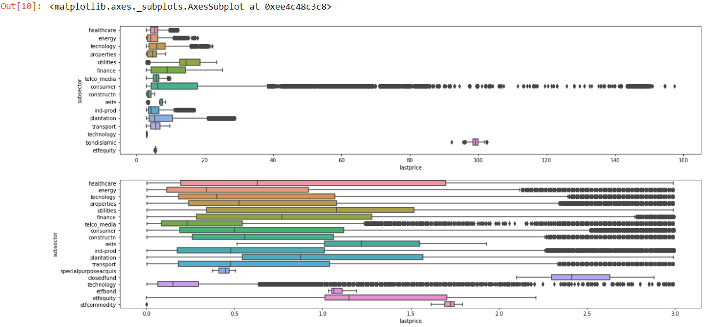
Quantitative analysis
Outlier handling

Slide 14
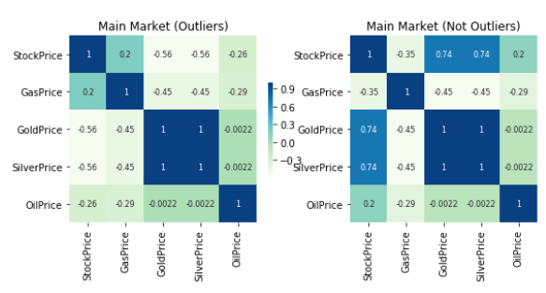
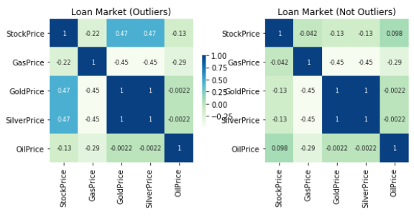
Quantitative analysis

Slide 15
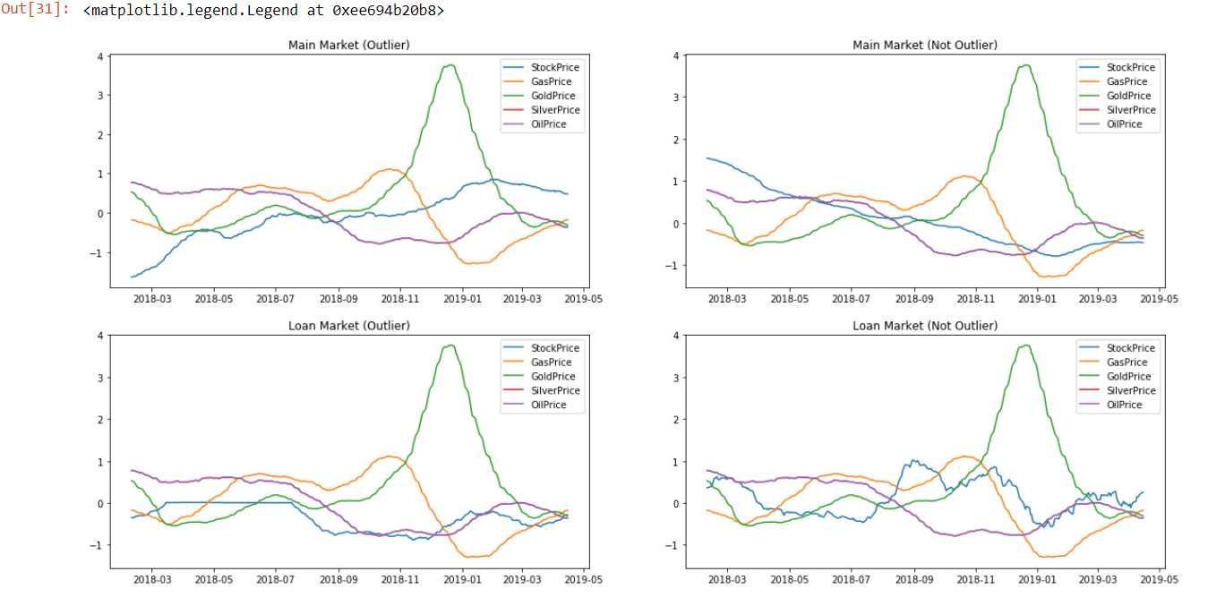
Quantitative analysis

Slide 16
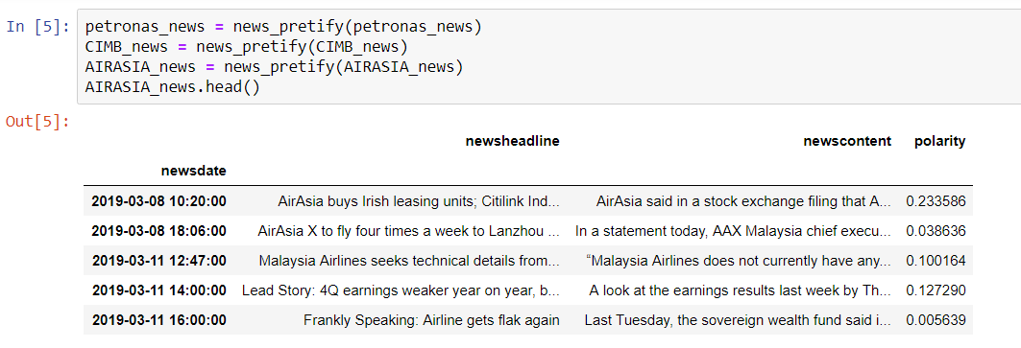
Qualitative analysis
News data

Slide 17
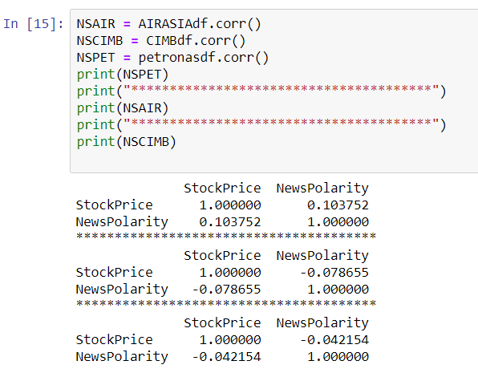
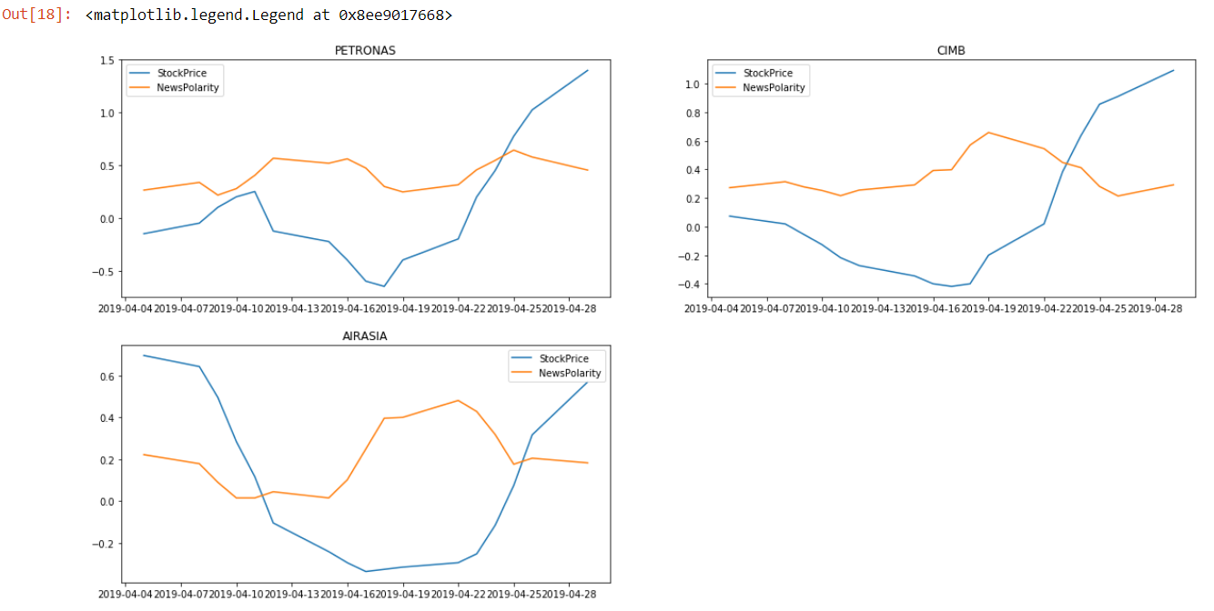
Qualitative analysis

Slide 18
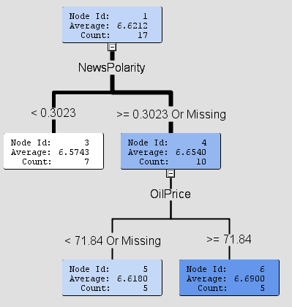
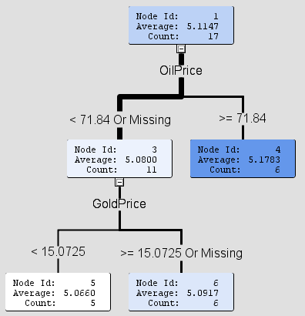
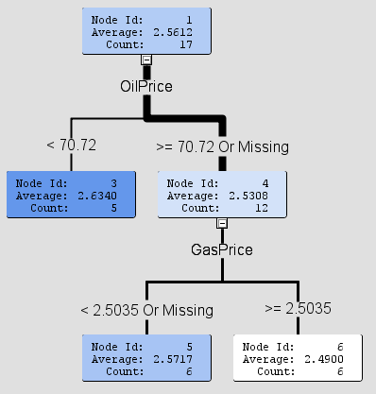


Build a model
Decision tree

