Slide 1

AI for Environmental and Marine Science

Slide 2
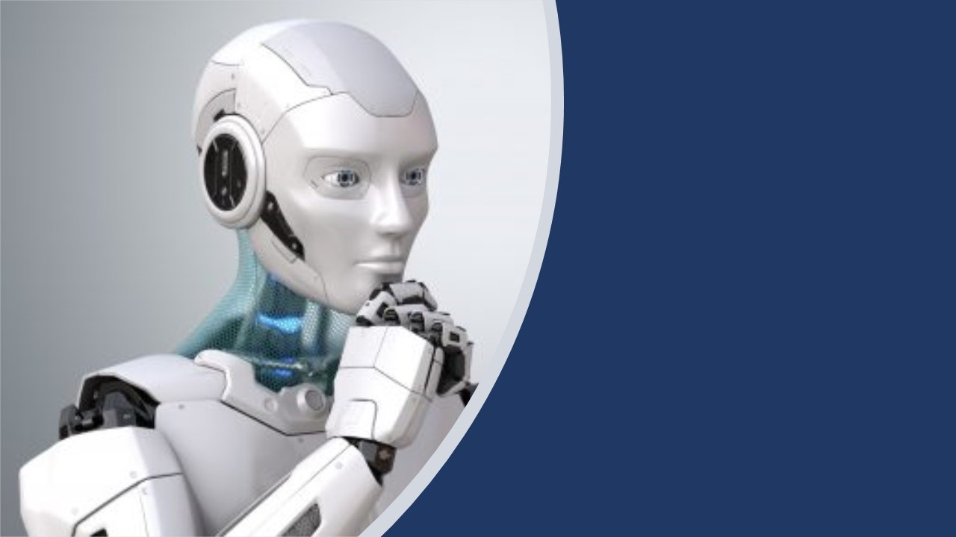
Reinforcement Learning and Optimisation

Slide 3

Trustworthy and Explainable AI

Slide 4
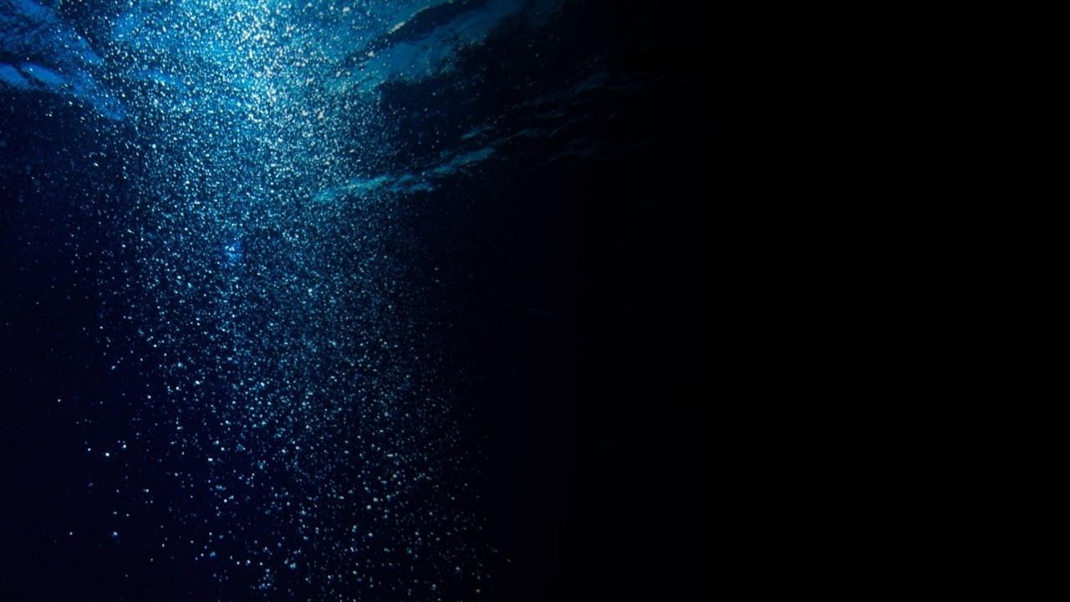
Mathematical Foundations of Generative Models

