Slide 1

Numerical modeling of CO₂ fracturing
Mostafa Mollaali
Vahid Ziaei-Rad
Supervisor: Prof. Yongxing Shen
University of Michigan-Shanghai Jiao Tong University Joint Institute

Slide 2
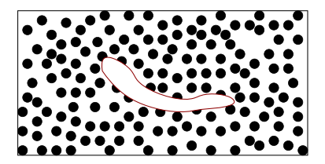
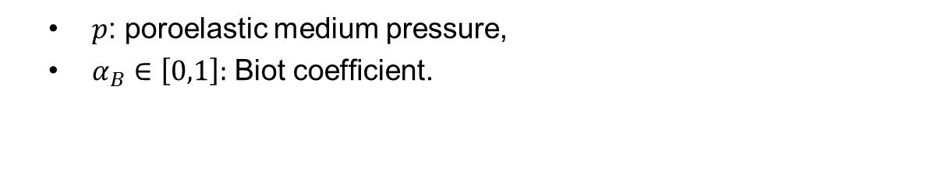
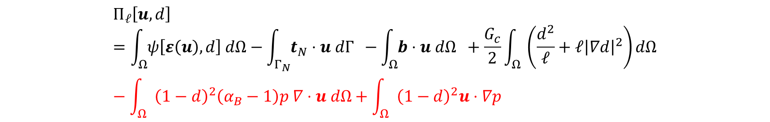
Phase field governing equation for pressurized fracture
$$Π_{ℓ}\left[u, d\right]=\int_{Ω}{ψ\left[ε\left(u\right), d\right] dΩ}−\int_{Γ_{N}}{t_{N}⋅u dΓ } −\int_{Ω}{b⋅u dΩ }+\frac{G_{c}}{2}\int_{Ω}{ \left(\frac{d^{2}}{ℓ}+ℓ{\left|∇d\right|}^{2}\right)dΩ}−\int_{Ω}{{\left(1−d\right)}^{2}\left(α_{B}−1\right)p ∇⋅u dΩ+\int_{Ω}{{\left(1−d\right)}^{2}u⋅∇p }}$$
$p$: poroelastic medium pressure,
$α_{B}∈\left[0,1\right]:$ Biot coefﬁcient.
A crack that embedded in a porous medium
Mikelic, A., M. Wheeler, and T. Wick. "A quasi-static phase-field approach to the fluid filled fracture, 2013." ICES Report: 13-22.‏

Slide 3

Thermal

Slide 4
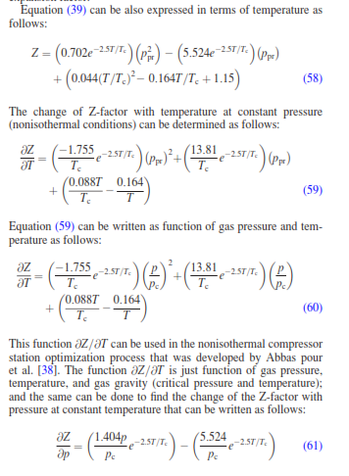
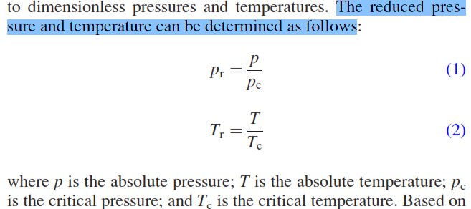
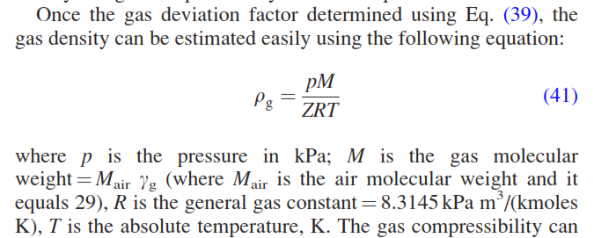
Equation of state

Slide 5
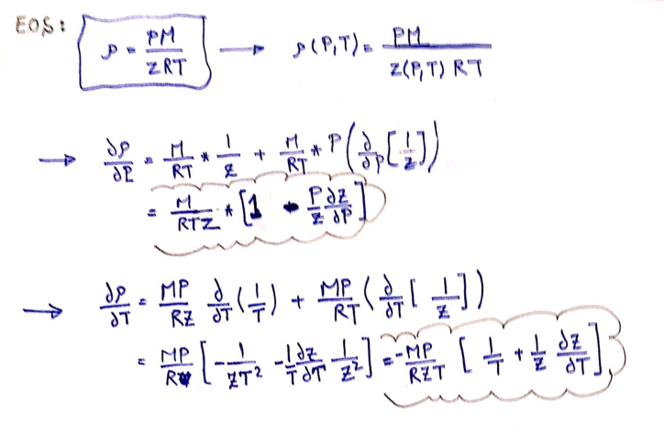
Equation of state
Density derivatives respect to temperature and pressure in non-isothermal condition

Slide 6
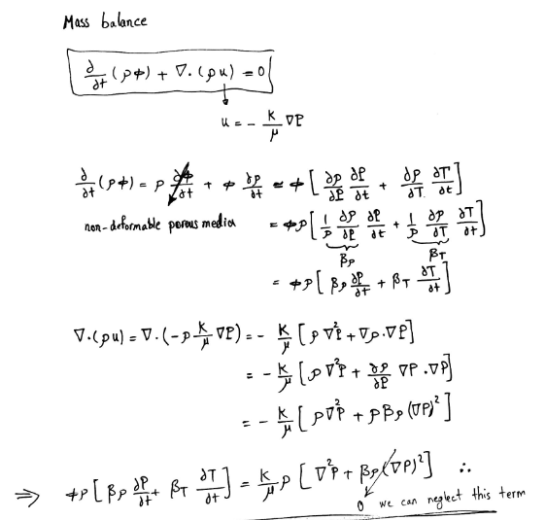

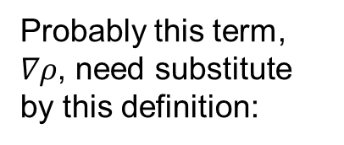
Governing equations- Mass balance
Probably this term, $∇ρ$, need substitute by this definition:
$$∇ρ=\frac{∂ρ}{∂P}∇P+\frac{∂ρ}{∂T}∇T$$
?????

Slide 7
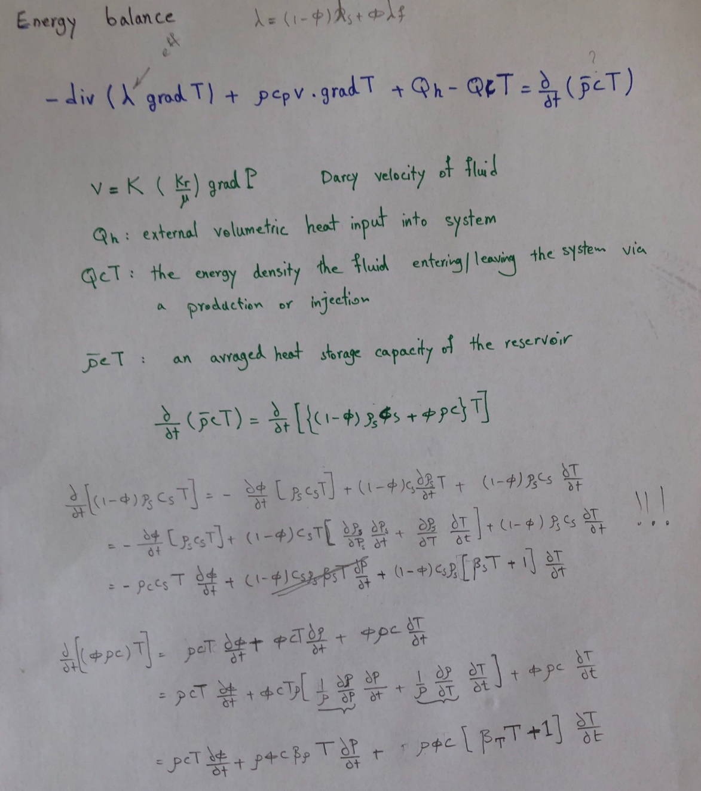
Governing equations-Energy balance

Slide 8
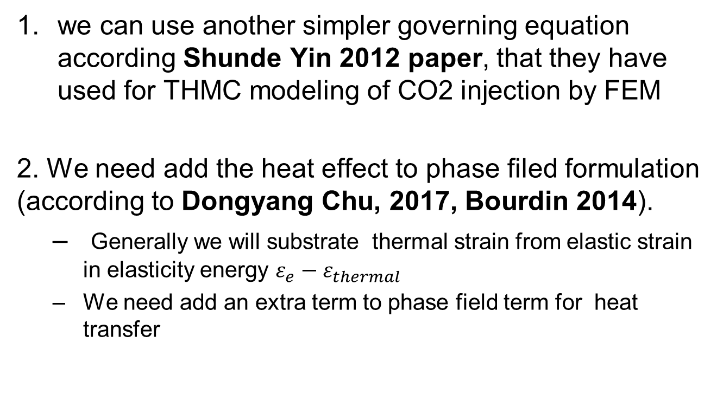
Challenges
we can use another simpler governing equation according Shunde Yin 2012 paper, that they have used for THMC modeling of CO2 injection by FEM
2. We need add the heat effect to phase filed formulation (according to Dongyang Chu, 2017, Bourdin 2014).
Generally we will substrate thermal strain from elastic strain in elasticity energy $ε_{e}−ε_{thermal}$
We need add an extra term to phase field term for heat transfer

