Slide 1
Project Report: End-to-End Retail Performance and Behavioral Analytics
Company: RetailNova Inc.
Name: Shaik Vaheed
Tools Used: Python, SQL, Power BI

Slide 2
Objective
Analyze retail sales, customer behavior, product performance, and returns
Help RetailNova improve profitability and make data-driven decisions.

Slide 3
Datasets Used
• sales_data.csv – Sales transactions
• customers.csv – Customer details
• products.csv – Product info
• stores.csv – Store operations
• returns.csv – Product returns

Slide 4
Steps: Data Cleaning & EDA (Python)
• Removed nulls/duplicates
• Fixed data types and created columns like profit and age group
• Performed basic trend and distribution analysis

Slide 5
Steps: SQL Analysis
• Loaded data into SQL database
• Wrote queries to answer 10 business questions
• Exported results for dashboard use

Slide 6
Steps: Power BI Dashboards
• Built 5 dashboards: Sales, Customers, Products, Stores, Returns
• Included filters, KPIs, and interactive visuals

Slide 7
Key Insights
• Electronics and Apparel are top-selling categories
• Online sales have higher average profit
• Return rate is high in personal care category
• Top 5 customers generate significant profit
• Some stores have high costs but low profit

Slide 8
Deliverables
• Cleaned datasets
• Python EDA notebook
• SQL scripts & ER diagram
• Power BI dashboards
• Final report & business insights

Slide 9
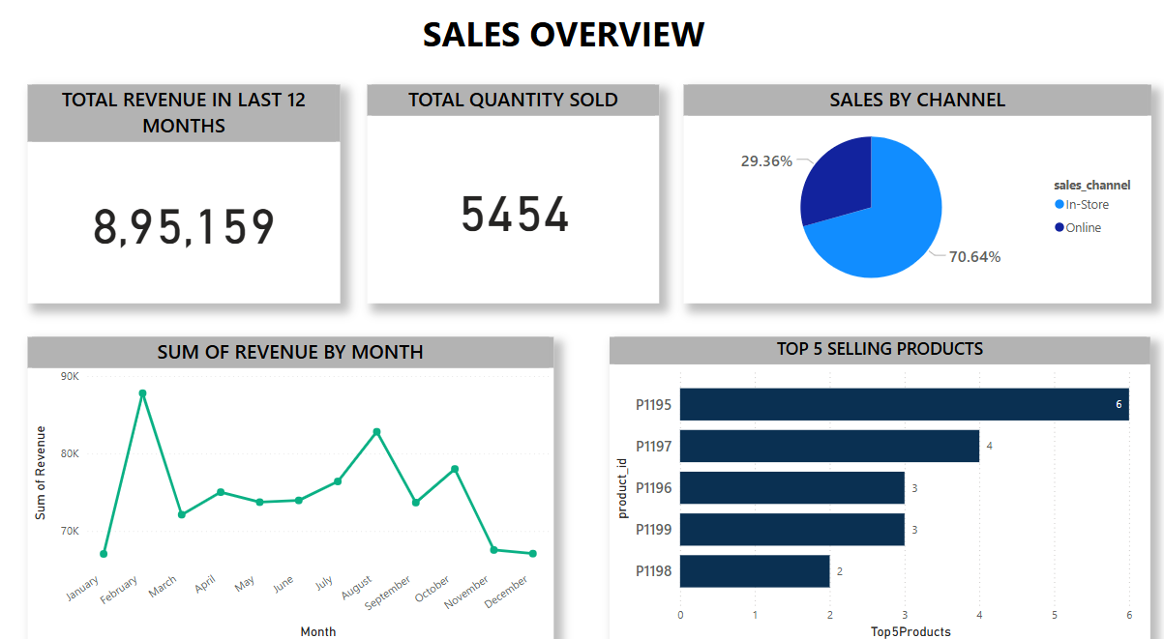
SALES OVERVIEW

Slide 10
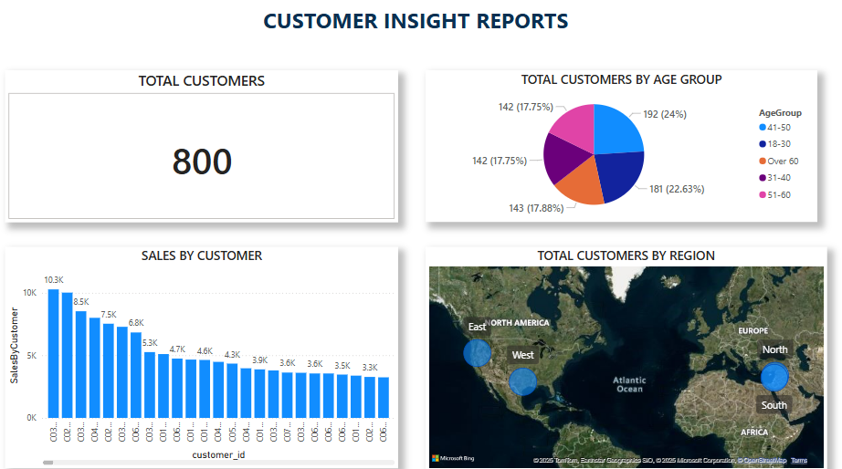
CUSTOMER INSIGHT REPORTS

Slide 11
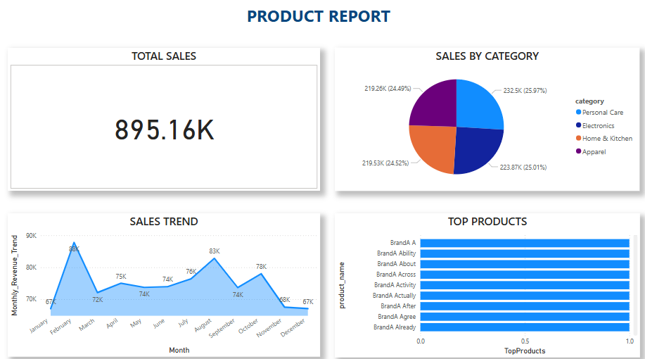
PRODUCTREPORT

Slide 12
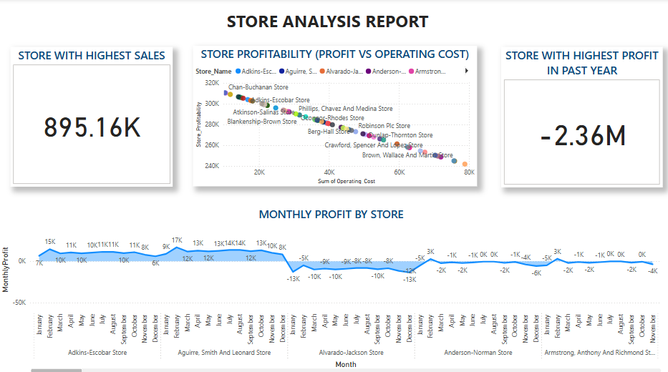
STORE ANALYSIS REPORT

Slide 13
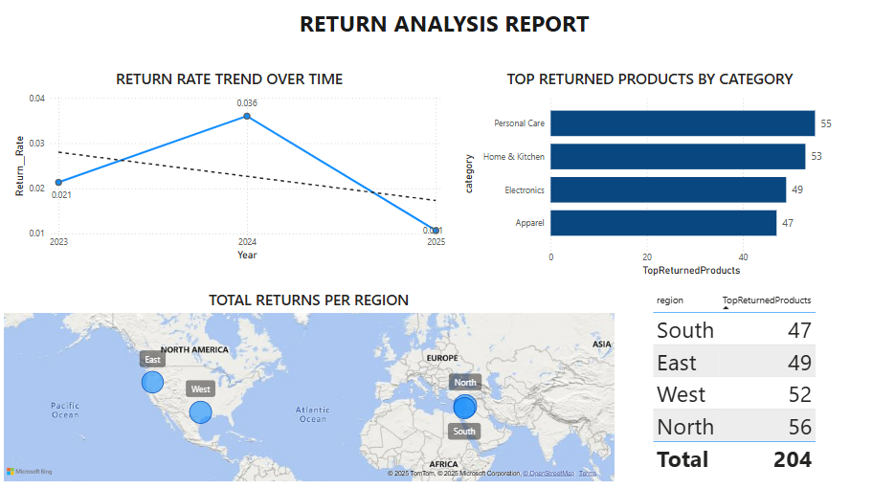
RETURN ANALYSIS REPORT

