Slide 1

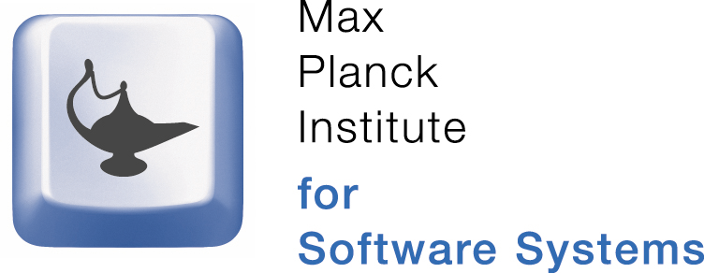











Trusted Storage
Anjo Vahldiek, Eslam Elnikety, Ansley Post, Peter Druschel,
Deepak Garg, Johannes Gehrke, Rodrigo Rodrigues
1. Problem
2. Trusted Storage
Complex storage systems threaten data integrity & confidentiality.
Bugs, security vulnerabilities, operator errors, sabotage
Lack of transparency/accountability in third-party storage
Problem:
Lack of storage level control
Who can read what & when?
Who can modify what & when?
Where is data stored?
How many replicas?
What is the access history?
Enforces a policy per named application object (e.g. file) and certifies its state.
Key Idea:
User provides a policy for every application object
Storage device enforces compliance with policy
Storage device certifies
its properties (location, type, reliability, etc.)
current policies associated with stored objects
index and access history of stored objects
Benefits:
Resilient against viruses, bugs, FS corruption
Policies give users control over provider data use
Certificates make provider accountable
Minimizes trusted computing base
Application
OS
FS
NFS
Driver
Net
Storage Web-Service
3. Example Policies
User-provided specification of access restrictions.
Identity: Requires proof of identity
Attestation: Requires proof of hw/sw configuration
Quota: Limit number of read accesses
Location Aware: Allow writes at specified locations
Storage Lease: Allow writes after given date
Time Capsule: Allow reads after given date
Expiration: Allow reads prior to given date
Certificates
Application
OS
FS
NFS
Driver
Net
User
Storage Web-Service
Trusted Storage Device
4. Certificates
5. Trusted Storage Device
Signed by trusted storage device.
Certificates testify
Properties for application objects: Full path name, size & hash of data, physical layout, policy, access history
Device properties:
Type, firmware, service life
Speed, capacity, # of disks/heads
Location, time, reliability
A device (e.g., single disk or enclosure) that provides trusted primitives.
Trusted firmware with secure updates (manufacturer-certified)
Cryptographic support (credentials, encryption, …)
Secure channel between two trusted storage devices
Trusted network servers for time & location
6. Properties & Guarantees
7. Status
Data confidentiality, integrity & accountability guarantees only depend on firmware integrity.
Trusted storage implementation within firmware
Assumes no physical attacks
Implementation in progress, promising simulation results:
Additional flash memory (0.05 % of device capacity)
< 3% latency increase

