Slide 1
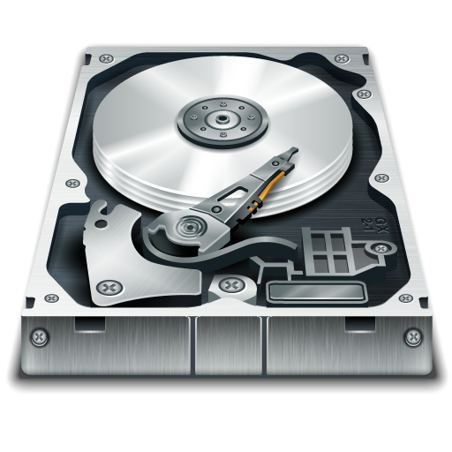

Trusted Storage
Anjo Vahldiek, Eslam Elnikety, Ansley Post, Peter Druschel, Deepak Garg, Johannes Gehrke, Rodrigo Rodrigues
MPI-SWS
Notes:
Thank you for the opportunity to present our work about Trusted Storage, which
uses trusted primitives at the storage layer to ensure data integrity and confidentiality independently of higher software layers.

Slide 2




Complex storage system
Lines of code
Application
Database
50K-10M
Operating System
10-50M
File System
NFS
30-100K
Disk Driver
Net Protocol
10K
Net Driver
10K
3rd-party storage service
NFS
Operating System
File System
Disk Driver
Bugs, exploits, operator error threaten
data integrity, durability, confidentiality
Notes:
Today’s storage system are increasingly complex,
They consist of many software layers with millions of lines of code
including databases, OSs, file systems, drivers, etc.
click
Network storage introduces more layers of software increasing the complexity further.
Click
3rd party storage services additional complexity, because the client cannot even verify what safeguards the provider takes to protect data.
Click
This complexity makes storage systems vulnerable to bugs, security breaches & operator error,
which in turn threaten the integrity, durability & confidentiality of the data stored in them.

Slide 3




Trusted Storage
Trusted primitives provided by storage device
Certificate:
Full path name
Policy
Content hash
Physical layout
Access history
Policy:
Identity
HW/SW Configuration
Quota
Time
Location
Application
Database
Operating System
File System
Disk Driver
Trusted storage device
Ensure data integrity, confidentiality, accountability independent of higher software layers
Notes:
We address this problem with a trusted storage architecture. It uses trusted primitives at the storage device layer.
klick
A trusted storage device enforces user-provided policies associated with application objects like files.
Policies grant read/write permissions based on e.g. requestor identity, hw/sw configurations, or time.
klick
Moreover, trusted storage devices issue signed statements about the state of application objects,
including their fully qualified name, size, content hash and policy in effect.
By this, trusted storage can ensures data integrity, confidentiality & accountability independent of higher software layers.

Slide 4
Example: Ensuring integrity of backup data
Threat:
Software bug, virus or operator error corrupts online backup data
Time-based Policy:
No writes before a pre-determined expiration date of the backup
Notes:
Lets look at two simple examples showcasing the power of trusted storage.
In the first example, lets consider a software bug, virus or operator error
that threatens to corrupt online backup data.
click
With trusted storage, we chose a policy for a backup snapshot that allows no writes prior to a specified date,
which corresponds to the snapshot’s expected lifetime.
For instance, for incremental backups, daily backups may be retained for a week,
weekly may be kept for a month, and so on.
With this policy in place, no action outside the trusted storage can tamper with the backup data.

Slide 5
Example: Ensuring integrity of executable files
Threat:
Virus replaces executable file with a Trojan
Identity-based Policy:
Disallow writes unless signed by vendor and version number is at least current - 1
Notes:
In the second example a virus threatens to replace an executable file with a trojan.
click
When using a trusted storage device, we chose a policy for executable files where writes are allowed only if the
new data is signed by the vendor and the version number is at least current -1 to limit rollback attacks.
This policy makes it impossible for the virus to replace an existing executable file with a trojan.
These were just two simple examples of the types of policies trusted storage can enforce.
In general, it is possible to control both the integrity and confidentiality of data based on e.g. the requestor’s identity (using authentication),
the requestor’s hw/sw configuration (using remote attestation), time and geolocation.
Moreover, the certificates can be used to verify the number and location of data replicas,
and to authenticate the results of simple data queries.

Slide 6

Summary
Trusted storage provides storage level accountability and enforcement of application policies
Guarantees independent of higher software layers
Implementation in progress
0.05% NAND flash memory
< 3% performance overhead
Please come see our poster!!!
Notes:
In summary, we use trusted primitives at the storage layer to control the integrity and confidentiality of application objects independent of higher software layers.
We’re currently in the process of implementing trusted storage. With a small NAND flash memory of about .05% the disk capacity,
We expect to implement trusted storage with performance overheads of less than 3%.
Thank you very much. PLEASE COME SEE OUR POSTER or talk to me at any time….
I‘d like to take your questions now.

