Slide 1

ERIM: Secure, Efficient in-process Isolation with Memory Protection Keys
Anjo Vahldiek-Oberwagner, Eslam Elnikety, Nuno O. Duarte, Michael Sammler, Peter Druschel, Deepak Garg
Notes:
Hello,
I’m Anjo and this talk is about joint work with my colleges from MPI-SWS.
In this work we demonstrate how to securely & efficiently isolate sensitive data within the same process by using Memory Protections Keys.
MPK is a recent hardware feature in x86 and power that allows applications to control access to a set of pages.

Slide 2



Applications in the Absence of Isolation
All state accessible at all times to
Bugs
Security vulnerabilities
Application
Notes:
Before I talk about isolation, lets first look at the drawbacks of applications without in-process isolation.
When sensitive data is not isolated, it is vulnerable to being leaked or corrupted by bugs and malicious attacks.
****
For instance a malicious attacks could exploiting a security vulnerabilities to leak or corrupt data.

Slide 3

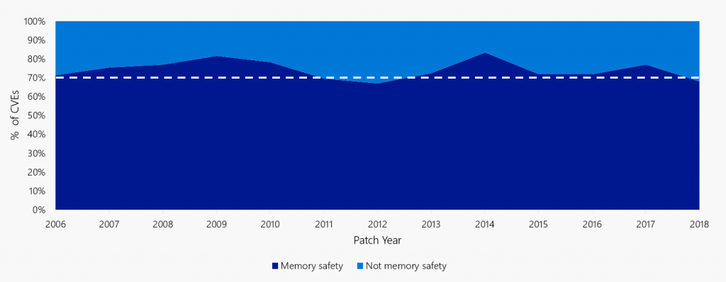
Applications in the Absence of Isolation
Heartbleed Bug
~70% of CVE assigned by Microsoft are memory safety issues.
Microsoft Security Response Center: “A proactive approach to more secure code”, 2019
Notes:
In the past we have seen wide-spread attacks against sensitive data like the heartbleed bug. Private webserver keys leaked all over the internet
More generally, memory safety issues account for a large number of reported software bugs as just recently described in an article from Microsoft.

Slide 4
Example In-Process Isolation Use Cases
Cryptographic Secrets
Managed runtimes from native libraries
Untrusted
Application
Trusted
Crypto Library
Managed Runtime
Native Library
Notes:
We all know that we can protect sensitive data by isolating it. Bugs and security vulnerabilities are then unable to leak or corrupt the sensitive data.
For instance, we can isolate the cryptographic keys from the remaining application and permit access only via a narrow interface to en/decrypt. An attacker in the untrusted application can no longer directly access and leak the key.
***
Memory safe languages and their managed runtimes provide memory safety. When using native libraries written in unsafe languages, these managed runtimes become vulnerable again. To avoid bugs in the native library from violating the managed runtime’s security invariants, the runtime should isolate its memory from the native library.
Unfortunately, todays applications make only limited use of isolation to protect sensitive data due to the lack of an efficient and robust memory isolation technique.

Slide 5
User-space Threat Model
Untrusted Application
Attacker’s Capabilities include, but not limited to
Control-flow hijacks
Memory corruption (i.e., out-of-bounds accesses)
Out of scope:
Side-channel, row hammer or microarchitectural attacks
Trusted Compartment
Untrusted
Trusted
Operating System
CPU
Notes:
I will quickly clarify the threat model we considered.
The CPU, OS, and the isolation technique are trusted.
But we don’t trust the application except for the trusted compartment.
In particular we allow malicious attacks to exploit, e.g., memory corruption or control flow hijack vulnerabilities that may exist in the untrusted application
On the other hand! We consider Side-channel, raw hammer and microarchitectural attacks to be out of scope
(and rely on the properties MPK provides)

Slide 6
State of In-Application Isolation Techniques
 | Execution overhead |  | Switch overhead
 | Untrusted | Trusted
OS/VMM-based² | Low | Low | Medium
Lang. & RT³ | Medium – High | None | None
ERIM | Low | None | Low
OS/VMM Technique
Application
Sensitive Data
Application
OS + VMM
¹ LwC, SMVs, Shreds, Wedge, Nexen, Dune, SeCage, TrustVisor
² SFI
Notes:
Based on this threat model, I will quickly outline the drawbacks of existing isolation techniques.
Techniques relying on hardware-provided isolation, such as page tables, suffer from high switch cost between the untrusted application and the sensitive data.

Slide 7
State of In-Application Isolation Techniques
 | Execution overhead |  | Switch overhead
 | Untrusted | Trusted
OS/VMM-based² | Low | Low | Medium
Lang. & RT³ | Medium – High | None | None
ERIM | Low | None | Low
Language and Runtime Techniques
Application
Sensitive Data
Operating System
¹ LwC, SMVs, Shreds, Wedge, Nexen, Dune, SeCage, TrustVisor
² SFI
Notes:
This is in contrast to Language and Runtime techniques which incur no switch cost.
They isolate by instrumenting the UA with bounds checks on indirect memory accesses. Such techniques have to be combined with a CFI technique to prevent malicious attacks from circumventing the instrumentation. As a result, they suffer from high execution overhead to perform the safety checks

Slide 8
State of In-Application Isolation Techniques
 | Execution overhead |  | Switch overhead
 | Untrusted | Trusted
OS/VMM-based² | Low | Low | Medium
Lang. & RT³ | Medium – High | None | None
ERIM | Low | None | Low
ERIM
Application
Sensitive data
ERIM
Operating System
¹ LwC, SMVs, Shreds, Wedge, Nexen, Dune, SeCage, TrustVisor
² SFI, Native Client, Memsentry-MPX
Notes:
Goal of ERIM is avoid costly CFI and costly context switches.
We achieved this by relying on MPK and strengthening its threat model.

Slide 9
Memory Protection Keys (MPK)
Available in Skylake server CPUs
Tag memory pages with PKEY
Address Space
Page 3
Page 1
Page 2
Page Table Entry (PTE)
…
PKEY
0
…
Page 1
…
Notes:
Before I provide an overview of ERIM, I’ll introduce Memory Protection keys.
MPK is a recent ISA extension to x86 and Power and available, e.g., in Skylake server CPUS
Allows to tag memory pages in PTE with protection key.
All pages start with PKEY 0.

Slide 10
Intel Memory Protection Keys (MPK)
Available in Skylake server CPUs
Tag memory pages with PKEY
Address Space
Page 3
Page 1
Page 2
Page Table Entry (PTE)
…
PKEY 2
…
Page 1
…
Notes:
Using a new system call, an application can update the Pkey of a page, assigning it to one of 16 per-process pkeys.

Slide 11
Intel Memory Protection Keys (MPK)
Available in Skylake server CPUs
Tag memory pages with PKEY
Permission Register (PKRU)
Address Space
Page 3
Page 1
Page 2
CPU Core
PKRU Register
Page Table Entry (PTE)
15
W
15
R
…
2
W
2
R
1
W
1
R
0
W
0
R
…
PKEY 2
…
Page 1
…
0
0
…
0
0
0
0
1
1
Notes:
Access to memory pages of a pkeys is controlled via a new processor register called PKRU.
For every PKEY it holds a read and write bit.
At application start only pkey 0 is accessible.

Slide 12
Intel Memory Protection Keys (MPK)
Available in Skylake server CPUs
Tag memory pages with PKEY
Permission Register (PKRU)
Userspace instruction to update PKRU
Fast switch between 11 – 260 cycles/switch
Address Space
Page 3
Page 1
Page 2
CPU Core
PKRU Register
Page Table Entry (PTE)
15
W
15
R
…
2
W
2
R
1
W
1
R
0
W
0
R
…
PKEY 2
…
Page 1
…
0
0
…
1
1
0
0
1
1
Notes:
To enable or disable access to a protection key, a new userspace instruction called WRPKRU updates the bitmap. This userspace instruction is the key to fast switching. In our experiments we observed a single switch to take between 11 and 260 cycles depending on the pipeline state, but mostly below 100 cycles per switch. In contrast, the fasted page table switch based on VMFUNC takes at least 330 cycles in a simple microbenchmark.
****
After updating the permission register, data of a page can be accessed
Using MPK, an application can divide its address space into upto 16 memory domain and selectively grant access with little overhead.

Slide 13
Intel Memory Protection Keys (MPK)
Available in Skylake server CPUs
Tag memory pages with PKEY
Permission Register (PKRU)
Userspace instruction to update PKRU
Fast switch at 50 cycles/switch
Address Space
By itself, MPK does not protect against malicious attacks.
Page 3
Page 1
Page 2
CPU Core
PKRU Register
Page Table Entry (PTE)
15
W
15
R
…
2
W
2
R
1
W
1
R
0
W
0
R
…
PKEY 2
…
Page 1
…
1
1
…
1
1
1
1
1
1
Notes:
Unfortunately, the fast userspace switching makes MPK vulnerable to malicious attacks.
a malicious attack can simply create its own permission register update instructing granting access to all protection keys.
Hence, by itself MPK cannot prevent malicious attacks.

Slide 14

Overview of ERIM
Prevent MPK exploitation
Safe call gates
Prevent execution of permission register updates outside of call gates
Untrusted Application
PKEY 0
Trusted Compartment
PKEY 1
Code:
48 83 c0 08 44 01 fa 83 fa 07 77 0f 01 ef 83 ff 07 0f 96 c2 80
Notes:
Here is an overview of how ERIM prevents this privilege escalation
we isolate the sensitive data in a trusted compartment in pages marked with PKEY1.
To prevent malicious attacks gaining access to PKEY 1, we rely on a two step approach.
***
Frist, we then define a safe way to switch between the application and the TC.

Slide 15

Overview of ERIM
Prevent MPK exploitation
Safe call gates
Prevent execution of permission register updates outside of call gates
Untrusted Application
PKEY 0
Trusted Compartment
PKEY 1
Code:
48 83 c0 08 44 01 fa 83 fa 07 77 83 ff 07 0f 96 c2 80
0f 01 ef
Notes:
Second, we prevent the attacker from executing instructions that violate the isolation of the TC.
ERIM prevents this by vetting all executable memory before enabling execute permission
If ERIM finds an unsafe permission register update, the execution is simply stopped

Slide 16
Overview of ERIM
Prevent MPK exploitation
Safe call gates
Prevent execution of permission register updates outside of call gates
Creating usable binaries
Inadvertent PKRU update instruction
Rewrite strategy
Untrusted Application
PKEY 0
Trusted Compartment
PKEY 1
Code:
48 83 c0 08 44 01 fa 83 fa 07 77 83 ff 07 0f 96 c2 80
0f 01 ef
0f 90 01 ef
Notes:
Now an attacker is unable to circumvent ERIM’s isolation.
In the process though ERIM may stop the execution of some applications.
These apps are not inline with ERIM’s safety checks. As they may include inadvertent instruction sequences which update the permission register.
*****
To enable execution of such binaries, we devising a rewrite strategy to eliminate the permission register updates while maintaining the semantics of the binary code.
Our rewriting approach has enjoyed independent interest and has already been used in other work.

Slide 17
Overview of ERIM
Prevent MPK exploitation
Safe call gates
Prevent execution of permission register updates outside of call gates
Creating usable binaries
Inadvertent PKRU update instruction
Rewrite strategy
Evaluation
Frequently-switching use cases
10% higher throughput compared to best existing technique
Untrusted Application
PKEY 0
Trusted Compartment
PKEY 1
Code:
48 83 c0 08 44 01 fa 83 fa 07 77 83 ff 07 0f 96 c2 80
0f 90 01 ef
Notes:
Lastly we applied ERIM to frequently-switching use cases and observe substantially lower overhead compared to prior art

Slide 18
Updating the permission in PKRU register
WRPKRU
Write EAX into PKRU
XRSTOR
If bit 9 of EAX is set
Load PKRU register from specified memory address
Notes:
Before I tell you how we prevent malicious attacks in detail. Let me introduce the two culprit instructions which update the permission register
WRPKRU writes the eax register directly in the PKRU register
While XRSTOR loads the register contents from memory.
Our goal is prevent an attacker from making unsafe use of these instructions.

Slide 19
Safe switching using call gates
Trusted
Compartment
perm = UNTRUSTED WRPKRU (perm)
perm = TRUSTED
WRPKRU (perm)
goto trusted_entry(T)
perm = TRUSTED
Untrusted
Application
Notes:
At first we define safe call gates which switch between TC and UA. They allow the efficient switching.
When switching from UA to TC, the permission register is updated to grant access to the trusted compartment and calls a designated entry point of the TC via a direct jump. Afterwards TC guarantees to reduce the permissions before handing back the execution to the UA.
When switching back to the UA, the permission register is updated to exclude the TC. Without any further protection, **** this WRPKRU is vulnerable to an attack where the EAX register is prepared to include the TC and then a control flow hijack is performed to jump directly to the WRPKRU instruction. Afterwards the control would continue in the untrusted application violating the isolation guarantees of the TC.

Slide 20
Safe switching using call gates
Trusted
Compartment
perm = UNTRUSTED WRPKRU (perm)
if (perm != UNTRUSTED) exit;
perm = TRUSTED
WRPKRU (perm)
goto trusted_entry(T)
Untrusted
Application
Notes:
This attack requires an additional safety check after the WRPKRU instruction. With this check we ensure that the access permissions have been reduced to UA only or the execution is stopped.

Slide 21

Prevent execution of WRPKRU/XRSTOR outside of call gates
Trusted
Compartment
FAULT
Prevent execution of unvetted pages by
Monitoring system calls and removing the execute permission
ERIM’s fault handler scans memory pages and ensures:
WRPKRU is part of a call gate
XRSTOR is followed by if(eax | 0x100) exit();
New Memory (No Execute)
Untrusted
Application
System Calls
ERIM
Operating System
Notes:
Now that we can safely use WRPKRUs, the goal is to eliminate all unsafe uses of WRPKRU and XRSTORS.
ERIM prevents the execution of pages that include unsafe WRPKRU/XRSTORS by vetting every executable page.
Therefore ERIM monitors the untrusted application and removes the execute permissions from system calls that set the page permissions.
As a result, the execution of a new page without execute permissions leads to a page fault. ERIM trusted pagefault handler is invoked and scans the page. The execution only continues if it does not find violating WRPKRU and XRSTOR instruction.

Slide 22
Overview of ERIM
Prevent MPK exploitation
Safe call gates
Prevent execution of permission register updates outside of call gates
Creating usable binaries
Inadvertent PKRU update instruction
Rewrite strategy
Evaluation
Frequently-switching use cases
10% higher throughput compared to best existing technique
Untrusted Application
PKEY 0
Trusted Compartment
PKEY 1
Code:
48 83 c0 08 44 01 fa 83 fa 07 77 83 ff 07 0f 96 c2 80
0f 01 ef
Notes:
Given these techniques, we prevent an attacker from accessing the trusted compartment.
In the process though we introduced checks which may result in halting the execution of regular applications.

Slide 23
Creating usable binaries
ERIM halts executables with inadvertent WRPKRUs/XRSTORs
→Eliminate inadvertent WRPKRU/XRSTOR by binary rewriting at compile time, runtime prior to enabling execute permission, or via static binary rewriting for pre-compiled binaries
Inter-Instruction WRPKRU
Intra-Instruction WRPKRU
Instruction 1
Instruction 2
Instruction 1
…0F
01EF…
010F01EF0000
Notes:
Our next goal now is to rewrite binaries so that do not contain unsafe instructions.
This is a challenge due to the complex x86 instruction set and its ability to execute at any byte-aligned address.
These two example show that a WRPKRU instruction sequence hex 0f01ef can appear across two instructions or within a long instruction.
While I focus on WRPKRUs as an example, the techniques similarly apply to XRSTORs. Both instructions are 3 byte long.
ERIM relies on binary rewriting to eliminate these inadvertent WRPKRU. Rewriting may be integrated into the compilation process, At runtime prior to enabling the execute permission, Or statically before the application starts.
We devised 7 rewrite rules to generate semantically equivalent instructions without unsafe instruction sequences that cover all cases.

Slide 24
Rewriting inadvertent WRPKRUs/XRSTORs
Devise rewrite rules for inadvertent WRPKRUs
Inter-Instruction:
Instruction 1
Instruction 2
…0F
01EF…
…0F
90
01EF…
Nop
Notes:
In this instance the WRPKRU sequence crosses two instructions.
In this case a simple rewrite is to insert a NOP instruction between the two original instructions.
Breaking the seqeunce

Slide 25
Rewriting inadvertent WRPKRUs/XRSTORs
Devise rewrite rules for inadvertent WRPKRUs
Intra-instruction WRPKRU
Simplified x86 instruction format:
Prefix
Opcode
Mod R/M
SIB
Displacement
Immediate
Required
Optional
Notes:
Rewriting the sequence within a large instruction is more difficult.
X86 instructions follow a general format. We use this format to devise rewrite rules independent of the instruction. As a result our rewrite rules only depend on which part the sequence occurs in.

Slide 26
Rewriting inadvertent WRPKRUs/XRSTORs
Devise rewrite rules for inadvertent WRPKRUs
Example rewrite rule:
add ecx, [ebx + 0x01EF0000]
→ push eax; mov eax, ebx; add ecx, [eax + 0x01EF0000]; pop eax;
Opcode
Mod R/M
Displacement
0x01
0x0F
0x01EF0000
Opcode
Mod R/M
Displacement
0x01
0x07
0x01EF0000
Notes:
For instance, this add instruction includes a WRPKRU in its mod r/m field and displacement value.
Here we choose to rewrite by changing the registers used. We first free the eax register and change the register bit in the instruction to use eax instead. As a result the leading 0F changes to 07.
This was just one sample rule, we have devised similar rules for the complete x86 instruction format and I’d urge you To read the paper for details.

Slide 27
Overview of ERIM
Prevent MPK exploitation
Safe call gates
Prevent execution of permission register updates outside of call gates
Creating usable binaries
Inadvertent PKRU update instruction
Rewrite strategy
Evaluation
Frequently-switching use cases
10% higher throughput compared to best existing technique
Untrusted Application
PKEY 0
Trusted Compartment
PKEY 1
Code:
48 83 c0 08 44 01 fa 83 fa 07 77 83 ff 07 0f 96 c2 80
0f 90 01 ef
Notes:
Now we have a secure and useable isolation technique.
We applied it to frequently-switching use cases and observe substantial overhead reduction compare to prior art

Slide 28
Prototype implementation
ERIM userspace library
Call gates
Memory allocator for trusted component overloading malloc-like functions
Memory inspection (exclude unsafe WRPKRU/XRSTOR)
Prevent execution on pages with unsafe WRPKRUs/XRSTOR
P-Trace and seccomp BPF userspace monitor
Linux Security Module
Remove inadvertent WRPKRUs/XRSTORs
Static binary rewrite tool based on DynInst
Notes:
We implemented ERIM as a userspace library providing Call gates to switch between trusted and untrusted, A Memory allocator for trusted memory allocations overloading malloc-like functions,And the inspection to find unsafe WRPKRU/XRSTORS.
To intercept system calls that enable execution of pages that have not been vetted we provide two options
A P-Trace-based userspace monitor which relies on Berkley Package Filters to intercept mmap-like system calls.
Linux Security Module with minor Kernel modifications
In addition we implemented the binary rewriting rules in a static binary rewriter based on DynInst.

Slide 29
Evaluation
How frequent are inadvertent WRPKRUs/XRSTORs?
Inspected about 200,000 executable files of 5 Linux distributions
Found 1213 inadvertent WRPKRU/XRSTOR in binary code
DynInst disassembled 1,023
100% rewrite success
What is ERIM’s overhead in frequently-switching use cases?
Isolating session keys in Nginx
Isolating a managed runtime (node.js) from native libraries
Isolating in-memory state of reference monitors (CPI/CPS)
Notes:
Besides microbenchmarks. We evaluate ERIM, by asking 2 main questions.
First, How frequently do inadvertent WRPKRU/XRSTORs occur?
Inspected about 200,000 binaries from 5 linux distributions
found about 1,200 inadvertent WPKRU/XRSTOR Instances
DynInst, our static rewriting tool, was able to disassemble about 1,000 which is a prerequisite to statically rewrite them.
Using the rewrite rules we were able to rewrite all these WRPKRU/PKRU instances.
In the paper we describe a dynamic rewriting approach for pages that cannot be disassembled statically
****
Second, What is ERIM’s overhead in frequently-switching use cases and how does it compare to existing techniques?
Due to limited time, I will only talk about the use case of isolating session keys in Nginx – a high performance commercial web server. You can Find the remaining results in the paper.

Slide 30
Use case: Session Key Isolation
Address Space
NGINX
OpenSSL &
LibCrypto
AES Compartment
Connection Management
Content
HTTPS session
Handshake protocol
Cryptographic keys
AES encrypt/decrypt
AES key initialization
Notes:
Today’s implementation of NGINX uses Openssl and does not isolate any keys. It is vulnerable to bugs and sec. vuln leaking the keys such as heartbleed
*********
With ERIM we isolate the AES session keys and allow access only by the key initialization und enc/decryption functions.

Slide 31
Nginx Throughput with protected session keys
ERIM throughput within 5% of native.
Native
ERIM
Notes:
This experiment runs a single worker nginx instance and queries different file sizes. We compare the native throughput without any isolation to the previously described isolation with ERIM.
Overall the throughput of ERIM is within 5% of native performance, while protecting the session keys against bugs and security vulnerabilities in the NGINX server and large parts of OpenSSL.

Slide 32
Nginx Throughput with protected session keys
1.3 million switches per second
Native
ERIM
Notes:
We achieve this high throughput, despite performing about 1.3 million switches per second.

Slide 33
Comparison to Prior Art
95.4% ERIM
86.4% VMFUNC
73.2% MemSentry-MPX
Notes:
Existing techniques cannot sustain such high rates of switching. the best performing alternative VMFUNC’s switch cost is about 3x higher.
Runtime techniques based on hardware-provided bounds checks incur high runtime overheads and this result is without additional CFI cost.
At larger file sizes the experiment becomes network bound and techniques achieve similar performance.

Slide 34
Summary
Prevent MPK exploitation
Safe call gates
Prevent execution of permission register updates outside of call gates
Creating usable binaries
Inadvertent PKRU update instruction
Rewrite strategy
Evaluation
Frequently-switching use cases
10% higher throughput compared to best existing technique
Untrusted Application
PKEY 0
Trusted Compartment
PKEY 1
Code:
48 83 c0 08 44 01 fa 83 fa 07 77 83 ff 07 0f 96 c2 80
0f 90 01 ef
Notes:
To summarize.
ERIM efficiently, securely isolates sensitive data within the same process using memory protection keys. We protect against malicious attacks by creating safe call gates and monitoring the executable memory.
To overcome the limitations of ERIM’s limiting environment, we devise rewrite rules to create runnable binaries.
Our extensive evaluation shows how ERIM can be applied to frequently switching use cases and we observe substantial overhead reduction compare to prior art

Slide 35
Thank you!
ERIM: Secure, Efficient in-process Isolation with Memory Protection Keys
Anjo Vahldiek-Oberwagner, Eslam Elnikety, Nuno O. Duarte, Michael Sammler, Peter Druschel, Deepak Garg
Code available at https://gitlab.mpi-sws.org/vahldiek/erim
Notes:
I would like to thank for your attention and mention that the code is/will be available.
I’d be happy to take you questions.

Slide 36
Backup

Slide 37
Intel Memory Protection Keys (MPK)
Tag memory pages with a memory domains (bits 62:59 in page table)
Permission register (PKRU) enables R/W to a domain
Update accessible permissions from userspace
Fast switching, without context/PT switch
By itself, protects against bugs only
Page Table Entry
PKRU register (32 bit, 2 bits per domain)
…
2
…
…
…
11
…
…
Domain (bits 62:59)
Domain 1
…
Domain 0
Domain 3
Domain 2
Notes:
MPK allows to tag a page with one of 16 domains in the page table via system call
A permission register controls read/write memory access permissions to each domain
If a page is taged in domain 2, for each memory access to this page the CPU checks that the permission register permits Access to domain 2 for the access type.
To update permission register, applications call the new userspace WRPKRU instruction.
Allowing fast switching without OS involvement
On the other hand, the fast userspace permission switching permits malicious attacker simply update the permission register to access all domains.

Slide 38
State of the art: Isolating in-memory state
ASLR-based Hiding
OS/VMM-Based
 | Execution overhead |  | Switch overhead | Threat model
 | Untrusted | Trusted
ASLR¹ | Low | None | None | Application bugs only
OS/VMM-based² | Low | Low | Medium | Any userspace
Lang. & RT³ | Medium – High | None | None | Any userspace
ERIM | Low | None | Low | Any userspace
Application
Application
Sensitive data
Sensitive data
Operating System
OS + VMM
Language and Runtime Techniques
ERIM: Memory Isolation using Intel MPK
Application
Application
Sensitive data
Sensitive data
¹ ASLR-Guard, Near, XnR
ERIM
² LwC, SMVs, Shreds, Wedge, Nexen, Dune, SeCage, TrustVisor
Operating System
Operating System
³ MemSentry, SFI
38
Notes:
In this work our was aim to provide memory isolation at low execution and switch overhead, while also protecting malicious attacks. We achieve this by using Intel’s Memory protection keys and hardening its threat model.

Slide 39
Isolating sensitive state with Intel MPK
Address Space
Permission Register (PKRU)
Sensitive State
TRUSTED
11
00
11
Domain 1
00
Domain 0
Untrusted
Application State
D0
D1
UNTRUSTED
Domain switch is a user-mode register write: efficient but vulnerable to attack.
Notes:
When isolating with MPK, we isolate the SS and tag the memory to be in domain 1, the trusted domain.
The remainder of the application state remains in the default domain 0.
At application start only domain 0 is accessible while the untrusted application executes.
To access the sensitive state a WRPKRU instruction updated the permission register
To permit updates to memory pages of domain 1.
This switch occurs before executing trusted code and is reversed, once the trusted code
Finished its work to allow the untrusted application to continue.
Unfortunately this protects only against bugs, which don’t actively
Alter the permission register.
In the remainder of this talk, I will present our work on securely using MPK assuming the presence
Of a malicious attacker.

Slide 40
Using ERIM to isolate memory
Inlined switches
fct_A(…) {
….
switch(Trusted)
access sensitive data
switch(Untrusted)
…
}
Function overwriting
fct_A(…) {
….
}
BUILD_BRIDGE(fct_A);
fct_B(…) {
…
CALL_BRIDGE(fct_A, args);
…
}
Function overloading via LD_PRELOAD
Shared library defines:
fct_A(…) {
f = dlsym(fct_A, …);
switch(Trusted);
ret = f(args);
switch(Untrusted);
return ret;
}

Slide 41
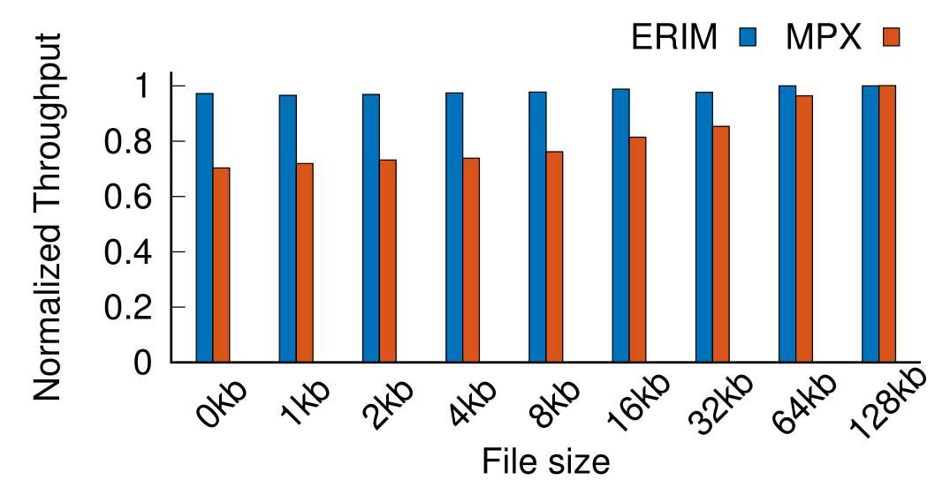
Comparison to MPX

Slide 42
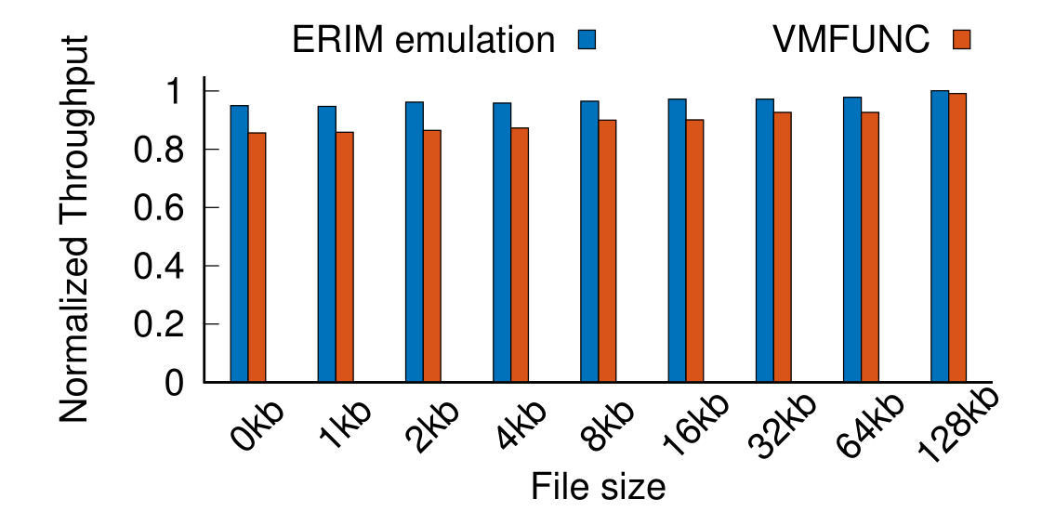
Comparison to VMFUNC EPT switch

Slide 43
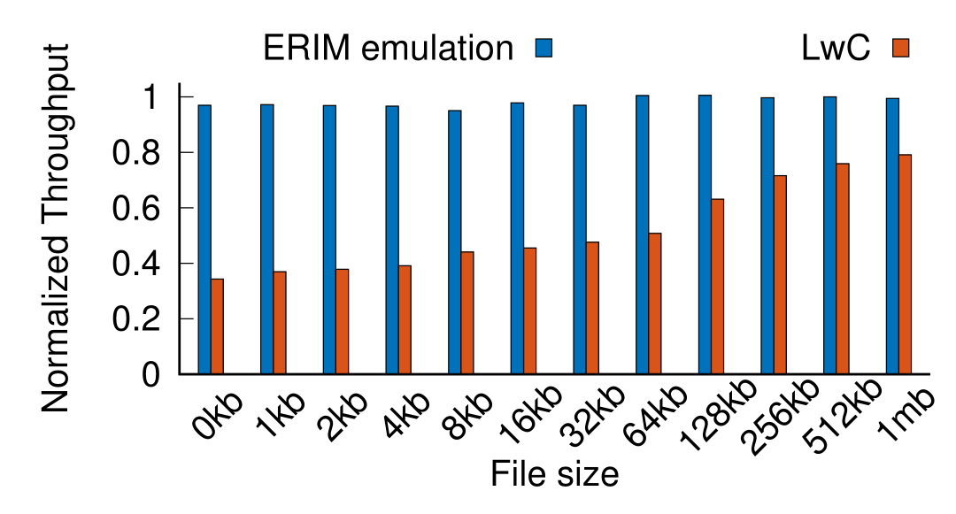
Comparison to LwC

Slide 44
How frequent are inadvertent WRPKRUs/XRSTORs?
 | Debian 8 | Ubuntu 14 | Ubuntu 16 | Gentoo | Gentoo Gold
Elf files | 56035 | 58548 | 69907 | 9940 | 9940
Elf files with WRPKRU/XRSTOR | 665 | 603 | 720 | 73 | 34
Executable WRPKRU/XRSTOR | 4244 | 1147 | 2105 | 124 | 46
WPKRU/XRSTOR in code | 481 | 276 | 384 | 41 | 31
Disassembled by Dyninst | 420 | 215 | 332 | 32 | 24
Inter-instruction | 30 | 29 | 44 | 5 | 5
Intra-instruction | 390 | 186 | 288 | 27 | 19

Slide 45
How frequent are inadvertent WRPKRUs?
 |  | Debian 8 |  |  | Ubuntu 14 |  |  | Ubuntu 16 |  |  | Gentoo |  |  | Gentoo Gold
Elf files |  | 56035 |  |  | 58548 |  |  | 69907 |  |  | 9940 |  |  | 9940
 |  | All | WRPKRU | XRSTOR | All | WRPKRU | XRSTOR | All | WRPKRU | XRSTOR | All | WRPKRU | XRSTOR | All | WRPKRU | XRSTOR
Elf files w/ WRPKRU/XRSTOR |  | 665 | 174 | 541 | 603 | 215 | 435 | 720 | 189 | 580 | 73 | 22 | 59 | 34 | 17 | 20
Executable WRPKRUXRSTOR |  | 4244 | 288 | 3956 | 1147 | 442 | 705 | 205 | 235 | 1870 | 124 | 26 | 98 | 46 | 18 | 28
WPKRU/XRSTOR in code |  | 481 | 63 | 418 | 276 | 66 | 210 | 384 | 83 | 301 | 41 | 9 | 32 | 31 | 14 | 17
Disassembled by Dyninst |  | 420 | 52 | 368 | 215 | 55 | 160 | 332 | 73 | 259 | 32 | 9 | 23 | 24 | 14 | 10
Inter-instruction | Number | 30 | 30 | 0 | 29 | 29 | 0 | 44 | 41 | 3 | 5 | 5 | 0 | 5 | 5 | 0
 | Rewritable by NOP | 30 | 30 | 0 | 29 | 29 | 0 | 44 | 41 | 3 | 5 | 5 | 0 | 5 | 5 | 0
Intra-instruction | Number | 390 | 22 | 368 | 186 | 26 | 160 | 288 | 32 | 256 | 27 | 4 | 23 | 19 | 9 | 10
 | Rewritable by rule 5 | 199 | 22 | 177 | 181 | 26 | 155 | 246 | 32 | 214 | 27 | 4 | 23 | 19 | 9 | 10
 | Rewritable by rule 4/6 | 191 | 0 | 194 | 5 | 0 | 5 | 42 | 0 | 42 | 0 | 0 | 0 | 0 | 0 | 0

Slide 46
ERIM Related Work
Hardware-based Isolation:
Trusted Execution Engines (TEE) [SGX, TrustZone]
Reducing TCB of TEE [Flicker]
Sandbox applications in TEE [Haven, Scone]
Hypervisor/OS-based:
Reference monitors [Dune, Wedge, LwC]
Sandboxing Applications [Capsicum]
Privilege Separation [PrivTrans]
Hiding secrets in execute-only code [Redactor, Near]

Slide 47
ERIM Related Work
Software-fault isolation:
Compilation-based [NativeClient]
Emulation [Vx32]
Just-in-time compiled languages [NativeClient++]
Inlined Reference Monitoring:
Control-Flow Integrity [CPI]
Sandboxing annotated code [Shreds]
Intercepting Android framework [Aurasium]

Slide 48
Call Gates
WRPKRU (RW_TRUSTED)
// entry point to trusted
WRPKRU (DIS_TRUSTED)
cmp DIS_TRUSTED, EAX
je continue
exit
continue:
Elevate privileges and transfer to trusted entry point
Remove privileges, check for reduced privileges and return from trusted component

Slide 49
Creating safe binaries
Devise rewrite rules for WRPKRU in code segment
Inter-instruction WRPKRU (0x0F01EF)
Example rewrite rule:
Instruction 1
Instruction 2
…0F
01EF…
…0F
Nop
01EF…
Notes:
Executable, but not in code region are mostly in read-only section of executable
Link application with 3 program segments R, RX, RW for read-only static data, code and rw data for variables

Slide 50
Creating safe binaries
Intra-instruction WRPKRU
Simplified x86 instruction format:
Example rewrite rule:
add ecx, [ebx + 0x01EF0000]
→ push eax; mov eax, ebx; add ecx, [eax + 0x01EF0000]; pop eax;
Prefix
Opcode
Mod R/M
SIB
Displacement
Immediate
Opcode
Mod R/M
Displacement
0x01
0x0F
0x01EF0000
Opcode
Mod R/M
Displacement
0x01
0x07
0x01EF0000
Notes:
Executable, but not in code region are mostly in read-only section of executable
Link application with 3 program segments R, RX, RW for read-only static data, code and rw data for variables

Slide 51
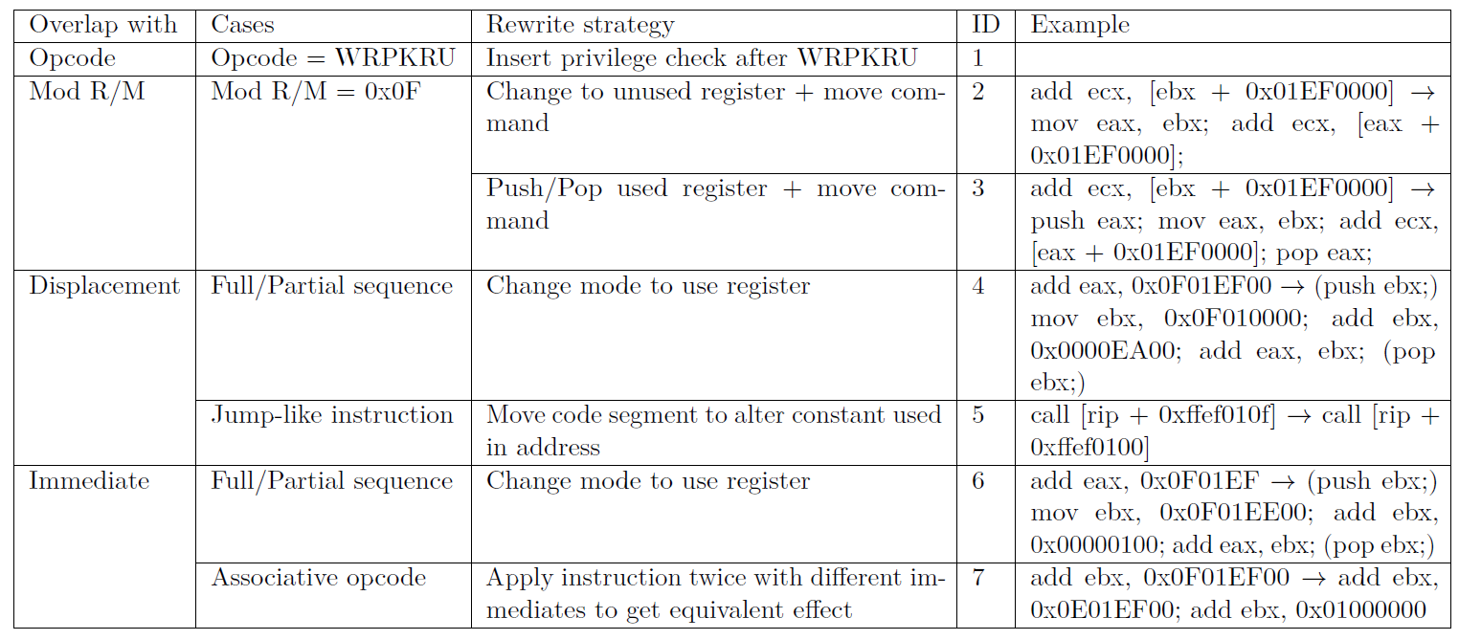
Creating safe binaries: Rewrite Rules
Notes:
Executable, but not in code region are mostly in read-only section of executable
Link application with 3 program segments R, RX, RW for read-only static data, code and rw data for variables

Slide 52
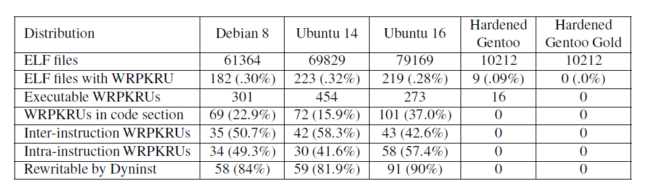
WRPKRU Occurrances

Slide 53
Nginx Throughput with protected session keys
File size | Native (req./s) | ERIM rel. (%) | Switches/s | CPU load
0 | 95,761 | 95.83 | 1,342,605 | 100
1 | 87,022 | 95.18 | 1,220,266 | 100
2 | 82,137 | 95.44 | 1,151,877 | 100
4 | 76,562 | 95.25 | 1,073,843 | 100
8 | 67,855 | 95.98 | 974,780 | 100
16 | 45,483 | 97.10 | 812,173 | 100
32 | 32,381 | 97.31 | 779,141 | 100
64 | 17,827 | 100.0 | 679,371 | 96.7
128 | 8,937 | 99.99 | 556,152 | 86.4
CPU bound
Network bound

Slide 54
ERIMized C Program
typedef struct secret {
int number;
} secret;
secret* initSecret() {
ERIM_SWITCH_T;
secret * s = malloc(sizeof(secret));
s->number = random();
ERIM_SWITCH_U;
return s;
}
int compute(secret* s, int m) {
int ret = 0;
ERIM_SWITCH_T;
ret = f(s->number, m);
ERIM_SWITCH_U;
return ret;
}

Slide 55
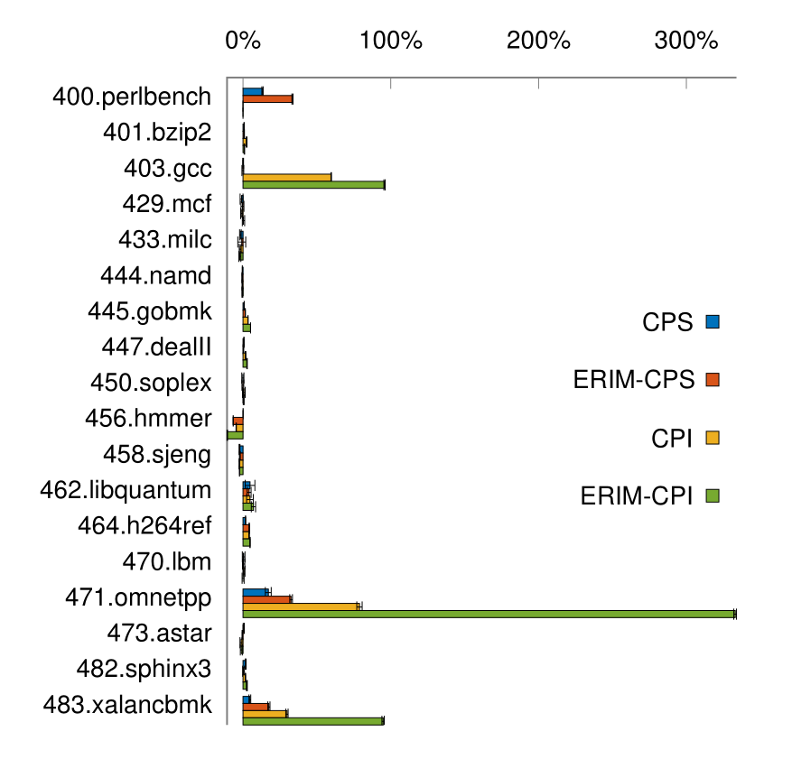
SPEC 2006 with CPS/CPI

Slide 56
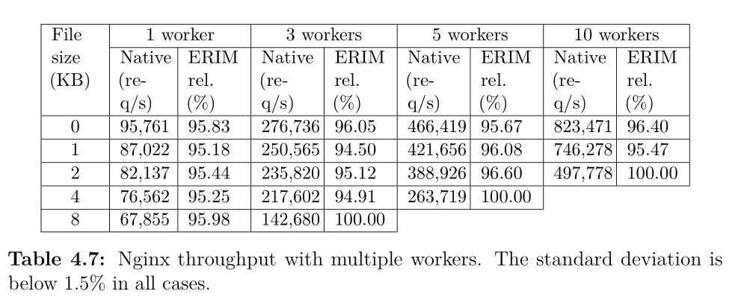
NGINX multiple worker

