Slide 1
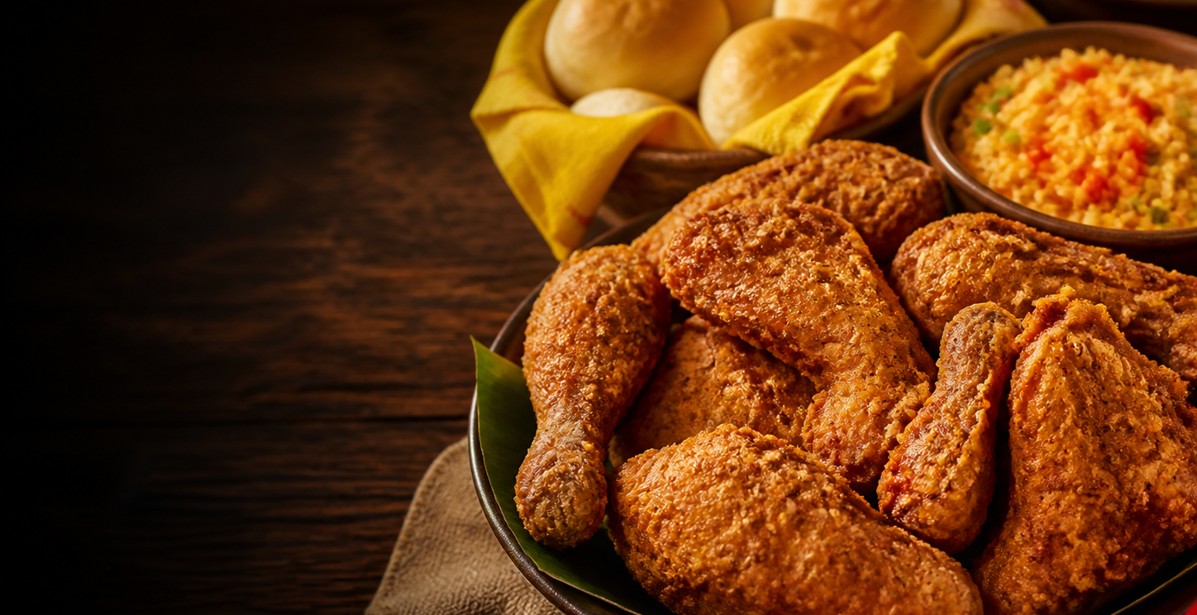
globalpayments
Welcome
Genius for Pollo Campero
POLLO
CAMPERO
Notes:
[Sources]
- Background image: generated with OpenAI image generation for this presentation; prompt metadata retained in the project build notes.
- Visual reference: user-provided Title Slide.pdf.
- Pollo Campero brand context: https://us.campero.com/our-story
[/Sources]

