Slide 1
Linux kernel
ggg.instigate.training

Slide 2
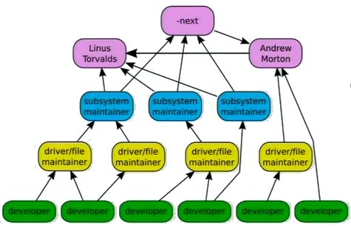
Who is doing and how it is being done?
Fastest moving project known to everybody (during 2007-2008, per day)
  4,300 lines added
  1,800 lines removed
  1,500 lines modified
By 2008
  9.2 million lines of code
  2399 developers

Slide 3
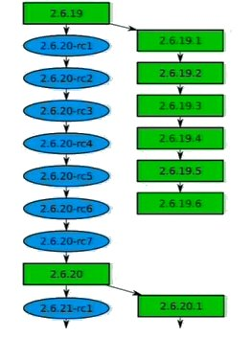
Releases
New enhancements and bug fixes in rc-s
Support of the previous version
Important is to not break kernel for existing arch-s
The main testing is done by the users
The patches done on old release should be done
also on the upstream tree
New release every 2 ¾ months

Slide 4
Kernel Architecture
Hardware platform
User Applications
User Space
GNU C Library (libc)
System Call Interface
Kernel
Kernel Space
Architecture Dependent Kernel Code

Slide 5
User and Kernel Space Components
User applications
Glibc – provides the system call interface that connects to the kernel
System call interface – provides the basic functions (read and write)
Kernel
  Architecture-independent kernel code common to all processor architectures
  Architecture-Dependent Code - processor and platform specific code
Kernel Subsystems
System Call Interface
Process Management
Virtual File System
Memory Management
Network Stack
Arch
Device Drivers

Slide 6
Kernel Subsystems
System Call Interface
  Provides the means to perform function calls from user space into the kernel
Process Management
  Focused on the execution of the processes
  Each has an individual virtualization of the processor (data, stack, registers)
  Kernel provides API to start start, stop and communicate with processes
  Kernel implements constant time scheduling algorithm regardless the # of threads
Memory Management
  Memory is managed in pages (typically 4KB per page)
  Keeps tracks of which pages are full, partially used, empty,
  Swaps to disk if physical memory runs out

Slide 7
Virtual File System
Virtual File system
  Presents a common API (open, close, read, write)
  Support over 50 different file systems
Buffer Cache - Optimizes access to the physical devices by caching
Network Stack
  Managing connections
  Moving data between endpoints
Device Drivers – most of the kernel source code
Virtual File System
Ext3
...
FAT32
/proc
Buffer Cache
Device Drivers
Physical Devices

Slide 8
Modularity
Many components of the Linux kernel may be compiled as modules which the kernel can dynamically load and remove as required.
The best components to modularize are ones not required at boot time, for example peripheral devices and supplementary file systems.
  lsmod - list currently loaded modules
  rmmod - remove a single module
  insmod - insert a single module
  depmod - create the database of module dependencies modules.dep
  modprobe - insert a module and dependencies listed in modules.dep
  modinfo - list information about the author, license type and module parameters

Slide 9
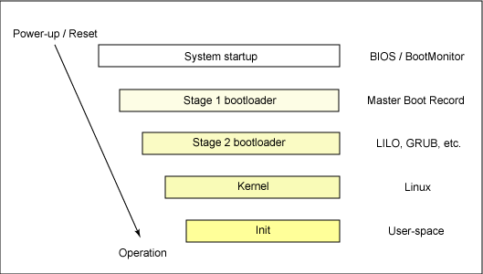
Booting
Processor executes code at a
well-known location – BIOS, located
in the flash memory of MB
  BIOS determines devices to boot
First-stage boot loader is loaded into
RAM and executed (< 512 bytes)
  Loads the second-stage boot loader
Second-stage boot loader is loaded
into RAM and executed
  Passes control to the kernel image
  and the kernel is decompressed and initialized
Kernel - checks the system hardware, enumerates the attached hardware devices, mounts the root device, loads the necessary kernel modules and starts init.

Slide 10
Building Linux Kernel
Why upgrade or build your own kernel?
  You want to optimize a kernel (for speed, size, etc.)
  Optimize for security with extra enhancements (e.g. remove modules support, remove networking support, limit drivers)
  You want to patch your kernel to use non-standard features.
  You are adding a new hardware to machine not supported under current kernel

Slide 11
References
Architecture of the Linux Kernel
Greg Kroah Hartman on the Linux Kernel
Booting process

Slide 12
Instigate Training Center Foundation
134/1 Tsarav Aghbyur Str, Yerevan, 0054, Armenia
+374.60.510710
ggg.instigate.training

