Slide 1
Employee Data Analysis Using Excel
STUDENT NAME: VAISHNAVI J
REGISTER NO: 312209455
DEPARTMENT: B.COM (ACCOUNTING AND FINANCE)
COLLEGE: ANNA ADHARSH COLLEGE FOR WOMEN
NM ID: B42559A5C19F005A7DF48AA89D6FEBF3

Slide 2
PROJECT TITLE
Employee Performance Analysis using Excel

Slide 3


AGENDA
Problem Statement
Project Overview
End Users
Our Solution and Proposition
Dataset Description
Modelling Approach
Results and Discussion
Conclusion
3/21/2024 Annual Review

Slide 4

PROBLEM STATEMENT
Inefficient manual processes: Current performance analysis processes are time-consuming, prone to errors, and difficult to scale.
Lack of data-driven insights: Limited ability to identify trends, patterns, and correlations in employee performance data.
Inconsistent evaluation criteria: Performance assessments may be subjective, biased, or inconsistent across departments or managers.
Insufficient employee feedback: Limited opportunities for employees to receive constructive feedback, hindering growth and development.
Poor talent identification and development: Struggling to identify high-potential employees, leading to missed opportunities for growth and succession planning.

Slide 5

PROJECT OVERVIEW
Develop an Excel-based tool to analyze employee performance data, providing a comprehensive evaluation of individual and team performance.

Slide 6

WHO ARE THE END USERS?
HR Managers
Team Leads
Supervisors
Talent development teams
Compensation and benefits teams
Diversity, equity and inclusion (DEI) teams

Slide 7

OUR SOLUTION AND ITS VALUE PROPOSITION
Filtering - Remove missing Values
CONDITIONAL FORMATTING - Blank
FORMULA – Performance
PIVOT TABLE – SUMMARY
GRAPH - Data Visualisation

Slide 8
Dataset Description
Employee ID
Name
Department
Job Title
Performance Metrics (e.g., sales, productivity, quality ratings)
Time Period (e.g., quarterly, annually)

Slide 9

THE "WOW" IN OUR SOLUTION
Automated data analysis and visualization
Customizable dashboards for tailored insights
Identification of high-performing employees and areas for improvement
=IFS(Z8>=5,”VERYHIGH”,Z8>=4,”HIGH”,Z8>=3,”MID”,TRUE,”LOW”)
Data-driven recommendations for talent development and resource allocation
3/21/2024 Annual Review
9

Slide 10
MODELLING
Descriptive analytics: summarize and visualize performance data
Diagnostic analytics: identify factors influencing performance
Predictive analytics: forecast future performance trends
10

Slide 11
RESULTS
Key findings and insights from data analysis
Performance trends and patterns
Recommendations for improvement and development
11

Slide 12
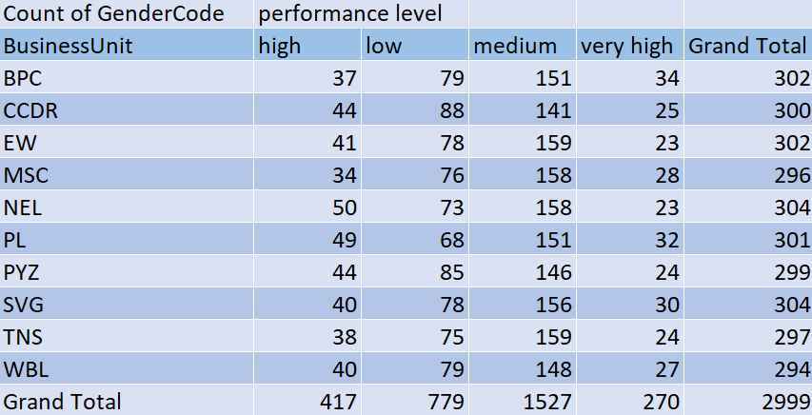

Slide 15
Conclusion
Summary of project outcomes and impact
Future directions for performance analysis and improvement

