Slide 1
Memory Management optimization strategies

Slide 2
Introduction
Memory management optimization is the efficient use of memory in a program.
It helps reduce memory wastage and improves performance.
It ensures proper allocation and deallocation of memory.
It prevents problems like memory leaks and fragmentation.

Slide 3
What is Memory Optimization
It is the process of:
Reducing unnecessary memory usage
Improving allocation/deallocation efficiency
Preventing memory leaks and fragmentation

Slide 4
Memory Management in C
Manual memory management.
Dynamic allocation functions.
Free function.
Programmer controls allocation and deallocation.

Slide 5
Types of memory in C
1. Static Allocation: Static allocation is a type of memory allocation where memory is assigned at compile time (before the program runs), and its size cannot be changed later. For examples
int a = 10; // single variable.
int arr[5]; // fixed-size array.
2. Dynamic Allocation (Heap): Dynamic Memory Allocation (DMA) means memory is allocated during program execution (runtime) and can be changed or freed whenever needed.

Slide 6
Functions in C
:.
(.
Malloc(): Allocates a single block of uninitialized "garbage" memory of the specified byte size
calloc():Allocates memory for an array of num elements and initializes all bytes to zero.
free(): Releases the allocated memory block back to the system.

Slide 7
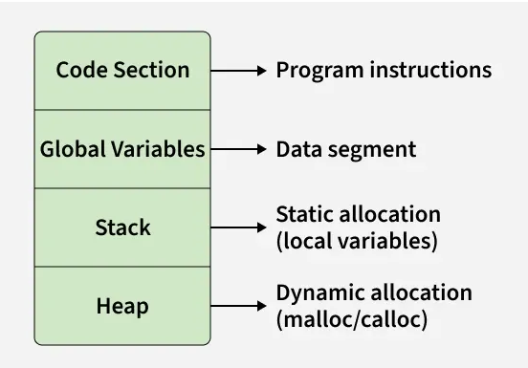
Memory Layout of a C Program

Slide 8
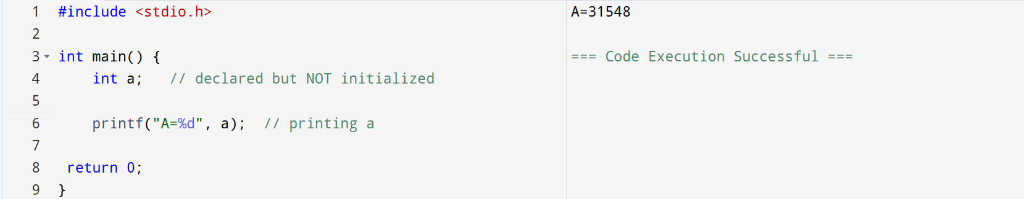
Garbage Value
Garbage value means a variable contains a random value because it is not initialized.

Slide 9
Memory Management in Java
Automatic memory management
Handled by JVM using Garbage Collection

Slide 10
Why Use Memory Management in Java
Prevents memory leaks
Improves safety
Reduces programmer effort

Slide 11
Garbage Value:
A garbage value is a random or unknown value stored in a variable when it is not initialized.

Slide 12
Types in Java
1. Stack Memory
2. Heap Memory
3. Method Area

Slide 13
Conclusion
C = Control + Responsibility
Java = Automation + Safety

