Slide 1


Memory management optimization strategies
COLLABORATIVE WORK BY:
V.VAIBAV
R.KOTTEESWARAN

Slide 2
Introduction
Memory management optimization is the efficient use of memory in a program.
It helps reduce memory wastage and improves performance.
It ensures proper allocation and deallocation of memory.
It prevents problems like memory leaks and fragmentation.

Slide 3
What is Memory Optimization
It is the process of:
Reducing unnecessary memory usage
Improving allocation/deallocation efficiency
Preventing memory leaks and fragmentation

Slide 4
Memory Management in C
Manual memory management.
Dynamic allocation functions.
Free function.
Programmer controls allocation and deallocation.

Slide 5
Types of memory in C
1. Static Allocation: Static allocation is a type of memory allocation where memory is assigned at compile time (before the program runs), and its size cannot be changed later. For examples
int a = 10; // single variable.
int arr[5]; // fixed-size array.
2. Dynamic Allocation (Heap): Dynamic Memory Allocation (DMA) means memory is allocated during program execution (runtime) and can be changed or freed whenever needed.

Slide 6
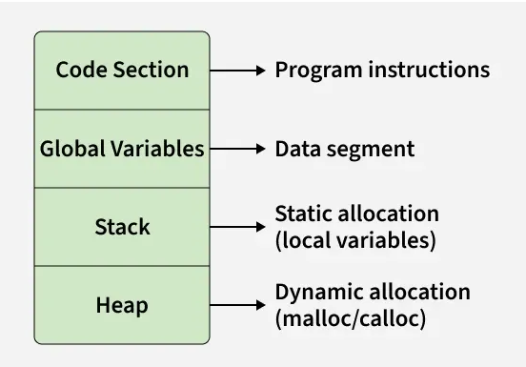
Memory Layout of a C Program

Slide 7
Functions in C
:.
(.
Malloc(): Allocates a single block of uninitialized "garbage" memory of the specified byte size
To use malloc(), you must include the <stdlib.h> header file.
size: The total number of bytes to allocate. It is of type size_t, an unsigned integer.
Syntax : #include <stdlib.h>void* malloc(size_t size);
calloc():Allocates memory for an array of num elements and initializes all bytes to zero.
free(): Releases the allocated memory block back to the system.

Slide 8
Uninitialized Variable & Garbage Value (C)
A variable is created without giving any value It just reserves memory, but no proper value is stored
Examples: int a; // declared but NOT initialized.

Slide 9
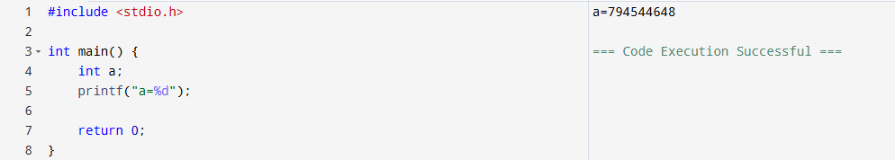
Garbage Value
Garbage value means a variable contains a random value because it is not initialized.

Slide 10
Memory Management in Java
Automatic memory management.
Handled by JVM using Garbage Collection.
Memory divided into Stack, Heap, and Method Area.
Objects stored in Heap using new keyword.
Unused objects are automatically removed.
Improves program safety and reduces errors .

Slide 11
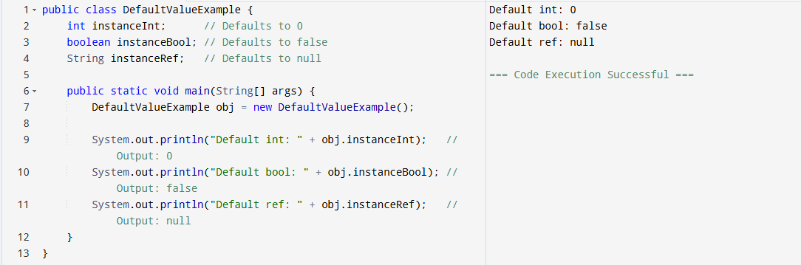
Garbage Value:
A garbage value is a random or unknown value stored in a variable when it is not initialized.

Slide 12
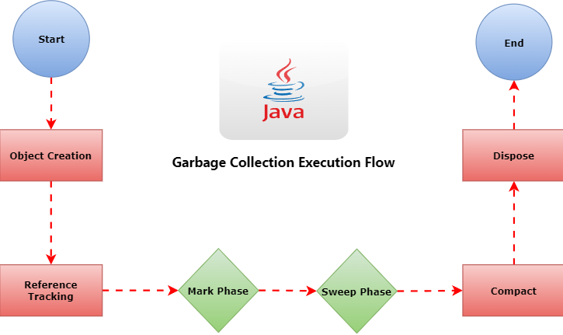
Java (GCE) Flow

Slide 13
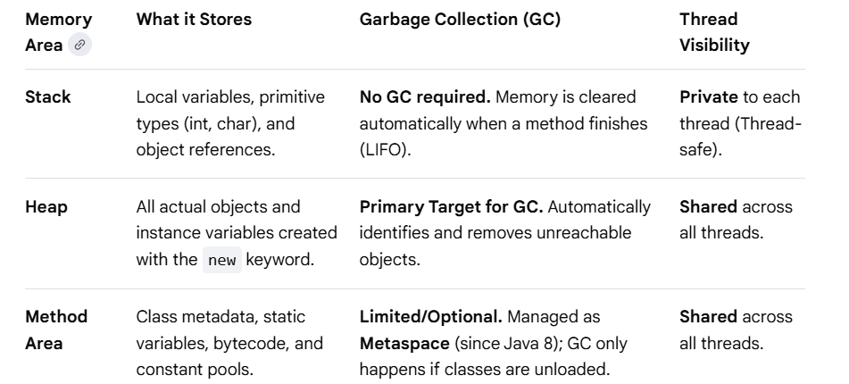
Applications of Java
1. Stack Memory
2. Heap Memory
3. Method Area

Slide 14
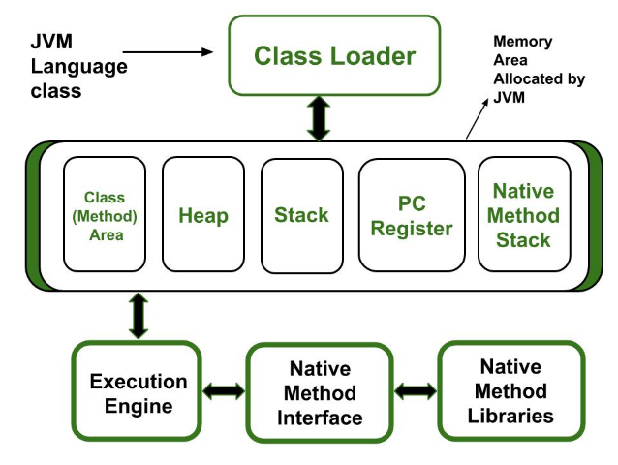
Java Memory Management Working

Slide 15
Conclusion
Efficient Memory Allocation
Proper Memory Deallocation
Minimizing Unnecessary Objects and Variables
Memory Reuse and Optimization

