Slide 1
Memory Management optimization strategies

Slide 2
Introduction
Memory management optimization is the efficient use of memory in a program.
It helps reduce memory wastage and improves performance.
It ensures proper allocation and deallocation of memory.
It prevents problems like memory leaks and fragmentation.

Slide 3
What is Memory Optimization
It is the process of:
Reducing unnecessary memory usage
Improving allocation/deallocation efficiency
Preventing memory leaks and fragmentation

Slide 4
Memory Management in C
Manual memory management.
Dynamic allocation functions.
Free function.
Programmer controls allocation and deallocation.

Slide 5
Types of memory in C
1. Static Allocation: Static allocation is a type of memory allocation where memory is assigned at compile time (before the program runs), and its size cannot be changed later. For examples
int a = 10; // single variable.
int arr[5]; // fixed-size array.
2. Dynamic Allocation (Heap): Dynamic Memory Allocation (DMA) means memory is allocated during program execution (runtime) and can be changed or freed whenever needed.

Slide 6
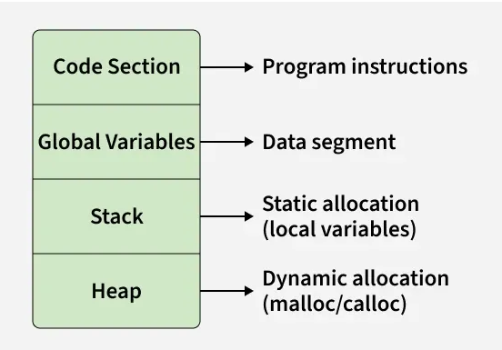
Memory Layout of a C Program

Slide 7
Functions in C
:.
(.
Malloc(): Allocates a single block of uninitialized "garbage" memory of the specified byte size
To use malloc(), you must include the <stdlib.h> header file.
size: The total number of bytes to allocate. It is of type size_t, an unsigned integer.
Syntax : #include <stdlib.h>void* malloc(size_t size);
calloc():Allocates memory for an array of num elements and initializes all bytes to zero.
free(): Releases the allocated memory block back to the system.

Slide 8
Uninitialized Variable & Garbage Value (C)
A variable is created without giving any value It just reserves memory, but no proper value is stored
Examples: int a; // declared but NOT initialized.

Slide 9
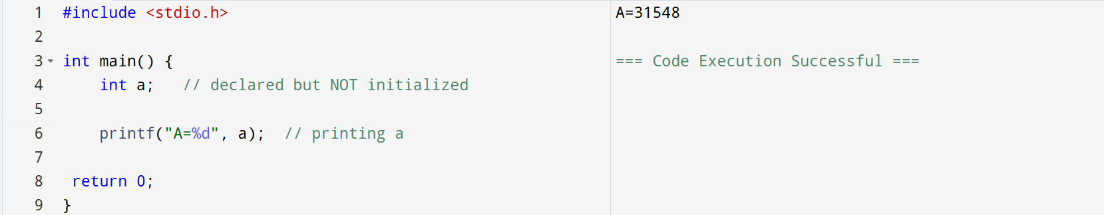
Garbage Value
Garbage value means a variable contains a random value because it is not initialized.

Slide 10
Memory Management in Java
Automatic memory management
Handled by JVM using Garbage Collection

Slide 11
Garbage Value:
A garbage value is a random or unknown value stored in a variable when it is not initialized.

Slide 12
Types in Java
1. Stack Memory
2. Heap Memory
3. Method Area

Slide 13
Conclusion
C = Control + Responsibility
Java = Automation + Safety

