Slide 1
AUTOMATIC TRAFFIC SIGN DETECTION
BY
VAIBHAV CHARAN B
TEJESHWAR SIDDARTH S

Slide 2
OBJECTIVES
The goal of this project is to recognize traffic signs and traffic signs are captured using a vehicle-mounted camera and manual localization and recognition is performed off-line by a human operator to check for consistency with the existing database.
Road and traffic sign recognition is the field of study that can be used to aid the development of an inventory system (for which real-time recognition is not required) or aid the development of an in-car advisory system (when real-time recognition is necessary).

Slide 3
ABSTRACT
Automatic detection and recognition of traffic signs plays a crucial role in management of the traffic-sign inventory. It provides an accurate and timely way to manage traffic-sign inventory with a minimal human effort. In the computer vision community, the recognition and detection of traffic signs are a well-researched problem.
We adopt a convolutional neural network (CNN) approach, the mask R-CNN, to address the full pipeline of detection and recognition with automatic end-to-end learning.
This approach is applied to detection of 200 traffic-sign categories represented in our novel dataset. The results are reported on highly challenging traffic-sign categories that have not yet been considered in previous works.

Slide 4
EXISTING SYSTEMS
The process described involves the detection of traffic signs using Convolutional Neural Networks (CNNs) in conjunction with image acquisition and processing techniques. Initially, the image undergoes preprocessing tasks to enhance its quality, including noise reduction and contrast adjustment.
Subsequently, the image is segmented using color information from the HSV color model, followed by morphological operations to refine the segmented areas.
Some of the major disadvantages of the existing systems are that it lacks accuracy, misses context in detecting signs, limited focus and more.

Slide 5
LITERATURE SURVEY
AUTHOR, JOURNAL YEAR | TITLE | CONCEPT | PROS AND CONS
Saturnino Maldonado-Bascón, Member, IEEE, Sergio Lafuente-Arroyo, Pedro Gil-Jiménez, Hilario Gómez-Moreno, Member, IEEE, and Francisco López-Ferreras 2022 | Road-Sign Detection and Recognition Based on Support Vector Machines | This paper introduces an automatic road-sign detection and recognition system leveraging support vector machines (SVMs). The system is capable of identifying various traffic sign shapes, including circular, rectangular, triangular, and octagonal, covering all Spanish traffic signs. Divided into three stages, the system employs color-based segmentation. | PROs The system's segmentation stage based on colors such as red, blue, yellow, white, or combinations thereof enables the detection of all types of traffic signs, including those with various colors. CONs Integrating additional features or cues beyond color could enhance robustness in challenging condition.

Slide 6
LITERATURE SURVEY
AUTHOR, JOURNAL YEAR | TITLE | CONCEPT | PROS AND CONS
Jack Greenhalgh and Majid Mirmehdi, Senior Member, IEEE. 2023 | Real-Time Detection and Recognition of Road Traffic Signs | This paper introduces a novel system for automatic traffic sign detection and recognition. It utilizes maximally stable extremal regions (MSERs) for robust region detection under varying lighting conditions. Recognition is achieved through a cascade of support vector | PROs Leveraging maximally stable extremal regions (MSERs) for candidate region detection ensures robustness to variations in lighting conditions. CONs One potential limitation of this system is its reliance on synthetic template images for training data.

Slide 7
LITERATURE SURVEY
AUTHOR, JOURNAL YEAR | TITLE | CONCEPT | PROS AND CONS
Andreas Møgelmose, Mohan Manubhai Trivedi, and Thomas B. Moeslund. 2022 | Vision-Based Traffic Sign Detection and Analysis for Intelligent Driver Assistance Systems: Perspectives and Survey | This paper presents a comprehensive survey of the literature on traffic sign detection for driver assistance systems. It outlines recent advancements in segmentation, feature extraction, and final sign detection stages. | PROs This survey paper provides a comprehensive overview of the traffic sign detection literature, including recent advancements and open research issues. CONs European traffic signs and the limited utilization of publicly available image databases may hinder the generalizability of findings.

Slide 8
LITERATURE SURVEY
AUTHOR, JOURNAL YEAR | TITLE | CONCEPT | PROS AND CONS
Jian-He Shi and Huei-Yung Lin, Taiwan. 2021 | A Vision System for Traffic Sign Detection and Recognition | This paper introduces an automatic traffic sign recognition system utilizing videos from an on-board dashcam. It employs image processing techniques such as bilateral Chinese transform and vertex and bisector transform to extract traffic sign areas | PROs This system leverages a combination of image processing techniques, support vector machines, and neural networks to achieve automatic traffic sign recognition. CONs Varying lighting conditions, occlusions, and the presence of non-standard or obscured traffic signs.

Slide 9
LITERATURE SURVEY
AUTHOR, JOURNAL YEAR | TITLE | CONCEPT | PROS AND CONS
Zhiyong Huang, Yuanlong Yu, Jason Gu, and Huaping Liu. 2023 | An Efficient Method for Traffic Sign Recognition Based on Extreme Learning Machine | This paper presents a computationally efficient method for traffic sign recognition (TSR) consisting of two modules: 1) extraction of histogram of oriented gradient variant (HOGv) feature and 2) a single classifier trained by extreme learning machine (ELM) algorithm | PROs The proposed method offers a balance between computational efficiency and recognition accuracy, suitable for real-time applications systems. CONs The performance may vary depending on the complexity of traffic sign images, leading to reduced accuracy in challenging scenarios.

Slide 10
LITERATURE SURVEY
AUTHOR, JOURNAL YEAR | TITLE | CONCEPT | PROS AND CONS
Prashengit Dhar 1, Md. Zainal Abedin, Tonoy Biswas, Anish Datta 2021 | Traffic Sign Detection- A New Approach and Recognition Using Convolution Neural Network | This research presents a Traffic Sign Recognition (TSR) system designed for Bangladeshi traffic signs, employing color cues and Convolutional Neural Network (CNN) for feature extraction and classification. The system undergoes image acquisition, pre-processing, color-based segmentation, morphological closing, and region filtering to extract sign areas | PROs The proposed algorithm demonstrates good accuracy in experimental evaluations, contributing to safer driving practices in Bangladeshi road conditions. CONs While the algorithm's performance is comparable and recognition accuracy is good, there may be scope for further optimization

Slide 11
DRAWBACKS
The effectiveness of the CNN model heavily relies on the quality and diversity of the training dataset. If the dataset used for training is biased or lacks diversity, the model's performance may be limited, leading to reduced accuracy and generalization capability, especially when encountering novel or rare traffic sign classes.
While CNNs are capable of learning robust representations, they may still struggle with variations in environmental conditions such as changes in lighting, weather, or occlusions. This could lead to decreased performance in adverse conditions or under challenging scenarios, affecting the system's reliability in real-world deployments.

Slide 12
PROPOSED SYSTEM
Augmenting the training dataset with diverse variations of traffic signs and incorporating data from different regions and countries can enhance the model's ability to generalize across various environmental conditions and sign designs.
Optimizing the computational efficiency of the system to achieve real-time performance on resource-constrained platforms is crucial for practical deployment in vehicles and edge devices. This could involve model compression techniques, hardware acceleration using specialized processors (e.g., GPUs, TPUs), or implementing lightweight architectures tailored for embedded systems.

Slide 13
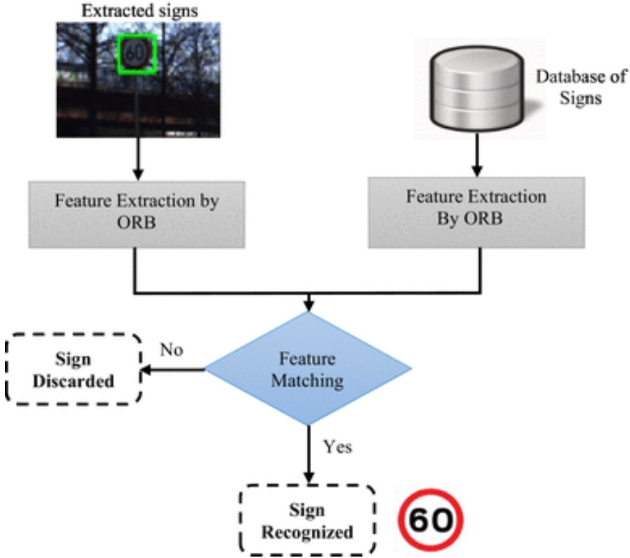
SYSTEM ARCHITECTURE

Slide 14
IMAGE PREPROCESSING
Image pre-processing is the name for operations on images at the lowest level of abstraction whose aim is an improvement of the image data that suppress undesired distortions or enhances some image features important for further processing and analysis task.
It does not increase image information content. Its methods use the considerable redundancy in images.
Neighbouring pixels corresponding to one real object have the same or similar brightness value.
If a distorted pixel can be picked out from the image, it can be restored as an average value of neighbouring pixels.
In the proposed approach image pre-processing methods are applied to the captured image which are stored in image database.
Optimizing the computational efficiency of the system to achieve real-time performance on resource-constrained platforms is crucial for practical deployment in vehicles and edge devices. This could involve model compression techniques, hardware acceleration using specialized processors (e.g., GPUs, TPUs), or implementing lightweight architectures tailored for embedded systems.

Slide 15
MODEL TRAINING
Image data is the input for the model which consist of a particular pixel size.
The model consists of different types of layers which transforms the image’s pixel value by using filters.
Creating a training and testing split of your dataset is one method to quickly evaluate the performance of an algorithm.

Slide 16
IMAGE AUGMENTATION
Image augmentation artificially creates training images through different ways of processing or combination of multiple processing, such as random rotation, shifts, shear and flips, etc.
It is a technique that is used to artificially expand the data-set.
This is helpful when we are given a data-set with very few data samples.
In case of deep learning, this situation is bad as the model tends to over-fit when we train it on limited number of data samples.

Slide 17
ADVANTAGES
Increasing throughput & reducing subjectiveness arising from human experts in detecting the traffic signals.
It is essential to detect any random sign in roads.
In our country many drivers can fetch information from this system, increasing safety and security of the driver.

Slide 18
CONCLUSION
In conclusion, this mini project signifies a notable advancement in the domain of traffic sign detection and classification by employing Convolutional Neural Network (CNN) technology.
Through the utilization of deep learning, particularly CNN-based object detection methodologies, the system achieves remarkable performance in real-time recognition of traffic signs.
This classification step is crucial for providing meaningful information to drivers or autonomous vehicle systems, aiding in decision-making processes such as speed adjustment, lane changing, or traffic signal adherence.

Slide 19
FUTURE ENHANCEMENT
Augmenting the training dataset with diverse variations of traffic signs and incorporating data from different regions and countries can enhance the model's ability to generalize across various environmental conditions and sign designs. Additionally, collecting annotated data for underrepresented or rare traffic sign classes can further improve the model's classification accuracy and coverage.
Optimizing the computational efficiency of the system to achieve real-time performance on resource-constrained platforms is crucial for practical deployment in vehicles and edge devices. This could involve model compression techniques, hardware acceleration using specialized processors (e.g., GPUs, TPUs), or implementing lightweight architectures tailored for embedded systems.

Slide 20
REFERENCES
Road-Sign Detection and Recognition Based on Support Vector Machines –
Saturnino Maldonado-Bascón, Member, IEEE, Sergio Lafuente-Arroyo, Pedro Gil-Jiménez, Hilario Gómez-Moreno, Member, IEEE, and Francisco López-Ferreras
Real-Time Detection and Recognition of Road Traffic Signs - Jack Greenhalgh and Majid Mirmehdi, Senior Member, IEEE.
Vision-Based Traffic Sign Detection and Analysis for Intelligent Driver Assistance Systems: Perspectives and Survey - Andreas Møgelmose, Mohan Manubhai Trivedi, and Thomas B. Moeslund.

Slide 21
REFERENCES
A Vision System for Traffic Sign Detection and Recognition - Jian-He Shi and Huei-Yung Lin, Taiwan.
An Efficient Method for Traffic Sign Recognition Based on Extreme Learning Machine - Zhiyong Huang, Yuanlong Yu, Jason Gu, and Huaping Liu.
Traffic Sign Detection- A New Approach and Recognition Using Convolution Neural Network - Prashengit Dhar 1, Md. Zainal Abedin, Tonoy Biswas, Anish Datta

Slide 22
THANK YOU

