Slide 1

ELECTRICITY PRICE
AND
DEMAND FORECASTING
Presented By (Group 2) –
PRAVEENA G
praveena.25it@licet.ac.in
Vittamsetty Divya sai mani chandana
vd8196752@gmail.com
Prabhat Kumar Nayak
prabhat123dkl@gmail.com
Kumar Pushpam
kumarpushpam2003@gmail.com
Prachi wadhave
prachiwadhave20@gmail.com
Soumita Bhattacharjee
soumitabhattacharjee02@gmail.com
Vaibhav Malhotra
vaibhav.malhotra@adgitmdelhi.ac.in
Sanjai M
msanjai401@gmail.com
KARI. Sai Vardhan
saivardhankari@gmail.com
19 JULY 2024

Slide 2
Problem Statement
Objective:
Develop machine learning models for accurate prediction of
electricity demand and price.
Data Integration:
Integrate historical demand patterns, weather data, and other relevant
factors to enhance forecasting accuracy.
Impact:
Support smart grid operations and enable data-driven decision-making in
the energy market to optimize resource allocation and pricing strategies.

Slide 3
Content
Data Introduction
Exploratory Data Analysis (EDA) and Data Preprocessing
Feature Engineering
Model Implementation
Model Comparison
Model Selection
Conclusion

Slide 4
Data Introduction
Overview of the datasets used:
Weather Data: Contains various weather-related features such as temperature, humidity, wind speed, and weather conditions.
Energy Data: Includes features related to energy production and consumption, such as different types of generation (e.g., fossil, hydro, solar), load, and price information.
Dataset Shapes:
Weather Data: (178396, 17)
Energy Data: (35064, 29)

Slide 5
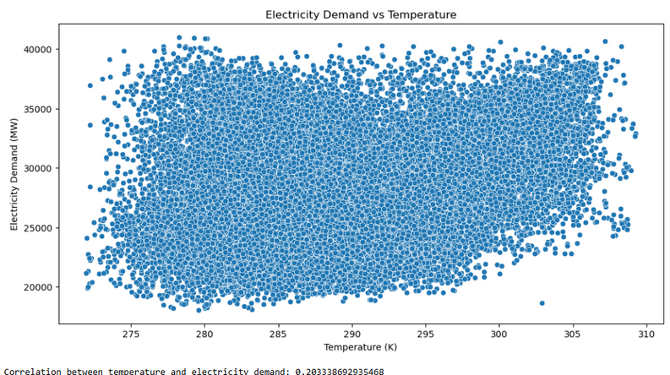
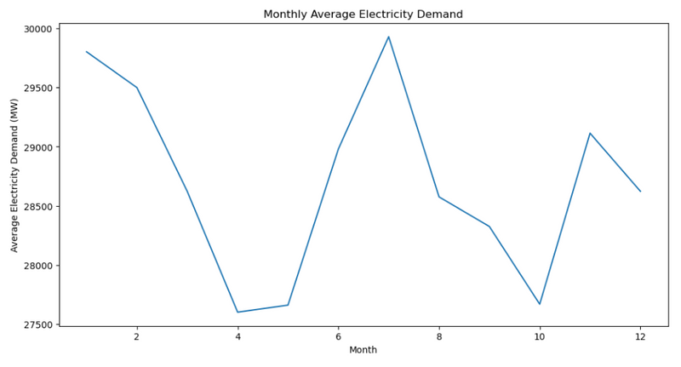
EDA and Data Preprocessing
Data preprocessing:
Removed columns with all NAN or zero value.
Handled missing values: numeric columns with mean, categorical columns with mode
Replace outliers with NaN using the IQR method.
The hypothesis is supported but with a weak correlation.
Demand peaking at times consistent with extreme temperatures.

Slide 6
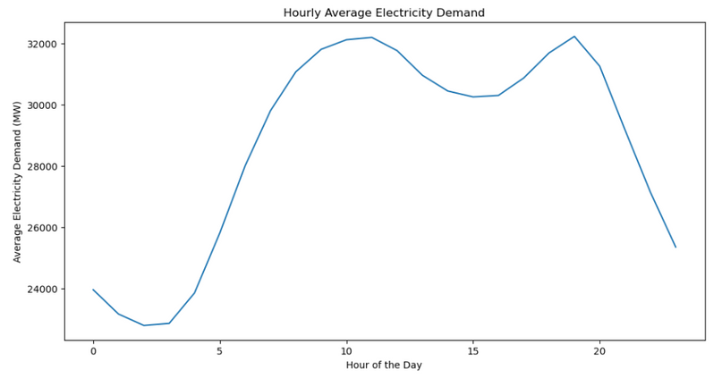
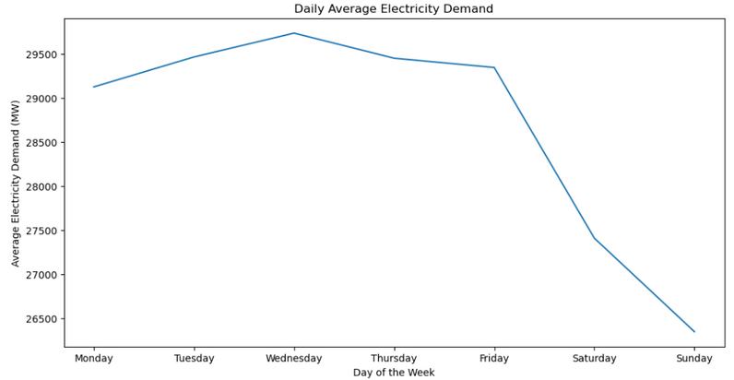
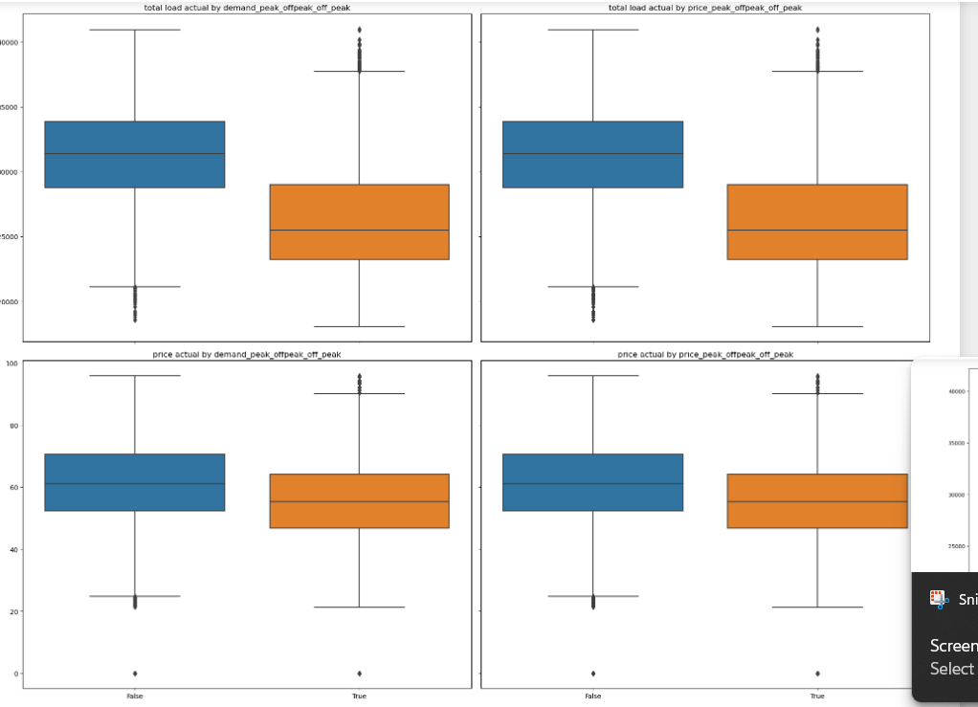
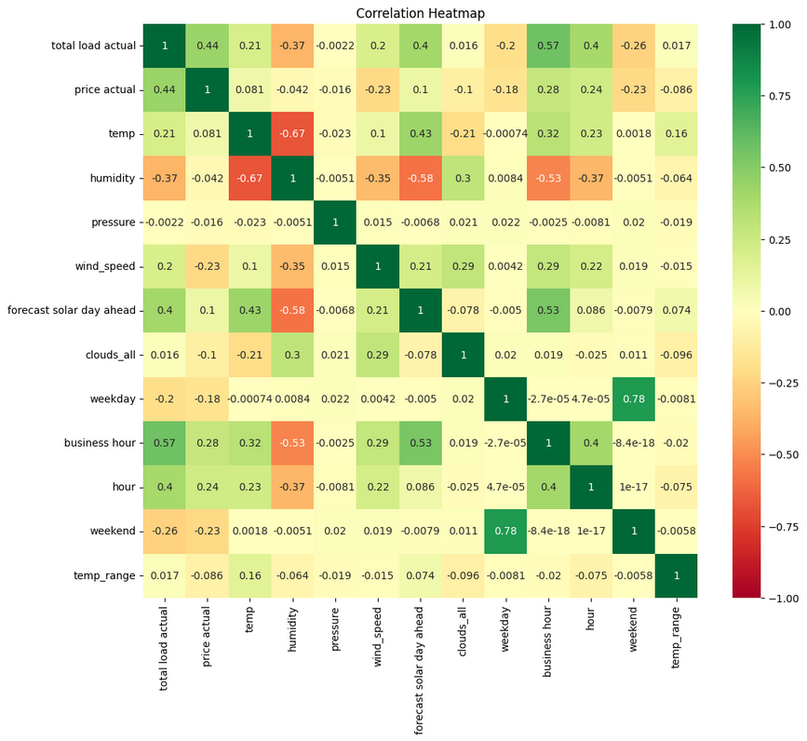
Distinct peaks and troughs corresponding to different hours of the day.
Electricity demand patterns differ between weekdays and weekends.
1 had a higher median score, while 2 showed greater variability in exam scores.

Slide 7
Feature Engineering
Temporal Features:
Hour of Day
Categorical Features:
Peak/Off-Peak Classification
Day of Week and Weekend Classification:
One-Hot Encoding
Month and Seasonal Variation:
One-Hot Encoding
Temperature Features:
Squared and Cubed Temperatures

Slide 8
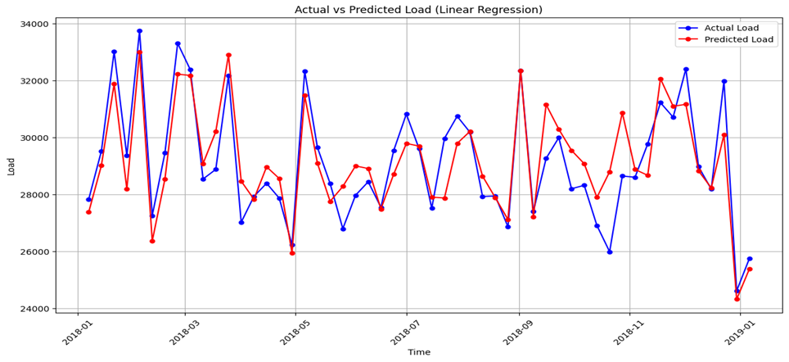
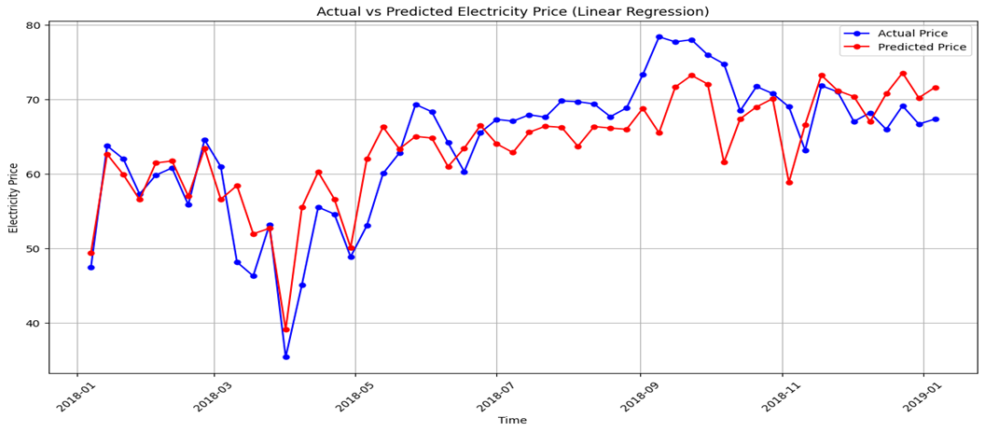
Model Implementation
Linear Regression
Total Load Actual Prediction
Price Actual Prediction:
MSE: 3424259.6515
RMSE: 1850.4755
R^2: 0.832
Adjusted R^2: 0.831
MAPE: 0.0525
MSE: 72.67491
RMSE: 8.52495
R^2: 0.6504359
Adjusted R^2: 0.648
MAPE: 0.12604

Slide 9
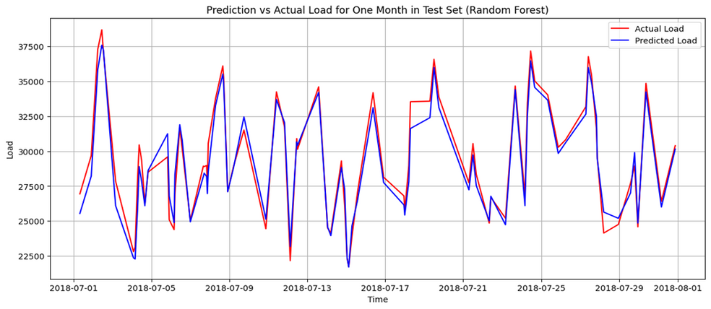
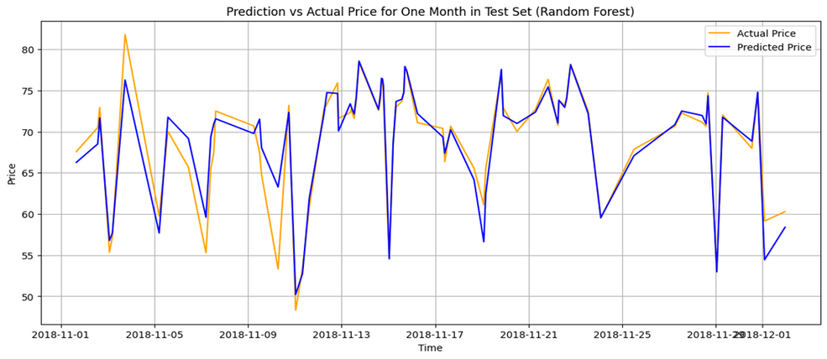
Random Forest
Total Load Actual Prediction
Price Actual Prediction:
MSE : 1019573.590
RMSE : 1009.7393
R^2: 0.950250
Adjusted R^2 : 0.9499
MAPE : 0.02673
MSE: 13.0598
RMSE: 3.6138
R^2: 0.93718
Adjusted R^2 : 0.9367
MAPE : 0.04757

Slide 10
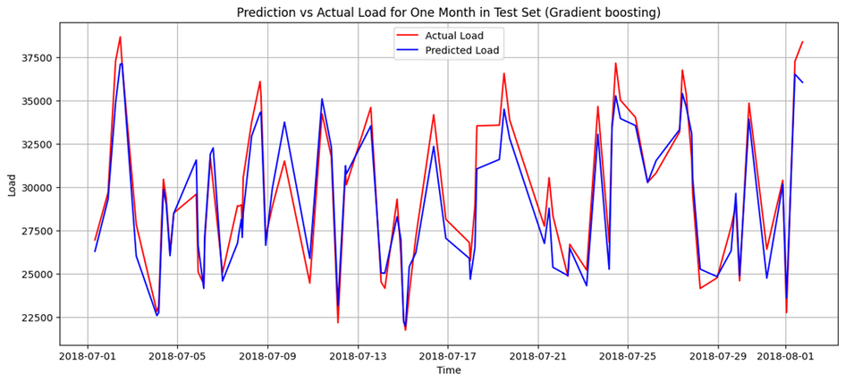
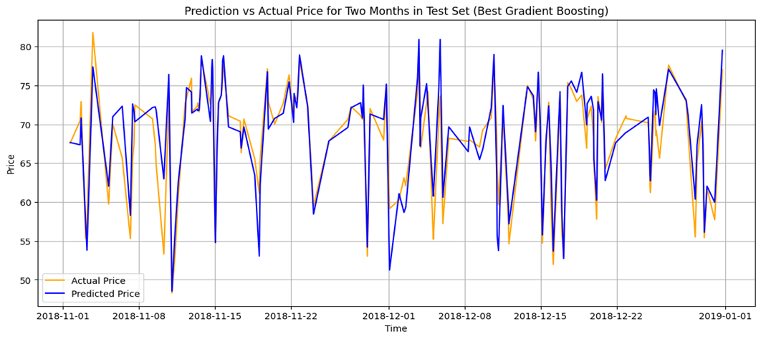
Gradient Boosting
Total Load Actual Prediction
Price Actual Prediction:
MSE : 1153222.99942
RMSE : 1073.882209
R^2 : 0.9437290
Adjusted R^2 :0.943357
MAPE : 0.029599
MSE : 13.7578800
RMSE : 3.7091617
R^2 : 0.933825
Adjusted R^2 : 0.93336
MAPE : 0.051809

Slide 11
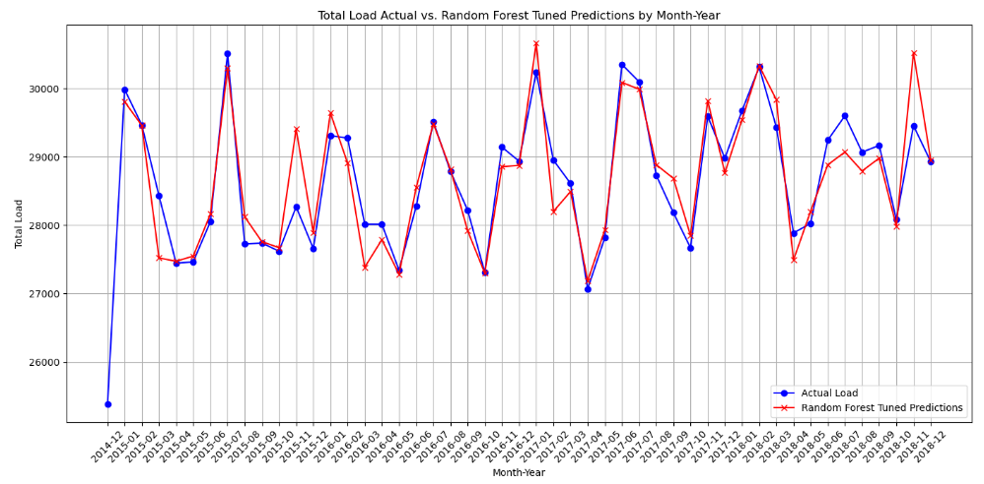
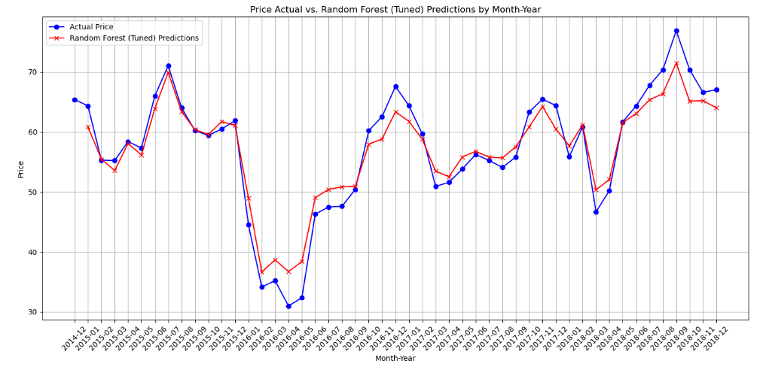
Random Forest (Tuned)
Total Load Actual Prediction
Price Actual Prediction:
MSE: 1019573.76
RMSE: 1009.739
MAPE: 0.027
R²: 0.950
Adjusted R²: 0.950
MSE: 4.2886
RMSE: 3.6138
MAPE: 0.040
R²: 0.93
Adjusted R²: 0.93

Slide 12
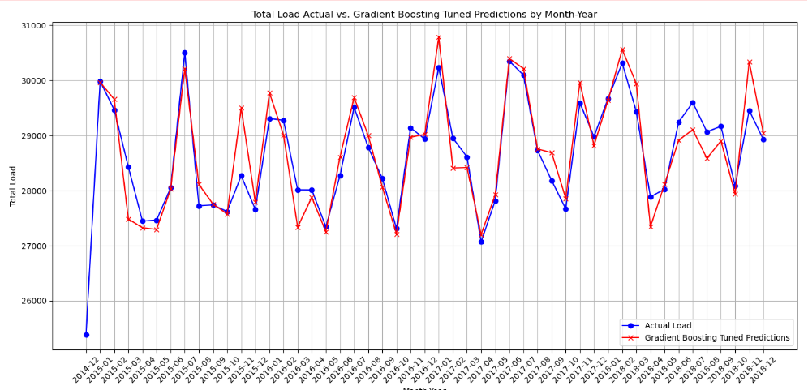
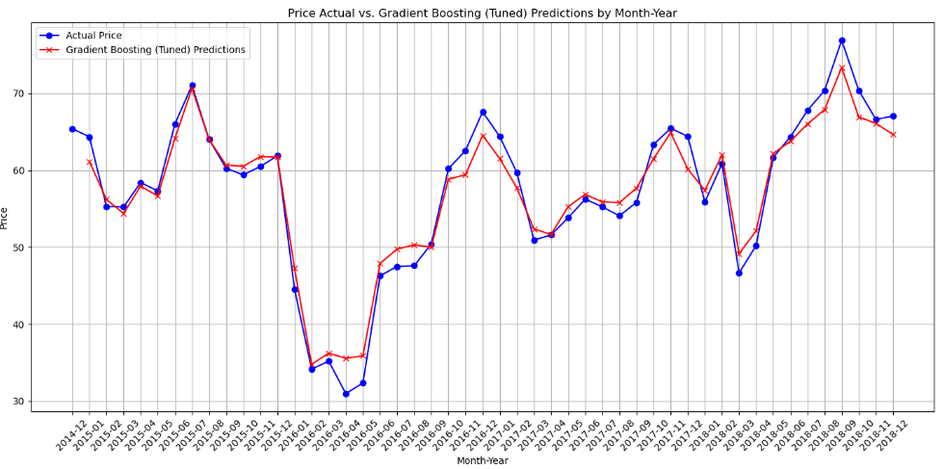
Gradient Boosting (Tuned)
Total Load Actual Prediction
Price Actual Prediction:
MSE: 11532233.00
RMSE: 1073.882
MAPE: 0.030
R²: 0.944
Adjusted R²: 0.943
MSE: 13.75
RMSE: 3.7090
MAPE: 0.050
R²: 0.93
Adjusted R²: 0.0.93

Slide 13
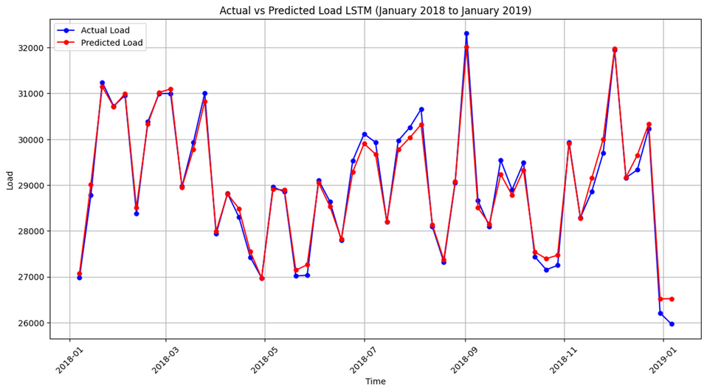
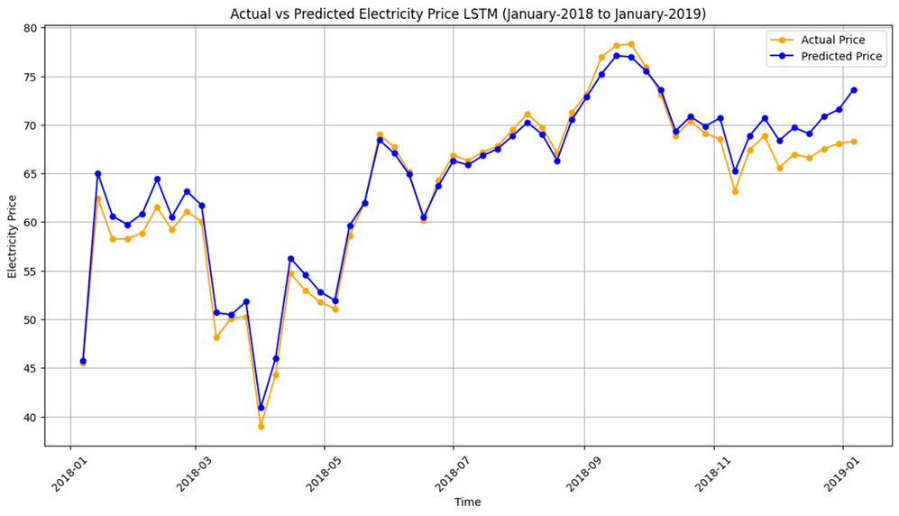
LSTM
Total Load Actual Prediction
Price Actual Prediction:
MAE : 517.2379
RMSE :683.33461
R² : 0.977845
Adjusted R² : 0.9776883
MAPE : 0.0180829
MAE : 2.426148
RMSE : 3.002346
R² : 0.8557
Adjusted R² : 0.85475
MAPE : 0.03565

Slide 14
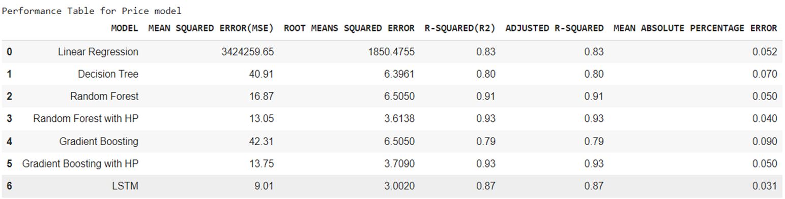
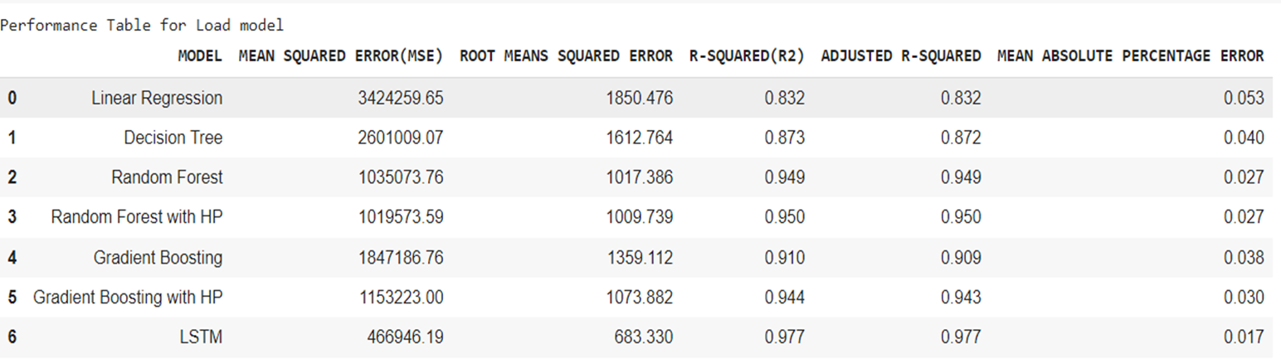
Model Comparison
For Price actual: LSTM
For Load actual: LSTM

Slide 15
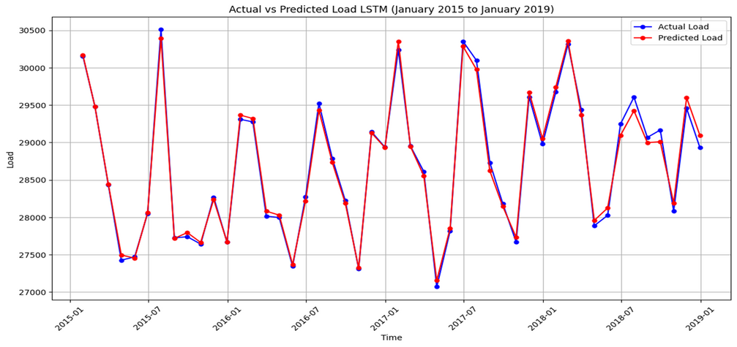
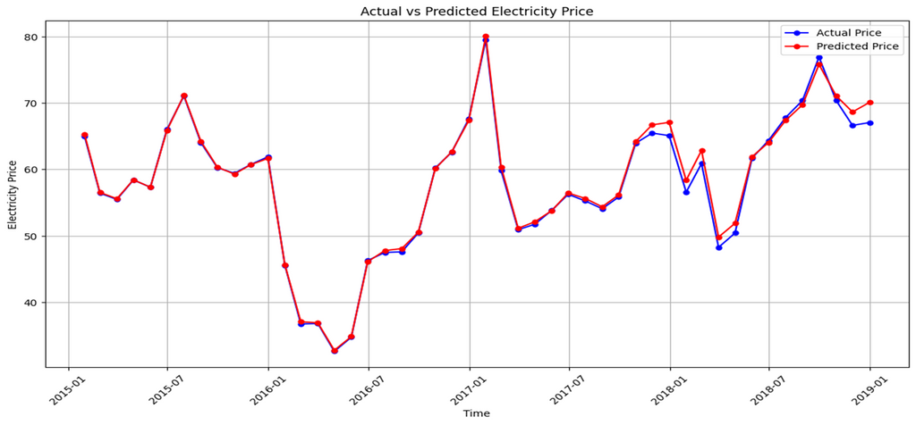
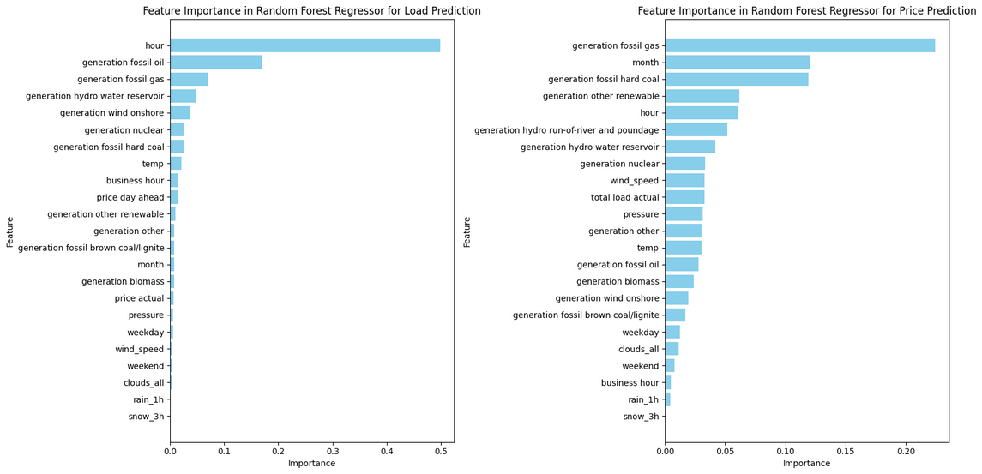
Model Selection
For Load actual: LSTM model performed well with good R^2 and MAPE value.
For Price actual: LSTM model performed well with good R^2 and MAPE value.

Slide 16
Conclusion
Model Selection and Tuning:
LSTM (for price) and LSTM (for load) outperformed other models.
Least MAPE% and better R² and adjusted R² values influenced our choice.
Data-Driven Insights:
Uncovered relationships between demand, price, and influencing factors.
These insights inform long-term energy planning.
Scalable Solutions:
Consider scalability as data volumes grow.

