Slide 1

Predicting The Churn Of Bank Customers
- Vaibhav Agarwal

Slide 2
What Is Churn Rate?
The churn rate, also known as the rate of attrition or customer churn, is the rate at which customers stop doing business with an entity.
Churn rate usually lies in the range from 10% up to 30%.

Slide 3
Why does churn happen?
Availability of latest technology
Customer-friendly bank staff
Low interest rates
Location
Services offered

Slide 4
Importance of this Analysis
The cost of attracting new customers can be five to six times more than holding on to an existing customers
Long term customers become less costly to serve, they generate higher profits, and they may also provide new referrals
Losing a customer usually leads to loss in profit for the bank.

Slide 5
Data: Churn prediction variables
Credit Score
Age
Gender
Geography
Number of products
Estimated Salary
Balance
Tenure
Has Credit Card or not
Is active member or not

Slide 6
Exploratory Analysis

Slide 7
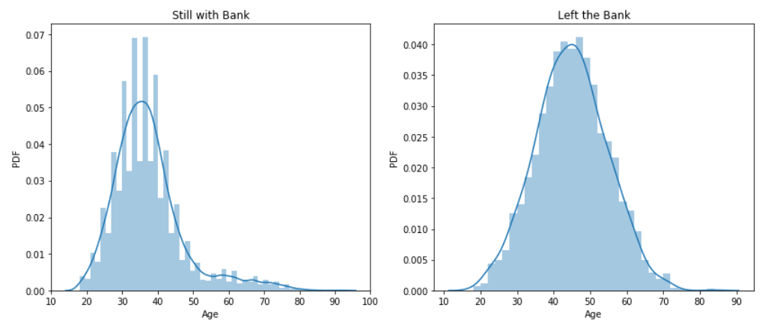
Age
The median age of people whom the bank retained is 37 and the
median age of people who exited the bank is 45.

Slide 8
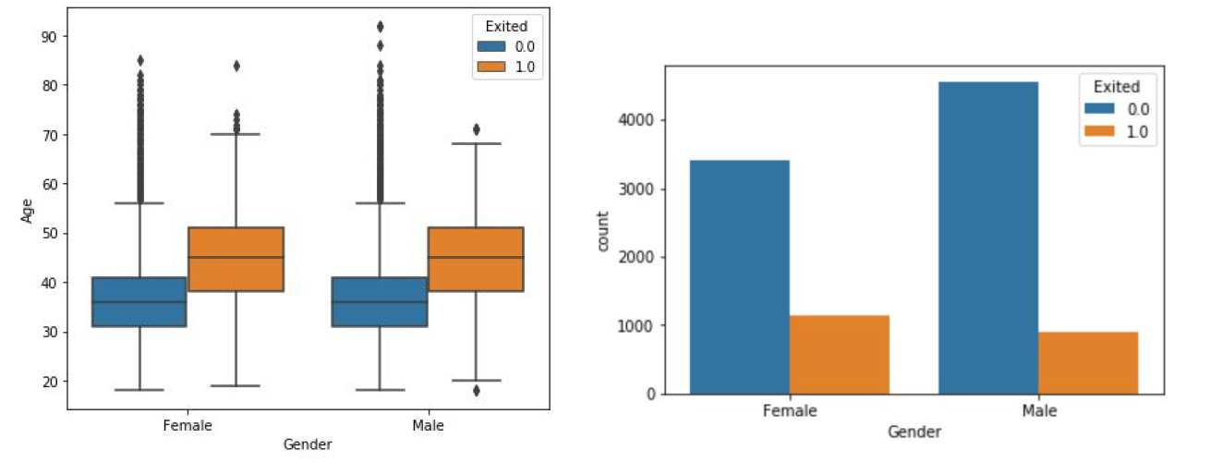
Gender
It is female who left the bank more than the male. The percentage of the female who left the bank is 25%, whereas for males it is 16%.

Slide 9
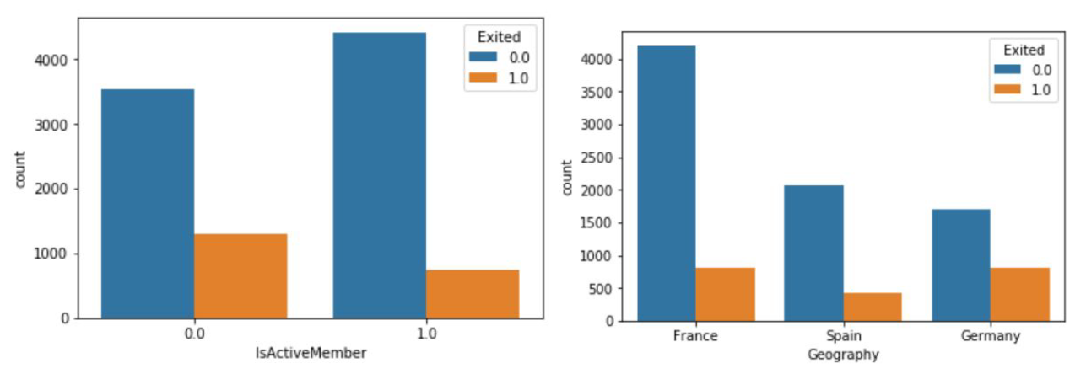
Active Member and Geography count
The inactive members churned more with 27%. Only 14% of active members churned. Most churning of customers happened in Germany with almost 32% of customers leaving the bank.

Slide 10
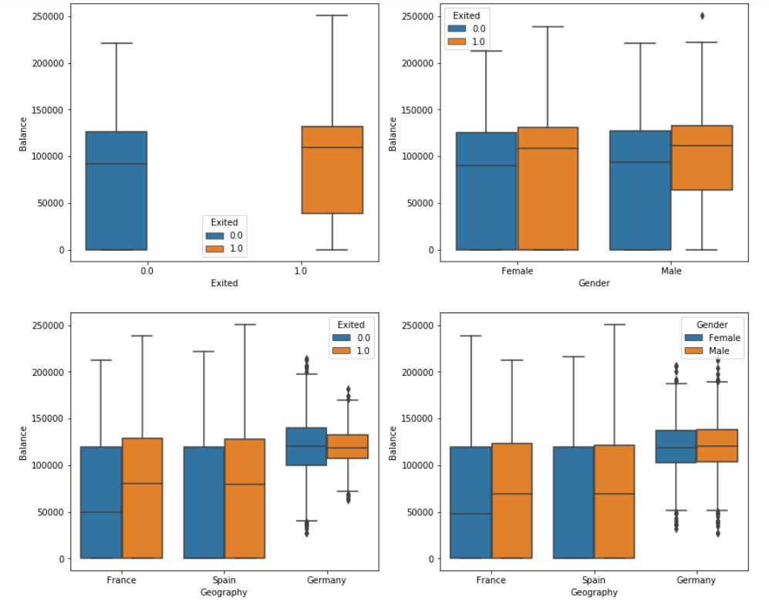
Balance vs others
Little or no impact

Slide 11
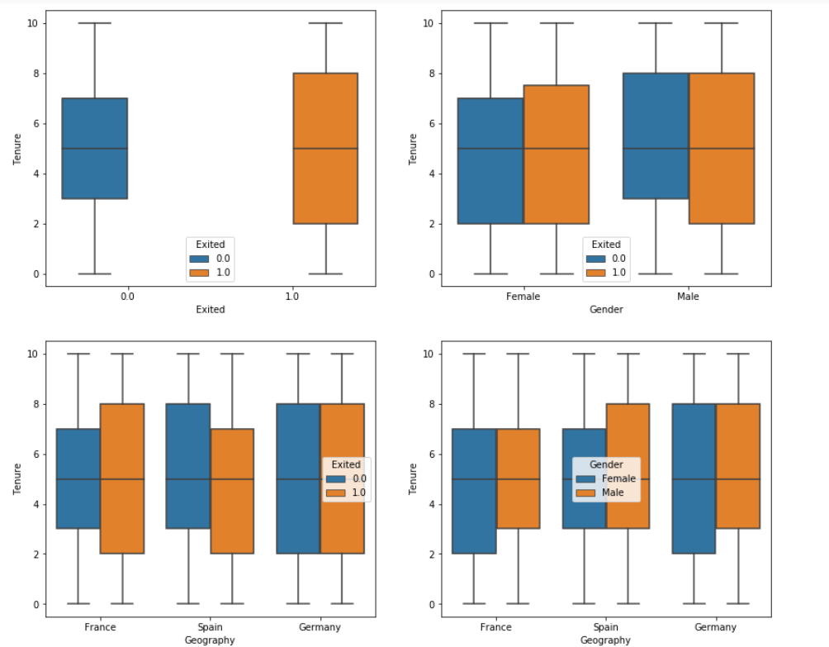
Tenure vs others
Little or no impact

Slide 12
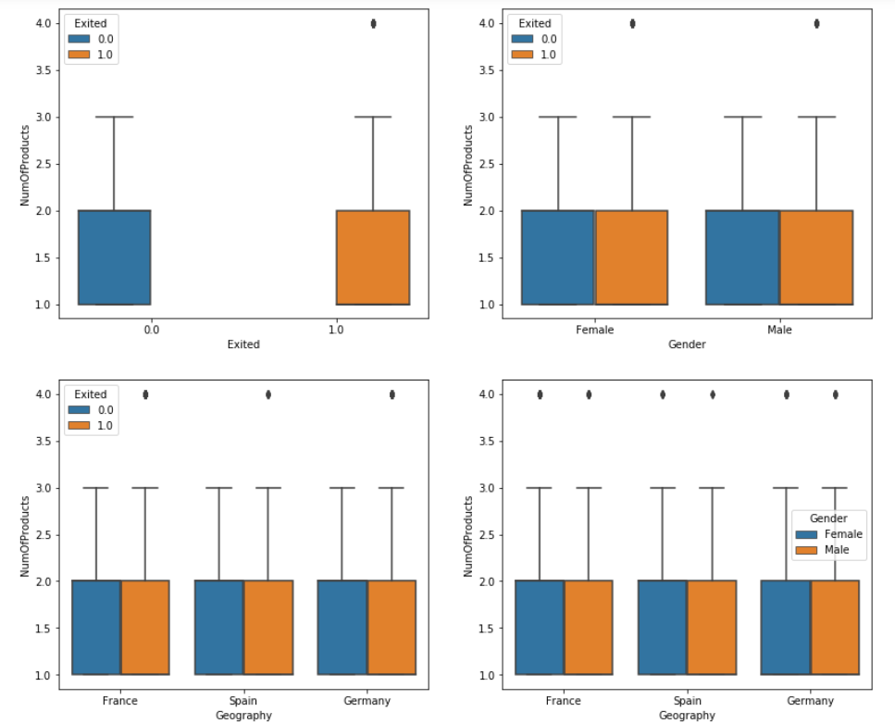
Number of Products vs others
Little or no impact

Slide 13
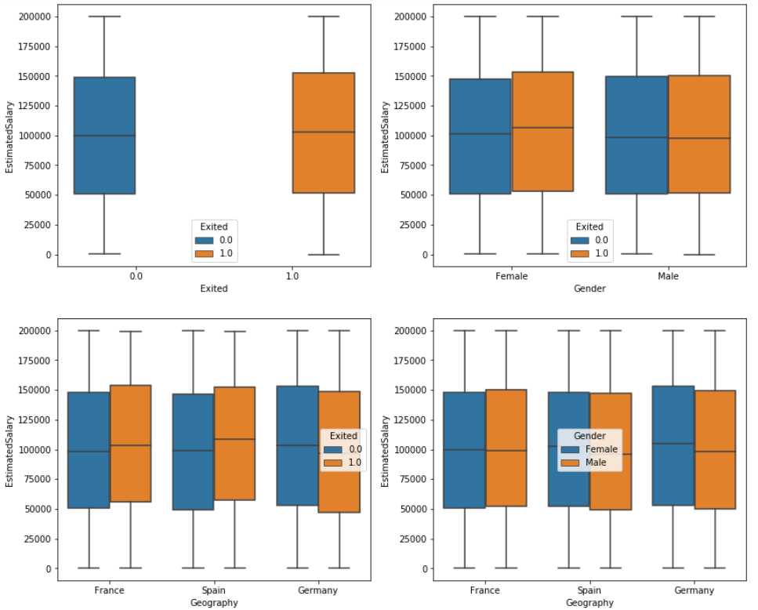
Estimated Salary vs Others
Little or no impact

Slide 14
Hypothesis Testing

Slide 15
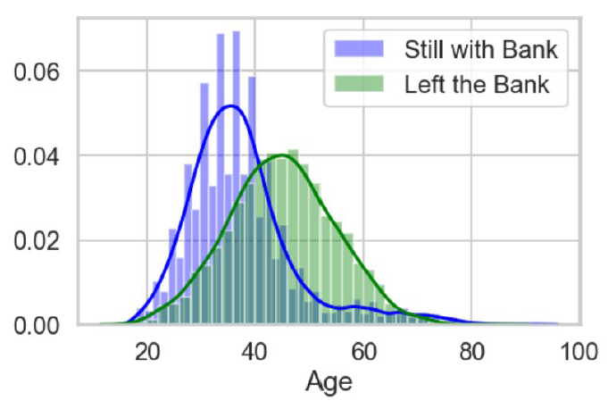
Hypothesis 1: Age
Hypothesis Null: Age of people who left the bank and who did not are similar. Alternative: Not similar.
We reject the Null hypothesis. The probability of the null hypothesis is almost zero which is less than the significance level of 0.05.

Slide 16
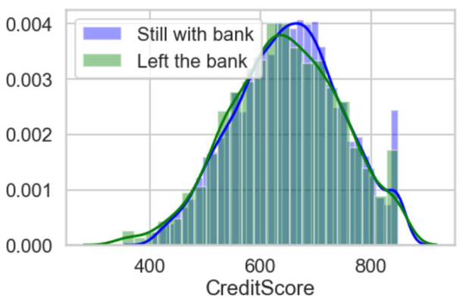
Hypothesis 2: Credit Score
Hypothesis Null: Credit score of people who left the bank and who did not are similar. Alternative: Not similar.
We reject the Null hypothesis. The probability of the null hypothesis is 0.0085 or 0.85 % which is less than the significance level of 0.05

Slide 17
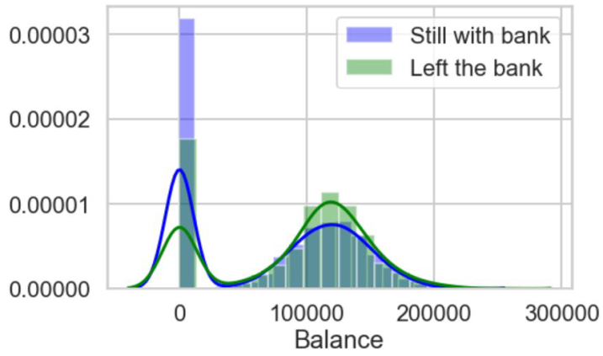
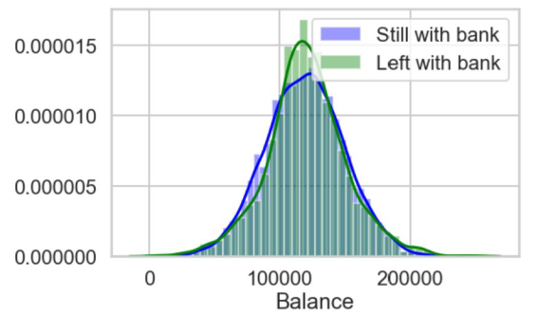
Hypothesis 3: Balance
Hypothesis Null: Balance of people who left the bank and who did not are similar. Alternative: Not similar.
The Balances of Zero are too many in the data. When we consider all the data, we reject the Null Hypothesis. When we only remove the Balances which are Zero, the probability of the null hypothesis becomes 19.06% which is significant. Then we reject Alternative Hypothesis.

Slide 18
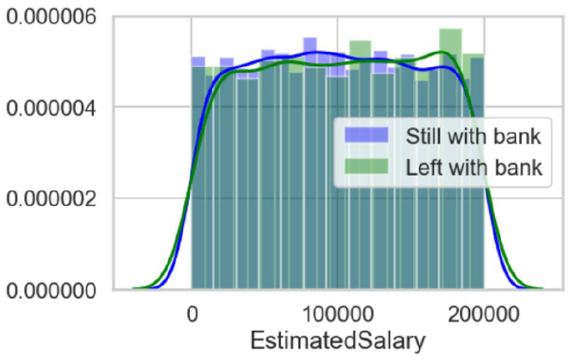
Hypothesis 4: Estimated Salary
Hypothesis Null: Estimated Salary of people who left the bank and who did not are similar. Alternative: Not similar.
We do not reject the Null hypothesis. The probability of the null hypothesis using the t-test is 0.2416 or 24.16% and using bootstrapping is 0.1222 or 12.22% which is more than the significance level of 0.05

Slide 19
Data Pre-processing
Feature Selection
Label encoding
Scaling
Over Sampling
Data splitting

Slide 20
Predictive Modelling

Slide 21
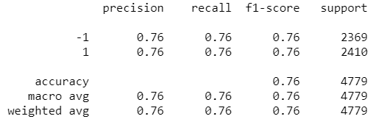
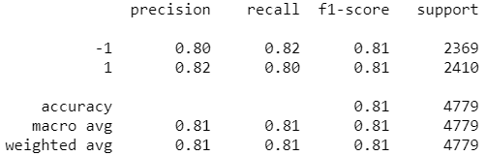
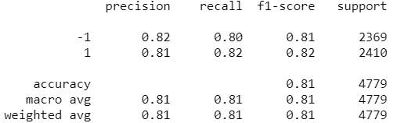
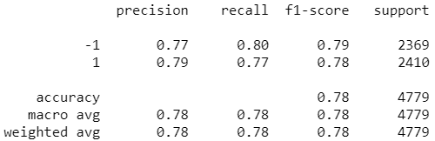

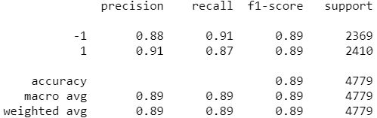
Logistic Regression kNN
SVM with ‘rbf’ SVM with ‘poly’
Random Forest XGBoost

Slide 22
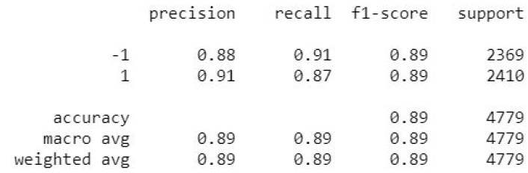
Best Classifier: XGBoost
Training Accuracy: 0.8885
Roc Auc Score: 0.9532
Classification Report:

Slide 23
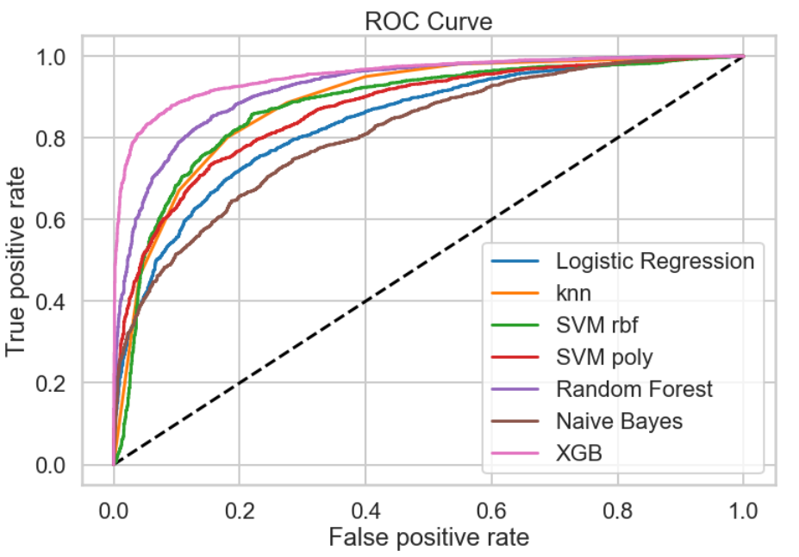

Slide 24
Model Results
Good Precision and Recall
XGBoost Classifier gave best results
Results improved using Over Sampling method.
Need continuous data for best accuracy.

Slide 25
Assumptions and Limitations
This is not continuous data. Thus the assumption is that the data is a snapshot as some point in time e.g. the balance is for a given date.
There are customers who have exited but still have a balance in their account. The assumption is that the customers had that much of amount when they cleared the account.
There is an active member but have exited. This should mean that the customer was an active member before they left.
A break down to the products bought into by a customer could provide more information topping listing of product count

Slide 26
Thank You

