Slide 1

Detecting Malaria using Image classification
- Vaibhav Agarwal

Slide 2
Introduction
Problem Statement: To solve with the best accuracy by detecting Image Cells that contain Malaria or not.
The data used in this project is taken from kaggle. The dataset is divided into two parts, one containing infected cells images and the other containing uninfected cell images.

Slide 3
Importance of this Analysis
Malaria is a life-threatening disease caused by parasites that are transmitted to people through the bites of infected female Anopheles mosquitoes. It is preventable and curable.
This project will help them as a Healthcare company will be able to classify the malaria-infected and uninfected cells. They will be able to deploy this predictive system even in remote corners of the world.

Slide 4
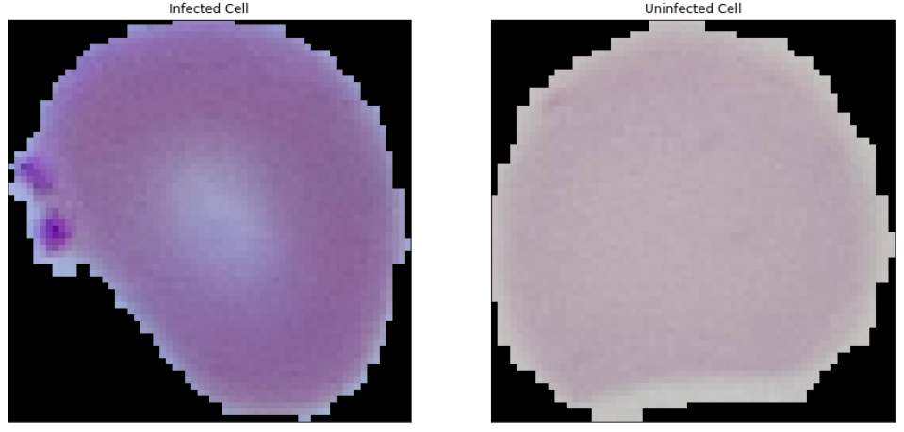
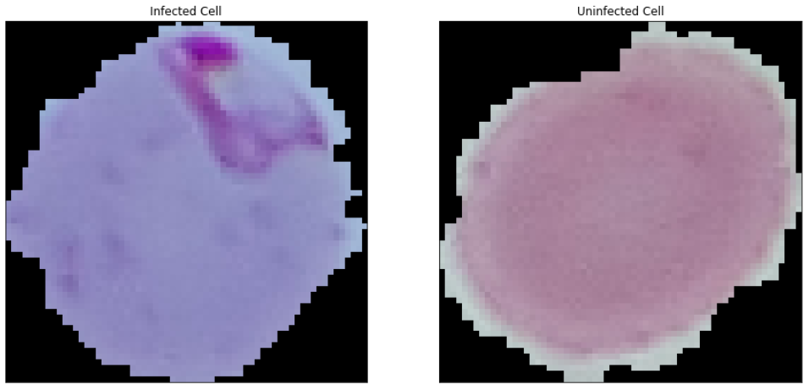
Sample Images

Slide 5
Data
The shape of the data is (27558, 64, 64, 3).
27558: the length of the list is the number of images
(64, 64): is the pixel size of image
3: contains the values of RGB of the image.
The shape of the labels is (27558, 2).
27558: the length of the list corresponding to the images data
2: labels categorical values of 0 or 1

Slide 6
Data Processing
The data and labels are converted into numpy array. It can be numpy array before but just to be sure.
An array is generated containing numbers zero to the length of data. The array is then randomly shuffled.
The array is used to shuffle the data and labels. As they were containing first infected then uninfected images.
The data is converted to float data type. This is done so when scaling is done, the numbers after decimal remains.
The data is scaled by dividing it by 255, the largest number in representing colors.
The data is then split in 70-30 ratio. With 70% of data in train and 30% data in test.
The model was run in google colab due to its high requirement of computing process

Slide 7
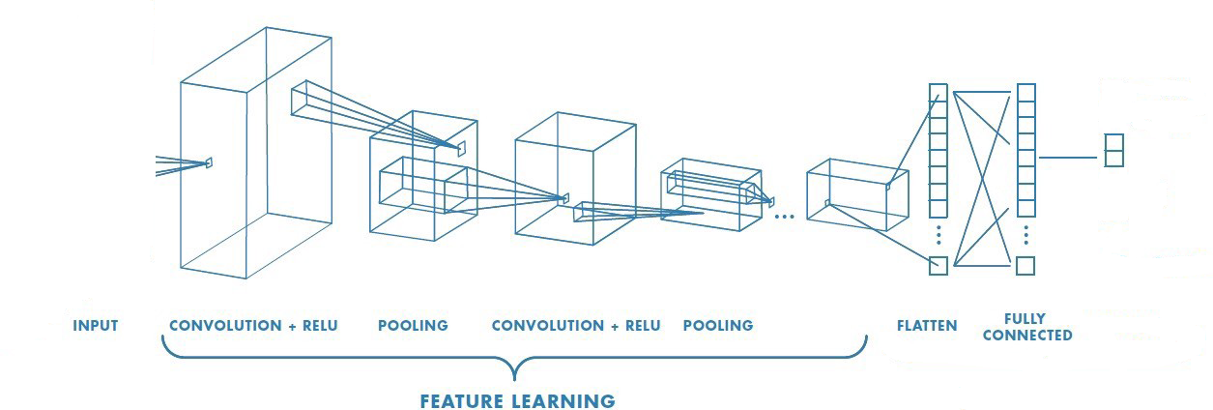
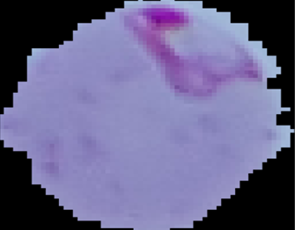
Architecture
PROBABILITY
OF INFECTED
PROBABILITY
OF UNINFECTED

Slide 8
Deep Learning Model

Slide 9
Data Augmentation Parameters
We have done data augmentation to create similar images with a bit of distortions like zooming, flipping the image. This makes the model more robust against the new images.
Train:
rescale = 1./255,
shear_range= 0.2,
zoom_range= 0.2,
horizontal_flip= True,
vertical_flip= True
shuffle = False
Validation/Test:
rescale=1./255
Note: Because the shuffle parameter in data augmentation is True by default the recall was low initially. We have to put False in Shuffle so we can get the proper labels when we are testing against prediction.
These parameters and following parameters are finalized after multiple values were iterated.

Slide 10
Callbacks
We put a few callback functions to keep the model running smooth. The earlystopping function is to stop the training when the validation loss is not improving and model checkpoint is the save the model at the lowest validation loss.
Earlystopping:
Monitor: val_loss
Min_delta = 0.001
Patience = 7
Verbose = 2
Mode = ‘min’
ModelCheckpoint:
Monitor = 'val_loss'
Verbose = 1,
Save_best_only = True
Mode = 'min'
Save_weights_only = False

Slide 11
Model
These are the model parameters used in training the model. We are using four layers of image processing steps in this scenario. The activation function used is relu middle layers and sigmoid in final layer.
Input shape = (64,64,3) #the shape of an image as array
Layers = 4
Method = SeparableConv2D
Each layer method
Conv2D
Filters = 64, 128, 256, 64
Kernel size = (3,3)
Activation = relu
BatchNormalization
Max Pooling = (2,2)
Dropout = 0.2
Flatten = Yes
Pre-final layer = Dense: 256 nodes, activation: relu
Dropout = 0.2
Final Layer = 2 output nodes, activation: sigmoid

Slide 12
Compile and Fit
We are using binary crossentropy as a loss function as it is a binary classification. The optimizer used here is adam.
Compile
Loss = binary_crossentropy
Optimizer = adam (The learning rate is set to be default.)
Metrics = accuracy
Fit
steps_per_epoch = 1000
verbose = 1
validation_steps = 200
epochs = 10
use_multiprocessing=True

Slide 13
Observations

Slide 14
Accuracy and Loss
Model | Accuracy | Loss
Training | 0.9416 | 0.1792
Validation | 0.9630 | 0.1298
Testing | 0.9506 | 0.1489

Slide 15
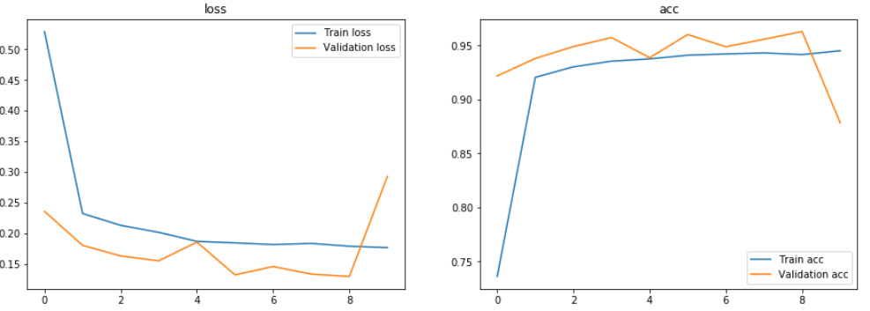
Model Training
Accuracy
Loss
Epochs
Epochs
The point of best accuracy and minimum loss was loaded for predictions.

Slide 16
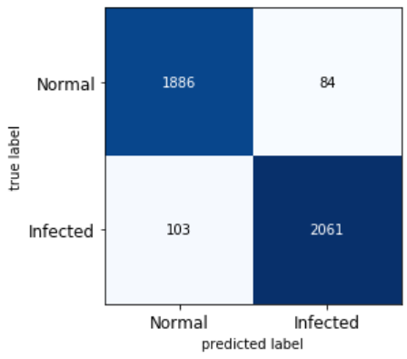
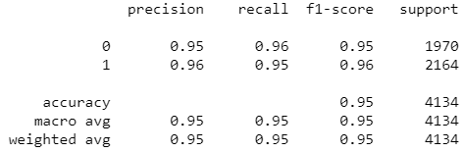
Confusion Matrix
Results
Classification Report
The False positives(84) and False negatives(103) are very low compared to Tp and Tn. But we have to be very careful in Fp and Fn cases as a Fp case will suggest to start treatment when the disease is not present and Fn case will suggest that the patient doesn’t have the disease when in reality the patient is infected. The high precision and recall is a good sign that this method can be used in real scenarios.

Slide 17
Conclusion
We have got a good test accuracy of 0.95. The model is with good precision able to successfully predict from the blood cell image if it is infected or not.
The only assumption we took here is that the infected cells are only infected by malaria, no other disease is affecting the cells. We have trained malaria infected cells against healthy cells only.
The model needs to be updated regularly with new images. This model can be used in integration with other models when other diseases might be present.

Slide 18
Thank You

