Slide 1




MOVIE RECOMMENDATION SYSTEM
Vaibhav Negi : 22BTCSE0319
Vineet Saini : 22BTCSE0035
Upendra Kr. Yadav : 22BTCSE0297

Slide 2


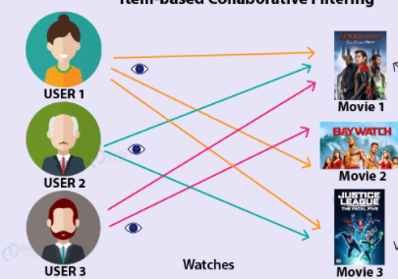
PROBLEM STATEMENT
Users struggle to find relevant movies.
Traditional search methods are time-consuming.
Our system aims to provide personalized recommendations using advanced filtering techniques (Content-Based Filtering) .

Slide 3
OBJECTIVE
Develop a movie recommendation system using Machine Learning.
Use Cosine Similarity to find and suggest similar movies.
Create an interactive UI with Streamlit for easy access.

Slide 4
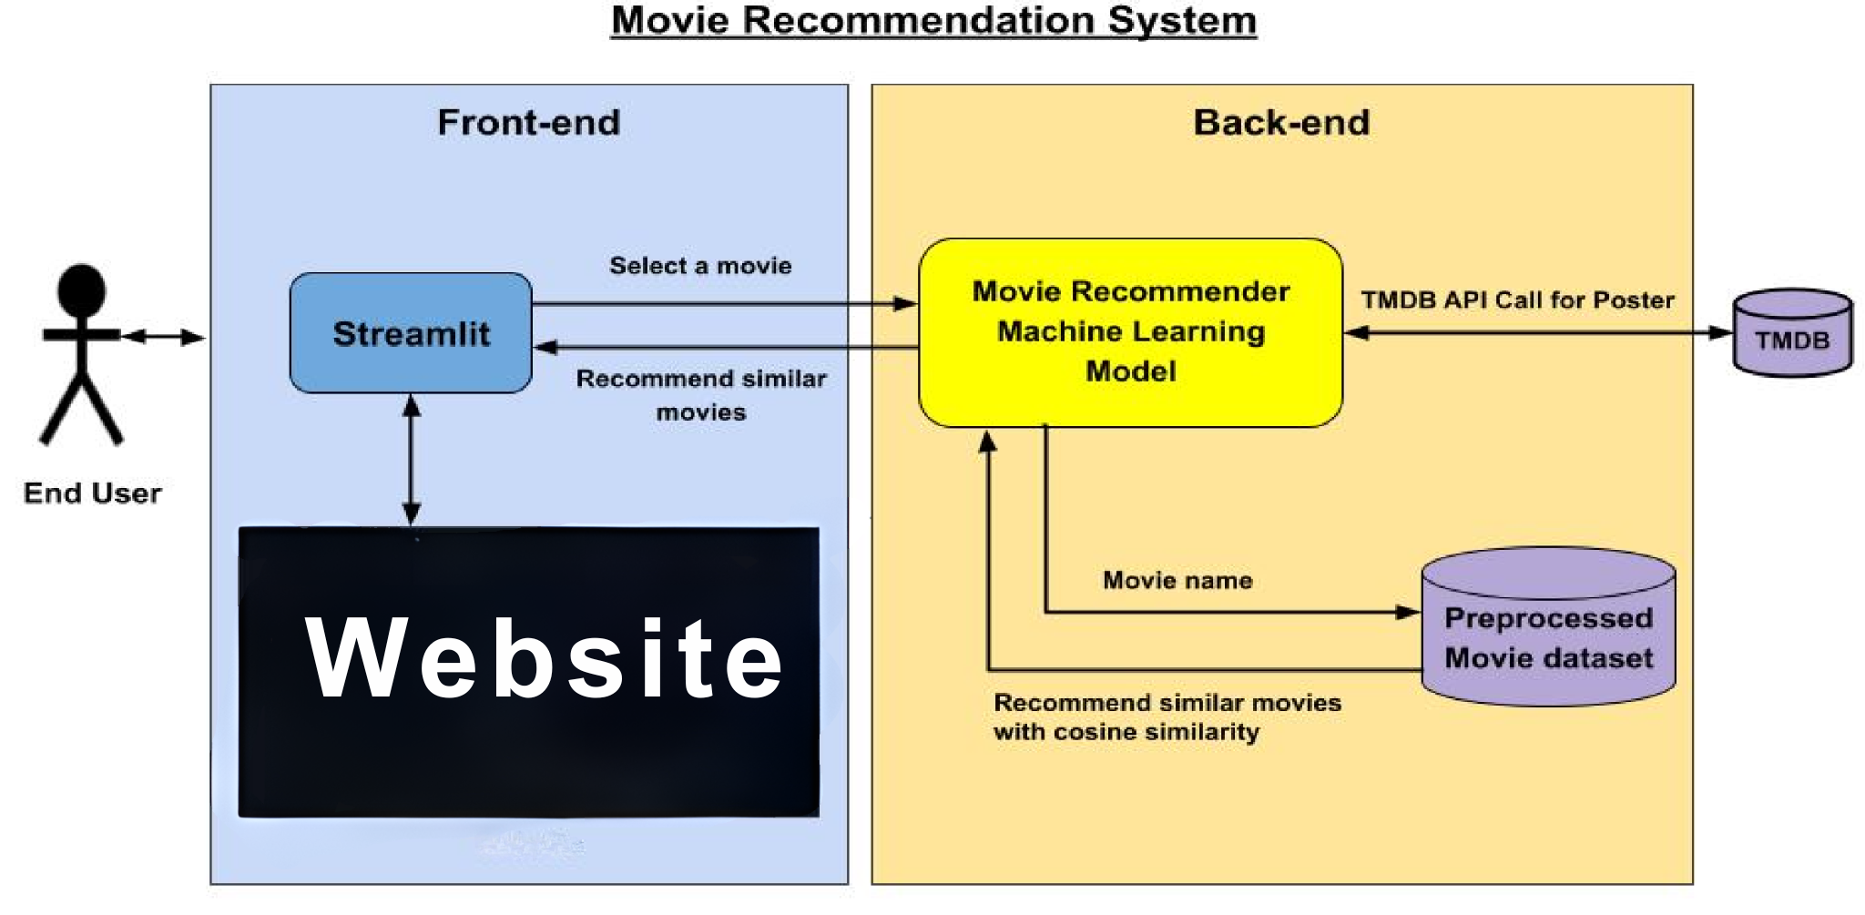
SYSTEM ARCHITECTURE

Slide 5
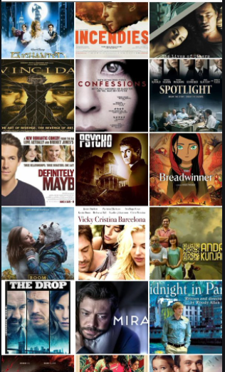
TECHNOLOGIES :
Programming Language: Python
Libraries: Pandas, NumPy, Scikit-learn, Streamlit, Pickle
Tools: Jupyter Notebook
Algorithm : Cosine Similarity (technique : vectorization)
Bi tool : Power BI

Slide 6
METHODOLOGY
Dataset Collection: Import a dataset containing movie details.
Feature Engineering: Extract important features like genre, cast, and keywords.
Data Cleaning: Remove missing values and standardise text formats.
Recommendation Function: Suggest top 5 movies based on input.
Pickle Model: Save the trained model for real-time use.
User Interface: Use Streamlit for interactive recommendations.

Slide 7
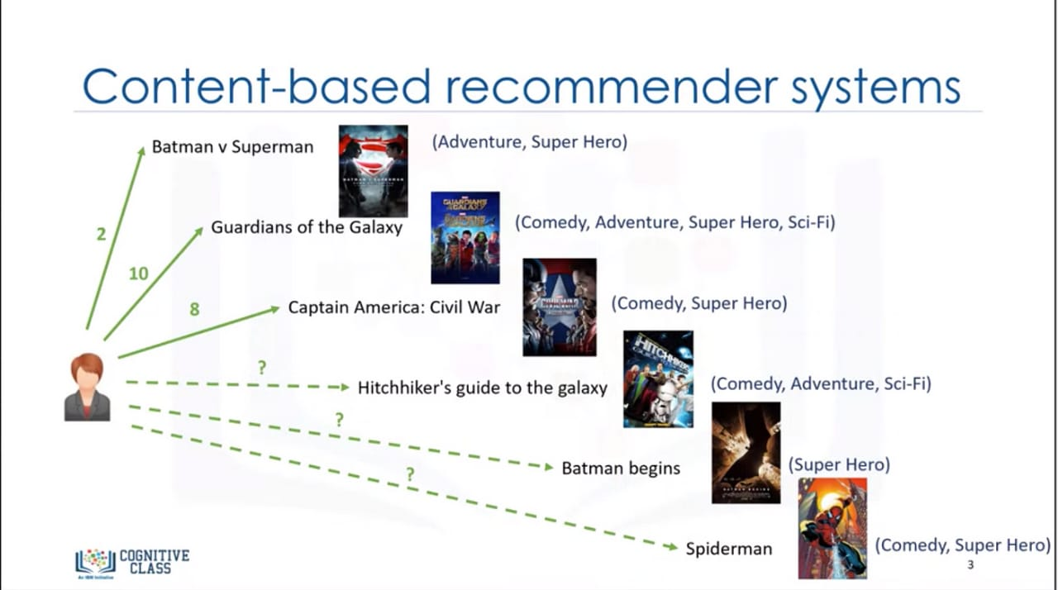
ALGORITHM USED: COSINE SIMILARITY
For our project, we focused on Content-based filtering for generating recommendations.
Content-Based Filtering

Slide 8
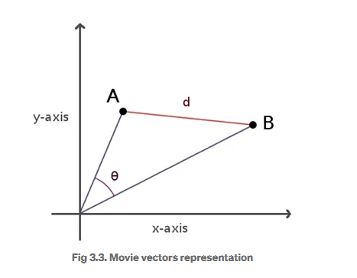
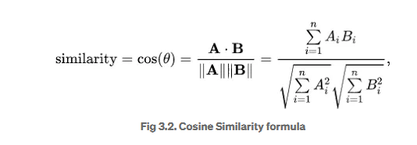
COSINE SIMILARITY
Cosine Similarity can be defined as a method to measure the difference between two non-zero vectors.
A.B = Dot product between the two movies vectors,
||A||||B|| = Product of the magnitudes of the two movie vectors

Slide 9
Challenges Faced & Solutions
Challenge | Solution
🔴 Power BI slow with large data | ✅ Removed unnecessary columns and optimised dataset.
🔴 Some cast/crew columns were lists as strings | ✅ Converted using Python’s ast.literal_eval()
🔴 Genre filtering not updating visuals | ✅ Ensured genre values are de-normalised and not null
🔴 Confusion over NLP usage | ✅ Clarified and explained CountVectorizer + preprocessing steps

Slide 10

FUTURE ENHANCEMENTS
Hybrid Recommendation System – Combine Content-Based & Collaborative Filtering for better accuracy.
User Ratings & Preferences – Allow users to rate movies, improving personalised recommendations.
Web & Mobile Deployment – Expand into a mobile app for a seamless experience.

Slide 11

ΤΗΑΝΚ ΨΟΥ !

