Slide 1
AWT
Arvind Bhave

Slide 2
AWT
AWT (Abstract Window Toolkit) was Java’s first GUI framework, which was introduced in Java 1.0.
It is used to create GUIs (Graphical User Interfaces).
Although programmers use more advanced frameworks like Swings , it is important to know that they are built on top of AWT.

Slide 3
AWTclasses
The AWT framework contains many classes and interfaces using which we can create GUIs.
The AWT package is java.awt.
Java AWT components are platform-dependent i.e. components are displayed according to the view of operating system.
AWT is heavyweight i.e. its components are using the resources of OS.
Some of the frequently used AWT classes are listed :

Slide 4
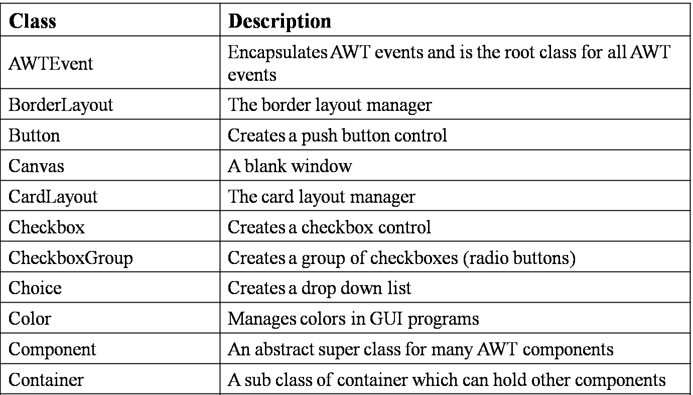
AWT classes

Slide 5
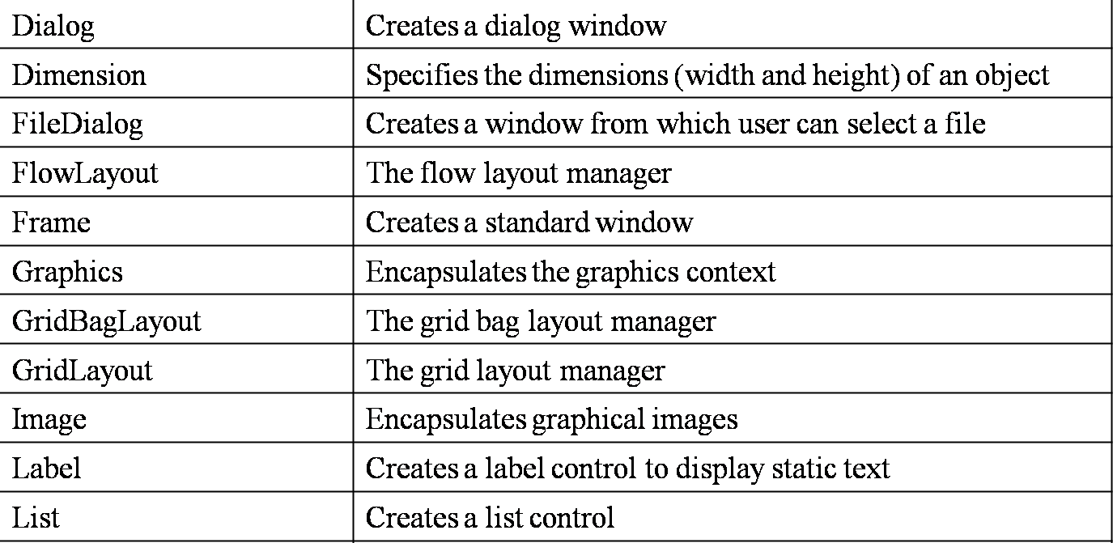
AWT classes

Slide 6
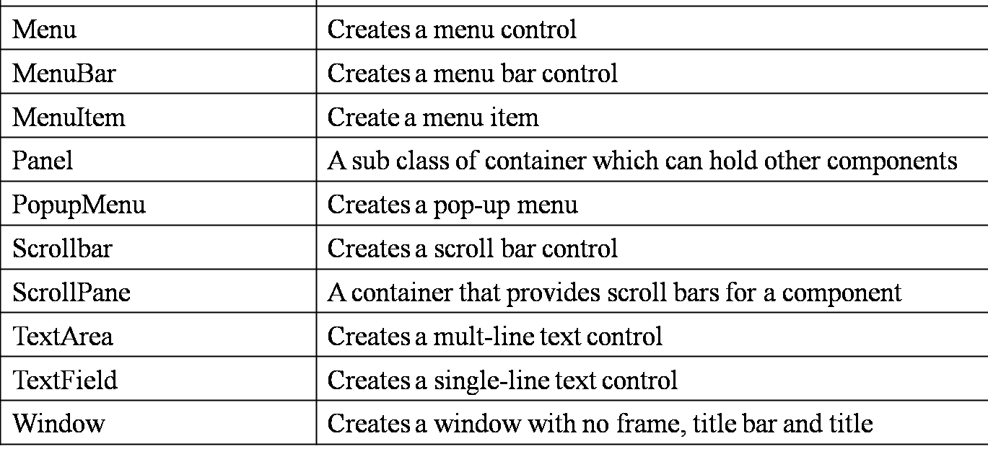
AWT classes

Slide 7
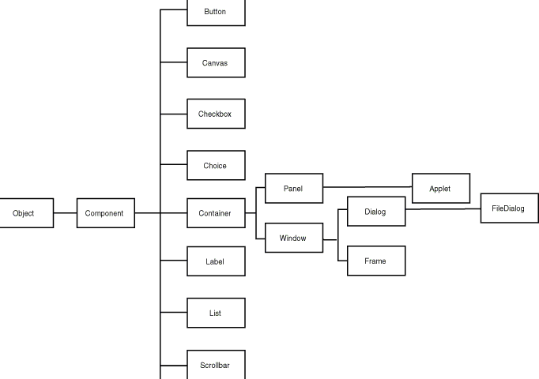

AWT

Slide 8
Component and Container
The Component is the abstract root class for many GUI control classes. Container is a sub class of Component class.
A component is an object that can be displayed on the screen and can interact with user.
Except for menus, most of the GUI components are inherited from the Component class.
The Component and various Container classes are arranged in a hierarchy as shown below:

Slide 9
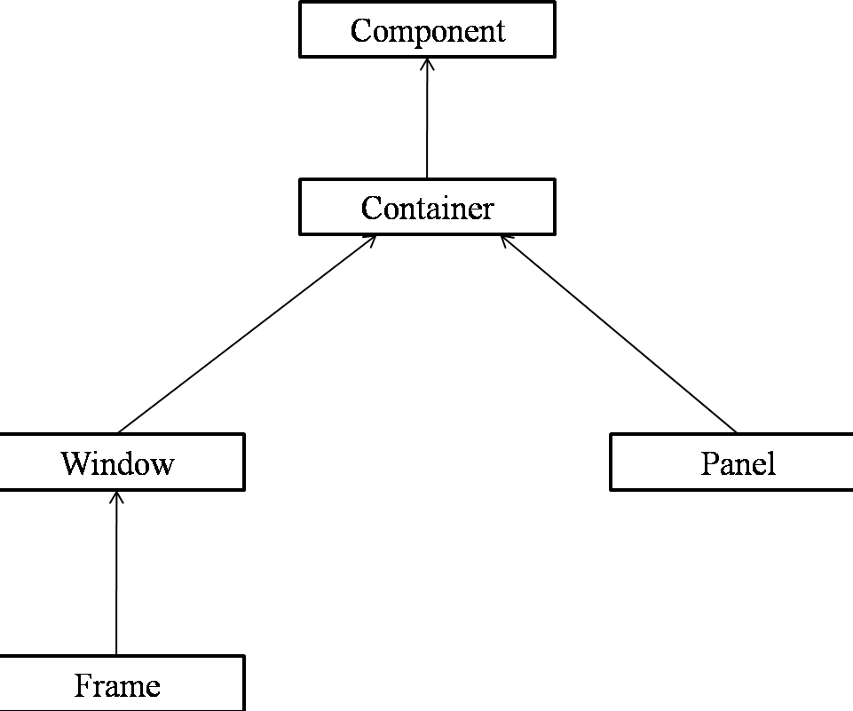
Component and Container

Slide 10
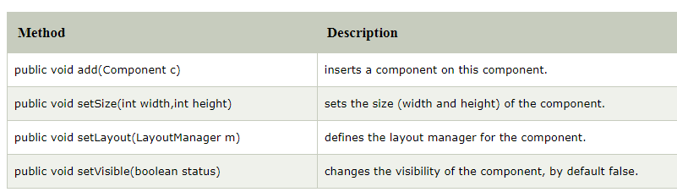
Methods of Component class

Slide 11
Container
Container is a sub class of the Component class which can be used to hold other components.
A Container object can hold other Containers also.
A Container is responsible for laying out (positioning) the components.
can contain another components like buttons, textfields, labels etc.
The classes that extends Container class are known as container such as Frame, Dialog and Panel.

Slide 12
Types of Containers
Types of containers: As explained above, a container is a place wherein we add components like text field, button, checkbox etc.
There are four types of containers available in AWT:
i) Window, ii) Frame, iii) Dialog and iv) Panel.
Window: An instance of the Window class has no border and no title
Dialog: Dialog class has border and title. An instance of the Dialog class cannot exist without an associated instance of the Frame class. .

Slide 13
Types of Containers
Panel: Panel does not contain title bar, menu bar or border. It is a generic container for holding components.
An instance of the Panel class provides a container to which to add components. Frame: A frame has title, border and menu bars. It can contain several components like buttons, text fields, scrollbars etc.
This is most widely used container while developing an application in AWT

Slide 14
Window
The window is the container that have no borders and menu bars. You must use frame, dialog or another window for creating a window.
Window is a sub class of Container class. A Window creates a top-level container which can hold other components or containers.
An instance of the Window class has no border and no title.

Slide 15
Dialog
Dialog:
Dialog class has border and title. An instance of the Dialog class cannot exist without an associated instance of the Frame class.

Slide 16
Panel
Panel class is a concrete sub class of the Container class.
A Panel object is a window without title bar, menu bar and border.
Panel is the super class of Applet class and is capable of holding other components or containers.
It can have other components like button, textfield etc.

Slide 17
Frame
Frame
Frame is a concrete sub class of Window class.
A top-level display surface (a window) with a border and title
The Frame encapsulates a window.
Frame contains a title bar, menu bar, borders and resizable corners.
To create stand alone applications in Java, we generally use Frame

Slide 18
Canvas
Canvas
Canvas class is derived from the Component class. A Canvas encapsulates a blank window on which we can draw.
A canvas is a component that has no default appearance or behavior.
Used for custom drawing regions and work areas
Can receive input from mouse and keyboards.

Slide 19
Frame
import java.awt.*;
import java.awt.event.*;
class myframe
{
public static void main(String args[])
{
Frame f=new Frame("My Frame");
f.setBackground(Color.red);
f.setSize(300,400);
f.setVisible(true);
System.out.println("Quit....Ctrl+C on dos prompt");
}
}

Slide 20
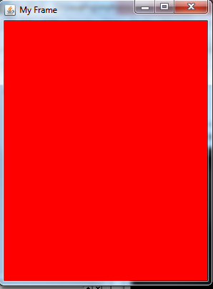
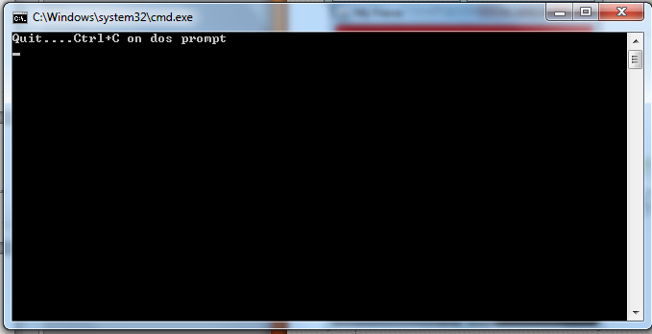
Frame

Slide 21
Frame
import java.awt.*;
import java.awt.event.*;
class myframe extends Frame
{
myframe()
{
super(“This is My Frame”);
f.setBackground(Color.cyan);
f.setSize(300,400);
f.setCursor(Frame.HAND_CURSOR);
show();
}
public static void main(String args[])
{
new myframe();
System.out.println("Quit....Ctrl+C on dos prompt");
}
}

Slide 22
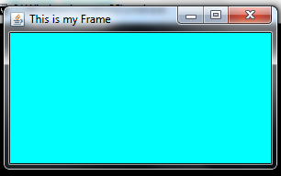

Slide 23
Button
A button is a class
It has a label
It can respond when pressed
Syntax:-
Button() //construct button with no label
Button(String label) //with label

Slide 24
Frame Program
import java.awt.*;
class FirstFrame extends Frame
{
FirstFrame()
{
Button b=new Button("click me");
b.setBounds(100,100,80,50);// setting button position
//setBounds(int xaxis, int yaxis, int width, int height)
add(b);//adding button into frame
setSize(300,300);//frame size 300 width and 300 height
setLayout(null);//no layout manager
setVisible(true);//now frame will be visible, by default not visible
}
public static void main(String args[])
{
FirstFrame f=new FirstFrame();
}
}

Slide 25
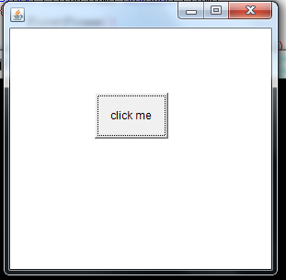
Frame Program

Slide 26
Layout Manager
Layout
the arrangement of components within the container.
placing the components at a particular position within the container
Java components borrow their behavior from the window system underlying hardware on which the JVM is running.
Layout Manager
automatically positions all the components within the container
The task of lay outing the controls is done automatically
Each container will have a default layout manager.

Slide 27
Layout Managers
We can manually arrange the position of each component (not recommended) by passing null to setLayout() method and by using setBounds() method on each component. Different layout managers available in AWT are:
FlowLayout
BorderLayout
GridLayout
CardLayout
GridBagLayout

Slide 28
FlowLayout
The flow layout manager arranges the components one after another from upper left corner, left-to-right and top-to-bottom manner.
It gives some space between components.
When no more components fit on a line, the next appears on next line.
Flow layout manager instance can be created using anyone of the following constructors:
FlowLayout() // default layout
FlowLayout(int align)
FlowLayout(int align, int hspace, int vspace)
align specifies the alignment,
hspace specifies horizontal space, a
nd vspace specifies vertical space.

Slide 29
FlowLayout
Valid values for alignment are as follows:
FlowLayout.LEFT
FlowLayout.CENTER
FlowLayout.RIGHT
FlowLayout.LEADING
FlowLayout.TRAILING

Slide 30
Flow Layout
import java.awt.*;
class fl extends Frame
{
fl(String s)
{
super (s);
setSize(300,200);
setLayout(new FlowLayout());
for(int i=1;i<=9;i++)
add(new (Button No”+i));
setVisible(true);
addWindowListener(new WindowAdapter()
{
public void windowClosing(WindowEvent we)
{
System.exit(0);
}
}
);
}
}
class testFL
{ public static void main(String args[])
{
fl f=new fl(“Flow Layout demo”);
}
}

Slide 31
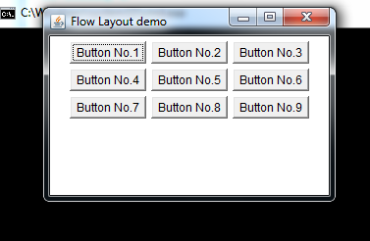
Flow Layout

Slide 32
Border Layout
BorderLayout Manager
The border layout manager divides the container area into five regions namely: north, south, east, west, and center.
Default region is center.
You have to be careful with border layout as controls might be stacked over one another.
Border layout instance can be created by using one of the below constructors:
BorderLayout()
BorderLayout(int hspace, int vspace)
where , hspace signifies horizontal space between components and vspace signifies vertical space between components.

Slide 33
Border Layout
BorderLayout classs has five constraint.
BorderLayout.EAST
BorderLayout.WEST
BorderLayout.NORTH
BorderLayout.SOUTH
BorderLayout.CENTER
Public void add(Componenet c, Constraint c1)

Slide 34
Border Layout
import java.awt.*;
class bl extends Frame
{
bl(String s)
{
super (s);
setSize(300,200);
add(new Button(“North”),BorderLayout.NORTH); add(new Button(“East”),BorderLayout.EAST);
add(new Button(“South”),BorderLayout.SOUTH);
add(new Button(“West”),BorderLayout.WEST);
add(new Button(“Center”),BorderLayout.CENTER);
setVisible(true);
}
}
class testBL
{
public static void main(String args[])
{
bl f=new bl(“Border Layout demo");
}
}

Slide 35
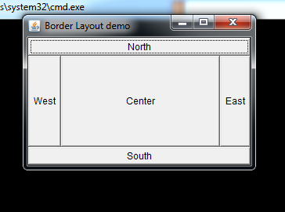
Border Layout

Slide 36
GridLayout Manager
GridLayout Manager
The grid layout manager arranges the components in a 2-dimensional grid.
While creating the instance of GridLayout, we can specify the number of rows and columns in the grid.
the number of cells in the grid and the number of components being added to the grid must match.

Slide 37
GridLayout Manager
An instance of GridLayout can be created using one of the following constructors:
GridLayout()
GridLayout(int numRows, int numCols)
GridLayout(int numRows, int numCols, int hspace, int vspace)

Slide 38
GridLayout Manager
import java.awt.*;
import java.awt.event.*;
public class MyFrameGrid extends Frame
{
Button b1, b2, b3, b4;
MyFrameGrid()
{
setSize(300, 300);
setTitle("My Application");
setLayout(new GridLayout(2, 2));
b1 = new Button("1");
b2 = new Button("2");
b3 = new Button("3");
b4 = new Button("4");
add(b1); add(b2); add(b3); add(b4);
setVisible(true);
}
public static void main(String[] args)
{
MyFrameGrid mf = new MyFrameGrid();
}
}

Slide 39
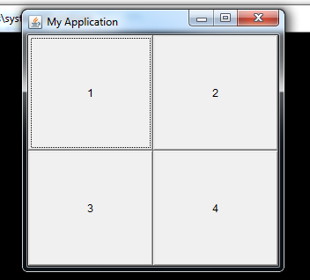
GridLayout

Slide 40
Default Layout Managers
Default layout managers for some of the container classes are given below:
Panel – Flow Layout
JPanel – Flow Layout
Applet – Flow Layout
JApplet – Border Layout
Frame – Border Layout
JFrame – Border Layout

Slide 41
Awt Controls
We can add and remove controls to a Container like Applet and Frame using the following methods available in the Container class:
Component add(Component ref)
Component remove(Component ref)

Slide 42
AWT Control
Label
A label is a GUI control which can be used to display static text. Label can be created using the Label class and its constructors which are listed below:
Label()
Label(String str)
Label(String str, int align)

Slide 43
AWT Control
The parameter align specifies the text alignment. Valid values are
Label.LEFT, Label.CENTER or Label.RIGHT.
Some of the methods available in the Label class are as follows:
void setText(String str) – To set or assign text to the label.
String getText() – To retrieve the text of a label.
void setAlignment(int align) – To set the alignment of text in a label.
int getAlignment() – To get the alignment of text in a label.

Slide 44
AWT Control
Buttons
A push button is the frequently found GUI control.
can be created by using the Button class and its constructors which are given below:
Button()
Button(String str)
methods available in the Button class are as follows:
void setLabel(String str) – To set or assign the text to be displayed on the button.
String getLabel() – To retrieve the text on the button.

Slide 45
AWT Control
Buttons
When a button is clicked, it generates an ActionEvent which can be handled using the ActionListener interface and the event handling method is actionPerformed().
If there are multiple buttons we can get the label of the button which was clicked by using the method getActionCommand()..

Slide 46
AWT Control
Checkboxes
A checkbox control can be created using the Checkbox class and its following constructors:
Checkbox()
Checkbox(String str)
Checkbox(String str, boolean on)
Checkbox(String str, boolean on, CheckboxGroup cbGroup)
Checkbox(String str, CheckboxGroup cbGroup, boolean on)

Slide 47
AWT Control
Checkboxes
various methods available in the Checkbox class:
boolean getState() – To retrieve the state of a checkbox.
void setState(boolean on)– To set the state of a checkbox.
String getLabel() – To retrieve the text of a checkbox.
void setLabel(String str) – To set the text of a checkbox.
A checkbox when selected or deselected, generates an ItemEvent which can be handled using the ItemListener interface and the corresponding event handling method is itemStateChanged().

Slide 48
AWT Control
In AWT, there is no separate class for creating radio buttons.
The difference between a checkbox and radio button is, a user can select one or more checkboxes.
Whereas, a user can select only one radio button in a group.
Radio buttons can be create by using Checkbox class and CheckboxGroup class

Slide 49
AWT Control
Dropdown Boxes
A drop down box or a combo box contains a list of items (strings). When a user clicks on a drop down box, it pops up a list of items from which user can select a single item.
A drop down box can be created using the Choice class. There is only one constructor in the choice class using which we can create an empty list.

Slide 50
AWT Control
various methods available in Choice class:
void add(String name) – To add an item to the drop down list.
String getSelectedItem() – To retrieve the item selected by the user.
int getSelectedIndex() – To retrieve the index of the item selected by the user.
int getItemCount() – To retrieve the number of items in the drop down list.
void select(int index) – To select an item based on the given index.
void select(String name) – To select an item based on the given item name.
void getItem(int index) – To retrieve an item at the given index.

Slide 51
AWT Control
import java.awt.*;
import java.awt.event.*;
public class MyFrameChBox extends Frame
{
Checkbox c1, c2;
MyFrameChBox()
{ setSize(400, 200); setTitle("My Application"); setLayout(new FlowLayout());
setVisible(true);
c1 = new Checkbox("Option1"); c2 = new Checkbox("Option2");
add(c1); add(c2); }
public static void main(String[] args)
{
MyFrameChBox mf = new MyFrameChBox();
}
}

Slide 52
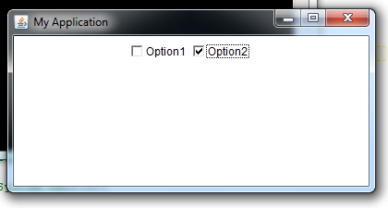
checkbox

Slide 53
import java.awt.event.*;
import java.awt.*;
public class MyFrameCBG extends Frame
{
Checkbox c1, c2; CheckboxGroup cbg;
MyFrameCBG()
{ setSize(400, 200); setTitle("My CheckBoxGroup");
setLayout(new FlowLayout()); setVisible(true);
cbg = new CheckboxGroup();
c1 = new Checkbox("Male", cbg, false); c2 = new Checkbox("Female", cbg, false);
add(c1); add(c2);
addWindowListener(new WindowAdapter()
{ public void windowClosing(WindowEvent we)
{ System.exit(0); } } );
}
public static void main(String[] args)
{
MyFrameCBG mf = new MyFrameCBG();
}
}

Slide 54
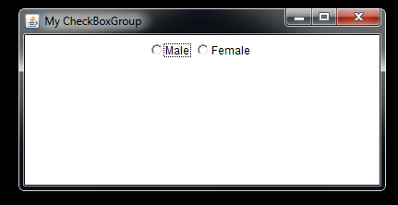

Slide 55
Dropdown Boxes (ComboBox)
import java.awt.*;
import java.awt.event.*;
public class MyFrameCombo extends Frame
{
Choice myList;
MyFrameCombo()
{
setSize(400, 200); setTitle("My Choice"); setLayout(new FlowLayout());
setVisible(true);
myList = new Choice();
myList.add("CSE"); myList.add(“MCA"); myList.add("EEE");
myList.add("IT"); add(myList);
addWindowListener(new WindowAdapter() {
public void windowClosing(WindowEvent we) { System.exit(0); } } );
}
public static void main(String[] args)
{
MyFrameCombo mf = new MyFrameCombo();
}
}

Slide 56
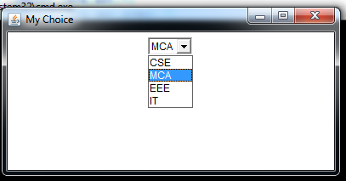
Dropdown Boxes (ComboBox)

Slide 57
List Boxes
List Boxes
A List box contains a list of items among which the user can select one or more items.
More than one items in the list box are visible to the user.
A list box can be created using the List class along with the following constructors:
List()
List(int numRows)
List(int numRows, boolean multipleSelect)
numRows -----number of items to be visible to the user multipleSelect ----- whether the user can select multiple items or not.

Slide 58
List Boxes
List Boxes
When a list item is double clicked, ActionEvent is generated. It can be handled with ActionListener and the event handling method is actionPerformed().
When a list item is selected or deselected, ItemEvent is generated. It can be handled with ItemListener and the event handling method is itemStateChanged().
We can use getItemSelectable() method to obtain a reference to the object that raised this event.

Slide 59
List Boxes
List Boxes
Following are some of the methods available in the List class:
void add(String name) – To add an item to the list box.
void add(String name, int index) – To add an item at the specified index in the list box.
String getSelectedItem() – To get the item name which is selected by the user.
int getSelectedIndex() – To get the item index which is selected by the user.
String[] getSelectedItems() – To retrieve the selected item names by the user.
int[] getSelectedIndexes() – To retrieve the selected item indexes by the user.
int getItemCount() – To retrieve the number of items in the list box.
void select(int index) – To select an item based on the given index.
String getItem(int index) – To retrieve the item at the given index.

Slide 60
List Boxes
import java.awt.*;
import java.awt.event.*;
public class MyFrameList extends Frame
{
List myList;
MyFrameList()
{
setSize(400, 200); setTitle("My Application");
setLayout(new FlowLayout());
myList = new List();
myList.add("CSE"); myList.add("MCA");
myList.add("EEE"); myList.add("IT");
add(myList);
addWindowListener(new WindowAdapter()
{ public void windowClosing(WindowEvent we)
{ System.exit(0); } } ); setVisible(true);
}
public static void main(String[] args)
{
MyFrameList mf = new MyFrameList();
}
}

Slide 61
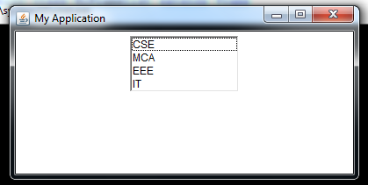
List Boxes

Slide 62
TextField
Text Fields
A text field or text box is a single line text entry control which allows the user to enter a single line of text.
A text field can be created using the TextField class along with its following constructors:
TextField()
TextField(int numChars)
TextField(String str)
TextField(String str, int numChars)
In the above constructors numChars specifies the width of the text field,
and str specifies the initial text in the text field.

Slide 63
TextField
Following are various methods available in TextField class:
String getText() – Retrieves the text in the text field.
void setText(String str) – Assigns or sets text in the text field.
String getSelectedText() – Retrieves the selected text in the text field.
void select(int startindex, int endindex) – To select the text in text field from startindex to endindex – 1.
boolean isEditable() – To check whether the text field is editable or not.
void setEditable(boolean canEdit) – To make a text field editable or non-editable.
void setEchoChar(char ch) – To set the echo character of a text field. This is generally used for password fields.
boolean echoCharIsSet() – To check whether the echo character for the text field is set or not.
char getEchoChar() – To retrieve the current echo character.

Slide 64
TextField
import java.awt.*;
import java.awt.event.*;
public class MyFrameTF extends Frame
{
Label myLabel; TextField tf;
MyFrameTF()
{
setSize(400, 200); setTitle("My Application"); setLayout(new FlowLayout());
myLabel = new Label("Enter name: ");
tf = new TextField(20); add(myLabel); add(tf);
addWindowListener(new WindowAdapter()
{ public void windowClosing(WindowEvent we)
{ System.exit(0); } } );
setVisible(true); }
public static void main(String[] args)
{
MyFrameTF mf = new MyFrameTF();
}
}

Slide 65
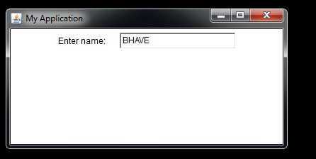
TextField

Slide 66
TextArea
Text Areas
A text area is a multi-line text entry control in which user can enter multiple lines of text. A text area can be created using the TextArea class along with the following constructors:
TextArea()
TextArea(int numLines, int numChars)
TextArea(String str)
TextArea(String str, int numLines, int numChars)
TextArea(String str, int numLines, int numChars, int sBars)
In the above constructors, numLines specifies the height of the text area, numChars specifies the width of the text area, str specifies the initial text in the text area and sBars specifies the scroll bars. Valid values of sBars can be any one of the following:
SCROLLBARS_BOTH
SCROLLBARS_NONE
SCROLLBARS_HORIZONTAL_ONLY
SCROLLBARS_VERTICAL_ONLY

Slide 67
TextArea
Following are some of the methods available in the TextArea class:
String getText() – To retrieve the text in the text area.
void setText(String str) – To assign or set the text in a text area.
String getSelectedText() – To retrieve the selected text in a text area.
void select(int startindex, int endindex) – To select the text in text field from startindex to endindex – 1.
boolean isEditable() – To check whether the text field is editable or not.
void setEditable(boolean canEdit) – To make a text field editable or non-editable.
void append(String str) – To append the given string to the text in the text area.
void insert(String str, int index) – To insert the given string at the specified index.
void replaceRange(String str, int startIndex, int endIndex) – To replace the text from startIndex to endIndex – 1 with the given string.

Slide 68
TextArea
import java.awt.*;
import java.awt.event.*;
public class MyFrameTA extends Frame
{
TextArea ta;
MyFrameTA()
{ setSize(400, 200); setTitle("My Application");
setLayout(new FlowLayout()); ta = new TextArea(3, 20); add(ta);
addWindowListener(new WindowAdapter()
{ public void windowClosing(WindowEvent we)
{ System.exit(0); } } );
setVisible(true); }
public static void main(String[] args)
{
MyFrameTA mf = new MyFrameTA();
} }

Slide 69
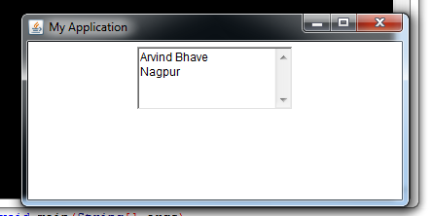
TextArea

