Slide 1
Event Handling
Arvind Bhave

Slide 2
Event Handling
What is an Event?
Change in the state of an object is known as event
Events are generated as result of user interaction with the graphical user interface components.
For example,
clicking on a button,
moving the mouse,
entering a character through keyboard,
selecting an item from list,
scrolling the page
are the activities that causes an event to happen.
The process of handling events is known as event handling.

Slide 3
Event Handling
Types of Event
classified into two categories:
Foreground Events - Those events which require the direct interaction of user. They are generated as consequences of a person interacting with the graphical components in Graphical User Interface.
For example, clicking on a button, moving the mouse, entering a character through keyboard, selecting an item from list, scrolling the page etc.
Background Events - Those events that require the interaction of end user are known as background events. Operating system interrupts, hardware or software failure, timer expires, an operation completion are the example of background events.

Slide 4
Event Handling
What is Event Handling?
Event Handling is the mechanism that controls the event and decides what should happen if an event occurs. This mechanism have the code which is known as event handler that is executed when an event occurs.
Java Uses the Delegation Event Model to handle the events. This model defines the standard mechanism to generate and handle the events. Let's have a brief introduction to this model.

Slide 5
Event Handling
Delegation Event Model
java.awt.event Package
Sources of Events

Slide 6
Event Handling
Delegation Event Model has the following key participants namely:
Source - The source is an object on which event occurs. Source is responsible for providing information of the occurred event to it's handler. Java provide as with classes for source object.
Listener - It is also known as event handler. Listener is responsible for generating response to an event. From java implementation point of view the listener is also an object. Listener waits until it receives an event. Once the event is received , the listener process the event an then returns.

Slide 7
Event Handling
Delegation Event Model
The delegation event model provides a consistent way of generating and processing events. In this model a source generates an event and sends it to one or more listeners. A listener waits until it receives an event and once it receives an event, processes the event and returns.
The advantage of this model is the application logic for processing the events is clearly separated from the user interface logic. In this model the listeners must register with a source to receive the events.
Another advantage of this model is, notification of events is sent only to the registered listeners.

Slide 8
Event Handling
A source must be registered with listeners in order for the events to be detected.
The general form of a registration method is as follows:
public void addTypeListener(TypeListener tl)
A listener can also be unregistered from the source using the remove method whose syntax is as follows:
public void removeTypeListener(TypeListener tl)

Slide 9
Event Handling
Event Listeners
A listener is an object that is notified when an event occurs.
A listener has two major requirements.
First is, listener must be registered with a source to receive notifications and second is, it must implement methods to receive and process these notifications.
In Java, events and sources are maintained as classes, listeners are maintained as interfaces. Most of them are available in java.awt.event package.
Examples of listeners are MouseListener, Key Listener etc.

Slide 10
Event Handling
java.awt.event Package
The java.awt.event package contains many event classes which can be used for event handling.
Root class for all the event classes in Java is EventObject which is available in java.util package.
Root class for all AWT event classes is AWTEvent which is available in java.awt package and is a sub class of EventObject class.
Some of the frequently used event classes available in java.awt.eventpackage are listed below:

Slide 11
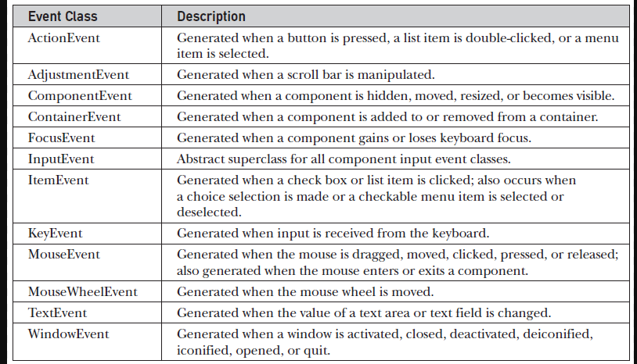
Event Handling

Slide 12
Event Handling
Various constructors and methods available in the above listed event classes are as follows:
ActionEvent
An action event is generated when a button is clicked, or a list item is double-clicked, or a menu item is selected.
ActionEvent class contains the following methods:
String getActionCommand() – Used to obtain the command name for the invoking ActionEvent object.
int getModifiers() – This method returns an integer that indicates which modifier keys (ALT, CTRL, META, and/or SHIFT) were pressed.
long getWhen() – Returns the time when the event was generated.

Slide 13
Event Handling
AdjustmentEvent
The adjustment event is generated when the scroll bar is adjusted. There are five types of adjustment events. For each type there is a constant declared in the class which are as follows:
BLOCK_DECREMENT
BLOCK_INCREMENT
TRACK
UNIT_DECREMENT
UNIT_INCREMENT
Following are the methods available in AdjustmentEvent class:
Adjustable getAdjustable() – Returns the object that generated the event.
int getAdjustmentType() – Returns one of the five constants that represents the type of event.
int getValue() – Returns a number that represents the amount of adjustment.

Slide 14
Event Handling
ComponentEvent
A component event is generated when the visibility, position and size of a component is changed. There are four types of component events which are identified by the following constants:
COMPONENT_HIDDEN
COMPONENT_SHOWN
COMPONENT_MOVED
COMPONENT_RESIZED
Following method is available in the ComponentEvent class:
Component getComponent() – Returns the component that generated the event.

Slide 15
Event Handling
ContainerEvent
A container event is generated when a component is added to or removed from the container. There are two types of container events which are represented by the following constants:
COMPONENT_ADDED
COMPONENT_REMOVED
Following are the methods available in the ContainerEvent class:
Container getContainer() – Returns the reference of the container that generated the event.
Component getChild() – Returns the reference of the component that is added to or removed from the container.

Slide 16
Event Handling
FocusEvent
A focus event is generated when a component gains or loses input focus. These events are identified by the following constants:
FOCUS_GAINED
FOCUS_LOST
Following are the methods available in the FocusEvent class:
Component getOppositeComponent() – Returns the other component that gained or lost focus.
boolean isTemporary() – Method returns true or false that indicates whether the change in focus is temporary or not.

Slide 17
Event Handling
ItemEvent
An item event is generated when the user clicks on a check box or clicks a list item or selects / deselects a checkable menu item. These events are identified by the following constants:
SELECTED
DESELECTED
Following are the methods available in the ItemEvent class:
Object getItem() – Returns a reference to the item whose state has changed.
ItemSelectable getItemSelectable() – Returns the reference of ItemSelectableobject that raised the event.
int getStateChange() – Returns the status of the state (whether SELECTED or DESELECTED)

Slide 18
Event Handling
KeyEvent
A key event is generated when a key on the keyboard is pressed, released or typed. These events are identified by the following constants:
KEY_PRESSED (when a key is pressed)
KEY_RELEASED (when a key is released)
KEY_TYPED (when a character is typed)
There are several other constants which recognizes various keys on the keyboard and they are as follows:
KeyEvent is a sub class of InputEvent.
Following are the methods available in KeyEvent class:
char getKeyChar() – Returns the character entered from the keyboard
int getKeyCode() – Returns the key code

Slide 19

Event Handling

Slide 20
Event Handling
MouseEvent
The mouse event is generated when the user generates a mouse event on a source. Mouse events are represented by the following constants:

Slide 21
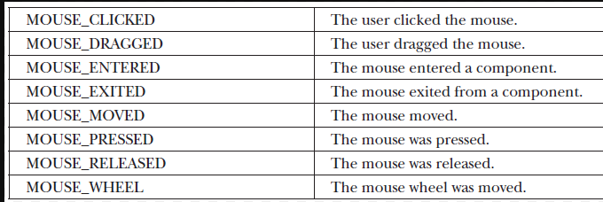
Event Handling

Slide 22
Event Handling
Following are some of the methods available in MouseEvent class:
int getX() – Returns the x-coordinate of the mouse at which the event was generated.
int getY() – Returns the y-coordinate of the mouse at which the event was generated.
Point getPoint() – Returns the x and y coordinates of mouse at which the event was generated.
int getClickCount() – This method returns the number of mouse clicks for an event.
int getButton() – Returns an integer that represents the buttons that caused the event. Returned value can be either NOBUTTON, BUTTON1 (left mouse button), BUTTON2 (middle mouse button), or BUTTON3 (right mouse button).
Following methods are available to obtain the coordinates relative to the screen:
Point getLocationOnScreen()
int getXOnScreen()
int getYOnScreen()

Slide 23
Event Handling
TextEvent
The text event is generated when the user enters a character into a text field or a text area. This event is identified by the following constant:
TEXT_VALUE_CHANGED

Slide 24
Event Handling
WindowEvent
A window event is generated when a user performs any one of the window related events which are identified by the following constants:

Slide 25
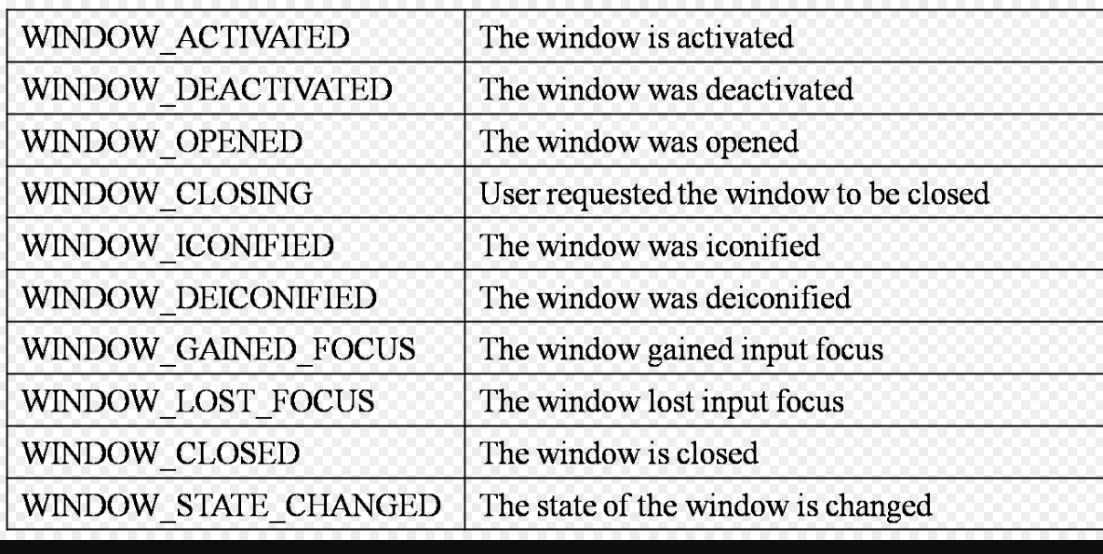
Event Handling

Slide 26
Event Handling
Following are some of the methods available in the WindowEvent class:
Window getWindow() – Returns the reference of the window on which the event is generated.
Window getOppositeWindow() – Returns the reference to the previous window when a focus event of activation event has occurred.
int getOldState() – Returns an integer indicating the old state of the window.
int getNewState() – Returns an integer indicating the new state of the window.

Slide 27
Event Handling
Sources of Events
All GUI elements which are derived from the Component class are examples of sources which generates events. Following are some of the examples of event sources available in Java:

Slide 28
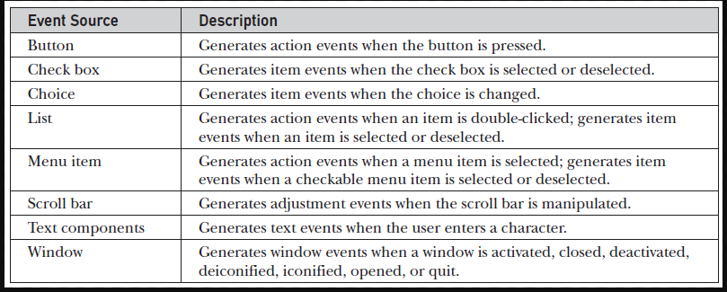
Event Handling

Slide 29
Event Handling
Event Listener Interfaces
The event delegation model contains two main components. First are the event sources and second are the listeners.
Most of the listener interfaces are available in the java.awt.event package.

Slide 30
Event Handling
In Java, there are several event listener interfaces which are listed below:
ActionListener
This interface deals with the action events.
The event handling method available in the ActionListener interface:
void actionPerformed(ActionEvent ae)

Slide 31
Event Handling
AdjustmentListener
This interface deals with the adjustment event generated by the scroll bar.
void adjustmentValueChanged(AdjustmentEvent ae)
ComponentListener
This interface deals with the component events.
void componentResized(ComponentEvent ce)
void componentMoved(ComponentEvent ce)
void componentShown(ComponentEvent ce)
void componentHidden(ComponentEvent ce)

Slide 32
Event Handling
ContainerListener
This interface deals with the events that can be generated on containers
methods available
void componentAdded(ContainerEvent ce)
void componentRemoved(ContainerEvent ce)
FocusListener
This interface deals with focus events that can be generated on different components or containers.
void focusGained(FocusEvent fe)
void focusLost(FocusEvent fe)

Slide 33
Event Handling
import java.awt.*;
import java.awt.event.*;
import java.applet.*;
public class MyAppletMouseAWT extends Applet implements MouseListener, MouseMotionListener
{
Label label;
public void init()
{
setSize(600,600);
//setLayout(new FlowLayout());
setLayout(null);
label = new Label();
add(label);
label.setBounds(50,50,100,160);
addMouseListener(this);
addMouseMotionListener(this);
}

Slide 34
Event Handling
public void mouseClicked(MouseEvent me)
{
label.setText("Mouse is clicked");
}
public void mousePressed(MouseEvent me){label.setText("Mouse is Pressed");
}
public void mouseReleased(MouseEvent me){label.setText("Mouse is Relesed");
}
public void mouseEntered(MouseEvent me){}
public void mouseExited(MouseEvent me){}
public void mouseDragged(MouseEvent me){}
public void mouseMoved(MouseEvent me)
{
label.setText("Mouse is moved");
}
}

Slide 35
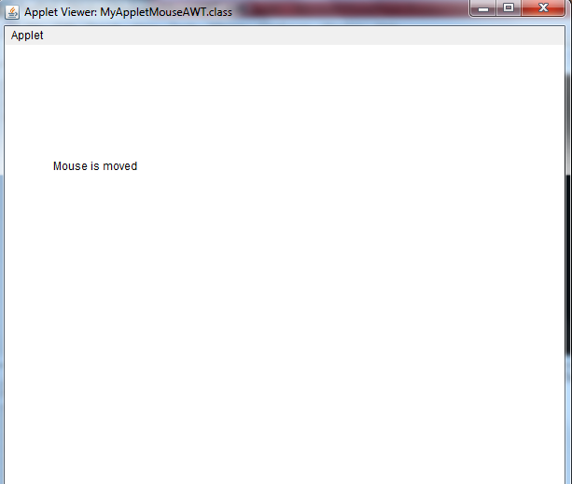
Event Handling

Slide 36
Event Handling
import java.awt.*; import java.awt.event.*; import java.awt.Graphics;
public class ActionListenerExample {
public static void main(String[] args) {
Frame f=new Frame("ActionListener Example");
final TextField tf=new TextField(); tf.setBounds(100,100, 150,30);
Button b=new Button("Press Me"); b.setBounds(150,150,60,30);
b.setForeground(Color.red);
b.addActionListener(new ActionListener(){
public void actionPerformed(ActionEvent ae){
tf.setText("Welcome to IICC.");
tf.setForeground(Color.white);
tf.setBackground(Color.blue);
} });
f.add(b);f.add(tf); f.setSize(400,400);
f.setLayout(null); f.setVisible(true);
}
}

Slide 37
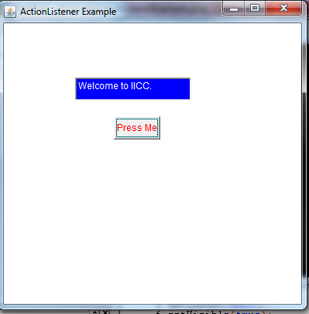
Event Handling

Slide 38
Event Handling ItemListener
import java.awt.*; import java.awt.event.*;
public class ItemListenerExample implements ItemListener{
Checkbox checkBox1,checkBox2; Label label;
ItemListenerExample(){
Frame f= new Frame("CheckBox ItemListener Example");
label = new Label(); label.setAlignment(Label.CENTER);
label.setSize(400,100);
checkBox1 = new Checkbox("C++"); checkBox1.setBounds(100,100, 50,50);
checkBox2 = new Checkbox("Java"); checkBox2.setBounds(100,150, 50,50);
f.add(checkBox1); f.add(checkBox2); f.add(label);
checkBox1.addItemListener(this);
checkBox2.addItemListener(this);
f.setSize(400,400); f.setLayout(null); f.setVisible(true);
}

Slide 39
Event Handling ItemListener
public void itemStateChanged(ItemEvent ie) {
if(ie.getSource()==checkBox1)
label.setText("C++ Checkbox: "
+ (ie.getStateChange()==1?"checked":"unchecked"));
if(ie.getSource()==checkBox2)
label.setText("Java Checkbox: "
+ (ie.getStateChange()==1?"checked":"unchecked"));
}
public static void main(String args[])
{
new ItemListenerExample();
}
}

Slide 40
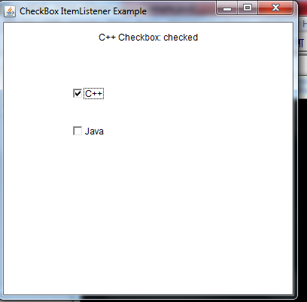
Event Handling ItemListener

Slide 41
Java AWT Panel
The Panel is a simplest container class. It provides space in which an application can attach any other component. It inherits the Container class.
It doesn't have title bar.

Slide 42
Java AWT Panel
import java.awt.*; import java.awt.event.*; import java.awt.Color;
public class PanelExample {
PanelExample()
{
Frame f= new Frame("Panel Example");
Panel panel=new Panel(); panel.setBounds(40,80,200,200);
panel.setBackground(Color.gray);
Button b1=new Button("Button 1"); b1.setBounds(50,100,80,30);
b1.setBackground(Color.yellow);
Button b2=new Button("Button 2"); b2.setBounds(100,100,80,30);
b2.setBackground(Color.green);
panel.add(b1); panel.add(b2); f.add(panel);
f.setSize(400,400); f.setLayout(null); f.setVisible(true);
}
public static void main(String args[]) {
new PanelExample(); }
}

Slide 43
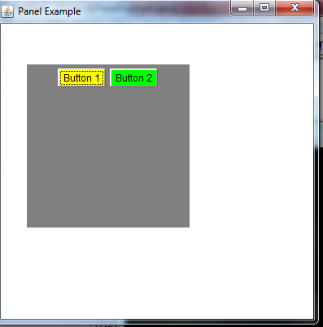
Java AWT Panel

Slide 44
Scrollbar
import java.awt.*;
class ScrollbarExample{
ScrollbarExample(){
Frame f= new Frame("Scrollbar Example");
Scrollbar s=new Scrollbar();
s.setBounds(100,100, 50,100);
f.add(s);
f.setSize(400,400);
f.setLayout(null);
f.setVisible(true);
}
public static void main(String args[]){
new ScrollbarExample();
}
}

Slide 45
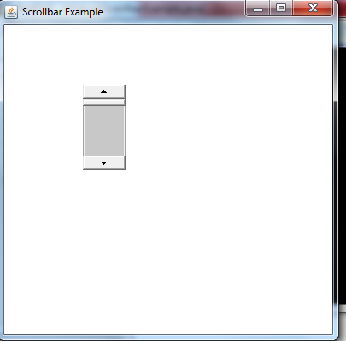
Scrollbar

