Slide 1
Applet
Applications are stand alone programs
executed with Java interpreter
Applet is a small program
can be placed on a web page
will be executed by the web browser
give web pages “dynamic content”

Slide 2
Applet
Applets are small Java applications that can be accessed on an Internet server, transported over Internet, and can be automatically installed and run as a part of a web document.
After a user receives an applet, the applet can produce a graphical user interface. It has limited access to resources so that it can run complex computations without introducing the risk of viruses or breaching data integrity.
Any applet in Java is a class that extends the java.applet.Applet class.
An Applet class does not have any main() method. It is viewed using JVM. The JVM can use either a plug-in of the Web browser or a separate runtime environment to run an applet application.

Slide 3
Applet
Built using one of general definitions of applets
Applet class
JApplet class
Java applets can
Draw graphics in a defined screen area
Enable user interaction with GUI elements

Slide 4
Java Applet Classes
Abstract Windowing Toolkit AWT
Earlier versions of Java
Applet class is one of the AWT components
Java Foundation Classes JFC
Extension to Java in 1997
Has a collection of Swing components for enhanced GUIs
Swing component classes begin with J

Slide 5
Applets are Java programs that can be embedded in HTML documents
To run an applet you must create a .html file which references the applet
Ready to Program also will run an applet
When browser loads Web page containing applet
Applet downloads into Web browser
begins execution
Can be tested using appletviewer program

Slide 6
Applet
Applet
Program that runs in
appletviewer (test utility for applets)
Web browser (IE)
Executes when HTML (Hypertext Markup Language) document containing applet is opened and downloaded
Applications run in command windows

Slide 7
Applet Architecture
An applet is a GUI-based program.
Its architecture is different from the console-based programs

Slide 8
Applet Architecture
Event driven
An applet waits until an event occurs.
The AWT notifies the applet about an event by calling event handler that has been provided by the applet.
The applet takes appropriate action and then quickly return control to AWT
All Swing components descend from the AWT Container class
User initiates interaction with an Applet

Slide 9
applet and application
Both are Java programs
Applets are not fully featured programs
Applets accomplish a small task
Applet do not use main() method
Applet can not be run independently . They are run from inside a web page using HTML tag.
Applets cannot communicate with other servers on the network.

Slide 10
applet and application
Applets cannot read from or write to the files in the local computer.
Applets are restricted from using libraries from other languages like c, c++ ( java supports this feature through native methods )

Slide 11
Life Cycle of an Applet
The Life Cycle of an Applet consists of four states.
Born
Running
Idle
Dead

Slide 12
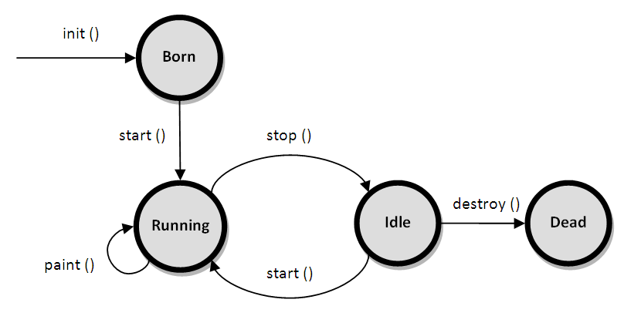
Life Cycle of an Applet

Slide 13
Life Cycle of an Applet
The life cycle of an applet starts with init() method and ends with destroy() method.
Other life cycle methods are start(), stop() and paint().
The methods to execute only once in the applet life cycle are init() and destroy().
Other methods execute multiple times.

Slide 14
Life Cycle of an Applet
Applets method order when it is loaded.
init(),start(), paint()
init() :- This method is called when the applet is first created. This method is invoked only once during entire life time of an applet. Variable declaration and initialization operations are performed in this method.

Slide 15
Life Cycle of an Applet
start():- This method is automatically invoked after init() method. This method may be invoked more than once. It also executes whenever the applet is restored, maximized or moving from one tab to another tab in the browser.

Slide 16
Life Cycle of an Applet
paint():- This method is invoked to display the output on the screen in the form of txt, graphics. The paint() method executes after the execution of start() method and whenever the applet or browser is resized.

Slide 17
Life Cycle of an Applet
Applets method order at the time of termination.
stop(),destroy()
stop():- This method is invoked automatically when web page containing running applet is closed or left temporarily and applet enters the idle state. The stop() method stops the execution of the applet. The stop() method executes when the applet is minimized or when moving from one tab to another in the browser.

Slide 18
Life Cycle of an Applet
destroy():- This method is invoked to remove an applet permanently from the memory. It releases all the resources held by the applet.

Slide 19
Writing Applet
Create an applet code (.java file)
Create an executable applet(.class)
Design a web page using HTML tags
Prepare <APPLET> tag
Include <APPLET>tag into web page
Create HTML file
Test the applet code

Slide 20
Applets and Web Pages – HTML
Applets embedded in a web page
Executed when web page loaded by browser
Web pages structured with HTML codes
HyperText Mark-up Language
Syntax <command> . . . </command>
Turns format on
Turns format off

Slide 21
Applets and Web Pages – HTML
Embedding Java applets
Insert applet tags <APPLET> </APPLET>
Call the specific applet by its file name
<APPLET CODE = “filename.class" WIDTH = nnn HEIGHT = mmmm> <\APPLET>
Where nnn and mmm are specific pixel sizes

Slide 22
Applets and Web Pages – HTML
Create the web page code using a text editor
Save it with an .html suffix
Open this file with appletviewer or with a web browser that supports Java
Java Plug-in must be installed

Slide 23
Applets and Web Pages – HTML
<HTML>
<HEAD>
</HEAD>
<BODY>
<APPLET CODE = . . . >
</APPLET>
</BODY>
</HTML>

Slide 24
Applets and Web Pages – HTML
Client Web browser anywhere can access this web page from its host server
Embedded Java applet runs on client browser (of any type platform)
This means a client anywhere on any type of platform can run a piece of software developed on any other type of platform

Slide 25
A simple Java Applet
import java.awt.*;
import java.applet.*;
public class app1 extends Applet
{
public void paint(Graphics g)
{
g.drawString("A simple Applet", 100, 160);
}
}

Slide 26
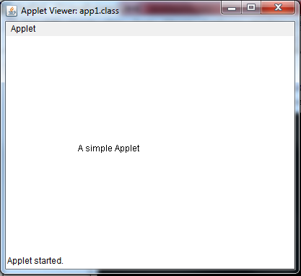
160
100

Slide 27
import java.applet.Applet;
import java.awt.Graphics;
public class HelloApplet extends Applet {
public void paint (Graphics g)
{
g.drawString ("Hello. Welcome to",25,25);
g.drawString ("Java Programming",25,40);
}
}

Slide 28
There are two ways to run an applet
By html file.
By appletViewer tool (used for testing)

Slide 29
By HTML file
Now create an .html file to run the applet
<html>
<applet code = "HelloApplet.class" width=275, height = 100>
</applet>
</html>
Save it as HelloApplet.html
Make sure you save it in the same directory as the .java file

Slide 30
By appletviewer tool
import java.applet.Applet;
import java.awt.Graphics;
public class HelloApplet extends Applet {
public void paint (Graphics g)
{
g.drawString ("Hello. Welcome to",25,25);
g.drawString ("Java Programming",25,40);
}
}
/* <applet code = "HelloApplet.class" width=275, height = 100> </applet> */

Slide 31
By appletviewer tool
c:\>javac HelloApplet.java
c:\>appletviewer HelloApplet .java

Slide 32
Applet Tag
<APPLET
[CODEBASE=codebaseURL]
CODE=AppletFile
[ALT=alternative text]
[NAME=appletinstance Name]
WIDTH=pixels HEIGHT=pixels
ALIGN=alignment
[VSPACE=pixels]
[HSPACE=pixels]>
<PARAM name=appletParameter1 VALUE=value]
<PARAM name=appletParameter2 VALUE=value]
….
</APPLET>

Slide 33
Applet Tag
CODEBASE=code base URL (optional)
Specifies theURL of the applet-the directory or folder that contains the applets code. If this attribute is not specified, then the documents URL is used.
CODE=applet file(required)
It contains the applets compiled Applet subclass (filename.class)
ALT=alternate text
This optional attrite specifies any text that should be displayed if the browser understands the APPLET tag.

Slide 34
Applet Tag
NAME- appletlnstanceName This optional
Attribute specifies a name for the applet instance which makes it possible for applets on the same page to find (and communicate with) each other.
WIDTH –pixels HEIGHT –pixels (required attributes) give the initial width and height
(In pixels) of the applet display area, not counting any windows or dialogs that the applet brings up.

Slide 35
Applet Tag
ALIGN- alignment(required attribute) specifies the alignment of the applet. The possible values of this attribute are the same (and have the same effects) as those for the IMG tag: left, right, top, texttop. middle, absmiddle, baseline, bottom, absbottom.

Slide 36
Applet Tag
VSPACE= pixels HSPACE = pixels( optional attributes ) specify the number of pixels above and below the applet (VSPACE) and on each side of the applet (HSPACE). They're treated the same way as the IMG tag's VSPACE and HSPACE attributes.

Slide 37
Applet Tag
<PARAM NAME = appletParameter1 VALUE = value>
<PARAM> tags are the only way to specify applet-spect parameters. Applets read user-specified values for paramerers with the getParameter() method.

Slide 38
Applet Tag
Alternate Message
If the HTML page containing this <APPLET> tag is viewee
browser that doesn't understand the <APPLET> tag,
The browser will ignore the <APPLET> and <PARAM> tags, and interpreting any other HTML code between the <APPLET>
</APPLE> tags. Java-compatible browsers ignore this alternate message.

Slide 39
paint(), update() and repaint()
paint(), update() and repaint()
The paint method is called each time of your applet's must be redrawn.
For example the applet window is minimized and then maximized, paint is also called when applet begins execution. So, whenever the applet must redraw it output paint() is called.
update() method is called when your applet has requested that a portion of its window be redrawn. This method is used to avoid flickering effect.
repaint() is also called when the applet begins execution.. repaint() method is causes the entire window to be repainted.
Syntax: void repaint()

Slide 40
Passing Parameters to Applets
We can pass the user defined parameter to an applet using a <PARAM> tag .
The <PARAM> tag appear just after the <APPLET> tag for the applet they affect.
It has two attributes NAME and VALUE.
The NAME attribute is the name of the parameter passed to the applet and the
VALUE attribute is the value of the variable passed.

Slide 41
Passing Parameters to Applets
The syntax of the <PARAM> tag is
<APPLET>
<PARAM NAME=paramet er l_name VALUE=parameteri_value>
<PARAM NAME=parameter2_name VALUE=parameter2 value>
<PARAM NAME=parametern_name VALUE==parametern value> .
.
.
</APPLET>

Slide 42
Passing Parameters to Applets
For example, consider the following statements to set the text attribute of applet to This is an example of Parameter!!!
<APPLET>
<PARAM NAME=text VALUE=This is an example of Parameter!! !>
<APPLET>

Slide 43
Passing Parameters to Applets
Ex.. <PARAM NAME="backcolor” VALUE="red'>
You can access the values from the param tag of the HTML using the getParameter() method of the Applet class.
Syntax:
String param_val=getParameter("parameter name"):
Stirng color=getParameter("backcolor”);

Slide 44
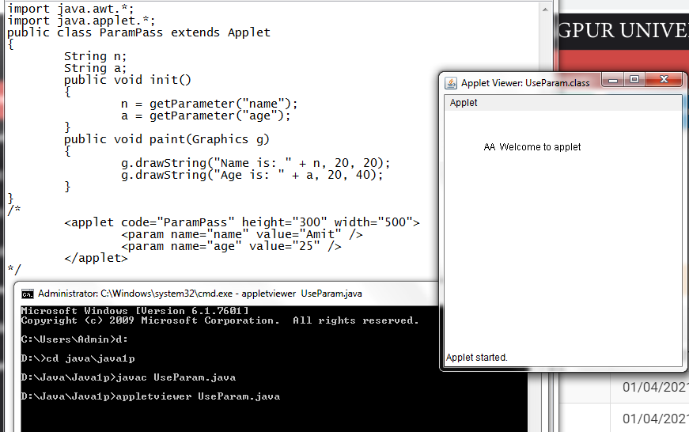
Passing Parameters to Applets

