Slide 1
Multithreading in java
Arvind bhave
Asst. prof. ,iicc, rtmnu

Slide 2
content
Thread concepts
Main thread
Creating threads
Life cycle of a thread

Slide 3
Thread concept
Process and Thread are two basic units of Java program execution
Process: A process is a self contained execution environment and it can be seen as a program or application.
A program contains only single sequential flow of control (start, performs series of operation, ends)(only one statement under execution at any given point of time)
A Thread is like a program which has a single flow of control.( it has starting point, execution part and an end)
• Thread: It can be called lightweight process
• Thread requires less resources to create and exists in the process
• Thread shares the process resources

Slide 4
Thread concept
The main programs which has single sequential flow can be called single-threaded programs.
Java also allows us to use multiple flows of control in a program and such program is known as multithreaded program.
In multithreaded program, each thread is separate tiny module which runs in parallel with other threads. (not running at same time)
If thread running on a single processor , it means only one thread is executed at a given time.
Switching from one thread to another thread occurs so fast that it gives an illusion to the user that all the threads are being at the same time.
All the threads in a main application program share the same address space in memory

Slide 5
Thread concept
Multithreading in Java is a process of executing multiple threads simultaneously.
Ex. One thread can read data , another thread can process it and thirdthread can write it thus improving the overall performance.
Multithreading in java is a process of executing multiple processes simultaneously
• A program is divided into two or more subprograms, which can be implemented at the same time in parallel.
• Multiprocessing and multithreading, both are used to achieve multitasking.
• Java Multithreading is mostly used in games, animation etc.

Slide 6
Thread concept
Multithreading advantages
1) It doesn't block the user because threads are independent and you can perform multiple operations at the same time.
2) You can perform many operations together, so it saves time.
3) Threads are independent, so it doesn't affect other threads if an exception occurs in a single thread.

Slide 7
Thread concept
Multitasking
Multitasking is a process of executing multiple tasks simultaneously. We use multitasking to utilize the CPU. Multitasking can be achieved in two ways:
Process-based Multitasking (Multiprocessing)
Thread-based Multitasking (Multithreading)
Process-based Multitasking (Multiprocessing)
Each process has an address in memory. In other words, each process allocates a separate memory area.
A process is heavyweight.
Cost of communication between the process is high.
Switching from one process to another requires some time for saving and loading registers, memory maps, updating lists, etc.
Thread-based Multitasking (Multithreading)
Threads share the same address space.
A thread is lightweight.
Cost of communication between the thread is low.

Slide 8
Thread concept
Main thread
Java program always contains at least one thread. This is called main thread
When we start a program ,it starts executing immediately
It can be used to create and start other child threads
It is created automatically
It is controlled through thread object
We have to call currentthread() method ehich a public static member of thread class.

Slide 9
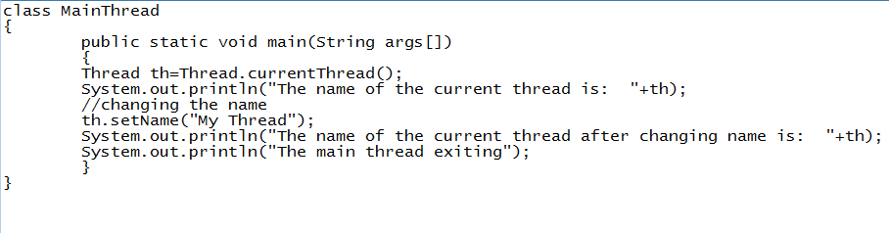
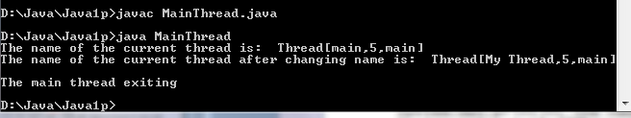
Thread concept

Slide 10
Life cycle of a Thread (Thread States)
A thread can be in one of the five states.
According to sun, there is only 4 states in thread life cycle in java
newborn,
Runnable
running ,
blocked and
dead state.

Slide 11
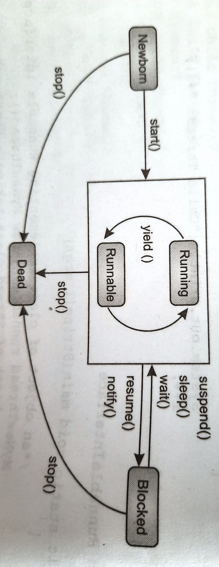
Life cycle of a Thread (Thread States)

Slide 12
Life cycle of a Thread (Thread States)
Newborn State
when a thread is created, it enters a state called newborn state.
It is the first state in the life cycle of a thread in which the thread is newly born and it is not yet ready to run.
That is, the thread is considered not active.
During this stage, we can either schedule the thread for running by calling the
start () method or kill it using stop () method.
We cannot use any other method in the newborn state otherwise it will throw exception.

Slide 13
Life cycle of a Thread (Thread States)
Runnable State
The thread enters the runnable state when it is ready to run and waiting for the CPU to be allocated to it.
Whenever a thread is ready to run, it is placed in the queue of threads that are waiting for the availability of the CPU.
The thread schcduler picks one of the threads in the queue based on their priority.
If all the threads in the queue have equal priority, the scheduler gives time slots for execution in round robin fashion.
A thread can voluntarily give up its turn and give the control to another thread of equal priority using a static method called yield ().
It then joins the queue at the end and waits for its turn to come.

Slide 14
Life cycle of a Thread (Thread States)
Running State
A thread is said to be in the running state when it gets the processor for execution,
that is, when the thread scheduler picks it to be the currently executing thread. The thread will be executed by the processor and will keep running until it gets preempted by a thread of higher priority or it gives up the control in either of the following conditions.
When being suspended using suspend () method
When it is made to sleep using sleep () method
When it is made to wait using wait () method

Slide 15
Life cycle of a Thread (Thread States)
Blocked State
A thread is in blocked state when the thread is either suspended, or sleeping or waiting.
The thread in this state is not considered dead, so it can re-enter the runnable state and subsequently run if the CPU is available.

Slide 16
Life cycle of a Thread (Thread States)
Dead State
A thread is said to be in dead state if its run () method completes or it has been killed deliberately by invoking the stop () method at any state. Once a thread enters the dead state, it cannot re-enter any other state even if the start () method is invoked.

Slide 17
Creating thread
Threads are implemented in the form of objects.
• The run() and start() are two inbuilt methods which helps to thread implementation
• The run() method is the heart and soul of any thread
– It makes up the entire body of a thread
The run() method can be initiating with the help of start() method.
The run()method is automatically invoked when we invoke start() method

Slide 18
Creating thread
2 ways
1. By extending Thread class
Create a class that extends thread class defined in java.lang package and creating an instance of the class.
the extending class must override the run() method. The code that neeeds to be executed by the thread will be defined inside the run() method.
2. By implementing Runnable interface
Runnable interface consists of a single method run() which is required for implementing thread

Slide 19
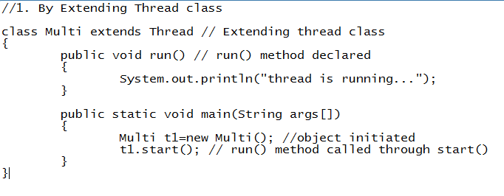

Creating thread

Slide 20
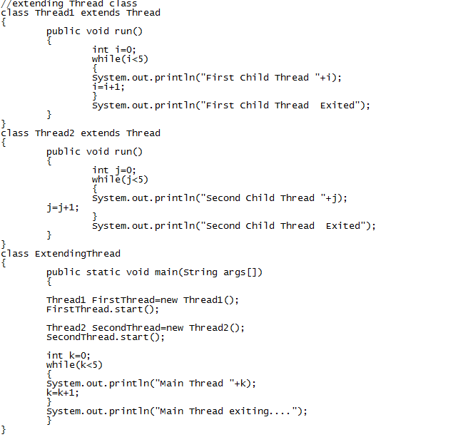
Creating thread

Slide 21

Creating thread

Slide 22

Creating thread

Slide 23
Creating thread
2. By implementing Runnable interface
Define a class that implements Runnable interface.
The Runnable interface has only one method,
run(), that is to be defined in the method with the code to be executed by the thread.

Slide 24
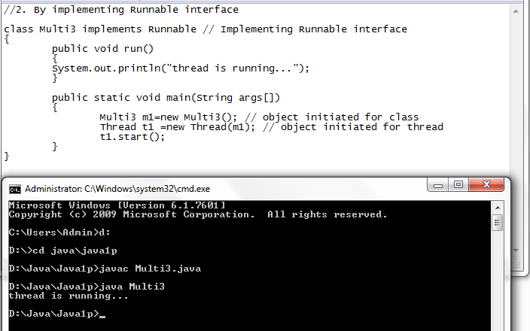
Creating thread

Slide 25
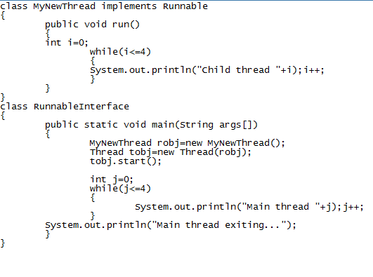
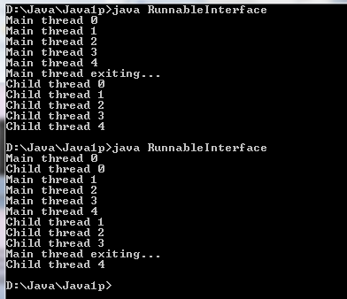
Creating thread

Slide 26
THREAD METHODS
Thread is a class found in java.lang package.
void start()
This method will start a new thread of execution by
calling run() method of Thread/runnable object.
void run()
This method is the entry point of the thread.
Execution of thread starts from this method.
There are various other methods of thread class. They are yield (), sleep (), stop (), isAL1ve () and join () method

Slide 27
THREAD METHODS
Using yield (), sleep () and stop () method
the yield (), sleep () and stop () methods are responsible for controlling the behavior of a thread and the transition of thread from one state to another
void sleep(sleeptime)
This method suspend the thread for mentioned time duration in argument (sleeptime in ms)
void yield()
By invoking this method the current thread pause its execution temporarily and allow other threads to execute
A yield() method is a static method of Thread class and it can stop the currently executing thread and will give a chance to other waiting threads of the same priority. If in case there are no waiting threads or if all the waiting threads have low priority then the same thread will continue its execution. The advantage of yield() method is to get a chance to execute other waiting threads so if our current thread takes more time to execute and allocate processor to other threads

Slide 28
THREAD METHODS
The general form of sleep () method is:
static void sleep (long milliseconds) throwS Interrupted Exception
where, milliseconds is the number of milliseconds to suspend.
As the sleep () method throws an exception, the call to sleep () method must be enclosed in a try block followed catch block otherwise the program will not compile.
The general form of stop () method is:
static void stop ()
The general form of yield () method is:
static void yield ()

Slide 29
THREAD METHODS
Sr No | Type/Modifier | Method | Meaning
1) | void | start() | It is used to start the execution of the thread.
2) | void | run() | It is used to do an action for a thread.
3) | static void | sleep() | It sleeps a thread for the specified amount of time.
4) | static Thread | currentThread() | It returns a reference to the currently executing thread object.
5) | void | join() | It waits for a thread to die.
6) | int | getPriority() | It returns the priority of the thread.
7) | void | setPriority() | It changes the priority of the thread.
8) | String | getName() | It returns the name of the thread.
9) | void | setName() | It changes the name of the thread.

Slide 30
THREAD METHODS
Sr No | Type/Modifier | Method | Meaning
10) | long | getId() | It returns the id of the thread.
11) | boolean | isAlive() | It tests if the thread is alive.
12) | static void | yield() | It causes the currently executing thread object to pause and allow other threads to execute temporarily.
13) | void | suspend() | It is used to suspend the thread.
14) | void | resume() | It is used to resume the suspended thread.
15) | void | stop() | It is used to stop the thread.
16) | void | destroy() | It is used to destroy the thread group and all of its subgroups.
17) | boolean | isDaemon() | It tests if the thread is a daemon thread.
18) | void | setDaemon() | It marks the thread as daemon or user thread.

Slide 31
THREAD METHODS
Sr No | Type/Modifier | Method | Meaning
19) | Thread.State | getState() | It is used to return the state of the thread.
20) | ThreadGroup | getThreadGroup() | It is used to return the thread group to which this thread belongs
21) | String | toString() | It is used to return a string representation of this thread, including the thread's name, priority, and thread group.
22) | void | notify() | It is used to give the notification for only one thread which is waiting for a particular object.
23) | void | notifyAll() | It is used to give the notification to all waiting threads of a particular object.
24) | Thread.State | getState() | It is used to return the state of the thread.
25) | ThreadGroup | getThreadGroup() | It is used to return the thread group to which this thread belongs
26) | String | toString() | It is used to return a string representation of this thread, including the thread's name, priority, and thread group.
27) | void | notify() | It is used to give the notification for only one thread which is waiting for a particular object.

Slide 32
Using isAlive () and join () Method
the main thread must often be the last thread to terminate since it performs several other tasks.
For this, we can invoke sleep () method within main () method which makes the main thread sleep for specified period of time until all the child threads complete their execution.
However, it 1s not considered a good approach as the main thread has no information when a child thread will finish its execution.
In this case, the main thread has to sleep for a period of long enough to assure the termination of child threads prior to its termination.
For example. the main thread is made to sleep for 2500 milliseconds and the child threads altogether take 10 milliseconds to terminate, then there will be a delay of 1500 milliseconds for the main threaD To terminate.
Thus, it is necessary for the main thread to know when the child threads have finished

Slide 33
Using isAlive () and join () Method
There are two ways to determine whether a thread has ended.
Isalive() and join() methods
isAlive() : It tests if this thread is alive. A thread is alive if it has been started and has not yet died. There is a transitional period from when a thread is running to when a thread is not running. After the run() method returns, there is a short period of time before the thread stops. If we want to know if the start method of the thread has been called or if thread has been terminated, we must use isAlive() method. This method is used to find out if a thread has actually been started and has yet not terminated.
General Syntax :
final boolean isAlive( )
Return Value: returns true if the thread upon which it is called is still running. It returns false otherwise.

Slide 34
Using isAlive () and join () Method
join() :
When the join() method is called, the current thread will simply wait until the thread it is joining with is no longer alive.
Or we can say the method that you will more commonly use to wait for a thread to finish is called join( ).
This method waits until the thread on which it is called terminates. Its name comes from the concept of the calling thread waiting until the specified thread joins it.
Additional forms of join( ) allow you to specify a maximum amount of time that you want to wait for the specified thread to terminate. Syntax :final void join( ) throws InterruptedExceptionHere is an improved version of the preceding example that uses join( ) to ensure that the main thread is the last to stop. It also demonstrates the isAlive( ) method.

Slide 35
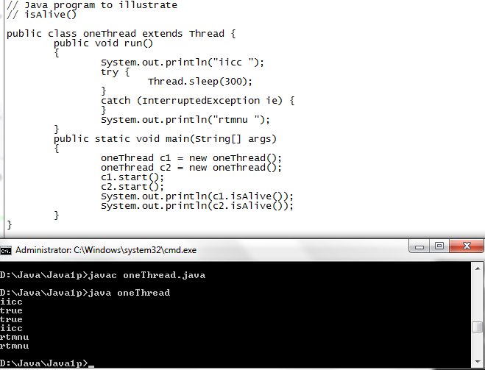
Using isAlive () and join () Method

Slide 36
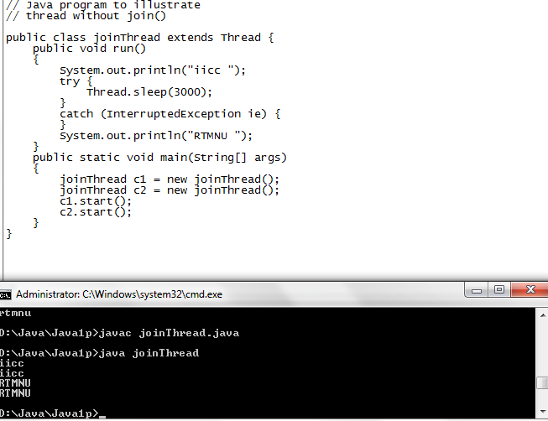
Using isAlive () and join () Method

Slide 37
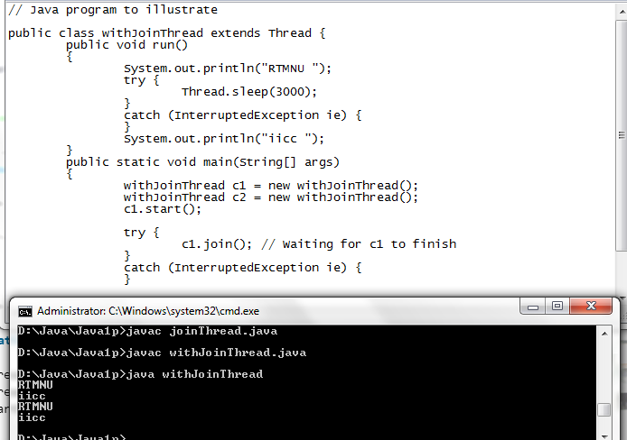
Using isAlive () and join () Method

Slide 38
THREADS PRIORITY
The threads we have seen so far are of equal priority in which the Java scheduler selects the thread for execution on the first-come, first-serve basis.
However, each thread can be assigned different priority which will decide the order in which it is scheduled for running.
Priorities are the integers which specify the relative priority of one thread to another.
When a thread is created, it inherits its priority from the thread that created it.
However, the priority of a thread can be changed by using the set Priority () method of the Thread class.
MIN_PRIORITY,
MAX PRIORITY and
NORM_PRIORITY are the constants defined in Thread class
But it is not guaranteed because it depends on JVM specification that which scheduling it chooses.
The syntax to set the priority of a thread is:
ThreadName. setPriority (n) ;
where, n is an integer value which ranges from MIN_PRIORITY (1) and MAX PRIORITY (10).
The default priority is NORM_PRIORITY whose value is 5.

Slide 39
THREADS PRIORITY
When there are multiple threads ready to execute, the highest priority thread is chosen and Executed.
Only when the high priority thread stops, yields or enters blocked state, the low priority thread starts running.
However, if any higher priority thread enters, it will preempt the currently running thread forcing it to move to the runnable state.

Slide 40
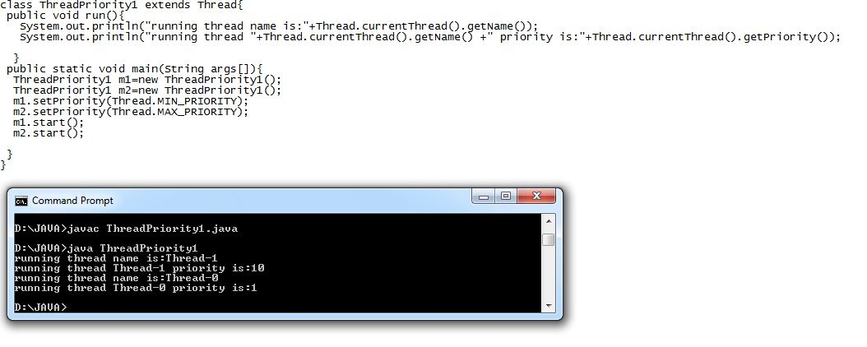
THREADS PRIORITY

Slide 41
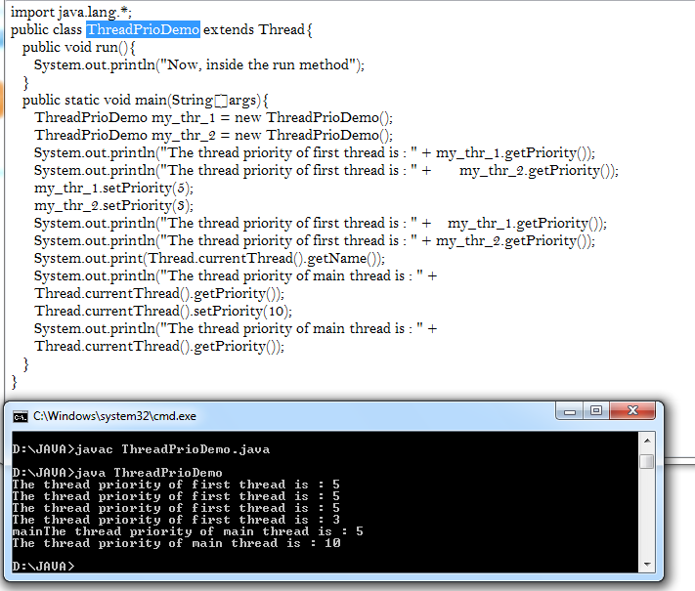
THREADS PRIORITY

Slide 42
SYNCHRONIZATION OF THREADS
Synchronization in java is the capability to control the access of multiple threads to any shared resource.
Java Synchronization is better option where we want to allow only one thread to access the shared resource.
the synchronization is mainly used to
To prevent thread interference.
To prevent consistency problem.
There are two types of synchronization
Process Synchronization
Thread Synchronization

Slide 43
SYNCHRONIZATION OF THREADS
When multiple threads need access to a single resource, there must be a way to ensure that only one Thread will use the resource at any given point of time otherwise it may lead to a severe problem.
For example, if one thread in a program reads salary from a file and another thread tries to update it, Then the program may produce an undesirable output. The solution to this problem can be achieved using a technique known as synchronization.
The objective of synchronization is to control the Access to shared resources.

Slide 44
SYNCHRONIZATION OF THREADS
Synchronization uses the concept of monitor.
A monitor is an object which is used as Mutually exclusive lock. That is, it can be owned by only one thread at any given point of time.
A Tread is said to have entered the monitor when it acquires a lock.
Any other thread which attempts To acquire the lock has to wait until the first thread comes out of the monitor.
There are two ways to IMplement synchronization.
Synchronizing Methods
Synchronizing Statements

Slide 45
SYNCHRONIZATION OF THREADS
Synchronizing Methods
We can synchronize a subset (or all) of the methods of any class by using synchronized Keyword.
When a method is declared synchronized, Java creates a monitor.
To enter the monitor, We need to call a synchronized method.
Only one of the synchronized methods in a class object Can execute at any given time.
Java hands over the monitor to the thread that calls the method first.
AS long as a thread is inside a synchronized method, other threads trying to call it (or any other SYNchronized method) on the same instance have to wait.
Only when the currently executing thread FiniShes executing and exits the monitor another waiting thread can enter the monitor.
The syntax to declare a method as synchronized is:
Synchronized data type method_name () {
// code for the method
}

Slide 46
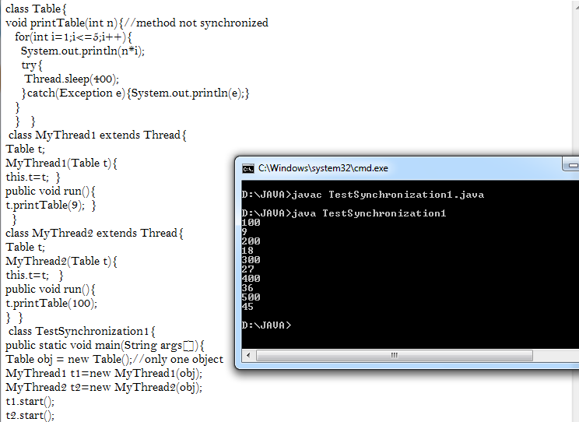
SYNCHRONIZATION OF THREADS

Slide 47
SYNCHRONIZATION OF THREADS
If you declare any method as synchronized, it is known as synchronized method. Synchronized method is used to lock an object for any shared resource.
When a thread invokes a synchronized method, it automatically acquires the lock for that object and releases it when the thread completes its task.

Slide 48
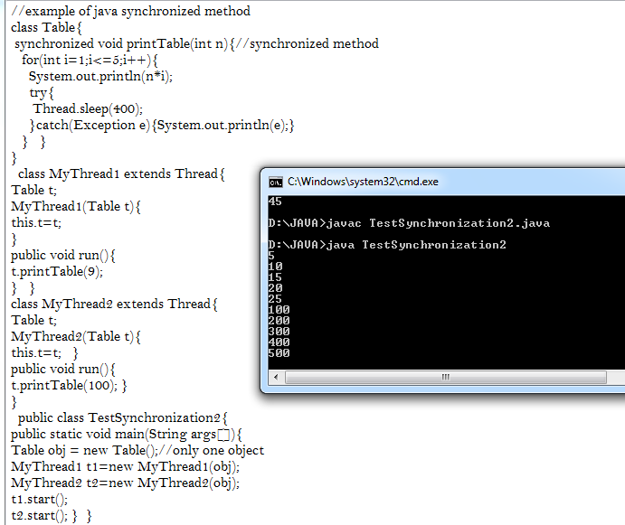
SYNCHRONIZATION OF THREADS

Slide 49
SYNCHRONIZATION OF THREADS
Synchronizing Statements
Another way of managing the execution of the thread is to synchronize a block of code or statements. This is more powerful. Synchronizing a method does not work in all cases.
For example. the class we want to access is created by someone else, which does not have synchronized methods and we do not have access rights to modify it. In this case, the access to objects of this class can be synchronized by placing the call to the methods defined by this class inside a synchronized block
Two block of codes synchronized on the same instance cannot execute at the same time.

Slide 50
SYNCHRONIZATION OF THREADS
The general form to synchronize a block of code
Synchronized (object)
{
//statements to be synchronized
}
where,
object is a reference to the object being synchronized.

Slide 51
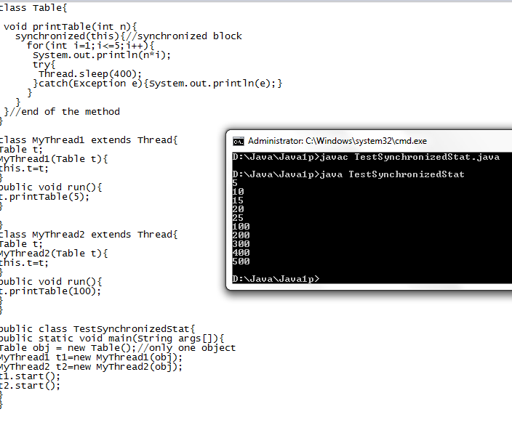
SYNCHRONIZATION OF THREADS

Slide 52
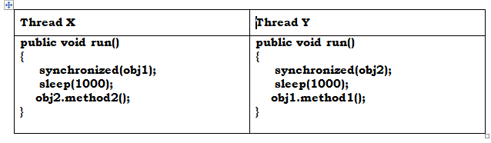
Deadlock
Deadlock is a situation that occurs when two or more threads are in simultaneous wait state and Each of them is waiting for the release of a resource held by one of the other waiting thread.
both threads are waiting for each other to release the lock, the condition is called deadlock.

Slide 53
deadlock
First Thread x starts and synchronizes on the Object obj1
This prevents to call the methods of obj1 to other threads
Thread x then calls the sleep() method and allow thread y to start
Thread y starts and synchronizes on the object obj2
This prevents to call the methods of obj2 to other threads
Thread Y then calls the sleep() method and allow thread X to start
Then thread x continues execution & tries to call method2 on obj2. but it cannot call until thread y finishes execution on obj2.
So thread x can not proceed & thread y gets control & tries to call method1 on obj1but this not possible until code in thread x finishes.
This condition is deadlock

Slide 54
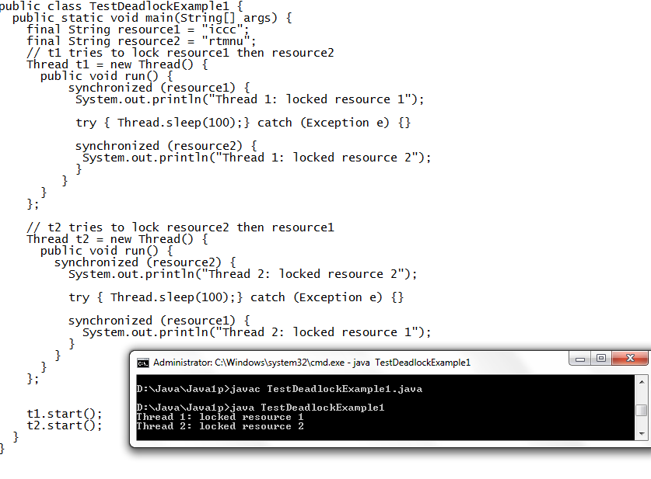
deadlock

Slide 55
Inter-thread communication in Java
Inter-thread communication or Co-operation is all about allowing synchronized threads to communicate with each other.
Java provide benefits of avoiding thread pooling using inter-thread communication. The wait(), notify(), and notifyAll() methods of Object class are used for this purpose. These method are implemented as final methods in Object, so that all classes have them. All the three method can be called only from within a synchronized context
it is a mechanism in which a thread is paused running in its critical section and another thread is allowed to enter (or lock) in the same critical section to be executed. It is implemented by following methods of Object class:
wait()
notify()
notifyAll()

Slide 56
Inter-thread communication in Java
public void wait()
Causes the current thread to wait until another thread invokes the notify().
public void notify()
Wakes up a single thread that is waiting on this object's monitor.
public void notifyAll()
Wakes up all the threads that called wait( ) on the same object.
These methods have been implemented as final methods in Object, so they are available in all the classes. All three methods can be called only from within a synchronized context.

Slide 57
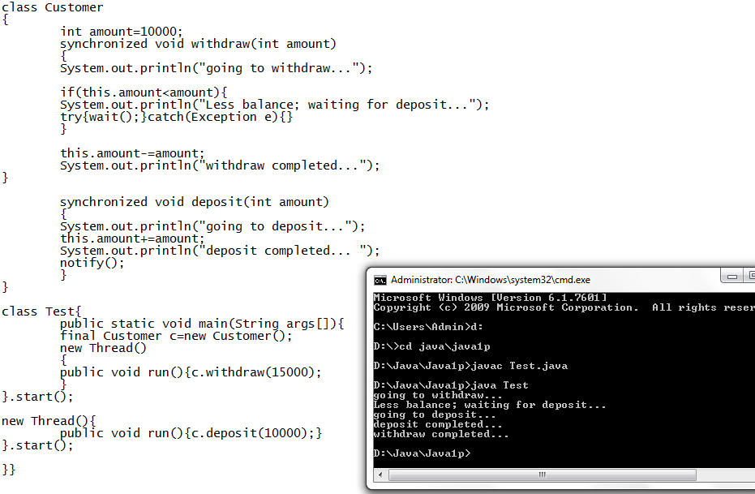
Inter-thread communication in Java

