Slide 1
Unit 4
Introduction to Transaction management

Slide 2
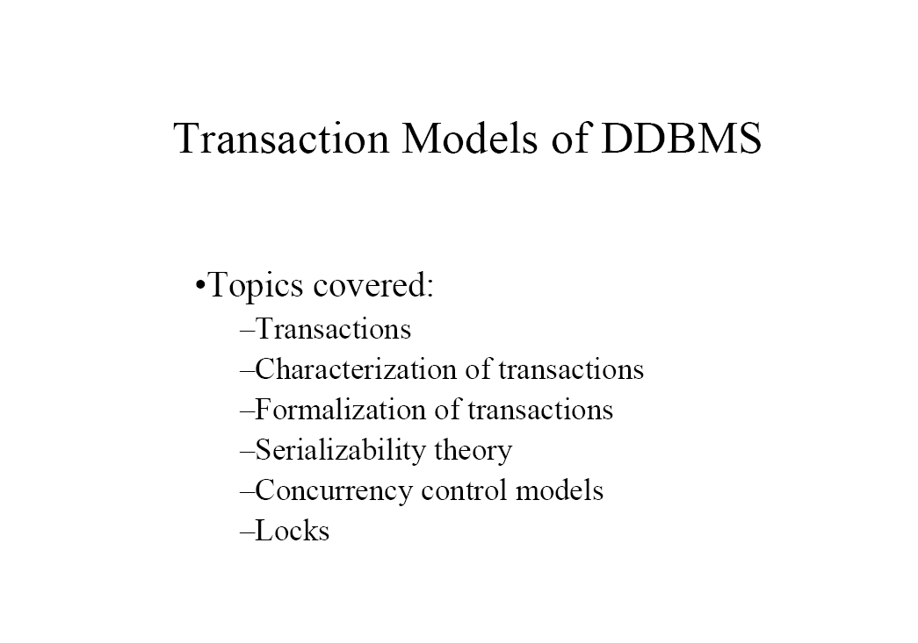

Slide 3
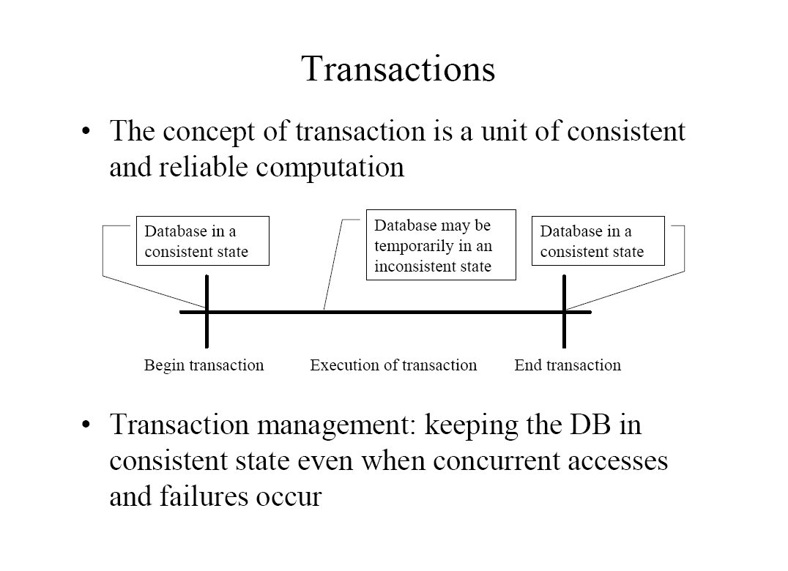

Slide 4
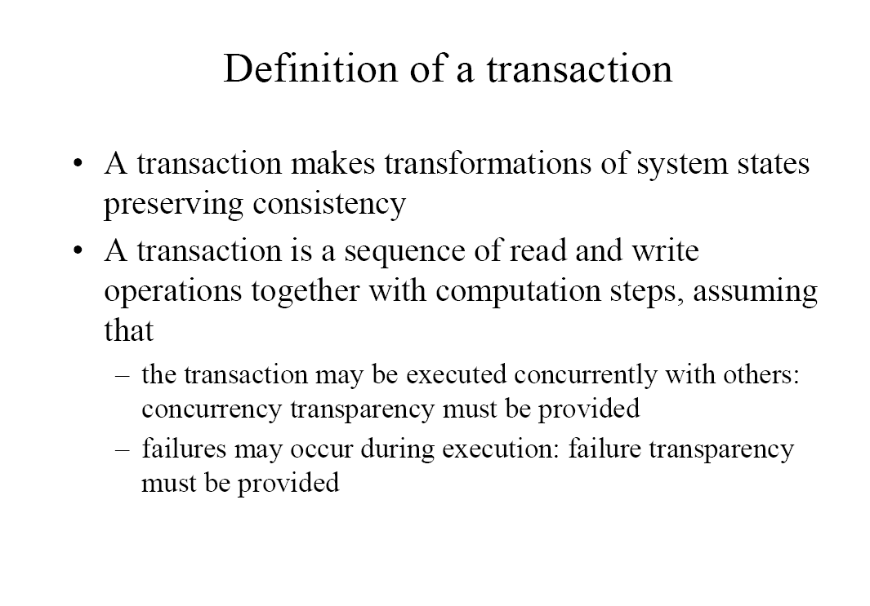

Slide 5
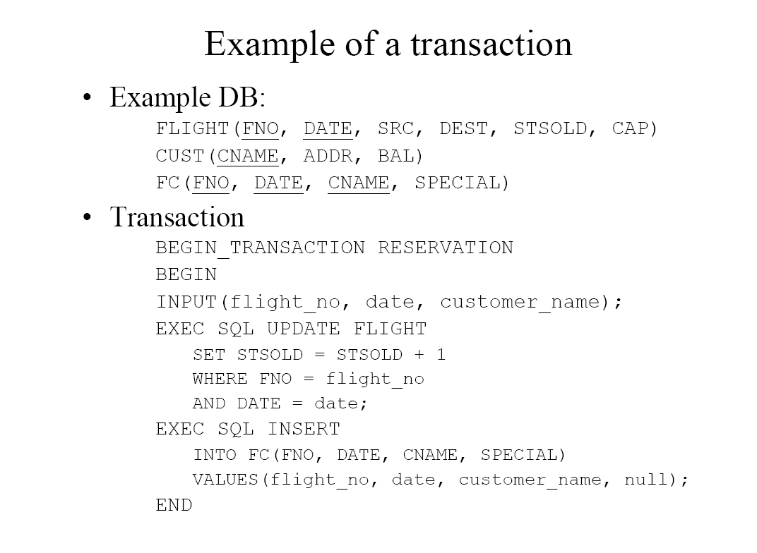

Slide 6
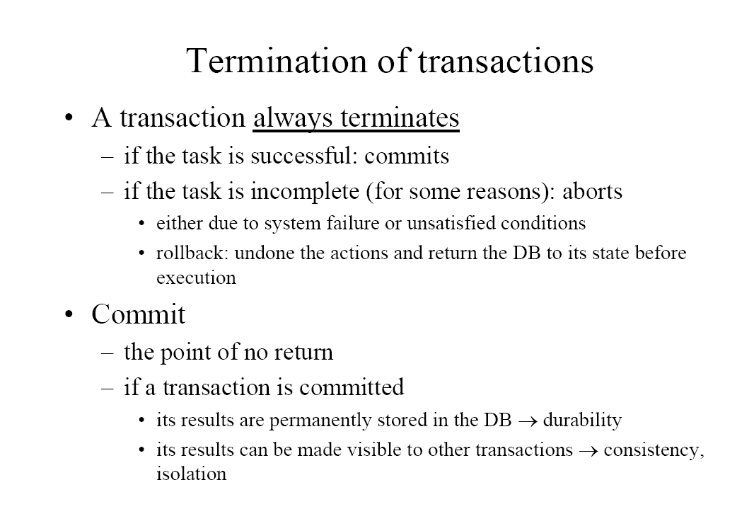

Slide 7
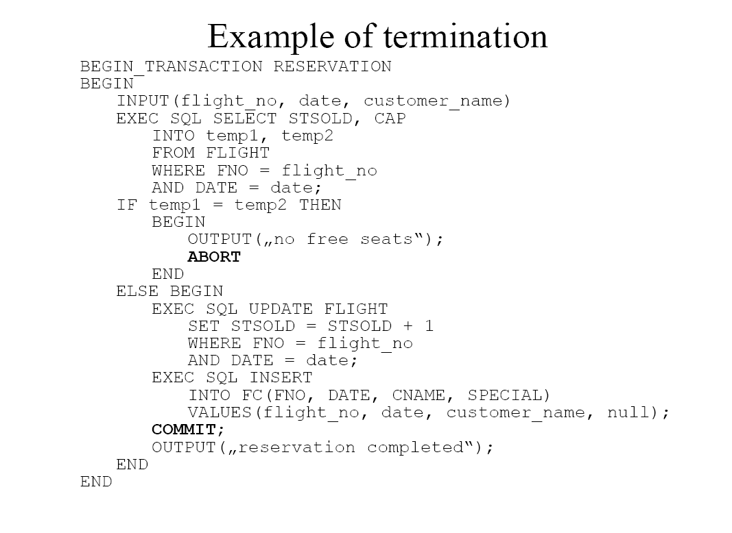

Slide 8
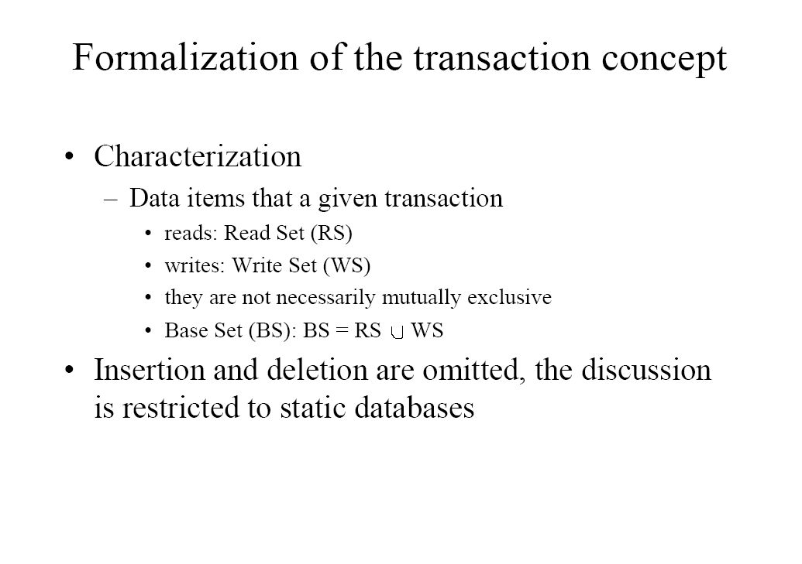

Slide 9
Characterization of Transaction
Read set (RS)
Write set (WS)
(Base set) BS=RS U WS
Example
RS [Reservation]={FLIGHT.STSOLD,FLIGHT.CAP}
WS [Reservation]={ FIGHT.STSOLD,FC.FNO,FC.DATE, FC.CNAME , FC.SPECIAL}
BS [Reservation] ={FLIGHT.STSOLD,FLIGHT.CAP, FC.FNO, FC.DATE, FC.CNAME, FC.SPECIAL}

Slide 10
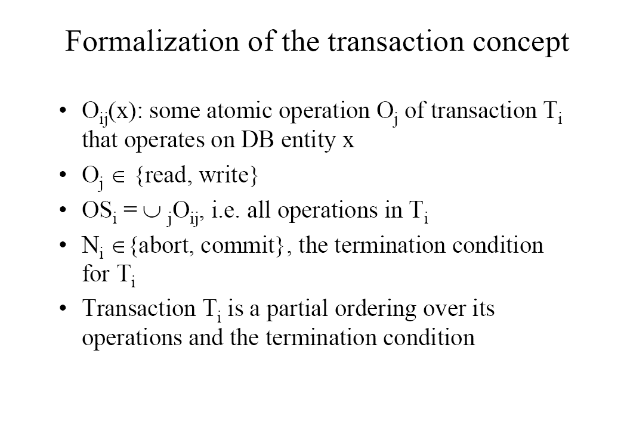

Slide 11
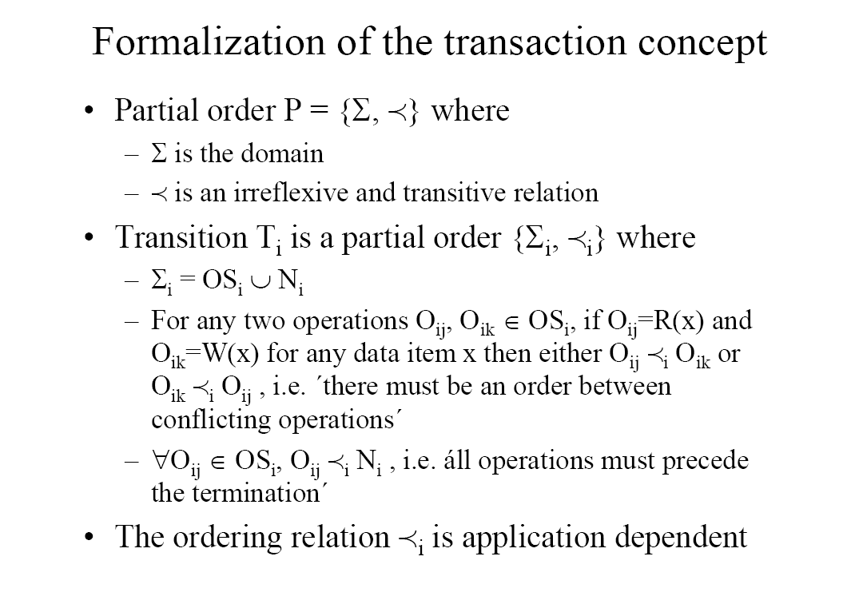

Slide 12
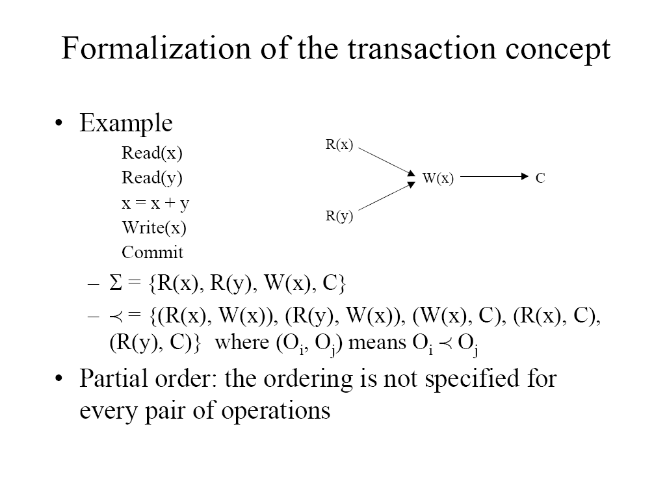

Slide 13
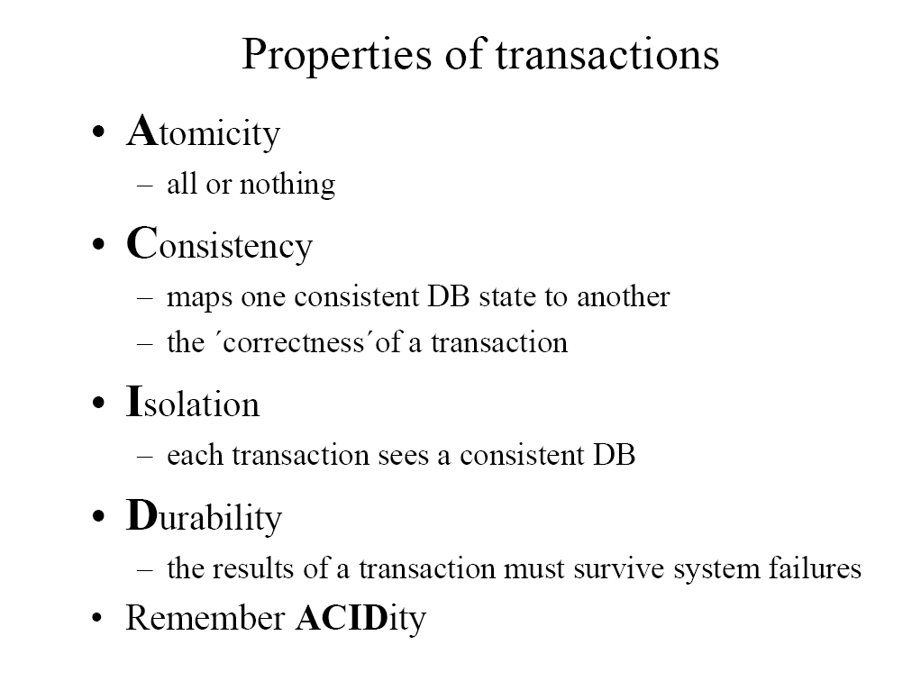

Slide 14
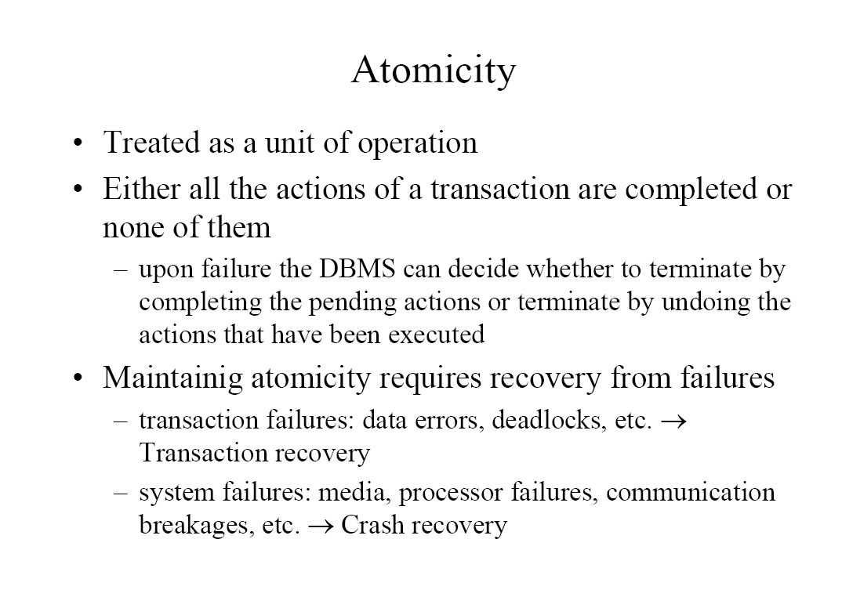

Slide 15
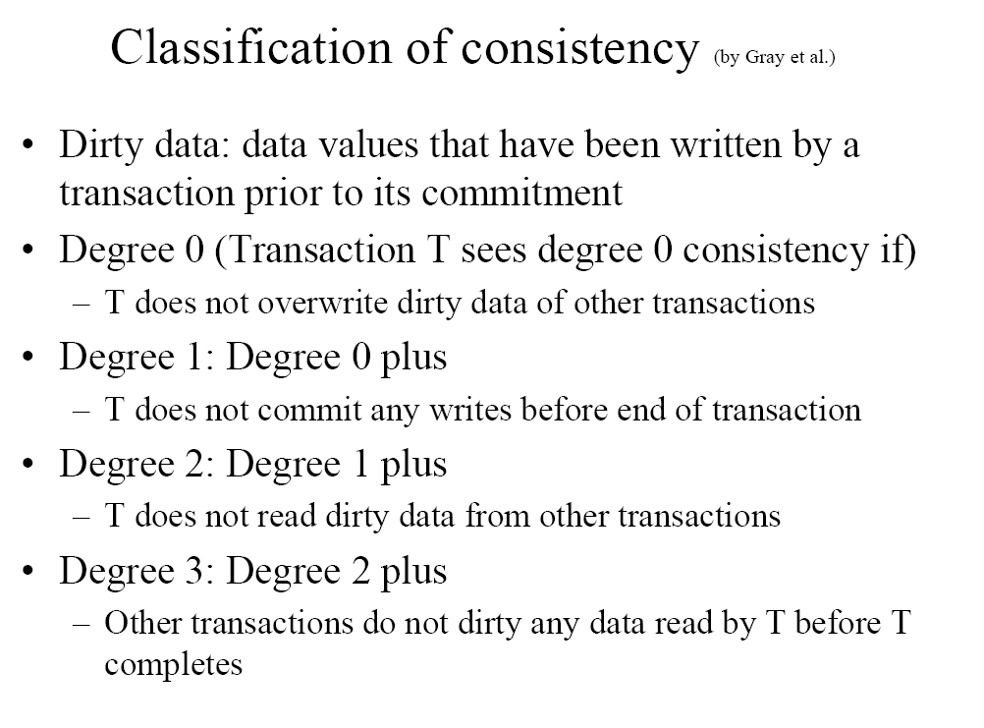

Slide 16
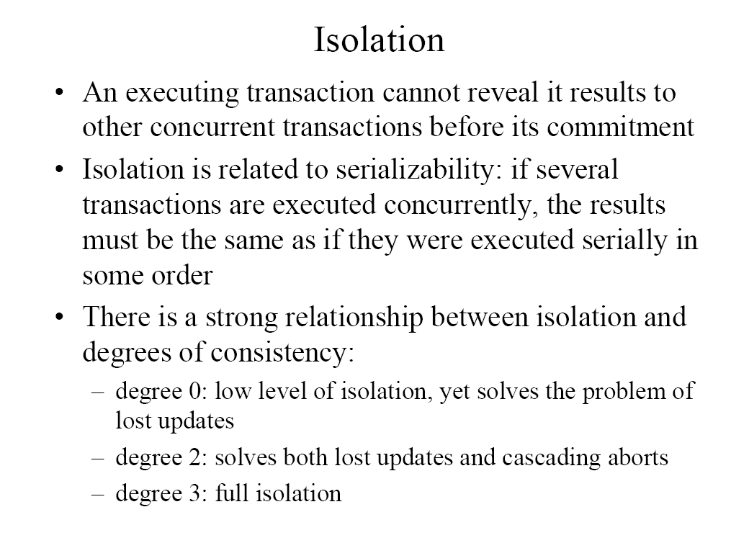

Slide 17
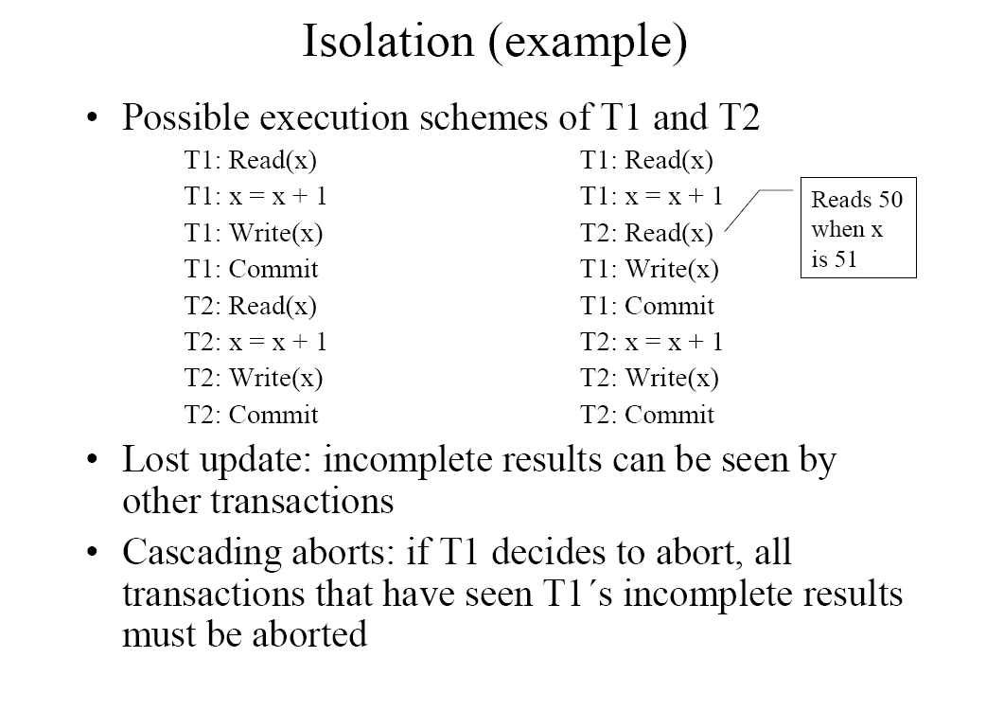

Slide 18
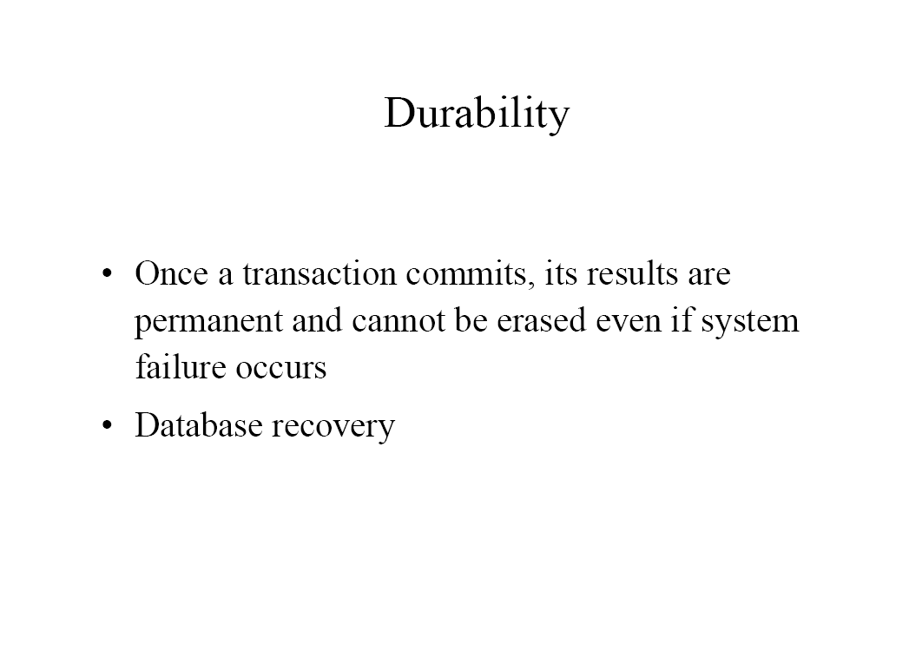

Slide 19
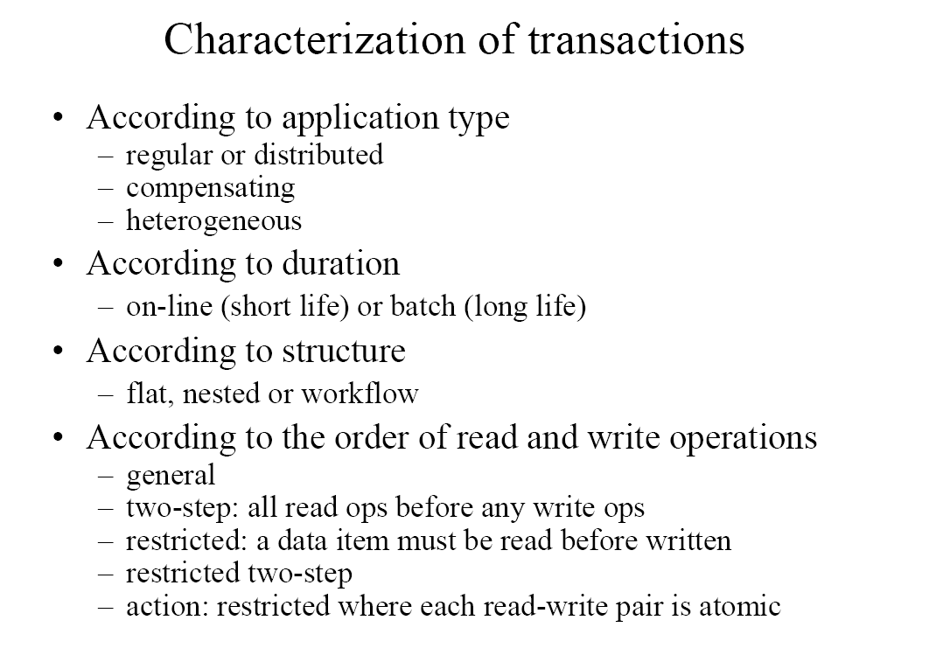

Slide 20
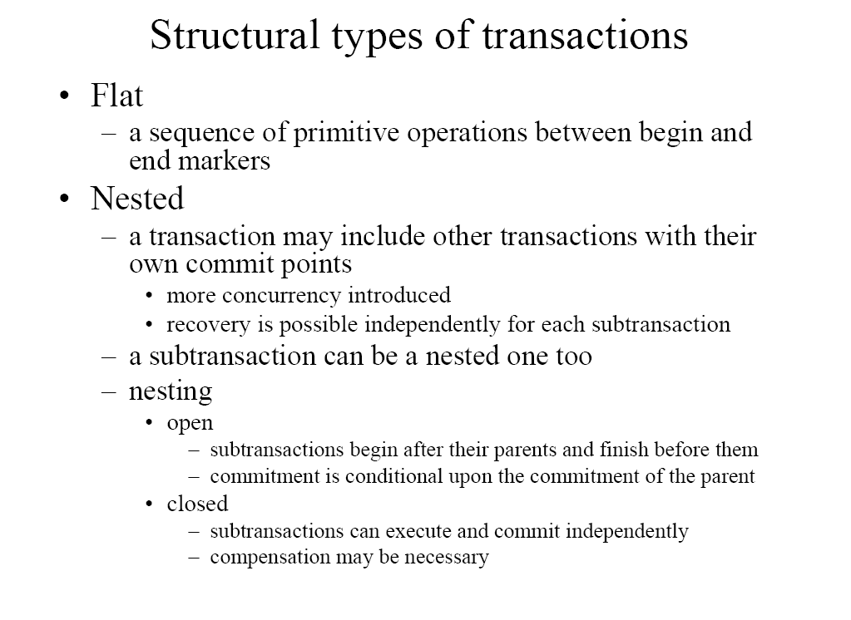

Slide 21
