Slide 1
Welcome to the world of
Distributed Database Systems
Unit I
By
Vikas Yeotikar

Slide 2
Disadvantages of File System & Advantages of DDBMS
Data Redundancy & Inconsistency
Difficult in accessing Data
Data Isolation
Integrity Problems
Atomicity Problems
Concurrent-Access Problems
Security Problems

Slide 3
Objectives
Difference between data, Information & Metadata.
Overall understanding of Entities, Attributes and database System
Concepts of Data Model and their Types etc.
Data
Information
Metadata

Slide 4
Association between fields
1. One-to-one association (1:1 <------------>)
2. One-to-many association (1:M <--------------->>)
3. Many -to-many association (M:N <<---------->>)
4. Many-to-one association (M:1 <<------------->)
5. One-to-one conditional association (<-------o------>)

Slide 5
ASSOCIATION BETWEEN FILES (RECORD TYPES)
1. One-to-one association
2. One-to-many association
3. Many-to-many association
4. Many-to-one association
5. Multiple Association
6. One-to-one conditional association
7. Recursive association

Slide 6
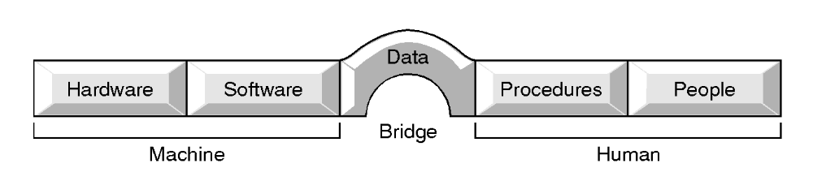
Components of DBMS Environment
16

Slide 7
Components of DBMS Environment
Hardware
  Can range from a PC to a network of computers.
Software
  DBMS, operating system, network software (if necessary) and also the application programs.
Data
  Used by the organization and a description of this data called the schema.
17

Slide 8
Components of DBMS Environment
Procedures
  Instructions and rules that should be applied to the design and use of the database and DBMS.
People
18

Slide 9
Objectives of Three-Level Architecture
All users should be able to access same data.
Users should not need to know physical database storage details.
6

Slide 10
Objectives of Three-Level Architecture
DBA should be able to change database storage structures without affecting the users' views.
Internal structure of database should be unaffected by changes to physical aspects of storage.
DBA should be able to change conceptual structure of database without affecting all users.
7

Slide 11
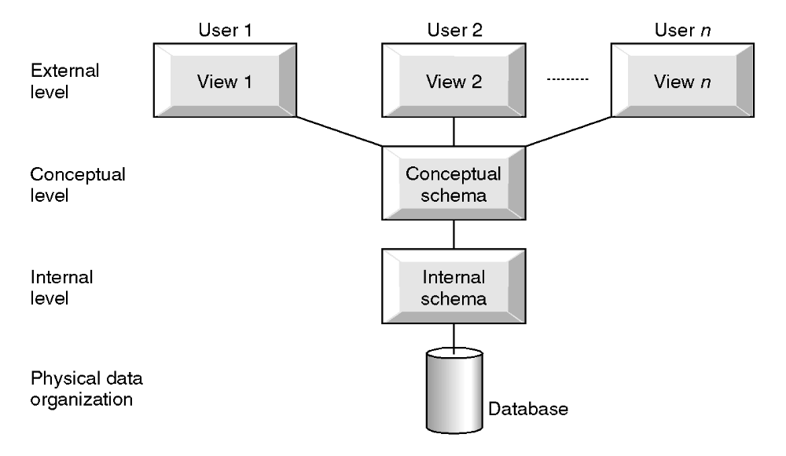
ANSI-SPARC Three-level Architecture
8

Slide 12
ANSI-SPARC Three-level Architecture
External Level
  Users' view of the database. Describes that part of database that is relevant to a particular user.
Conceptual Level
  Community view of the database. Describes what data is stored in database and relationships among the data.
9

Slide 13
ANSI-SPARC Three-level Architecture
Internal Level
  Physical representation of the database on the computer. Describes how the data is stored in the database.
10

Slide 14
Database Languages
Data Definition Language (DDL)
  Allows DBA or user to describe and name entitles, attributes and relationships required for the application.
15

Slide 15
Database Languages
Data Manipulation Language (DML)
  Provides basic data manipulation operations on data held in the database.
  Procedural DML - allows user to tell system exactly how to manipulate data.
  Non-Procedural DML - allows user to state what data is needed rather than how it is to be retrieved.
16

Slide 16
Database Languages
Fourth Generation Language (4GL)
  Query Languages
  Forms Generators
  Report Generators
  Graphics Generators
  Application Generators
17

Slide 17
Disadvantages of DBMS
Complexity
Size
Cost of DBMS
Additional hardware costs
Cost of conversion
Performance
Higher impact of a failure
23

