Slide 1
Image super pixElation using deep learning
SUBMITTED BY
S.M. Aadithya, 2017UIT2520
Aman Hembram, 2017UIT2507
Vaibhav Sharan, 2017UCO1677
Under the supervision of
Dr. devender kumar
Dr. veenu

Slide 2
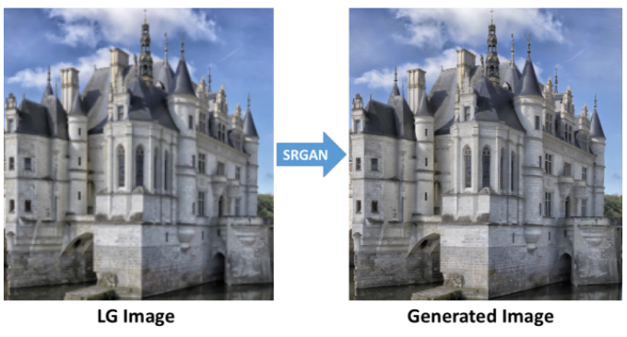
Abstract
A low-resolution image is processed and upscaled to a higher resolution output image using artificial intelligence models trained utilizing deep learning techniques like GANs and CNNs. Our aim is to create a model which, given an input image, will output a higher resolution image by filling in the unknown details by itself.

Slide 3
overview
Super Pixelation is the process of upscaling and improving the details inside an image. The details in the output image are guessed/estimated using AI models trained using Generative Adversarial Networks (GAN), a perceptual loss function which consists of an adversarial loss and a content loss. The adversarial loss pushes our solution to the natural image manifold using a discriminator network that is trained to differentiate between the super-resolved images and original photo-realistic images. Our deep residual network will be able to recover photo-realistic textures from heavily down sampled images.
Our Project consists of four main steps:
review and study recent works on the topic
implement one or more of the solutions and possibly compare pre-trained versions
get some data, train and test the model
improve the model and the data to get better results.

Slide 4
Related work
Image super-resolution
Recent overview articles on image SR are Yang et al. Here we will focus on single image super-resolution (SISR). Prediction-based methods were among the first methods to tackle SISR. While these filtering approaches, e.g. linear, bicubic filtering, can be very fast, they oversimplify the SISR problem and usually yield solutions with overly smooth textures. Methods that put particularly focus on edge-preservation have been proposed. More powerful approaches aim to establish a complex mapping between low- and high-resolution image information and usually rely on training data

Slide 5
Design of convolutional neural networks
The state of the art for many computer vision problems is meanwhile set by specifically designed CNN architectures. It was shown that deeper network architectures can be difficult to train but have the potential to substantially increase the network’s accuracy as they allow modelling mappings of very high complexity. To efficiently train these deeper network architectures, batch normalization is often used to counteract the internal co-variate shift. Deeper network architectures have also been shown to increase performance for SISR.
Loss Function
Pixel-wise loss functions such as MSE struggle to handle the uncertainty inherent in recovering lost high-frequency details such as texture: minimizing MSE encourages finding pixel-wise averages of plausible solutions which are typically overly-smooth and thus have poor perceptual quality. Reconstructions of varying perceptual quality the problem of minimizing MSE where multiple potential solutions with high texture details are averaged to create a smooth reconstruction.

Slide 6
Approach
In SISR the aim is to estimate a high-resolution, super resolved image ISR from a low-resolution input image ILR . Here ILR is the low-resolution version of its high resolution counterpart IHR. The high-resolution images are only available during training. In training, ILR is obtained by applying a Gaussian filter to IHR followed by a down sampling operation with down sampling factor 4.
Our ultimate goal is to train a generating function G that estimates for a given ILR input image its corresponding IHR counterpart. To achieve this, we train a generator network as a feed-forward CNN with residual blocks, and we also train a discriminator network as a fully connected CNN used as a classifier.
In this work we will specifically design a Perceptual Loss for lSR as a weighted combination of Content Loss and Adversarial Loss that model distinct desirable characteristics of the recovered SR image.

Slide 7
Network architecture
The general idea behind this formulation is that it allows one to train a generative model G with the goal of fooling a differentiable discriminator D that is trained to distinguish super-resolved images from real images. With this approach our generator can learn to create solutions that are highly similar to real images and thus difficult to classify by D. At the core of our very deep generator network G are B residual blocks with identical layout.

Slide 8
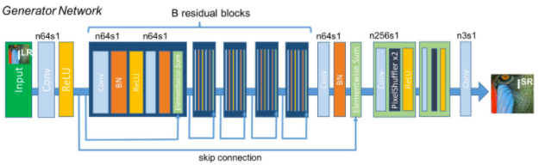
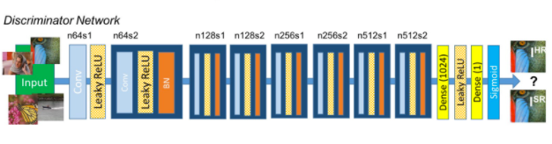
Generator Network is a residual CNN
Discriminator Network is a fully connected CNN

Slide 9
Dataset and experimental tools
Pretrained VGG19 model
DIV2K dataset: DIVerse 2K resolution high quality images as used for the challenges @ NTIRE (CVPR 2017 and CVPR 2018) and @ PIRM (ECCV 2018). Train data: starting from 800 high definition high resolution images we obtain corresponding low resolution images and provide both high and low resolution images for 4 downscaling factors. Validation data: 100 high definition high resolution images are used for genereting low resolution corresponding images, the low res images.
Tools Used:
TensorFlow
Keras
Jupyter Notebook
Spyder

Slide 10


Results
ORIGINAL
SRGAN

Slide 11
Papers referred and other links
Yulun Zhang, Yapeng Tian, et al. 2018. Residual Dense Network for Image Super-Resolution. arXiv:1802.08797.
Christian Ledig, Lucas Theis, Ferenc Huszar, et al. 2016. Photo-Realistic Single Image Super-Resolution Using a Generative Adversarial Network. arXiv:1609.04802.
H. A. Aly and E. Dubois. Image up-sampling using total-variation regularization with a new observation model. IEEE Transactions on Image Processing, 14(10):1647–1659, 2005.
C. Dong, C. C. Loy, K. He, and X. Tang. Image super-resolution using deep convolutional networks. IEEE Transactions on Pattern Analysis and Machine Intelligence, 38(2):295–307, 2016.
J. Johnson, A. Alahi, and F. Li. Perceptual losses for real-time style transfer and super- resolution. In European Conference on Computer Vision (ECCV), pages 694–711. Springer, 2016
W. Shi, J. Caballero, F. Huszar, J. Totz, A. P. Aitken, R. Bishop, D. Rueckert, and Z. Wang. Real-Time Single Image and Video Super-Resolution Using an Efficient Sub-Pixel Convolutional Neural Network. In IEEE Conference on Computer Vision and Pattern Recognition (CVPR), pages 1874–1883, 2016.
https://medium.com/idealo-tech-blog/zoom-in-enhance-a-deep-learning-based-magnifying-glass-part-2-c021f98ebede
https://github.com/idealo/image-super-resolution

