Slide 1
MODELLING ILLUSTRATIONS USING GENERATIVE ADVERSARIAL NETWORKS
SUBMITTED BY
Vaibhav Sharan, 2017UCO1677
MD Mehran, 2017UCO1651
S.M. Aadithya, 2017UIT2520
Under the supervision of
Dr. KuSHIL Saini Dr. Ankita Bansal

Slide 2
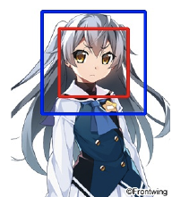
Abstract
Automatic generation of facial images has been well studied after the Generative Adversarial Network (GAN) became a well-known framework. Our goal is to explore the training of DCGAN models specialized on an animated facial image dataset. Its purpose is to automatically generate faces of animated characters based on the inputted facial feature tags.

Slide 3
Related work
Generative Adversarial Network
Generative Adversarial Network (GAN), proposed by Goodfellow et al., shows impressive results
in image generation , image transfer, super-resolution and many other generation tasks.
The essence of GAN can be summarized as training a generator model and a discriminator model
simultaneously, where the discriminator model tries to distinguish the real example, sampled from
ground-truth images, from the samples generated by the generator. On the other hand, the generator
tries to produce realistic samples that the discriminator is unable to distinguish from the ground-truth samples.

Slide 4
Design of convolutional neural networks
The state of the art for many computer vision problems is meanwhile set by specifically designed CNN architectures. It was shown that deeper network architectures can be difficult to train but have the potential to substantially increase the network’s accuracy as they allow modelling mappings of very high complexity. To efficiently train these deeper network architectures, batch normalization is often used to counteract the internal co-variate shift. Deeper network architectures have also been shown to increase performance.
GAN with labels
Incorporating label information is important in our task to provide user a way to control the generator. We add a multi-label classifier on the top of discriminator network, which try to predict the assigned tags for the input images.

Slide 5
Image collection and preparation
It is well understood that image dataset in high quality is essential, if not most important, to the success of image generation. Web services hosting images such as Danbooru2 and Safebooru3, commonly known as image boards, provide access to a large number of images enough for training image generation models. Previous works mentioned above all base their approaches on images crawled from one of these image boards, but their datasets suffer from high inter-image variance and noise. We hypothesize that it is due to the fact that image boards allow uploading of images highly different in style, domain, and quality, and believe that it is responsible for a non-trivial portion of quality gaps between the generation of real people faces and anime character faces.

Slide 6
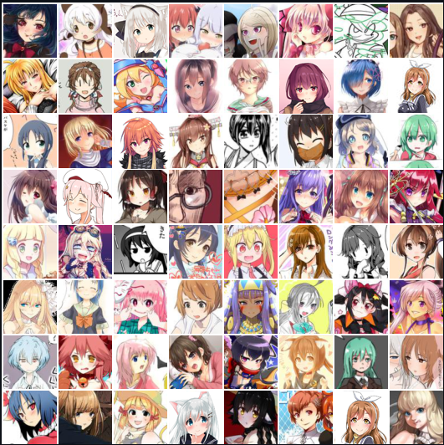
Sample training images which have been processed

Slide 7
Approach
Generative Adversarial Networks consist of two neural networks: a discriminator and a generator. The discriminator receives both real images from the training set and generated images produced by the generator. The discriminator outputs the probability that an image is real, so it is trained to output high values for the real images and low values for the generated ones. The generator is trained to produce images that the discriminator thinks are real. Both the discriminator and generator are trained simultaneously so that they compete against each other. As a result of this, the generator learns to produce more and more realistic images as it trains.
Our ultimate goal is to train a generating function G that estimates for a given set of input tags a corresponding image. To achieve this, we train a generator network as a feed-forward CNN with residual blocks, and we also train a discriminator network as a fully connected CNN used as a classifier.

Slide 8
Network architecture
The generator’s architecture is shown in Figure 3, which is a modification from SRResNet. The
model contains 16 ResBlocks and uses 3 sub-pixel CNN for feature map upscaling. Figure 4
shows the discriminator architecture, which contains 10 Resblocks in total. All batch normalization
layers are removed in the discriminator, since it would bring correlations within the mini-batch,
which is undesired for the computation of the gradient norm. We add an extra fully-connected layer
to the last convolution layer as the attribute classifier. All weights are initialized from a Gaussian
distribution with mean 0 and standard deviation 0:02.

Slide 9
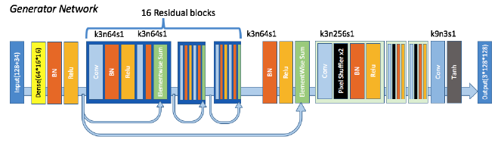
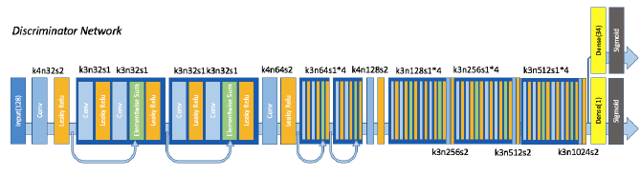

Slide 10
Dataset and experimental tools
anime-faces Dataset
Anime-style images of 126 tags are collected from danbooru.donmai.us using the crawler tool gallery-dl. The images are then processed by a anime face detector python-animeface. The resulting dataset contains ~143,000 anime faces.
Tools Used:
TensorFlow
Keras
Spyder

Slide 11
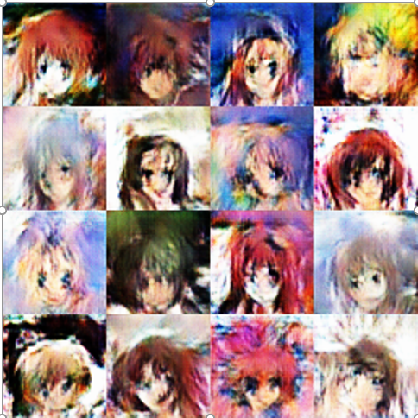
Results

Slide 12
Qualitative analysis
Attribute Precision
To evaluate how each tag affects the output result, we measure the precision of the output result
when the certain label is assigned. With each target, we fix the target label to true, and sample other
labels in random. For each label, 20 images are drawn from the generator. Then we manually check
generated results and judge whether output images behave the fixed attribute we assigned.

Slide 13
FID Evaluation
One possible qualitative evaluation method for GAN model is Fréchet Inception Distance(FID). To calculate the FID, they use a pre-trained CNN(Inception model) to extract vision-relevant features from both real and fake samples. The real feature distribution and the fake feature distribution are approximated with two gaussian distributions. Then, they calculate The Fréchet distance(Wasserstein-2 distance) between two gaussian distributions and serve the results as a measurement of the model quality.
To evaluate the FID score for our model, we sample 12800 images from real dataset, then generate a
fake sample by using the corresponding conditions for each samples real images. After that we feed
all images to the feature extractor and get a 4096-dimension feature vector for each
image. FID is calculated between the collection of feature vectors from real samples and that from
fake samples.
For each model, we repeat this process for 5 times and measure the average score of 5 FID calculation
trails.

Slide 14
Papers referred and other links
C. Dong, C. C. Loy, K. He, and X. Tang. Image super-resolution using deep convolutional networks. IEEE Transactions on Pattern Analysis and Machine Intelligence, 38(2):295–307, 2016.
J. Johnson, A. Alahi, and F. Li. Perceptual losses for real-time style transfer and super- resolution. In European Conference on Computer Vision (ECCV), pages 694–711. Springer, 2016
W. Shi, J. Caballero, F. Huszar, J. Totz, A. P. Aitken, R. Bishop, D. Rueckert, and Z. Wang. Real-Time Single Image and Video Super-Resolution Using an Efficient Sub-Pixel Convolutional Neural Network. In IEEE Conference on Computer Vision and Pattern Recognition (CVPR), pages 1874–1883, 2016.
Yanghua Jin, Jiakai Zhang, Towards the Automatic Anime Characters Creation with Generative Adversarial Networks arXiv:1708.05509v1
https://github.com/tdrussell/IllustrationGAN
https://github.com/pavitrakumar78/Anime-Face-GAN-Keras
https://github.com/jayleicn/animeGAN
https://github.com/forcecore/Keras-GAN-Animeface-Character

Slide 15
THANK YOU

