Slide 1
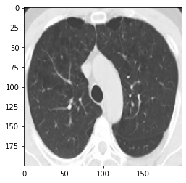
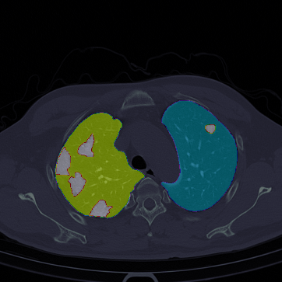
Fallfest
Theme : Healthcare(Corona diagnosis of lungs using Deep learning)
Team name : iNets
Team members : 1. Vaibhav Bhatt
2. Gunjan Haldar
3. Aman Mittal

Slide 2
Do you know the number of covid testing centres in each state of India?
Total no : 1191(Goverment labs) 1042(private labs).
Heighest in Tamil Naidu with 67 Goverment labs and 161 private labs.
39(Goverment labs) and 25(Private labs) in Rajasthan.
Price of corona tests in India:
Lowest in oddisha : 400.
700-800 in various states like Rajasthan, Gujrat, Uttar Pradesh and Delhi.
The RT-PCR covid test that is the most widely used testing procedure can take upto 5-10 minutes for testing and the entire procedure can take upto 4-8 hours!
Even there are so much workforce required for testing of covid.
And every person involved in the testing of covid has to wear a ppe kit.
People involved in the process have very high chance of spreading the infection among themselves because of either the gathering of large number of people due to unavailability of test centres or either due to the compact process that is involved in the testing.
We tried to develop a new approach for testing corona virus which can defeat the drawback mentioned above

Slide 3
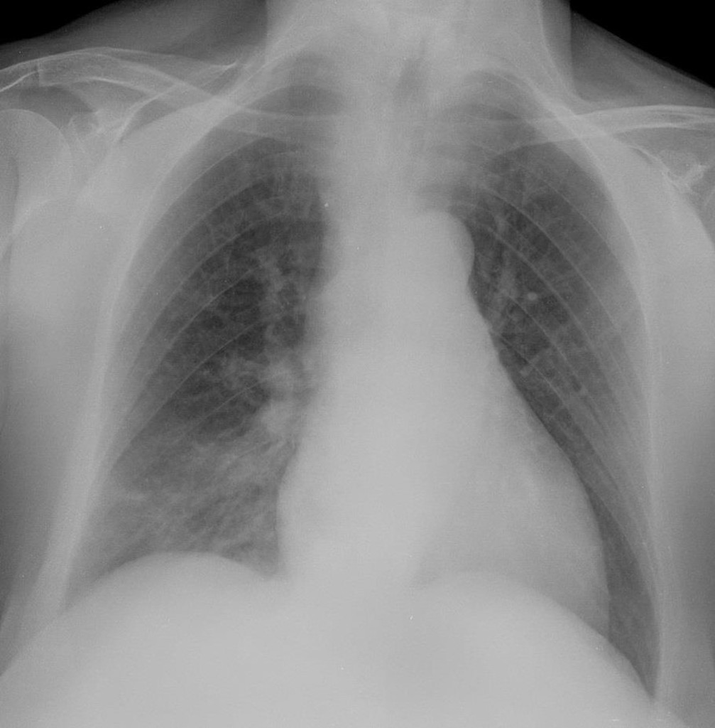
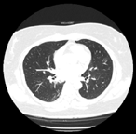
Prediction of covid using computer vision
As the infection travels your respiratory tract, your immune system fights back. Your lungs and airways swell and become inflamed. This can start in one part of your lung and spread.
Doctors can see signs of respiratory inflammation on a chest X-ray or CT scan On a chest CT
We built classifiers using computer vision techniques and Lung X-ray/Lung CT-scan datasets that can predict whether the patients have covid infection or not.

Slide 4
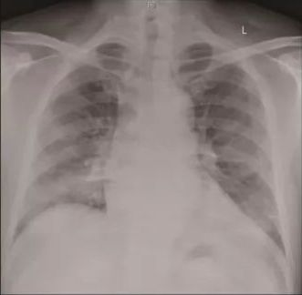
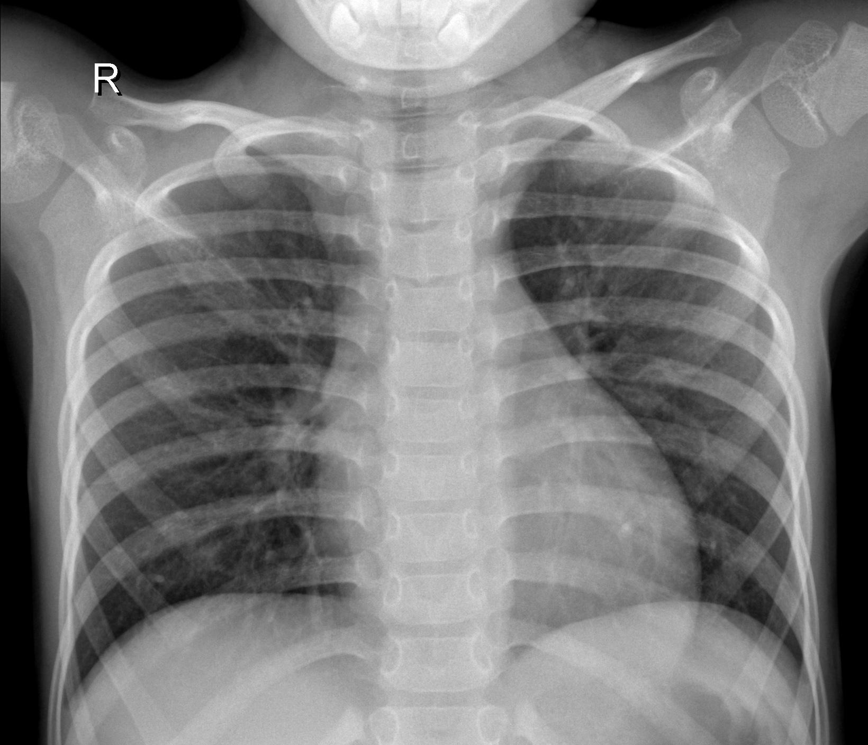
Covid prediction using X-rays
Tech Stack : Tensorflow, Keras
Dataset
Dataset used : X-Ray dataset
The dataset has over 224 training images and 50 validation images
A radiologist is required to differentiate between two images.Can you?
Covid positive
Normal

Slide 5
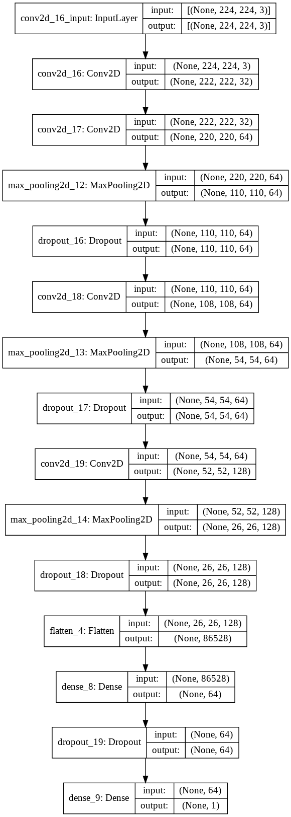
Model architecture:

Slide 6
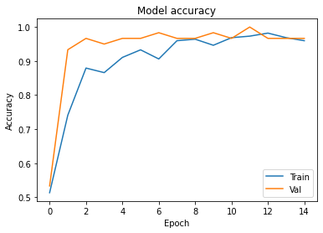
Results

Slide 7
Advantages of using X-ray images over RT-PCR covid test
There are more no. of diagnostic labs for X-Rays in India than the test centres which provide RT-PCR test.
X-Rays labs are even available in most of the rural areas too so the people living there won’t have to travel far in cities to get covid test.
Price of X-Rays is almost same as compared to RT-PCR test and even less in some states.
Deep learning model is time efficient, it can evaluate upto 1000 samples in 6 sec.
Not much workforce is required, the model can be deployed to even a simple app which will input X-Ray image and give result.
Workforce reduced is equal to reduce in the amount of money spend on buying ppe kits for more people.

Slide 8
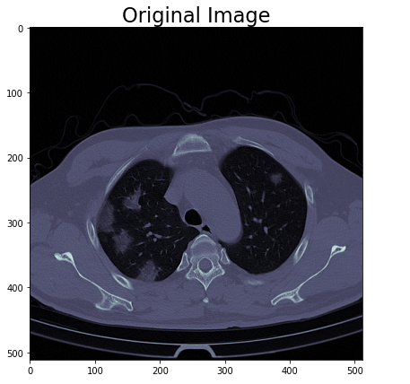
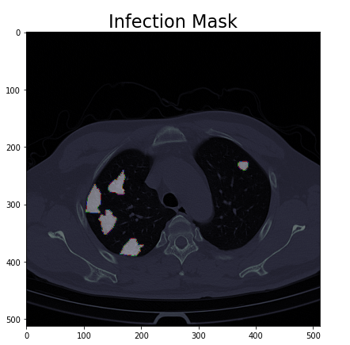
Segmentation of CT-Scans to mask infection
Tech Stack : Tensorflow, Keras
Dataset:
Dataset Used : CT-Scan Segmentation
The dataset has over 20 nii files which can be divide into 11191 images with masks

Slide 9
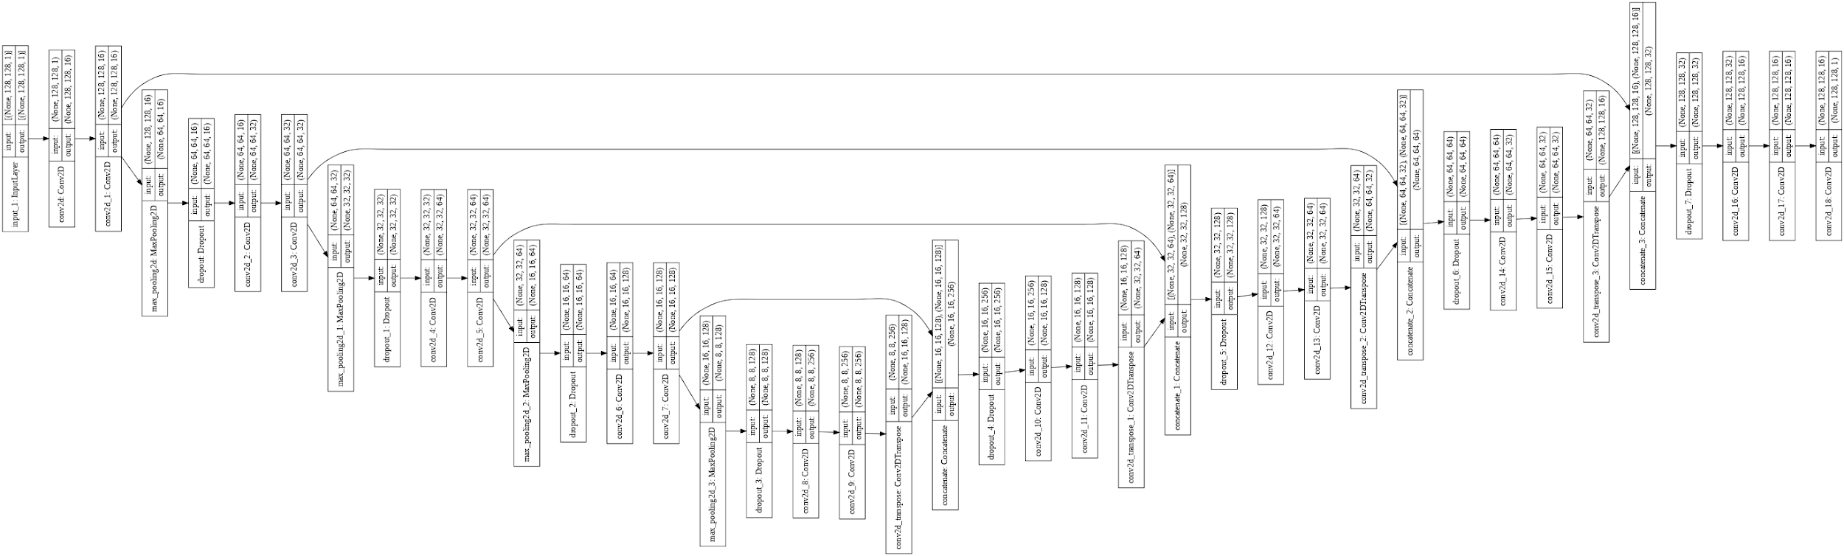
Used a U-Net architecture to segment images
Model architecture:

Slide 10
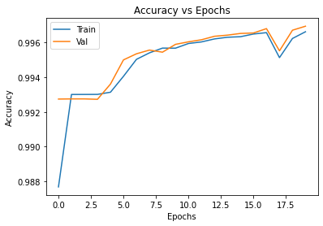
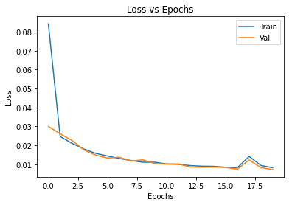
Results

Slide 11
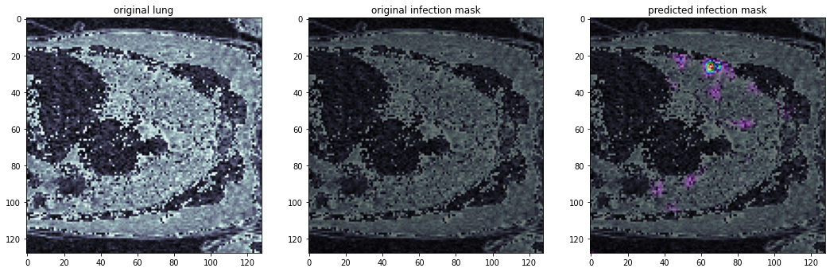

Slide 12
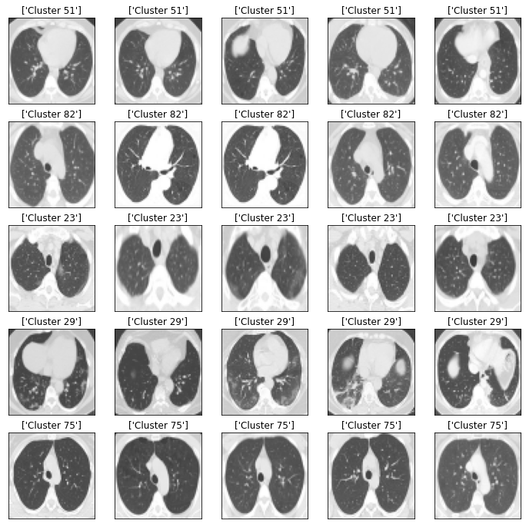
Covid prediction using CT-Scans
Tech stack : Tensorflow,Keras
Dataset:
Data used:CT-Scan Classification
The dataset contains over 2481 images in which 20% of the data is used as validation and rest is used as train

Slide 13
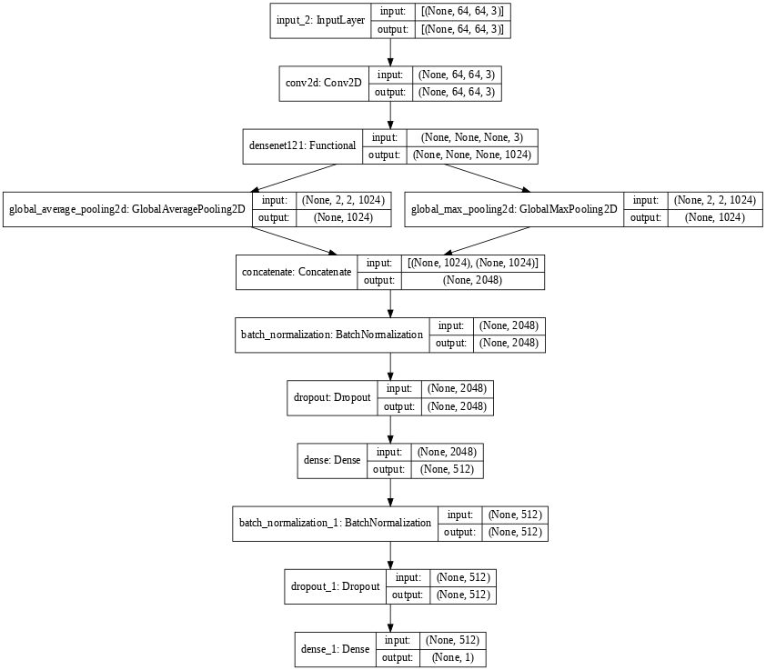
Model Architecture

Slide 14
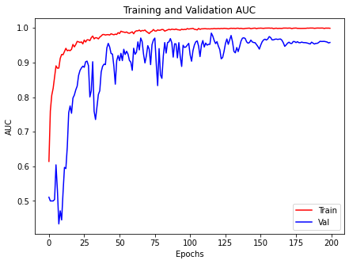
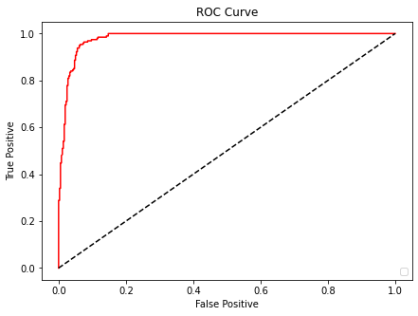
Results

Slide 15
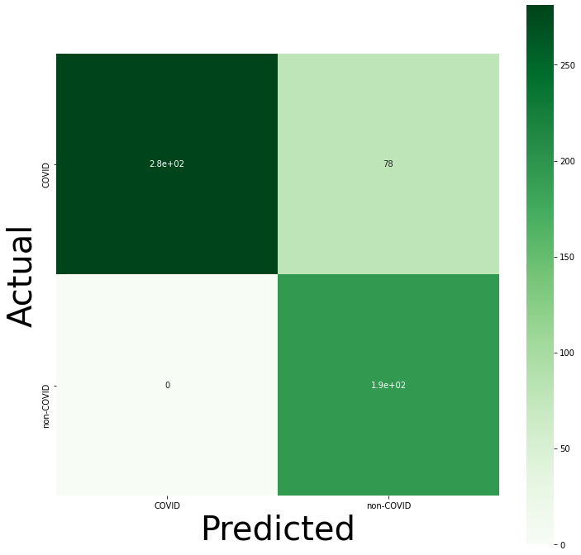

Slide 16
We saw that any of the two methods by using x-ray images or ct-scans can be easily used to easily predict whether a patient has covid or not. While in most cases x-rays seem to be reliable
By segmentation of CT-scans we can track the spread of corona virus in the lungs
By these method we successfully :
Increased the number of test centres.
Reduced time factor.
Decreased the chance of spread f infection in test centres.
Reduced the amount required by a lab to perform the test.

Slide 17
Thank you

