Slide 1


NAME:- VAIBHAV J ADESARA ENROLLMENT:- 191260107001 COLLEGE:- SAL ENGINEERING & TECHNICAL INSTITUTE SEM:- 8TH/ CE-A PROF. HIRAL PRAJAPATI
INTERNSHIP PRESENTATION

Slide 2
OUTLINE
Introduction of Project
Introduction of Company
12 Week Summary
Diagrams
Data Dictionary
Implementation (Website)
Tools and Technology for Implementation (SRS)
Testing
Conclusion
Feature work
Reference

Slide 3
INTRODUCTION OF PROJECT
Expense Manager is my project in the internship
EXPENSE MANAGER is Personal finance management is an important part of people’s lives. However, everyone does not have the knowledge or time to manage their finances in a proper manner. And, even if a person has time and knowledge, they do not bother with tracking their expenses as they find it tedious and time-consuming. Now, you don’t have to worry about managing your expenses, as you can get access to an expense tracker that will help in the active management of your finances. Understanding an Expense Tracker

Slide 4
People tend to overspend without realizing it, which can be disastrous. Using a daily expense manager can help you keep track of how much you spend every day and on what. At the end of the month, you will have a clear picture of where your money is going. This is one of the best ways to get your expenses under control and bring some semblance of order to your finances. This application reduces the daily expense's manual calculations and keeps track of the expenditure. If people manage their expenses properly, they can use their valuable money very efficiently.
Individuals and businesses often find it challenging to manage their expenses efficiently. They struggle to track their spending, categorize expenses, and generate reports for analysis. This can lead to overspending, missed payments, and financial instability. Traditional methods of managing expenses such as manual bookkeeping, spreadsheets, and paper receipts are time-consuming, error-prone, and lack real-time updates.
To address this problem, there is a need for an expense manager application that can help individuals and businesses track their expenses effectively.

Slide 5
SCOPES AND OBJECTIVES
To develop a user-friendly and intuitive expense manager application that allows users to track their expenses, set budgets, and analyse their spending habits.
To include features such as transaction categorization, expense tracking, budget setting, alerts for overspending, and data visualization.
To provide useful insights to help users make informed financial decisions and improve their financial well-being.
To simplify the process of managing personal finances and make it accessible to anyone, regardless of their financial literacy level or technical expertise.
To help users track their expenses and identify areas where they can save money.

Slide 6
DESCRIPTION OF MODULES IN YOUR SYSTEM.
There are two modules in the expense manager.
User: The main user who uses this application for their personal finance management. This application keeps a record of the user’s expenses and also will give a category-wise distribution of expenses. With the help of this application, users can track their daily/weekly/monthly expenses.
2. Admin: The addition of expenses and additional information about every expense
with its particular user-information status, account type, vendor, category, and its
respective subcategory is known to the admin.

Slide 7

COMPANY INTRODUCTION
UNNATI INFORMATICS LLP is an IT-based company in Ahmedabad.
It has envisaged providing solutions to every IT-related problem in the most cost-friendly way. With this noble vision, it has expanded globally giving innumerable IT solutions to our widely existing and growing client and customer base in India, Australia, USA, UAE, Nigeria, and Ghana.
It provides services for Software development, Web-Portal development, Website Designing, E-commerce development, SEO, Customized App Development, Data Management Software with cloud hosting facility, etc. UNNATI INFORMATICS is receptive to new ideas and promises help and support anytime and anywhere.
The Famous Products that company had made are Rangoli School, Sagarcon, Script Wallah, Shreeved School, World of 32, Lodgix, Galaxy School DIU, Devasya International School (Vastral, Nikol), Nisarg Glass, Aadhar shila Trading, Location Wizard, CYCLOP etc
Vision & Mission: To provide such software solutions that are functional, reliable, maintainable and cost-friendly to our existing and growing client and customer base. To consistently cater to their growing needs for an optimal solution, ensuring excellent support and service platform to give a hassle-free experience in achieving their dreams.

Slide 8
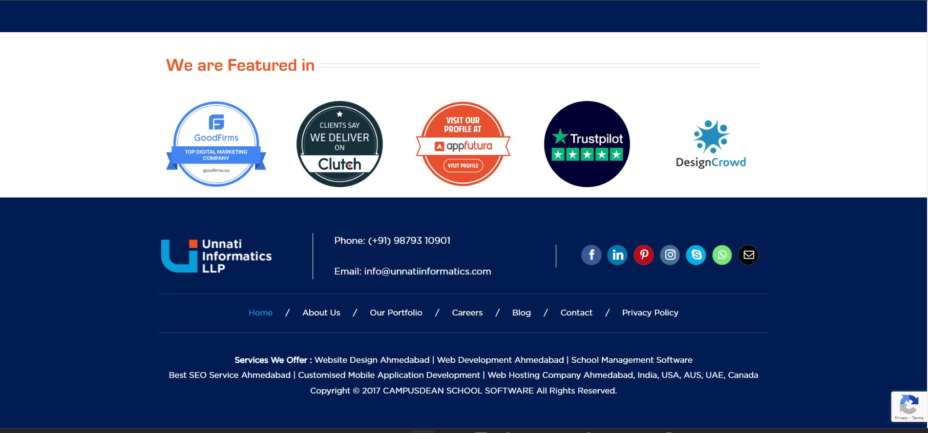

Slide 9
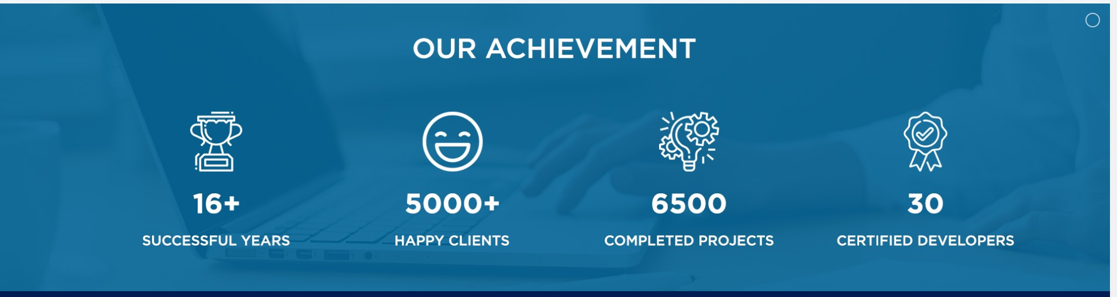
Company Website:- http://unnatiinformatics.com/

Slide 10
SUMMARY OF WORK DONE
Week 1 :- I learned some core concepts, Data structures, and some sorting algorithms in C and made 2 mini projects in C. I developed one Student information project to perform and Store Student Data as a CRUD (Create, Read, Update, Delete) operations in the local system as a File (File Structure in C Programming).
Week 2 :- I learned OOPs and core JAVA concepts with used them to make one project which was HOTEL MENU. It displays the entire menu of one hotel and you can choose items whatever you want to eat and give a total amount of bill. Then learn some advanced concepts of JAVA like Exception Handling, String Buffer.

Slide 11
SUMMARY OF WORK DONE
Week 3:- I build Hotel Coffee Menu in HTML. It enhanced my knowledge of the front-end side. I also developed one Timetable using HTML and its different TAGs.
Week 4:- Week 4 was very important because it was a time when I learned Advanced JAVA frameworks. first, we downloaded IDE for Spring Boot STS version 4.17.2 and MySQL workbench 8.0. I also learned about MVC architecture. MVC is used to keep the business logic and view login separate.

Slide 12
SUMMARY OF WORK DONE
Week 5:- update password using OTP. if OTP or email is wrong password won’t change & users can Update their Password. Make Category, Subcategory, Status(Paid/Unpaid) of Expenses in Database Perform a List to show data on the JSP page in ADMIN Dashboard Perform soft Delete, which deletes data in the Website but exists in the database to know which data was actually deleted.
Week 6:- Installation of Git and Git commands to upload project code on Github.com for version control. If any vendor or category is not there in future then deletion of that which is soft delete so that value will not be shown but will be present in the database. Also learned how to join two table’s data using join query.

Slide 13
SUMMARY OF WORK DONE
Week 7:- Select data using two different tables using join query. View Date in the view page if user wants to see all the details of that particular data. View in details will be only for that particular attribute by it’s id. Introduction to session and cookie. How to create a session and cookie.
Week 8:- Expense and Income date table on the user side using the particular id of expense and income. Signup, Login and forget password page design using Css, Bootstrap and basic Javascript. How to use cookies to identify each user differently and perform the task for that user only. Destroy the session on logout.

Slide 14
SUMMARY OF WORK DONE
Week 9:- Admin Dashboard design and User Dashboard design. Data table feature in all the lists on the admin side and user side so that data can be sorted and easily searched. Dynamic data on Admin Dashboard according to date will change every day and every month according to user use so that admin can identify the user statistics. Dynamic data also helps users manage their expenses easily and in less time.

Slide 15
SUMMARY OF WORK DONE
Week 10:- the Admin Dashboard will be enhanced with a bar chart showing monthly expenses, a line chart displaying transaction counts per month, and a donut chart indicating transaction distribution by payment type. Users will gain the ability to edit their profiles and profile images, while a filter will ensure web service access is limited to logged-in or signed-up users. Additionally, a pop-up message system will be implemented using a toaster for important notifications.

Slide 16
SUMMARY OF WORK DONE
Week 11:- the SpringBoot app will be enhanced by adding a FilterClass to ensure security, restricting access to the web service for users who haven't logged in. The User Dashboard will display dynamic data specific to each user. It will include a bar chart showing monthly expenses and a pie chart indicating the status (paid or unpaid) of expenses. At the user's side, there will be a section displaying the user's most recent expenses along with their status. On the Admin side, there will be a comprehensive display of all users’ expense history and details. The Admin will have the ability to view each user's expense details by clicking on a view button.

Slide 17
SUMMARY OF WORK DONE
Week 12:- new feature will be implemented that allows users to update the status of their expenses and make other necessary modifications. Additionally, an expense chart will be added on both the user and admin sides, specifically focusing on categories and vendors. This chart will provide information on the number of transactions and the total amount spent on specific categories and vendors.

Slide 18
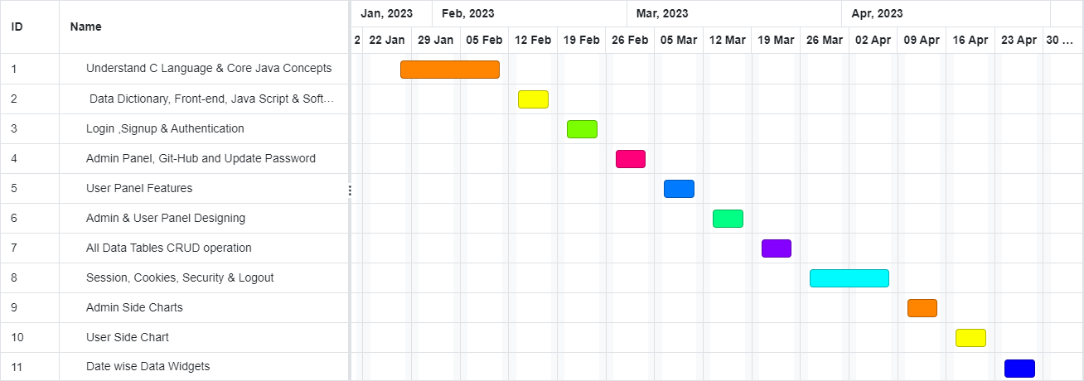
TIME LINE CHART (Gantt Chart)

Slide 19
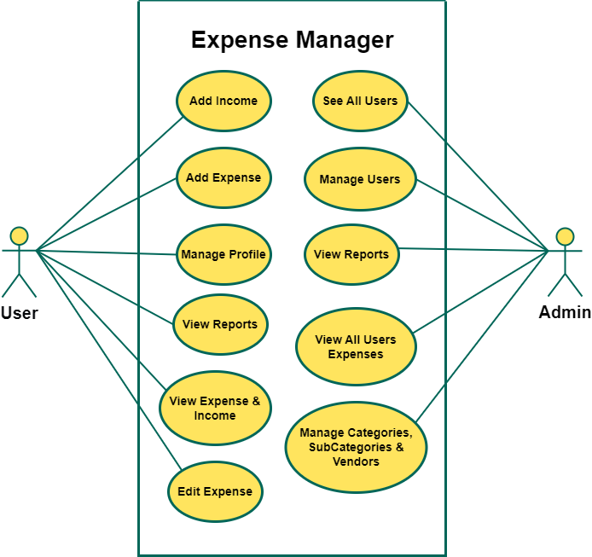
USE-CASE DIAGRAM

Slide 20
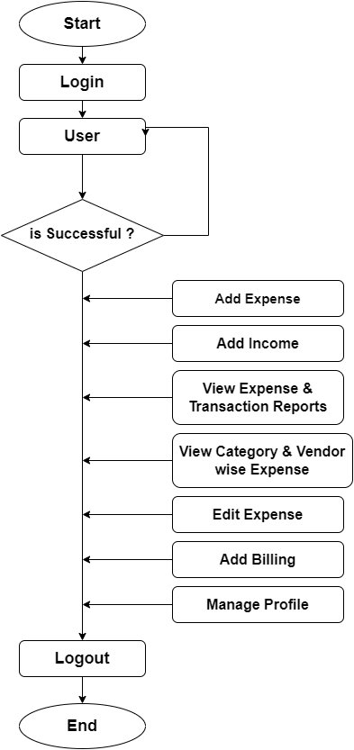
USER FLOW CHART

Slide 21
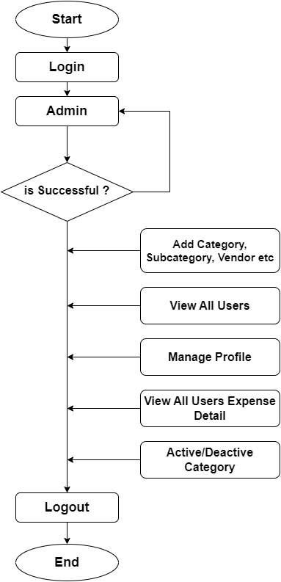
ADMIN FLOW CHART

Slide 22
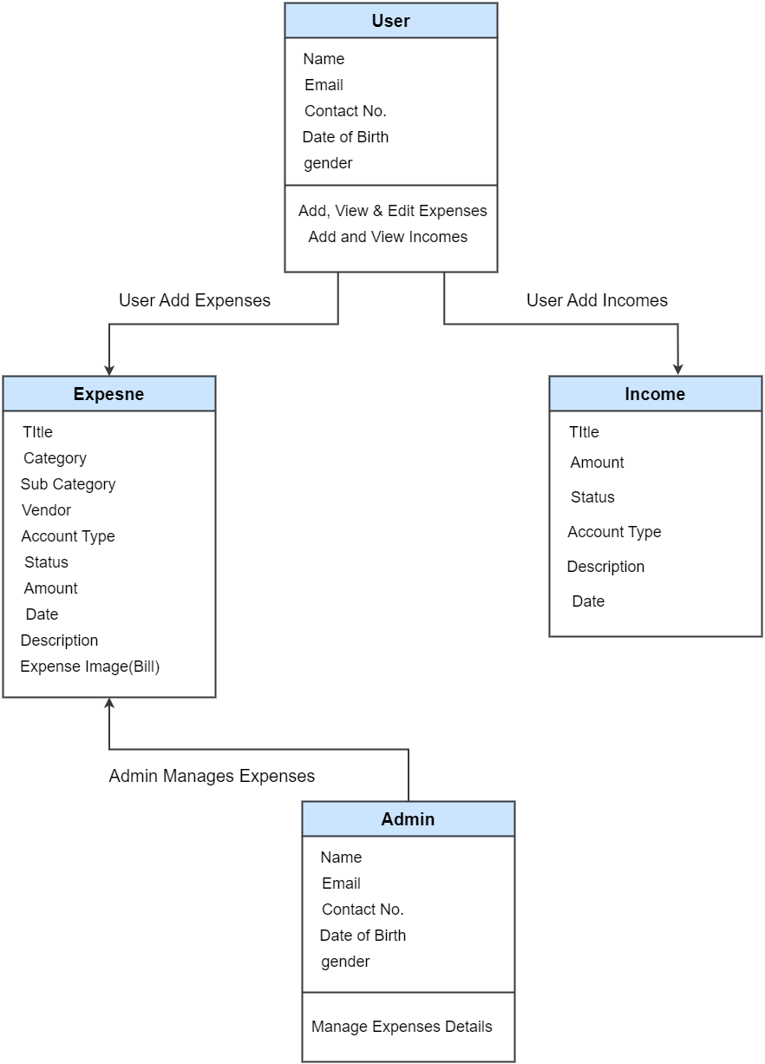
CLASS DIAGRAM

Slide 23
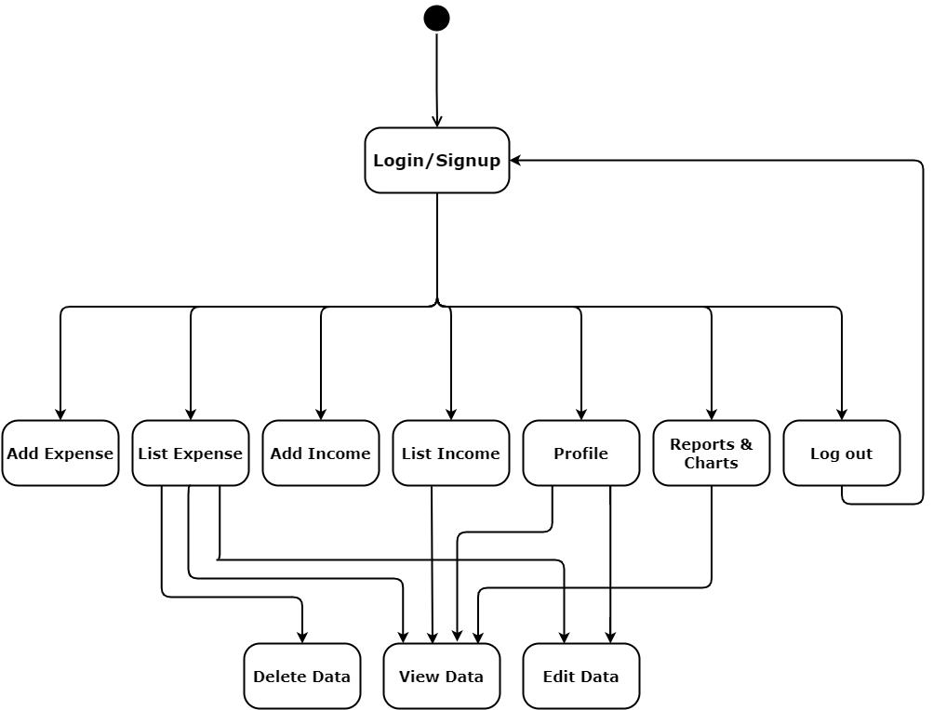
STATE DIAGRAM
USER

Slide 24
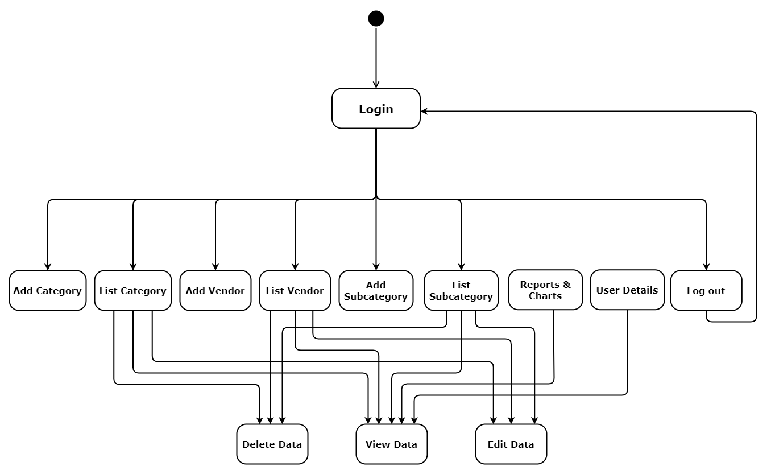
STATE DIAGRAM
ADMIN

Slide 25
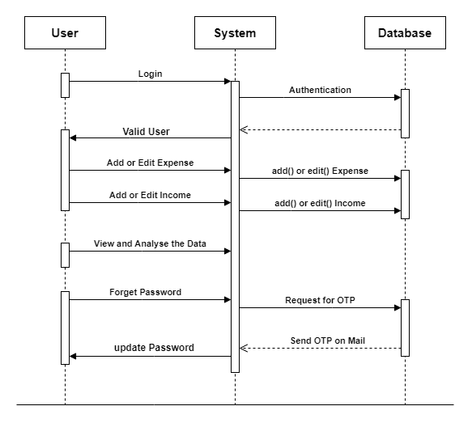
SEQUENCE DIAGRAM
USER

Slide 26
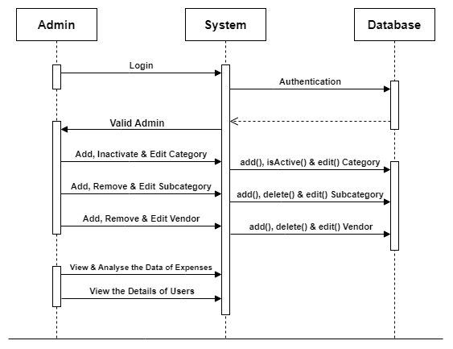
SEQUENCE DIAGRAM
ADMIN

Slide 27
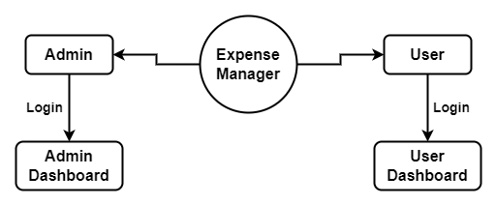
DATA FLOW DIAGRAM
LEVEL 0

Slide 28
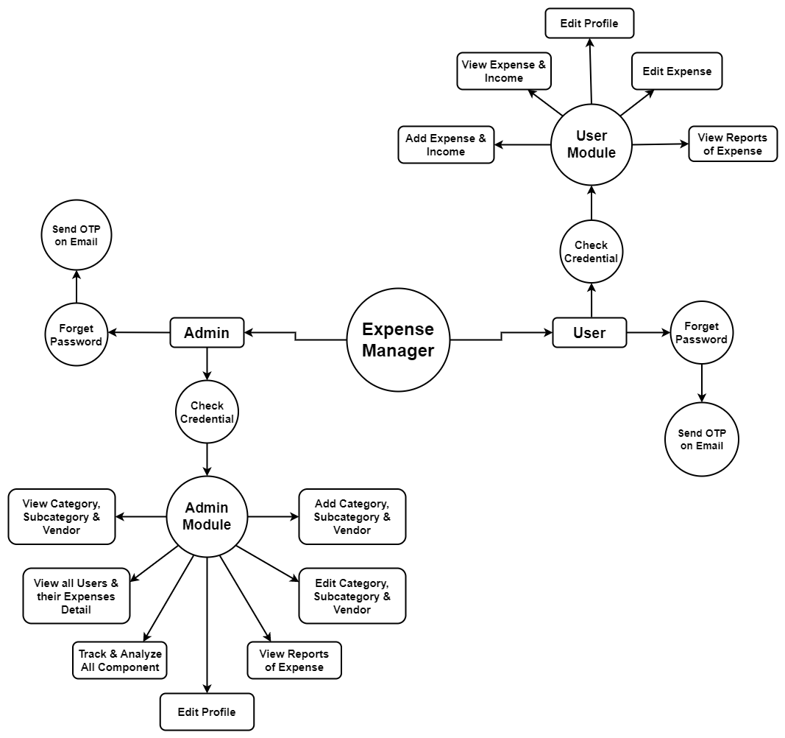
DATA FLOW DIAGRAM
LEVEL 1

Slide 29
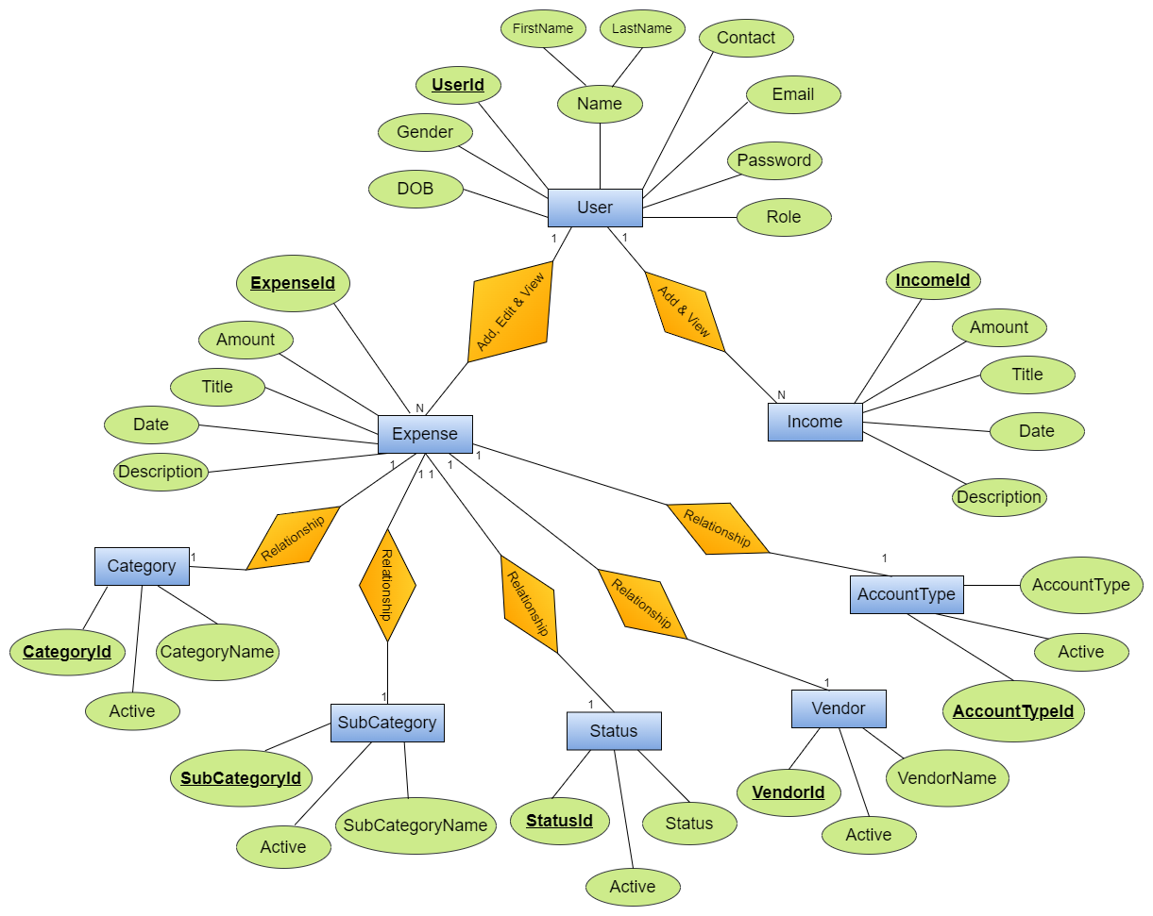
ER DIAGRAM

Slide 30
DATA DICTIONARY
Table Name | accounttype
Field Name | Data Type | Length | Nullable | Comments
accountTypeId | Int |  | No | Its Primary Key.
accountType | Varchar | 30 | No
deleted | Tinyint | 1 | Yes

Slide 31
DATA DICTIONARY
Table Name | category
Field Name | Data Type | Length | Nullable | Comments
categoryId | Int |  | No | Its Primary Key.
categoryName | Varchar | 30 | No
deleted | Tinyint | 1 | Yes

Slide 32
DATA DICTIONARY
Table Name | expense
Field Name | Data Type | Length | Nullable | Comments
expenseId | Int |  | No | Its Primary Key.
title | Varchar | 30 | Yes
categoryId | Int |  | Yes | Its Foreign key of category Table
subCategoryId | Int |  | Yes | Its Foreign key of subcategory Table
vendorId | Int |  | Yes | Its Foreign key of vendor Table
accountTypeId | Int |  | Yes | Its Foreign key of accounttype Table
statusId | Int |  | Yes | Its Foreign key of status Table
ammount | Int |  | Yes
date | Varchar | 30 | Yes
description | Varchar | 100 | Yes
userId | Int |  | Yes | Its Foreign key of user Table
billURL | Varchar | 1024 | Yes

Slide 33
DATA DICTIONARY
Table Name | income
Field Name | Data Type | Length | Nullable | Comments
incomeId | Int |  | No | Its Primary Key.
title | Varchar | 30 | Yes
date | Varchar | 30 | No
userId | Int |  | No | Its Foreign key of user Table
accountTypeId | Int |  | No | Its Foreign key of accounttype Table
description | Varchar | 150 | Yes
statusId | Int |  | No | Its Foreign key of status Table
ammount | Int |  | No

Slide 34
DATA DICTIONARY
Table Name | status
Field Name | Data Type | Length | Nullable | Comments
statusId | Int |  | No | Its Primary Key.
statusShow | Varchar | 30 | No
deleted | Tinyint | 1 | Yes

Slide 35
DATA DICTIONARY
Table Name | subcategory
Field Name | Data Type | Length | Nullable | Comments
categoryId | Int |  | No | Its Primary Key.
categoryName | Varchar | 30 | No
categoryId | Int |  | No | Its Foreign key of Category Table
deleted | Tinyint | 1 | Yes

Slide 36
DATA DICTIONARY
Table Name | user
Field Name | Data Type | Length | Nullable | Comments
userId | Int |  | No | Its Primary Key.
firstName | Varchar | 30 | No
lastName | Varchar | 30 | No
email | Varchar | 50 | No
password | Varchar | 80 | No
role | Int |  | No
otp | Varchar | 10 | Yes
gender | Varchar | 6 | No
dob | Varchar | 20 | No
contactNum | Varchar | 20 | Yes
joinDate | Varchar | 20 | No
imageURL | Varchar | 1024 | Yes

Slide 37
DATA DICTIONARY
Table Name | vendor
Field Name | Data Type | Length | Nullable | Comments
vendorId | Int |  | No | Its Primary Key.
vendorName | Varchar | 30 | No
deleted | Tinyint | 1 | Yes

Slide 38
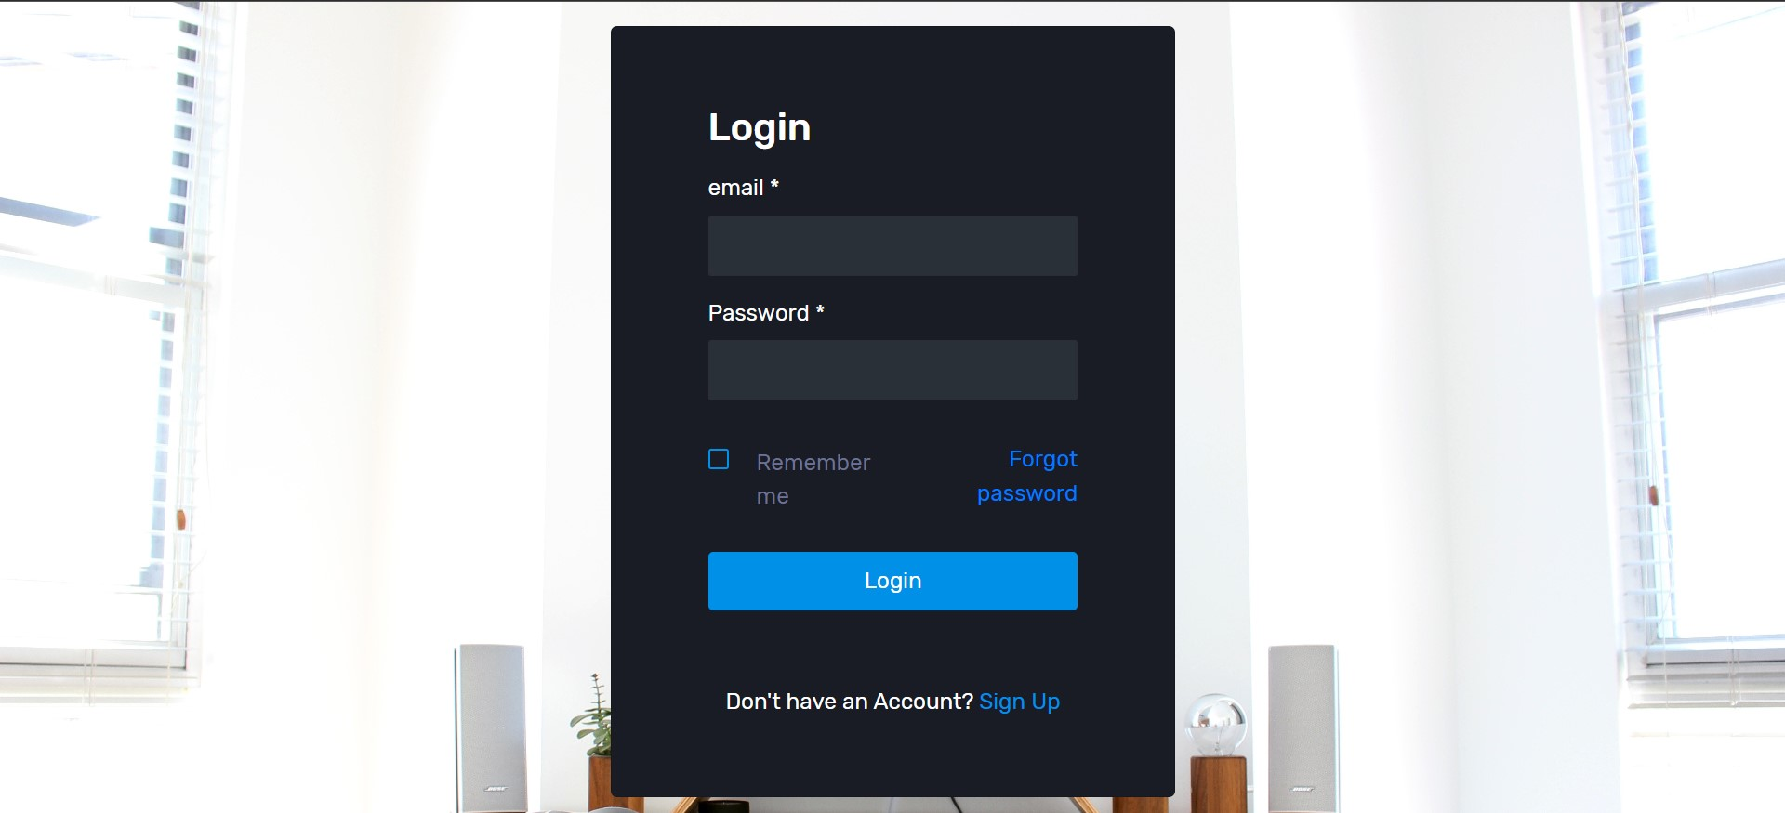
IMPLEMENTATION

Slide 39
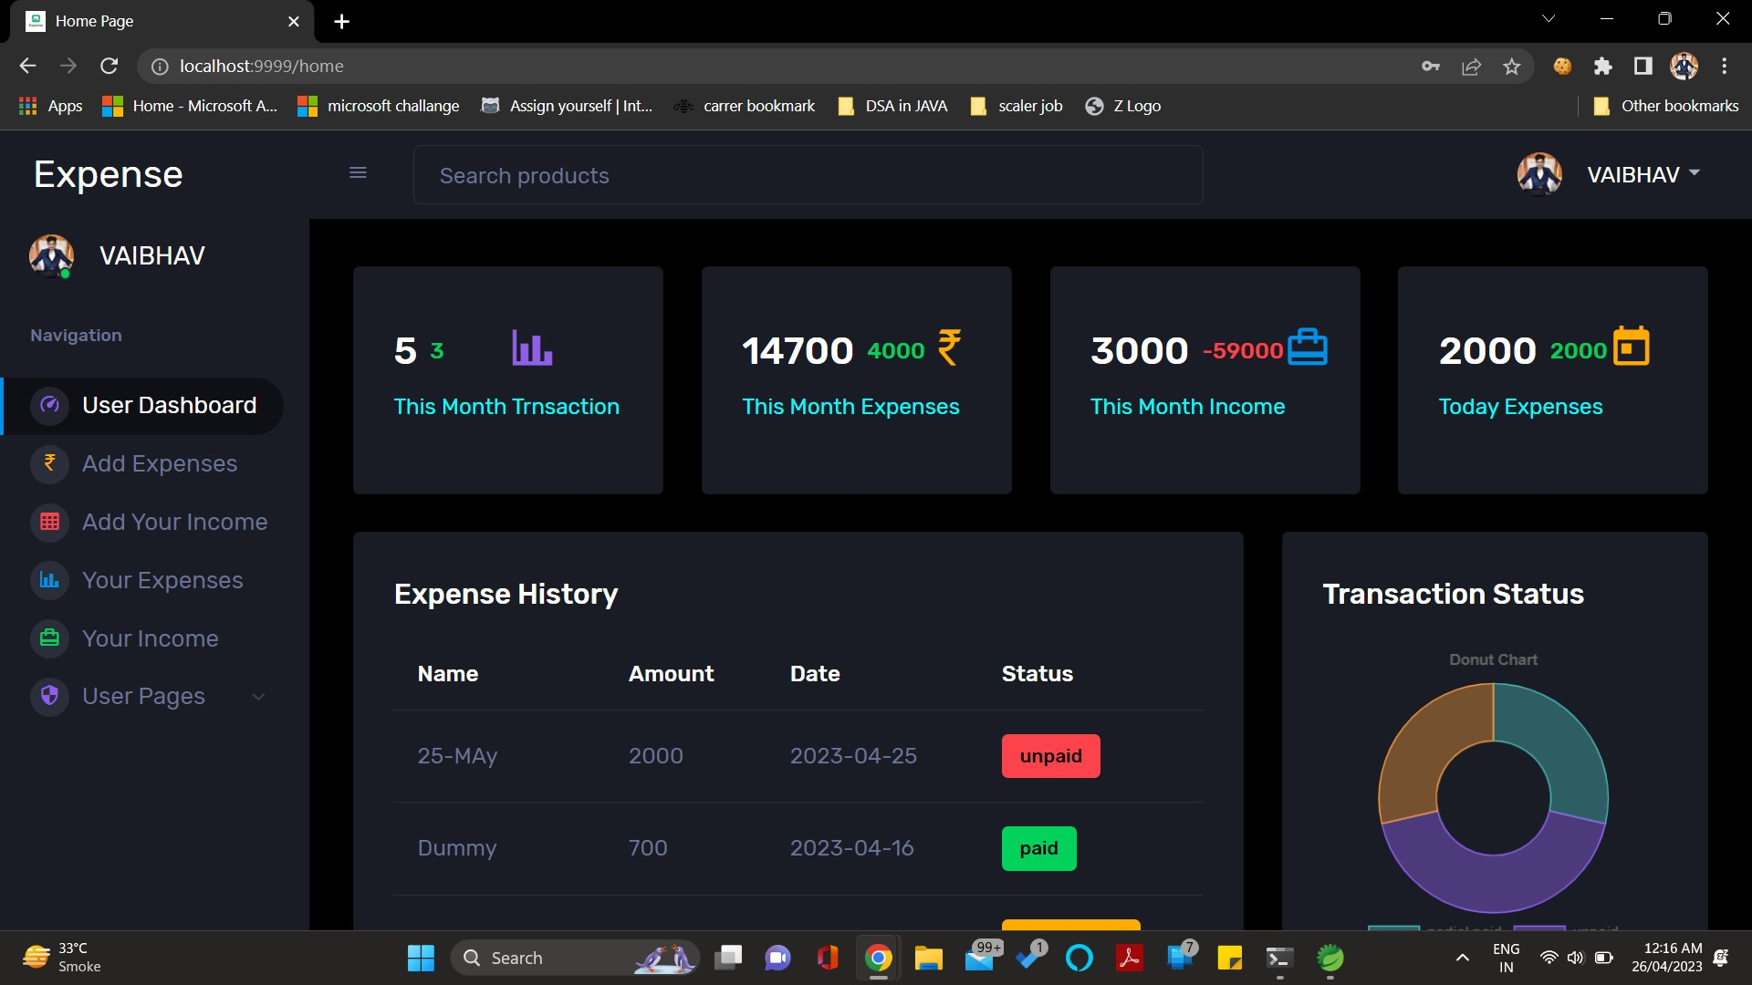
IMPLEMENTATION

Slide 40
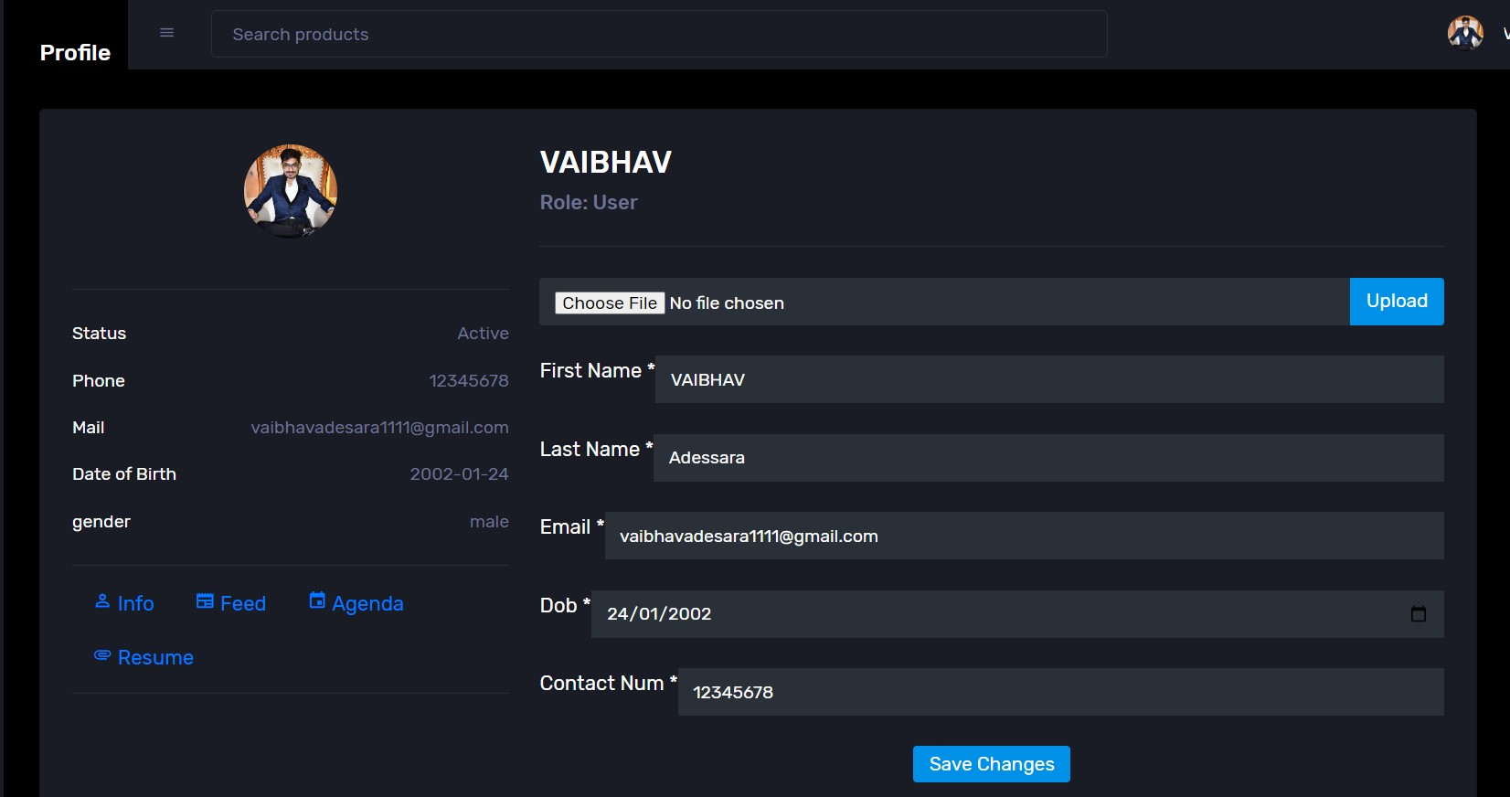
IMPLEMENTATION

Slide 41
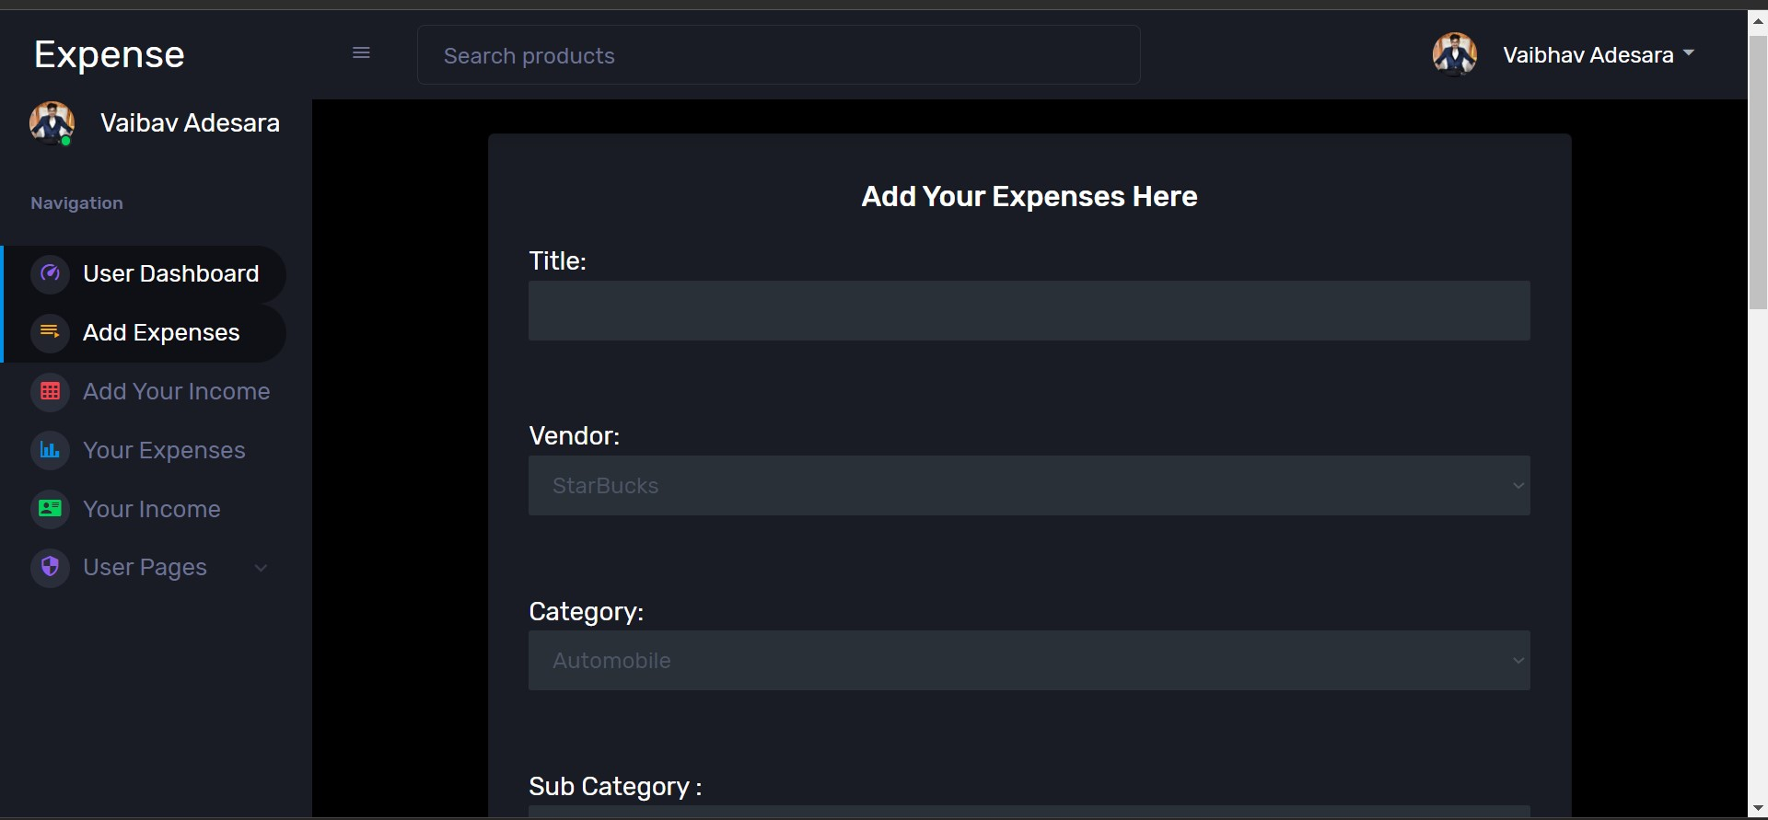
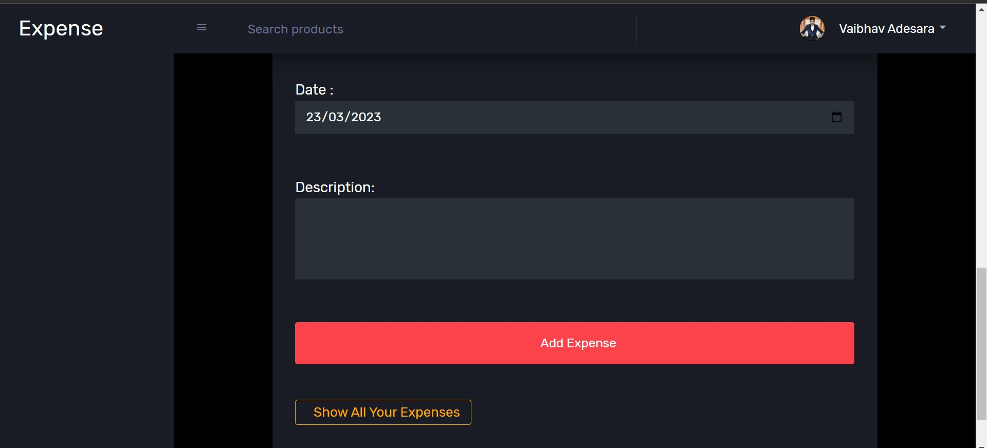
IMPLEMENTATION

Slide 42
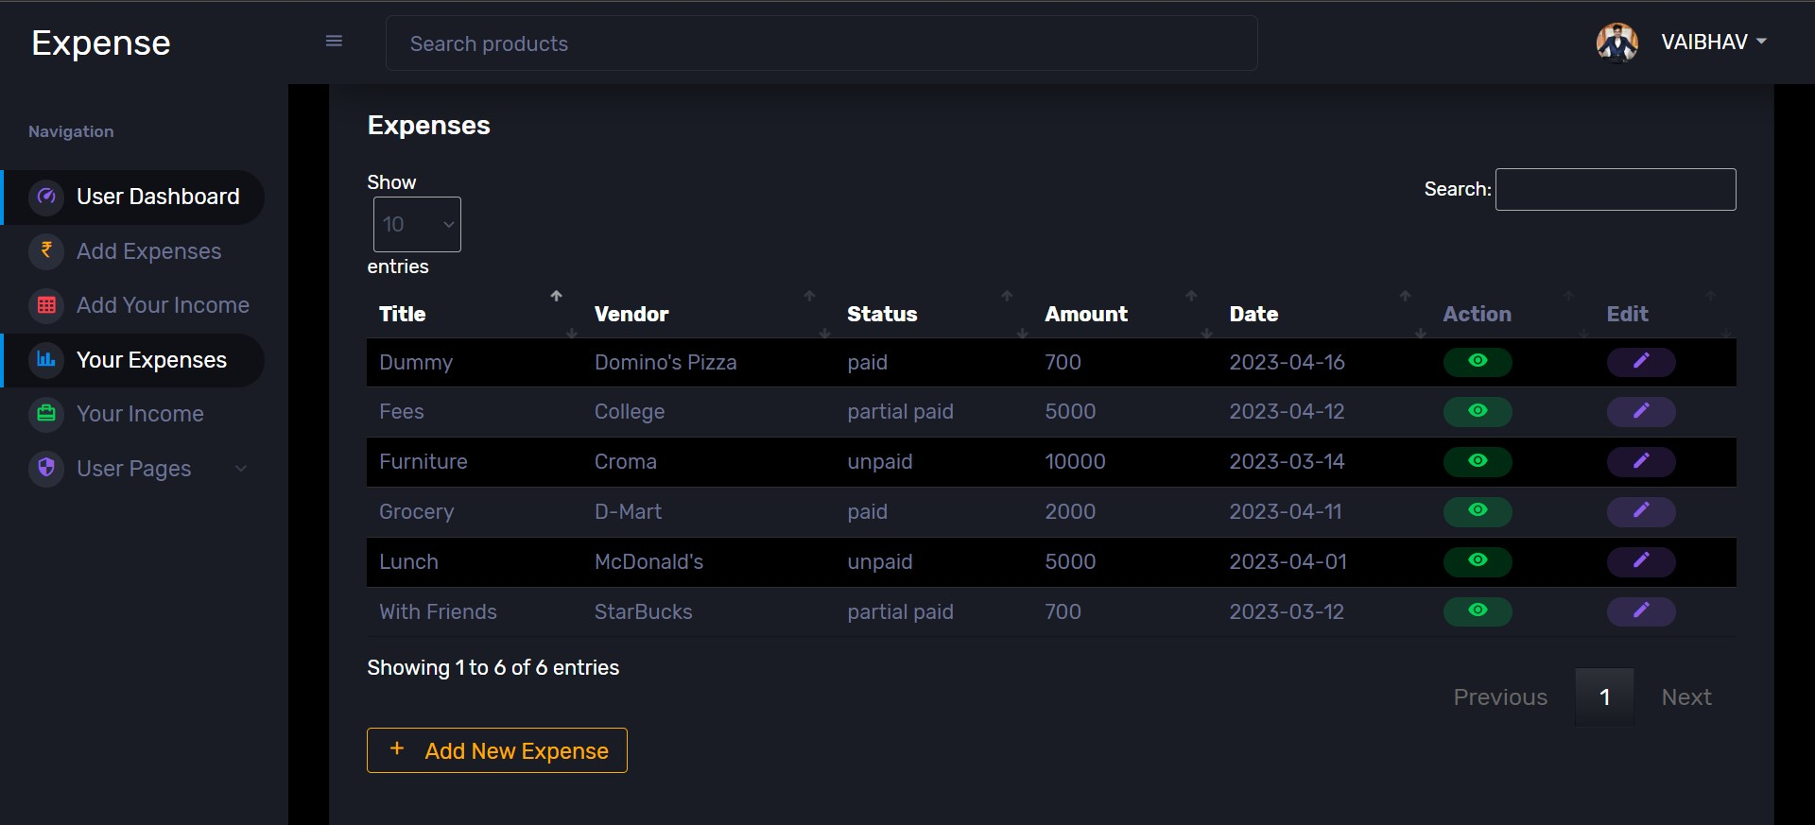
IMPLEMENTATION

Slide 43
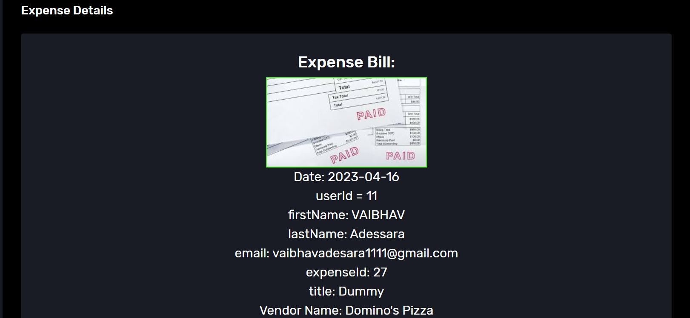
IMPLEMENTATION

Slide 44
SOFTWARE REQUIREMENTS SPECIFICATION
Programing Language:- JAVA
(JAVA Development Kit to Compile JAVA programming language)
STS (Spring Tool Suite) or Eclipse Enterprise Edition (For live preview)
Frontend:- Java Server Page(HTML+JAVA)
Backend:- Spring Boot (JAVA Framework)
Server:- Tomcat
Database:- MySQL (8.0.32)
Plugin:- Apache Maven
Libraries:- Tomcat Embedded Jasper, JDBD Drive
API:- JAVAx Mail
Version control:- GitHub

Slide 45
MINIMUM HARDWARE REQUIREMENTS
Processor:- Minimum 2.27Ghz processor
RAM- 2GB minimum Software Requirements
Hard disk- 20GB
A stable network connection is essential for users to access the Expense Manager application and database. The network should have sufficient bandwidth to support concurrent user access and file transfers

Slide 46
TESTING
In this project we have done manual testing to verify that all our functionality works properly or not. The testing process is carried out when we had completed the implementation of all the functionality So here the testing had been done at the end of the internship.
In this project, we have done functional testing that checks whether each functionality works properly or not. All the testing procedure is carried out manually. All the testing procedure is carried out from 2nd May to 3rd May.
First of all, we create the test cases for each functionality and what should be our expected output should be noted down. Then we check all the functionality and check the actual output and compare it with the expected output. If matches then we can pass the test case else we have to give the remarks that what changes should have to do.

Slide 47
TEST CASES
Test ID | Test Condition | Expected Output | Actual Output | Remark
1 | Customer Authentication Functionality | Login, Logout, Create Account should be done properly. | Done Properly with all the Authentication functionality. | No
2 | Email Should be Sent after we submit the email to get OTP for forget the password | Send the Email with details like email, otp. | Perfectly Send the Email with OTP | No
3 | Expense Service | User can add expense with all the proper details. | All the details should be saved properly and perfectly and expense service function work properly. | No
4 | Income Service | User can add income with all the proper details. | All the details should be saved properly and perfectly and income service function work properly. | No
5 | User Dashboard | User can see all expense and income history. User can edit/view/delete expense, income and edit profile. | All the User Dashboard pages are properly displayed with all the details. | No
6 | Admin Screens | Admin can manage all the service and managed all the users, category, subcategory, vendor, accounttype. | Admin managed all the things properly | No

Slide 48
LEARNING OUTCOMES
Planning:- The ability to think about and successfully manage activities with the help of any available resources to achieve specific goals.
Problem-solving skills:- No employer wants a worker who continually hits brick walls in their daily work and they want somebody capable of using their initiative and seeking out their own solutions.
Practical skills:- Of course each job role is different and you will encounter different software systems and tools for development.

Slide 49

CONCLUSION
During the internship first of all they gave the basic knowledge of our languages and then they gave the project. In the project first of all we have to design the webpages according they have given as per the SRS (Software Requirements Specification) then we have to design the databases for our website. After designing the database, we have to integrate all the webpages with the database and lastly, we have to do testing of our website. I uploaded my whole code in Git-Hub with timestamps and Details of every Feature which I had done during my internship.
Git-Hub link: - https://github.com/vaibhav-24hr/expenseapp_23

Slide 50
FURURE WORK
In our project Mobile Compatibility: If the Expense Manager is developed as a web app, it may have limitations in terms of mobile compatibility and responsiveness. Users may face difficulties accessing and using the app on smaller screens or mobile devices.
Limited Expense Tracking Options: The Expense Manager might primarily focus on tracking individual expenses and may not support more complex tracking needs, such as tracking shared expenses among multiple users or tracking expenses for specific projects or events.
Lack of Customization: Users may have limited flexibility in customizing the Expense Manager according to their specific needs and preferences. The ability to personalize categories, reporting formats, and budgeting features could enhance the user experience.
Future Enhancements for Expense Manager:
By Addressing above limitation, I will try to add those Features and Expense Manager can evolve into a comprehensive and versatile tool for users to effectively manage their expenses and make informed financial decisions.

Slide 51
REFERENCES
https://stackoverflow.com/
https://www.geeksforgeeks.org/
https://mvnrepository.com/artifact/org.apache.tomcat.embed/tomcat-embed-jasper/10.1.8
https://mvnrepository.com/artifact/commons-fileupload/commons-fileupload/1.4
https://mvnrepository.com/artifact/commons-io/commons-io/2.4
https://mvnrepository.com/artifact/org.springframework/spring-jdbc/6.0.4
https://mvnrepository.com/artifact/mysql/mysql-connector-java/8.0.32
https://mvnrepository.com/artifact/com.sun.mail/javax.mail/1.6.2
https://github.com/
https://www.javatpoint.com/
https://getbootstrap.com/

Slide 52
Thank You Vaibhav Adesara 191260107001

