Slide 1
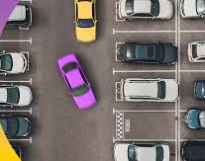
Smart Parking System
An IoT-based Automated Parking Solution with Zone Management

Slide 2
How it works
Cmos sensor
Detects and send data
Sqlite3 online database
Frequent exchange of
Data
Web Application takes the data from the database and displays it in the application
App shows the number of slots left

Slide 3
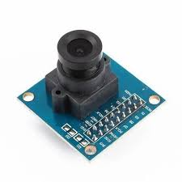
System Architecture
How sensors track slot availability and update the central server:
For example, Each zone has 100 slots, monitored using IoT sensors and
number plate recognition.
Each lane has got cmos sensors around them . As the cmos sensors
Detects a vehicle entering the slot in a zone it insert the data into the
Database for now sqlite3 database is being used .

Slide 4
Entry/Exit Automation
Vehicles enter and exit via number plate recognition, using ai and
updating slot availability. Each person has got their own unique user id and password
Slots can be rented for a certain amount of time

Slide 5
Server Dashboard
Displays real-time parking status for each zone,
ensuring efficient management.
Advantages & Conclusion
Reduces congestion, improves efficiency, and enable
s automated parking.

Slide 6
Advantages & Conclusion
Reduces congestion, improves efficiency, and enables automated parking.

