Slide 1
Chapter 2
Microprocessor Architecture

Slide 2
Microprocessor Architecture
The microprocessor can be programmed to perform functions on given data by writing specific instructions into its memory.
  The microprocessor reads one instruction at a time, matches it with its instruction set, and performs the data manipulation specified.
  The result is either stored back into memory or displayed on an output device.

Slide 3
The 8085 Architecture
The 8085 uses three separate busses to perform its operations
  The address bus.
  The data bus.
  The control bus.

Slide 4
The Address Bus
  16 bits wide (A₀ A₁…A₁₅)
    Therefore, the 8085 can access locations with numbers from 0 to 65,536. Or, the 8085 can access a total of 64K addresses.
  “Unidirectional”.
    Information flows out of the microprocessor and into the memory or peripherals.
  When the 8085 wants to access a peripheral or a memory location, it places the 16-bit address on the address bus and then sends the appropriate control signals.

Slide 5
The Data Bus
  8 bits wide (D₀ D₁…D₇)
  “Bi-directional”.
    Information flows both ways between the microprocessor and memory or I/O.
  The 8085 uses the data bus to transfer the binary information.
  Since the data bus has 8-bits only, then the 8085 can manipulate data 8 bits at-a-time only.

Slide 6
The Control Bus
  There is no real control bus. Instead, the control bus is made up of a number of single bit control signals.

Slide 7
Operation Types in a Microprocessor
All of the operations of the microprocessor can be classified into one of three types:
    Microprocessor Initiated Operations
    Internal Operations
    Peripheral Initiated Operations

Slide 8
Microprocessor Initiated Operations
These are operations that the microprocessor itself starts.
These are usually one of 4 operations:
  Memory Read
  Memory Write
  I/O Read (Get data from an input device)
  I/O write (Send data to an output device)

Slide 9
Microprocessor Initiated Operations
It is important to note that the microprocessor treats memory and I/O devices the same way.
  Input and output devices simply look like memory locations to the microprocessor.
    For example, the keyboard may look like memory address A3F2H. To get what key is being pressed, the microprocessor simply reads the data at location A3F2H.
  The communication process between the microprocessor and peripheral devices consist of the following three steps:
      Identify the address.
      Transfer the binary information.
      Provide the right timing signals.

Slide 10
The Read Operation
  To read the contents of a memory location, the following steps take place:
    The microprocessor places the 16-bit address of the memory location on the address bus.
    The microprocessor activates a control signal called “memory read” which enables the memory chip.
    The memory decodes the address and identifies the right location.
    The memory places the contents on the data bus.
    The microprocessor reads the value of the data bus after a certain amount of time.

Slide 11
Internal Data Operations
The 8085 can perform a number of internal operations. Such as: storing data, Arithmetic & Logic operations, Testing for condition, etc.
  To perform these operations, the microprocessor needs an internal architecture similar to the following:
Accumulator
Flags
B
C
D
E
H
L
Program Counter
Stack Pointer
Address
16
8
Data

Slide 12
The Internal Architecture
We have already discussed the general purpose registers, the Accumulator, and the flags.
The Program Counter (PC)
  This is a register that is used to control the sequencing of the execution of instructions.
  This register always holds the address of the next instruction.
  Since it holds an address, it must be 16 bits wide.

Slide 13
The Internal Architecture
The Stack pointer
  The stack pointer is also a 16-bit register that is used to point into memory.
  The memory this register points to is a special area called the stack.
  The stack is an area of memory used to hold data that will be retreived soon.
  The stack is usually accessed in a Last In First Out (LIFO) fashion.

Slide 14
Externally Initiated Operations
External devices can initiate (start) one of the 4 following operations:
  Reset
    All operations are stopped and the program counter is reset to 0000.
  Interrupt
    The microprocessor’s operations are interrupted and the microprocessor executes what is called a “service routine”.
    This routine “handles” the interrupt, (perform the necessary operations). Then the microprocessor returns to its previous operations and continues.

Slide 15
Externally Initiated Operations
  Ready
    The 8085 has a pin called RDY. This pin is used by external devices to stop the 8085 until they catch up.
    As long as the RDY pin is low, the 8085 will be in a wait state.
  Hold
    The 8085 has a pin called HOLD. This pin is used by external devices to gain control of the busses.
    When the HOLD signal is activated by an external device, the 8085 stops executing instructions and stops using the busses.
    This would allow external devices to control the information on the busses. Example DMA.

Slide 16
The Design and Operation of Memory
Memory in a microprocessor system is where information (data and instructions) is kept. It can be classified into two main types:
    Main memory (RAM and ROM)
    Storage memory (Disks , CD ROMs, etc.)
  The simple view of RAM is that it is made up of registers that are made up of flip-flops (or memory elements).
    The number of flip-flops in a “memory register” determines the size of the memory word.
  ROM on the other hand uses diodes instead of the flip-flops to permanently hold the information.

Slide 17
Accessing Information in Memory
For the microprocessor to access (Read or Write) information in memory (RAM or ROM), it needs to do the following:
  Select the right memory chip (using part of the address bus).
  Identify the memory location (using the rest of the address bus).
  Access the data (using the data bus).

Slide 18
Tri-State Buffers
An important circuit element that is used extensively in memory.
This buffer is a logic circuit that has three states:
  Logic 0, logic1, and high impedance.
  When this circuit is in high impedance mode it looks as if it is disconnected from the output completely.
The Output is Low
The Output is High
High Impedance

Slide 19
The Tri-State Buffer
This circuit has two inputs and one output.
  The first input behaves like the normal input for the circuit.
  The second input is an “enable”.
    If it is set high, the output follows the proper circuit behavior.
    If it is set low, the output looks like a wire connected to nothing.
Input
Output
OR
Input
Output
Enable
Enable

Slide 20
The Basic Memory Element
The basic memory element is similar to a D latch.
This latch has an input where the data comes in. It has an enable input and an output on which data comes out.
Data Input
Data Output
D
Q
Enable
EN

Slide 21
The Basic Memory Element
However, this is not safe.
  Data is always present on the input and the output is always set to the contents of the latch.
  To avoid this, tri-state buffers are added at the input and output of the latch.
Data Input
Data Output
D
Q
WR
RD
Enable
EN

Slide 22
The Basic Memory Element
The WR signal controls the input buffer.
  The bar over WR means that this is an active low signal.
  So, if WR is 0 the input data reaches the latch input.
  If WR is 1 the input of the latch looks like a wire connected to nothing.
The RD signal controls the output in a similar manner.

Slide 23
A Memory “Register”
If we take four of these latches and connect them together, we would have a 4-bit memory register
I₀
I₁
I₂
I₃
WR
D
D
D
D
Q
Q
Q
Q
EN
EN
EN
EN
EN
RD
O₀
O₁
O₂
O₃

Slide 24
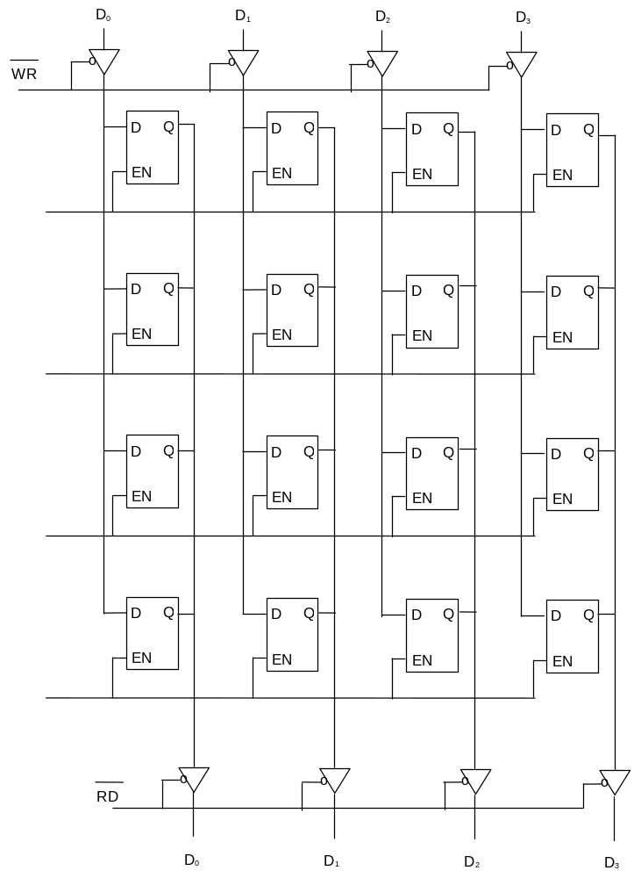
A group of memory registers
  Expanding on this
  scheme to add more
  memory registers we get
  the diagram to the right.

Slide 25
A group of Memory Registers
  If we represent each memory location (Register) as a block we get the following
I₀
I₁
I₂
I₃
WR
Input Buffers
EN₀
Memory Reg. 0
EN₁
Memory Reg. 1
EN₂
Memory Reg. 2
EN₃
Memory Reg. 3
RD
Output Buffers
O₀
O₁
O₂
O₃

Slide 26
The Design of a Memory Chip
Using the RD and WR controls we can determine the direction of flow either into or out of memory. Then using the appropriate Enable input we enable an individual memory register.
What we have just designed is a memory with 4 locations and each location has 4 elements (bits). This memory would be called 4 X 4 [Number of location X number of bits per location].

Slide 27
The Enable Inputs
How do we produce these enable line?
  Since we can never have more than one of these enables active at the same time, we can have them encoded to reduce the number of lines coming into the chip.
  These encoded lines are the address lines for memory.

Slide 28
The Design of a Memory Chip
  So, the previous diagram would now look like the following:
I₀
I₁
I₂
I₃
WR
Input Buffers
A
d
d
r
e
s
s
D
e
c
o
d
e
r
Memory Reg. 0
A₁
Memory Reg. 1
A₀
Memory Reg. 2
Memory Reg. 3
RD
Output Buffers
O₀
O₁
O₂
O₃

Slide 29
The Design of a Memory Chip
Since we have tri-state buffers on both the inputs and outputs of the flip flops, we can actually use one set of pins only.
  The chip would now look like this:
WR
Input Buffers
A
d
d
r
e
s
s
D
e
c
o
d
e
r
Memory Reg. 0
D₀
D₀
A₁
Memory Reg. 1
D₁
A₁
D₁
A₀
Memory Reg. 2
D₂
A₀
D₂
Memory Reg. 3
D₃
D₃
RD
Output Buffers
RD
WR

Slide 30
The steps of writing into Memory
What happens when the programmer issues the STA instruction?
  The microprocessor would turn on the WR control (WR = 0) and turn off the RD control (RD = 1).
  The address is applied to the address decoder which generates a single Enable signal to turn on only one of the memory registers.
  The data is then applied on the data lines and it is stored into the enabled register.

Slide 31
Dimensions of Memory
Memory is usually measured by two numbers: its length and its width (Length X Width).
    The length is the total number of locations.
    The width is the number of bits in each location.
  The length (total number of locations) is a function of the number of address lines.
# of memory locations = 2^{( # of address lines)}
    So, a memory chip with 10 address lines would have
2¹⁰ = 1024 locations (1K)
    Looking at it from the other side, a memory chip with 4K locations would need
Log₂ 4096=12 address lines

Slide 32
The 8085 and Memory
The 8085 has 16 address lines. That means it can address
2¹⁶ = 64K memory locations.
  Then it will need 1 memory chip with 64 k locations, or 2 chips with 32 K in each, or 4 with 16 K each or 16 of the 4 K chips, etc.
how would we use these address lines to control the multiple chips?

Slide 33
Chip Select
Usually, each memory chip has a CS (Chip Select) input. The chip will only work if an active signal is applied on that input.
To allow the use of multiple chips in the make up of memory, we need to use a number of the address lines for the purpose of “chip selection”.
  These address lines are decoded to generate the 2^{n} necessary CS inputs for the memory chips to be used.

Slide 34
Chip Selection Example
  Assume that we need to build a memory system made up of 4 of the 4 X 4 memory chips we designed earlier.
  We will need to use 2 inputs and a decoder to identify which chip will be used at what time.
  The resulting design would now look like the one on the following slide.

Slide 35
Chip Selection Example
RD
WR
D0
D1
RD
WR
RD
WR
RD
WR
RD
WR
A0
A0
A0
A0
A1
A1
A1
A1
CS
CS
CS
CS
A0
A1
2 X4
Decoder
A2
A3

Slide 36
Memory Map and Addresses
The memory map is a picture representation of the address range and shows where the different memory chips are located within the address range.
0000
EPROM
0000
Address Range of EPROM Chip
3FFF
RAM 1
4400
Address Range of 1st RAM Chip
5FFF
RAM 2
6000
Address Range of 2nd RAM Chip
Address Range
8FFF
RAM 3
9000
Address Range of 3rd RAM Chip
A3FF
RAM 4
A400
Address Range of 4th RAM Chip
F7FF
FFFF

Slide 37
Address Range of a Memory Chip
The address range of a particular chip is the list of all addresses that are mapped to the chip.
  An example for the address range and its relationship to the memory chips would be the Post Office Boxes in the post office.
      Each box has its unique number that is assigned sequentially. (memory locations)
      The boxes are grouped into groups. (memory chips)
      The first box in a group has the number immediately after the last box in the previous group.

Slide 38
Address Range of a Memory Chip
  The above example can be modified slightly to make it closer to our discussion on memory.
      Let’s say that this post office has only 1000 boxes.
      Let’s also say that these are grouped into 10 groups of 100 boxes each. Boxes 0000 to 0099 are in group 0, boxes 0100 to 0199 are in group 1 and so on.
  We can look at the box number as if it is made up of two pieces:
      The group number and the box’s index within the group.
      So, box number 436 is the 36th box in the 4th group.
The upper digit of the box number identifies the group and the lower two digits identify the box within the group.

Slide 39
The 8085 and Address Ranges
The 8085 has 16 address lines. So, it can address a total of 64K memory locations.
  If we use memory chips with 1K locations each, then we will need 64 such chips.
  The 1K memory chip needs 10 address lines to uniquely identify the 1K locations. (log₂1024 = 10)
  That leaves 6 address lines which is the exact number needed for selecting between the 64 different chips (log₂64 = 6).

Slide 40
The 8085 and Address Ranges
Now, we can break up the 16-bit address of the 8085 into two pieces:
A₁₅ A₁₄ A₁₃ A₁₂ A₁₁ A₁₀ A₉ A₈ A₇ A₆ A₅ A₄ A₃ A₂ A₁ A₀
  Depending on the combination on the address lines A₁₅ - A₁₀ , the address range of the specified chip is determined.
Chip Selection
Location Selection within the Chip

Slide 41
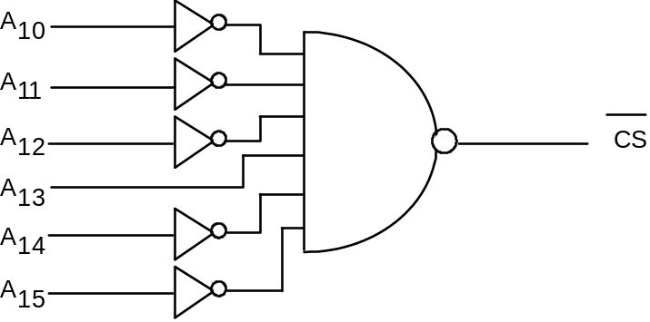
Chip Select Example
A chip that uses the combination A₁₅ - A₁₀ = 001000 would have addresses that range from 2000H to 23FFH.
  Keep in mind that the 10 address lines on the chip gives a range of 00 0000 0000 to 11 1111 1111 or 000H to 3FFH for each of the chips.
  The memory chip in this example would require the following circuit on its chip select input:

Slide 42
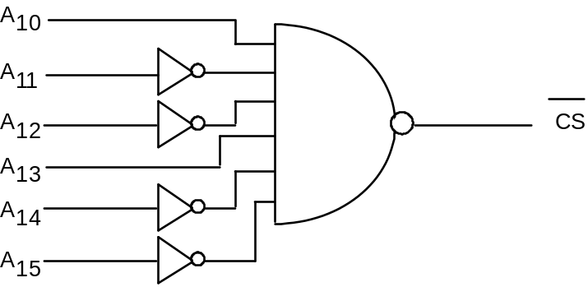
Chip Select Example
If we change the above combination to the following:
  Now the chip would have addresses ranging from: 2400 to 27FF.
  Changing the combination of the address bits connected to the chip select changes the address range for the memory chip.

Slide 43
Chip Select Example
  To illustrate this with a picture:
    in the first case, the memory chip occupies the piece of the memory map identified as before.
    In the second case, it occupies the piece identified as after.
Before
After
0000
0000
2000
23FF
2400
27FF
FFFF
FFFF

Slide 44
High-Order vs. Low-Order Address Lines
The address lines from a microprocessor can be classified into two types:
  High-Order
    Used for memory chip selection
  Low-Order
    Used for location selection within a memory chip.
  This classification is highly dependent on the memory system design.

Slide 45
Data Lines
All of the above discussion has been regarding memory length. Lets look at memory width.
We said that the width is the number of bits in each memory word.
  We have been assuming so far that our memory chips have the right width.
  What if they don’t?
    It is very common to find memory chips that have only 4 bits per location. How would you design a byte wide memory system using these chips?
    We use two chips for the same address range. One chip will supply 4 of the data bits per address and the other chip supply the other 4 data bits for the same address.

Slide 46
Data Lines
CS
A0
…
A9
CS
CS
D0
…
D3
D4
…
D7

