Slide 1
INDEX
Sr. No. | Particular | Page No.
1 | College Certificate | 3
2 | Acknowledgment | 5
3 | Problem Definition | 5
4 | Existing system and need for new system | 8
5 | Scope of the work | 7
6 | Feasibility study (H/W & S/W setup requirements) | 10
7 | Fact Finding Methods | 15
8 | ER Diagram | 18
9 | Normalized Database design and data Dictionary | 19
10 | Class Diagram | 26
11 | Object Diagram | 27
12 | Use case Diagram | 28
13 | Sequence Diagram | 29
14 | Collaboration Diagram | 30
15 | Activity Diagram | 31
16 | State Chart Diagram | 32
17 | Component Diagram | 33
18 | Deployment Diagram | 34
19 | Menus-Input screens using sample data reports, graphs using sample data | 35
20 | Limitations | 36
21 | Bibliography

Slide 2

A
PROJECT REPORT
On
“Hotel Management System”
Submitted to
Savitribai Phule University of Pune
For Practical fulfillment of
Bachelor of Computer Science
Submitted By
Mr. Dhokchaule Vaibhav Digambar
&
Mr. Gadekar Rajan Sanjay
Under the guidence of
Dr. H. V. Dube & Prof. S. R. Gagare
Department of Computer Science
Padmashri Vikhe Patil College of Arts, Science & Commerce, Pravaranagar(Loni)
Year 2019-2020

Slide 3
Pravara Rural Education Society
Padmashri Vikhe Patil College of Arts, Science & Commerce, Pravaranagar(Loni)
Certificate
Department of Computer Science
This is to certify that the project titled ”Hotel Management System”. Has been successfully completed by
Mr.Dhokchaule Vaibhav Digambar & Mr.Gadekar Rajan Sanjay students of TYBSC(Comp Sci). For the
Savitribai Phule University Pune
During Academic Year 2019-2020
Project Guide
Dr. H. V. Dube Prof. S. R. Gagare
HOD(Comp Sci)
Prof. R. R. Gondkar

Slide 4
A PROJECT PRESENTATION ON “ HOTEL MANAGEMENT SYSTEM ”

Slide 5
Introduction :
Our project on “Hotel Management System” it gives the idea about the management in hotels . Hotel management is a way of maintaining different activities of hotels where no. of staffs are engaged to perform the different activities with their roles.
There are large no. of hotels are available in our area so we are gives the real time example of our nearest hotel “Hotel M.T.D.C. LTD , The Pilgrims Inn Shirdi”. This hotel has been established under the companies act,1956. it was fully owned by Govt. of Maharashtra . The mtdc stands for “Maharashtra tourism development corporation”. This hotel can provide food as well as Ac, Non-Ac room booking facility.
MTDC online room booking facility are available on website –www.Maharashtratourism tourism.gov.in
After an information gathering process from several hotel managed by manual and computerized system the system analyst saw that the hotel indeed needed a computerized management system. Nowadays many of the hotels provide have their own sites on web which in turn allow the users to visit their sites and view the facilities and those people who are leaving the hotel they can send his feedback on website.

Slide 6
Computerized hotel management system is set of to find more convenient , well organized , faster , reliable and accurate information . Developing a software on topic like “Hotel management System” has much scope . This software is very useful to the hotel for managing their activities . our project provide various services to customer like room booking(advance/current) , cancellation , check-in check-out process about room availability etc.
The project has scope in hotel-:1] Routine activities of managing department is become more easy.
2] provide better data management facilities.
3] very secure and user friendly.
4] save time and money.
5]working load reduces and very secure.

Slide 7
Scope :
Easy backup of data.
Security provided.
Easy access to any stage.
User friendly interaction between user and system.
Working load reduces.
Save time and money.

Slide 8
Existing system :
The existing system is manual system.
In existing system the person who wants to book a room has to visit the hotel for booking hotel rooms and enquiry.
This existing system is not providing secure registration and profile management of all the users properly.
This manual system gives us very less security for saving data and some data may be lost due to mismanagement.
The existing system is costly and time consuming.
By using existing system the working load is always increases.
Disadvantages of existing system:
1] It is a time consuming process.
2] there is no surely availability of rooms.
3]lack of security.
4]chances of human errors.

Slide 9
Proposed system ( computerized ) :
This system maintain user’s personal info. address and contact details.
This system makes the overall project management easier and flexible.
This system can manage and keep the hotel records long time.
To enable automated data entry methods.
To enable online booking.
This system working accurate , fast and saves our amount of time.
Advantage:
1] This system provide better data management facility.
2] Easy to update and delete records.
3] very secure and user friendly.
4] working load reduces , save time customer quickly reserving rooms.
5]reduce the paper works.

Slide 10
Feasibility study :
The feasibility study is useful to evaluate the cost and benefits of requested system . while designing any system , first step of designing is to study requirement analysis . and it is done through different feasibility study.
Feasibility study is carried out to:
Identifying the problem & unexpected opportunities in the current system which may be manual or automated.
Identify the scope of current system to be studied.
Identify the major object of new system.
Develop rough estimate of the benefits drawbacks of each solutions.
Develop outlines of the project may carried out within idea of resources required.
There are three Types of Feasibility study- 1]operational feasibility 2]Technical feasibility 3]Economical feasibility

Slide 11
1. Operational feasibility :
Operational feasibility is the measure of how well a proposed system solves the problem , and takes advantage of the opportunities identified during scope definition and how it satisfies the requirements analysis phase of system development.
This project is based on our own assumption.so we assume that the management supports this project of hotel management system . if management supports this system , the implementation of the proposed system will be easier.by implementing the system , it can solve plenty of problems.

Slide 12
2.Technical Feasibility :
Technical feasibility is define as the feasibility that is concerned with specifying equipment and software that will successfully satisfy the user requirement.it compasses the technical needs of the system.
In this feasibility one has to test whether the system can be developed using existing technology or not . we have used visual basic as front-end and ms -access as a backend.it is evident that is necessary hardware and software are available for development and implementation of proposed system . we acquired the technical knowledge of working in visual basic language and then only we have started designing our project.

Slide 13
3.Economical feasibility :
Generally , it means whether a business or project is feasible cost wise and logistically . Economists calculate economic feasibility by analyzing the costs and revenues a business would incur by undertaking a certain project.
Economical feasibility analysis includes long term cooperative income stratergies , cost of resources needed for development , cost benefit analysis . In existing system they had to maintain many registers/books is a costly affair . this can be reduced by keeping data in the digital format that is reliable and cheaper . since the development cost for system satisfies the organization therefore the software is economically feasible.
As a part of this , the costs and benefits associated with the proposed system are compared and the project is economically feasible only if tangible and intangible benefits outweigh the cost . The cost for proposed hotel management system is maintaining the registers , book , files and generation of various reports.

Slide 14
1. Hardware requirement :
1] RAM- 4GB
2] Hard Disk- 500GB
3] Monitor- 17” LCD Monitor
4] Keyboard
5] Mouse
6] Printer
2.Software requirement:
1] Operating system- Linux
2] Front End-PHP, HTML, CSS , javaScript
3]Server-Apache
4]Browser-Mozilla Firefox
5] Database- PostgreSQL

Slide 15
Fact finding techniques:
Fact finding-: fact finding means it is process to collection of data or information based on techniques called as fact finding techniques.
it is one of the important step toward any system development.it is essential to gather all the information and facts about an existing system’s outputs , inputs and cos t . then it ensure that all strengths and weakness are discovered.
There are four types of fact finding techniques:
1] Interview
2] Questioners
3] Observation
4] Record review

Slide 16
1. Interview
This technique of fact finding is most popular .productive for good analysts and most probably widely used and gathering information in system words , interviewed questions designed to gather info. In about problem area . Interview are fact finding technique where the system analysts collect information from individual face to face . Interviewing can be used to find facts , verify facts , general enthusiasm etc.
2.Questionnaire:
We used this technique at initial phase of the project . we conduct this session by asking question to the owner of hotel . In the phase we prepare question to get some basic information about ‘hotel management System’.
1] How the existing system works actually?
2] what are the problems occurred while working with the existing system?
3] which are the requirement of users related to new designed system?
4] Do You familier with existing system ? if no then why?

Slide 17
3.Observation:
By observing the process of hotel management system we find alternative ways for how we can easily maintain the records by observing we get perfect idea how system actually works.
4.Record review:
This is most important technique for making a database for every entity we identify its need and relation with other entity . These technique helps for making normal form.

Slide 18
ER-diagram:
Check out
1
M
Customer
Rooms
1
M
Payment
has
M
manage
1
M
1
Invoice
Hotel
1
1
1
working
has
has
M
M
M
Bill
Booking
Employee

Slide 19
Designing Normalized database
Table 1 | Relationship | Table 2
Customer | 1 to M | Room
Customer | 1 to M | Hotel
Room | M to 1 | Hotel
Customer | 1 to M | Invoice
Hotel | 1 to M | Employee
Invoice | 1 to M | Bill
Hotel | 1 to M | Booking

Slide 20
Table Name : Customer
Field Name | Data type | size | Description | Constraints
Cid | int | 5 | Customer id
Cname | varchar | 20 | Customer name
Cpno | int | 10 | Customer pno
Address | varchar | 20 | Customer address

Slide 21
Table Name : Room
Field name | Data type | Size | Description | Constraints
Rid | int | 5 | Room id
Rtype | varchar | 20 | Room type
Area | Big int | 20 | Room area

Slide 22
Table Name : Hotel
Field Name | Data type | Size | Description | Constraints
Hid | int | 5 | Hotel id
Hname | varchar | 20 | Hotel name
Htype | varchar | 20 | Hotel type
Hdescription | varchar | 20 | Hotel description

Slide 23
Table Name : Employee
Field Name | Data type | Size | Description | Constraints
Eid | int | 5 | Employee id
Ename | varchar | 20 | Employee name
Eaddress | varchar | 20 | Employee address
Eemail | varchar | 20 | Employee email
Username | varchar | 20 | Employee username
Password | Big int | 10 | Employee password

Slide 24
Table Name : Booking
Field Name | Data type | Size | Description | Constraints
Bid | int | 5 | Booking id
Bdate | int | 10 | Booking date
Btype | varchar | 20 | Booking type
Bdescription | varchar | 20 | Booking description

Slide 25
Table Name : Bill
Field Name | Data type | Size | Description | Constraints
Billid | int | 5 | Bill id
Ammount | int | 10 | Bill amount
Date | int | 10 | Bill date
Quantity | int | 5 | Bill quantity

Slide 26
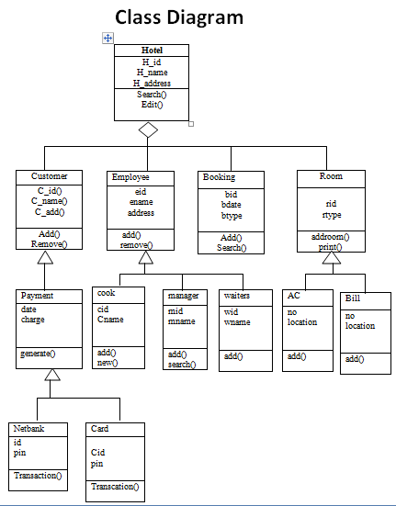

Slide 27
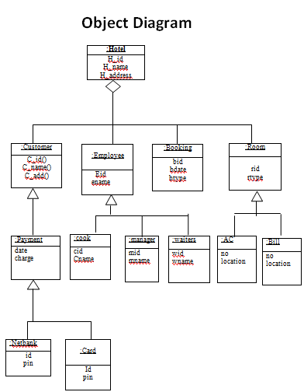

Slide 28
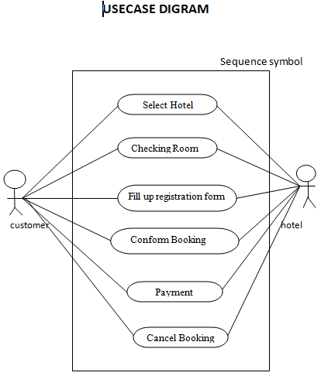

Slide 29
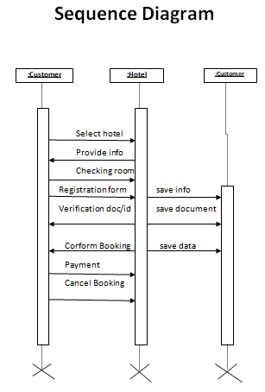

Slide 30
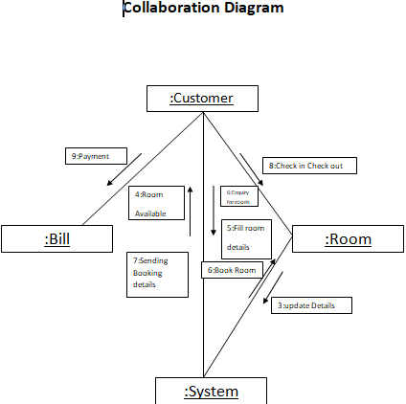

Slide 31
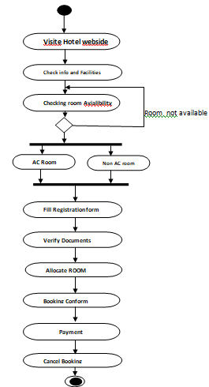
Activity Diagram

Slide 32
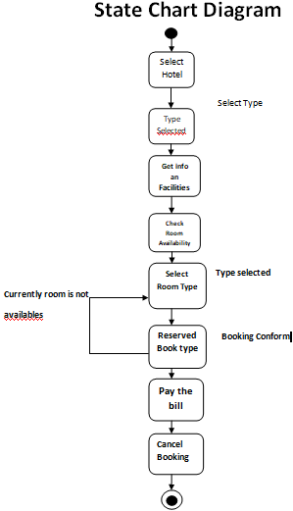

Slide 33
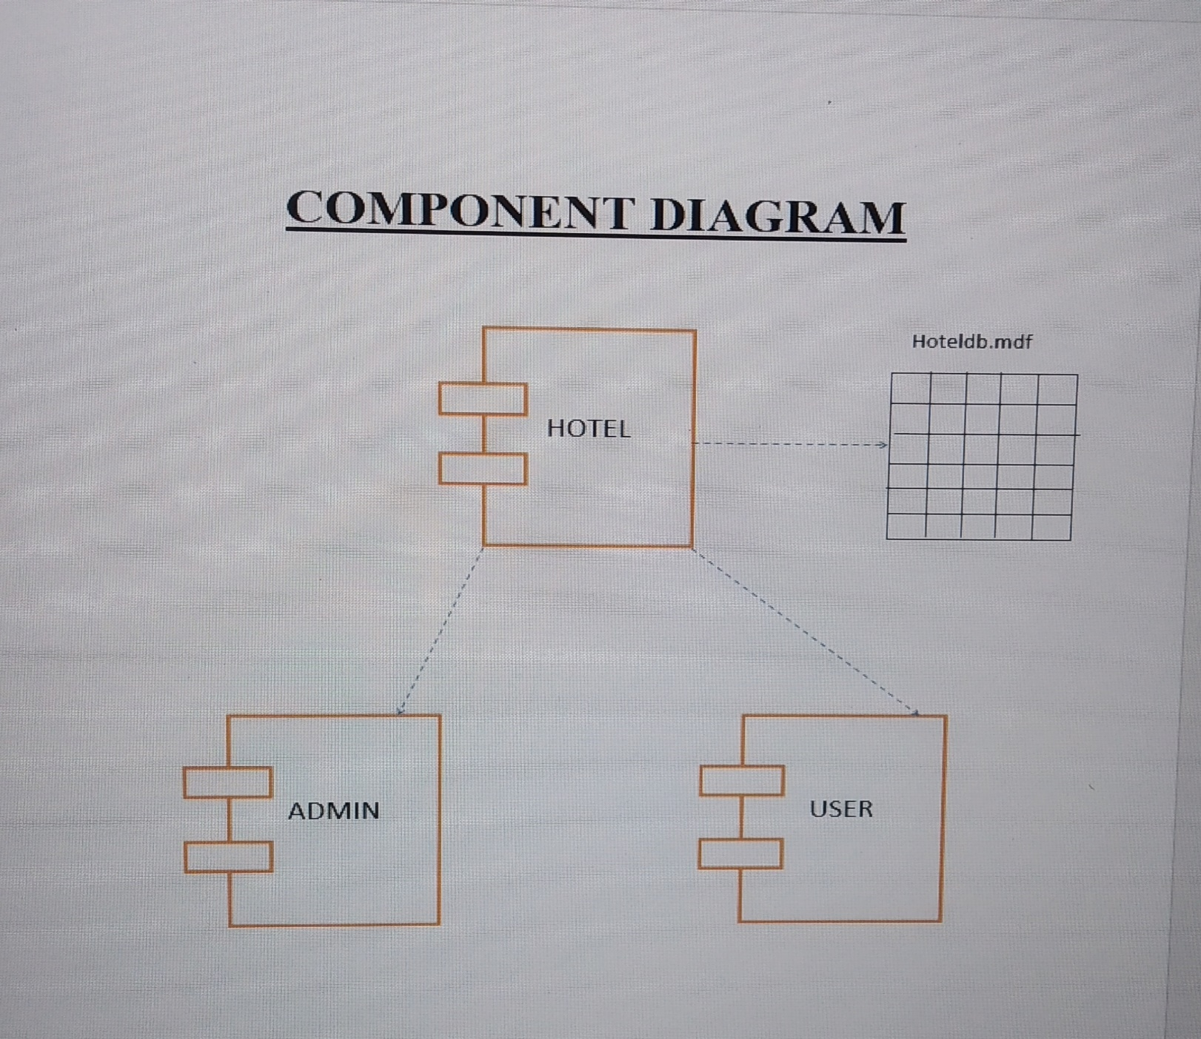

Slide 34
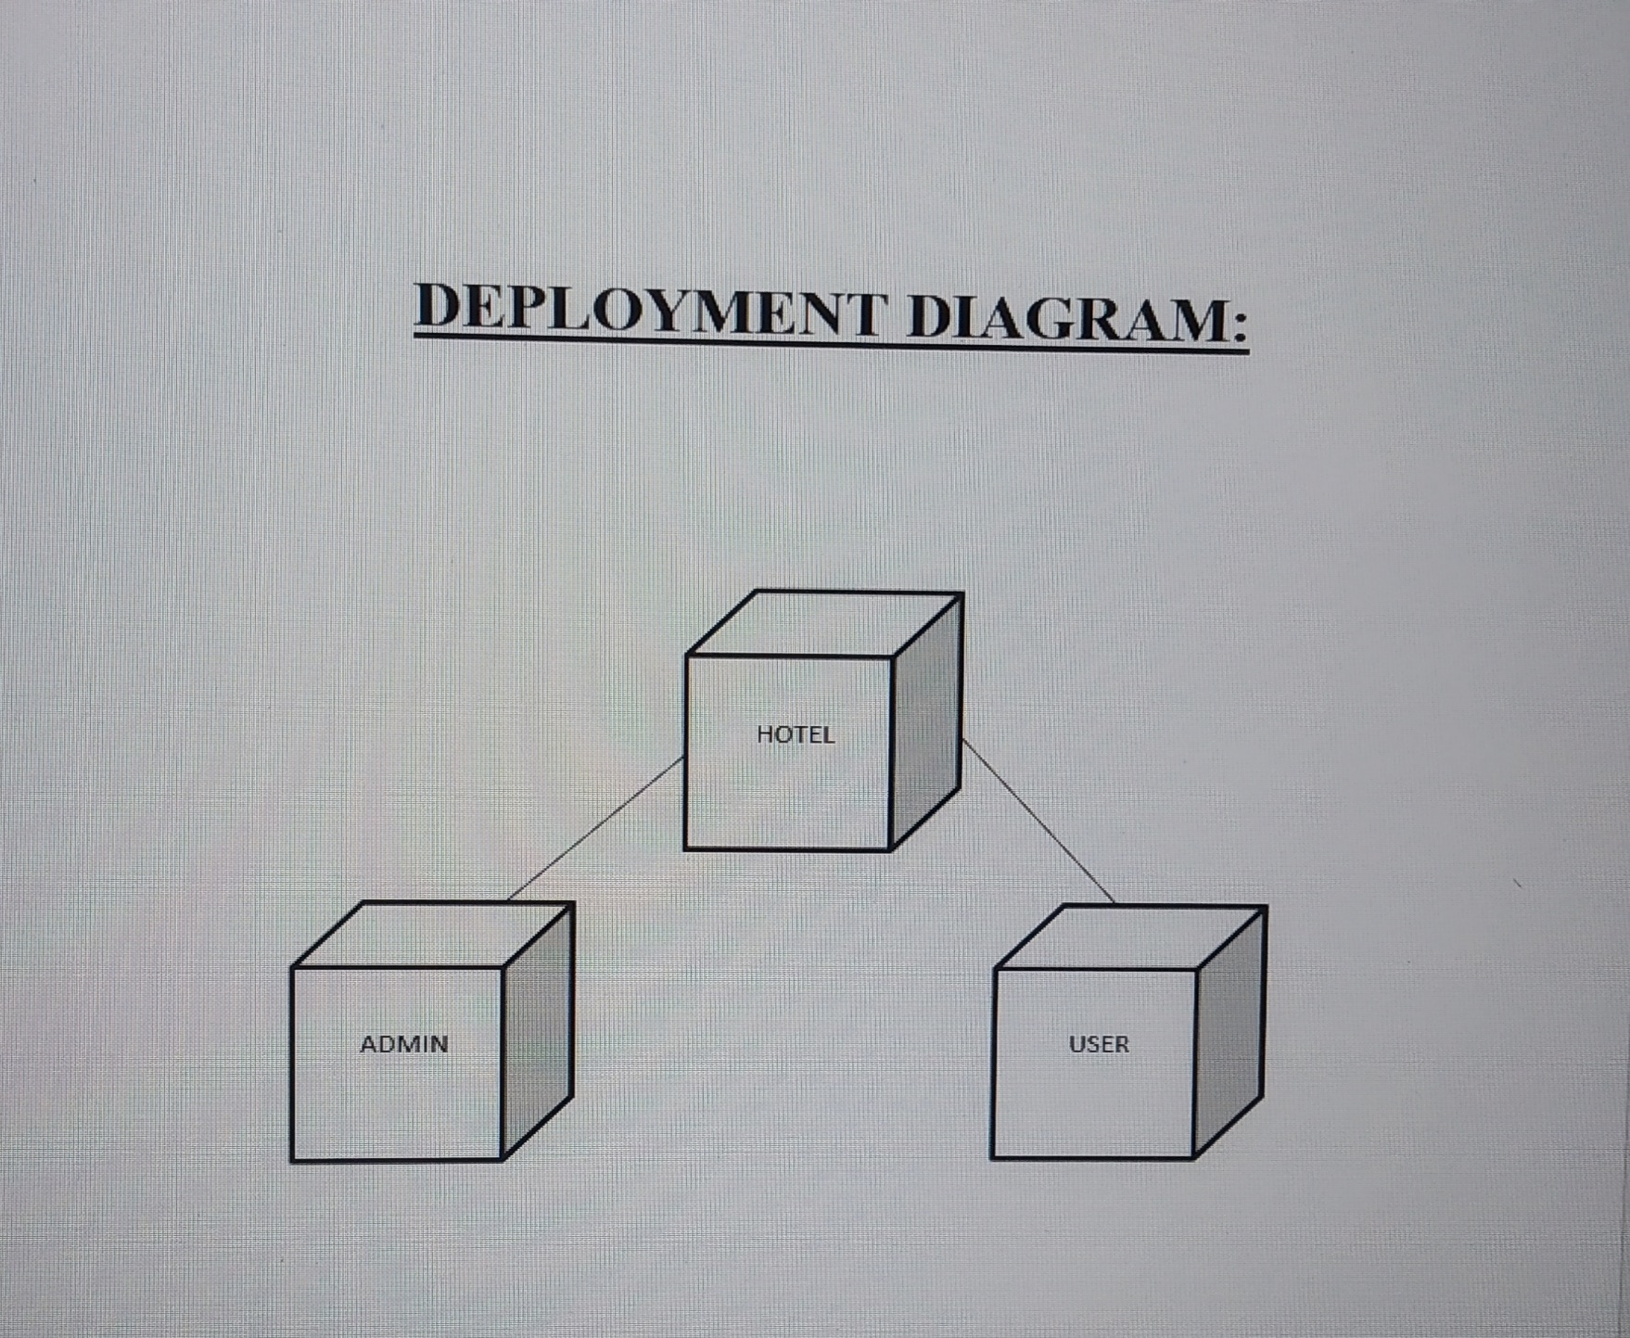

Slide 35
THANK YOU !!

