Slide 1


INVENTORY
MANAGEMENT
SYSTEM
Members:-
Mahek Dumasiya – 47
Rahul Dusane – 48
Vaibhav Gabani - 49

Slide 2
Welcome to our Inventory Management System!
Our user-friendly project simplifies inventory management for businesses, ensuring efficiency and easy tracking.
Track Products: Easily see what items you have in stock.
Monitor Suppliers: Keep supplier details handy for easy reordering.
We're dedicated to supporting your needs and ensuring your business thrives. Thanks for choosing our
Inventory Management System!

Slide 3


3 STRUCTURES
01
02
03
USER
PRODUCT
SUPPLIER
This Structure contains user_name,contact & password
This Structure contains product id,name,category,
manufecturer,quantiy,price,supplier_id
(from SUPPLIER strurcture)
This Structure contains supplier id,name,contact,
address,city

Slide 4


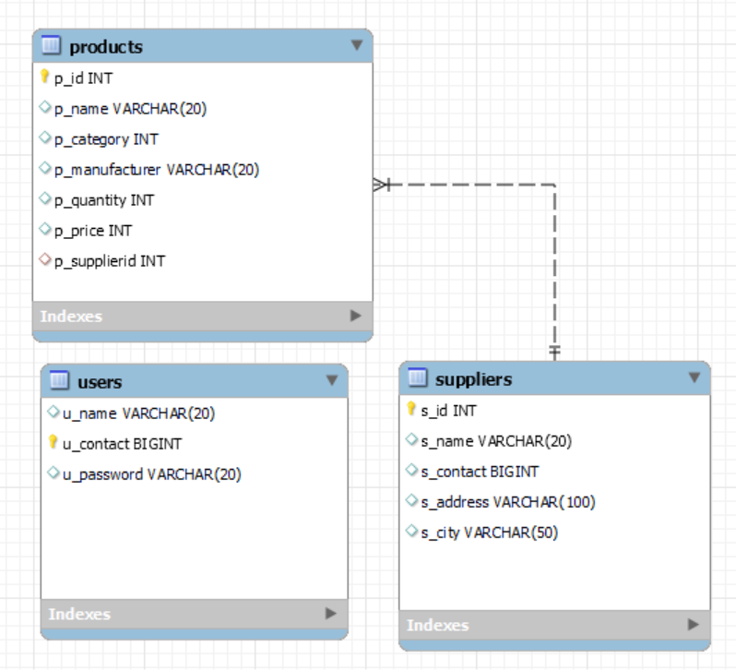
E-R MODEL

Slide 5
USER DEFINE FUNCTIONS
void signup();
void input_product();
void input_supplier();
void print_product();
void print_supplier();
void advanced_p_name_search();
void advanced manufacturer_search();
void p_quantity_search();
void p_price_search();

Slide 6
USER DEFINE FUNCTIONS
int check_product_id(int )
int check_supplier_id(int )
int check_supplier_contact(long long int );
int check_p_category(int )
int check_p_category_and_price(int )
int check_s_contact(long long int )
int check_product();
void advanced_s_name_search();
void advanced_s_city_search();

Slide 7
USER DEFINE FUNCTIONS
void short_p_name_asending();
void short_p_name_desending();
void short_s_name_asending();
void short_s_name_desending();
void short_P_price_asending();
void short_P_price_desending();
void short_p_quntity_asending();
void short_p_quntity_desending();

Slide 8
USER DEFINE FUNCTIONS
void delete_p_row_product();
void delete_p_row_supplier();
void delete_s_id_supplier();
void update_p_quantity();
void update_p_price();
void update_p_name();
void update_s_name();

Slide 9
Demonstration

Slide 10
THANK YOU

