Slide 1
Facebook’s strategic Move: Unveiling the WhatsApp Acquisition. Team 2

Slide 2



Introduction:
Facebook (now Meta), founded by Mark Zuckerberg in 2004, is a leading social media conglomerate, offering a range of services including the core Facebook platform, Instagram, Messenger, and later, the virtual reality company Oculus. It operates in the technology and social networking industry, catering to billions of users globally.
WhatsApp, established in 2009 by Brian Acton and Jan Koum, WhatsApp is an ad-free mobile application that allows users to send unlimited messages to contacts without using the wireless network or sustaining data fees. The app is free to download and is an alternative to the cell provider's traditional text messaging platform.

Slide 3

Facebook before WhatsApp Acquisition :
Financial Status:
Revenue: Around $7.87 billion in 2013.
Net Income: Approximately $1.5 billion in 2013.
Market Capitalization: Roughly $173 billion.
User Base:
User Base: 1.23 billion Monthly Active Users (MAUs) by end of 2013.
Mobile Users: Significant mobile user base, reflecting a successful mobile strategy.
Financial Ratios (General Insights):
Robust Return on Equity (ROE).
Healthy Debt-to-Equity Ratio.
Strong Earnings per Share (EPS).

Slide 4

WhatsApp before acquisition :
Before its acquisition by Facebook in 2014, WhatsApp had impressive numbers that showcased its rapid growth and popularity. By February 2014, WhatsApp had reached around 450 million monthly active users (MAU).
Financial statements or specific data were not publicly available since WhatsApp was a private company before its acquisition.
WhatsApp was reported to be gaining approximately more than 1 million new users joining every day in 2014.
In 2014, WhatsApp users were sending approximately 50 billion messages per day. This metric represented a staggering amount of communication happening on the platform, indicating its widespread adoption and usage for messaging purposes.

Slide 5
Rationale for the M&A
Strategic Objectives and Goals:
Market Expansion: Facebook sought to expand its user base by acquiring WhatsApp's already massive and diverse user community.
Mobile Dominance: With the increasing shift towards mobile usage, WhatsApp's extensive mobile presence was a strategic fit to complement Facebook's existing services.
Competitive Edge: Acquiring WhatsApp prevented a potential competitor from challenging Facebook's dominance in the messaging and social networking arena.
Diversification: The acquisition diversified Facebook's portfolio, reducing reliance on its primary platform and tapping into the lucrative messaging market.
Zuckerberg plans to merge the messaging platforms of Facebook, Instagram, and WhatsApp, so that users can communicate easily across all three.

Slide 6

Financial Implications:
Valuation and Funding:
Deal Value: The acquisition was valued at $19 billion, consisting of $4 billion in cash, around $12 billion in Facebook shares, and $3 billion in restricted stock units for WhatsApp's founders and employees. Facebook will now award 177.8 million shares of its Class A common stock and $4.59 billion in cash to WhatsApp’s shareholders, it said in an SEC filing over the weekend, plus 45.9 million shares (restricted stock units) to WhatsApp's employees to complete the deal. Fortunately for those parties, the value of Facebook's shares are now higher than they were when the deal was announced in February, making the deal worth around $21.8 billion.
Funding Sources: Facebook utilized a mix of cash and stock to fund the acquisition, leveraging its market position and stock value.

Slide 7
Financial Implications:
Impact on Financial Statements:
Income Statement: Initially, the acquisition expenses impacted Facebook's income statement, reflecting the costs associated with the purchase.
Balance Sheet: Facebook's balance sheet showcased the increase in assets due to the addition of WhatsApp's value and liabilities associated with the acquisition cost.
Cash Flow: The acquisition affected Facebook's cash flow from investing activities due to the substantial cash spent on the deal.

Slide 8

Impact on stakeholders

Slide 9
We will discuss its impact on the following things
1.Shareholders:
Positive Impact: Shareholders of WhatsApp likely benefited from the acquisition, as they received a substantial premium for their shares when Facebook acquired the company. The acquisition demonstrated Facebook's strategic move to expand its user base and strengthen its position in the messaging space.
Negative Impact: If there were controversies or challenges post-acquisition, such as regulatory issues or privacy concerns, it could have affected Facebook's stock price, impacting shareholder value.
2.Employees:

Slide 10
Positive Impact: Employees of WhatsApp might have experienced positive changes, such as access to greater resources, technology, and opportunities for professional growth within the larger Facebook ecosystem.
Negative Impact: Mergers often involve organizational changes, which may lead to redundancies, restructuring, or changes in company culture. Some employees might face challenges adapting to a new corporate environment.
3.Customers:
Positive Impact: Customers could benefit from improved features, integration, and innovations resulting from the collaboration between Facebook and WhatsApp.
Negative Impact: Concerns about data privacy and potential changes to the user experience could be a source of dissatisfaction for some customers.

Slide 11
Challenges and controversies
Privacy Concerns: The merger led to concerns about how Facebook would handle user data from WhatsApp, which initially operated independently with a focus on user privacy. Facebook's data-sharing practices and its plans to integrate WhatsApp more closely into its platform raised eyebrows and resulted in regulatory scrutiny.
Regulatory Scrutiny: The acquisition faced regulatory scrutiny in various jurisdictions. Some authorities raised questions about potential antitrust issues and the impact on competition in the messaging space.
User Trust Issues: Users of WhatsApp were concerned about the impact of the acquisition on the app's commitment to privacy. WhatsApp reassured users about its commitment to end-to-end encryption, but controversies over data sharing persisted.

Slide 12

Integration Process

Slide 13
Following strategies were taken up
1.Autonomous Operation:
WhatsApp continued to operate as an independent platform, maintaining its brand and services.
The autonomy allowed WhatsApp to preserve its user base and distinct features.
2.User Data Privacy Assurance:
Facebook and WhatsApp assured users that WhatsApp's commitment to end-to-end encryption and user privacy would remain intact.
Reassurances were provided to address concerns about potential changes in data handling and privacy policies

Slide 14
3.Gradual Feature Integration:
Facebook gradually introduced features that integrated the two platforms, such as the option to link Facebook and WhatsApp accounts.
The integration aimed to enhance user experience and provide additional functionalities without compromising privacy.
4.Technical Integration:
Behind the scenes, there were efforts to integrate technical infrastructure, allowing for smoother communication and interoperability between Facebook's ecosystem and WhatsApp.

Slide 15
Obstacles Encountered:
Regulatory Scrutiny:
The integration faced regulatory scrutiny, particularly regarding data privacy and potential antitrust concerns.
Regulatory challenges could have influenced the pace and extent of integration efforts.
User Trust and Privacy Concerns:
Maintaining user trust was a significant challenge, especially concerning privacy issues.
Some users were concerned about data sharing between Facebook and WhatsApp, leading to efforts to address these concerns through clear communication and privacy controls.

Slide 16
Cultural Differences:
Mergers and acquisitions often involve aligning organizational cultures. Differences in culture and practices between Facebook and WhatsApp might have posed challenges in terms of employee integration and collaboration.
Technical Challenges:
Technical integration of diverse systems and platforms can be complex and might have presented challenges during the integration process.
Ensuring a seamless experience for users across platforms required careful coordination and technical expertise.

Slide 17

Post Acquisition Performance

Slide 18
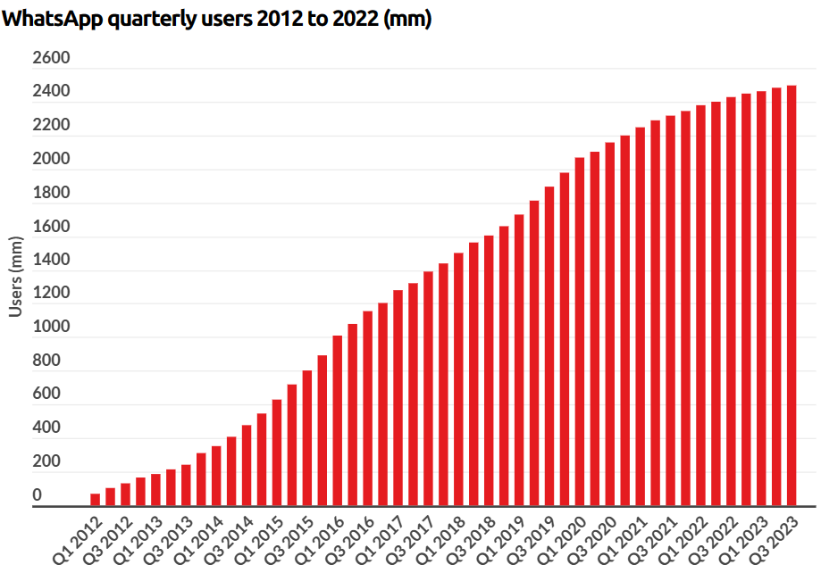

GAINS AND GOALS ACHIEVED
The goal of increasing userbase was completed easily as there was a steady growth of users since the acquisition as the users increased from 450 million in 2014 to 2.6 billion in 2022, which is around 6 times. It also became the most downloaded app on the PlayStore.
During the acquisition, the source of revenue generation was the subscription model of $1, then it changed to no money was charged. Facebook kept its word of not running ads on the app directly but introduced Whatsapp Business and payments in its largest marketplace India and Brazil and soon introduced ads on Instagram and Facebook using Whatsapp Business.
The ads model started generating revenue from Whatsapp and estimated revenue of Q1 in 2022 by Forbes is $27-$29 billion.

Slide 19
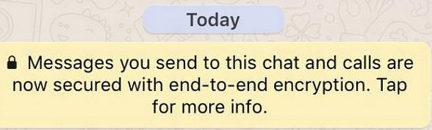



Issues Faced
Major controversy faced after the acquisition was the security concerns. As Whatsapp had the brand of privacy as it had end-to-end encryption. But governments had known the terrorists used such apps to communicate attacks so they wanted the messages being sent but these companies refused to revel them.
But after the reports of selling data by Facebook and using the users’ data the end-to-encryption was under scrutiny as there were concerns of using Whatsapp data.

Slide 20
Resources-
The Verge: The Verge's coverage of the acquisition and insights into the strategic motivations.
CNBC: CNBC's coverage on Zuckerberg's approach to maintaining user engagement across Facebook-owned platforms.
TechCrunch: TechCrunch's reporting on the integration strategies and potential challenges.
Business Insider: Business Insider's insights into the background and history leading up to the WhatsApp acquisition.
Facebook's Acquisition of WhatsApp: The Impact on Users and Competition: This research article provides insights into the impact of the acquisition on competition and user privacy.
Reuters: Reuters' reporting on regulatory scrutiny following the acquisition.
The Guardian: The Guardian's coverage of the acquisition announcement.

Slide 21
WhatsApp Blog: Official blog posts from WhatsApp might provide information on the company's stance and communication regarding the acquisition.
https://www.investopedia.com/articles/investing/032515/whatsapp-best-facebook-purchase-ever.asp
https://www.forbes.com/sites/parmyolson/2014/10/06/facebook-closes-19-billion-whatsapp-deal/?sh=574ac46c5c66
https://time.com/8806/facebooks-whatsapp-acquisition-explained/
Jeevesh Narayan-230508
Vaibhav Itauriya-231115
Soham Panchal-231014
Harsh Vazirani-230450
Divansh Singh-230385
We sincerely thank all the Secretaries and Coordinators for organizing this winter camp for real life experience of Investment Banking.

