Slide 1
PointsTrack
Architecture, Robustness & Scalability
Digitizing AICTE Activity Points — how it's built, why it stays correct under load, and how it grows
React Native + Expo · Next.js · Express + TypeScript · PostgreSQL + Drizzle · JWT
Every claim in this deck is backed by the live codebase and by tests run against a real server + database.

Slide 2
OVERVIEW
What PointsTrack is
AICTE requires engineering students to earn 100 activity points (80 for lateral entry) to graduate. Most colleges still track this in spreadsheets and PDFs. PointsTrack replaces that with a verifiable, real-time system.
Clubs / organizers
Students
The platform
Publish events, set capacity, check students in manually or by scanning a QR code.
Discover events, register, get checked in, and watch points land instantly toward their goal.
Awards points automatically and exactly once, tracks progress, and notifies everyone.
Replaces a previous Firebase stack with a custom, self-hosted backend — for full control over data, cost, and correctness under concurrent load.

Slide 3
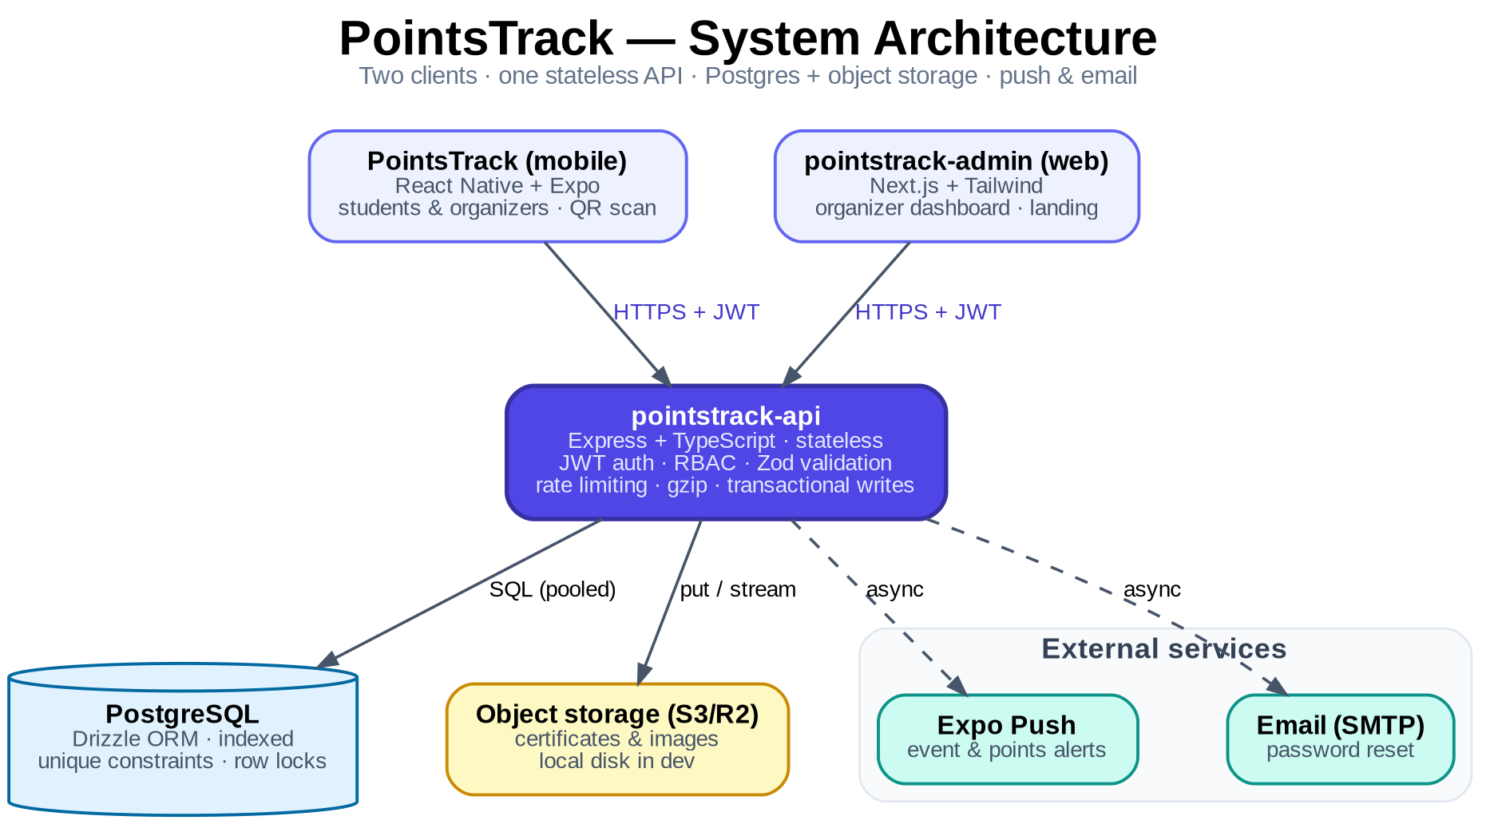
ARCHITECTURE
System architecture

Slide 4
ARCHITECTURE
Three components, one API
pointstrack-api
Express + TypeScript · PostgreSQL + Drizzle ORM · JWT
Stateless backend for both clients. Transactions, RBAC, rate limiting, validation.
pointstrack-admin
Next.js (App Router) + Tailwind + Framer Motion
Organizer web dashboard and the public landing page.
PointsTrack
React Native + Expo · NativeWind · expo-camera
Mobile app for students and organizers — feed, QR check-in, wallet, transcript.
Backend stack: Node · Express · TypeScript · Drizzle · PostgreSQL · JWT · bcrypt · Zod · helmet · express-rate-limit · compression

Slide 5
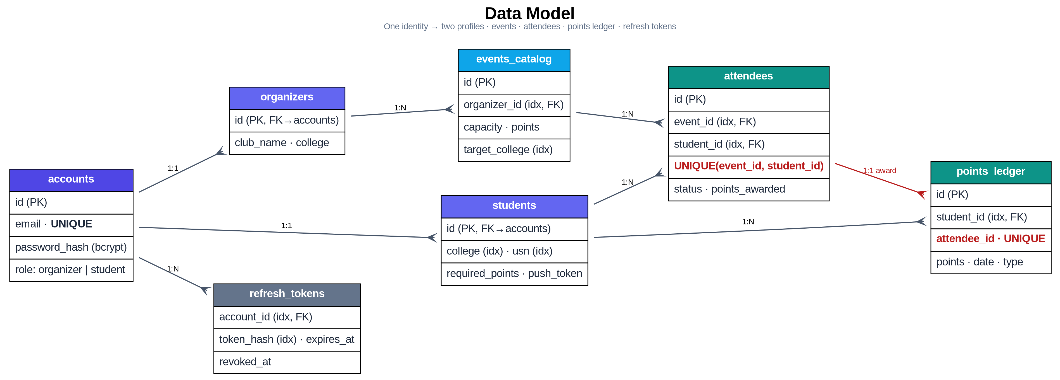
ARCHITECTURE
Data model
Two unique constraints carry the correctness guarantees: UNIQUE(event_id, student_id) → one registration per student; UNIQUE(attendee_id) on the ledger → one check-in awards points exactly once.

Slide 6
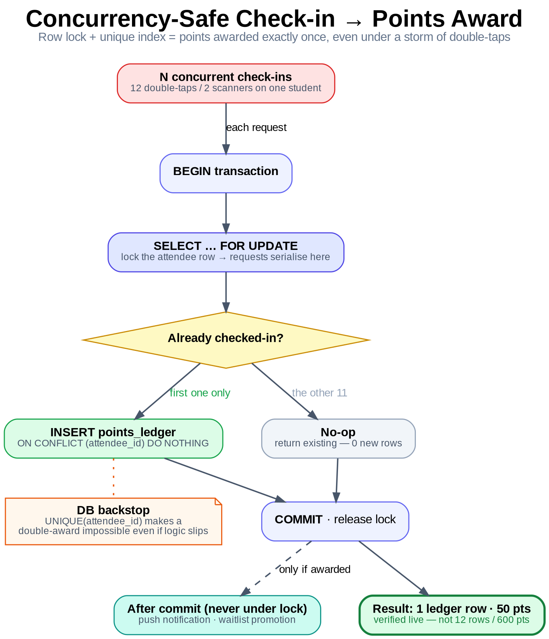
ROBUSTNESS
The hard part: correct under concurrency
Where naive apps break
▸ Double-tapped check-in buttons
▸ Two organizers scanning one student
▸ A popular event filling as dozens register at once
Two layers of defense
▸ Row locks (primary) every award/capacity write runs in db.transaction with SELECT … FOR UPDATE, serialising racers.
▸ Unique indexes (backstop) the DB physically refuses duplicate rows even if app logic slips.
▸ Side effects post-commit push & waitlist promotion run after COMMIT — locks never held over network I/O.

Slide 7
ROBUSTNESS
Proof — tests run live against a real server + DB
Not mocked. The same routes, transactions and constraints that run in production, hammered with concurrent HTTP, then ground-truth read straight from Postgres.
Concurrency scenario
Expected
Actual (measured)
12 simultaneous check-ins of one attendee
1 ledger row · 50 pts
1 ledger row · 50 pts
10 simultaneous duplicate applications
1 attendee row
1 row (9 × HTTP 409)
capacity = 1, 6 simultaneous applications
1 active · 5 waitlisted
1 active · 5 waitlisted
✓ 3 / 3 scenarios correct under concurrency — ALL PASS
Reproducible: npx tsx scripts/concurrency-proof.ts · run 2026-06-14 against localhost:4000 + Postgres 16

Slide 8
SCALABILITY
Built to grow
Stateless API
Bounded queries
auth is a JWT in the request — no server session — so you run N identical instances behind a load balancer.
every list endpoint uses capped limit/offset pagination; no request can ever ask for unbounded rows.
Efficient reads
Swap-in managed DB
indexes cover every hot lookup; per-event counts come from one grouped query, not N.
the app touches only DATABASE_URL → drop in Neon/Supabase for autoscaling + replicas; pooling via DB_POOL_MAX.
Storage abstraction
Lean transport
uploads go to S3/R2 in prod, local disk in dev — env-switched, zero code change. This is what keeps the API stateless.
gzip compression on responses; push notifications chunked through the Expo SDK.

Slide 9
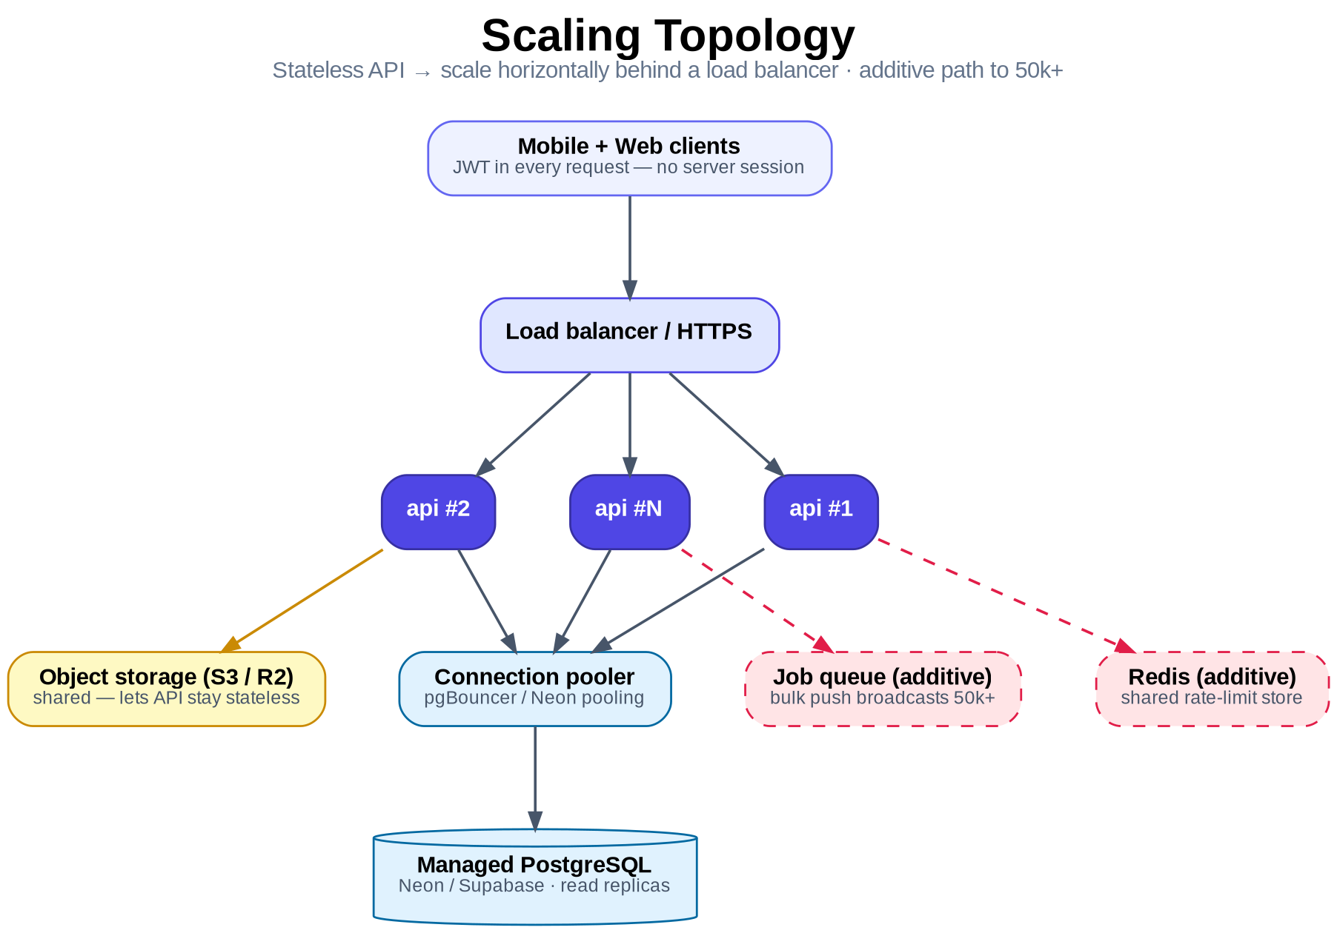
SCALABILITY
Topology & a real measurement
Measured throughput
single un-tuned dev instance · local Postgres
358 req/s
2,000 paginated reads @ concurrency 50
latency p50 134 ms · p95 180 ms · p99 246 ms
Honest capacity
▸ As-is a full college — low thousands of users — correct under bursty check-in load.
▸ To 50k+ add Redis rate-limit store + a broadcast queue. Additive — no rewrite.

Slide 10
SECURITY
Defense in depth
JWT + rotating refresh tokens
bcrypt password hashing
short-lived access tokens (~15 min); refresh tokens hashed in the DB, rotated on use, revocable.
no plaintext credentials ever stored.
Role-based access + ownership
Rate limiting
requireRole on every protected route; organizers can only touch their own events/attendees.
generous global ceiling + strict /auth limiter to blunt brute-force and credential stuffing.
Hardened transport
Clean error surface
helmet security headers, strict CORS allow-list in production, 1 MB JSON body cap.
Zod → 400, typed errors → status, unique violations → 409, everything else → 500 with no stack leaks.

Slide 11
Why it holds up
▸ Correctness is enforced by the database, not hope — row locks + unique constraints.
▸ Proven, not asserted — 3/3 concurrency scenarios pass live; 358 req/s measured.
▸ Stateless by design — scales horizontally with no architectural change.
▸ Growth path is additive — Redis + a queue take it to 50k+, no rewrite.
PointsTrack
Full write-up: docs/ARCHITECTURE.md · PointsTrack-Architecture-Report.pdf · reproduce: scripts/concurrency-proof.ts

